Slide 1
Balgaddy Housing Update
Q2 Report - Housing Maintenance & Estate Management

Slide 2
Response Maintenance 2024

Slide 3
Surrenders | Allocated
13 | 13
Allocations
Pre - Works | Work in Progress | Ready for Allocation | Total
0 | 13 | 1 | 14

Slide 4
Housing Maintenance Operations
Repairs to Vacant Properties –
Reduce turnaround times
6% reduction in relet turnaround times county-wide in comparison to 2023.
Response Maintenance and Property Management
January 2024 - Dedicated response maintenance contractor appointed for Palmerstown-Fonthill LEA.
Clean-up of communal areas completed 9th March 24, 11th May 24 & 10th August 2024.
Stock Condition Surveys –
Identify condition and maintenance requirements
Properties surveyed on 5-year cycle
Tender evaluation completed
Balgaddy included in year 1 surveys
Outcome of surveys will determine future planned maintenance programmes

Slide 5
Planned Maintenance 1
Roofing Works
Works completed at two locations within
Meile An Rí.
Works completed at three locations within
Tor An Rí.
Works completed at two locations within Buirg An Rí.
Energy Efficiency Retrofit Programme
Works in progress at fifteen locations within
Tor An Rí Walk.
Expected completion Q3-2024.
Fire Detection Safety Works Programme
Works have commenced within Buirg An Rí at 82 locations selected to upgrade fire detection systems to LD2 standard
Bin Storage Areas
Works have commenced in Foxdene Avenue.
Phase 1 of 3 completed

Slide 6
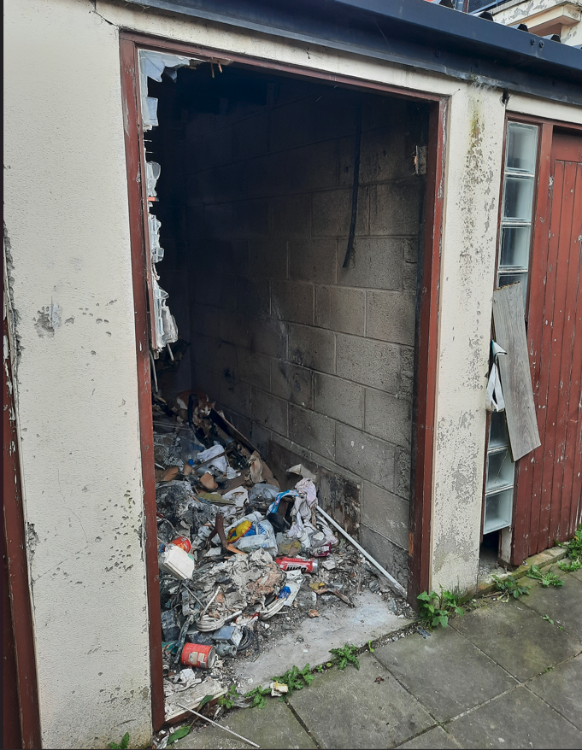
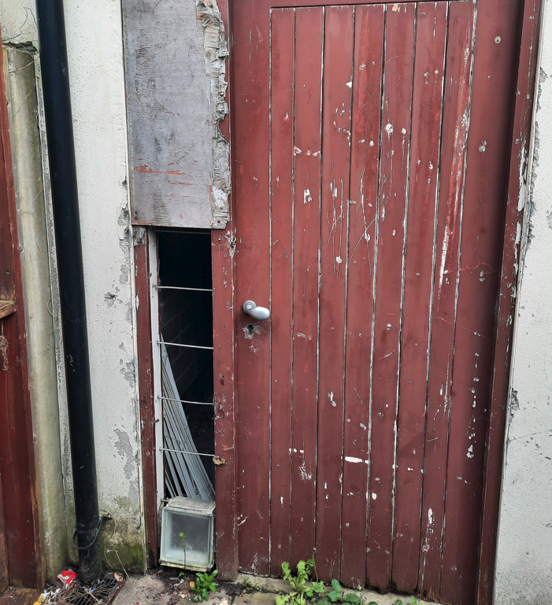
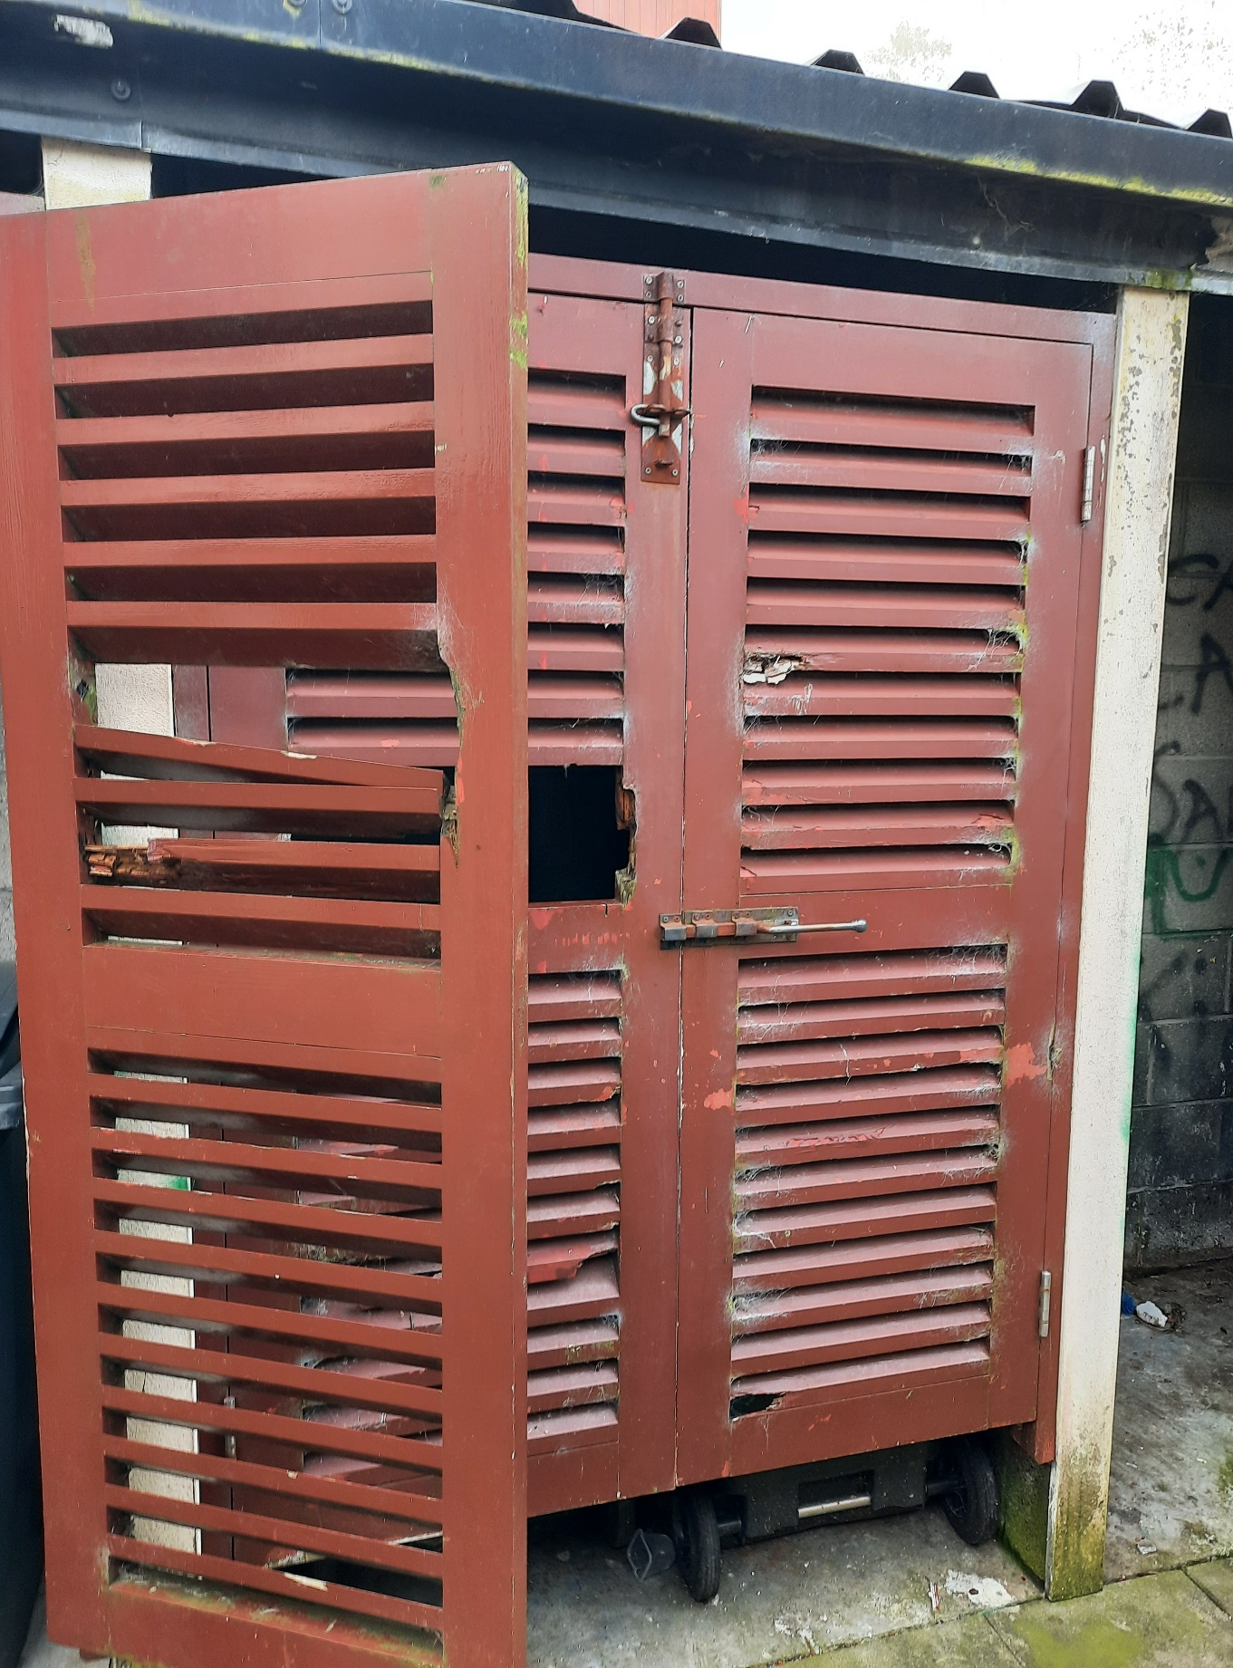
Bin Storage Areas

Slide 7
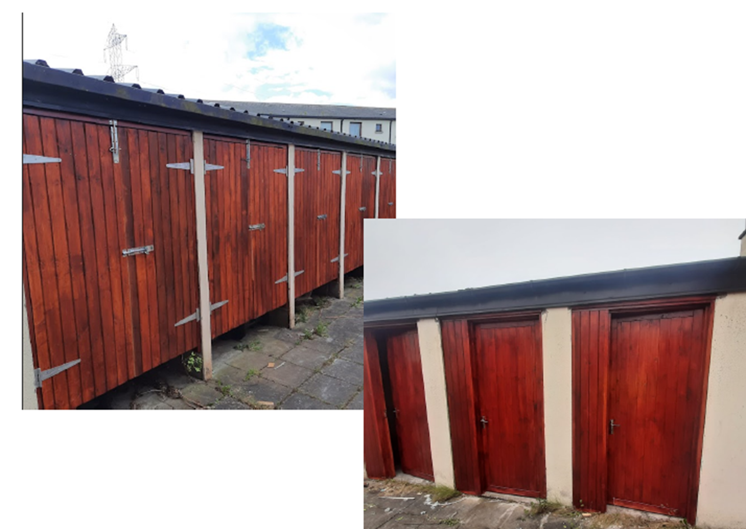
Bin Storage Areas

Slide 8
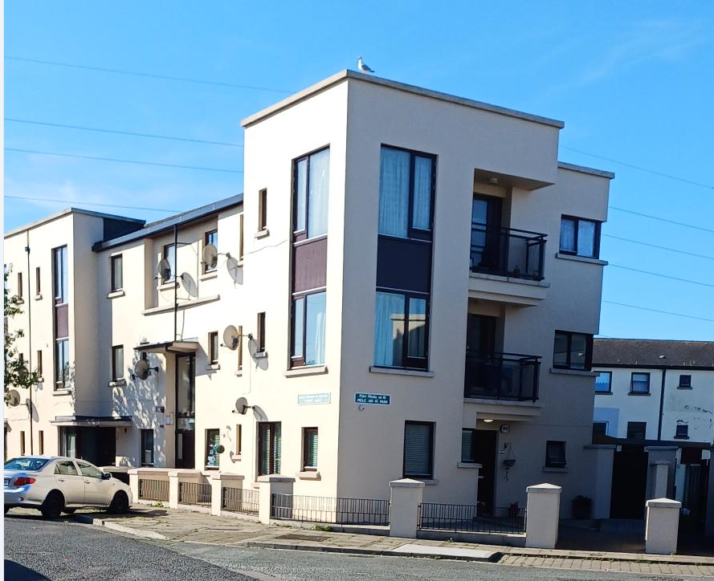
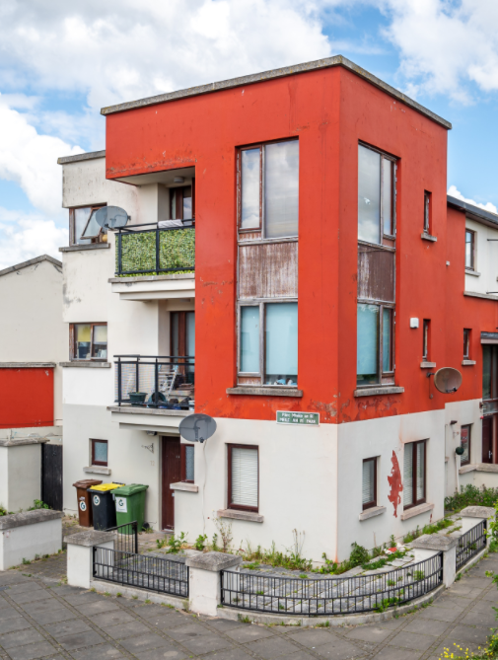
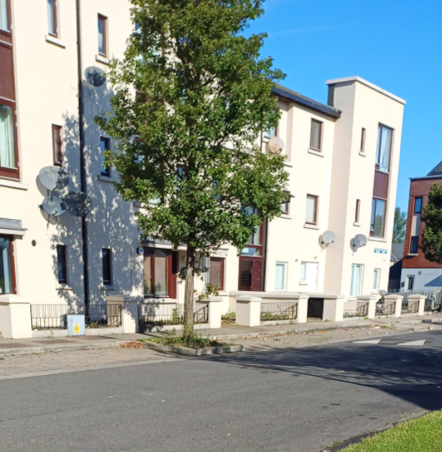
Planned Maintenance 2
Painting Programme
44 Units complete to date.
19 Units in progress.
18 Units surveyed and
awaiting commence of works

Slide 10
Estate Management Initiatives
Community Safety Officers and Housing Officer assigned in Q1 2024 – providing additional resource to existing Estate Management and Community Safety Anti-social Behaviour Officers
Quarterly meetings with Community Development Team to share information
Represent Estate Management on the Balgaddy Action Group – meetings take place quarterly.
Estate management and Housing Maintenance are currently liaising with residents regarding planned works to be carried out in Tor an Rí.
Joint housing maintenance and Estate Management approach agreed and commenced to monitor communal areas to ensure items do not accumulate. Records will be kept and notification/warning letters to issue as appropriate.
Anti-Social Team following up on issues regarding vacant dwellings in Tor an Ri.
Meeting with Estate Management and An Garda Síochána to identify ways to combat anti-social behaviour and identify those involved in intimidation and dealing in the area.
Garda / Estate Management Clinic to commence on 26th September 2024 in the Bush Centre.

Slide 11
Balgaddy Higher Level Working Group
New Independent Chair Liam Casey (Former Inspector Ronanstown Garda Station)
DLETB Representative appointed - Nominations sought for representatives from South Dublin County Partnership and Tusla awaiting response.
2 meetings have taken place to date in 2024 – next meeting Tuesday October 8th.
Construction works on the Balgaddy Community Centre continues, with expected completion in later October. The Community Section have been conducting a consultation with local community reps from Balgaddy, Neilstown and Rowlagh, on a proposal to establish a new Regional Board of Management to manage the operations of the Balgaddy, Neilstown and Rowlagh Community Centres, all of which has received broad community approval. Further meetings will be scheduled with both community reps and reps form the key support/stakeholder organisations over the coming weeks working to further progress the management proposal.

Slide 12
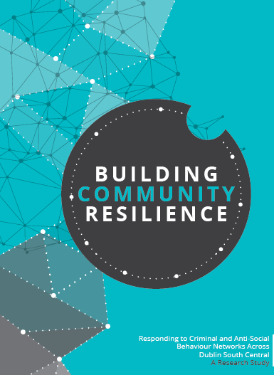
Balgaddy Working Group
The Balgaddy working Group was established to implement the recommendations outlined in the Community Crime Impact assessment undertaken in March 2021. Group meets on a quarterly basis. The membership consists of:
Estate Management and Community Development Teams from SDCC
An Garda Siochana (Ronanstown)
North Clondalkin Community Development Programme
Co- Ordinator from Clondalkin Drugs Task Force
Ronanstown Crosscare
Chair of Local Policing Forum
DDETB
Tusla (awaiting response and nomination)
South Dublin Partnership – Nomination to be requested
Meeting Dates for 2024
13th February 2024
14th May 2024
8th October 2024
10th December 2024

