Slide 1
Social Housing Delivery
Tallaght ACM
23rd September 2024

Slide 2
2024
Notes:
Housing for All Delivery Pipeline 2024
No alt text provided
No. of Potential Units Per LEA
No alt text provided
textbox
No alt text provided
Potential Units
No alt text provided
image
No alt text provided

Slide 3
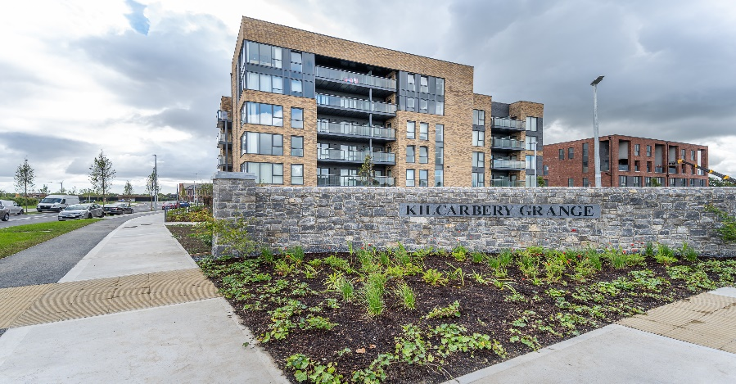
Large Development Sites
Kilcarbery Grange: 1,034 homes with 30% social (310 homes)
Phase 1 & 2 of this project is now complete, with delivery of 212 social homes to date. Construction work is continuing through phases 3 & 4. Full completion of project is anticipated by mid 2025.
Killinarden Foothills: 620 homes (including 125 social , 123 Private & 372 affordable purchase)
Pre-construction enabling and planning compliances works have commenced on site. Construction on phase 1 to commence in late 2024.
Clonburris: Phases 1 & 2 comprising 382 homes (149 social), Phases 3,4,5 with potential for 1,430* homes
The tender process for construction of 266 social, affordable, and cost rental homes in the Kishogue sector has recommenced. Anticipated on-site date in Q4 2024, to allow for completion of road construction works. Part 8 advertised in July 2024 118 social homes on PPP site adjacent to Lynch’s Lane. Submissions closed on Friday 6th September. Plans for approximately 1300 social and affordable homes are currently being advanced by external design teams with a Part 10 planning application to An Bord Pleanála expected in late 2024.
Belgard Square North: 133 cost rental apartments
Contractor commenced on site April 2023. Delivery March 2025
Rathcoole: Number of homes & tenure mix to be confirmed
Due to commence procurement process to appoint consultant to progress the masterplan through to Part 10 planning application application to An Bord Pleanála.
Kilcarbery Grange, Clondalkin
Killinarden Foothills

Slide 4
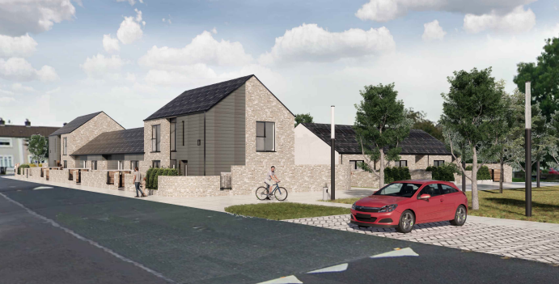
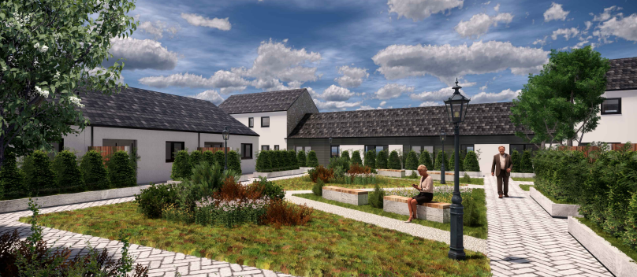
Own Build Developments
LEA | Project | Units | Status
Tallaght South | Rossfield Avenue | 16 | Tender Stage
Tallaght Central | St Aonghus Green (Age-Friendly) | 12 | Contractor Appointed. Commence works onsite August 2024.
3D Image – St Aongus Green
3D image – St Aongus Green

Slide 5
Planning Derogation Sites – Section 179A
Rossfield Avenue, Tallaght
16 Social Homes
Advertised 14/12/2023. Tender publication Sept 2024
Deansrath & Melrose, Clondalkin
27 Age-Friendly Social Homes
Advertised 14/12/2023. Tender publication Sept 2024
Kilcarbery Grange, Clondalkin
88 Social and Affordable Homes
Advertised 21/12/2023. Procurement Stage
Alpine Heights, Clondalkin
13 Age-Friendly Social Homes
Advertised 04/04/2024. Tender Advertised 10/09/2024
Sarsfield Park, Lucan
5 Age-Friendly Social Homes
Advertised 11/04/2024. Tender advertised 28/08/2024
Castlefield, Old Knocklyon Road
33 Social and Affordable Homes
Currently advertised. Statutory advertising period ends 19/09/2024
Old Castle, Clondalkin
130 Social, Affordable and Traveller Accommodation Units
Detailed design ongoing
Stocking Lane, Rathfarnham
25 Social Home
Detailed design ongoing
Owendoher Haven, Rathfarnham
9 Traveller Accommodation Units
FRA Ongoing
Kishogue Park, Clonburris
15 Traveller Accommodation Units
Advertised 30/05/2024. Tender preparation

Slide 6
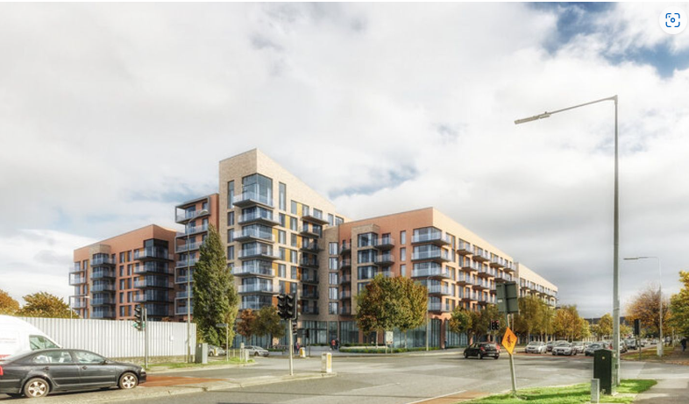
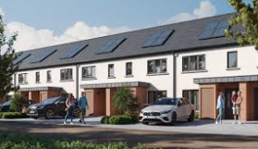
Approved Housing Bodies – Part V Delivery
LEA | Project | Units | Status
Tallaght South | Cuil Duin, Citywest Tuath Housing | 36 | All units delivered June 2024
 | Foxwood Barn, Citywest Tuath Housing | 108 | On site. Phased delivery from Q3.2024 to Q2.2025
 | Carrigmore Woods, Citywest. Tuath Housing | 137 | On-site – phased delivery from Q3.2025
Tallaght Central | Airton Plaza, Belgard Road Cluid Housing | 98 | On site. Due for delivery Q4.2024.
 | Airton Rise, Greenhills Road. Respond Housing | 213 | On-site – phased delivery from Q3.2025
 | Carrigmore View, Tallaght Dublin Simon | 4 | On-site – delivery Q1 2025
Airton Plaza, Belgard Road
Foxwood Barn, Citywest

Slide 8
SDCC Leasing 2024
Target 2024 (HFA) - 120

