Slide 1
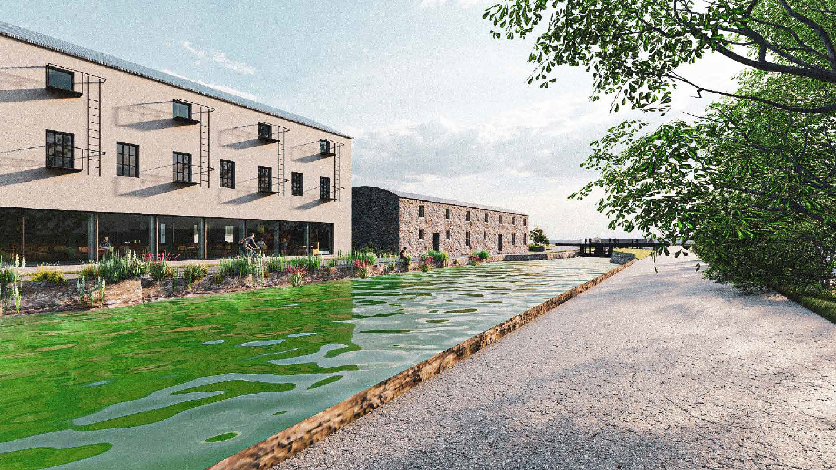
County Promotion Unit
Tourism Updates

Slide 3
The aim
Guide the activities and work programme
The evidence
Extensive stakeholder engagement, locally, regionally, nationally
The approach
Positions South Dublin County to capitalise on opportunity, become resilient, benefit from yields, identify action areas

Slide 4
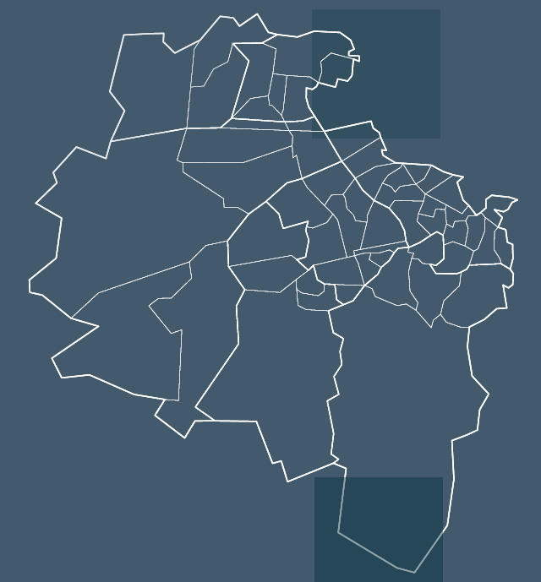
Estimated value of tourism to South Dublin County
€140m total tourism value
3,780 jobs based on tourism
€32.2m returned to the exchequer annually
€210m value to the regional economy

Slide 5
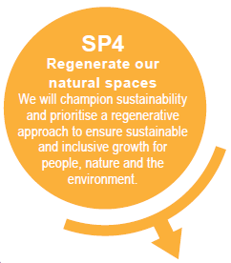
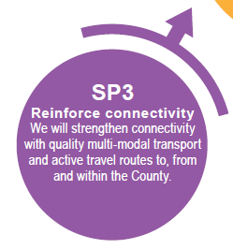
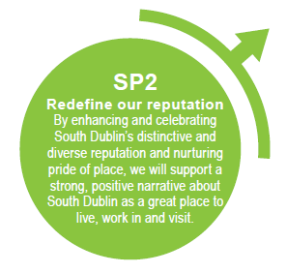
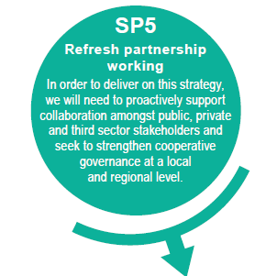
Strategic Priorities

Slide 6
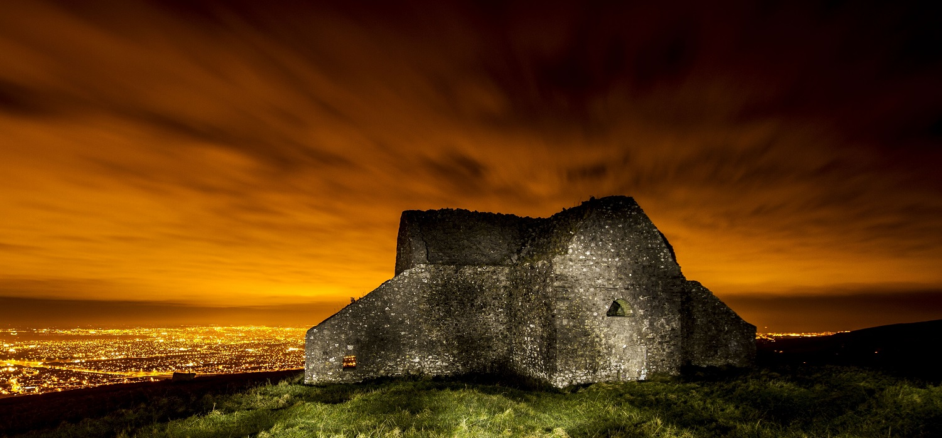
Significant pipeline tourism projects

Slide 8
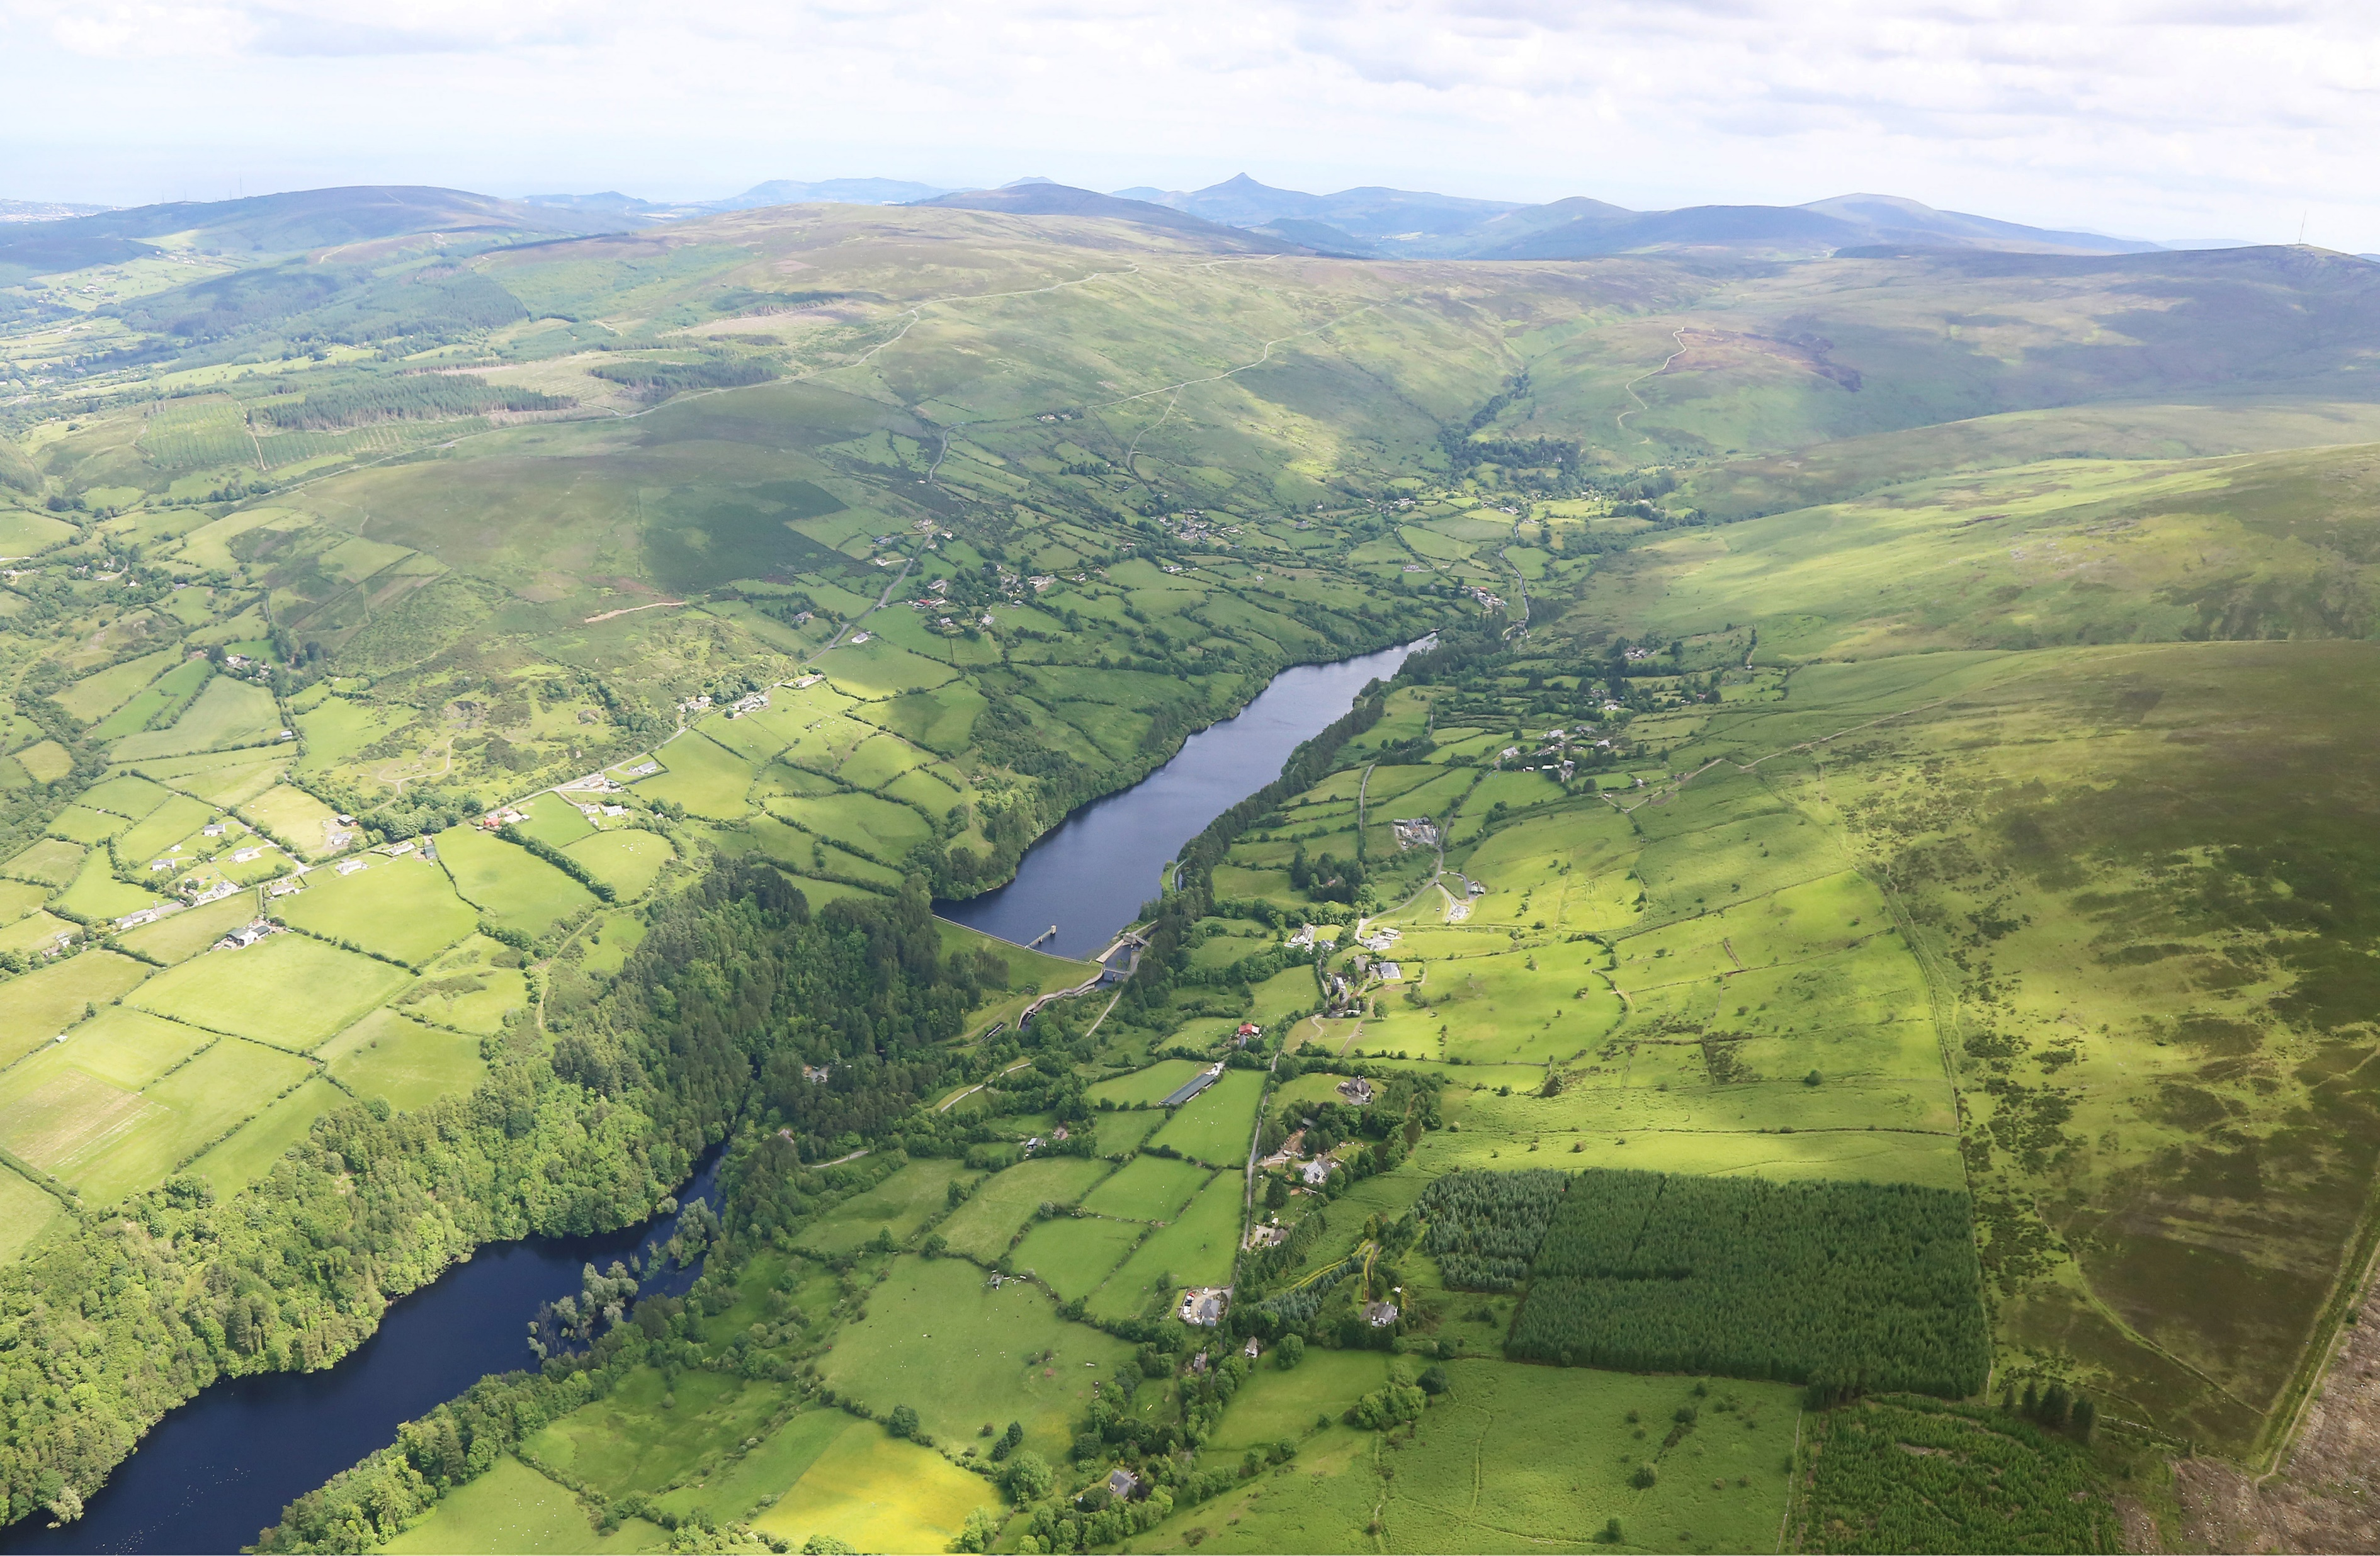
Catalytic projects
Action Points

Slide 9
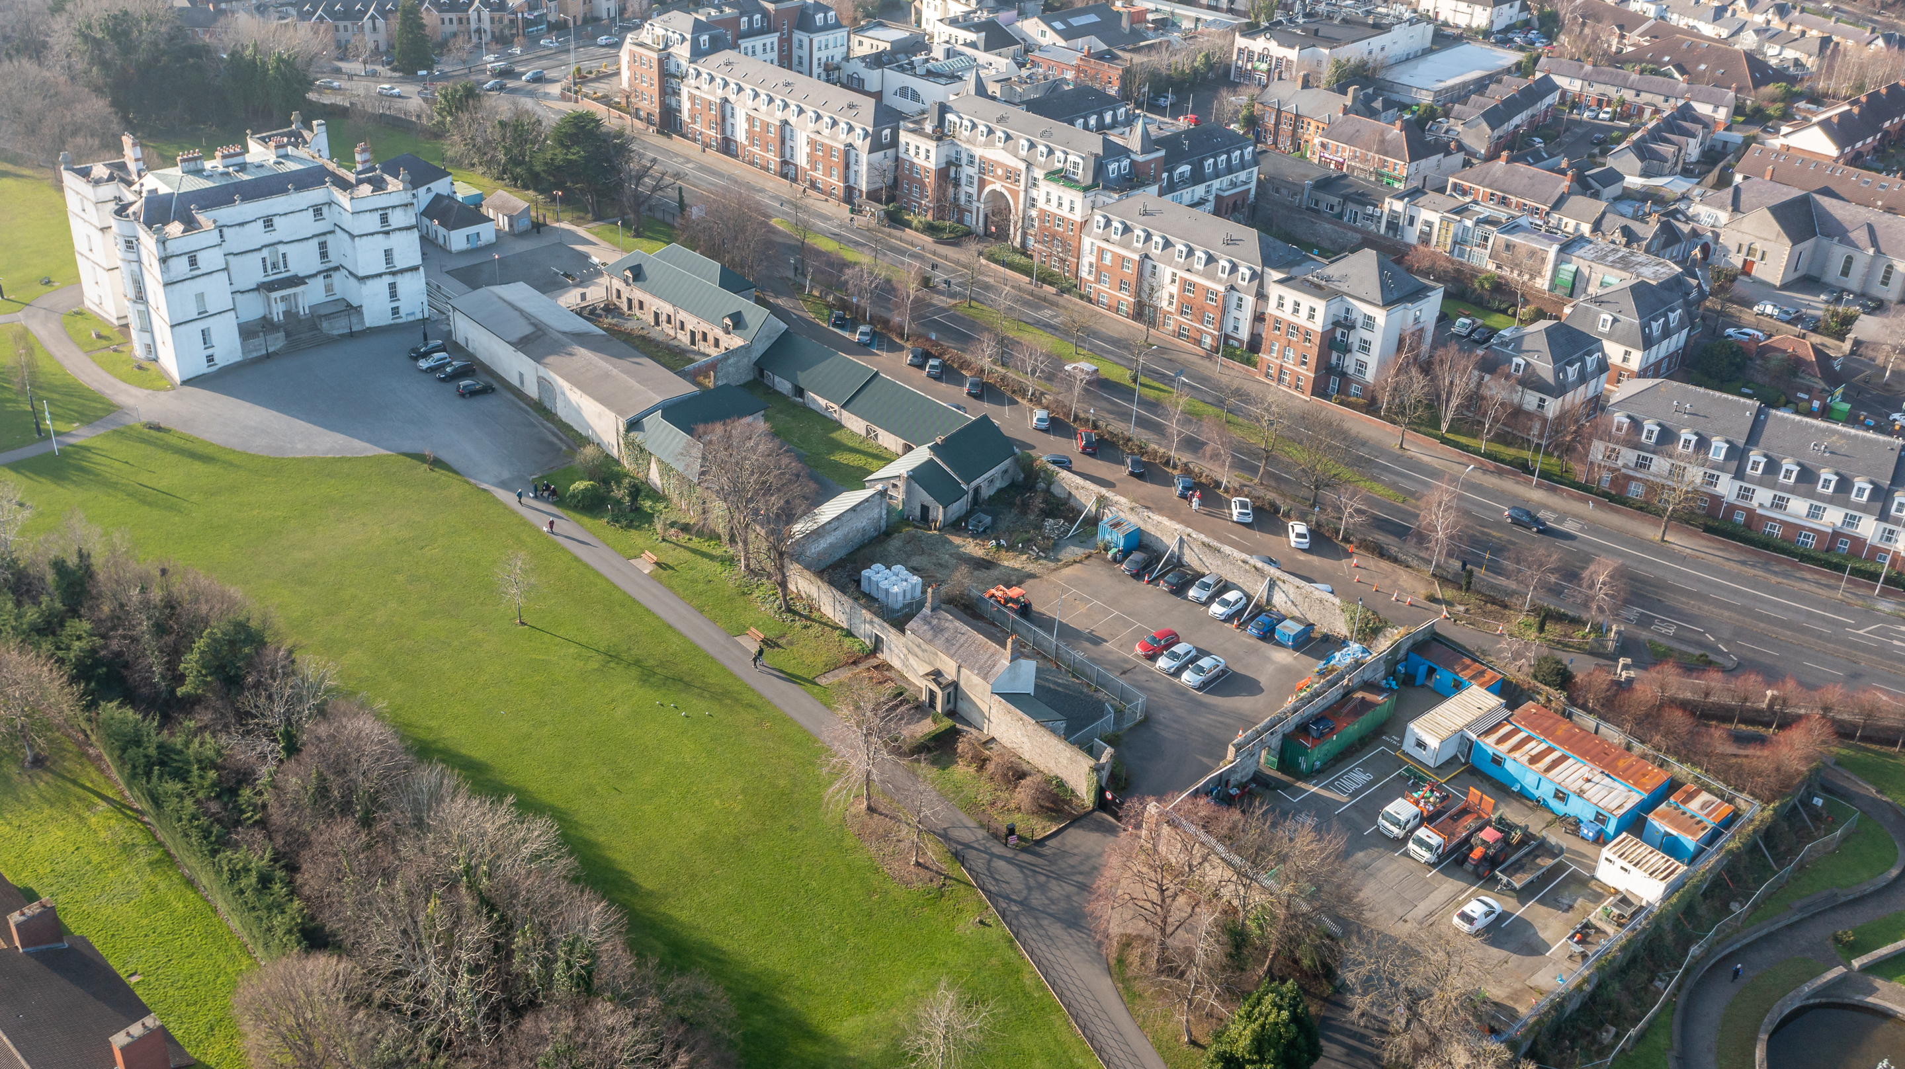
Castle Stables & Courtyard at Rathfarnham
Master Planning and Public Consultation

Slide 10
Steps To Date
Background
Commitment to the development of Rathfarnham Castle Stables and Courtyards is set out in the South Dublin Tourism Strategy 2004 - 2009
The approach to developing the site is heavily informed by the vision and objectives that underpin the County Development Plan, as well as the Tourism Strategy
Recruitment of:
Howley Hayes Cooney to lead the site design.
McHugh Group to act as the business partner for the development of any mixed-use, lifestyle and hospitality offerings.
Lorne Consultancy to manage a non-statutory public engagement process to underpin the master plan.

Slide 11
The non-statutory, public engagement process comprises three phases:
Inform
Consult
Interrogate & Refine

Slide 12
Public Consultation Timeline
Timing | Activity
Mid-April | Outreach Plan for Site Tours & Information Sessions launched
End-April | Site Tours instigated Open Online Consultation (soft launch)
May – Late May | Run Online Consultation & Promotion Campaign Closes 26/05/24
June | Run Focus Groups
Late June | Consultation Report to Inform Finalisation of Masterplan & Preparation of Part 8

Slide 13
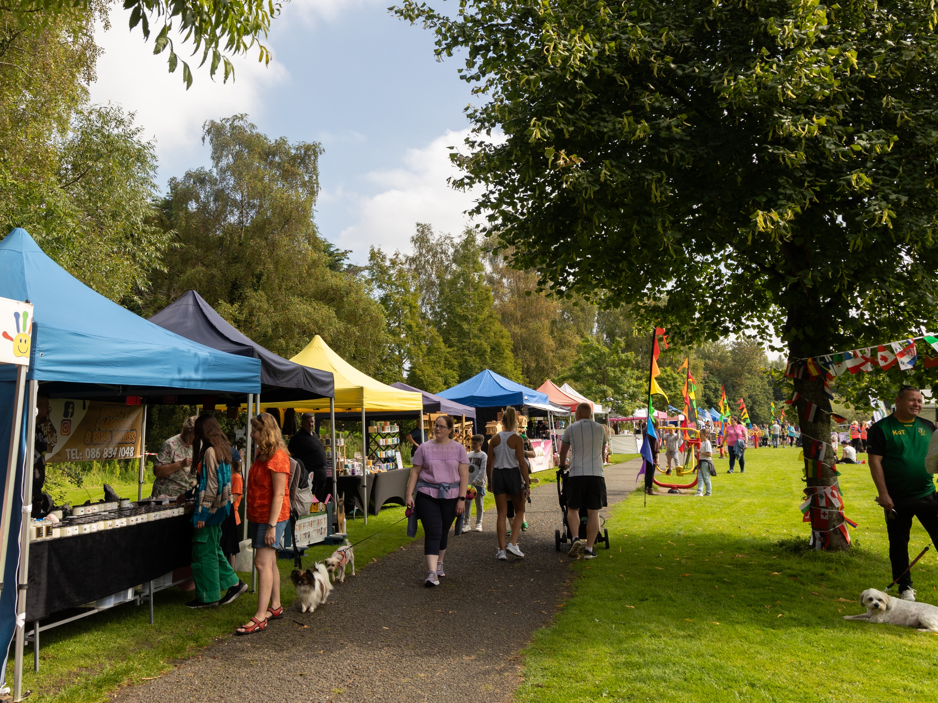
Outdoor Food & Craft Markets
Success of Tymon Park markets
Corkagh
Park Market
Christmas Markets

Slide 14
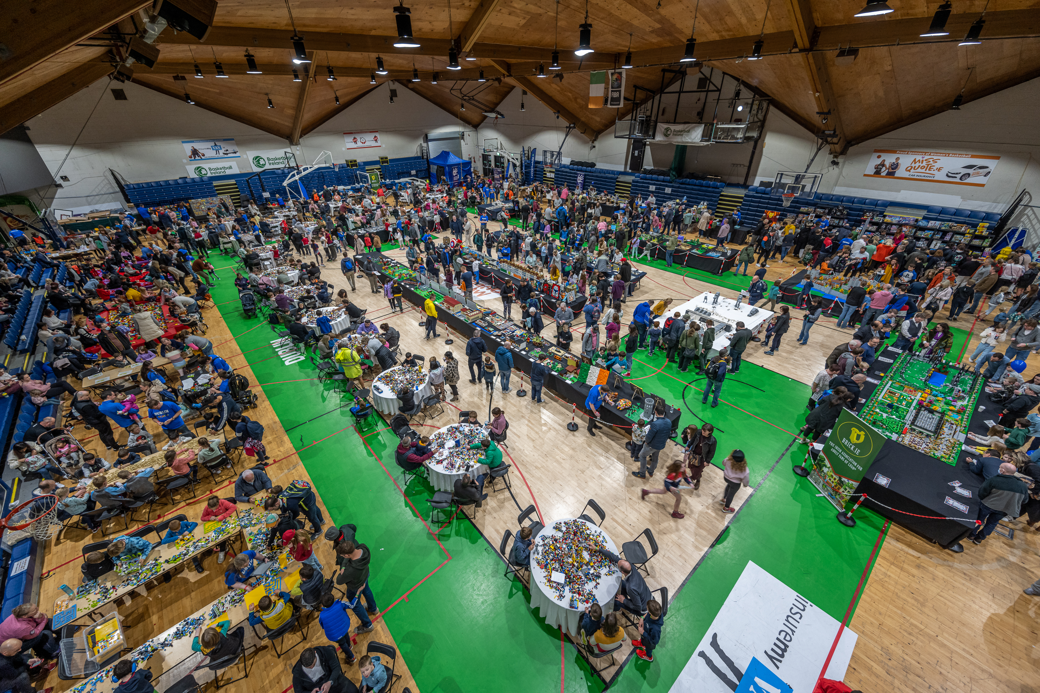
Tourism, Events and Festivals Grant
Events supported 2023
2023 Scheme Review
2024 Scheme

Slide 15
Events In May

Slide 16
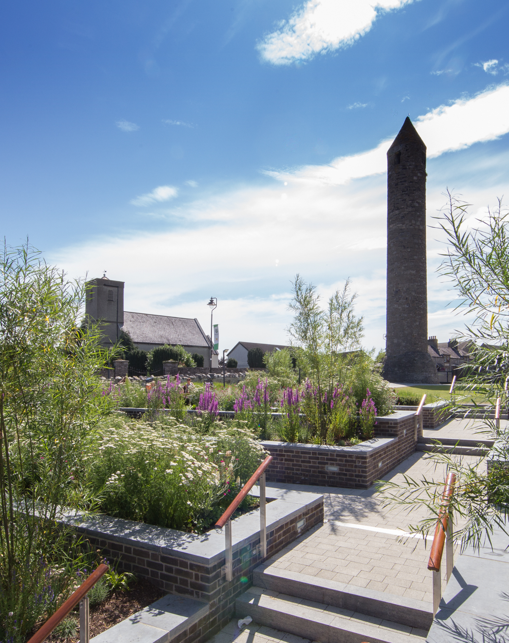
Clondalkin RTVC
Footfall Counters
Events
RTVC Design & Craft Shop

Slide 17
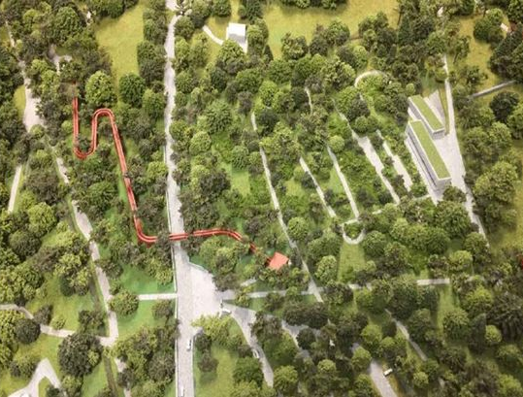
Dublin Mountains Visitor Centre
Detailed
Design
Survey
Work
Communications
Strategy
Construction Process

Slide 18
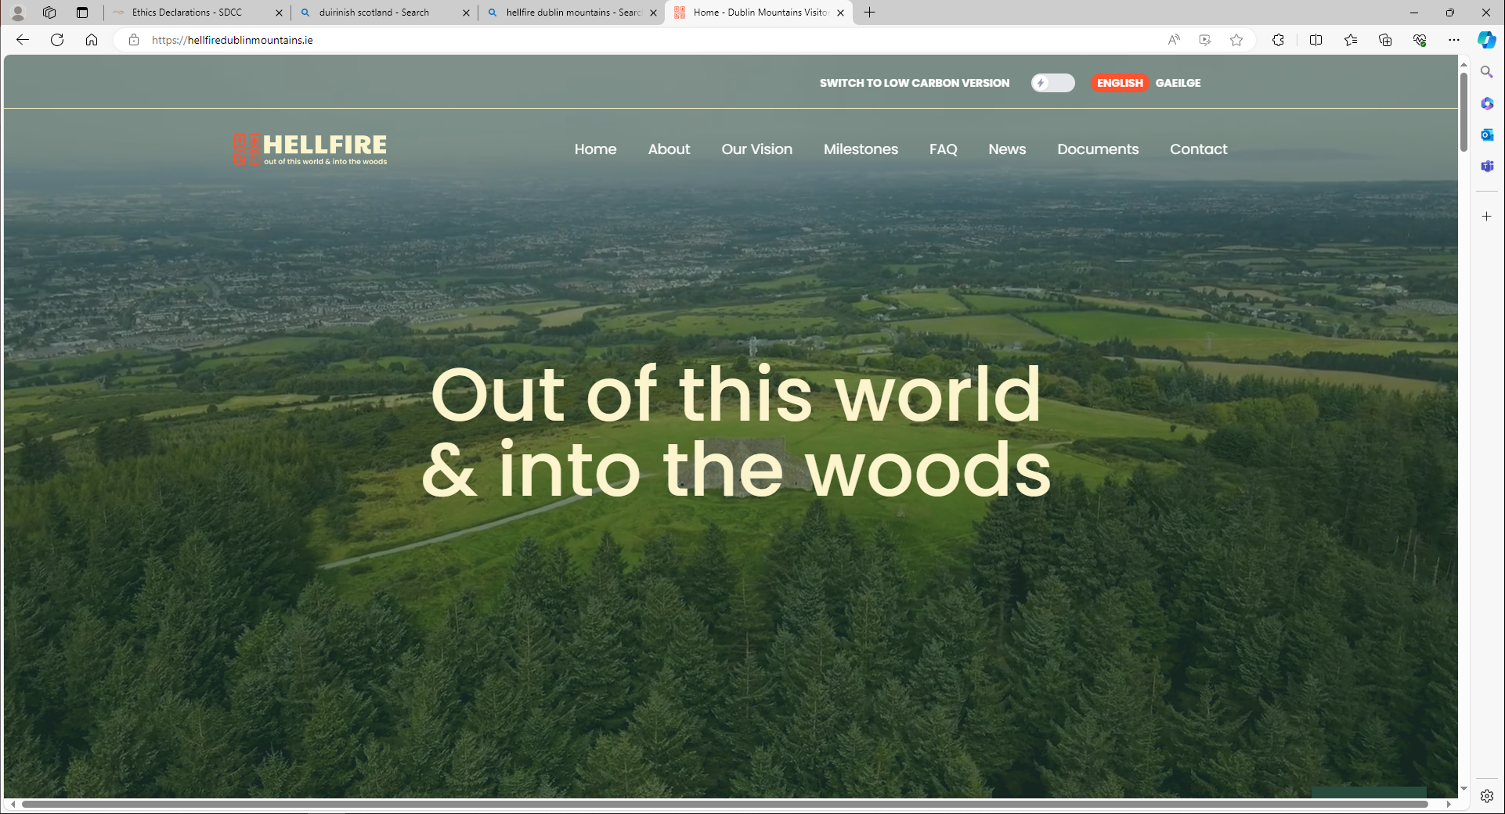

Slide 19
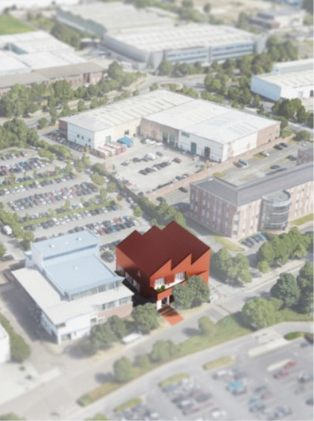
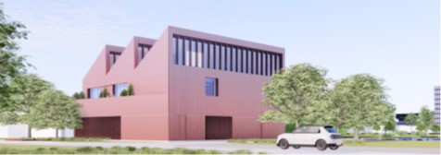
Tallaght Heritage Centre
Site Selection
Part 8 Approval
Interpretation & Planning
Detailed Design
Construction

