Slide 1
DeliveREE
Environment, Water, Climate Change & Biodiversity SPC
7th May 2024

Slide 2
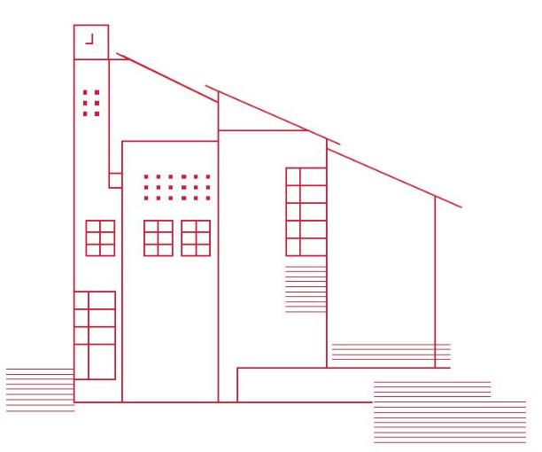
DeliveREE
DeliveREE is a project delivery mechanism to target the ‘thermal’ direct emissions in LA buildings within the 4 DLA region.
To accelerate the delivery of energy efficiency and renewable energy projects
Key delivery mechanism to meet targets set by SDCC Climate Action Plan 2024-2029
Total spend of €4million by 2026,
50:50 between SDCC and SEAI Pathfinder fund
Projects consist of
- Energy Performance Contracts for highest energy users
&
- Decarbonisation of public Buildings

Slide 3
Progress
Energy Performance Contract
Single Operator will be awarded the contract to manage energy consumption and emissions performance of 6 SDCC buildings, with the highest energy usage
- County Hall and Tallaght Library - Rua Red
- Clondalkin Civic Offices - Clondalkin Leisure Centre
- Civic Theatre - Tallaght Leisure Centre
Tender issued 1st March 2024 for EPC for 6 SDCC buildings.
Competitive dialog to commence May 2024
Tender award September/October 2024
Decarbonisation of Public Buildings
Works to Community Centres/Buildings, Libraries and Depots
Installation of Solar PV, Heat Pumps, Building Fabric Upgrades
10 Projects submitted to SEAI for approval on 18th March 2024
Additional properties being assessed

