Slide 1
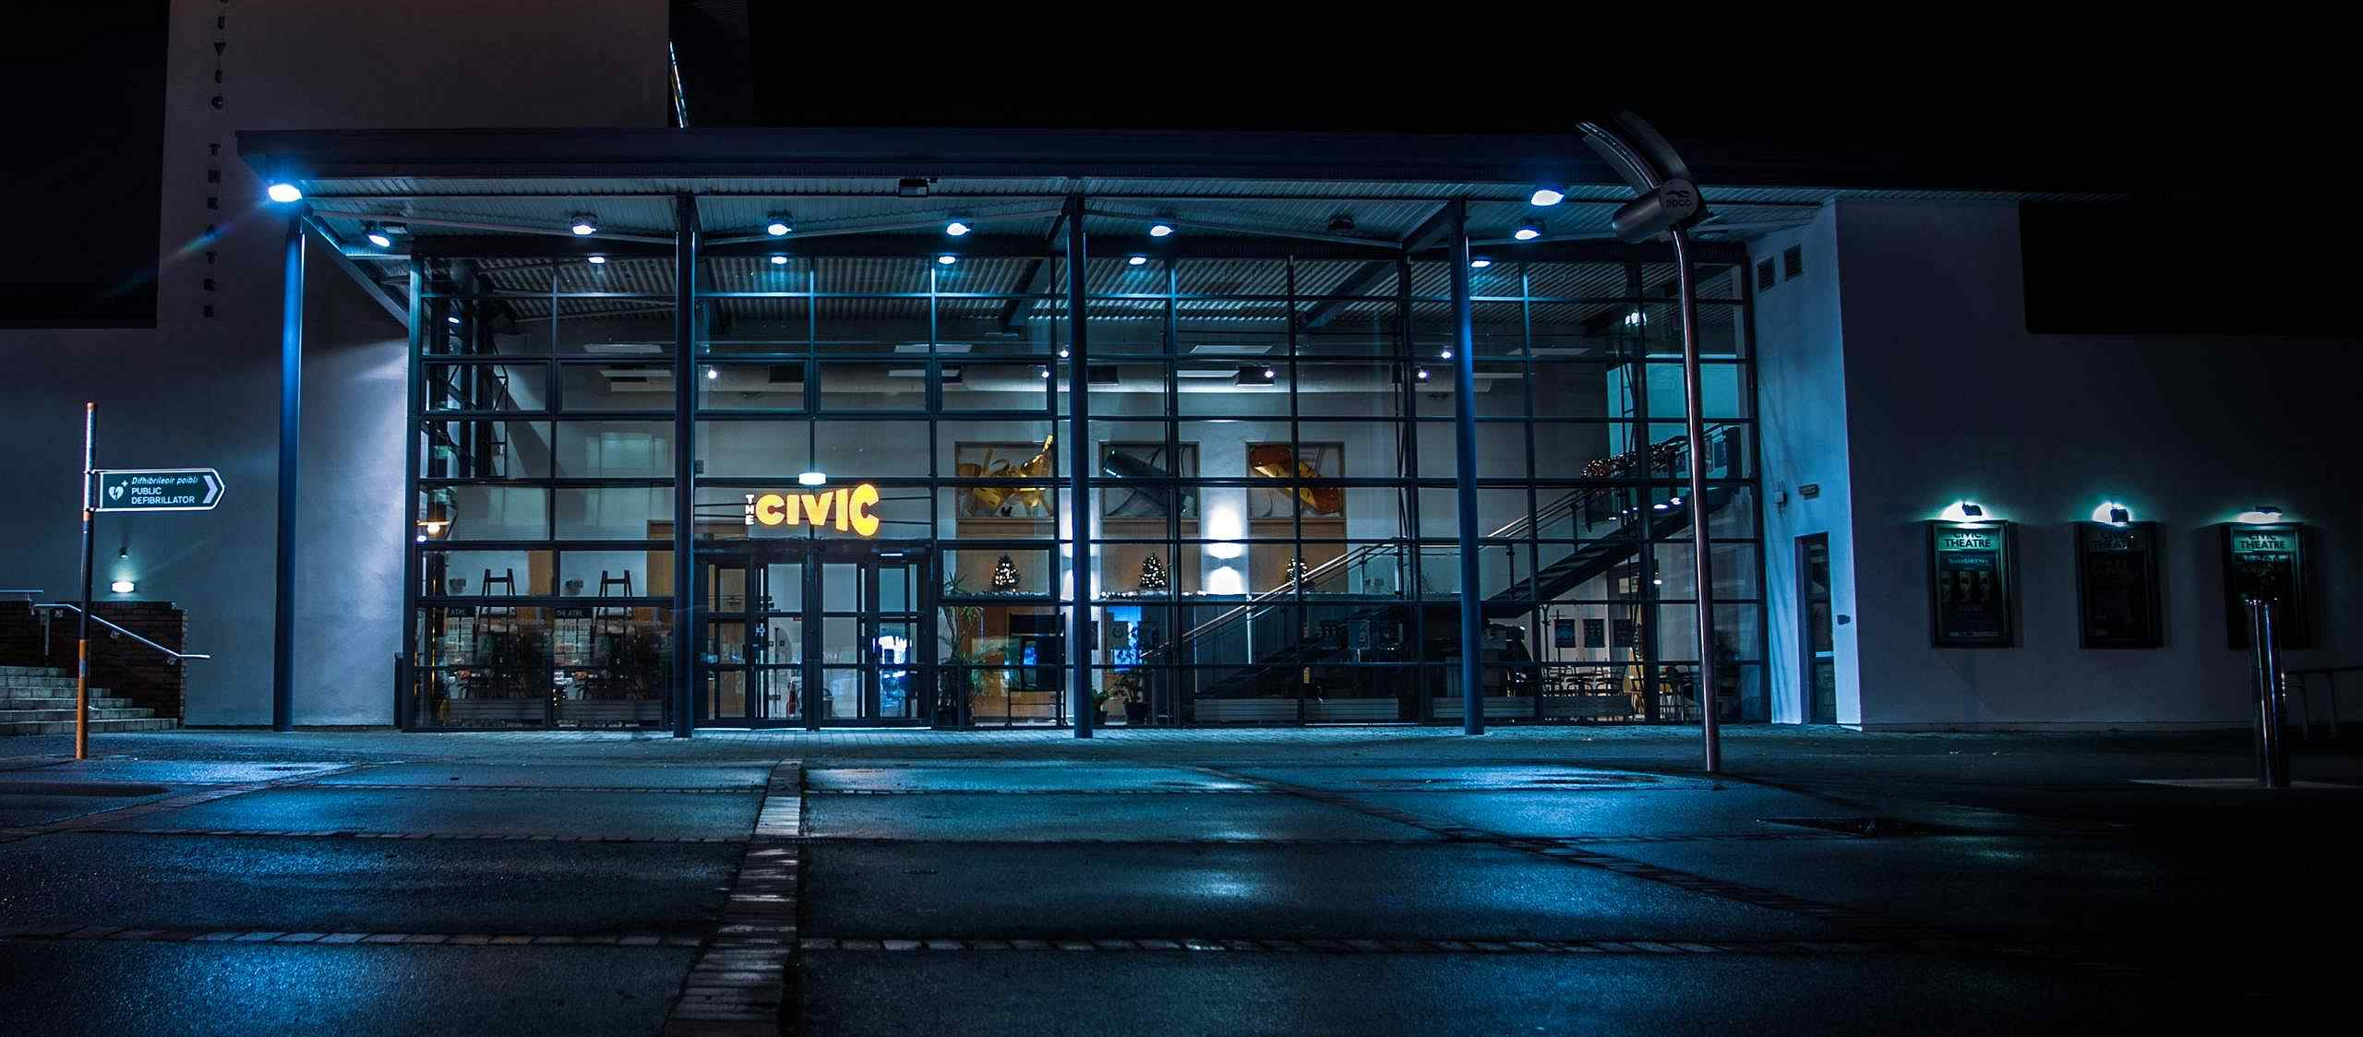
Evening-Time Economy
May - SPC 2024

Slide 2
Evening-Time Economy
Context
National Night Time Economy Taskforce
Tallaght Town Centre Local Area Plan (11,000 homes/15,000 jobs)
Tourism & Food Strategies
Vacancy Rates
Multi-Cultural Society
Evidence Based Analysis of Evening Time Economy
Business Support Fund
Significant Investment in Public Infrastructure
May - SPC 2024

Slide 3
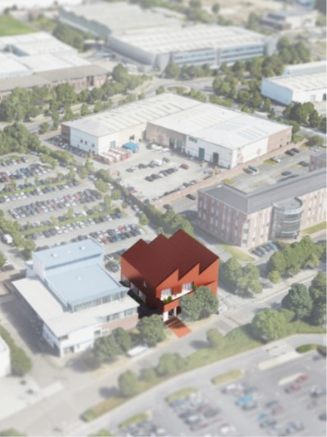
Evening-Time Economy
Opportunities
Promotion of Tallaght as a Destination for Evening Time Activity.
Vibrancy & Vitality of Town Centre.
Reduced Vacancy.
Cultural Quarter & Role of Public Realm.
Greater Collaboration Between Relevant Agencies.
Financial Support.
Local Economy & Job Creation.
Ability to Attract Initiatives normally Located Outside South Dublin.
Safety & Accessibility.
May - SPC 2024

Slide 4
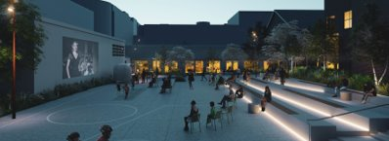
Evening-Time Economy
Next Steps
Tender for expert consultant to carry out research and analysis, directly engaging with Local Businesses & Relevant Business/Community Groups:
- Opportunities
- Challenges
- Recommendations
- Delivery Roadmap
Cross Departmental discussion on initiatives to Support Evening Time Economy:
- Sports and Wellness
- Civic Theatre
- Rua Red
- Libraries
- Local Businesses
- Social Enterprises
- Arts Office
- County Promotion
May - SPC 2024

Slide 5
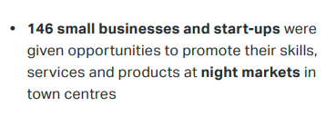
Evening-Time Economy
Best Practice
Similar initiatives have commenced in Kilkenny, Belfast, London, Sydney, Toronto, Montréal & Philadelphia.
Our aim is to refine learnings from initiatives already commenced to support the evening time economy in Tallaght.
Linked with evidence-based research.
Examples of Success:
May - SPC 2024

Slide 6
Evening-Time Economy
Thank You
Discussion & Questions
May - SPC 2024

