Slide 1
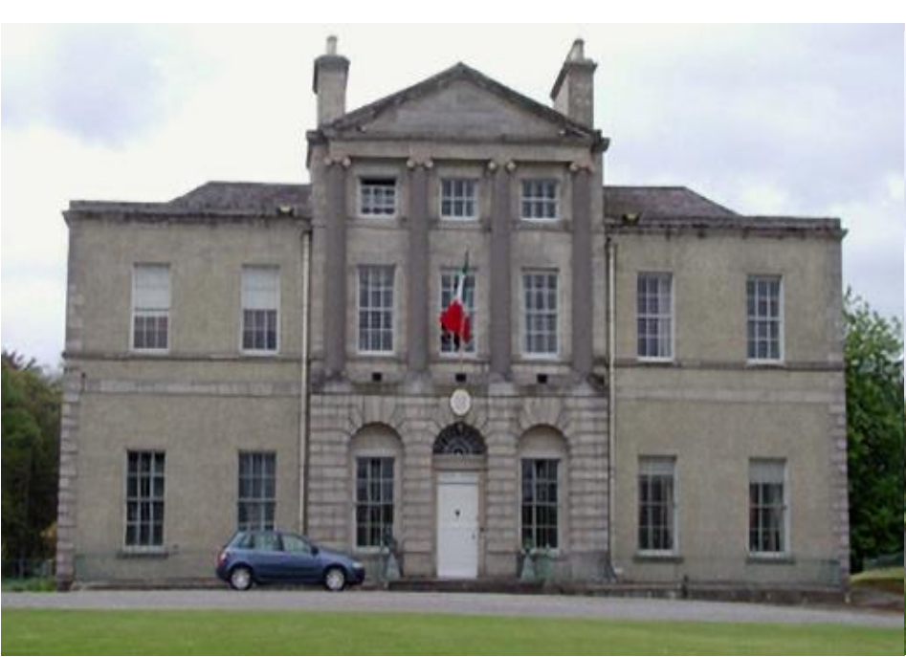
Lucan House Update
Lucan Palmerstown North Clondalkin Area Committee Meeting
23rd April 2024

Slide 2
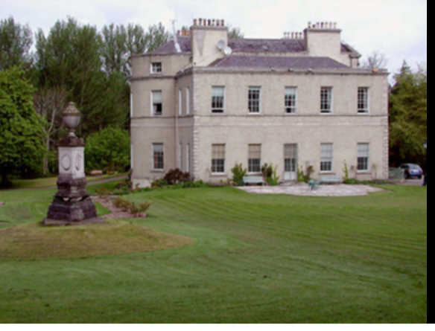
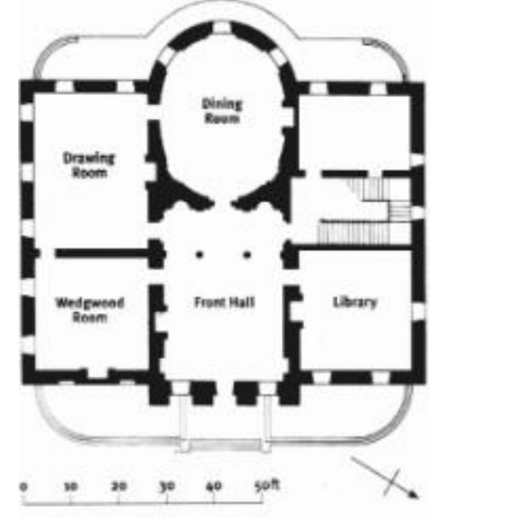
Lucan House
Lucan Village – Rich Natural & Built Heritage
Lucan House intrinsic to Village.
Palladian Villa built in 1772 by Vesey Family
Partly designed by William Chambers
House c.1,425 sqm Gross Internal Area
Detached seven bay two- storey over basement
Partial attic floor over rotunda
Entire contents of house sold at auction in 1925
Italian State interest in the property since1942
Property & part of grounds purchased by Italian
State in 1954]

Slide 3
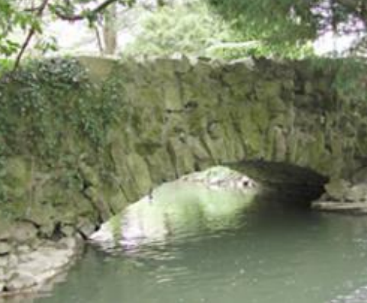
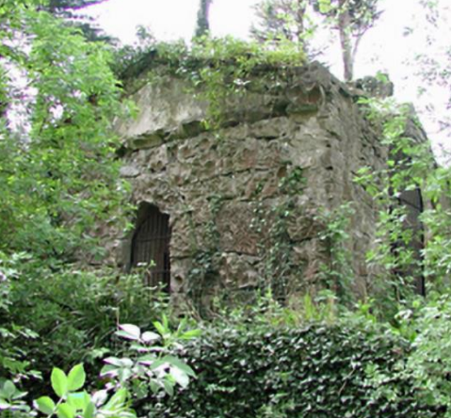
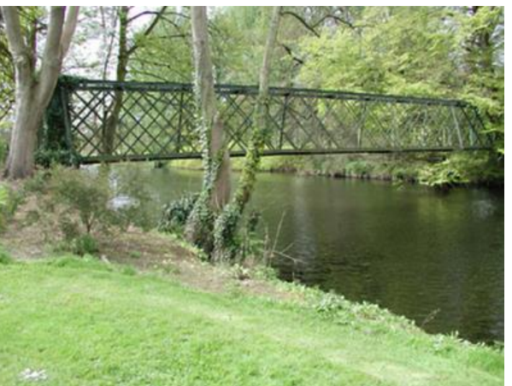
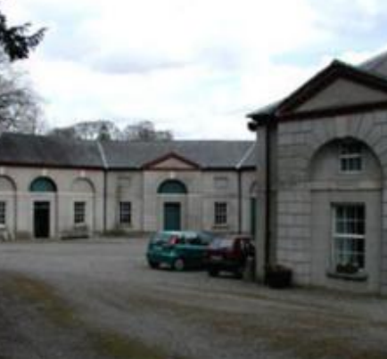
Additional buildings /structures of note
Bath House c.1785
Sarsfield Monument c.1790
Single Arch Stone Bridge c. 1790
Steelwork Bridge
Principal Entrance Gates c. 1775
Gate Lodges 1 & 2
Stable block

Slide 4
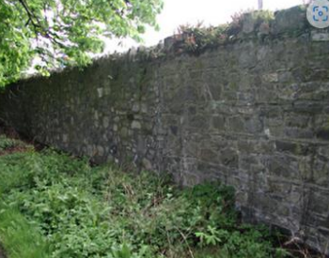
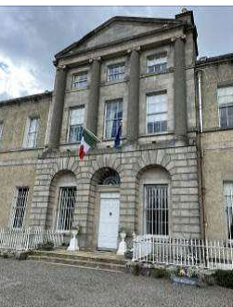
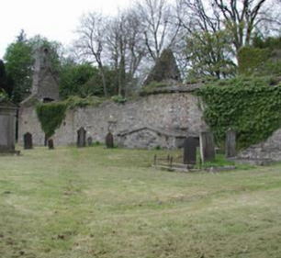
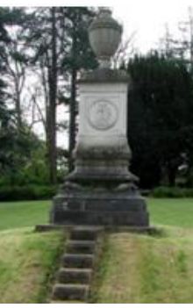
Lucan House Demesne
Strategic Location
Zoned High Amenity
Mixture of Lawns /Dense Woodland
Bounded by River Liffey to North
Historic Stone Bridge over River Griffeen
Includes small island in River Liffey
History dates back to 1560
Number of Protected structures

Slide 5
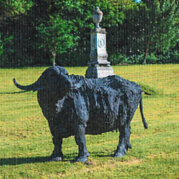
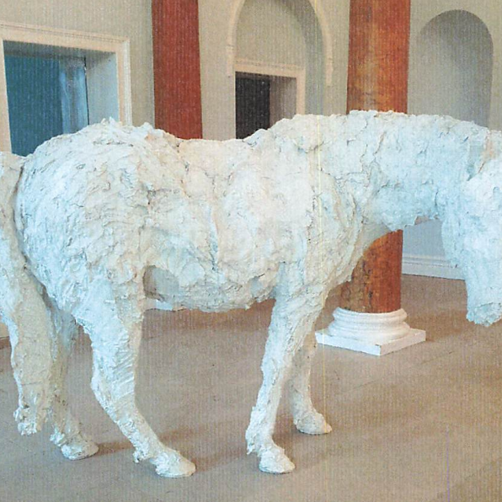
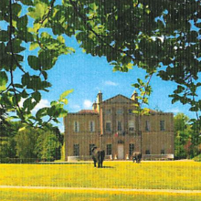
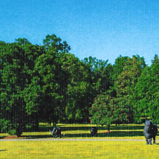
Parco Italia / Sculptures
12-acre front garden of grounds to be known as “Parco Italia” – recognising the significant historical association with Italian Embassy
Acquisition incorporates “Buffalo Grazing” sculpture trail by celebrated Italian artist Davide Rivalta comprising eight one-ton bronze buffalo sculptures
Trail concept devised by Ambassador & Italian National Gallery of Modern & Contemporary Art
White Cavallo fibreglass horse in front hall – in homage to Irish equestrian tradition

Slide 6
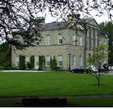
Next Steps
Closing of sale expected June 2024
Handover event to be arranged
€10.95 million 2024 provision for acquisition, assessment & management
Post handover:
assessment of property and grounds
facilitate managed public access to grounds
Appointment of consultants Q3 2024 to develop masterplan
Objectives:
Develop plan for Lucan House & Demesne as tourism, community & County amenity
Conservation of natural and built heritage
Examine optimal economic, recreational and environmental uses to benefit Lucan and wider County

