Slide 1
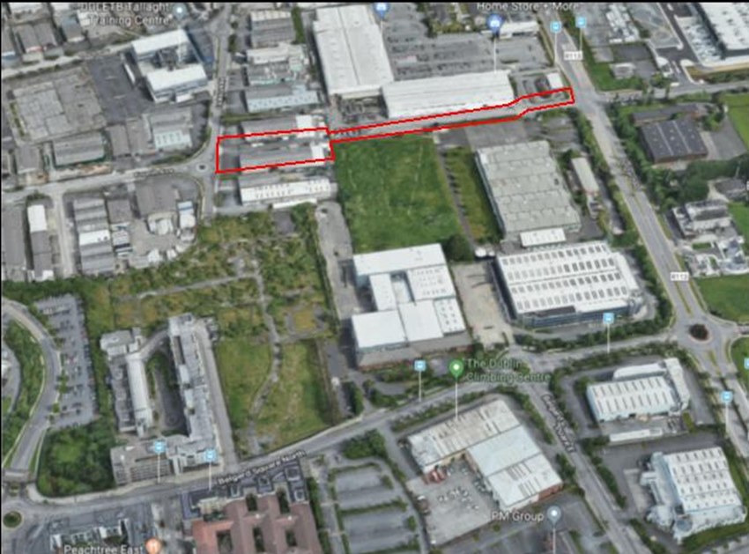
Airton Rd Extension
Part VIII – consultation period 13th Jan 2022- 24th February 2022
Voted on and passed at the 14th March 2022 meeting
The construction of approximately 328 m. of a two-way single carriageway road connecting Cookstown Industrial Estate Road to Belgard Road.
The construction of three signal-controlled junctions, Junction of Cookstown Ind. Estate Road with Airton Road Extension, Junction of Airton Road Extension with the entrance into Belgard Retail Park and the Junction of Airton Road Extension and Belgard Road.
The construction of boundary walls, fencing and access treatment.
Associated earthworks and appropriate landscape works.
Notes:
Heat is transferred from the Amazon data centre to highly insulated pipes which run underground, transferring heat to a blend of public, commercial, and private premises.

Slide 2
Airton Rd Extension
Notes:
Bespoke LED units with sharp optical cut-offs allowed for clearly defined boundary between the illuminated and non-illuminated areas, which minimised light spill.
The lights in particularly sensitive areas, i.e., foot bridges and Bushy Park, were not mounted on six metre poles but rather installed in handrails and low-level bollards to minimise the spill over of light.
Lights will be operated on a motion sensor basis that switches the lights on for a set period of time when a person is detected in the vicinity and completely off otherwise.

Slide 3
Airton Rd Extension Programme
Construction Begins
April 2024
Exit on to Belgard Rd
3 months Construction
Construction Completed
June 2025
Belgard Retail Park Junction Works
5 months Construction
Notes:
Bespoke LED units with sharp optical cut-offs allowed for clearly defined boundary between the illuminated and non-illuminated areas, which minimised light spill.
The lights in particularly sensitive areas, i.e., foot bridges and Bushy Park, were not mounted on six metre poles but rather installed in handrails and low-level bollards to minimise the spill over of light.
Lights will be operated on a motion sensor basis that switches the lights on for a set period of time when a person is detected in the vicinity and completely off otherwise.

