Slide 1
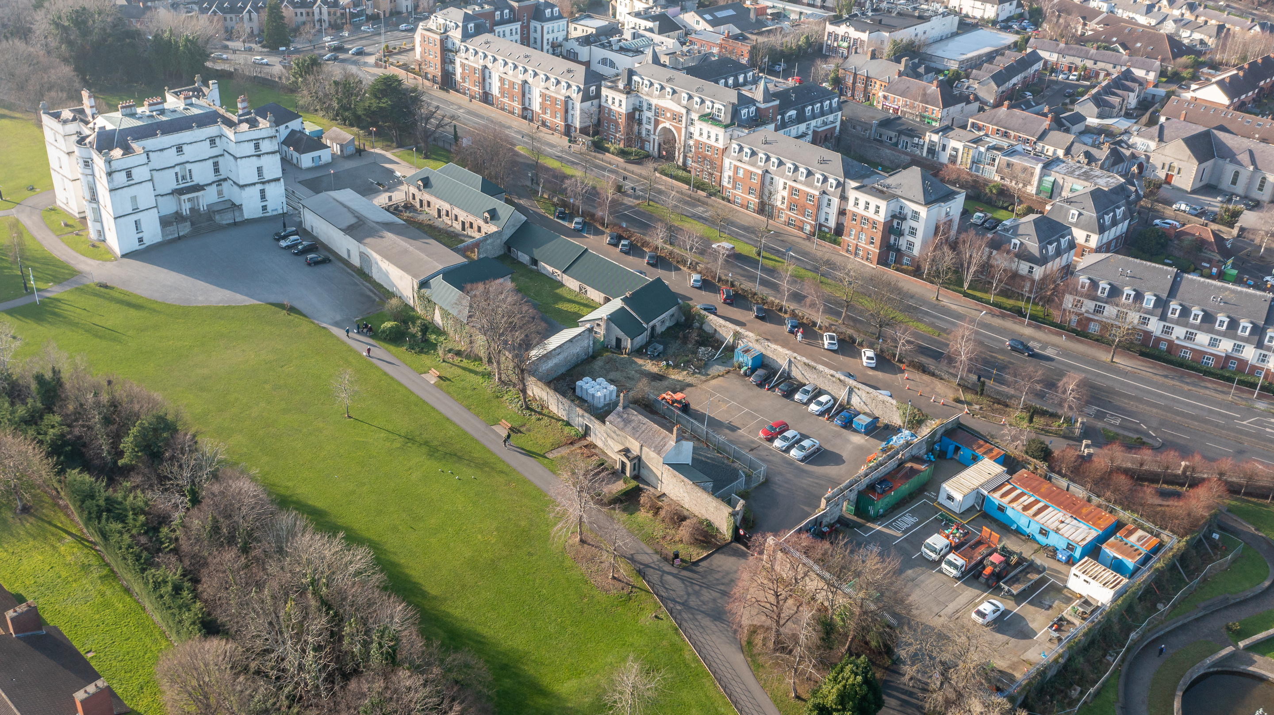
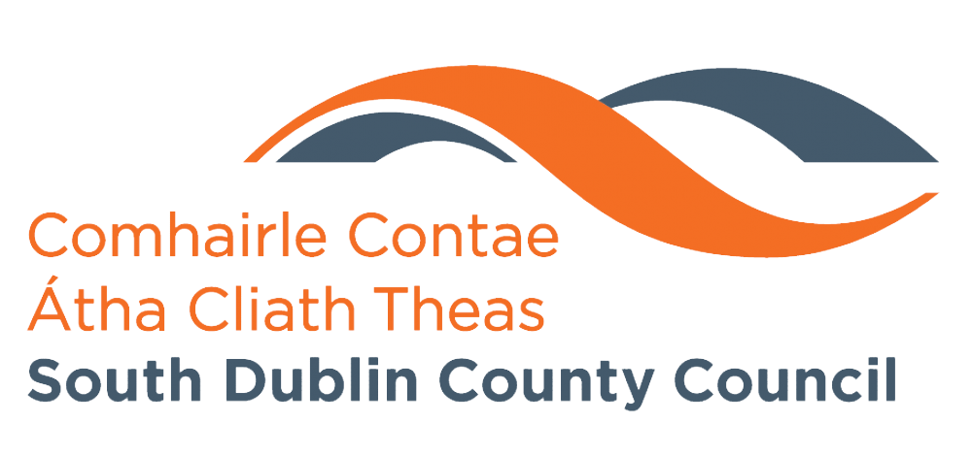
Rathfarnham Stables & Courtyards
Master-planning & Public Consultation
April 2024

Slide 2
Steps To Date
Background
Commitment to the development of Rathfarnham Castle Stables and Courtyards is set out in the South Dublin Tourism Strategy 2024 - 2029
The approach to developing the site is heavily informed by the vision and objectives that underpin the County Development Plan, as well as the Tourism Strategy
Recruitment of:
Howley Hayes Cooney to lead the site design.
McHugh Group to act as the business partner for the development of any mixed-use, lifestyle and hospitality offerings.
Lorne Consultancy to manage a non-statutory public engagement process to underpin the master plan.

Slide 3
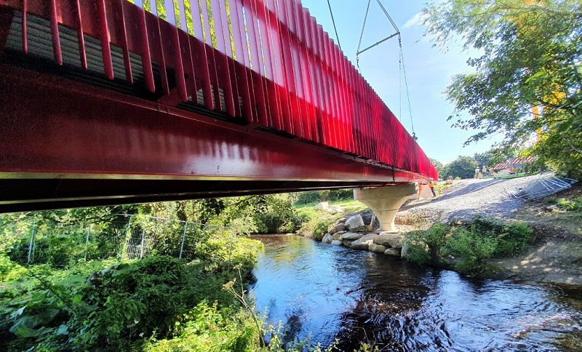
Public engagement process:
The non-statutory, public engagement process will comprise three phases:
Inform
Consult
Interrogate & Refine

Slide 4
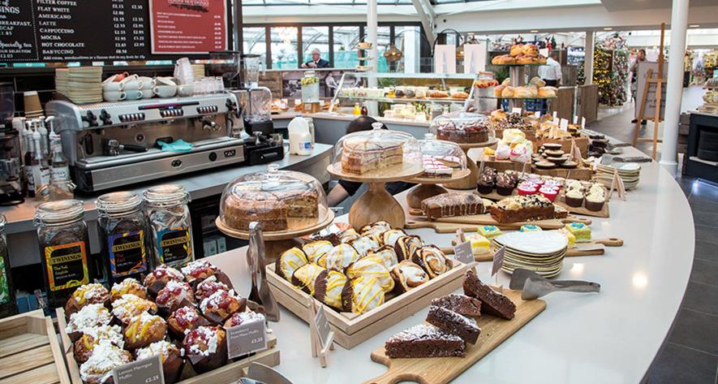
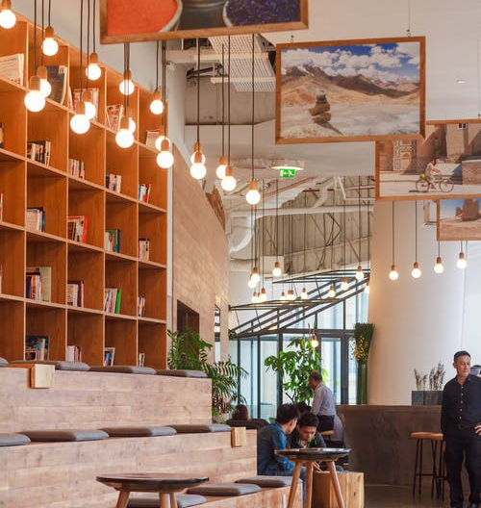
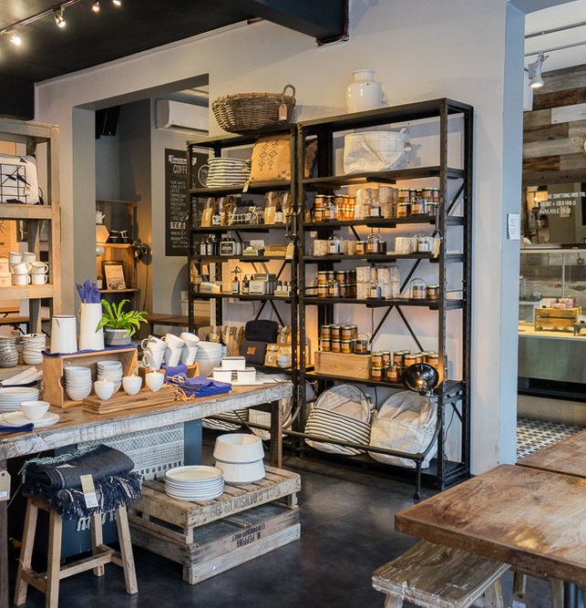
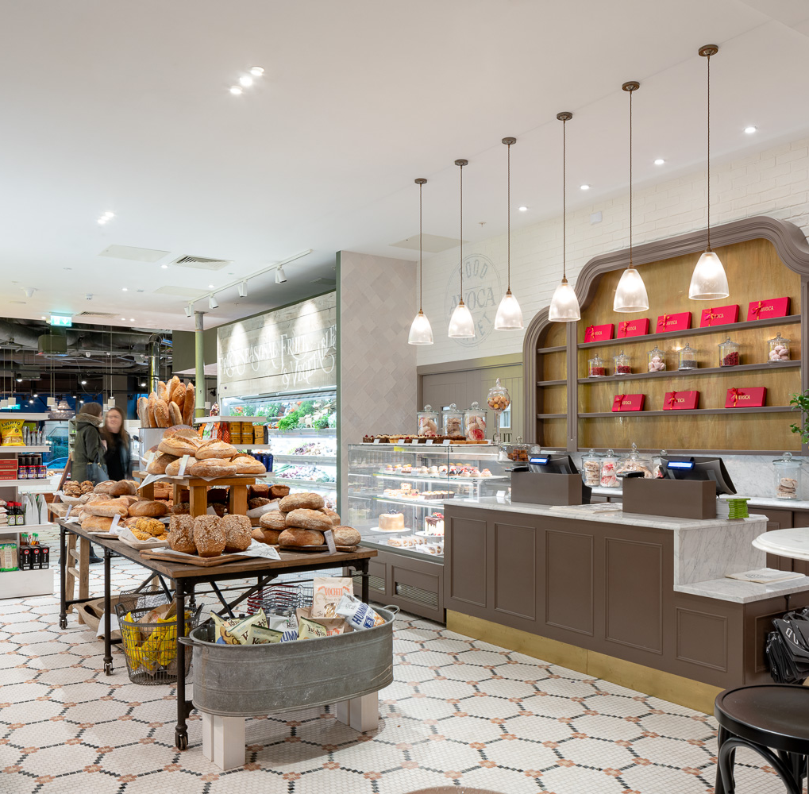
Public Consultation Process
Inform
Public information Tours
Historic Context
Project Objectives
Idea Generation
Masterplan Process
Consult
Online Consultation
Min. 3-week Period
Objectives
Guiding Principles
Detailed Questionnaire
Interrogate & Refine
Focus Groups
Volunteers from Public Consultation
Broad Segments of Population

Slide 5
Public Consultation Timeline
Timing | Activity
Mid-April | Launch Outreach Plan for Site Tours & Information Sessions
End-April | Instigate Site Tours Open Online Consultation (soft launch)
May – Late May | Run Online Consultation & Promotion Campaign
June | Run Focus Groups
Late June | Consultation Report to Inform Finalisation of Masterplan & Preparation of Part 8

Slide 6
Thank You
Questions

