Slide 1
Pavilions Programme Update
Meeting of South Dublin County Council
8th April 2024

Slide 2
Programme Review
Review of proposed locations
Change building model to modular system
Procure as a framework
Accelerate delivery
Funding

Slide 3
Locations
Original Programme
Griffeen Valley Park (Part 8 approved)
Corkagh Park ORR (Part 8 approved)
Dodder Valley Mt Carmel (Part 8 approved)
Collinstown Park
Griffeen Valley / Arthur Griffith Park
Tymon Park South (delivery with upgrade of 3 pitches)
Proposed Additional Locations
Kilnamanagh Open Space
Sean Walsh Park Artificial Pitch
Kiltipper Park
Willsbrook Park
-------------------------------------------------------------------------------------------------------
Future Artificial Pitch Locations

Slide 4
Proposed Usage & Provision
Location | Pitch / Facility | 2024 Season Allocations | Proposed Provision
Griffeen Valley Park | 5 x soccer 2 x GAA | Lucan Sarsfields, Ballyowen Celtic FC, Beech Park FC, Park Run | 6 Changing & 2 Storage Bays
Corkagh Park ORR | 4 x GAA 2 x baseball 2 x cricket 1 x soccer | Round Towers, Knockmitten United, Na Gaeil Óga, Adamstown Cricket Club, Baseball Ireland, Park Run | 6 Changing & 2 Storage Bays
Collinstown Park | 3 x soccer | Collinstown FC New team from Sept (tbc) | 2 Changing & 1 Storage Bays
Kilnamanagh Open Space | 2 x GAA | St. Kevin’s Killian’s | 2 Changing & 1 Storage Bays
Sean Walsh Park Artificial Pitch | 1 x artificial | Facilities available via booking system, with up to 15 regular club users & 1 1 school with daily access | 2 Changing & 1 Storage Bays
Dodder Valley Mt Carmel | 1 x grass athletics track 1 x soccer | Firhouse /Knocklyon (club tbc) Pearse Bros Athletics | 2 Changing &2 Storage Bays
Kiltipper Park | Proposed: 1 x GAA 1 x soccer | Pitches to be provided after construction tender: allocation tbc | 2 Changing & 1 Storage Bays
Griffeen Valley Park-Arthur Griffith | 2 x soccer 1 x GAA 1 x artificial athletics track, 1 x artificial hockey 1 x boules court | Arthur Griffith Park FC, Lucan Sarsfields, Lucan Harriers, Weston Hockey Club, Griffeen Valle, Petangue | 2 Changing & 1 Storage Bays
Willsbrook Park | 1 x soccer | Esker Celtic FC | 2 Changing & 1 Storage Bays
Tymon Park South | 1 x rugby 1 x American Football 1 x archery course | Tallaght Rugby, Panthers, Greenhills Archers Club | 2 Changing &2 Storage Bays

Slide 5
Operational Model
Objective: to maintain flexibility in provision & ensure changing facilities for as many clubs as possible in line with Sports Pitch Strategy.
SDCC management of facilities
Use of on-line pavilion booking system
Clubs with allocated pitches adjacent to the pavilions to book preferred changing room slots (subject to co-ordination between SDCC and local clubs & availability of slots)
Remaining slots available for booking by other clubs / teams / groups, e.g. school sports days, park runs, yoga, orienteering etc.
Proposed model will be subject to operational review after installation to maximise on-going effectiveness of facilities

Slide 6
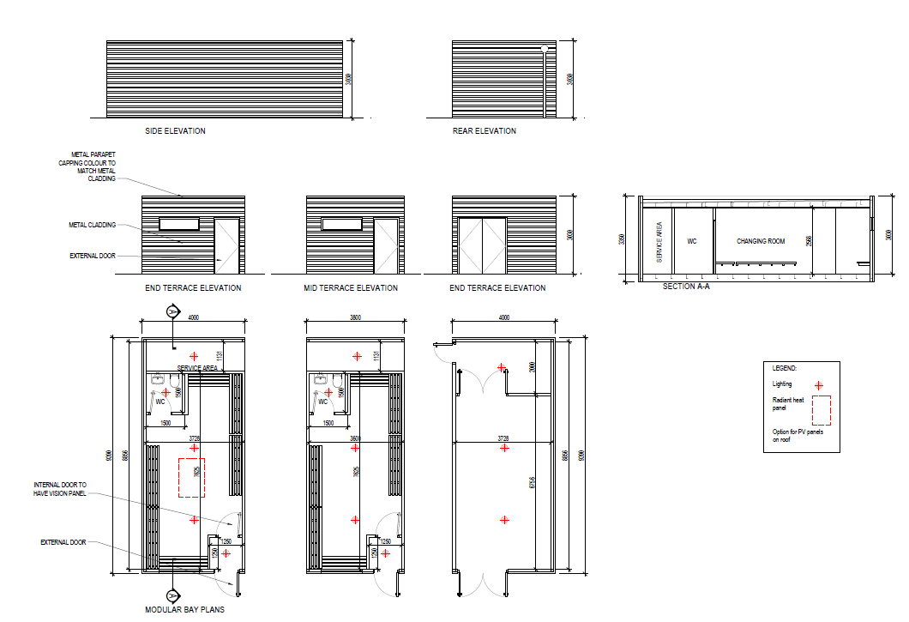
Modular Build for Flexibility

Slide 7
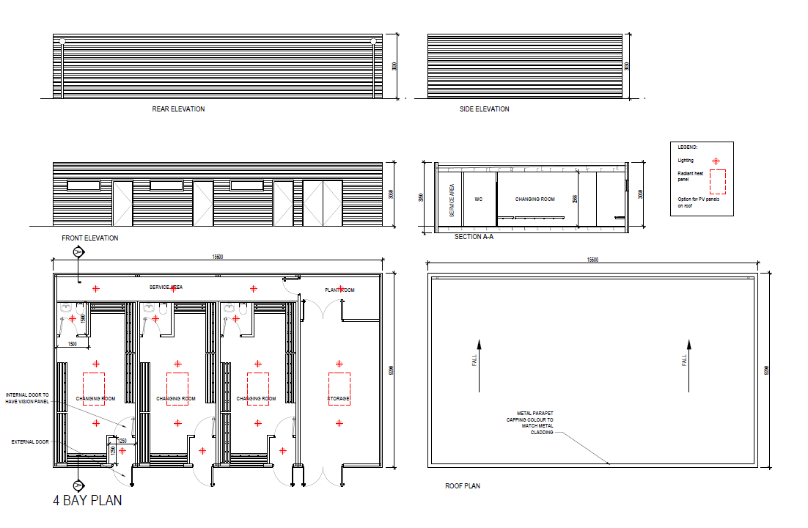
Modular Build for Flexibility

Slide 8
Funding
Approved Sports Capital Grants: Griffeen Valley Park €610,000
Corkagh Park ORR €550,000
Collinstown Park €455,905
Dodder Valley Mt Carmel €259,458
Total Sports Capital Grant funding to date: €1,875,363
€2 million SDCC funding in 2024-2026 Capital Programme
Additional €4.8m required for enhanced programme at: Kilnamanagh open space, Sean Walsh Park, Griffeen Valley/Arthur Griffith Park, Tymon Park South, Kiltipper Park & Willsbrook Park
Further Sports Capital Grant applications to be made & funding to be included in 2025-2027 Capital Programme

Slide 9
Projected Delivery Timelines
April 2024: Programme review presented to Council
May-Oct 2024: Part 8s for Collinstown, Kilnamanagh, Sean Walsh Park, Arthur Griffith Park, Tymon Park South, Kiltipper & Willsbrook
May-Aug 2024: Framework tenders for (1) civil works & (2) modular buildings framework using Corkagh & Griffeen
Sep 2024 Contractor mobilisation
Oct-Dec 2024: Civil works at Corkagh & Griffeen and concurrent modular manufacture
Jan-Mar 2025: Modular installation at Griffeen & Corkagh
Further approved locations progressed after Part 8 approval with estimated 28-week delivery timeframe
*Dates subject to change depending on planning, procurement, manufacture, construction etc.

Slide 10
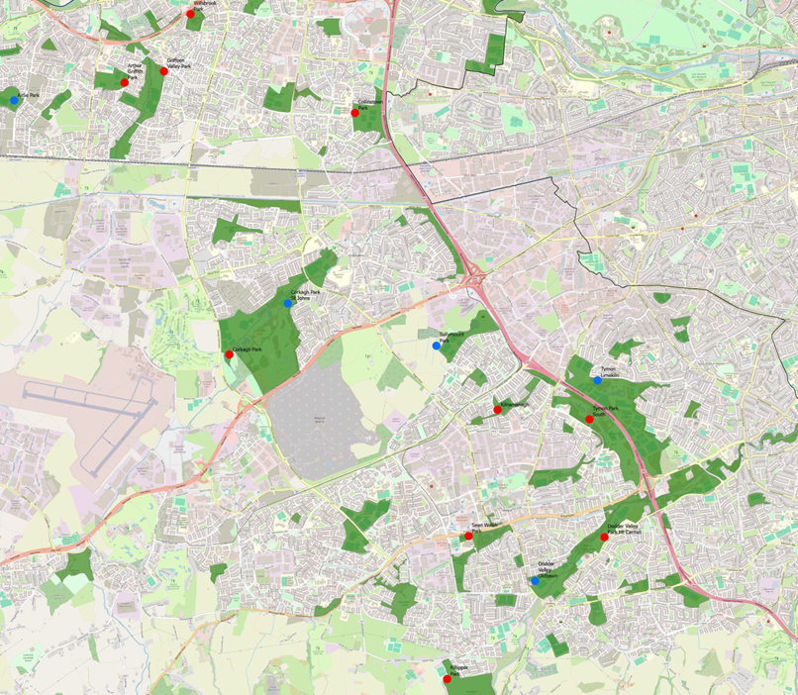
Location Map
Red = proposed locations
Blue = existing locations

