Slide 1
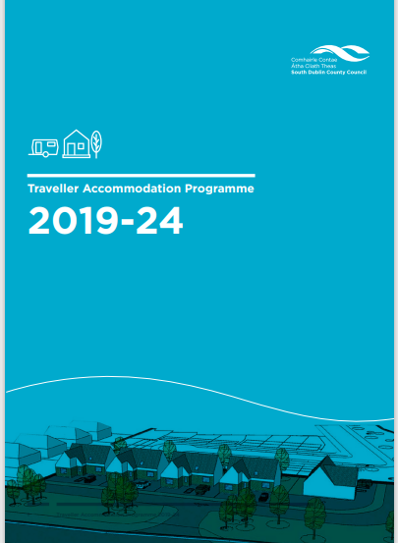
TAP Progress Report Update February 2024-April 2024 LTACC Meeting 4th April 2024

Slide 2
LTACC April Update
Item | Units | Comment
Allocations | 1 | 2 Daletree Place
Offers | 1 | Offer of Transfer to one Family from Oldcastle Park Halting Site to Standard Housing,
Re-let Works | 6 | Relet works ongoing in a Group House in Daletree Place. Completion works to be finalised in Bays 5 Stocking Hill, works to commence in Bays 1 & 2 Stocking Hill. An investigation is ongoing re extensive Fire Damage to recently completed Bay 7 Stocking Hill Following extensive Fire Damage.

Slide 3
LTACC April Update
Item | Comment
Oldcastle Park Redevelopment | Updated preliminary drawings circulated to tenants in Oldcastle Park. The Council and Clondalkin Travellers CDP held in person consultations with families on Wednesday February 14th, 2024. Meetings ongoing with Architects on proposed design and layout.
Kishogue Park Redevelopment | Site layout and design agreed with tenants, discussions near complete temporary relocation and temporary accommodation type whilst the works are ongoing. Working with SDCC Departments on design and services required
Owendoher Haven | Relocation of families to alternative accommodation to commence shortly. Council has appointed Consultants for Structural and Civil Engineering and Certifier Services for the re-development along with a Specialist Ecological Consultants for the provision of an Environmental Impact Assessment.
Fonthill Road | 7 homes to be allocated in April 2024

