Slide 1
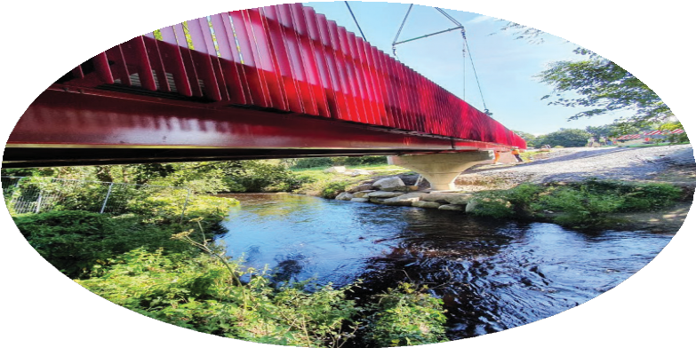
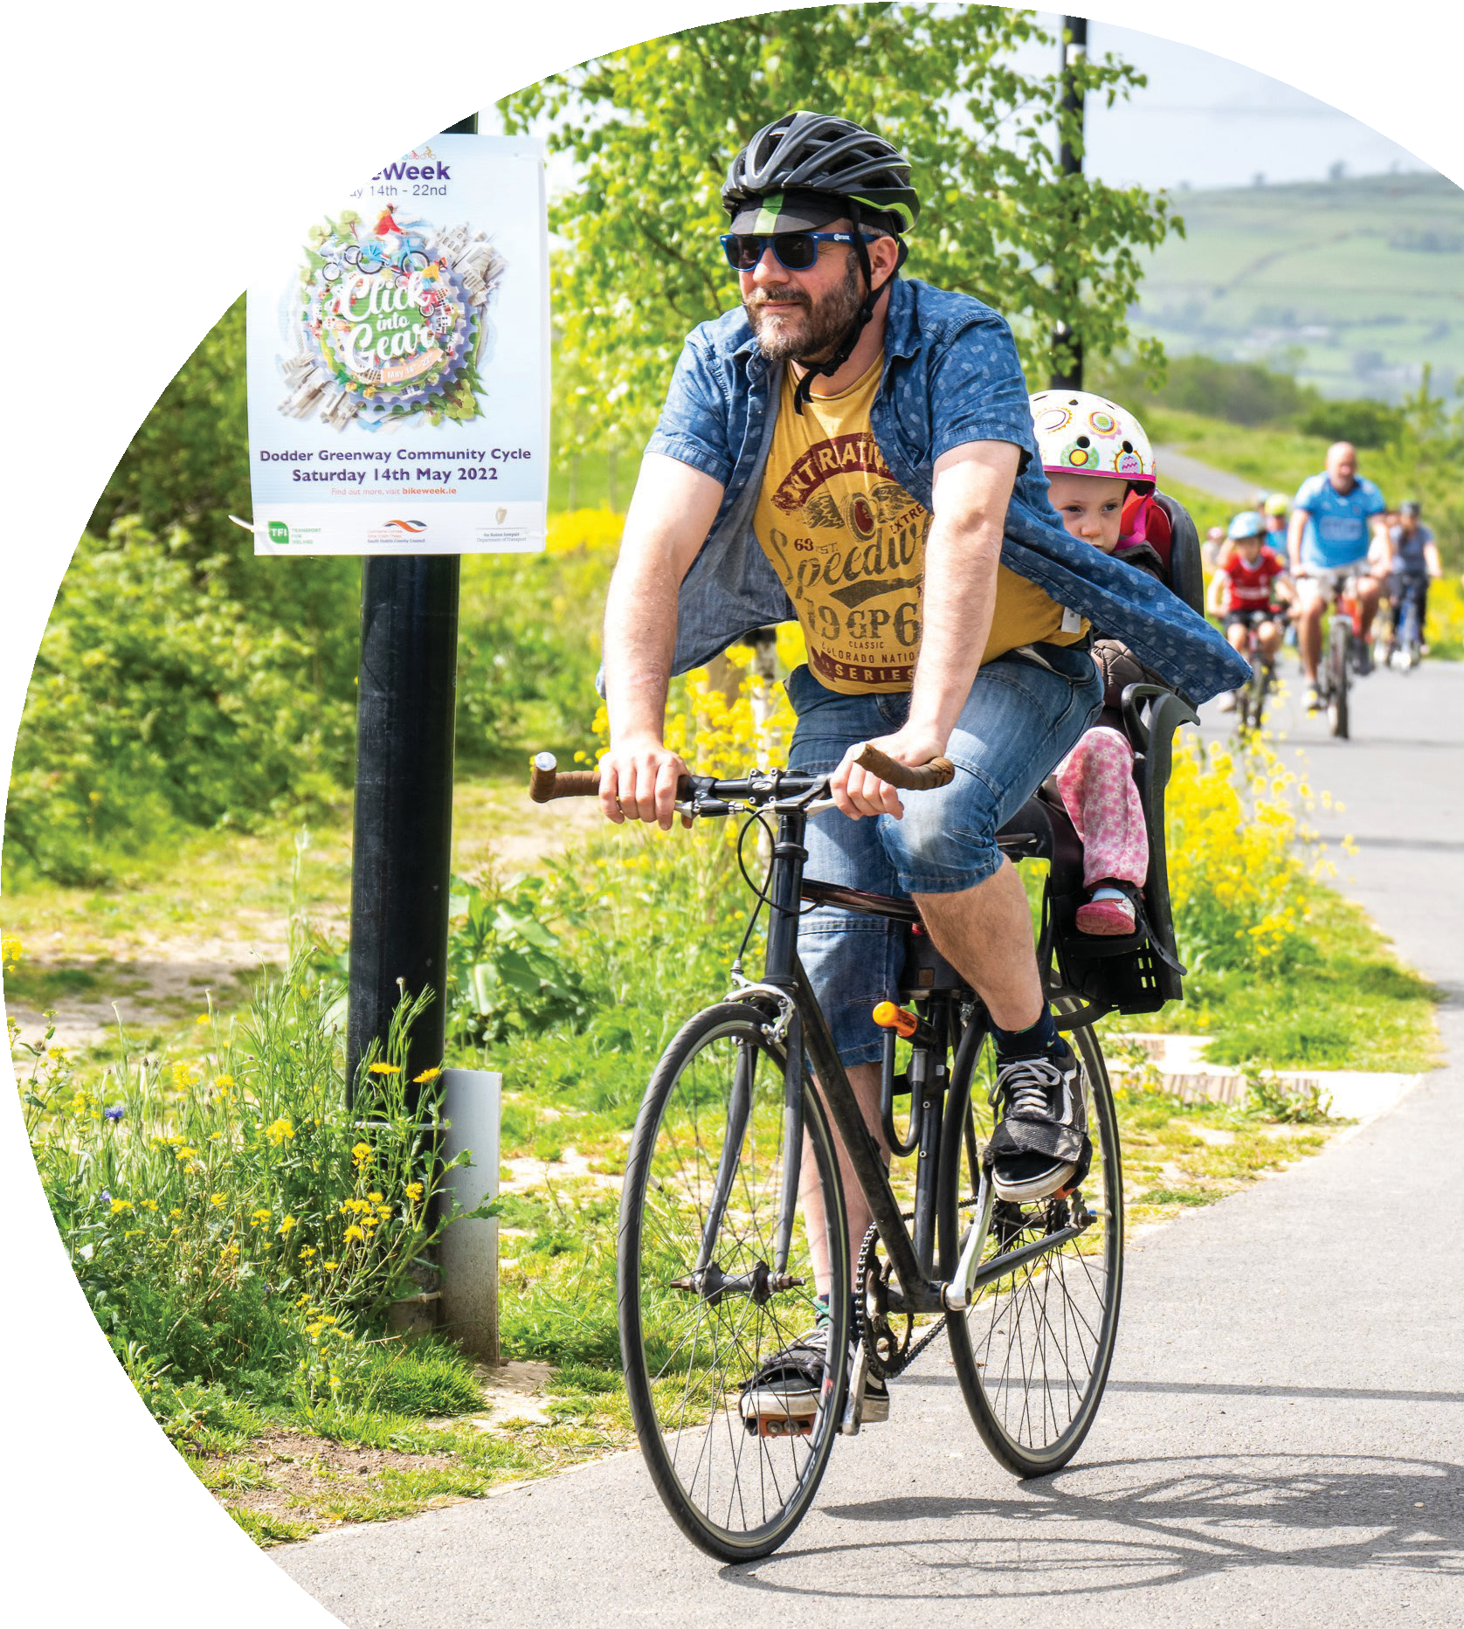
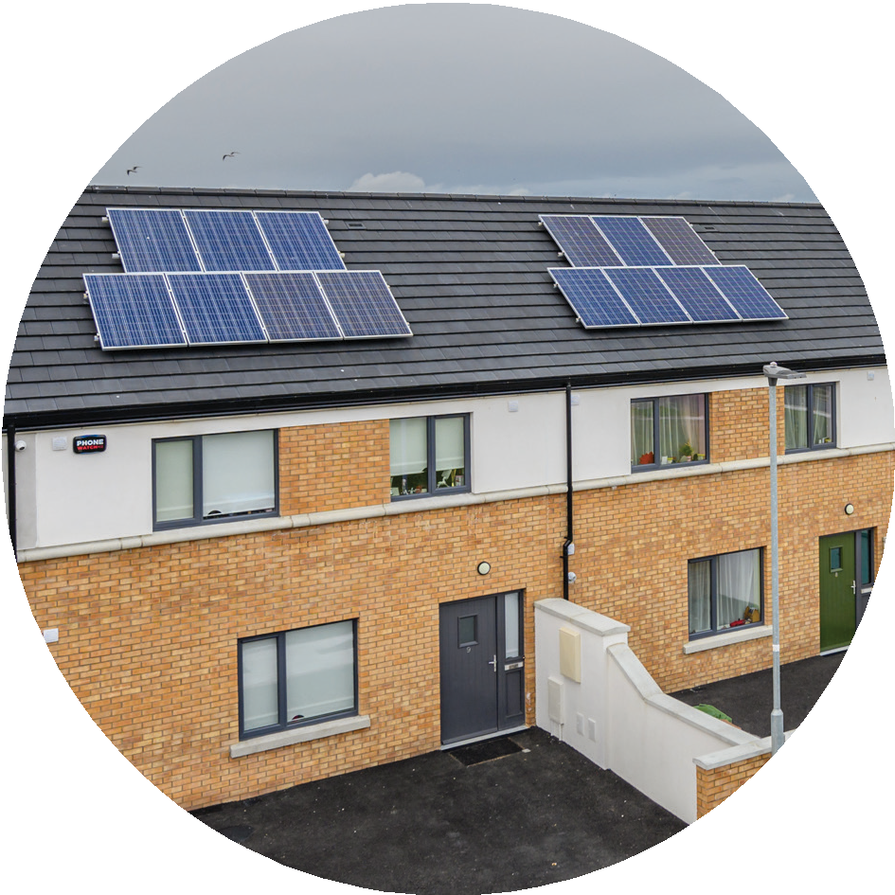

South Dublin County Council
Climate Action Plan 2024-2029
2024 Implementation Plan
Monday 8th April 2024
Teresa Walsh
Director of Environment, Water and Climate Change

Slide 2
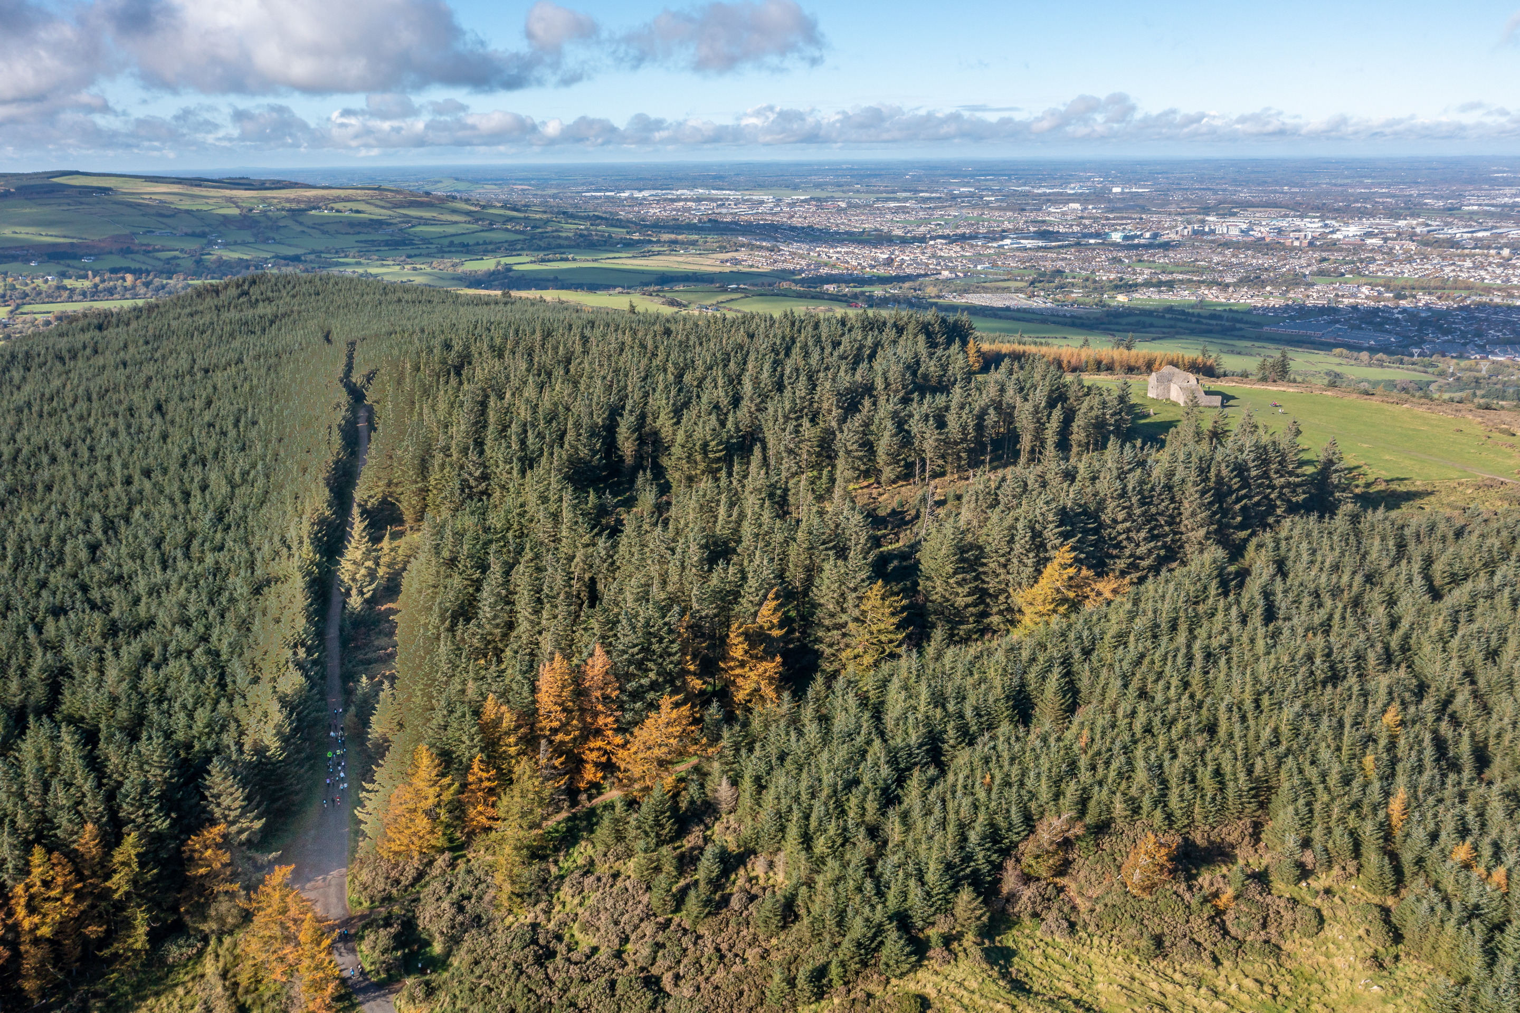
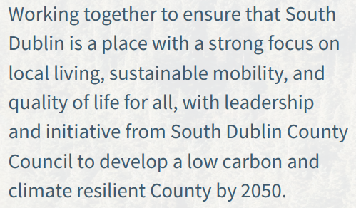
OUR VISION

Slide 3
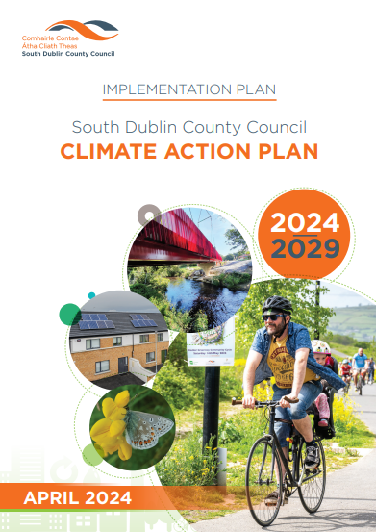
Objectives of CAP 2024 Implementation Plan:
Deliver Climate Action Plan actions across all thematic areas, overseen by the SDCC Climate Action Steering Group and six Action Teams;
Continue to maximise the draw down of external funding sources, from Government departments and other agencies;
Undertake ongoing engagement with the Council’s Environment, Public Realm and Climate Action Strategic Policy Committee (SPC) and official updates at Council Meetings;
Monitor the delivery of the Climate Action Plan, in accordance with national and sectoral requirements;
Roll-out the Community Climate Action Programme, in partnership with local groups across the County;
Prepare the Clondalkin Decarbonising Zone (DZ) Implementation Plan; and
Continue to work with the other Dublin LAs, Codema and Dublin CARO, to secure funding and other supports for climate action projects.

Slide 4
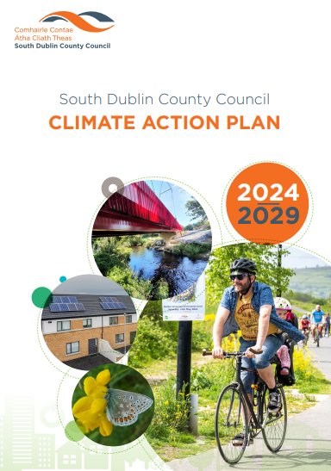
South Dublin County Council
Climate Action Plan 2024-2029
01. CAP Approval

Slide 5

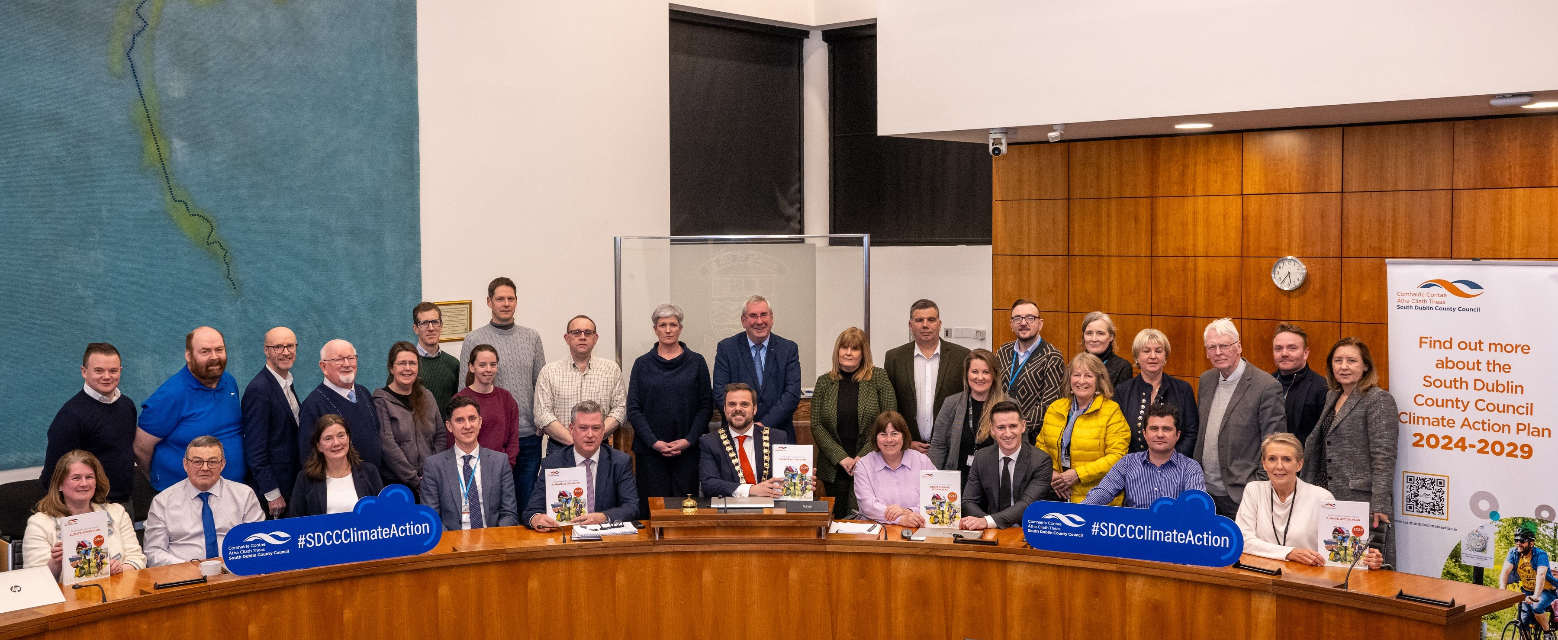
Statutory LA CAP 2024-2029 was ‘approved’ on Monday 12th February 2024, in accordance with the provisions of the Climate (Amendment) Act 2021.

Slide 6
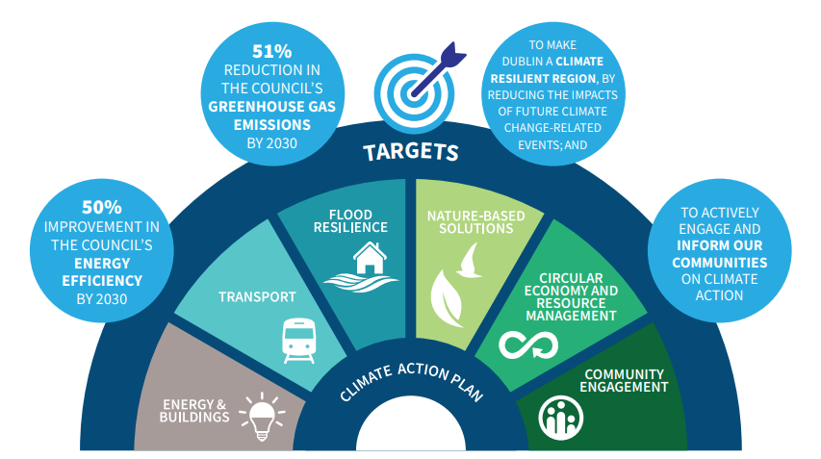

Slide 7
South Dublin County Council
Climate Action Plan 2024-2029
02. Working Together

Slide 8
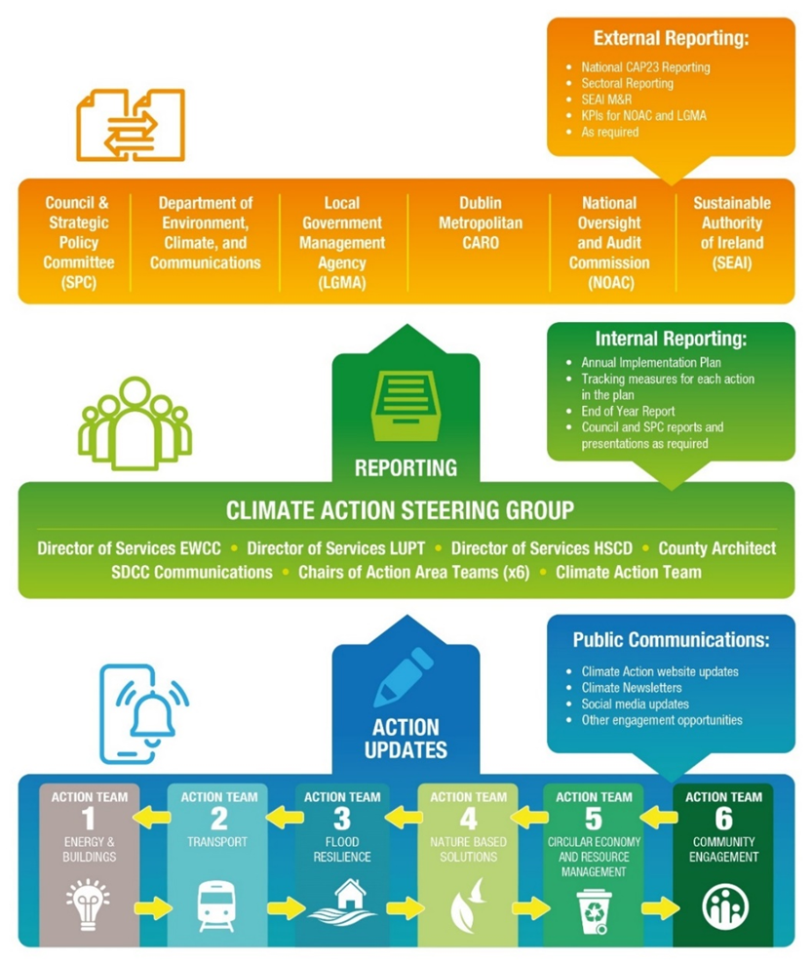
SDCC operating within an agreed Governance structure.
Climate Action Steering Group.
Six Action Area Teams.
Internal Reporting – SPC, CPG, Council Meetings.
External Reporting – KPIs, CARO, Sectoral, National.

Slide 9
South Dublin County Council
Climate Action Plan 2024-2029
03. Leadership and Initiative

Slide 10
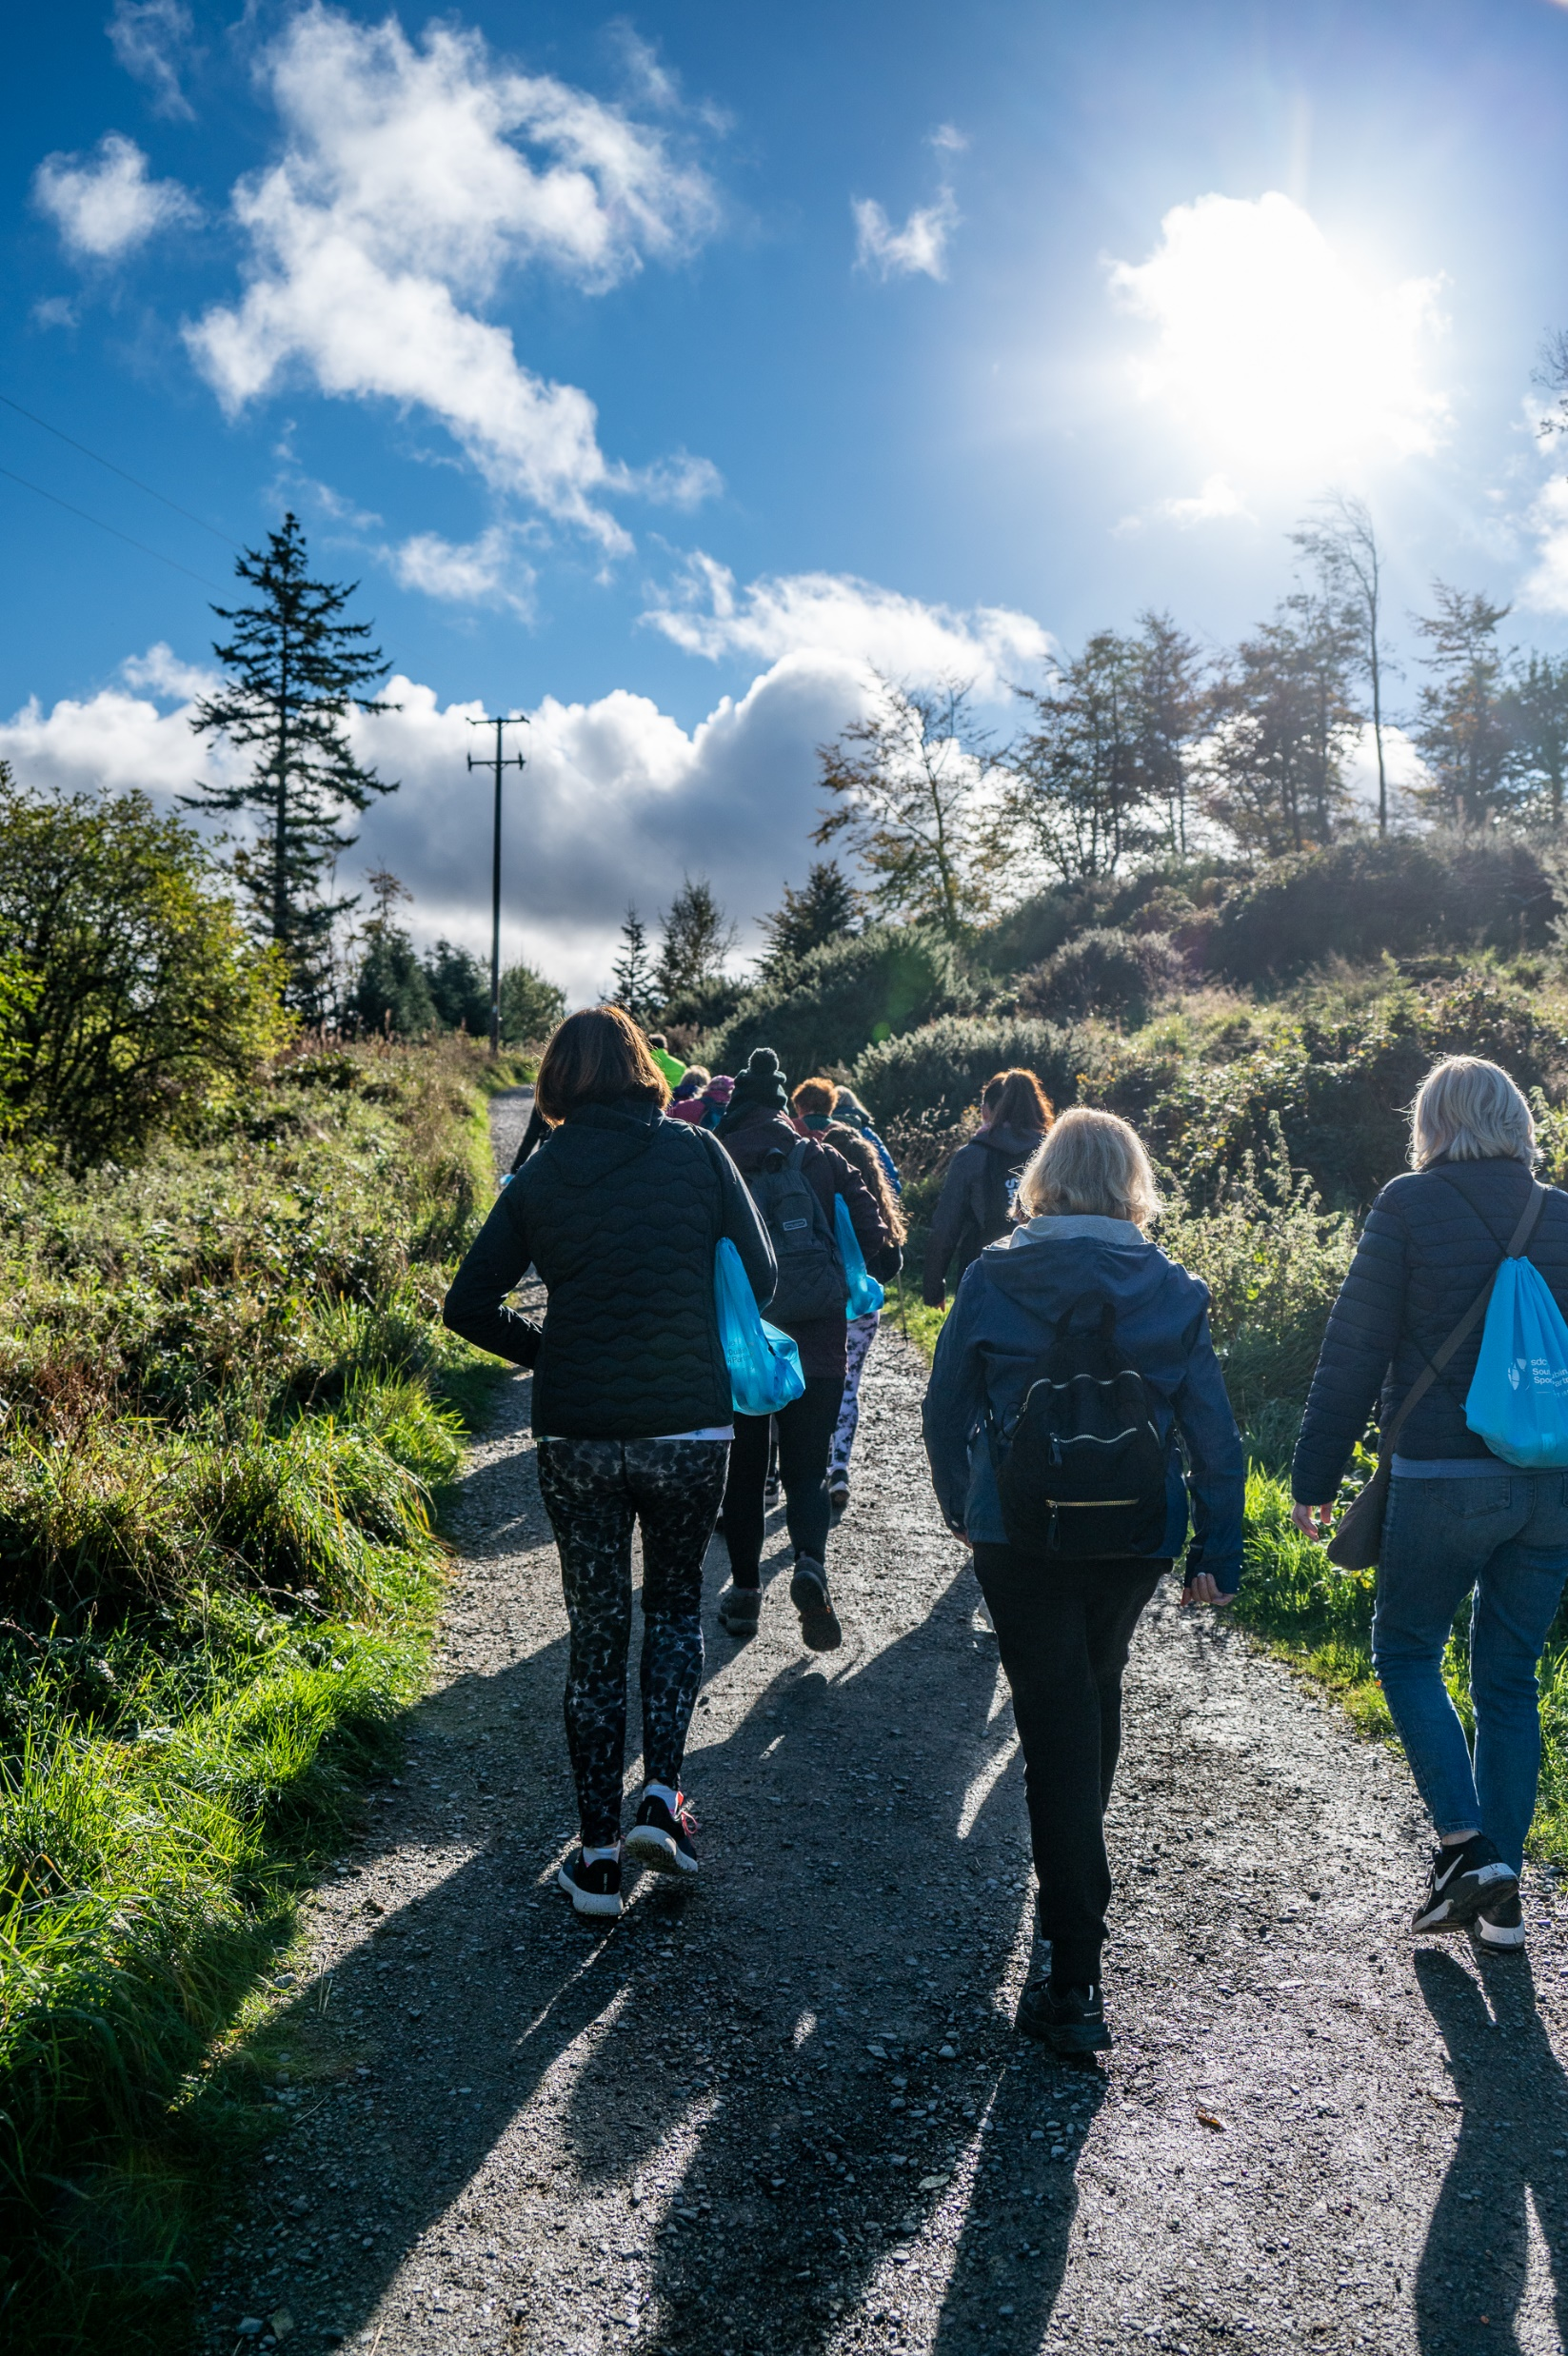
As part of the wider 2024 budget, €3.5m in additional funding is being provided to considerably expand the Council’s existing climate action programme.
The Capital Programme 2024-2026, provides for a range climate adaptation and mitigation actions, for each year.
Community Climate Action Programme €1.073m is available for local, not-for-profit community groups and organisations over an initial 18-month period, to undertake local climate action projects.

Slide 11
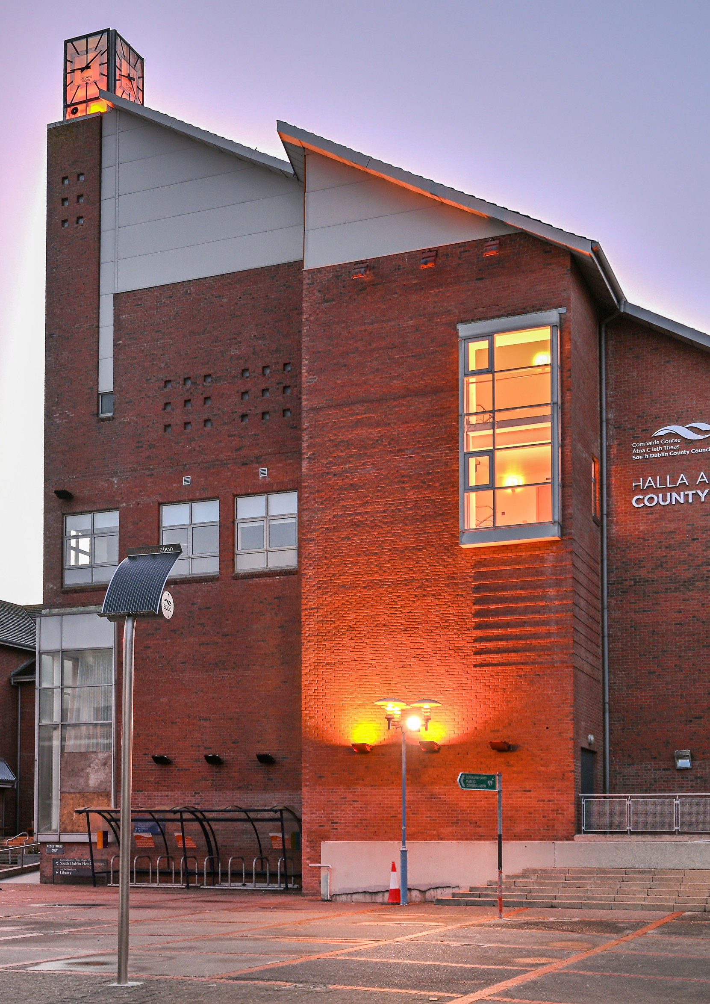
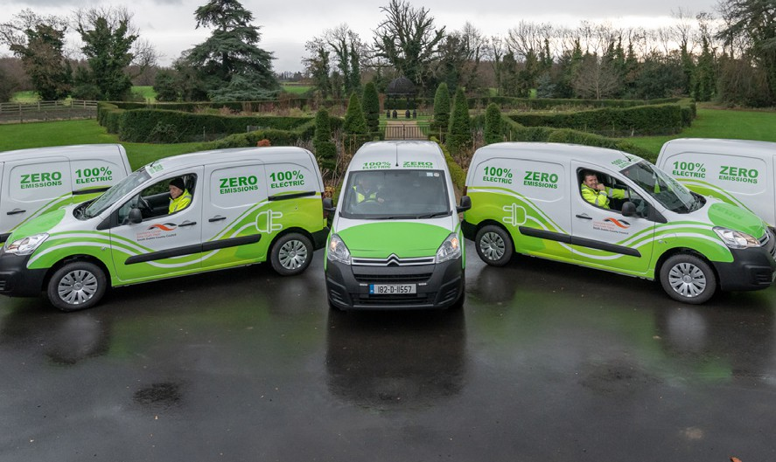
Annual Budget 2024
As part of the wider 2024 budget, €3,500,000 in funding is being provided to considerably expand the Council’s existing climate action programme:
Increased budget to accelerate the decarbonisation of the Council’s buildings and fleet;
Significantly increased investment in retrofit works to enhance the energy efficiency of the corporate, community and other buildings owned by the Council; and
Continued provision for the Climate Innovation Fund of €300,000 (annually), to support a range of Council climate action projects.

Slide 12
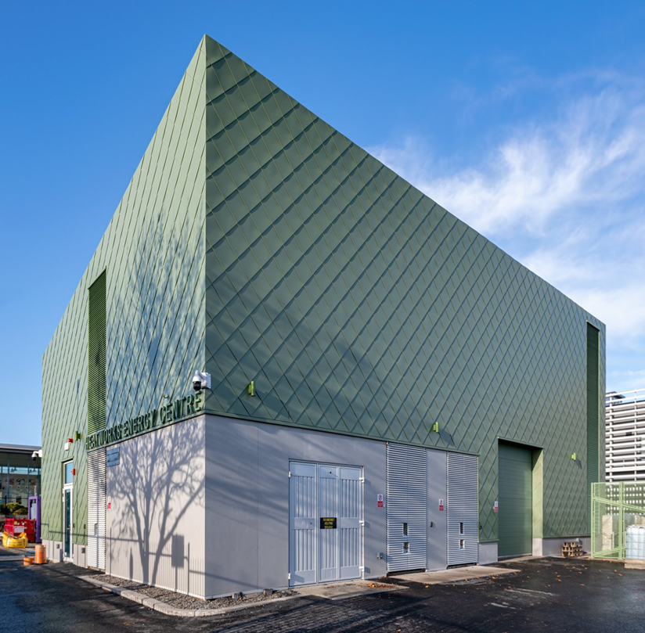
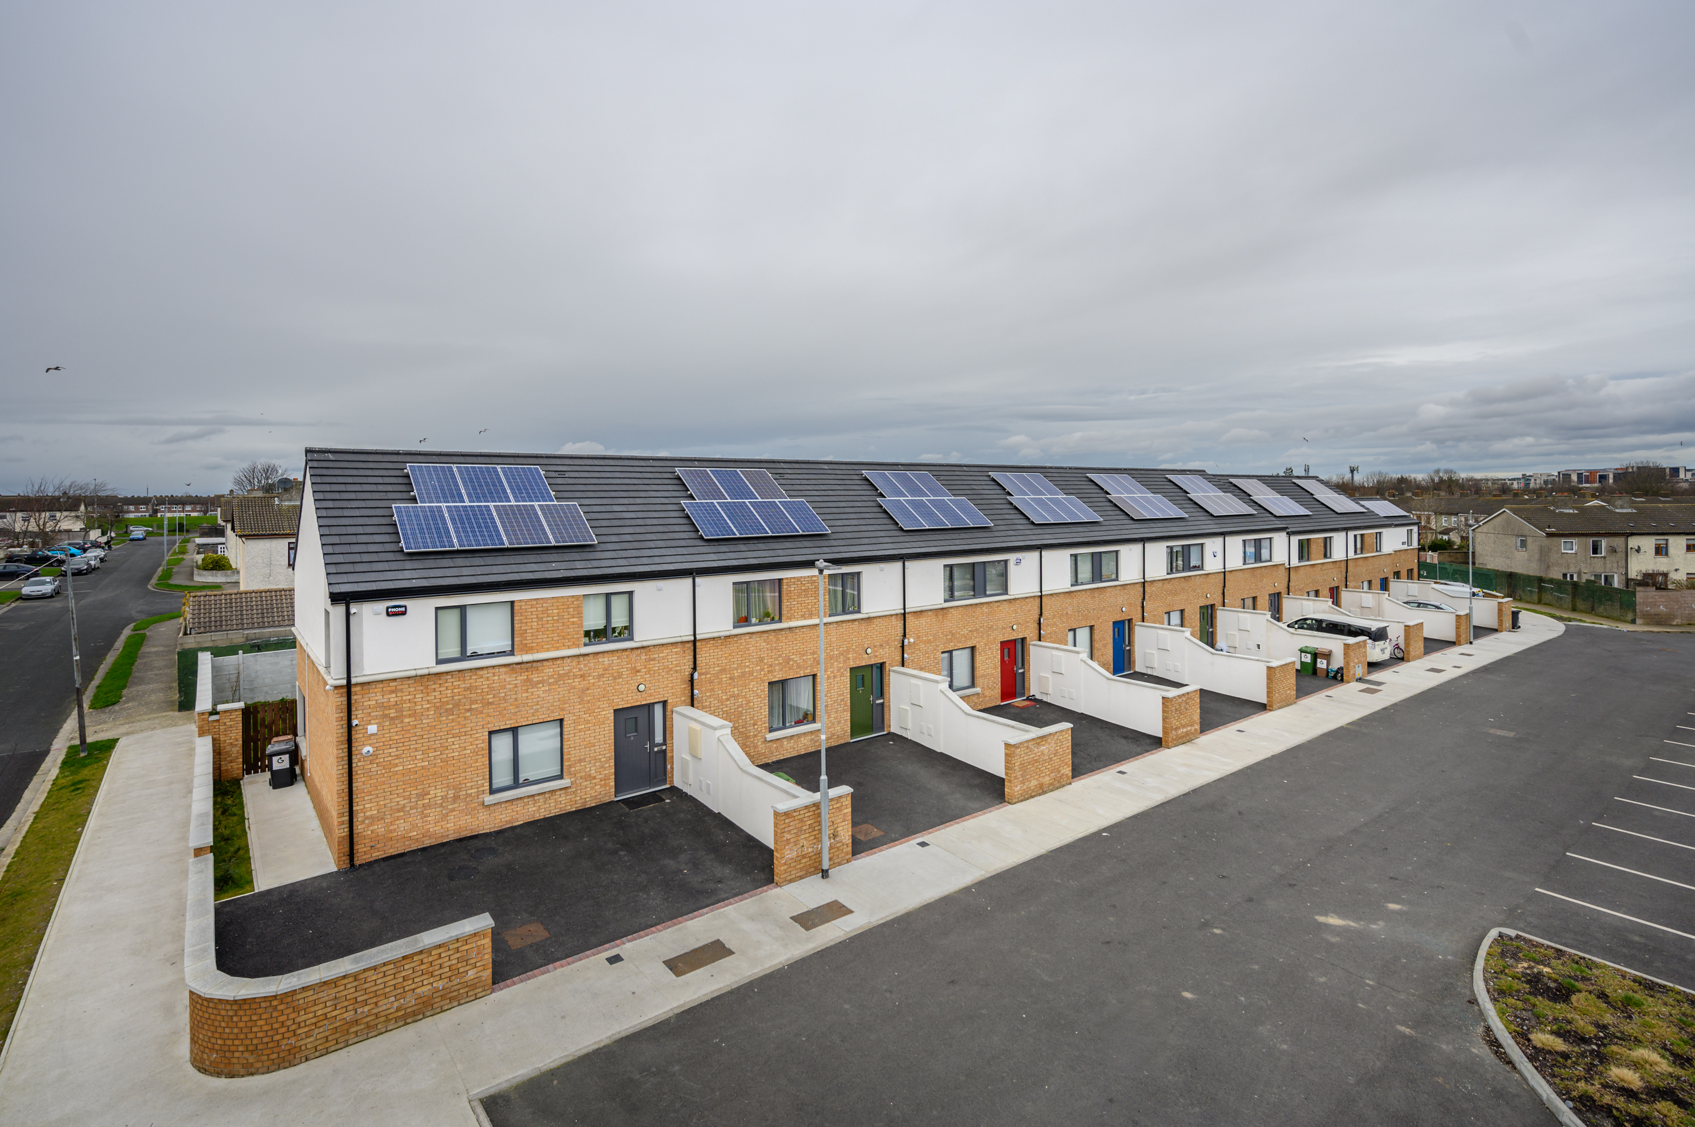
Three Year Capital Programme – 2024 Allocation includes:
Tallaght District Heating Scheme - €500,000;
DeliveREE project - €1,000,000, with match funding to be provided by the Sustainable Energy Authority of Ireland;
Decarbonise SDCC fleet - €1,500,000;
Vehicle and plant replacement allocation of €2,800,000;
Support Public Electric Vehicle Charging infrastructure - €175,000;
Continue to roll-out Flood Alleviation Schemes - €9,900,000;
Flood schemes and general maintenance projects undertaken across the County - €2,760,000;
Public Lighting upgrades - €950,000;
Continue Social Housing retrofit programme - €2,820,000;
Housing Windows & Doors Accelerated Maintenance Programme - €2,500,000;
Arthurstown Energy Efficiency Projects - €850,000; and
Expand Active Travel network - €22,400,000.

Slide 13

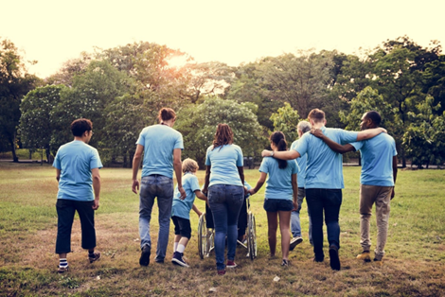
Community Climate Action Programme
Funding of €1.073m is available for local, not-for-profit community groups and organisations over an initial 18-month period (from first payment).
Project sizes include small (up to €20,000), medium (€20,000 - €50,000) and large (€51,000 - €100,000).
41 project submissions received by the deadline and currently being assessed by SDCC Assessment Panel.
Final project list to be approved by Department of the Environment, Climate & Communications.

Slide 14
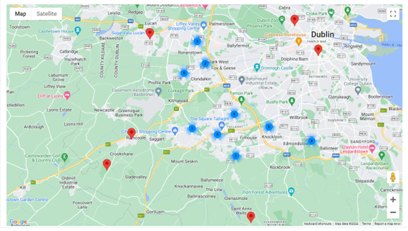
CAF General Application Distribution

Slide 15
South Dublin County Council
Climate Action Plan 2024-2029
04. Low Carbon & Climate Resilient County

Slide 16
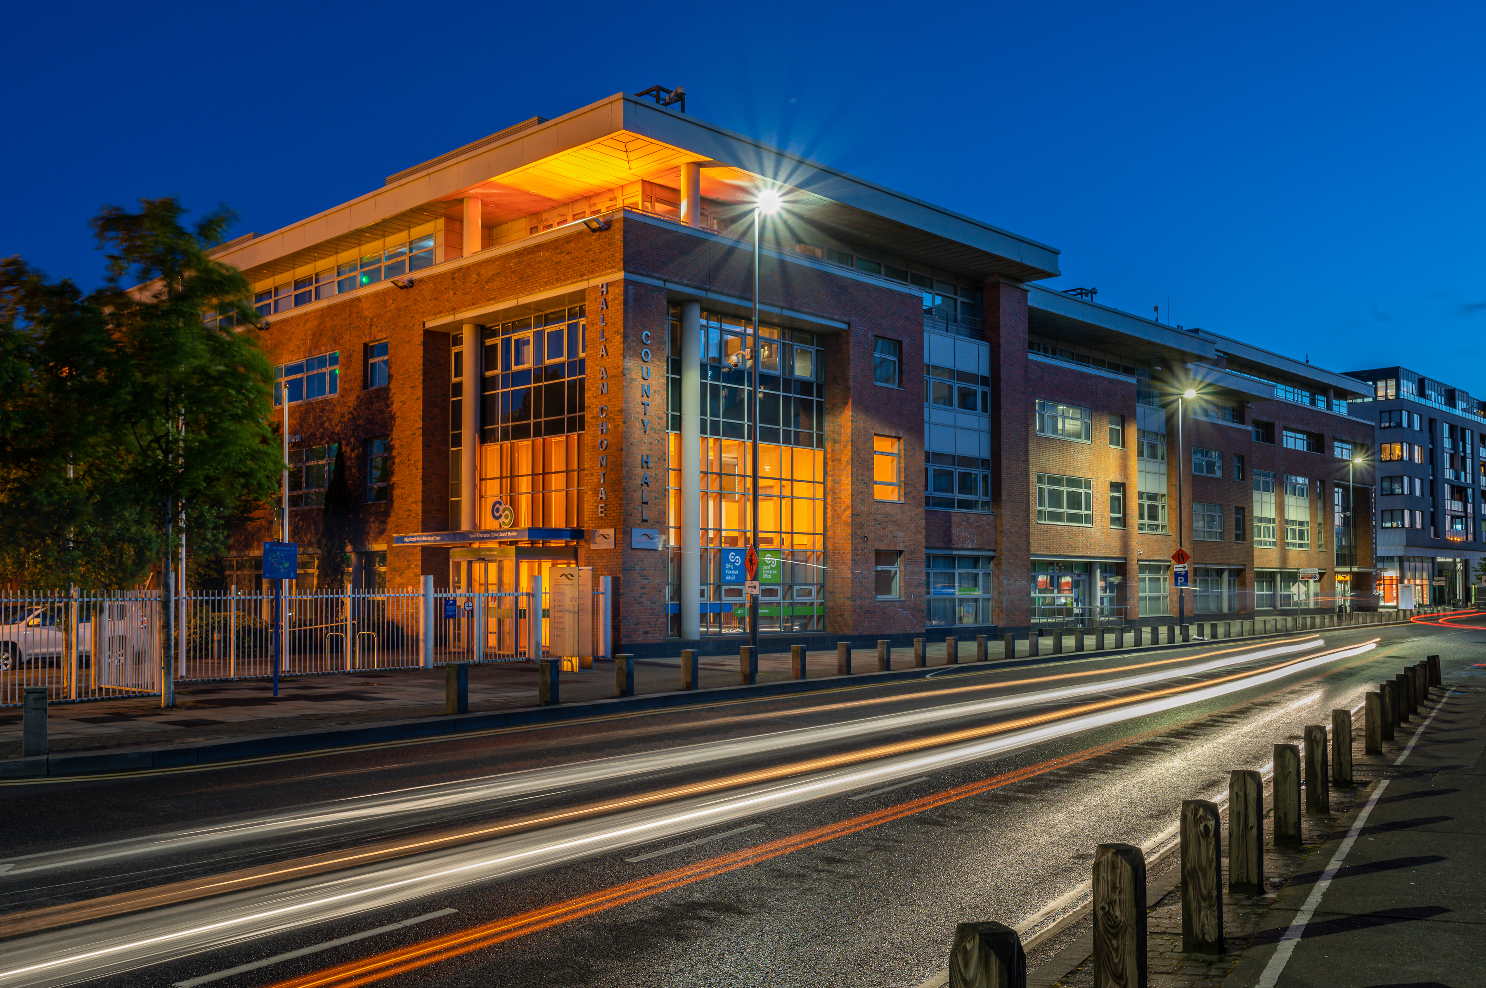
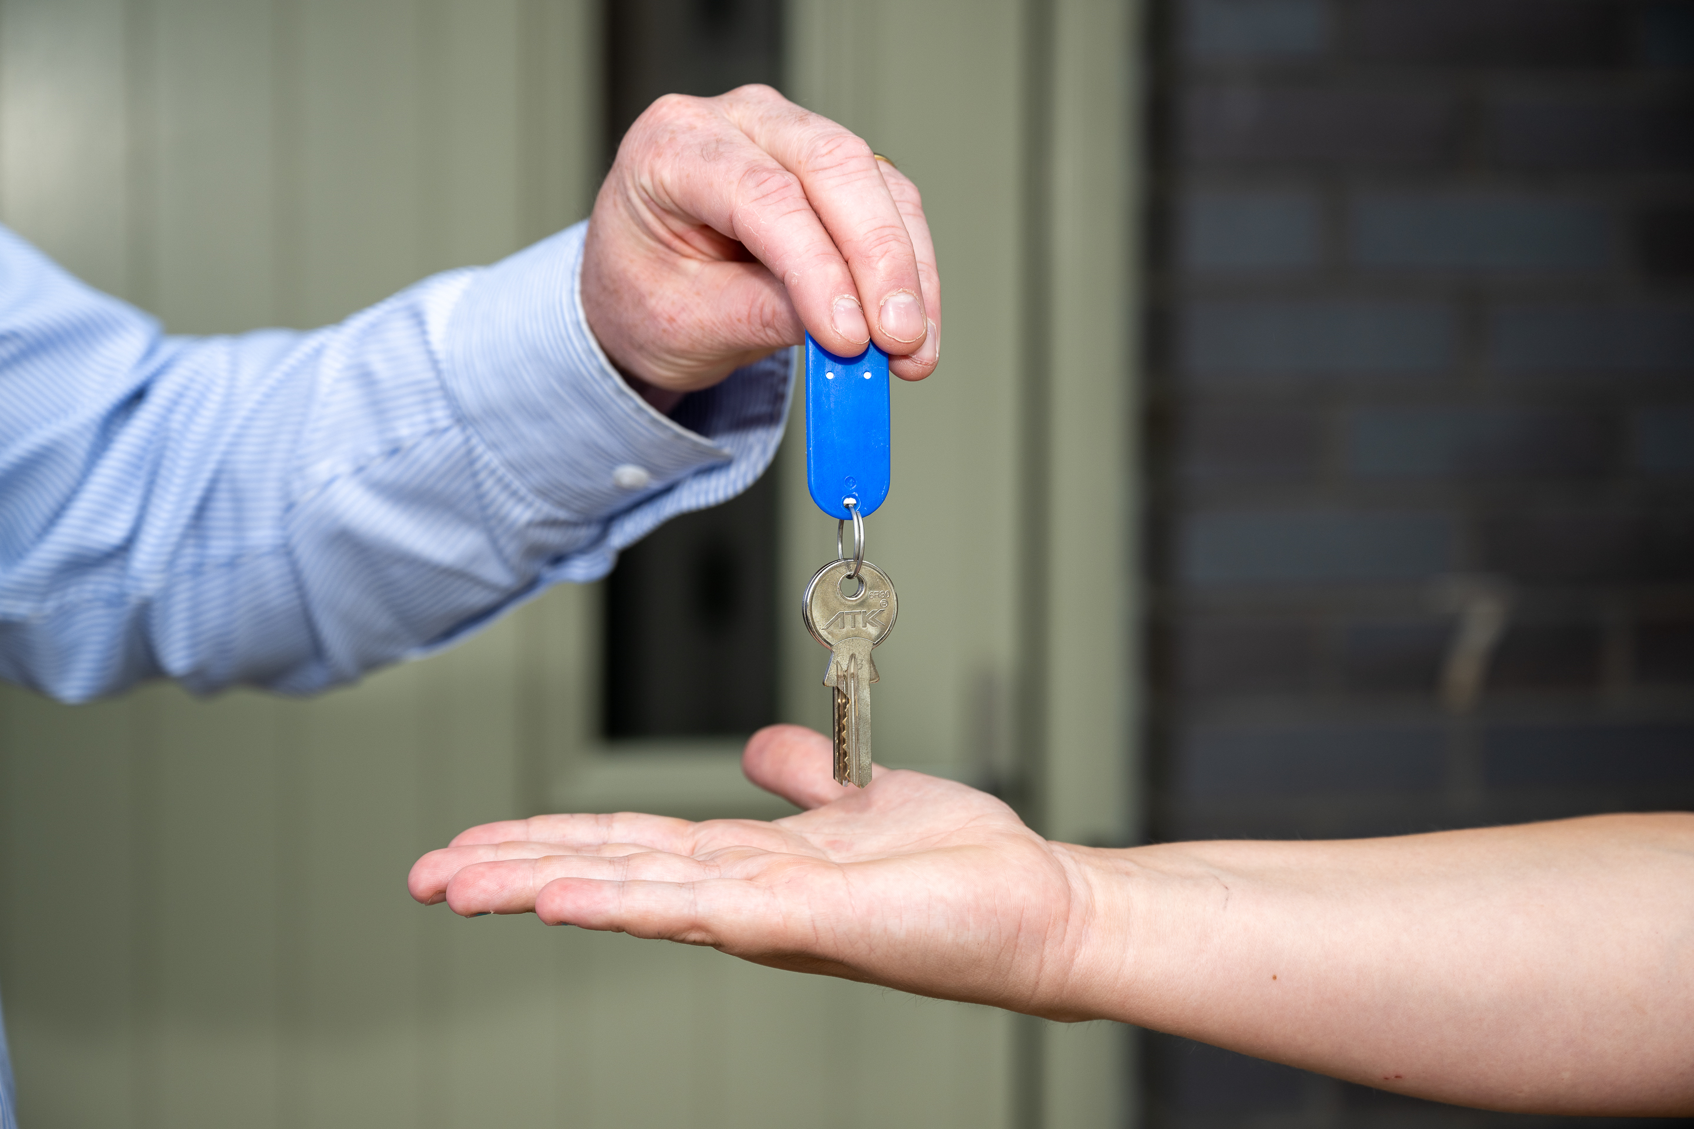
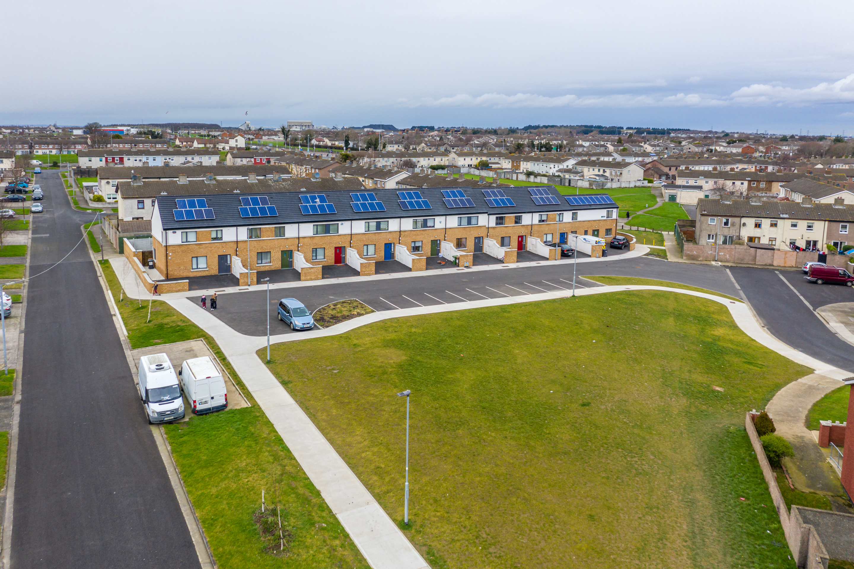
Energy and Buildings - 2024
SDCC is participating in SEAI’s ISO 50001 Accelerator Programme, with the aim of achieving certification in early 2025.
SDCC Energy Performance Contract expected to be in place by Q4 2024 – DeliverEE and SEAI Pathfinder.
SDCC’s approved retrofit target is 83 social housing units in 2024 – 244 units upgraded to date.
SDCC plans to upgrade 1,500 public lights in 2024. To date 67% have been upgraded.
Expansion of the Tallaght District Heating Scheme and options for Clonburris & Grangecastle.
Renewables – Solar developments at Arthurstown landfill.

Slide 17
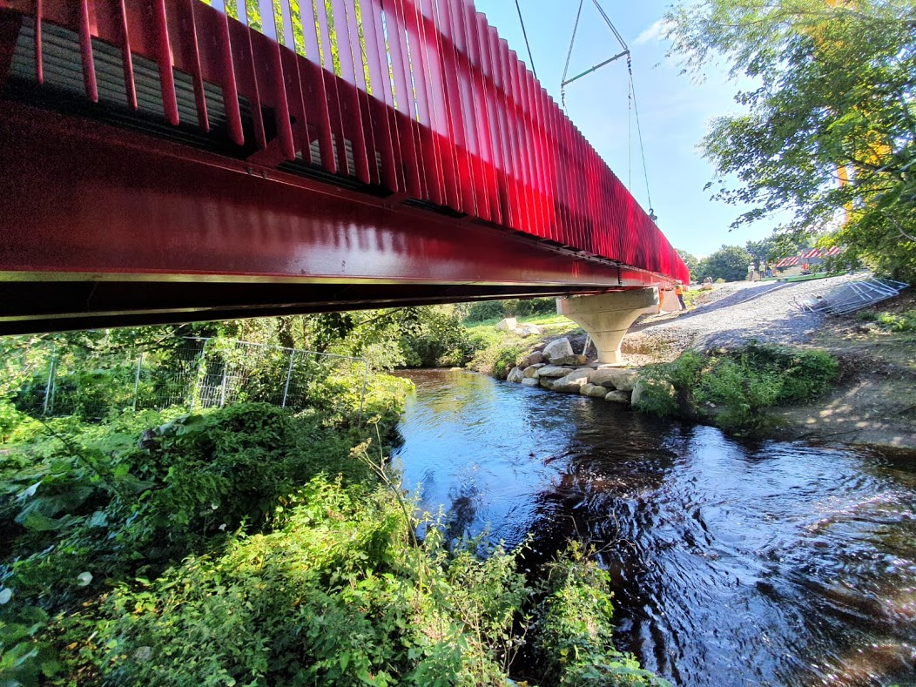
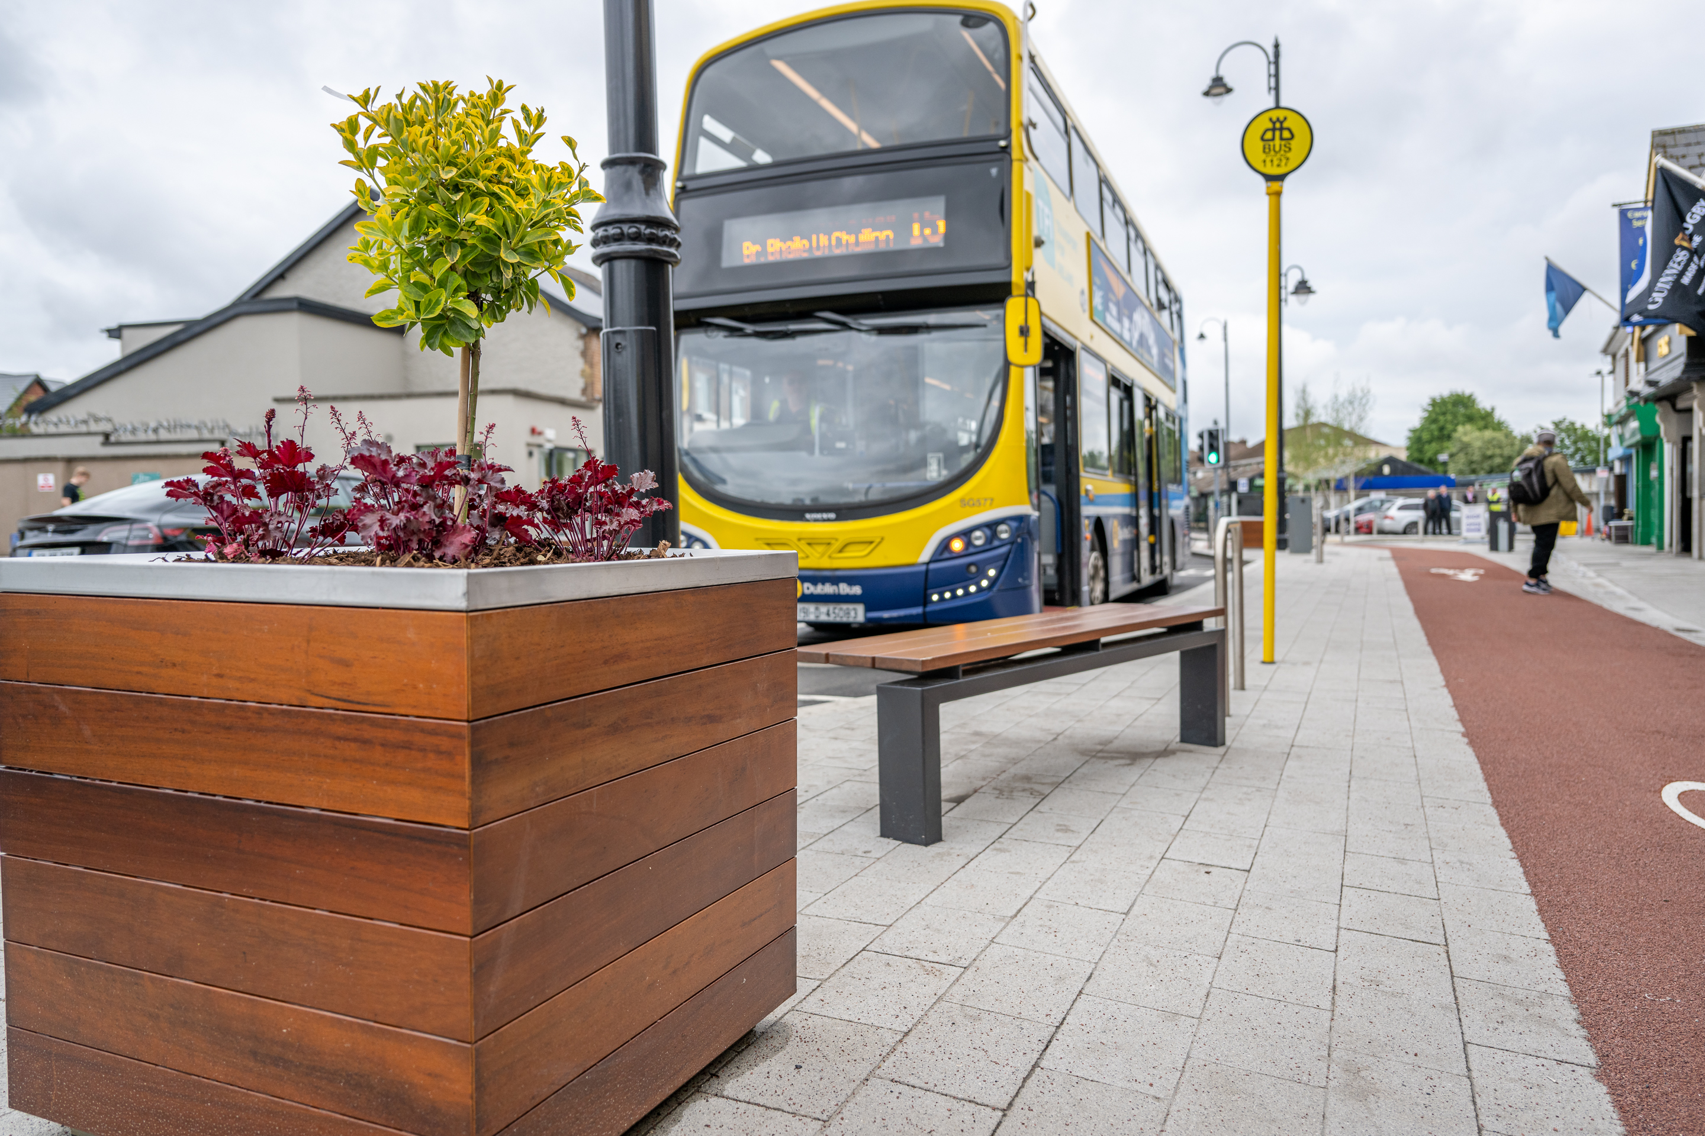
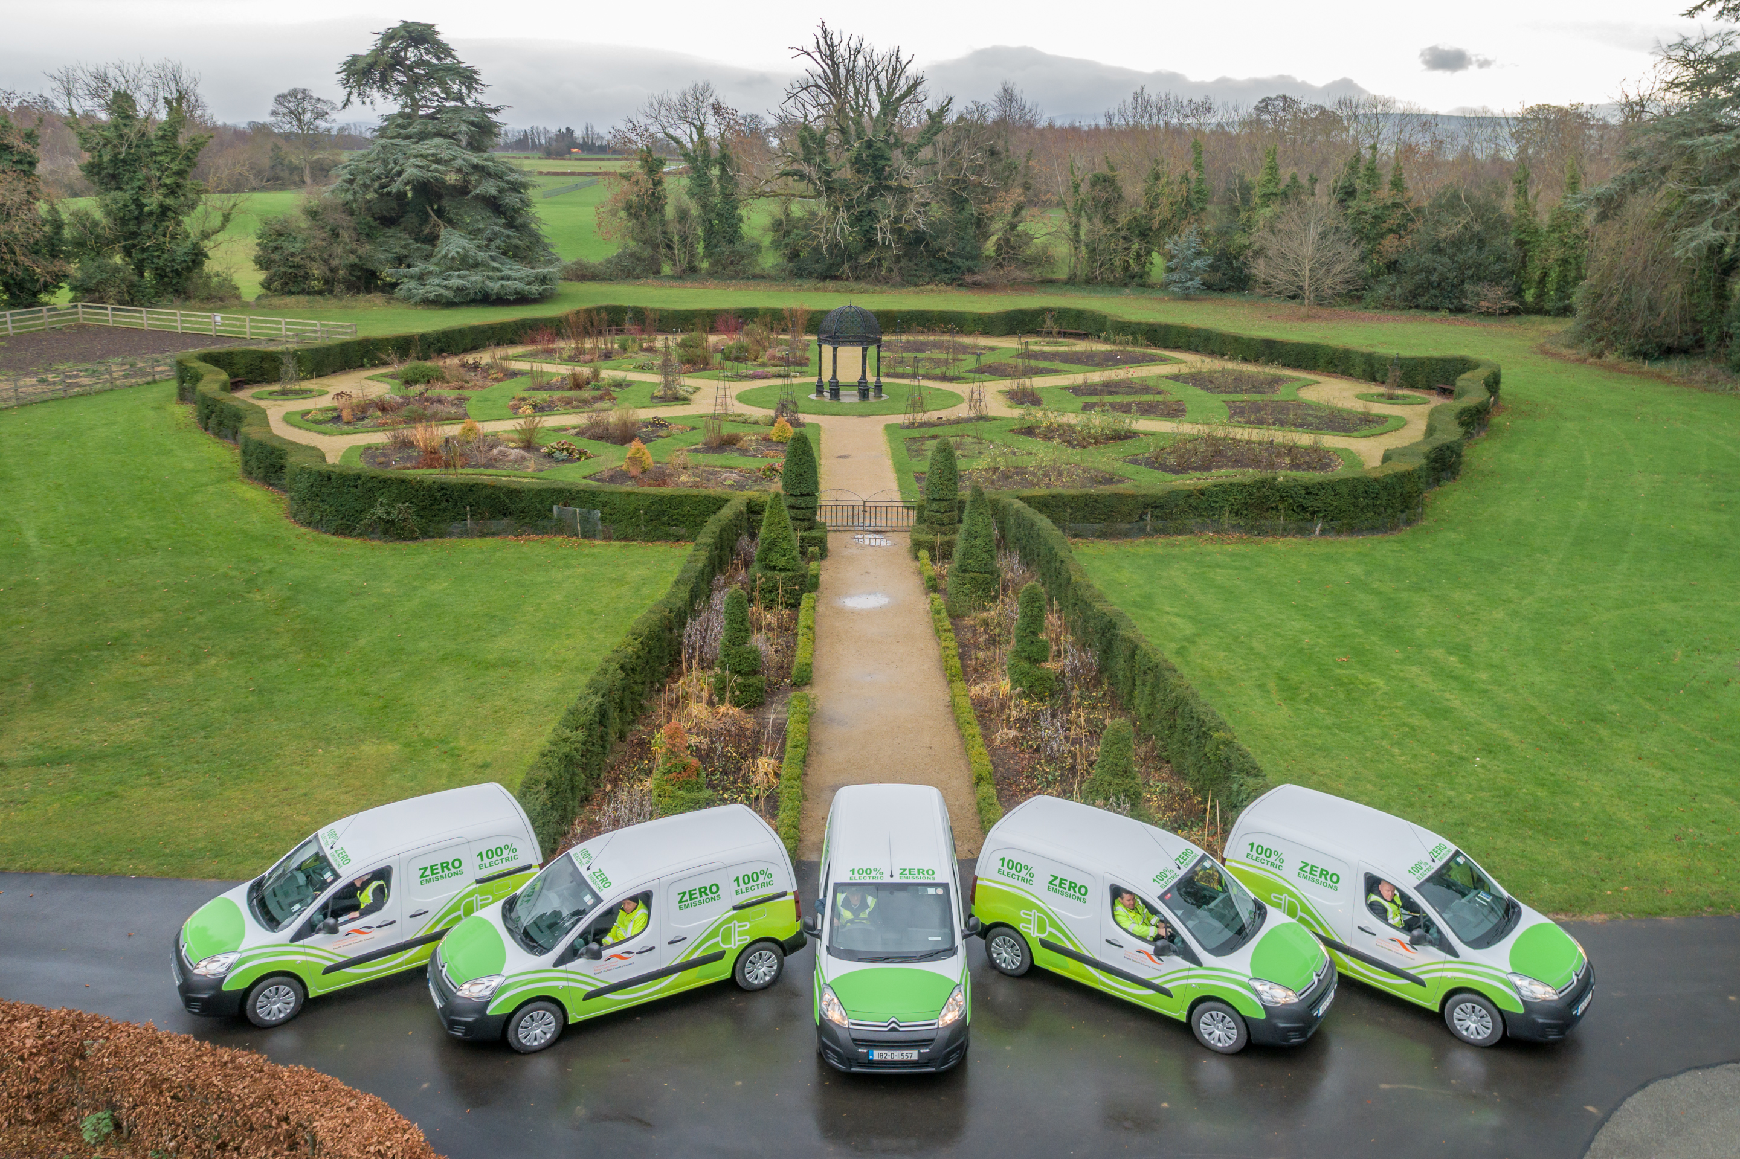
Transport - 2024
Advance Cycle South Dublin – 10-year scheme of 45 routes of 263km of new and improved cycle lanes.
Deliver an Active Travel Roadshow across the County in 2024.
11 kilometres of roads and streets identified for road space reallocation.
Implement the SDCC Fleet Transition Strategy – replace 128 vehicles and 451 plant items over next 5 years.
Complete Public EV Charging Services Tender with Codema – 14 initial sites identified.
Continue to engage with Public Transport Providers to expand network.
Water Protection and Flood Management Section role in surface water management.

Slide 18
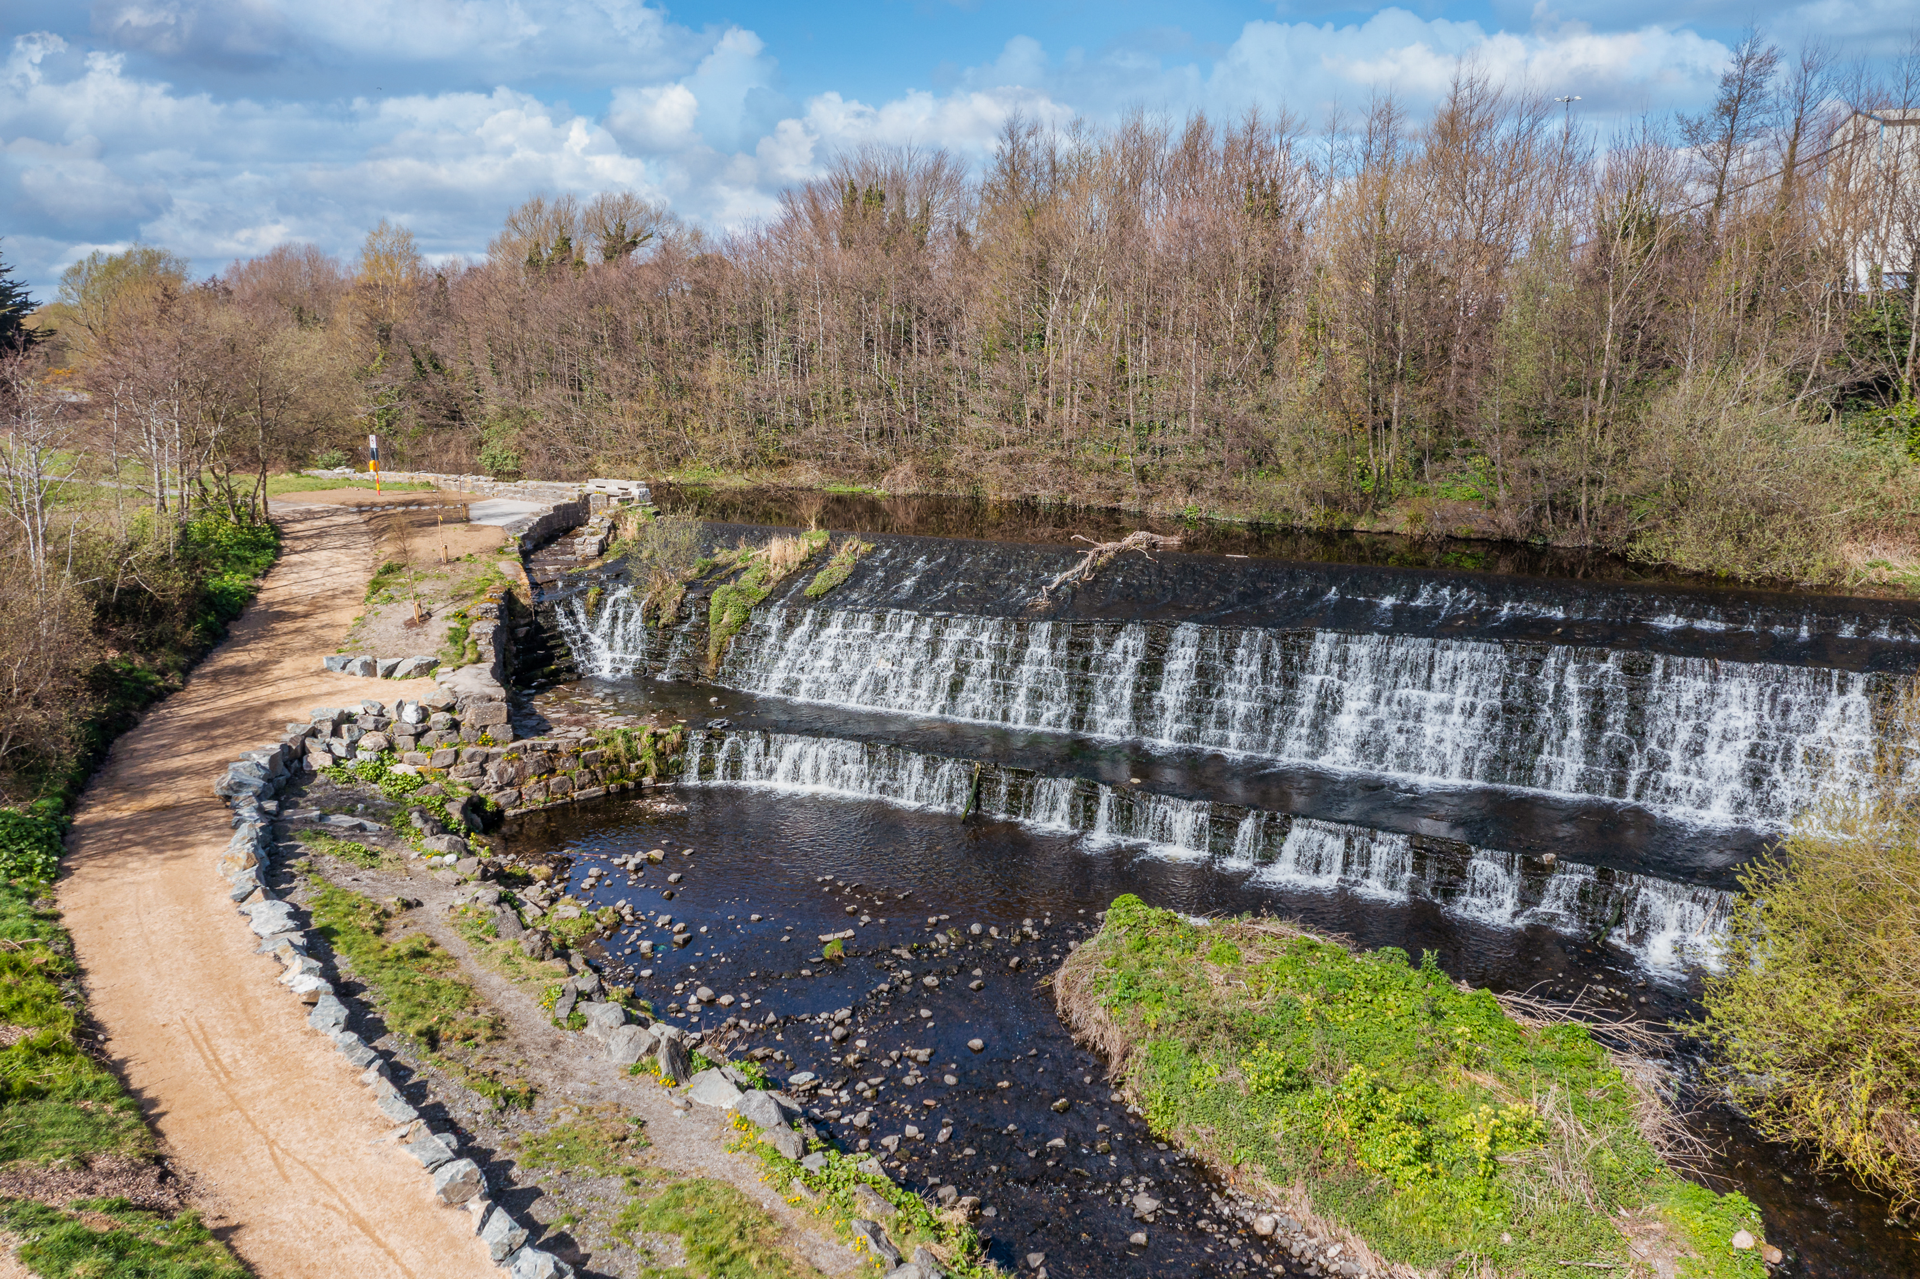
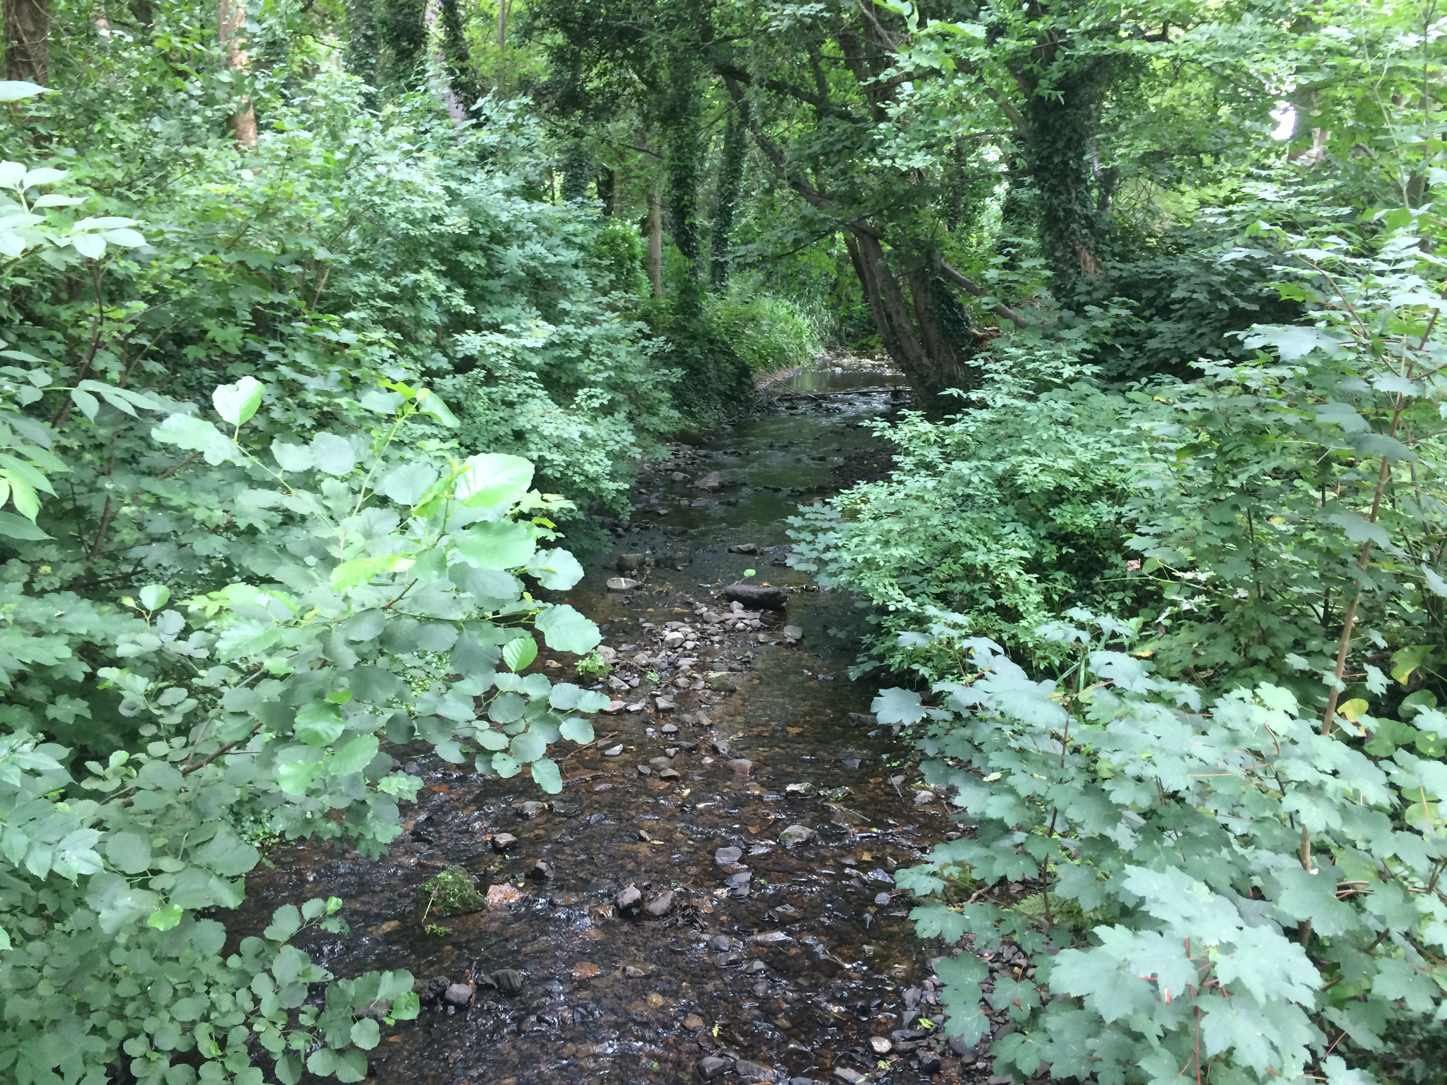
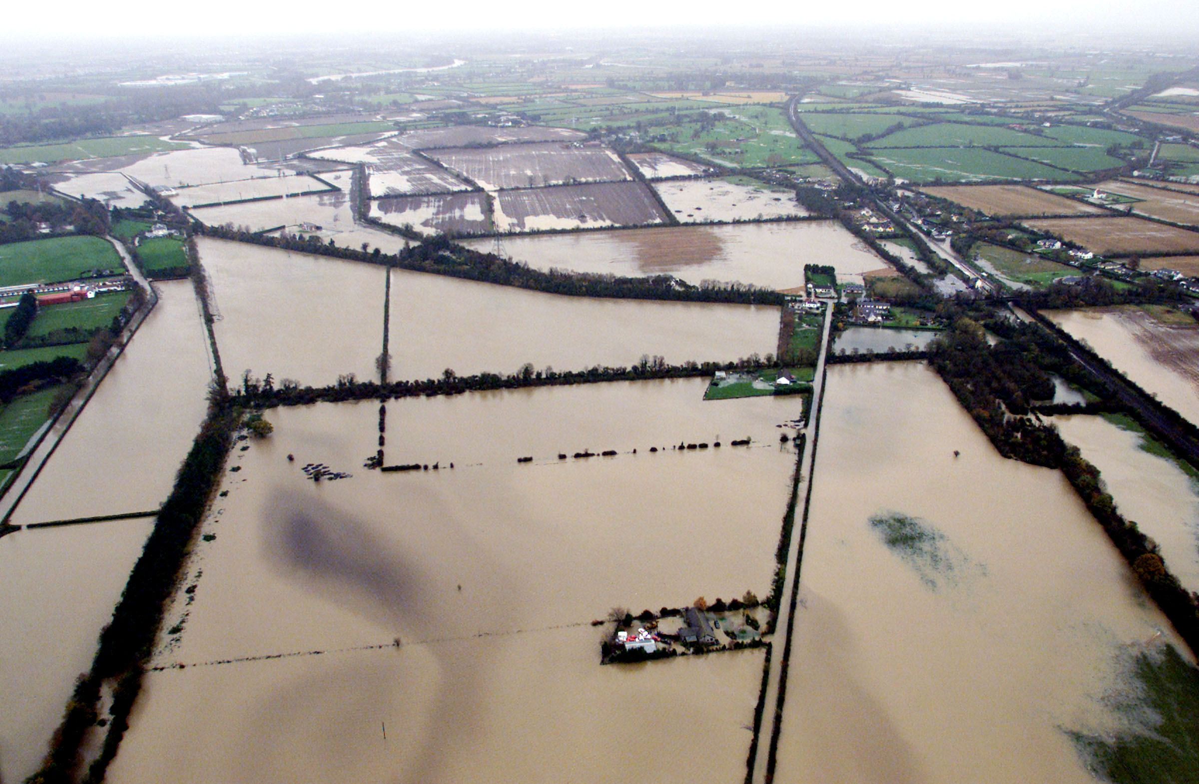
Flood Resilience - 2024
Continue Major Emergency Planning and Management.
Progress the Poddle, Whitechurch and Camac flood alleviation schemes.
Undertake flood schemes and general maintenance projects across the County.
Progress the Newcastle, Rathcoole, Saggart Surface Water Study.
Climate Proofing – SuDs Explanatory, Design and Evaluation Guide.
Public involvement – SDCC Householders Guide.
Develop a Surface Water Network Improvement Programme.
Continue to review gully maintenance and operations for improvements.

Slide 19
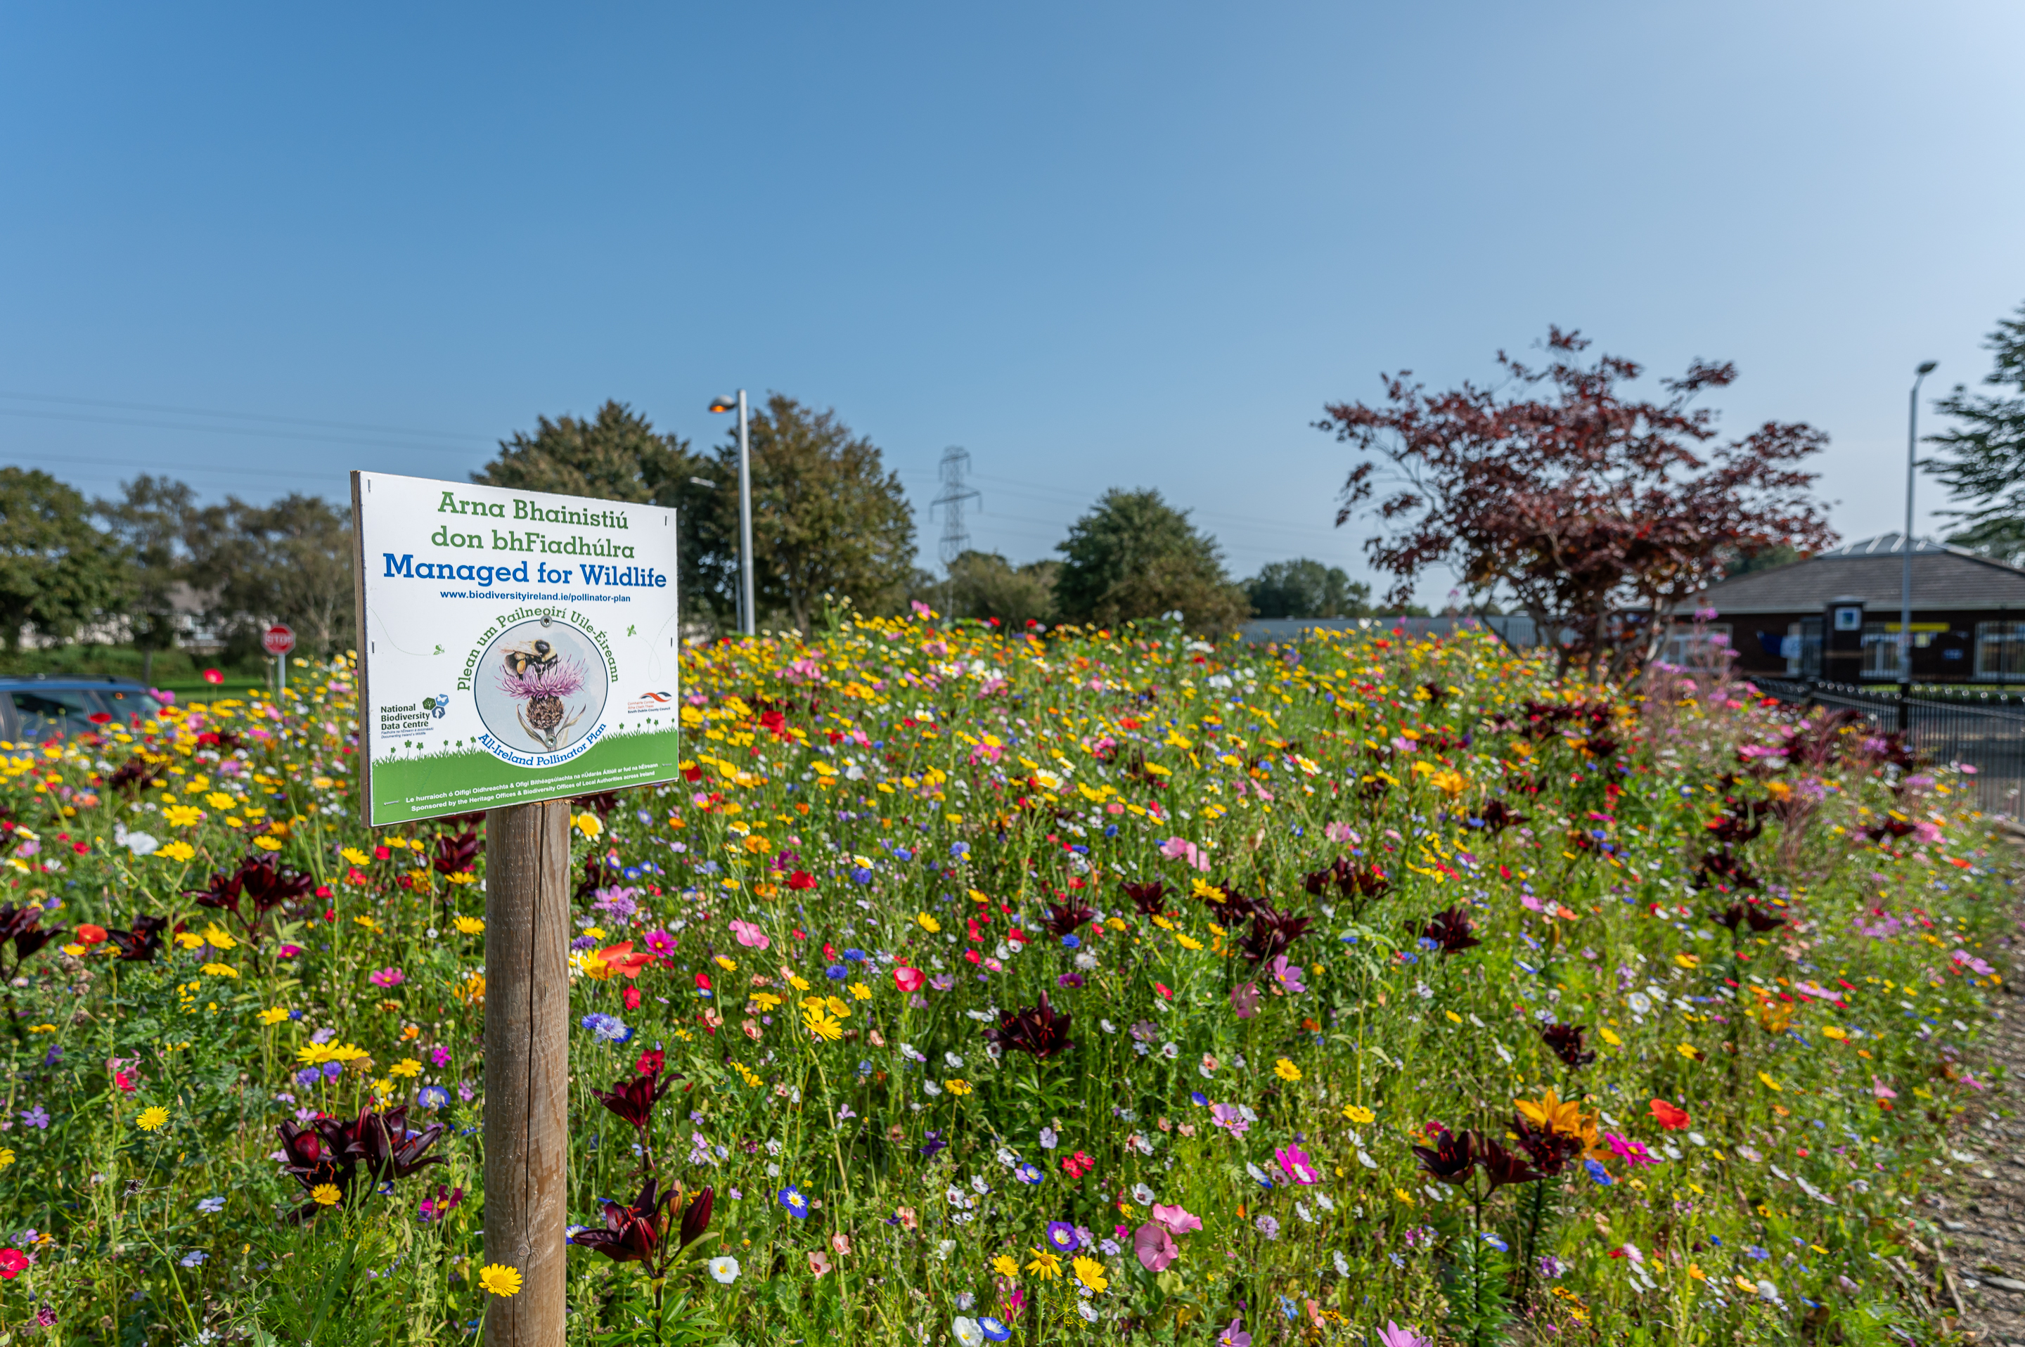
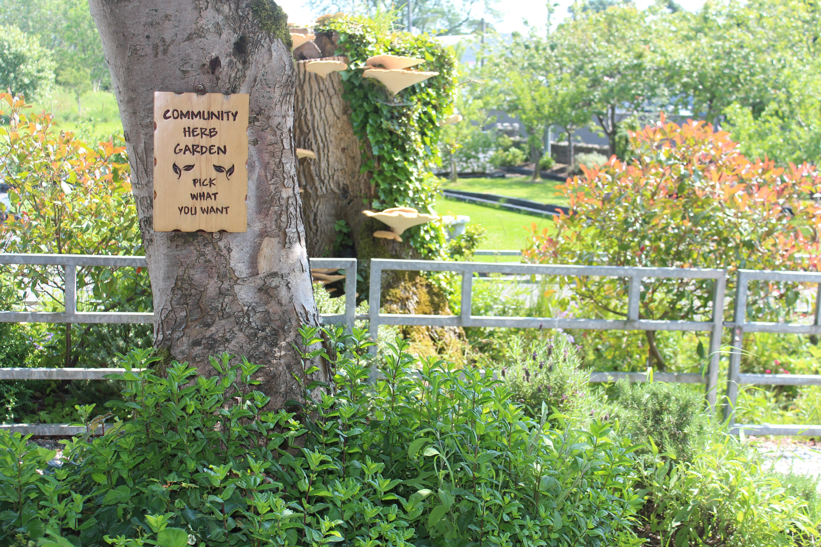
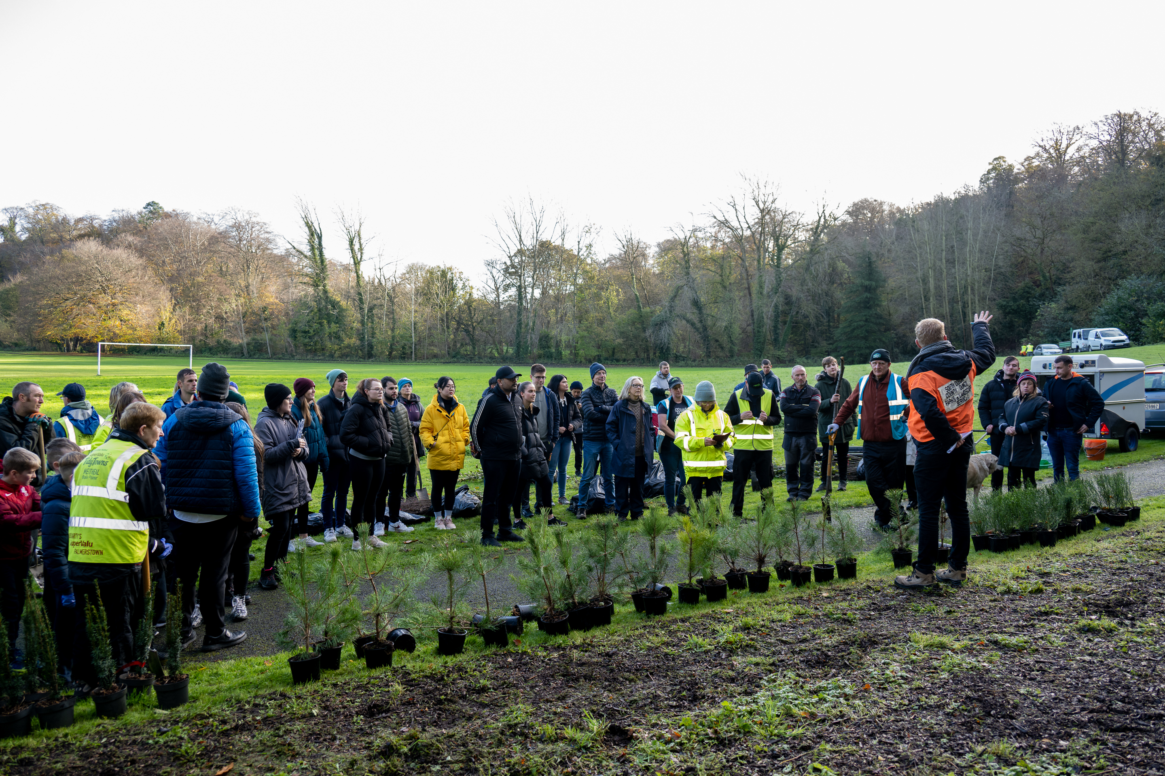
Nature Based Solutions - 2024
Increase tree planting across the County.
Aim to plant 12 mini-forests of between 25,000 – 30,000 whips.
Maintain and increase natural meadows, including areas for natural regeneration – 165 hectares.
Develop a Hedgerow Management Policy, to inform annual maintenance programme.
Develop Allotments and Community Gardens.
Develop a strategy to phase out harmful products such as glyphosate and acrylic paint.
Work with LAWPRO to develop the River Basin Management Programme in 2024.
Support implementation of the SDCC Biodiversity Action Plan – habitats and species surveys.

Slide 20
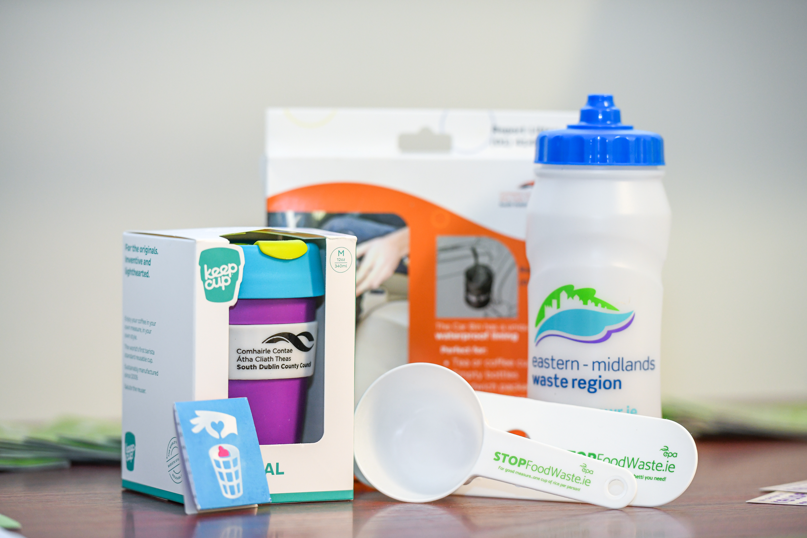
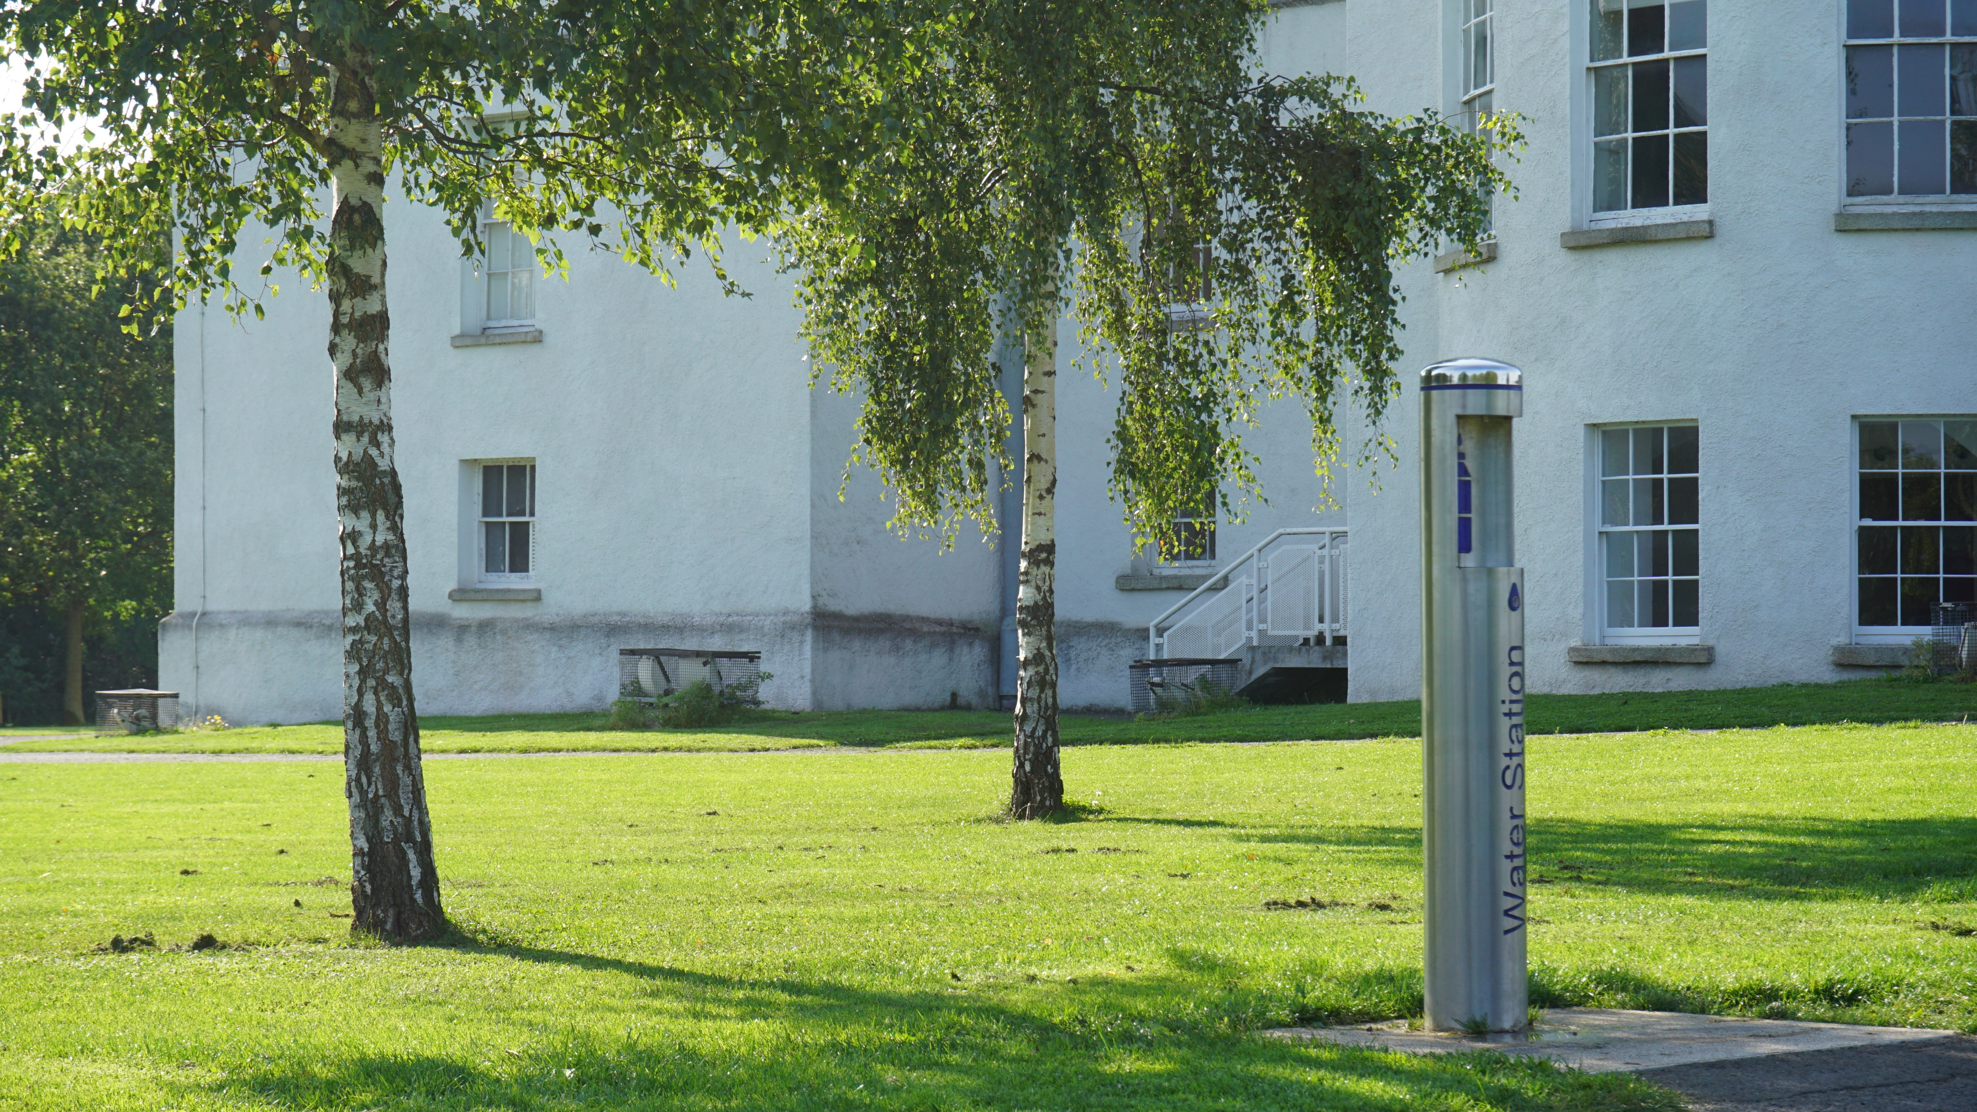
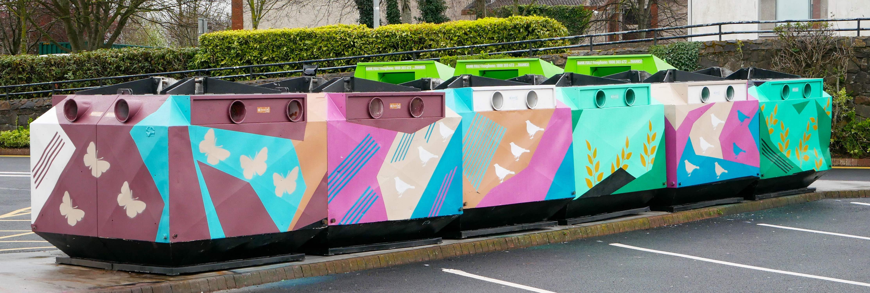
Circular Economy and Resource Management - 2024
SDCC is incorporating Green Procurement principles into tenders.
Support the National Waste Management Plan for a Circular Economy 2024-2030.
5 additional water fountains are planned for 2024.
SDCC continues to manage a bring banks network.
3 bin waste separation system to be installed in Q2 2024.
Review recommendations of Anaerobic Digesters Feasibility Study.
SDCC will continue to monitor and enforce waste regulation in the County.

Slide 21
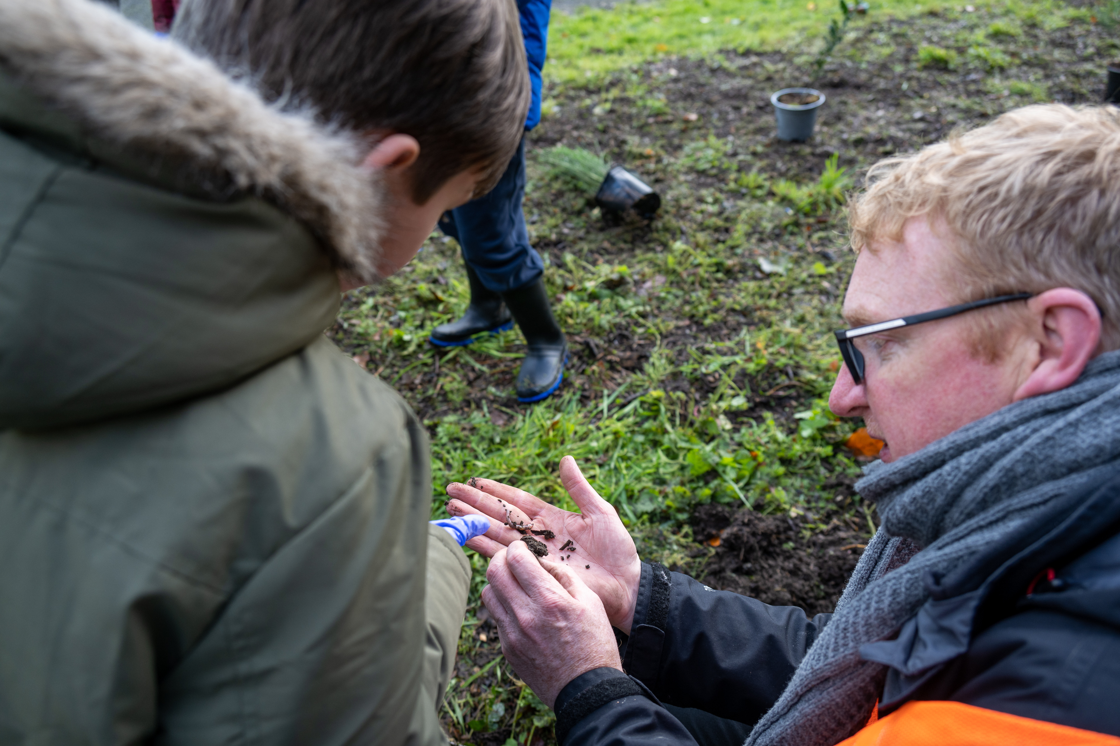
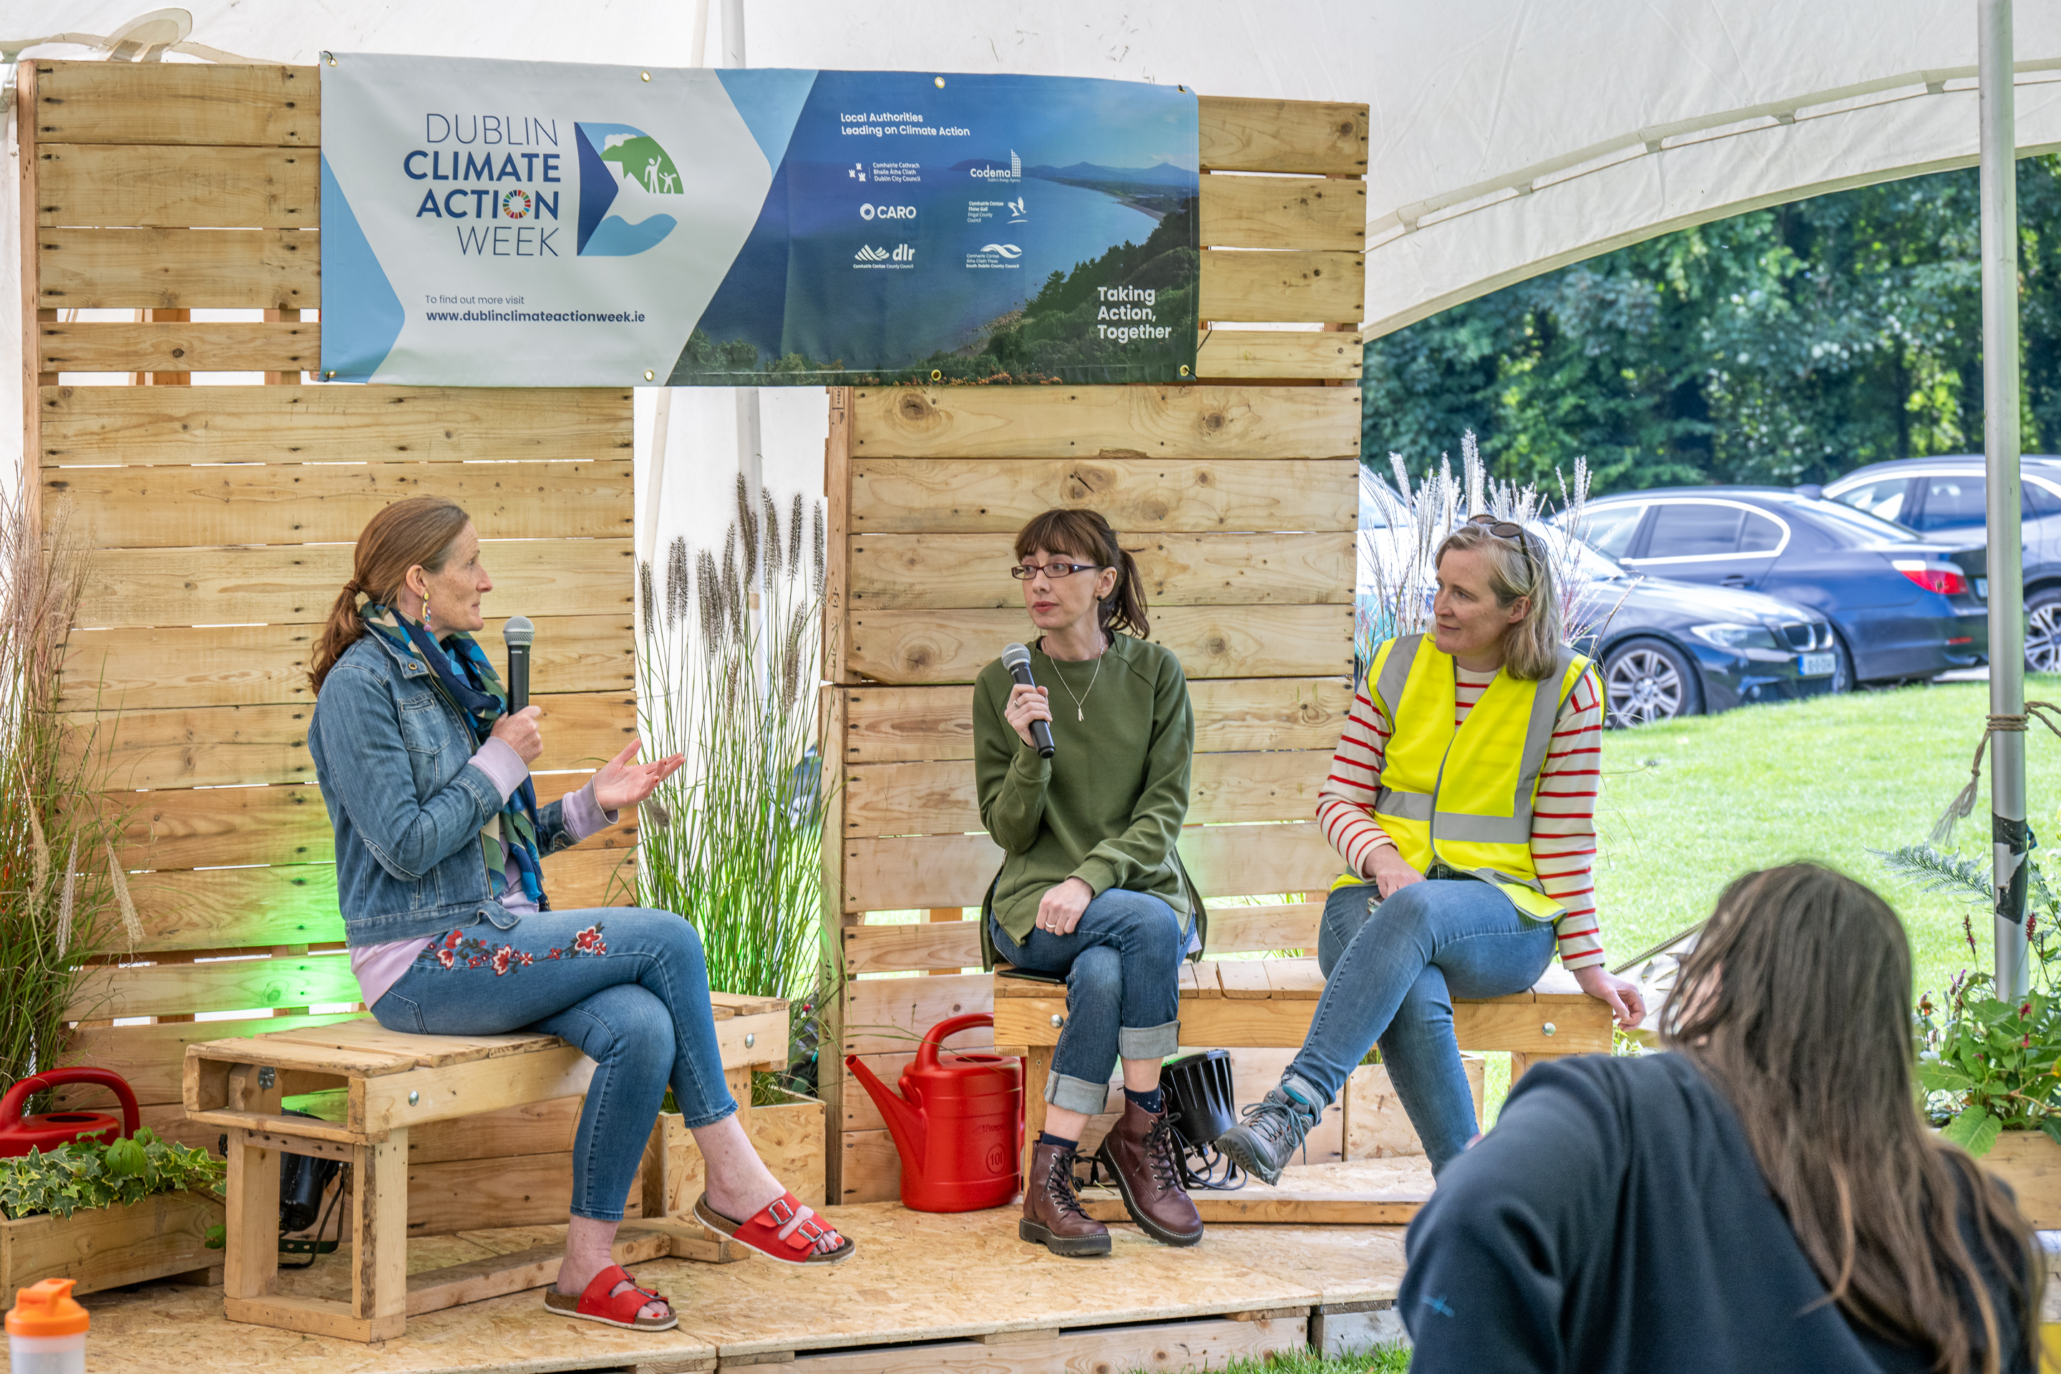
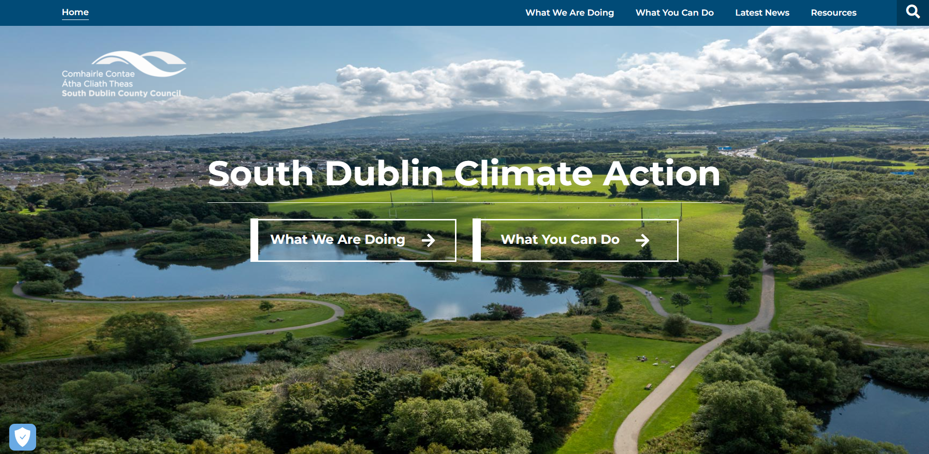
Community Engagement - 2024
Maintain SDCC website www.southdublinclimate.ie
Roll-out the Community Climate Action Programme.
Undertake home energy awareness raising events, in collaboration with SEAI and Codema.
Work with SDCC Mentor on enhancing the Sustainable Energy Communities programme.
Continue to deliver climate education programmes for Primary and Secondary schools – Eco Week 2024
LEO to continue wider engagement with local businesses and entrepreneurs, in the green transition.
Optimise the muse of IT, dashboards and smart data, in monitoring and displaying progress on CAP implementation.
Participate in Dublin Climate Action Week 2024.

Slide 22
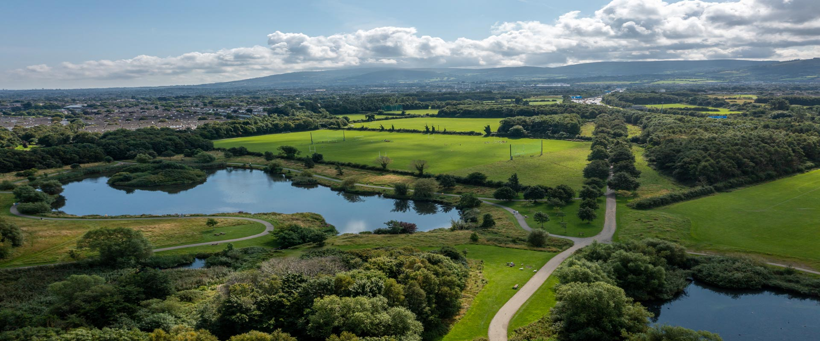
Thank You

