Slide 1
12th lock masterplan proposed part 8’s Lucan Palmerstown north Clondalkin area committee
March 26th, 2024.

Slide 2
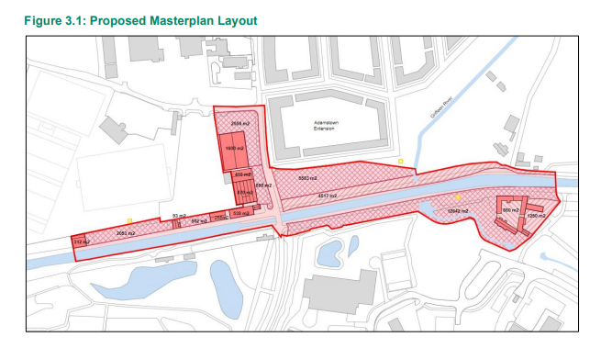
Study Area

Slide 3
Masterplan Overall Vision

Slide 4
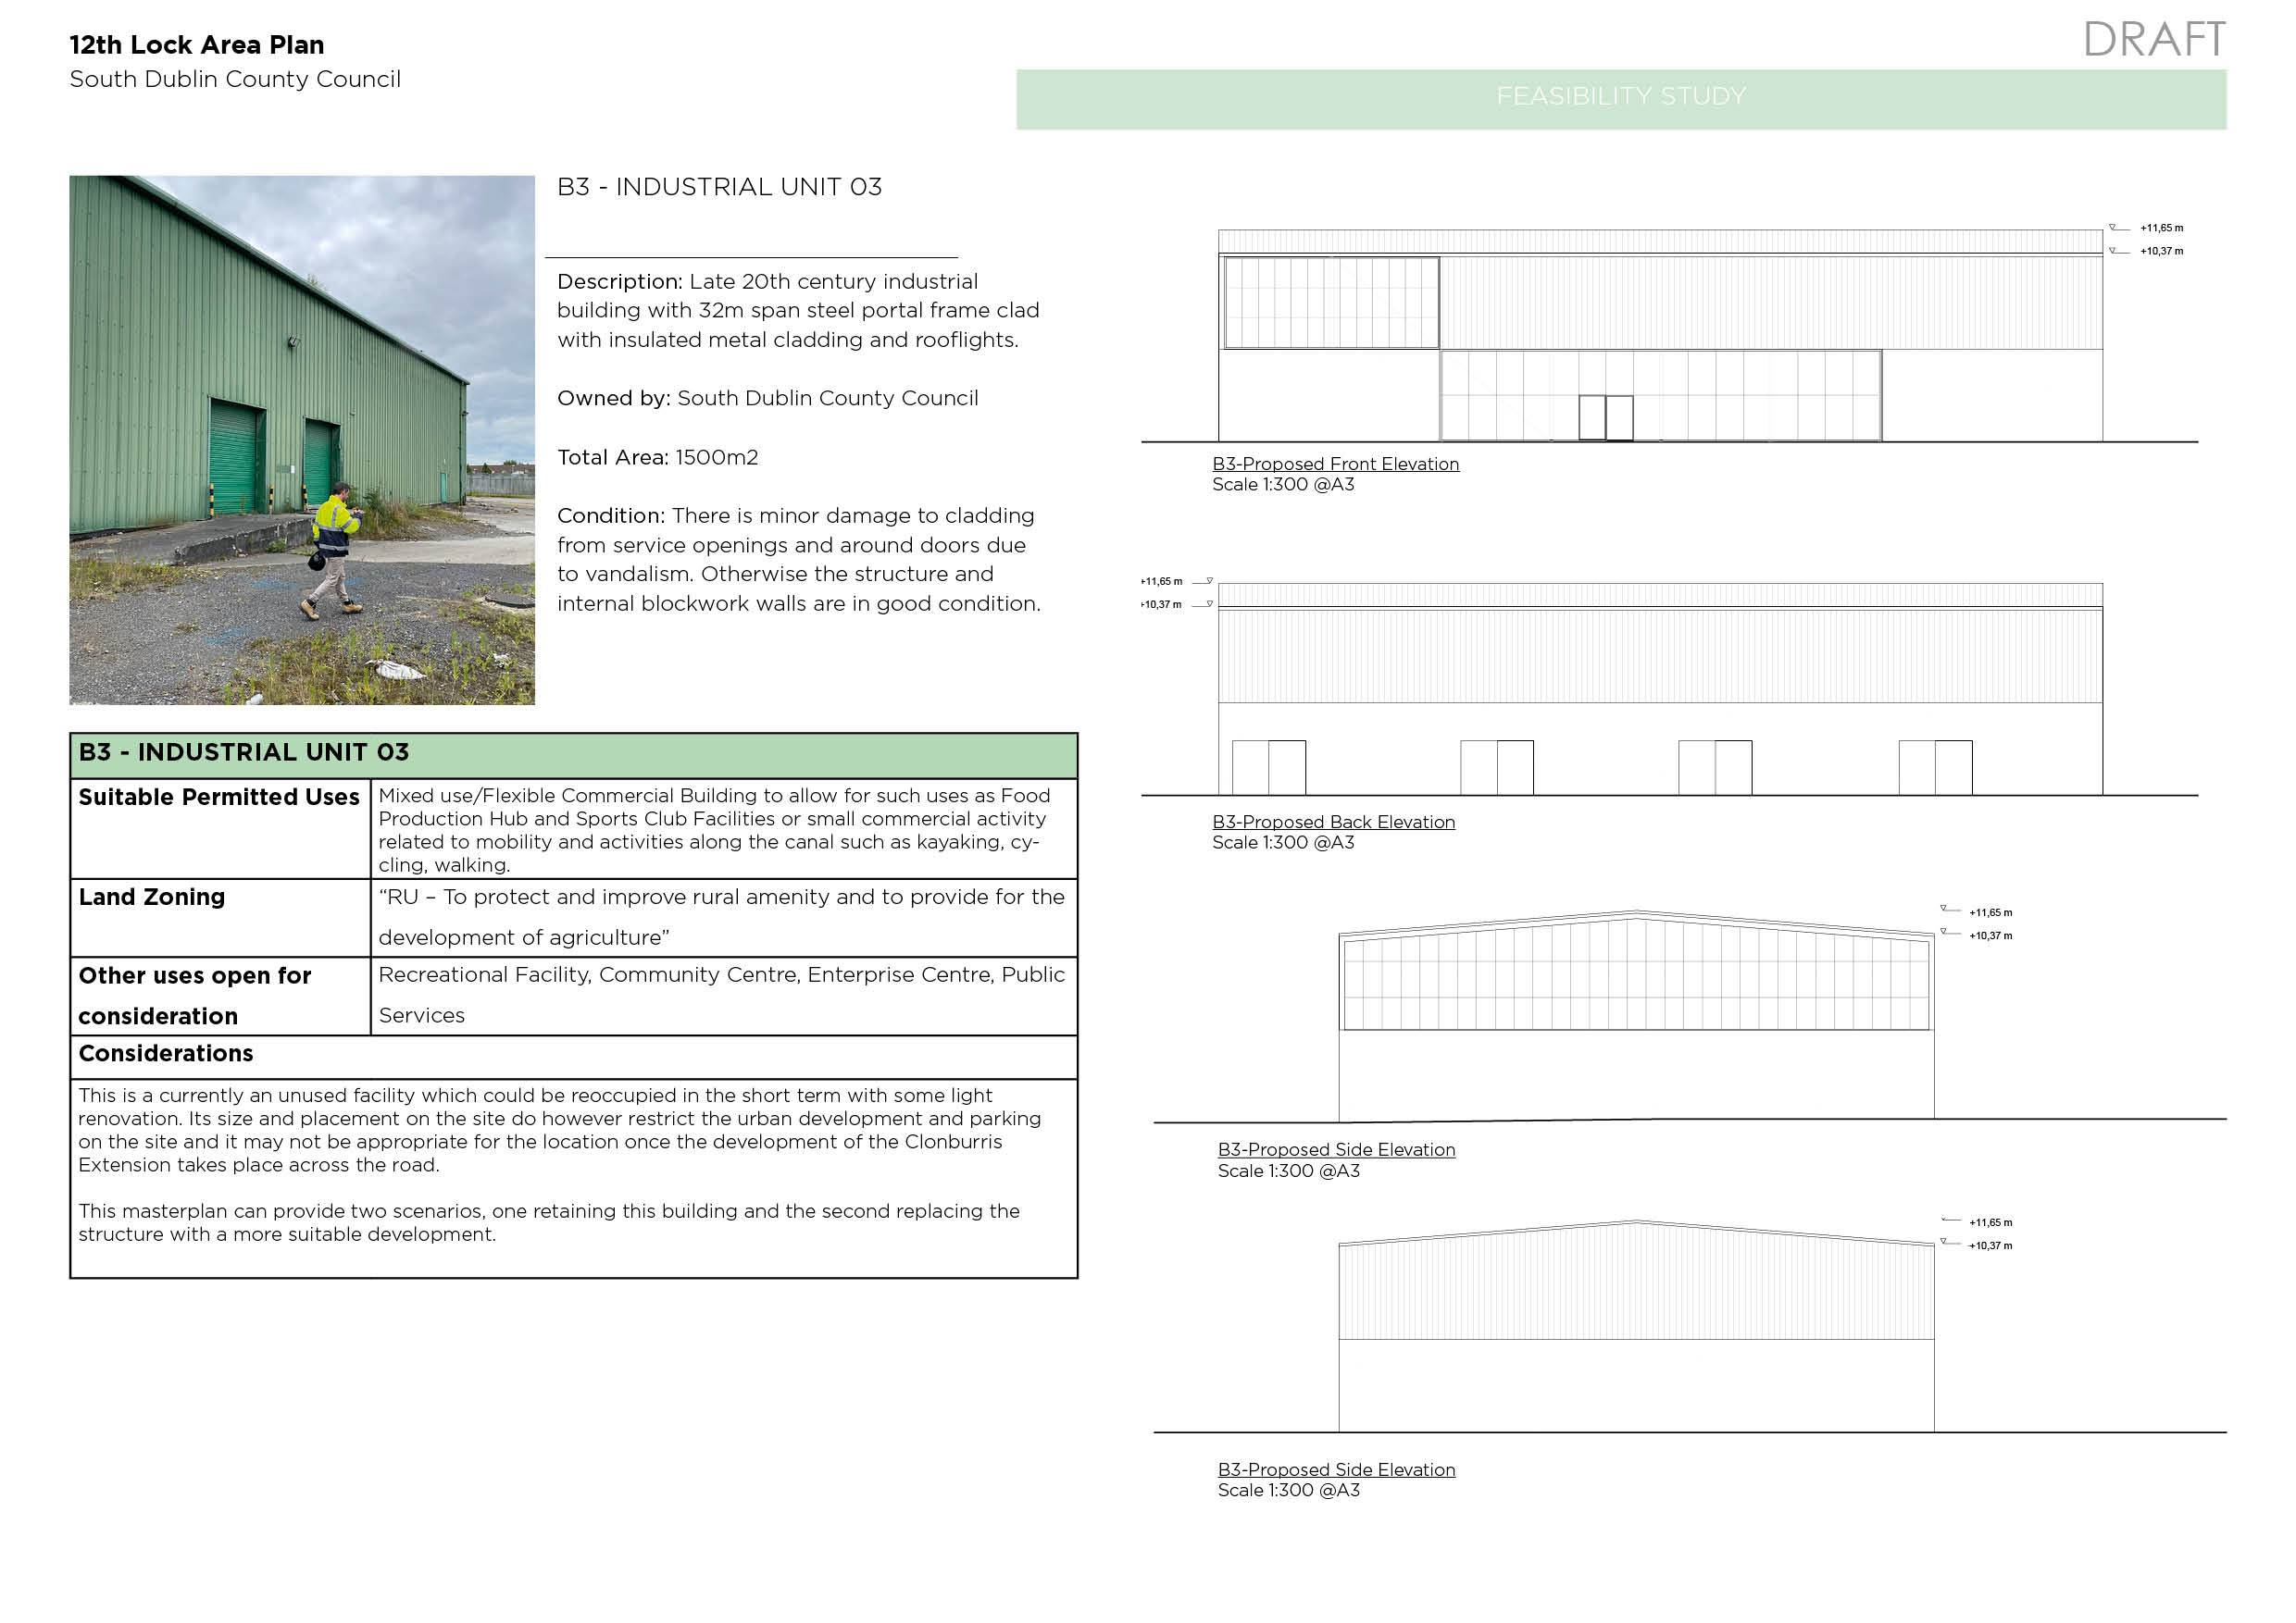

Slide 5
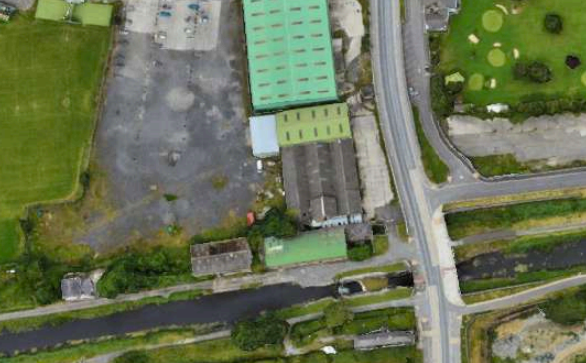
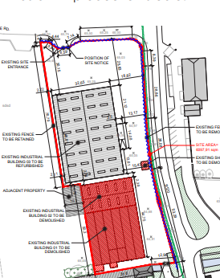
land use Boundary – overall site strategy

Slide 6
Phase 1- Site STRATEGY

Slide 7
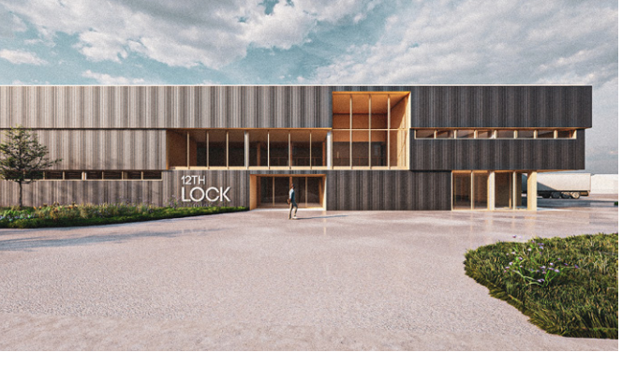
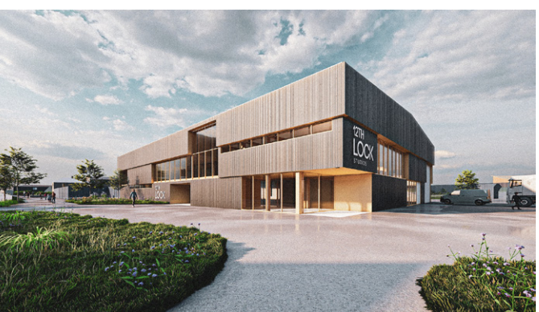
Proposed Façade 12th lock studios

Slide 8
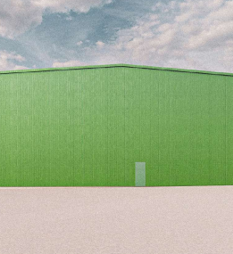
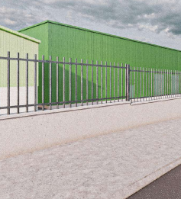
Exterior Views Industrial Unit

Slide 9
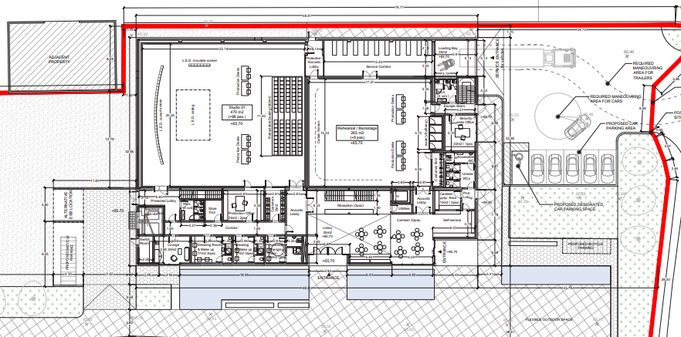
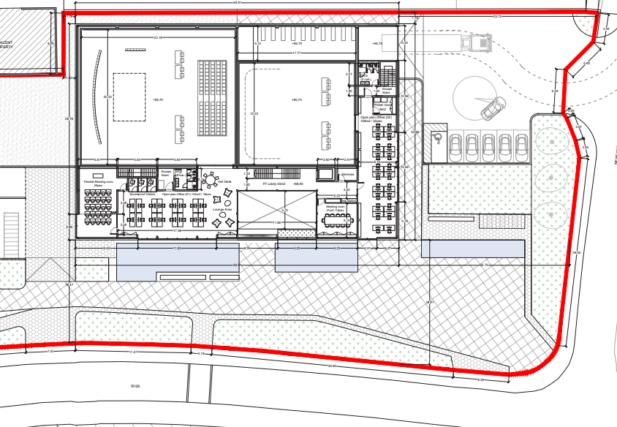
Proposed Interior layouts

Slide 10
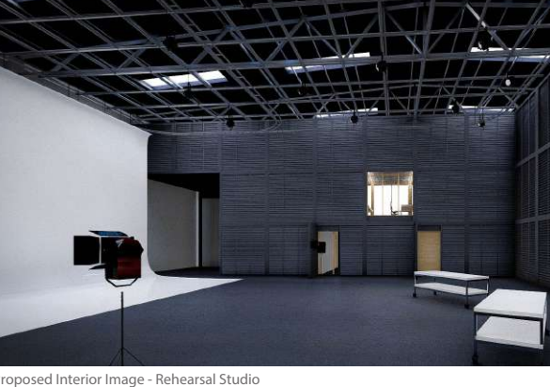
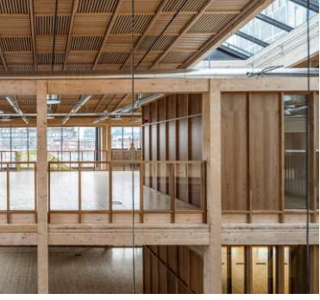
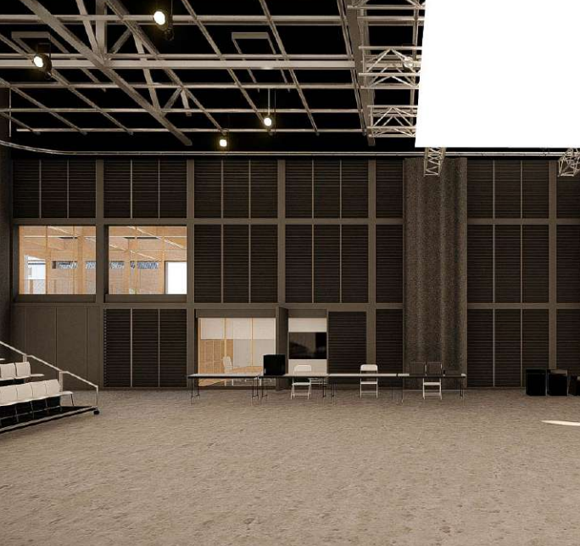
Studio Concept and First Floor

Slide 11
Landscape strategy

Slide 12
Proposed Phase 2

Slide 13
Proposed phase 3

Slide 14
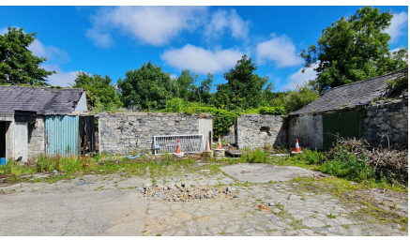
Grange Cottage

Slide 15
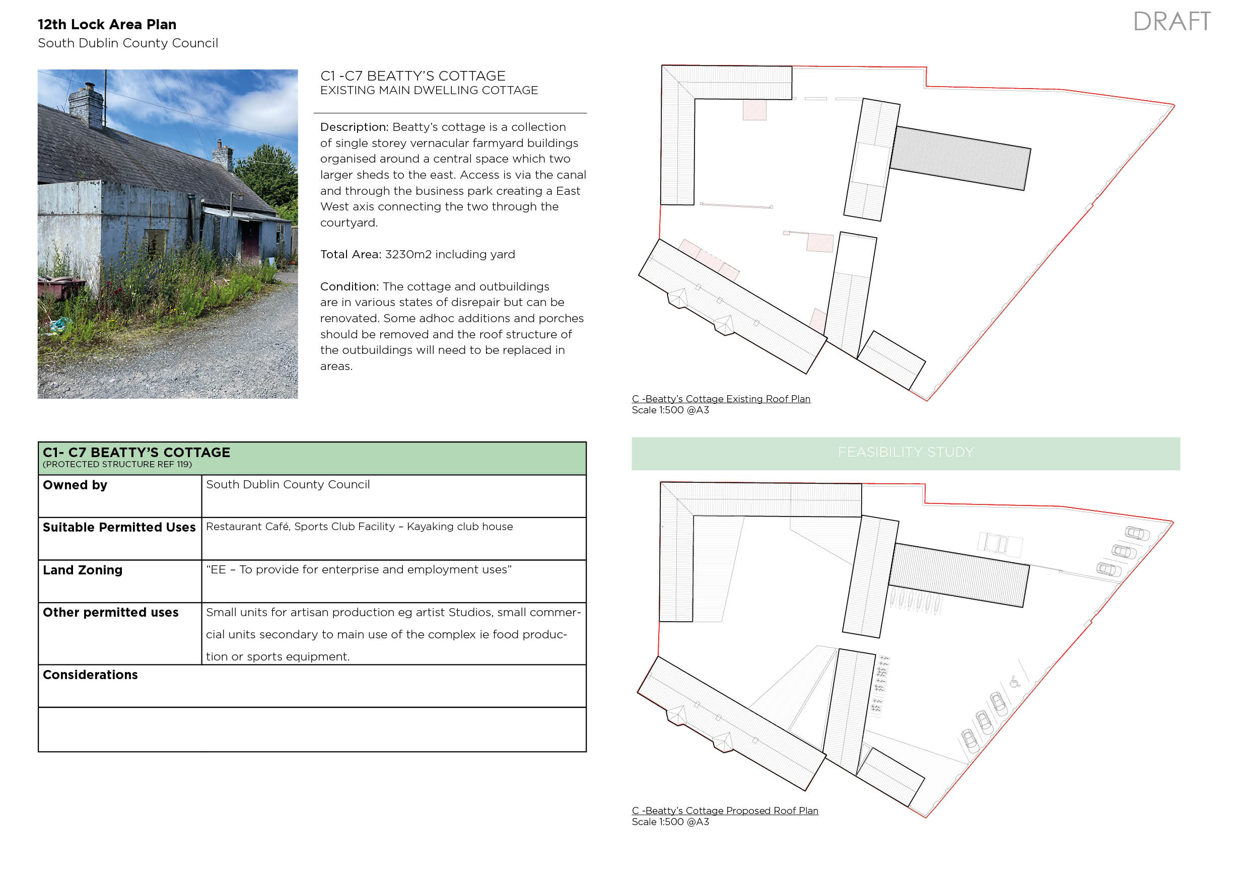

Slide 16
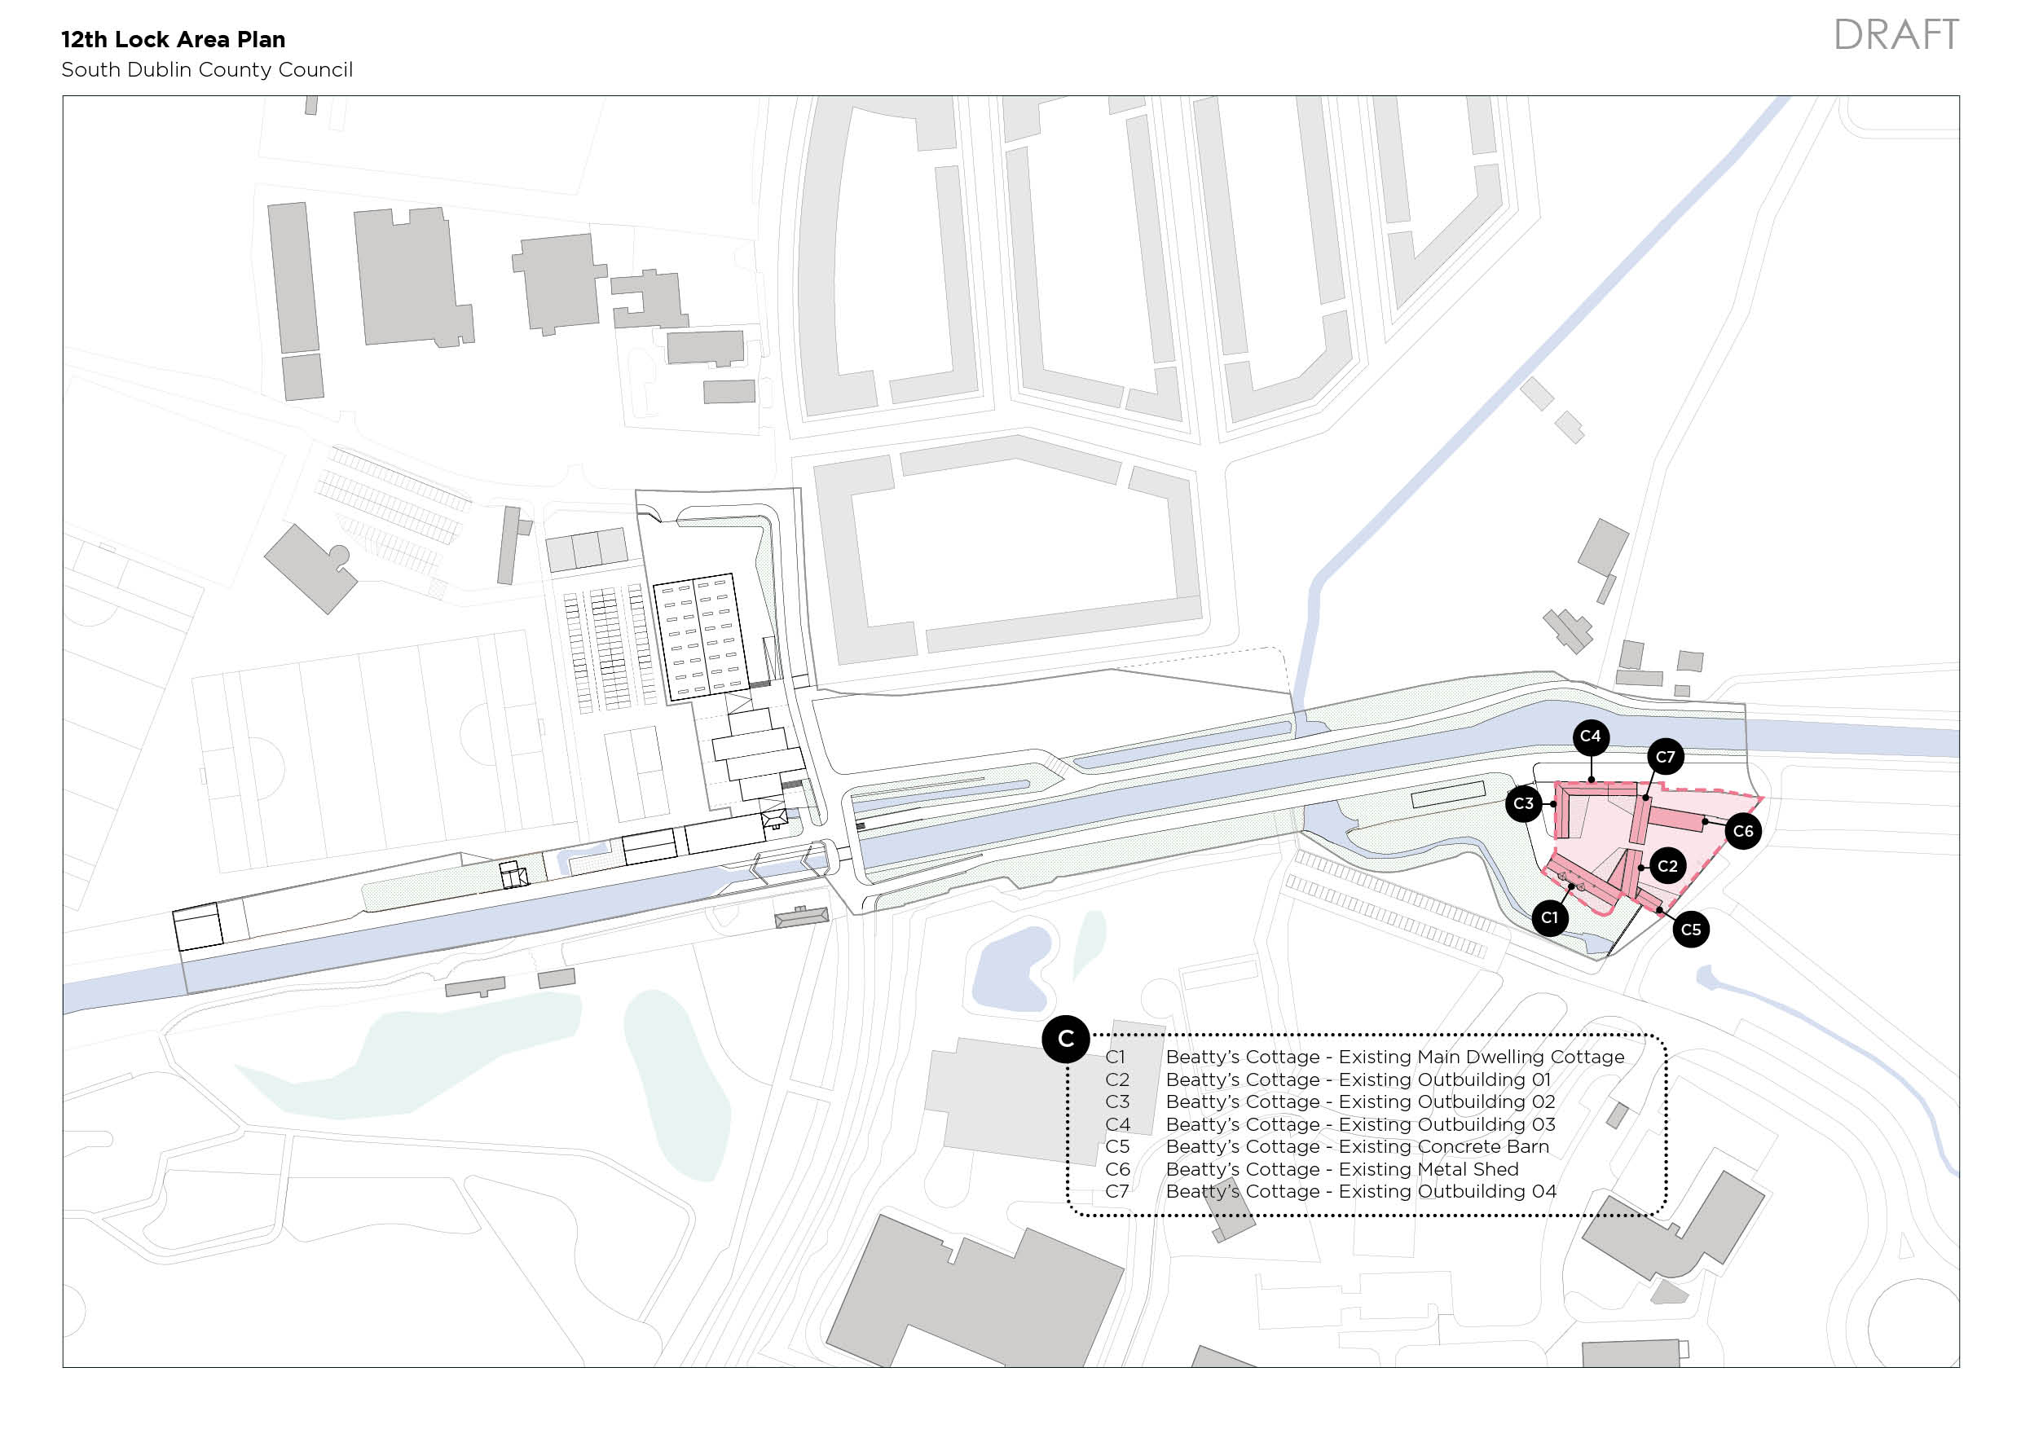

Slide 17
Grange Cottage area proposed uses

Slide 18
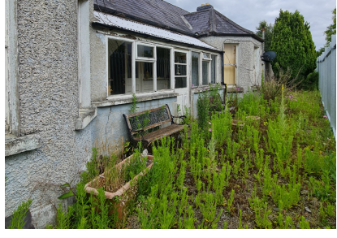
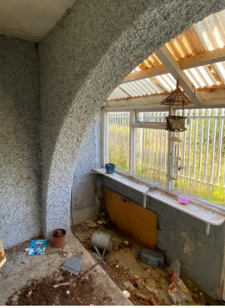
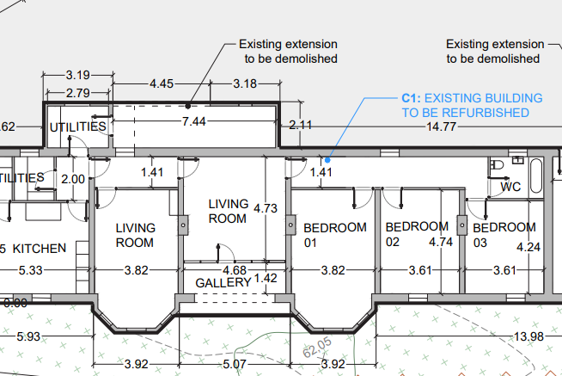
Grange cottage
Repurpose as Creche
Incorporate shop – small local shop

Slide 19
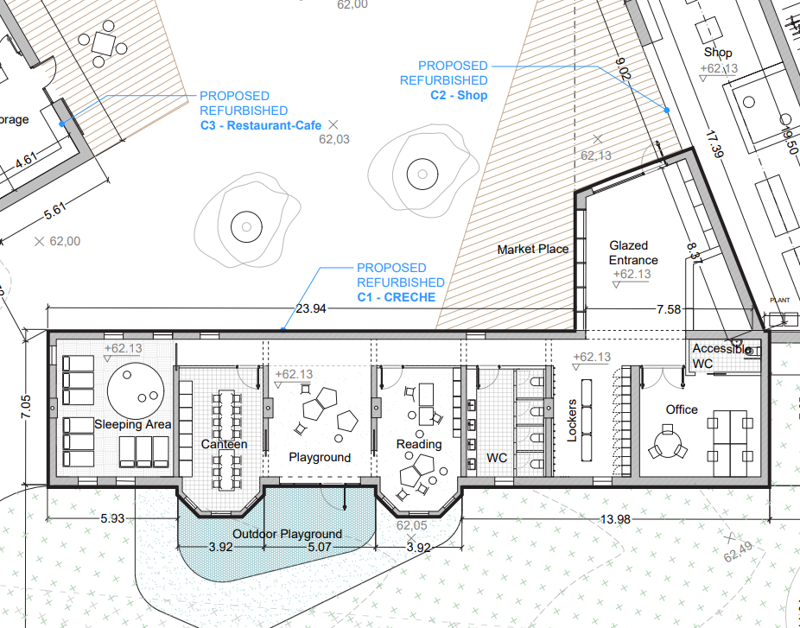
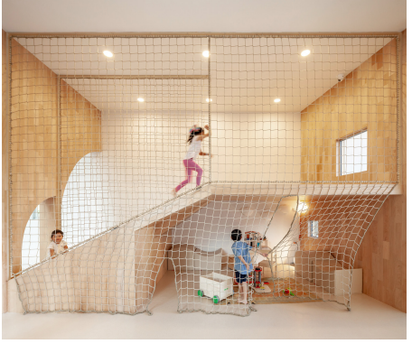
Proposed Internal Layout

Slide 20
Concept Design- Courtyard area

Slide 21
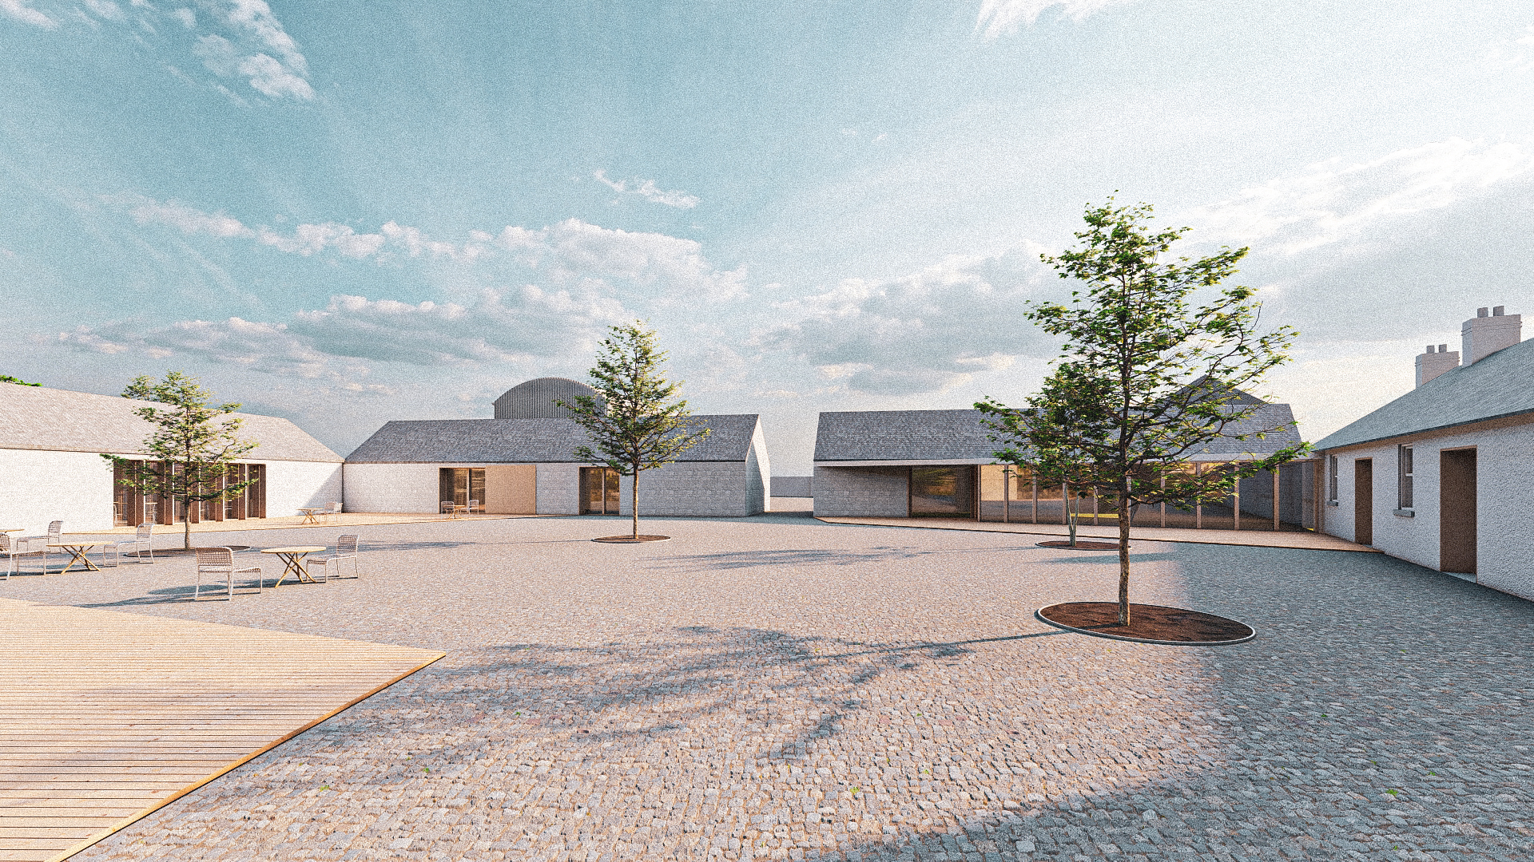
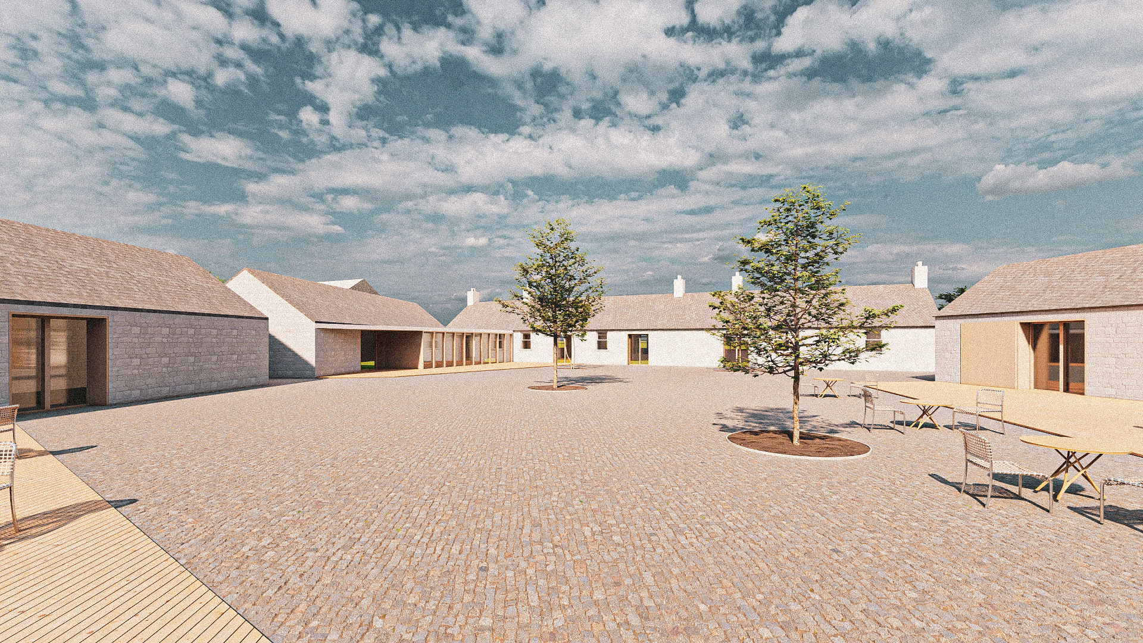
Grange Cottage Internal Courtyard Space
Zone C

Slide 22
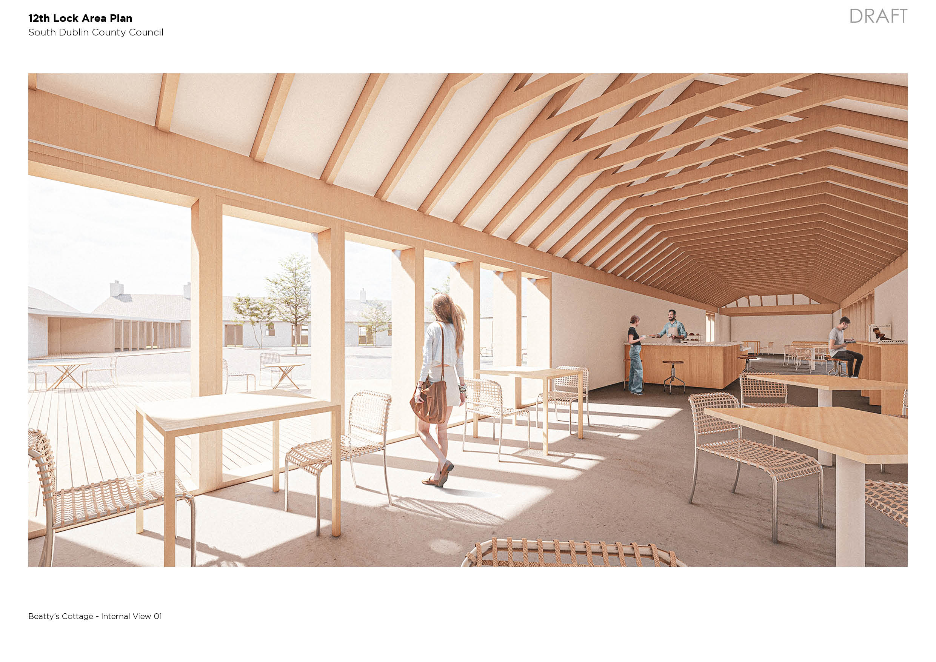

Slide 23
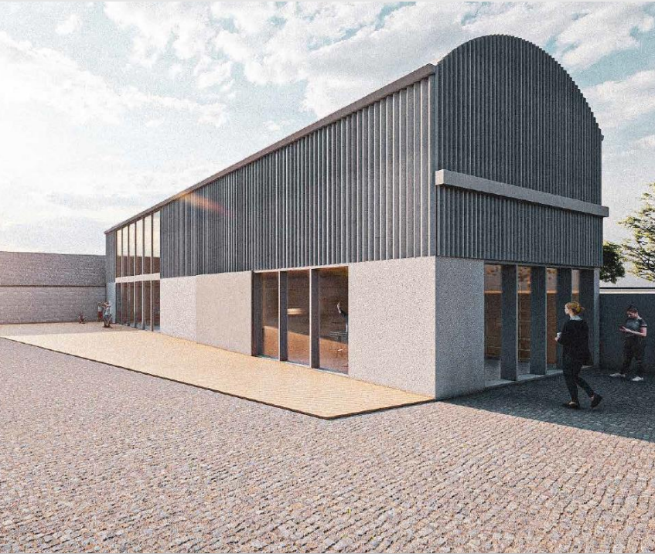
Re-purposed farm building
Artists studio space

Slide 24
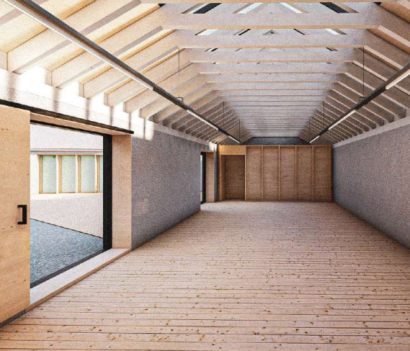
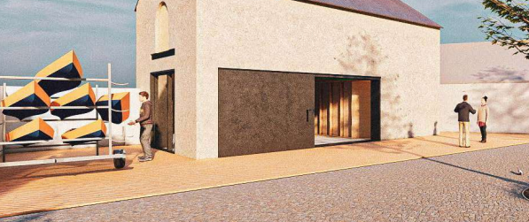
Re-purposed Courtyard buildings
Multi-purpose Event space
Water sports facilities

Slide 25
Proposed public Realm Development

Slide 26
Proposed INTEGRATION OF public Realm Development

Slide 27
Next steps -Proposed Timelines
Part 8 Public Consultation
1. Industrial Unit
2. Grange Cottage
1. March 2024
Council Approval July 2024
2. May 2024
Council Approval September 2024
Detailed Design /BoQ
Completed July 2024
Completed July 2024
Procurement of Operators
Procurement of Contractor/s
June – September 2024
July – September 2024
Phase 1 Redevelopment
Q4 2024 – Q1 2026

