Slide 1
Public Rights of Way Options for Progression
February 29th 2024 LUPT SPC

Slide 2
There is a requirement in the Planning Acts under Part II, section 10(2)(o) to include objectives for: ‘the preservation of public rights of way which give access to seashore, mountain, lakeshore, riverbank or other places of natural beauty or recreational utility, which public rights of way shall be identified by both marking them on at least one of the maps forming part of the development plan and by indicating their location on a list appended to the development plan’.

Slide 3
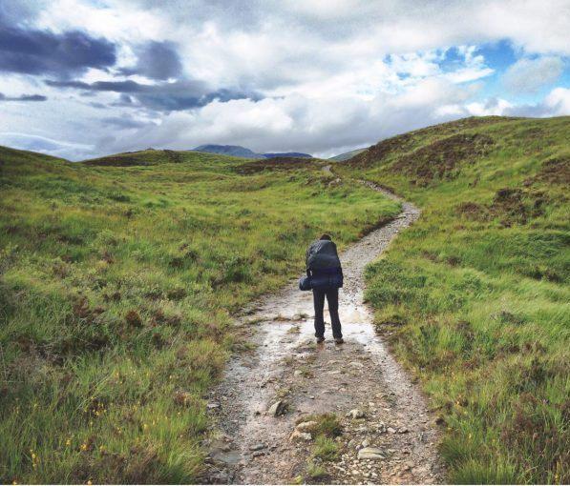
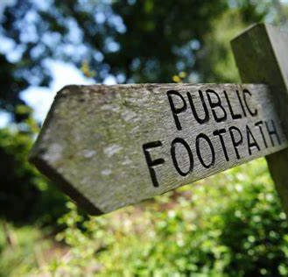
Development Plan Objective
EDE23 Objective 2:
To identify, in a logical and sequenced way, existing public rights of way in relevant areas of the County and to investigate the creation of new public rights of way by taking the following steps within two years of adoption of the Plan:
Identify and map those areas within the County which have the potential to give access to mountain, lakeshore, riverbank or other places of natural beauty or recreational utility;
Examine the identified areas for existing access routes;
Investigate whether existing access routes are public rights of way and where there is an understanding that a public right of way may exist, undertake the necessary steps for consultation set out in the Planning Acts;
Once verified, map and identify those public rights of way in the Development Plan;
Where public rights of way do not exist and access would be appropriate, consider using public rights of way agreements available under section 206 of the Planning and Development Acts;
Where public rights of way agreements are not possible, consider the use of compulsory purchase orders under section 207 of the Planning and Development Acts.

Slide 4
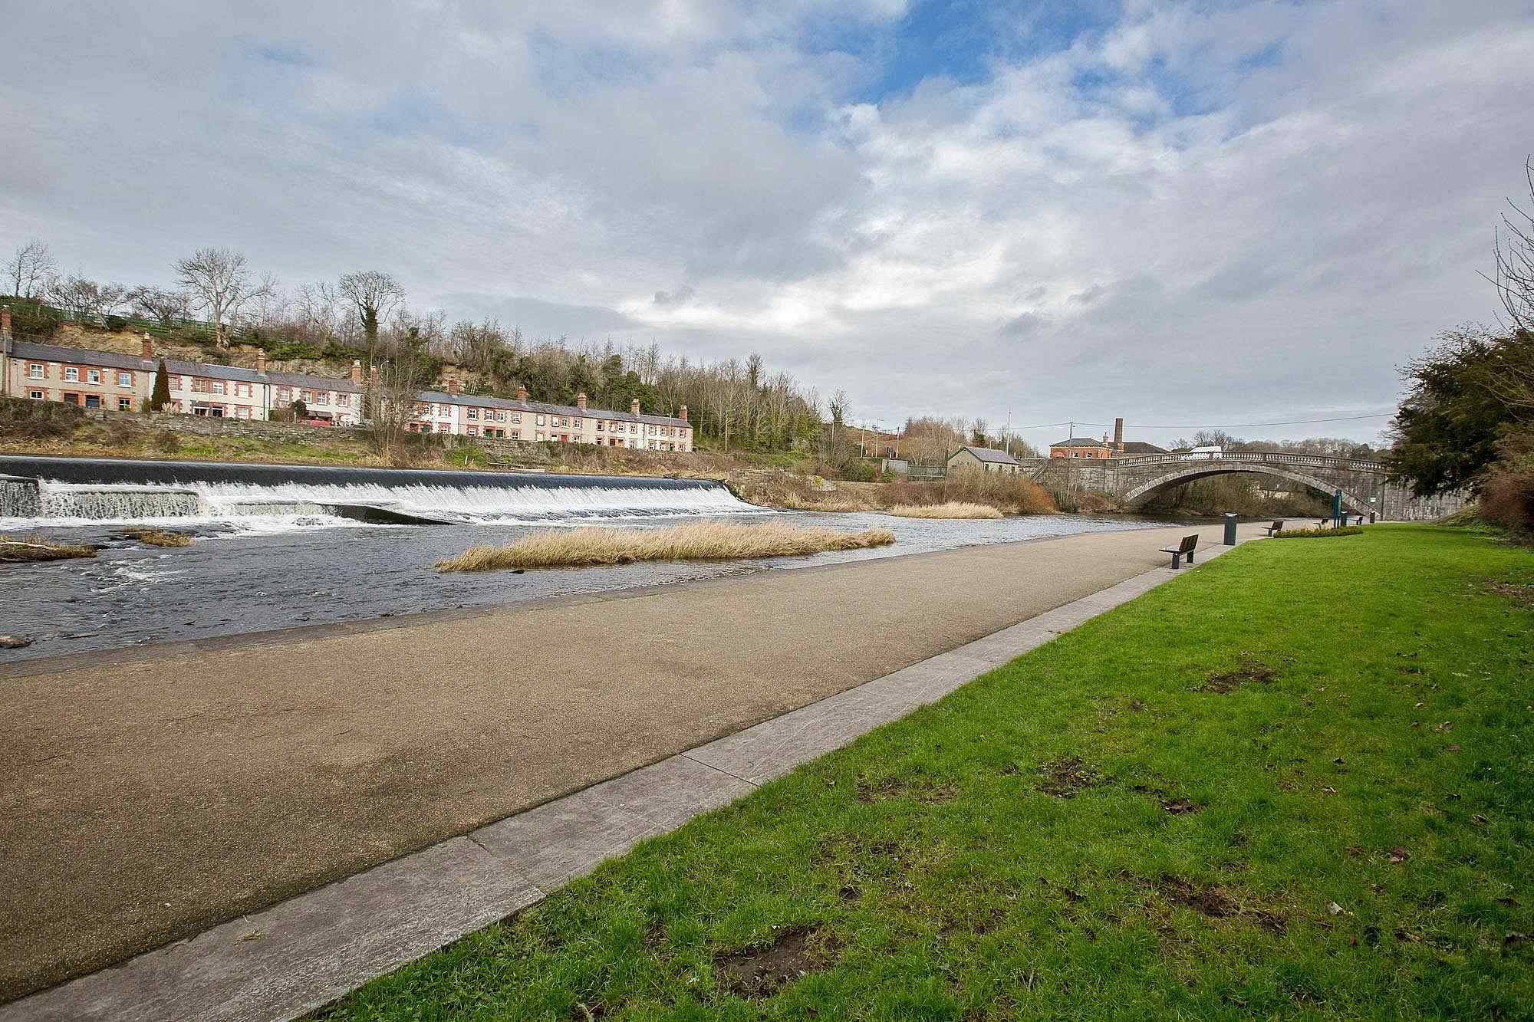
Current Status
Table 9.3: Public Rights of Way
Lucan Weir
From the Main Road in the Village running down the slip (Watery Lane) between the old St. Andrew’s national school house to the west and a commercial building to the east leading to the River Liffey walkway, as far as the western side of the Liffey bridge to exit at street level on the southern side of the bridge.

Slide 5
Options for Councillor Engagement
Through working with the Forward Planning section by way of:
A single sub-committee / working group of the LUPT SPC
A sub-committee / working group of all SPCs with maximum of 4-5 Councillors
A sub-committee / working group comprised of maximum 4-5 Councillor representatives from each ACM.
Public Rights of Way
Forward Planning Team
Councillors
Landowners / Public

