Slide 1
City Edge
LUPT SPC
29th February 2024

Slide 2
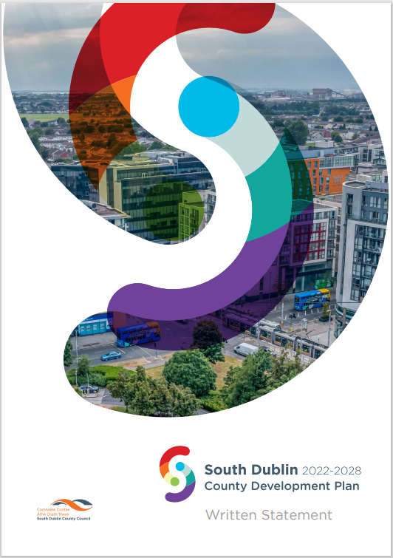
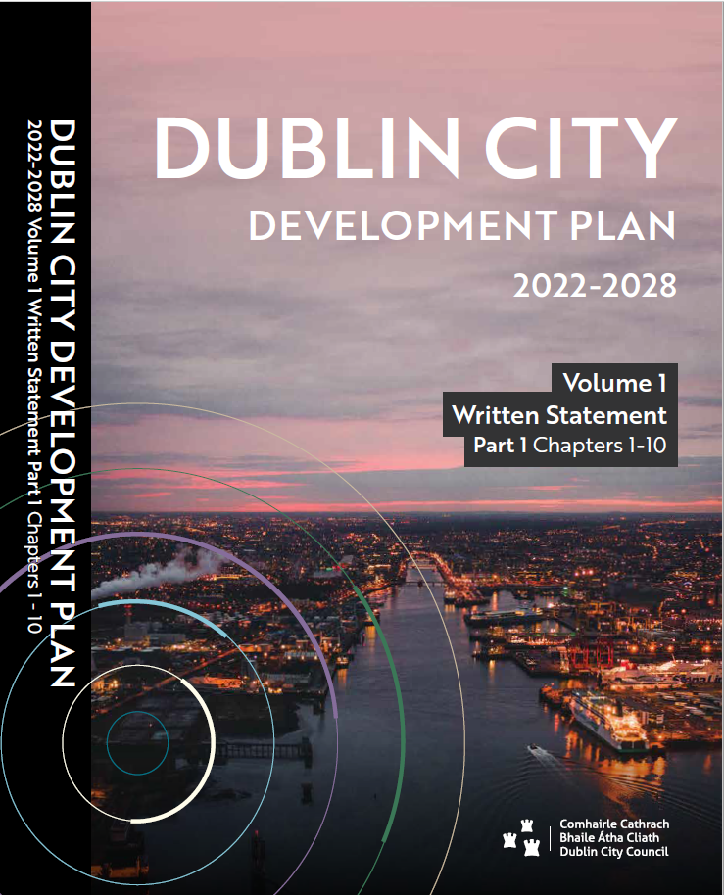
Proposed Development Plan Variation
Recap:
SDCC to propose Variation to County Development Plan 2022-2028
Purpose is to:
Provide a statutory basis for the future planning of the City Edge area
Refine provisions of Strategic Framework to provide more detailed planning and design guidance.
DCC to also undertake Variation to DCC CDP for the above reasons, plus to align land use zoning within DCC area with Strategic Framework vision.
Consultants’ services (Macreanor Lavington and sub-consultants) extended to advise on a planning strategy and evidence base to inform Variations. This work is ongoing and involves:
Further area-wide planning and urban design guidance
Detailed planning and urban design guidance for the 4 identified Priority Development Areas
Planning and urban design guidance for locations outside Priority Development Areas.

Slide 3
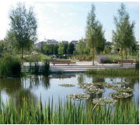
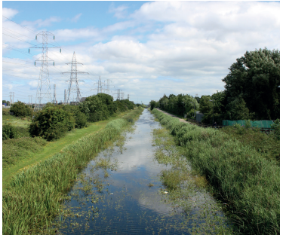
Further Studies informing Variation
Undergrounding OH Lines Feasibility Study:
LDA in conjunction with SDCC and DCC invited tenders for a feasibility study (published on 20.11.23) into the undergrounding of overhead high voltage lines within the City Edge area. Purpose is to release developable land and for improved placemaking. Tender evaluation completed with recommendation due imminently. Expected study duration 4/5 months.
Seveso Study:
Specialist consultants have been engaged to carry out risk contour mapping and interpretation to guide land use planning including appropriate uses and intensities of development in the vicinity of Seveso sites. Mapping has been completed. Interpretation is currently being carried out.
Energy Feasibility Study:
Codema has been engaged to carry out an energy feasibility study for the City Edge area. A draft report has been prepared including literature review, baseline emissions model, analysis of future building and transport scenarios in City Edge to develop zero carbon pathways model, and proposed policy-based recommendations and conclusions. Draft report currently being reviewed by SDCC/DCC with a view to iterative revisions (if required) to reflect output from emerging urban design strategy.
Environmental Reports:
SEA Screening/Scoping report and AA Screening report prepared. Full SEA and NIR required. Consultation carried out with prescribed bodies on SEA Scoping, and comments incorporated. Alternative scenarios being explored for SEA. SFRA to be carried out.
Ongoing stakeholder engagement with NTA, LDA, HSA, ESB/Eirgrid and UE

Slide 4
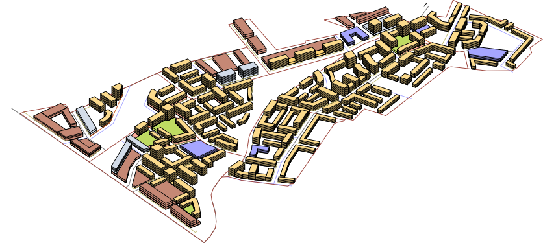
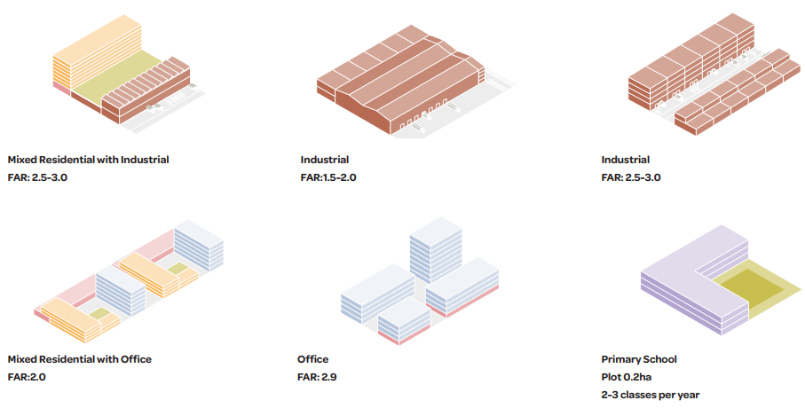
Proposed Variation
Proposed Variation – Iterative Direction (Draft)
a) Urban framework for area
b) Land use approach (requirements for mix of uses)
c) Sample typologies for mixed use (how to deliver mixed use)
d) Residential and non-residential capacity (units/ employment floorspace)
e) Distribution of social infrastructure (e.g community centre & education)
f) Parking strategy (pathway to near zero parking, storage hubs)
g) Location and approach to open space provision (on site, local and district)
h) Estimated foul capacity demand
i) Phasing approach (Infrastructure requirements for unit bands)
j) Sequencing of regeneration (Priority Development Areas)
k) Development management standards/requirements
Note: c) and d) above were covered in October SPC.

Slide 5
Strategic Framework – Early Development Areas
Early Development Areas were identified in the Strategic Framework.
Boundaries were deliberately not well-defined as more detailed analysis was required.
Early Development Areas were based on public transport accessibility, proximity to facilities such as open space and community infrastructure, planning history, linkage to existing environment and constraints.

Slide 6
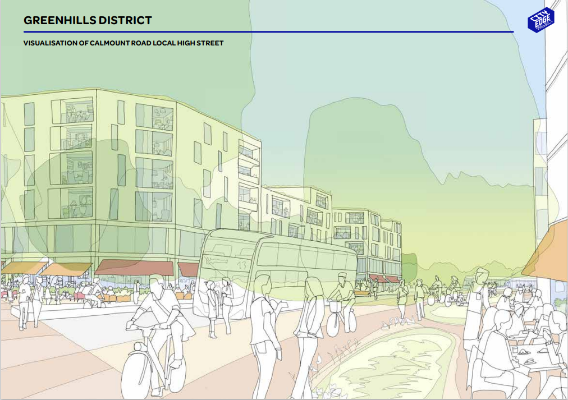
Proposed Variation –
Priority Development Areas
Priority Development Areas (PDAs) are a refinement of the Early Development Areas in the Strategic Framework.
PDAs are required in the context of the large scale and long timeframe for full build-out of City Edge.
They reflect the need to have a sequencing mechanism whereby initial development within City Edge is focussed in the most appropriate areas.
PDAs will facilitate the concentration of public funds and private investment in optimal locations for successful regeneration.
Proposed Variation will include phasing for each PDA whereby identified infrastructure will be required as development proceeds past set thresholds.
Will also include policies setting out approach to development proposals outside of PDAs.
Draft layouts have been progressed for each of the four PDAs:
Greenhills (SDCC area)
Red Cow/Cherry Orchard (mainly SDCC area with small DCC area)
Naas Road (mainly DCC area with some SDCC)
Kylemore (DCC area)
The emerging results of the Seveso study will inform the draft layouts.
Gross areas and main land uses envisaged for each PDA are set out in the table
PDA | Gross Area (Ha) | Estimated Population Capacity | Main Uses Envisaged
Cherry Orchard/Red Cow | 43.51 | C5,500 | Residential-Led Mixed Use
Greenhills | 53.25 | C7,000 | Residential-Led Mixed Use
Naas Road | 53.11 | C7,500 | Mixed Use Employment and Residential
Kylemore | 48.55 | C8,000 | Residential-Led Mixed Use and Mixed Use Employment and Residential
Total PDA Area | 198.42 (28% of City Edge area)

Slide 7
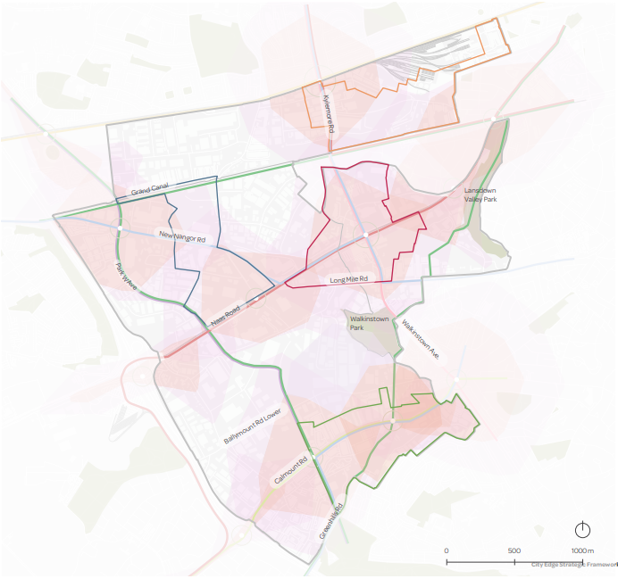
Proposed Priority Development Areas
Kylemore
Naas Road
Red Cow/ Cherry Orchard
Greenhills

Slide 8
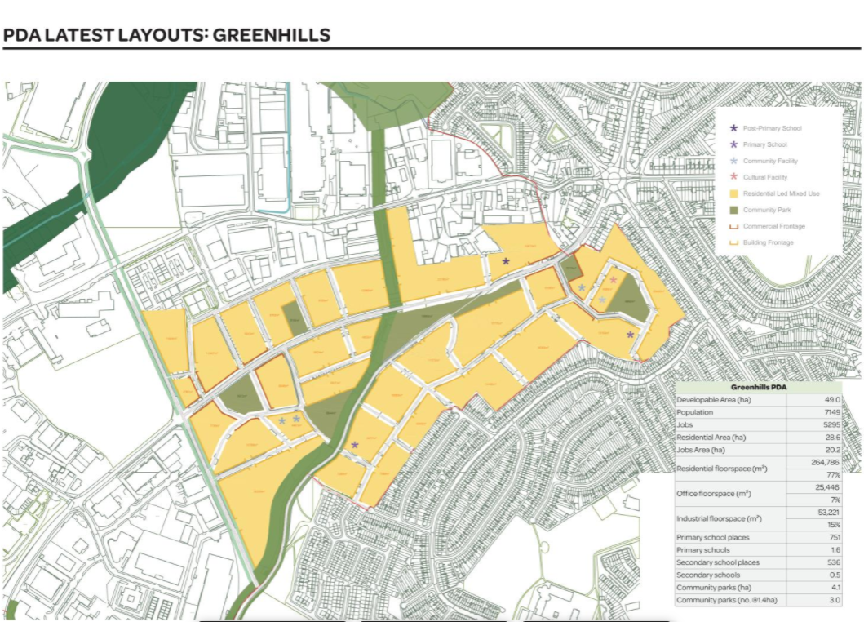
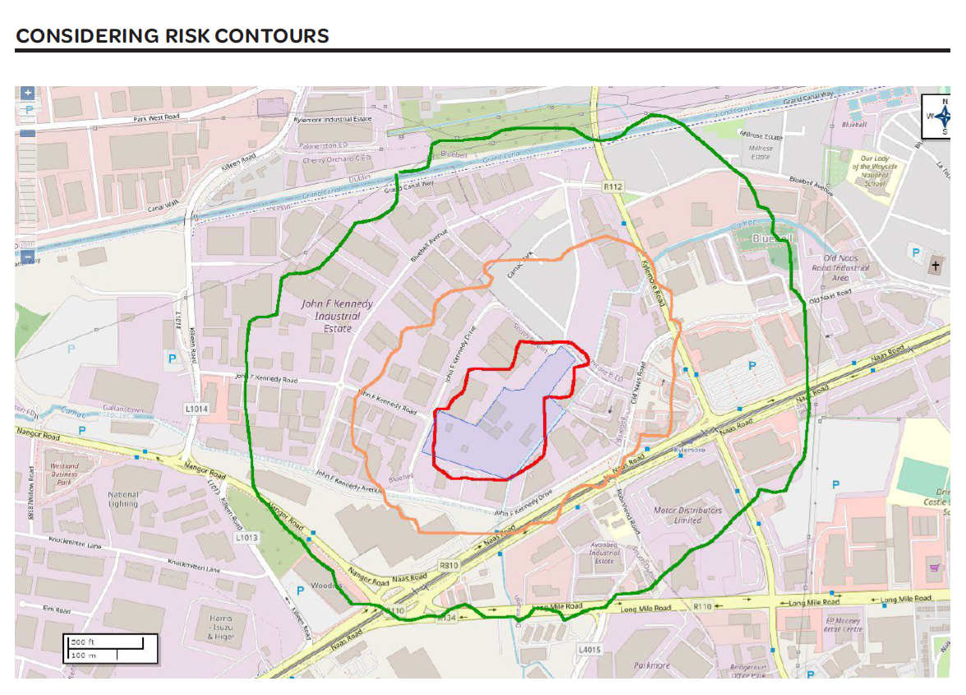

Slide 9
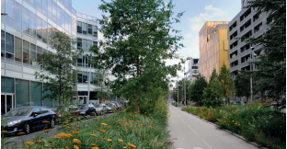
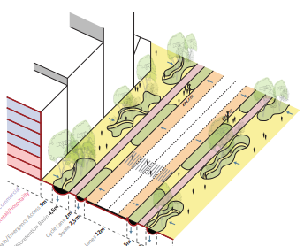
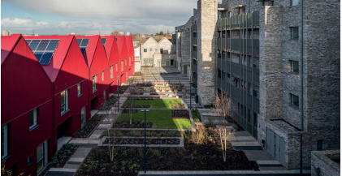
Variation Process and Timeline
Further presentations to SPC.
Commencement of statutory process after the Local Elections/Summer recess 2024.
Briefing of Elected Member before commencement of statutory process.
Public Consultation on the Proposed Variation to be at least 4 weeks.
Chief Executive’s report on Public Consultation to the Elected Members.
Members consider CE Report and make, modify or refuse Variation.
Material Alteration to Variation (if any), including SEA/AA.
Further Public Consultation, CE Report and consideration by Elected Members.
Estimated Timeline:
Commence Public Consultation in September 2024.
a) No Material Alteration – Variation decision in December 2024.
b) With Material Alterations process – Variation decision in March 2025.

