Slide 1
Housing Delivery Update Report Tallaght Area Committee Meeting 26th February 2024

Slide 2
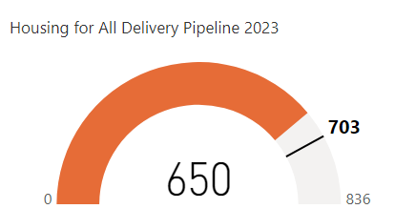
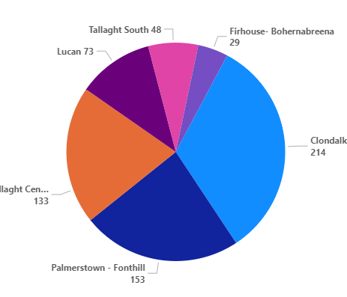
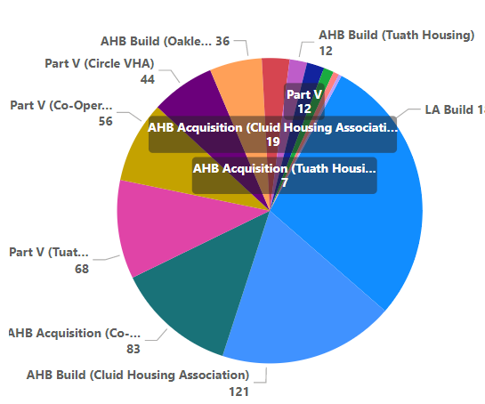
Housing for All – Delivered 2023
Target 2023
Delivery by LEA
Delivery Stream
Clondalkin
Tallaght-Central

Slide 4
Housing Developments Approved / Under Construction – Tallaght South & Tallaght Central
L.E.A | Project | Delivery | Units | Status
Tallaght South | Rossfield | LA Build | 16 | Part 8 Derogation advertised in December 2023. Procurement process for contractor to commence
 | Cuil Duin, Citywest | Part V | 36 | Onsite- delivery in 2024
 | Foxwood Barn, Citywest | Part V | 77 | Part V negotiations ongoing. Delivery 2024 /2025
 | Silken Avenue Kingswood | Part V | 1 | Part V under negotiation delivery Q1 24
 | Citywest Drive | Part V | 29 | Part V agreed. Delivery 2025/ 2026
 | Parklands, Citywest | Part V | 23 | Onsite- delivery in 2024
Tallaght Central | St Aongus Green (Age Friendly) | LA Build | 10 | Tender under evaluation.
 | Airton Rise, Airton Road | Part V | 50 | Part V agreed. Delivery 2025
 | Airton Plaza, Belgard Road | Part V | 30 | Part V agreed. Delivery 2024/2025

Slide 5
Large Development Sites
Kilcarbery: 1,034 homes with 30% social (310 homes)
Delivery of 74 social homes anticipated in 2024. Design work is continuing for the adjacent site with a proposed development of up to 88 social and affordable homes.
Killinarden Foothills: 620 homes (including 125 social , 123 Private & 372 affordable purchase).
Developer is currently completed pre-construction planning compliances and with a view to commencing works onsite.
Clonburris: Phases 1 & 2 comprising 382 homes (149 social), Phases 3,4,5 with potential for 1,430* homes ( approx. 40% social)
Construction continuing on-site Canal Extension. The tender process for construction of 266 social, affordable, and cost rental homes in the Kishogue sector has recommenced. Anticipated on-site date in Q3 2024, to allow for completion of road construction works. Design work is almost complete for 120 social homes on the PPP site adjacent to Lynch’s Park, with Part 8 due to commence once complete. Plans for approximately 1300 social and affordable homes are currently being advanced by external design teams with a Part 10 planning application to An Bord Pleanála expected in Summer 2024.
Belgard Square North: 133 cost rental apartments
Contractor commenced on site April’23. Delivery March 2025 .
Rathcoole: Number of homes & tenure mix to be confirmed
Due to commence procurement process to appoint consultant to progress the masterplan through to Part 10 planning application application to An Bord Pleanála.

Slide 6
Planning Derogation Sites - ( Section 179A)
Location | Units | LEA | Status | Next Action
Rossfield | 16 | Tallaght South | Planning | Scheme advertised in December 2023. Tender to be advertised in Q1 2024
Alpine Heights | 13 | Clondalkin | Detailed Design | Final design complete. Architects to meet with residents prior to advertising of scheme.
Deansrath/Melrose | 24 | Clondalkin | Planning | Scheme advertised in December 2023. Tender to be advertised in Q1 2024
Kilcarbery 2 (Social & affordable) | 88 | Clondalkin | Detailed Design | Scheme advertised in December 2023. Procurement process to be commenced shortly
Old Castle Clondalkin ( Social, affordable, & TA) | 130 | Clondalkin | Detailed Design | Consultation with residents ongoing. Design to be finalised.
Castlefield (Social & affordable) | 33 | Firhouse/Bohernabreena | Detailed Design | In house design. Detailed design ongoing
Stocking Lane | 25 | Firhouse/Bohernabreena | Feasibility Report | Progress for planning advertising
Sarsfield Park, Lucan | 5 | Lucan | Planning | DHLGH Funding approved Nov 2023
Owendoher Haven | 9 | Rathfarnham / Templeogue | Detailed Design | Design for the scheme currently being finalised
Kishogue Park | 15 | Lucan | Planning | Scheme design progressing

Slide 7
Tenant in Situ Acquisitions

