Slide 1
LUPT
SPC Meeting February 2024
Development Plan
Core Strategy Annual Monitoring Report

Slide 2
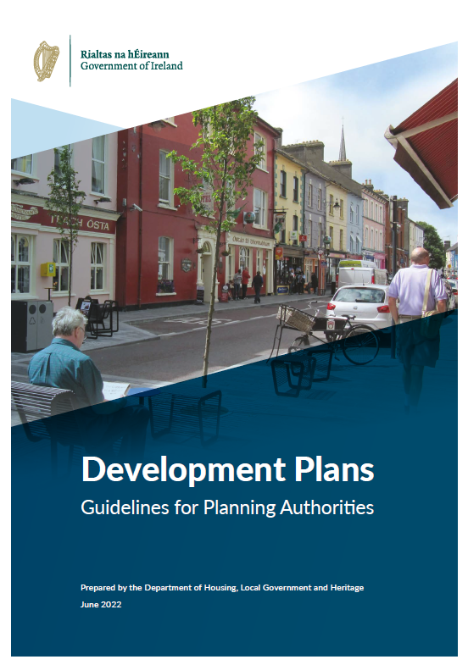
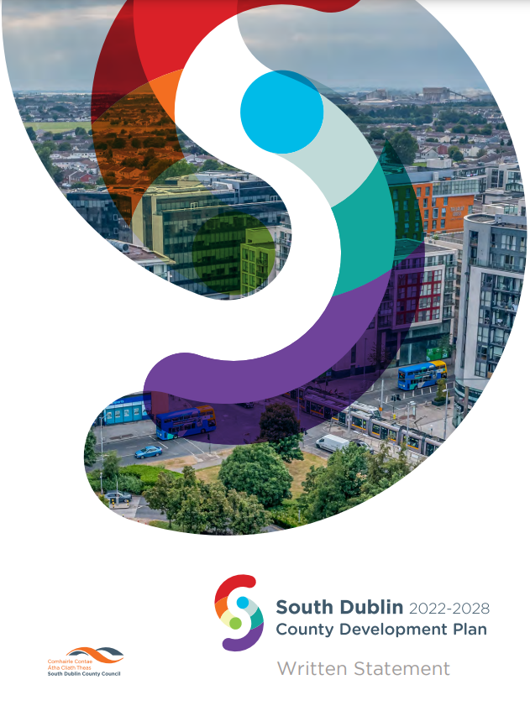
Development Plan Guidelines and the Annual Report
To assess the success with which the development plan is being implemented, the guidelines state that planning authorities will need to establish a frequent, reliable and ongoing monitoring system for their development plan as a permanent function.
The monitoring task of the planning authority for its development plan comprises of two strategic monitoring elements:
(a) Core Strategy Monitoring (Annual)
(b) Plan Objectives Monitoring (including SEA Monitoring)
This presentation relates to Part A the Core Strategy Annual Monitoring Report.
The Development Plan Guidelines specifically set out that the Core Strategy Monitoring Report should be carried out Annually and sets out specific indicators which have formed the structure of this presentation.

Slide 3
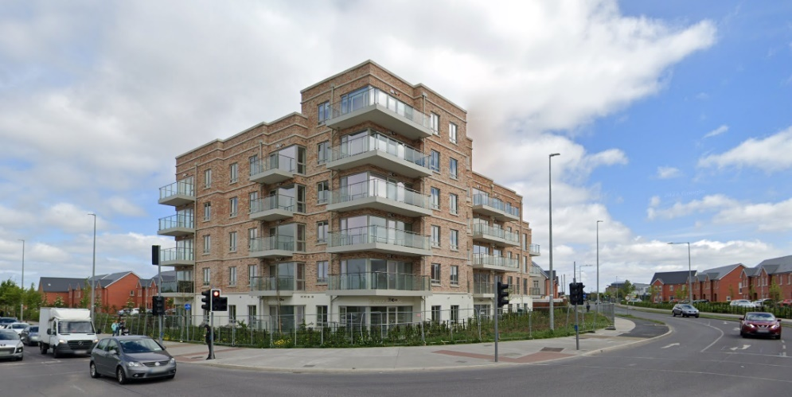
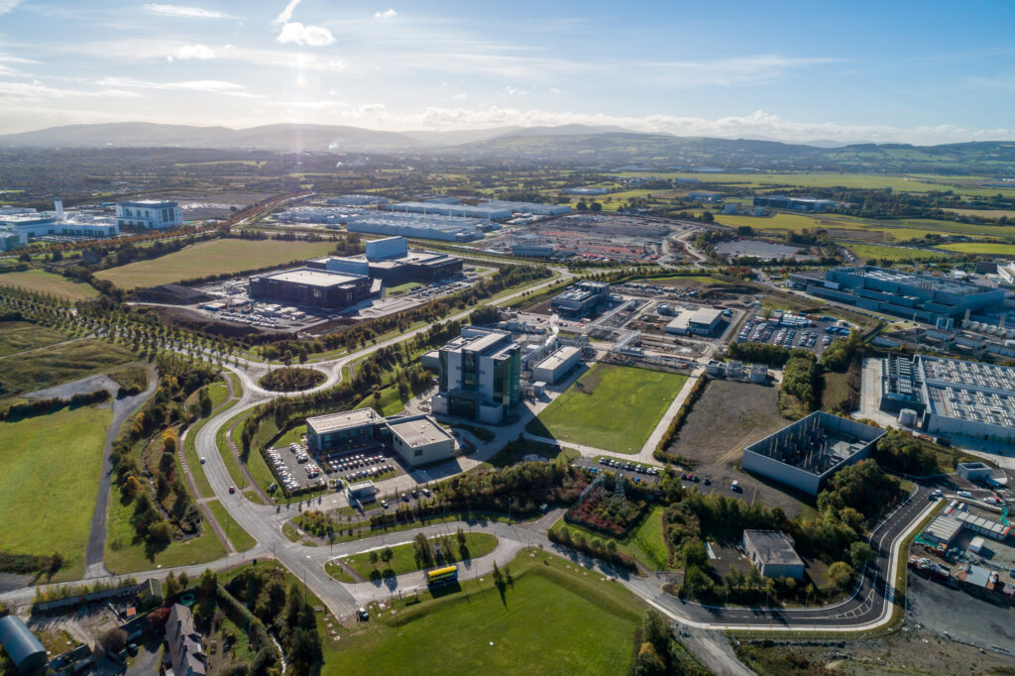
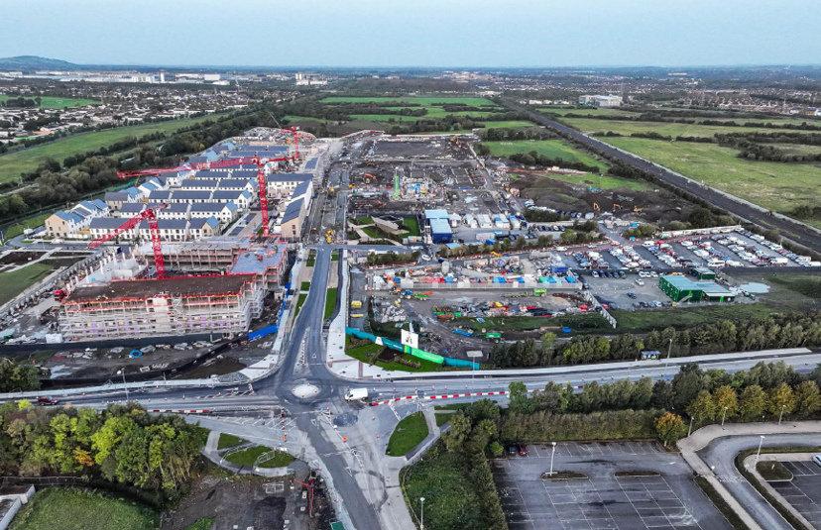
Presentation Structure
Part 1 Residential Monitoring
1.1 New home completions
1.2 New home completions per NPO 3
1.3 Planning permissions granted for residential development with:
1.4 Social and Affordable Housing Supply Pipeline during the plan period
1.5 The breakdown by relevant rural area type of rural housing:
Part 2 Commercial Monitoring
2.1 Developed and occupied commercial floorspace
2.2 Planning permissions for business/employment
Part 3 Settlement Consolidation Sites

Slide 4
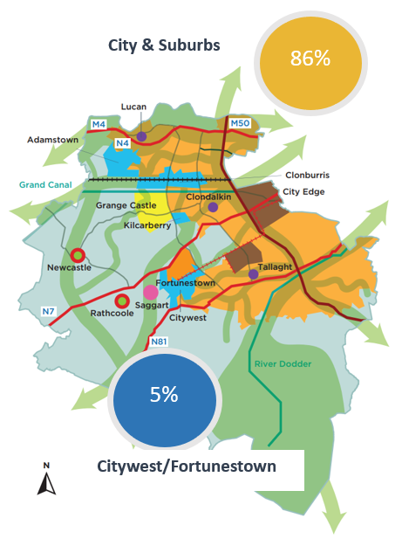
Part 1 Residential Monitoring
1.1 The Development Plan was adopted in June 2022 and came into effect in August 2022. Combining both private and public housing delivery for the period end of Q2 2022 to the end of Q2 2023 a total of 2,245 units were delivered across the County during this period.
The County Development Plan Core Strategy set out an overall target of delivering 15,576 units over the plan period. Overall unit delivery within year 1 of the plan equates to 14% of the target set out in the plan as set out in the Table below.
Neighbourhood Area | Target 2022 - 2028 Units | Q2 2022 - Q2 2023 | Percentage of Target Delivered | Remaining Units
 |  | Units Completed
Tallaght | 1865 | 71 | 4% | 1794
Naas Road/City Edge | 1010 | 0 | 0% | 1010
Templeogue/Walkinstown/Rathfarnham | 1677 | 642 | 38% | 1035
Clondalkin, Clonburris, Grangecastle | 5189 | 554 | 11% | 4635
Lucan/Adamstown/Palmerstown | 2673 | 669 | 25% | 2004
Citywest | 2113 | 112 | 5% | 2001
Newcastle | 398 | 157 | 39% | 241
Rathcoole | 487 | 1 | 0% | 486
Saggart | 165 | 0 | 0% | 165
One Off Infill Houses |  | 39
Total | 15577 | 2245 | 14% | 13371
1.2 It is an objective of NPO3 of the National Planning Framework to deliver at least 50% of all new homes in Dublin City and Suburbs within the existing built-up footprint.

Slide 5
Part 1 Residential Monitoring
4530Units
1.3 Planning Permissions Granted for residential development during the first year of the plan:
44%
56%
SDCC House Count Data indicates the following:
Housing Units
Apartments
 | Q2 2022 - to Q2 2023 Core Strategy Neighbourhood Areas | Units Permitted | Housing Units Permitted | Housing Mix |  |  |  |  |  | Apartment Units Permitted | Apartment Mix
Sites |  | Units |  | studio | 1-bed | 2-bed | 3-bed | 4-bed | 5-bed |  | studio | 1-bed | 2-bed | 3-bed | 4-bed | 5-bed
10 | CITYWEST NEWCASTLE SAGGART RATHCOOLE | 769 | 176 | 0 | 0 | 47 | 120 | 9 | 0 | 593 | 0 | 150 | 365 | 78 | 0 | 0
14 | CLONDALKIN CLONBURRIS GRANGECASTLE | 1183 | 374 | 0 | 6 | 15 | 295 | 42 | 0 | 809 | 0 | 207 | 378 | 140 | 0 | 0
15 | LUCAN PALMERSTOWN ADAMSTOWN | 1842 | 928 | 0 | 1 | 141 | 608 | 176 | 0 | 914 | 9 | 304 | 413 | 188 | 0 | 0
9 | TALLAGHT | 674 | 441 | 0 | 1 | 3 | 404 | 33 | 0 | 233 | 0 | 21 | 165 | 47 | 0 | 0
19 | TEMPLEOGUE WALKINSTOWN RATHFARNHAM | 62 | 57 | 0 | 10 | 17 | 22 | 7 | 1 | 5 | 0 | 4 | 1 | 0 | 0 | 0
0 | Naas Road | 0 | 0 | 0 | 0 | 0 | 0 | 0 | 0 | 0 | 0 | 0 | 0 | 0 | 0 | 0
67 | Totals | 4530 | 1976 | 0 | 18 | 223 | 1449 | 267 | 1 | 2554 | 9 | 686 | 1322 | 453 | 0 | 4530

Slide 6
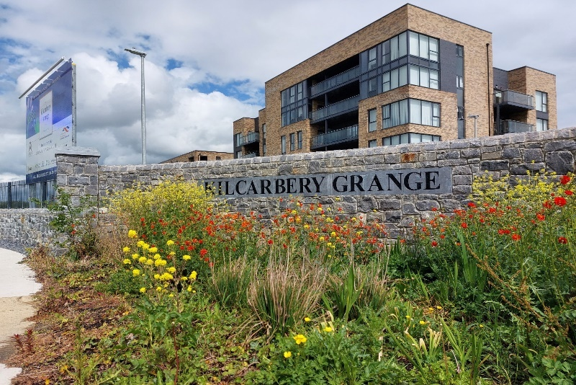
Part 1 Residential Monitoring
1.4 Social and Affordable Housing Supply Pipeline during the plan period
In addition to the above private housing developments there are a number of Social and Affordable Housing Developments which have been permitted through the Part 8 process and which are either under construction or at detailed design/preliminary construction stage.
Neighbourhood Area | Scheme Name | Part 8 Units Approved | Houses | Apartments
Tallaght | Oldbawn | 12 | 8 | 4
Clondalkin | Grand Canal Lindis Farne | 28 | 24 | 4
Clondalkin | Clonburris SDZ | 118 | 22 | 96
Clondalkin | Clonburris SDZ | 263 | 129 | 134
Total |  | 421 | 183 | 238
Other Live Part 8s
Templeogue Walkinstown | Homeville (2019) | 16 | 7 | 9
Clondalkin | Eircom Site Nangor Road (2019) | 93 | 15 | 78
Total |  | 109 | 22 | 87
Combined Total Potential |  | 530 | 205 | 325
39%
61%
Houses
Apartments
1.5 Rural Housing
South Dublin County Council made decisions on 5 planning applications for rural dwellings during the period Q2 2022 to the end of Q2 2023. 1 planning application was granted planning permission and 5 were refused permission.
Notes:
Table below sets out that there have been 421 Units permitted through the Part 8 process during the first year of the plan broken down into 183 Housing Units and 238 Apartments. In addition to these developments there are two sites which were previously permitted through the part 8 process which are due to commence works in 2024 totalling 109 Units (22 houses and 87 apartments), providing an overall potential pipeline of 530 social/affordable units with housing units making up 39% and Apartments making up 61% of this unit pipeline.

Slide 7
Part 2 Commercial Monitoring
2.1 Developed and occupied commercial floorspace
In order to decipher the level of developed and occupied commercial floorspace within the County from the end of Q2 2022 up to the end of Q2 2023, the postal service Geo-directory spatial dataset was used to identify all registered commercial buildings which had been identified as new additions during this period.
Industry Type | Floor Area (Sqm)
Light Industry | 42,983
Logistics | 48,649
Office/Service Industry | 18,512
Storage/Warehousing | 14,672
Retail Distribution | 88,025
Retail Sales (Includes general retail/cars sales etc | 10,698
Data Centre | 6,681
Total | 230,220
38%
21%
19%
Retail Distribution
Logistics
Light Industry
This table provides details in regard to the floor area of the developed and occupied commercial floorspace for each industry type identified totalling 230,220sqm.
Notes:
From a spatial perspective the analysis carried out identifies that 90% of light industry delivered was located within the Citywest/Saggart/Rathcoole Newcastle (CSRN) Neighbourhood Area at Greenougue. In regard to the Logistics Industry 78% of the buildings identified were also located within the CSRN Neighbourhood Area. This neighbourhood area also accounted for 67% of buildings identified as Retail Sales Industry Type. Within the retail and retails sale category the Naas Road/City Edge and Tallaght Neighbourhood areas accounted for 83% of the buildings delivered and occupied within the County.

Slide 8
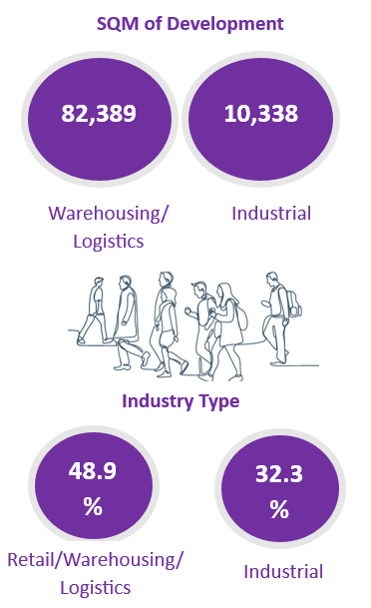
Part 2 Commercial Monitoring
2.2 Planning permissions for business/employment uses (m2 of development) for:
(i) Office, (ii) Industrial, (iii) Retail, (iv) Warehousing/Logistics
Since the adoption of the Plan South Dublin County Council have been maintaining a manual dataset relating to permissions for business/employment uses and the sqm of development permitted. The data set includes details of all development types in the County and from a monitoring perspective categorises all commercial permissions into the four identified categories of Office, Industrial, Retail and Warehousing/Logistics.
Industry Type | Total sqm of Development | SQM | Development Type (No.) | Development Type
Data Centre | 62,337 | 37.1% | 11 | 11.5%
Industrial | 10,338 | 6.1% | 31 | 32.3%
Office | 4,893 | 2.9% | 7 | 7.3%
Retail | 8,243 | 4.9% | 25 | 26.0%
Warehousing / Logistics | 82,389 | 49.0% | 22 | 22.9%
Totals | 168,199 | 100.0% | 96 | 100%
Notes:
Note: There were a further 112 planning applications relating to employment type developments which do not fall within the identified development types. Such permissions can relate to schools, healthcare, signage, childcare, telecommunications etc and accounted for a total floor area of 61,000 sqm.

Slide 9
Part 3 Settlement Consolidation Sites
High Level Overview Table of progression of Strategic Development Areas
For the purposes of this monitoring report such sites are considered to align with the identified Strategic Development Areas as set out in the Regional Spatial and Economic Strategy for the Eastern and Midland Region which within South Dublin relate to:
Adamstown SDZ,
Clonburris SDZ,
Tallaght Town Centre,
Naas Road/City Edge
Fortunestown Area.
Category | Adamstown | Clonburris | City Edge | Tallaght | Citywest/Fortunestown | Kilcarbery | Grangecastle
Enabling Infrastructure | Majority of main Infrastructure delivered DART + SW under consultation via Railway Order process | Dart+ SW will serve the new community at Clonburris with more regular trains and quicker journey times. Kishouge Station Opening 2024 | Engagement with NTA to progress public transport and active travel initiatives for City Edge. | SDCC has been progressing a number of Council led schemes within the Tallaght LAP development area. | Citywest Neighbourhood Park will enhance the open space and Green Infrastructure offering. Citywest junction link at Tallaght/Fortunestown LUAS has now been completed. | LIHAF Funding infrastructure Access Road Spine Road Joint Venture, Junction 1 and 2. Final Sections to be completed Mid 2024 | Grange Castle West Access Road Complete. €13 million investment including full services
Permissions Granted | Total Units 2967 930 Units permitted and Under Construction 2037 Units Permitted not commenced | 569 | 163 | 1918 | 2,378 | 1,133 | 11 grants of planning permission within Grangecastle since the plan has been adopted providing for a total of 102,000sqm.
Units Constructed | 1949 Units Constructed | 0, 115 units permitted and under construction. 415 Units permitted but not commenced. | 0 (163 Under Construction) | 32 (1095 permitted and under construction) | 1,345 Units constructed within the LAP Area. 2,378 Units permitted with 912 under construction and 1466 units permitted and yet to commence. | 285 Unit Constructed, 309 permitted and under construction. 539 Units permitted not commenced | N/A
Funding Applications Made | The €9.997 million in URDF funding announced will provide for public infrastructure and amenities that will facilitate the development of the Adamstown Town Centre | €186.3 Million allocated under URDF call 2 | URDF drawdown of €920,000 by SDCC/DCC to fund preparation of Strategic Framework, fully complete, with 25% match funding provided. | URDF Funding obtained c.€32 million with a further 25% funding by South Dublin County Council. | N/A | N/A | N/A
Project Timelines | Currently within Phases 6 of the SDZ Planning Scheme. | Phased in accordance with SDZ Planning Scheme | City Edge Strategic Framework published in August 2022, setting out the long term vision for the area to 2070. | Works underway and nearing completion. Tallaght Public Realm, Transport interchange, Affordable Housing, Contractor Appointed, 4Th Stand, Innovation Centre – Nearing Completion | The vast majority of the zoned residential lands within the LAP area are expected to be completed during the life of the current County Development Plan. | 2021 - 2025 | N/A

