Slide 1
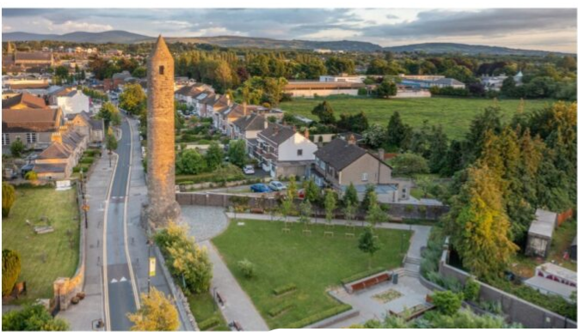


2nd Round of Public Consultation
North Clondalkin ACM 27th February 2024

Slide 2
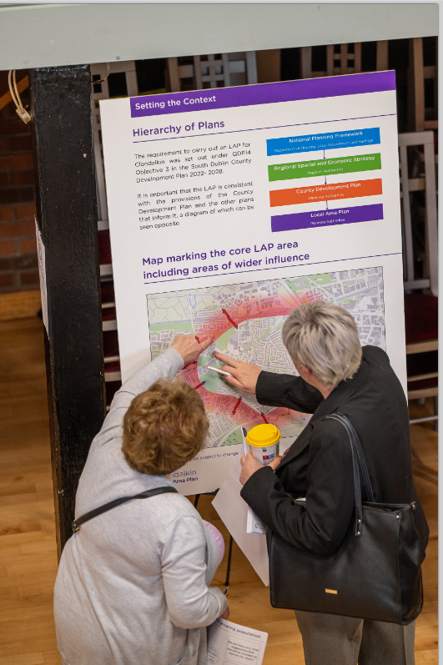
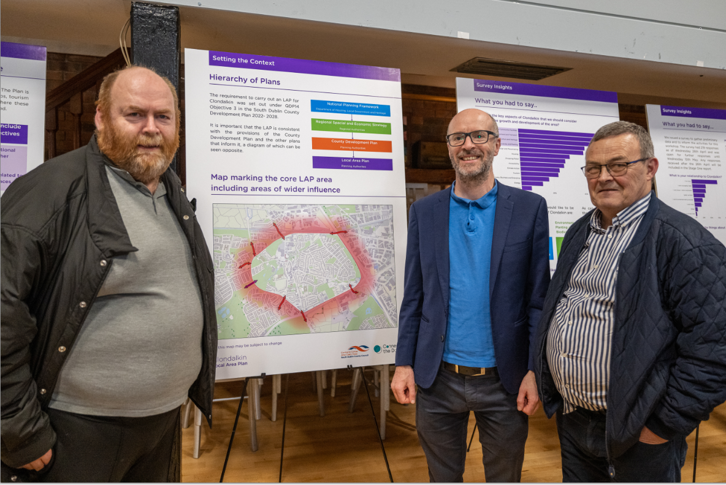
Clondalkin LAP preparation: 1st round Public Consultation
A first round of public consultation took place in March-May 2023
The Key issues raised by the public and the community related to:
Movement and traffic including accessibility and need for improved public transport and active travel
Desire to protect Cultural and Built Heritage
Concerns for the Environment, biodiversity and Planting
Desire for more social and community facilities
Concerns about inappropriate and over development
1. Movement and Transport
2. Social and Community Facilities
3. Culture and Heritage
4. Environment, Biodiversity and Planting
1. Movement and Transport
2. Social and Community Facilities
3. Culture and Heritage
4. Environment, Biodiversity and Planting
Notes:
Almost 13,000 in the study area total.

Slide 3
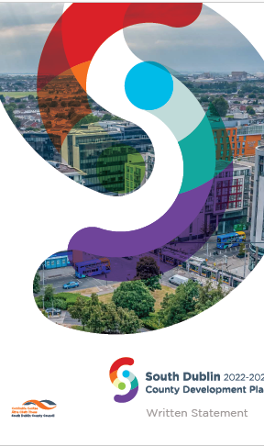
Informing Public Consultation – 2nd Round
Development Plan Objective:
A vision for the development of Clondalkin
Wider urban design principles
Framework plans for larger infill sites
A Conservation Plan
A local Green Infrastructure strategy derived from the County GI Strategy
Transport movement study
Notes:
Almost 13,000 in the study area total.

Slide 4
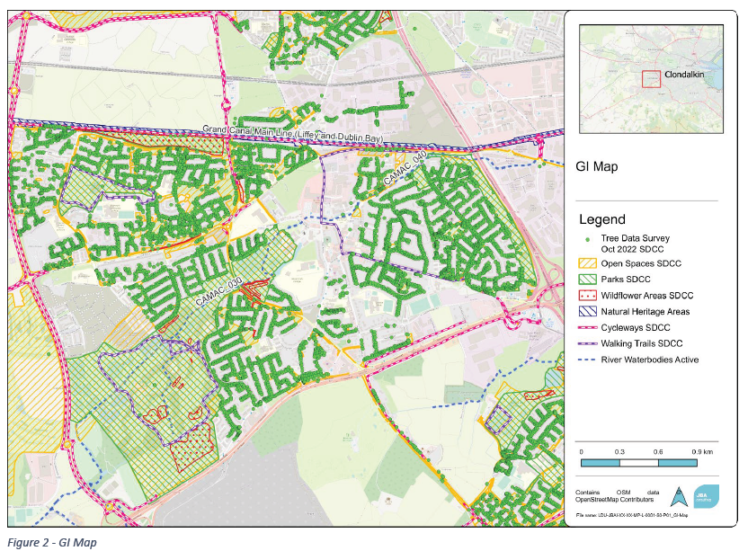
Informing Public Consultation
Urban Design Consultants OMP were appointed and have carried out an initial baseline study including a SWOT analysis. The principles for development of the identified Framework sites are being considered.
Conservation architects have been employed and have been on site in Clondalkin, identifying important heritage buildings and structures. They have made initial recommendations for the draft LAP with work on-going.
The urban design team includes expertise in green infrastructure to ensure that it is incorporated into the LAP and urban design
Environmental Consultants – SEA and AA
1. Movement and Transport
2. Social and Community Facilities
3. Culture and Heritage
4. Environment, Biodiversity and Planting
1. Movement and Transport
2. Social and Community Facilities
3. Culture and Heritage
4. Environment, Biodiversity and Planting
Notes:
Almost 13,000 in the study area total.

Slide 5
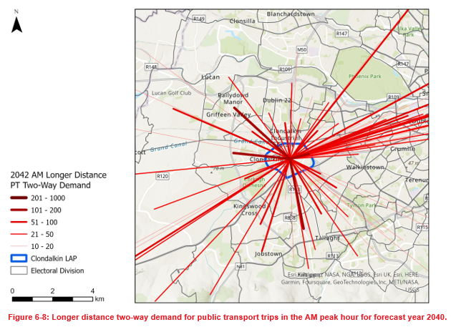
Informing Public Consultation
Transport Consultants
ARUP were appointed to deliver a movement strategy with the aim of maximising sustainable movement within and around the village.
Demand analysis has included traffic surveys which were conducted in October2023 to inform early baseline work.
Options around the routing of active travel schemes through the village are being investigated
1. Movement and Transport
2. Social and Community Facilities
3. Culture and Heritage
4. Environment, Biodiversity and Planting
1. Movement and Transport
2. Social and Community Facilities
3. Culture and Heritage
4. Environment, Biodiversity and Planting
Notes:
Almost 13,000 in the study area total.

Slide 6
Public Consultation - Scenario Approach
Three scenarios have been developed with the purpose of discussing high level options for the future development of the village. These are not set in stone but serve only to enable the conversation. These are broadly as follows.
What if we Emphasise Local Vitality:
Growing Clondalkin in a way that makes it easier to use. We focus on access to and from the town centre. This will require improved permeability, legibility, appropriate density, more connections and more access for pedestrians and cyclists
What if we Emphasise a Healthy Environment
Growing Clondalkin in a way that supports activity and access to public amenities , supporting a healthy environment for people and biodiversity. This will mean examining existing amenities, providing new open spaces for a growing population and protecting and enhancing green infrastructure.
What if we Emphasise the Heritage of the Village
Growing Clondalkin in a way that ensures ongoing protection of Clondalkin’s heritage assets whilst supporting the vitality and vibrancy of the village
:

Slide 7
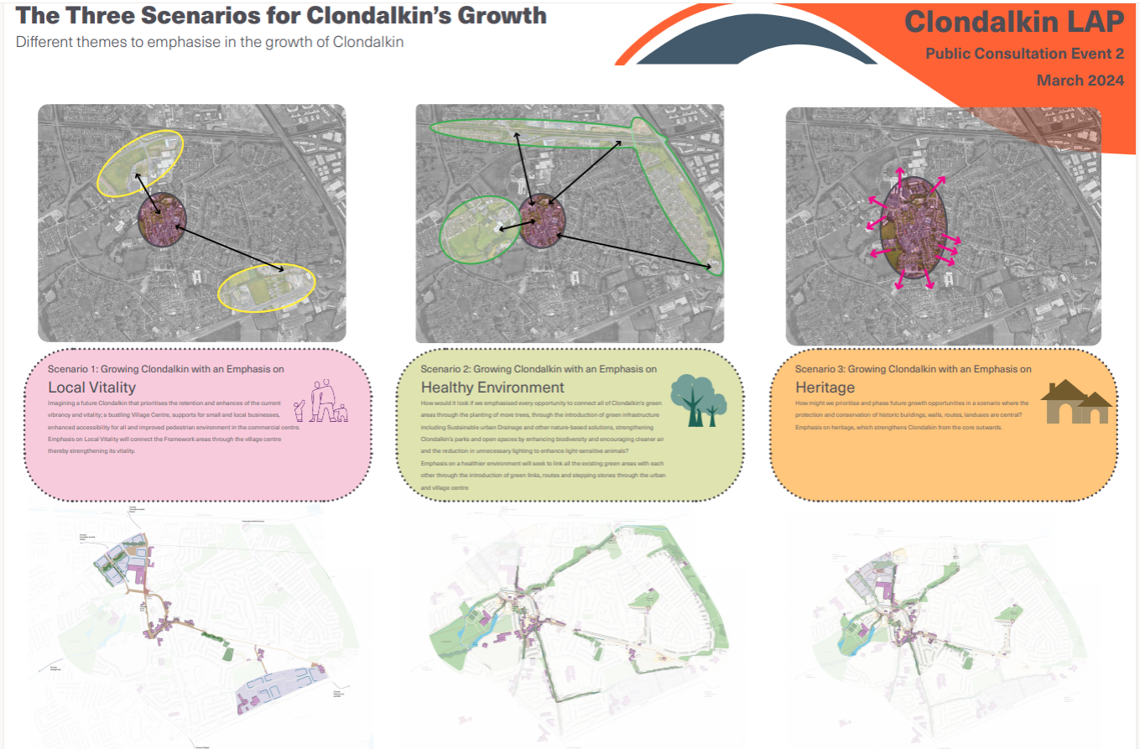

Slide 8
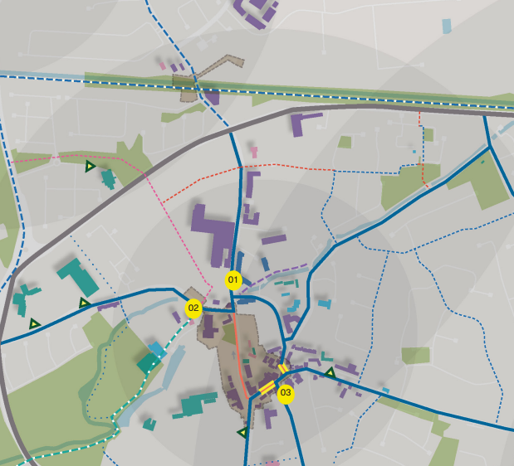
Village Enhancement Schemes
Each Scenario will include an option for a village enhancement scheme:
The Ninth Lock Road Streetscape Improvement; SDCC Public Realm Reconfiguration to provide more active frontage
Adaptive re-use of protected former RIC Barracks building on Old Nangor Road
Historic Junction Reconfiguration and Public Realm at the Laurels

Slide 9
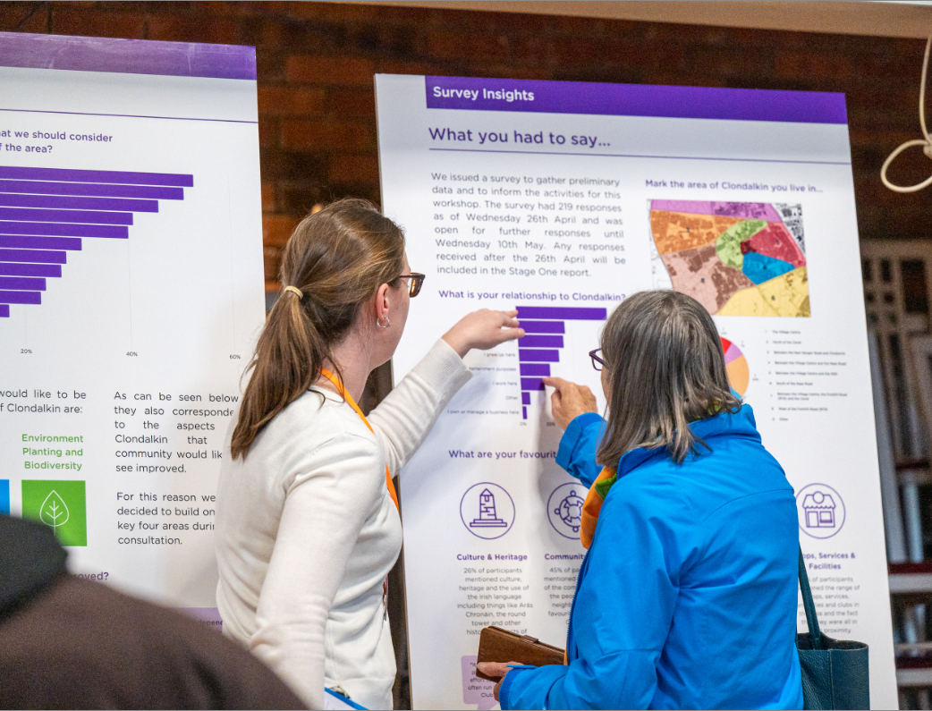
2nd Round Public Consultation - Events
Public Consultation using scenarios as a way of looking at priorities for growth will commence on 29th February
Workshop with schools on 22nd February
Online survey with accompanying video, leaflet and issues paper will be available on SDCC portal 29th Feb – 28th March
Round table workshops will be held as follows:
The Round Tower Centre, Clondalkin 7th March 7.00- 8.30pm &
Aras Chronain , Watery Lane, Clondalkin on 13th March 7-00-8.30pm

Slide 10
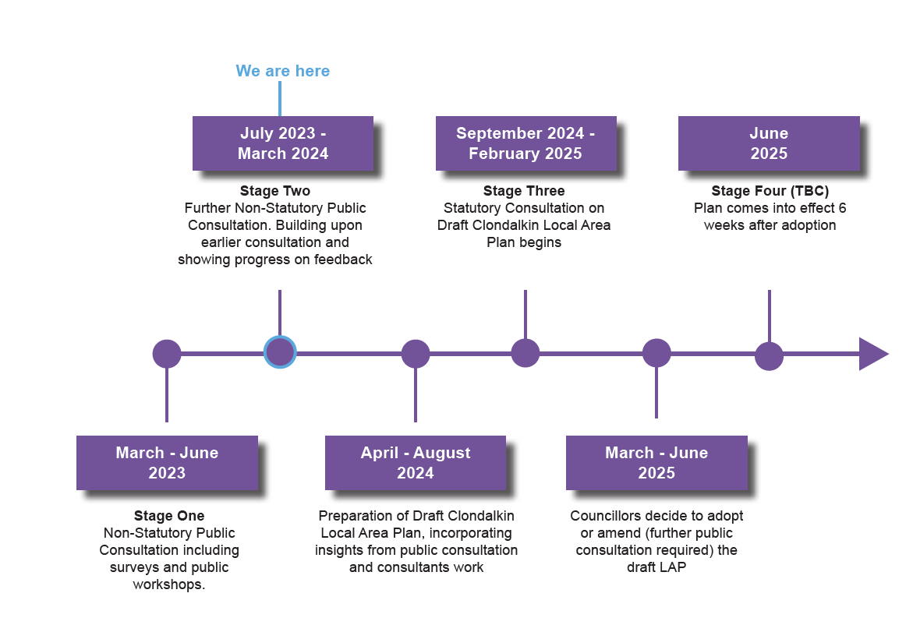
LAP TIMELINE

