Slide 1

Brine Saturation Facility
Part VIII Report – For Noting
Lucan / Palmerstown / North Clondalkin Area Committee Meeting
27/02/2024
Notes:
Sign in sheet

Slide 2

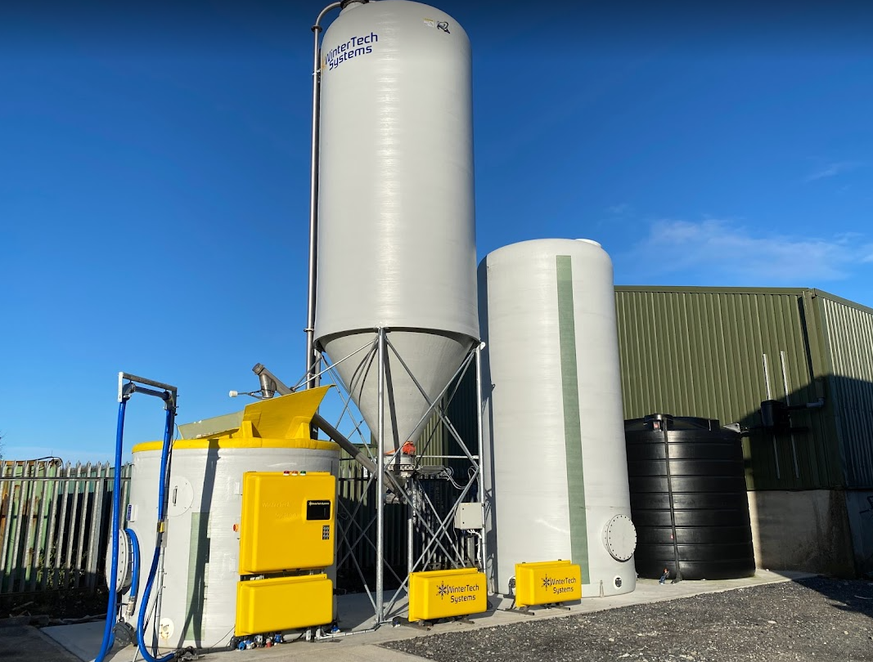
Context
SDCC wish to convert our winter maintenance process from dry treatment (rock salt) to pre-wet treatment (brine)
To enable this conversion we require a Brine Saturation Facility to be constructed beside the existing salt barn at our Palmerstown Depot
This facility requires Part VIII Planning Permission
Brine Saturation facility – Westmeath Co Co

Slide 3
What is Brine
Brine is a solution consisting of salt and water that is used in conjunction with rock salt for the treatment of roads during cold periods
Benefits of Brine
  Provides a faster acting treatment
  More efficient use of salt, can spread less while getting the same result
  Less salt wasted through bounce off
  Environmental benefits through less salt being spread
  Increases residual salt on the road

Slide 4
Project Proposal
The facility will consist of;
Rainwater harvesting tank with back up mains feed
Brine storage tank
Salt Silo
Brine Saturator
The whole facility will be constructed on a raised concrete plinth.
A cesspool will be constructed to store any brine run-off.
Brine Saturation facility – Westmeath Co Co

Slide 5
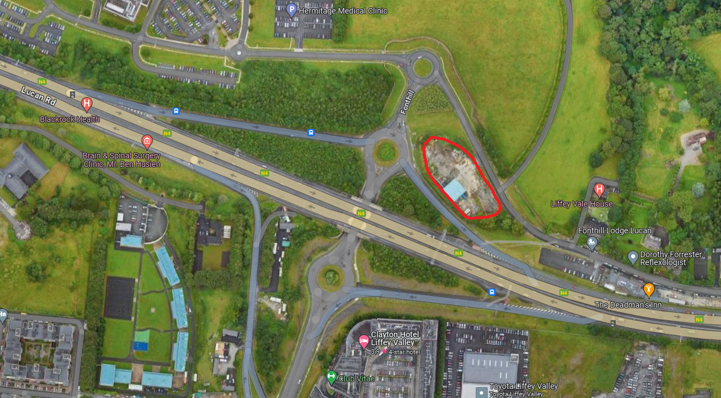
Site Location

Slide 6
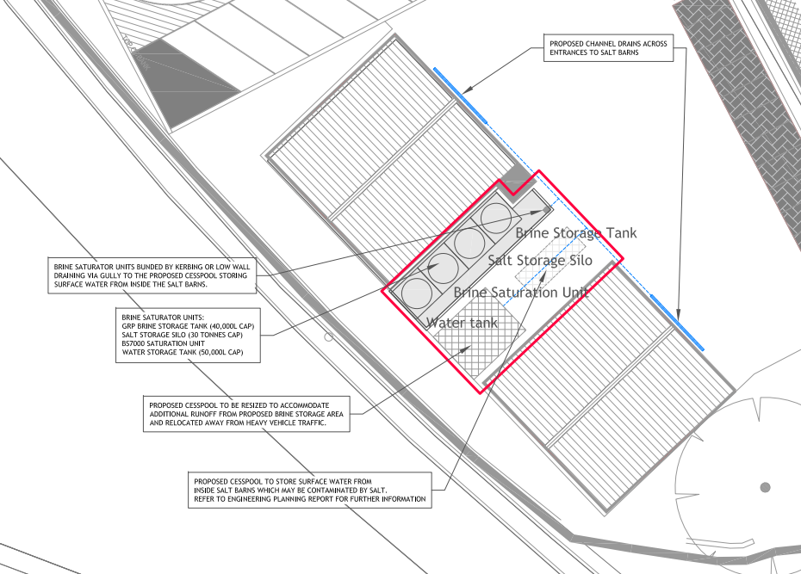
Site Location
Site has Part VIII approval for a mechanical depot to be constructed, this proposal is designed to have no impact on the delivery or functionality of that project

Slide 7
  Statutory Consultation
  21/12/2023 – 15/02/2024
Presentation at December ACM
Legal Notices erected on site
Newspaper Advertisement (The Echo)
Notification to prescribed bodies, access groups and local schools.
Regular Social Media Posts.
  Submissions
Zero submissions were received as part of this Part VIII Public Consultation

Slide 8
Recommendation
It is recommended that Part VIII approval is granted for the construction of a Brine Saturation Facility at the existing Salt Depot at the Old Dublin Road, Dublin 20.

