Slide 1
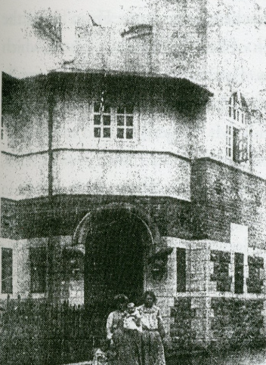
Clondalkin Library

Slide 2
Access Improvement and Refurbishment Works
Build a lift-block on the west elevation, providing universal access to both floors
Restore the first floor to full space, moving office space to ground floor
Restore entrance and remove internal porch (added in early 70s)
Restore/repair ground floor windows
Part 8 will be notified to AC in February and will launch in March, before going to Council for approval in July

Slide 3
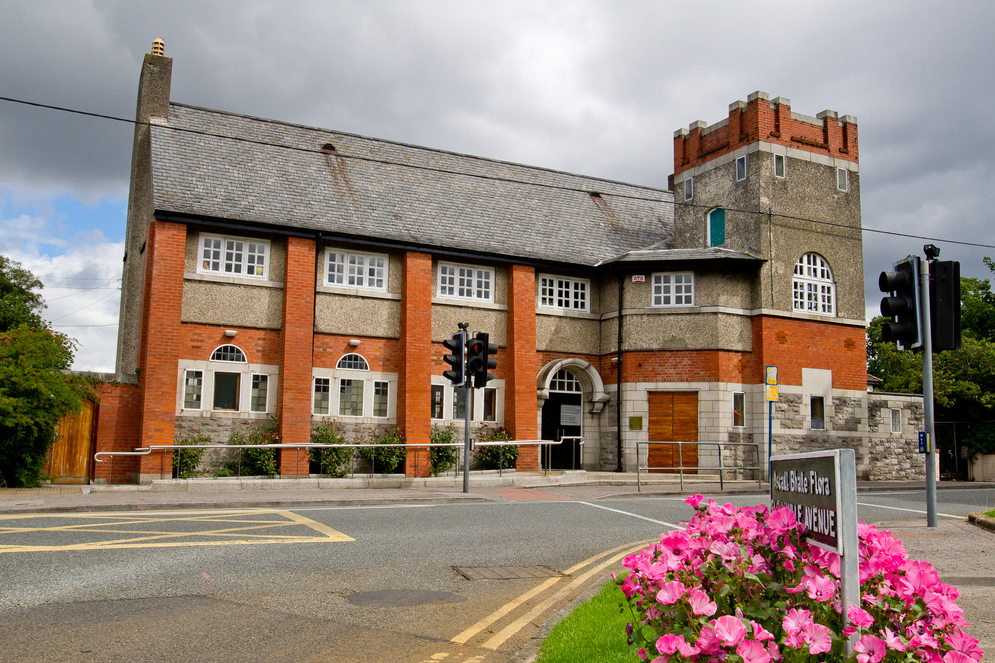

Slide 7
Changes inside…

