Slide 1
Castletymon Road South Castletymon Road Active Travel Scheme
ACM February 2024 - Part 8 Public Consultation

Slide 2
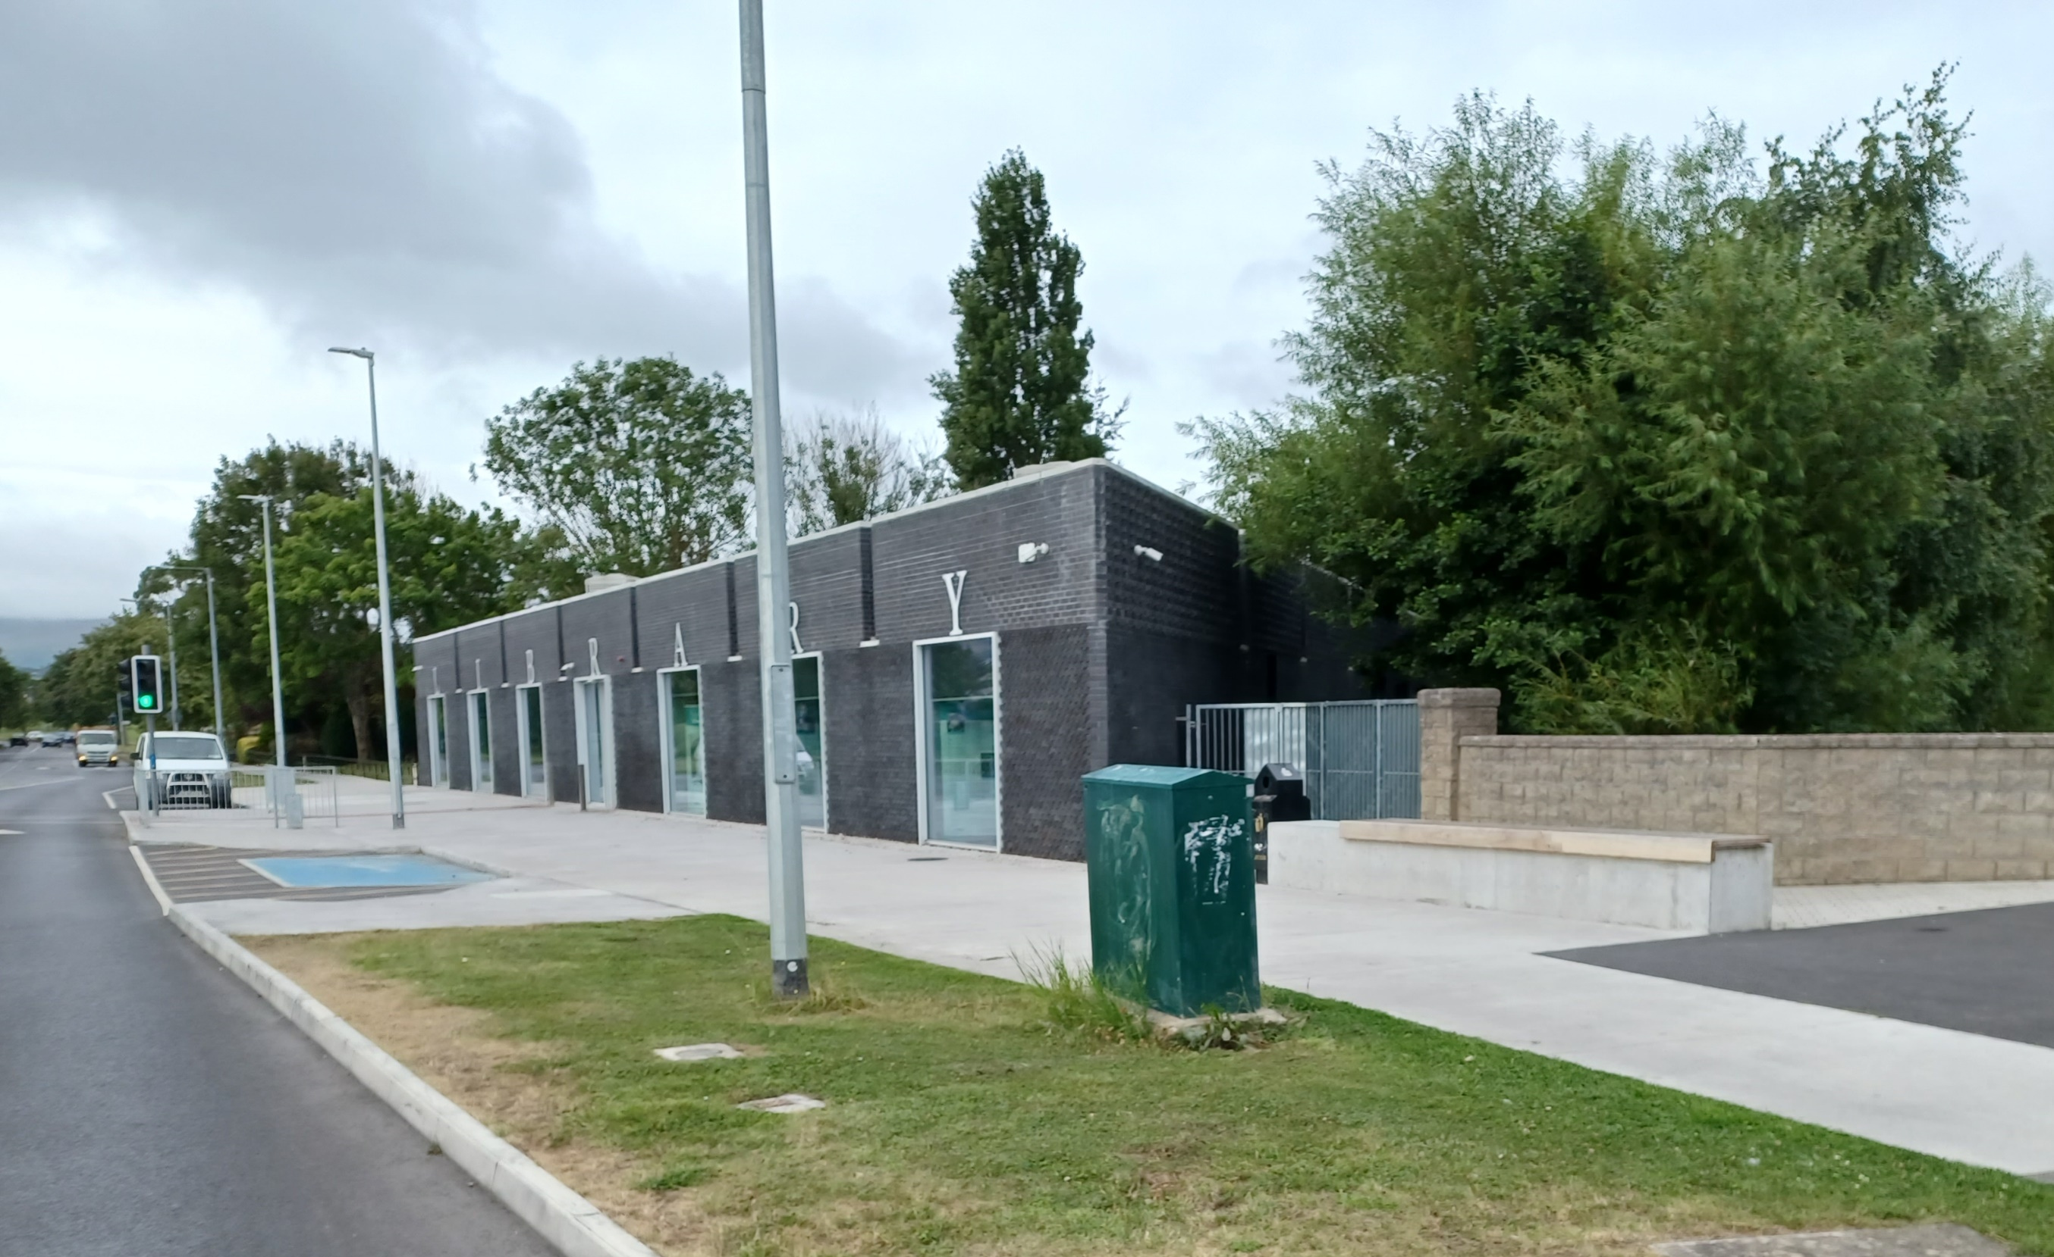
Project Overview
Castletymon Road Active Travel Scheme: Castletymon Road South
WHERE: Castletymon Road, Tallaght
WHY: The existing road has no cycle and minimal walking facilities for the community to access Bancroft Park and Tymon Park, Castletymon Library, Castletymon District Centre, and/or Local Area Schools. The proposed scheme aims to remedy this by creating an environment where all travel models can move safely and efficiently in the Castletymon area and be able to access all local amenities
WHAT: 1km walking and cycling facilities, junction amendments, and traffic calming measures along Castletymon Road, from Main Street to Castletymon Road Library.
HOW: Public Consultation as required by Part 8, Article 81 of the Planning and Development Regulations 2001 (as amended). Drawings and details on how to make a submission https://consult.sdublincoco.ie/
WHEN: The consultation closes on April 10th, 2024
Notes:
Castletymon Road is the main link for the Tymon area, connecting to the Tymon neighbourhoods to the wider area. The existing road has no cycle facilities and minimal walking facilities for the community to access Bancroft Park and Tymon Park, Castletymon Library, Castletymon District Centre, and/or Local Area Schools. The proposed scheme aim to remedy this by creating an environment where all travel models can move safely and efficiency in the Castletymon area and be able to access all local amenities

Slide 3
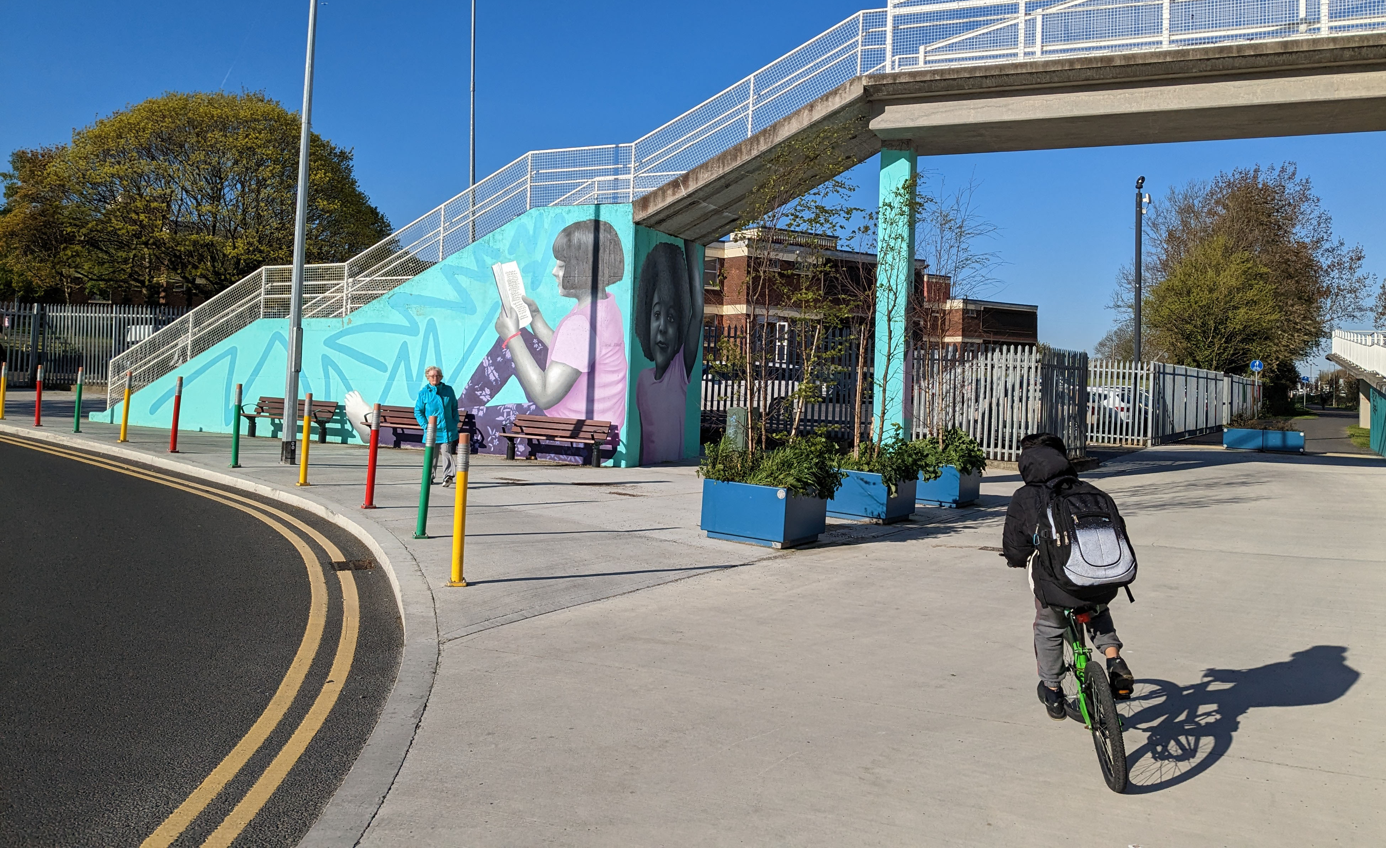
Consultation & Castletymon Road South
Castletymon Road Active Travel Scheme: Castletymon Road South
An informal consultation was held for the entire Castletymon Road Active Travel scheme from May 26th to June 30th, 2023.
While it was the intention to carry out the entire project in accordance with Section 38 of the Road Traffic Act 1994, the feedback received during informal consultation included design changes where a Part 8 planning would be advisable in the southern section, including changes to the boundary fences and works outside the road corridor.
Construction on Castletymon Road North began in October 2023 and will continue to progress under the Section 38.
As for Castletymon Road South, this statutory public consultation is being carried out per the Part 8, Article 81 of the Planning and Development Regulations 2001 (as amended) requirements.
The consultation closes 10th April 2024
Notes:
An informal consultation was held for the entire Castletymon Road Active Travel scheme from May 26th to June 30th, 2023. The feedback received during this process required a change in the scope of work to the southern section, it was determined necessary to divide the project into two sections. The two sections are Castletymon Road North and Castletymon Road South, with the Castletymon Shopping Centre as the dividing point
While it was the intention to carry out the entire project in accordance with Section 38 of the Road Traffic Act 1994, the change of scope in the southern section of Castletymon Road Active Travel Scheme, including the required changes to the boundary and open spaces determined a separate Part 8 process would be advisable.
Castletymon Road North will continue to progress under the Section 38 of the Road Traffic Act 1994, construction began in October 2023.
As for Castletymon Road South, this statutory public consultation is being carried out per the Part 8, Article 81 of the Planning and Development Regulations 2001 (as amended) requirements.

Slide 4
Context Map Castletymon Road South Active Travel Scheme

Slide 5
Key Feature/Changes
Castletymon Road Active Travel Scheme: Castletymon Road South
The equitable distribution of the road will allow 2-way traffic and for segregated cycle infrastructure from Main Street to the Castletymon District Centre.
Where side roads meet Castletymon Road, the junction will be improved to prioritize vulnerable road users (pedestrians and cyclists)
In order to preserve the existing on-street parking, the cycle track will be located on the verge between Main Road and Castle Park near St. Aengus' Church. The existing on-street parking in this location will be realigned into 9 parallel parking spaces.
The scheme will tie into the District Enhancement Scheme, requiring the relocation of 8 parking spaces outside the Castletymon Library.
In Castletymon Road South, the proposed designs will have minimal impact on the existing trees. 6 trees will be removed, and 18 trees are proposed.

Slide 6
Key Feature/Changes
Castletymon Road Active Travel Scheme: Castletymon Road South
School Improvements: There are proposed improvements at Scoil Aonghusa Junior and St Rose's National School campus and at Tallaght Community School Entrance. These improvements include widening footpaths, entrances, and other traffic calming and safe routes to school-style improvements.
Bus Stops on Castletymon Road will be aligned and upgraded to accommodate the new cycle tracks.
Proposed upgrades to the Main Road and Castletymon Road junction, to prioritise the safety of pedestrians’ and cyclists’ movements.
Please see the Drawing (Plans and Sections) and Artist Impressions, which can be found on the consultation page, for more information. https://consult.sdublincoco.ie/

Slide 7
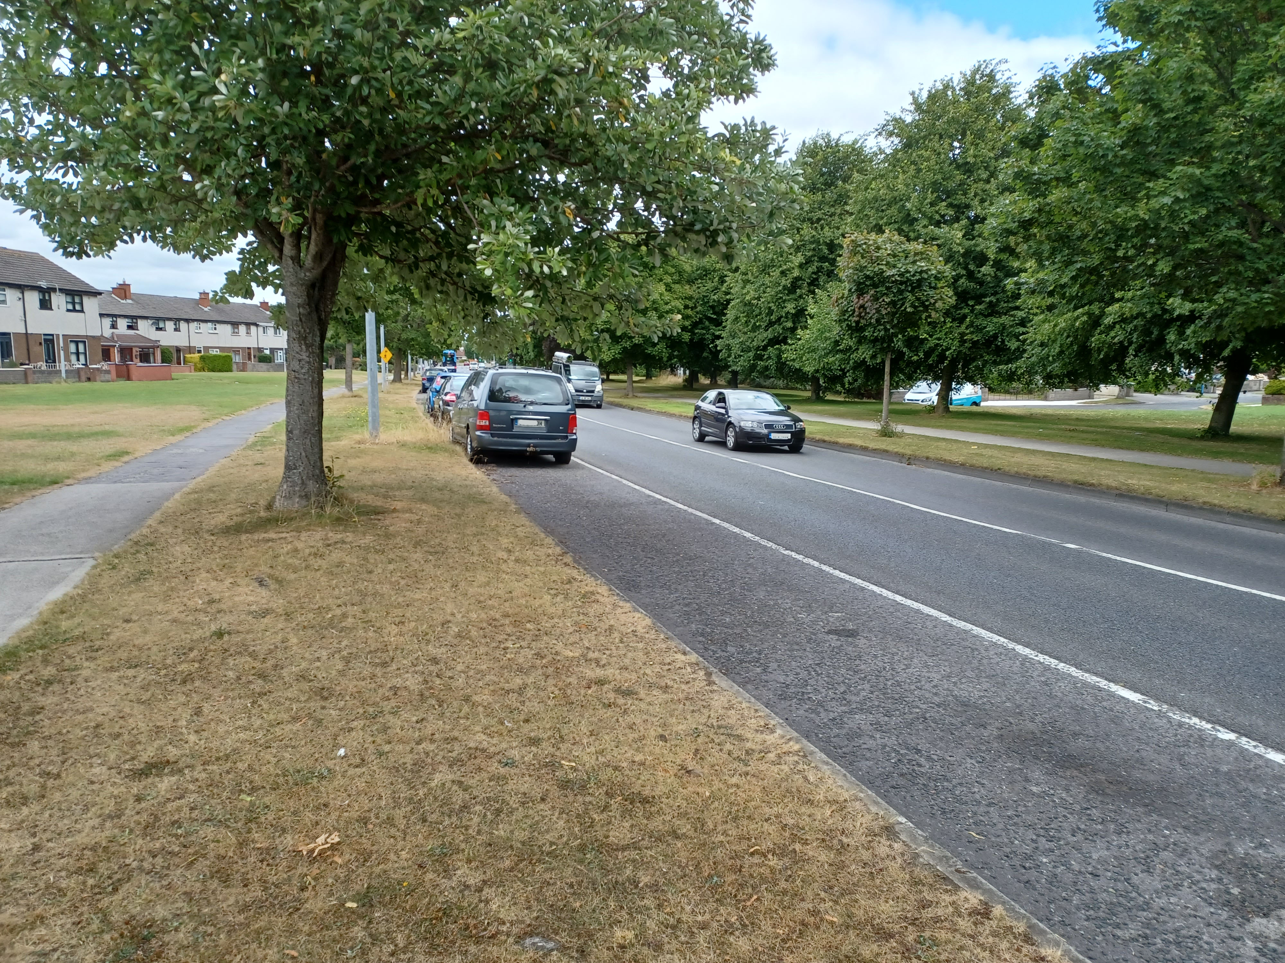
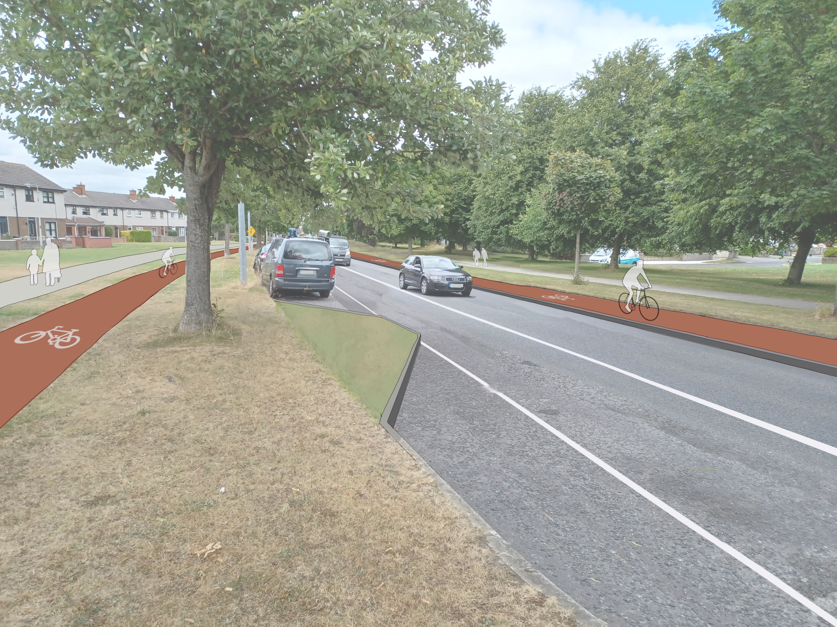
Artist Impression
Castletymon Road Active Travel Scheme: Castletymon Road South
Existing
Proposed

Slide 8
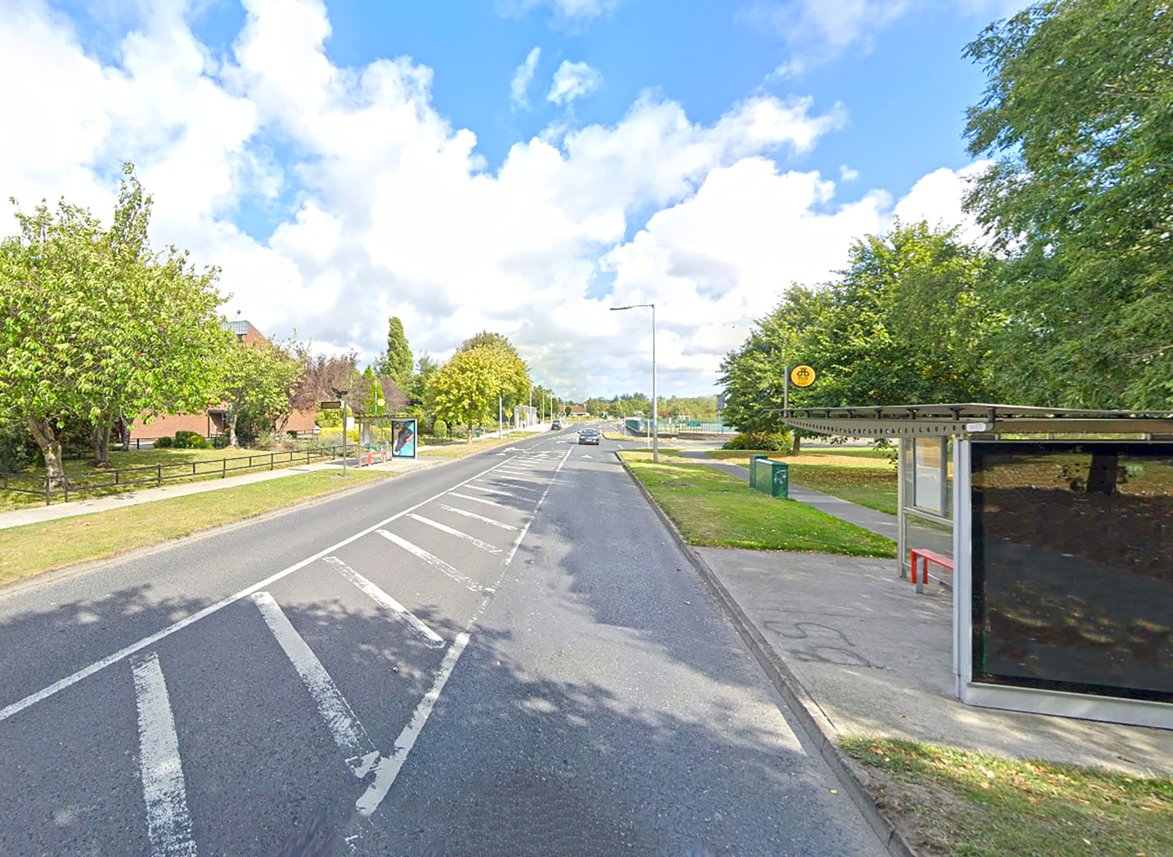
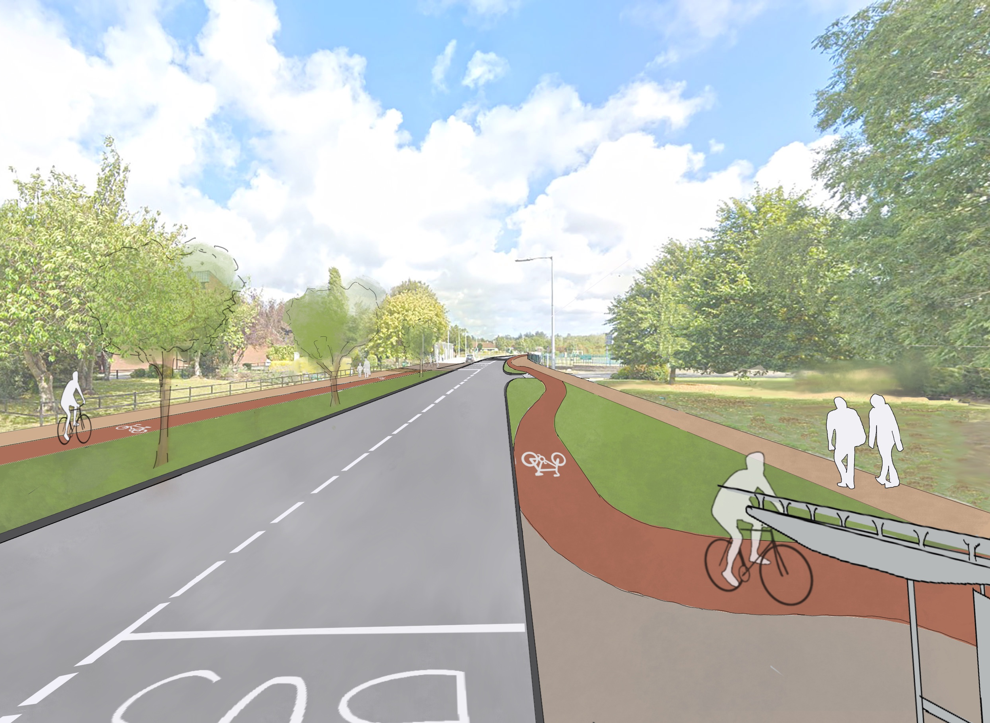
Artist Impression
Castletymon Road Active Travel Scheme: Castletymon Road South
Existing
Proposed

Slide 9
Sections
Castletymon Road Active Travel Scheme: Castletymon Road South

Slide 10
Sections
Castletymon Road Active Travel Scheme: Castletymon Road South

Slide 11
Next Steps
Castletymon Road Active Travel Scheme: Castletymon Road South
After the consultation, the SDCC Active Travel team will read and consider all the submissions. Below are the steps and timeline for the project:
The consultation closes 10th April 2024
April/May 2024: Incorporating feedback from the elected representatives, the community, and stakeholders.
Q3 2024: Present Report to Councillors
Q3/4 2024: Detailed design and procuring a contractor
Q4 2024: Construction to begin
Q2/3 2025: Construction to finish
Notes:
After the consultation period closes, a report will be presented to the South Dublin County Councillors. This report contains, amongst other items, a list of the persons or bodies who made submissions, along with a summary of the issues raised by them and the chief executive’s response.
Following consideration of the report, the scheme may be carried out as recommended in the report, or the Councillors, by resolution may decide to vary, modify or not proceed with the proposed scheme.

