Slide 1
Bawnogue Shopping Centre Carpark
Taking In Charge
February 2024

Slide 2
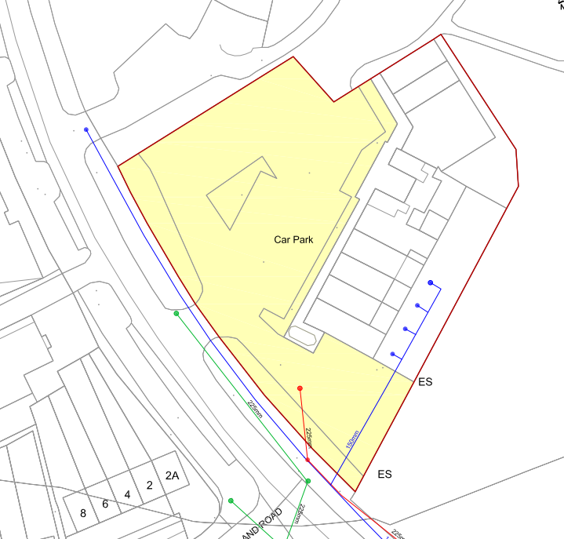
Site Location

Slide 3
Background
SDCC developed proposals for Bawnogue District Centre Enhancement Scheme (DCEP)
Carpark is registered to Bawnogue Shopping Centre Management Limited which is no longer operating.
Clear from feedback from locals and traders that there is a desire locally to address issues with carpark.
Potholes
Walls
Lighting etc.
DCEP Scheme benefits greatly by incorporating carpark into scheme
Public utility
Displacement of on street parking
Safe creche drop off
Lighting to deter anti-social behaviour

Slide 4
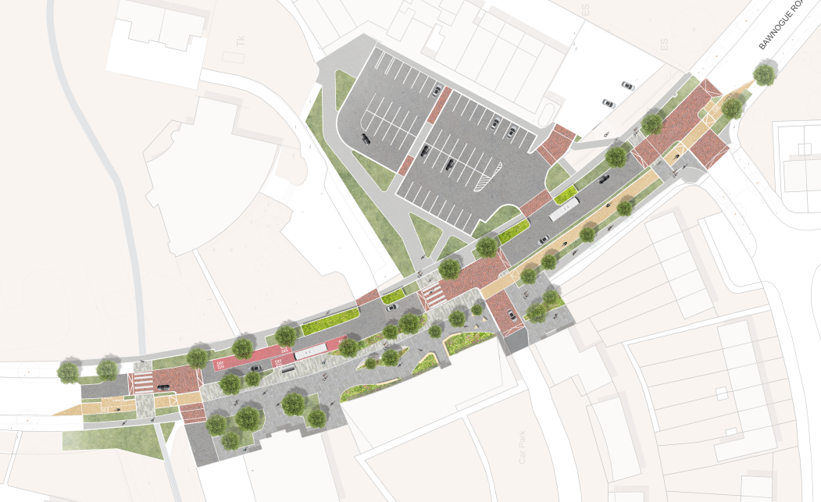
District Centre Enhancement Scheme
Part 8 Approved at February 2024 full council meeting
Works to carpark shown in DCEP approved scheme are contingent on TIC of carpark.

Slide 5
TIC Public Consultation Process
02/11/2023 – 14/12/2023
Non- Statutory Actions
Engagement with Traders in Advance of Launch (Informal)
Presentation at October ACM
Corriboard Signage Erected Locally
Social Media Posts
Statutory Actions
Newspaper Advert (The Echo)
Creation of a Consultation Portal
1 Submission received supportive of TIC

Slide 6
Submission
Submission Requested Following;
Repair Potholes
Modernise Shop Fronts
Remove the Second Storey of the Building
Review Location of Pedestrian Crossing

Slide 7
Recommendation
That the proposal to Take in Charge the open spaces, sewers, watermains, storm drains and public lighting within the attendant ground of Bawnogue Shopping Centre Carpark shall be considered by the Full Council at the March 2024 meeting.

