Slide 1
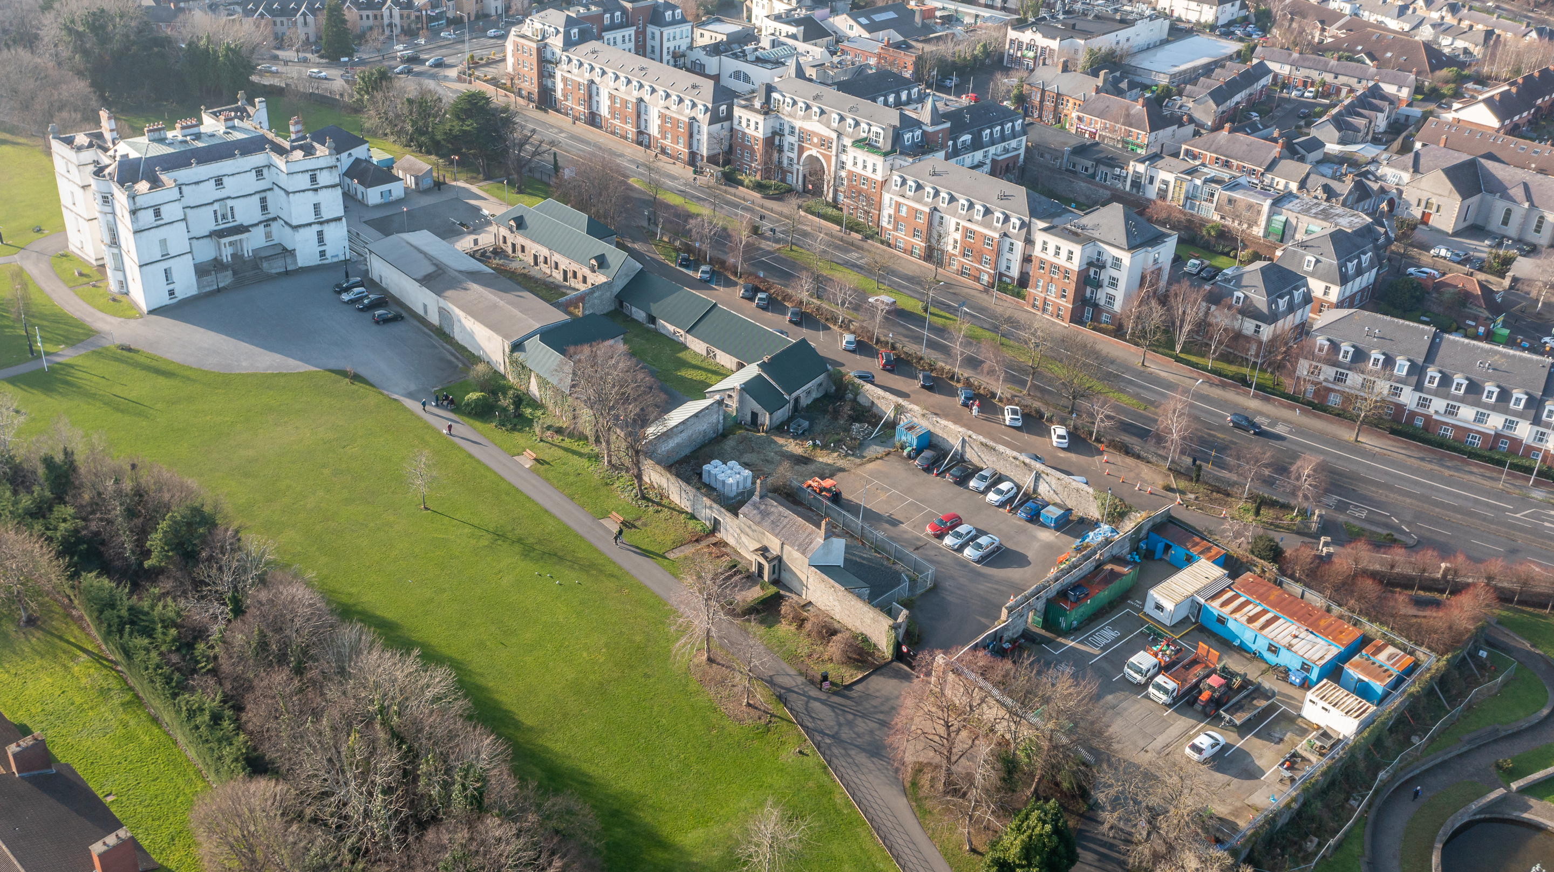
Rathfarnham Castle Outbuildings
Project Update

Slide 2
Overall Layout
Overall Layout

Slide 3
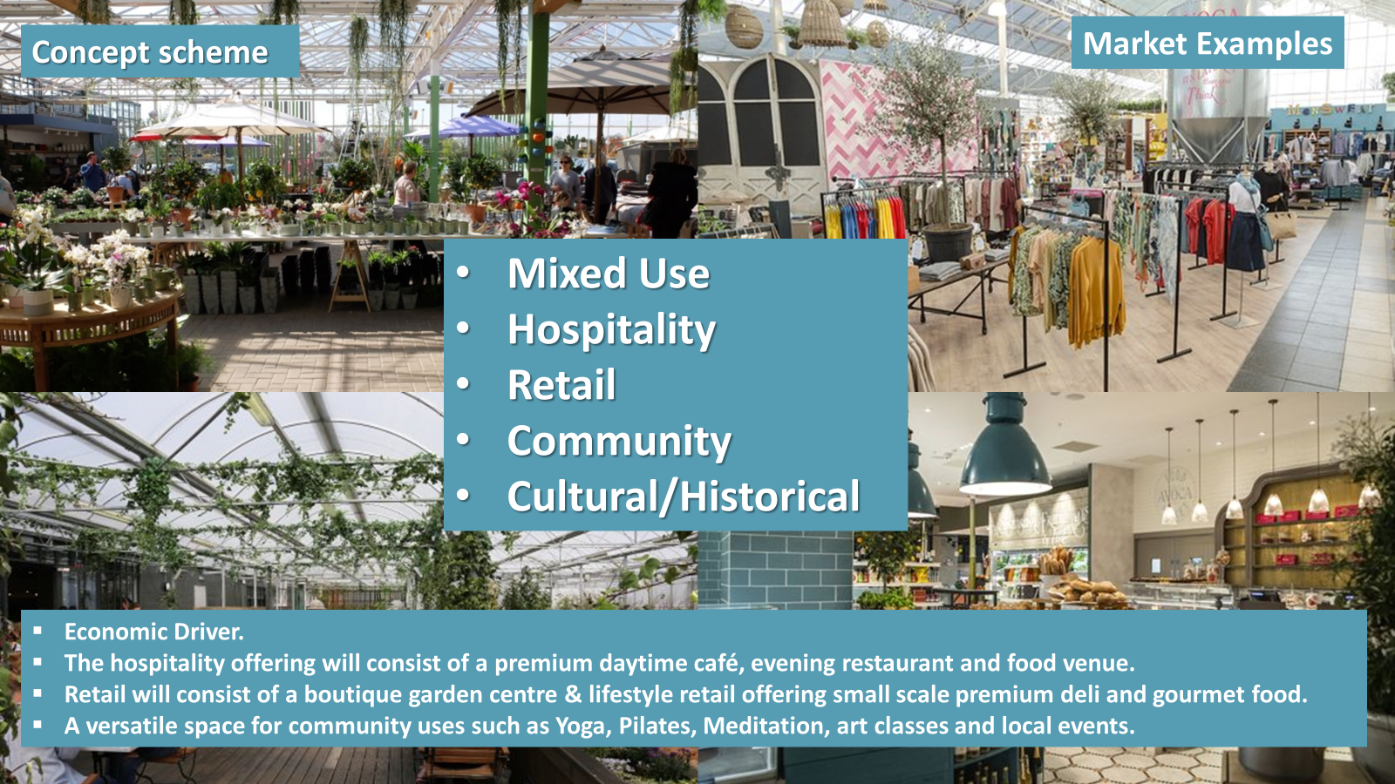

Slide 4
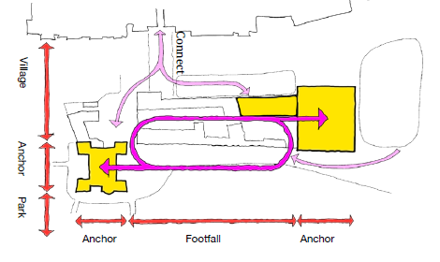
Existing Site – Site diagram

Slide 5
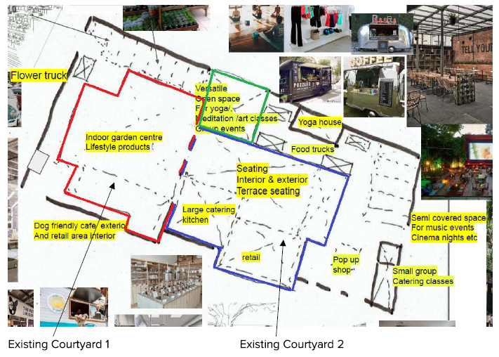

Preferred Operator
In business for over 50 years
Successfully operate 11 individual businesses
Restaurants (one each in Portmarnock, and Raheny), cafes, supermarkets and garden centres.

Slide 6

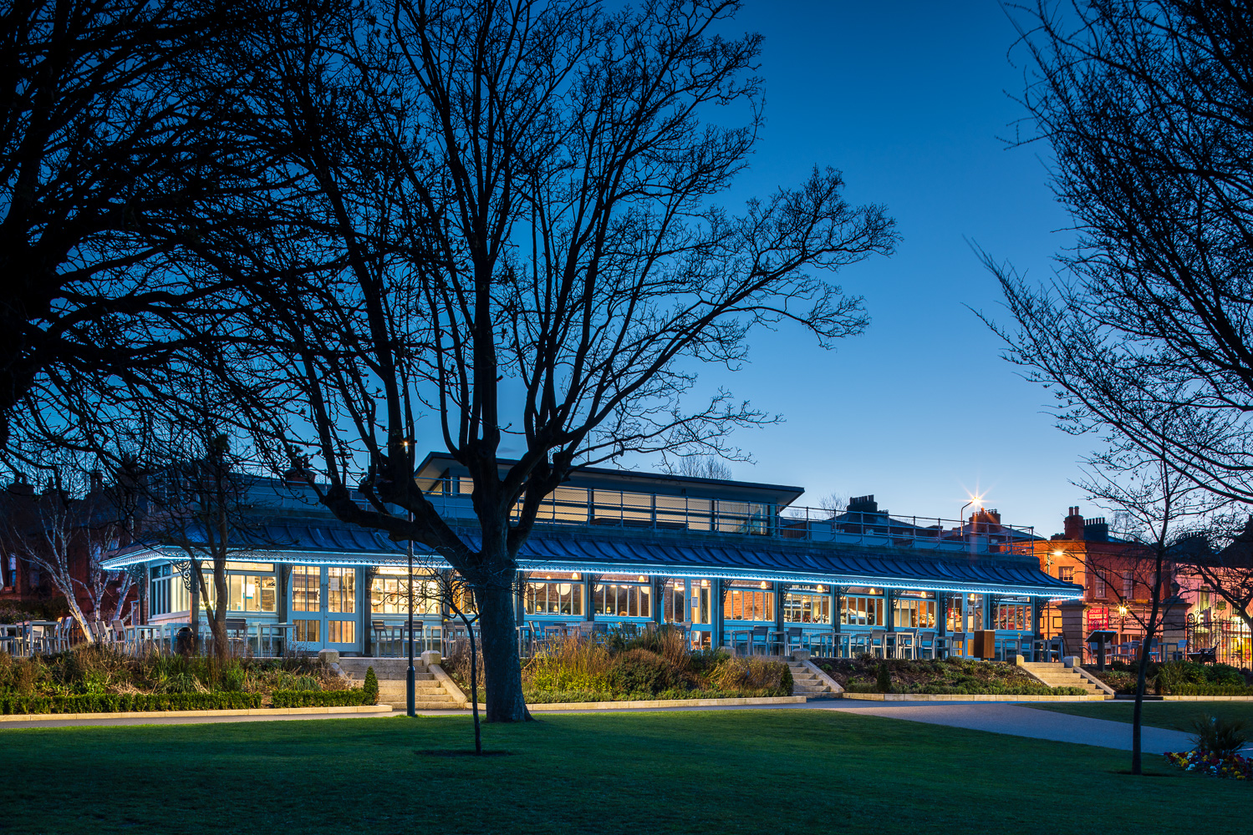
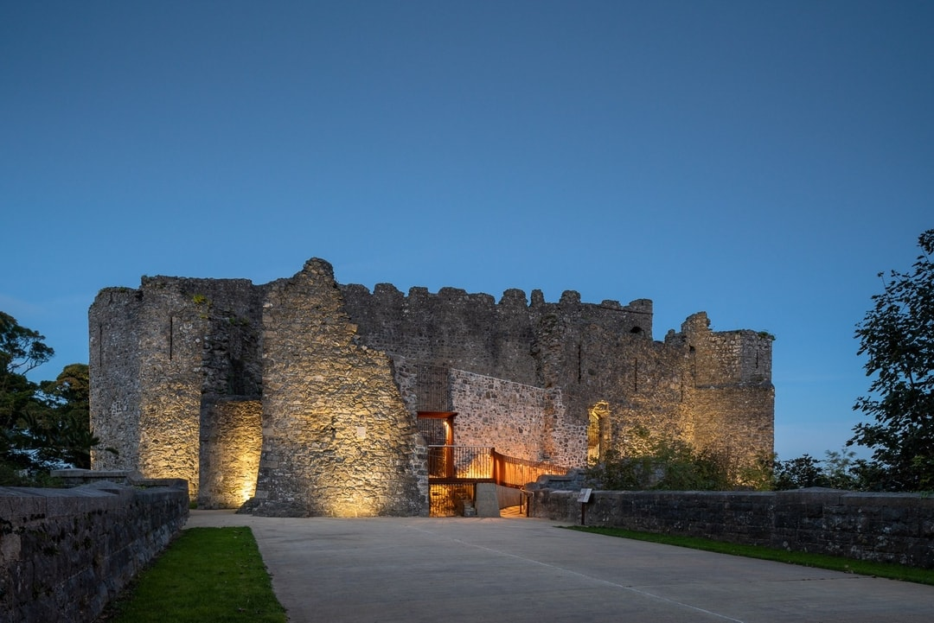
Architect led design team
People’s Park Pavilion
Carlingford Castle
Design led architects working at the intersection of contemporary design and creative conservation
Combining RIAI Architectural, Grade 1 Conservation Architect and Heritage Consultancy services from their Dublin based studio.
Source: https://www.hhcarchitecture.ie/

Slide 7
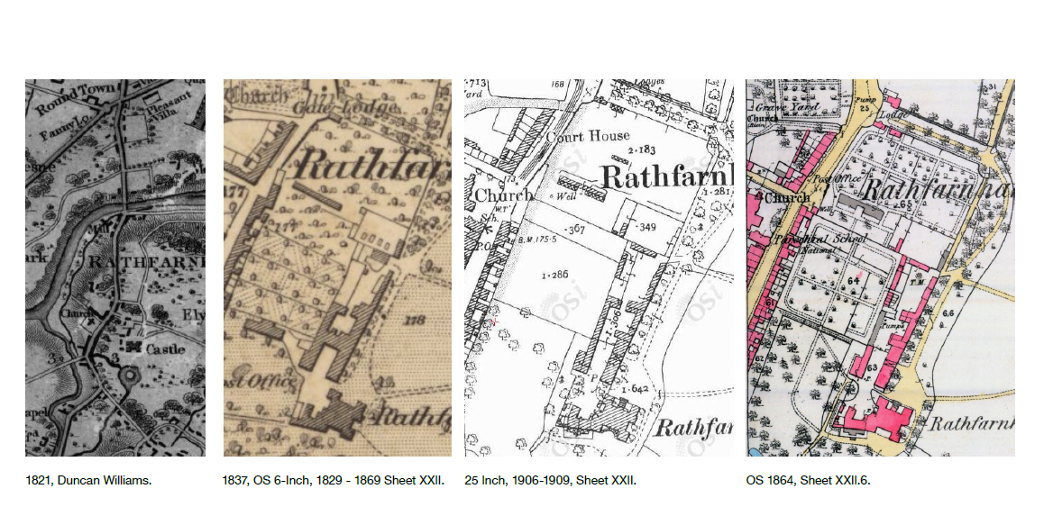
Existing Site – Historical Build Up
Floor Area c.1,400 sq. metres

Slide 8
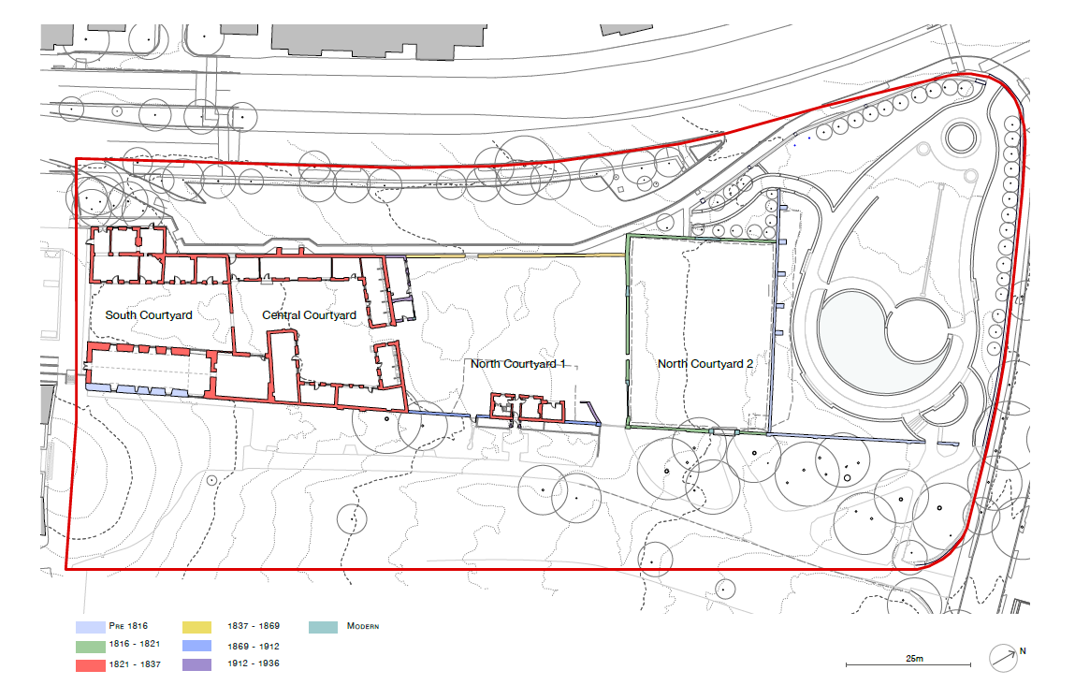
Existing Site – 1864 Historic Map Underlay – Current Site

Slide 9
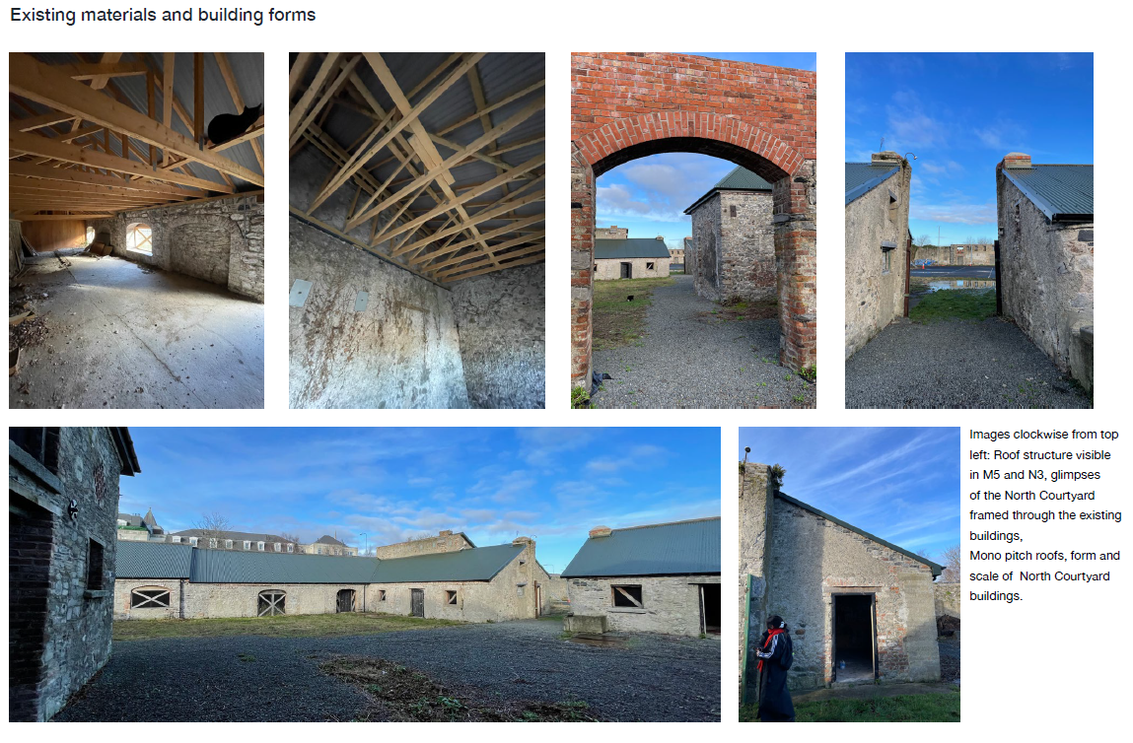
Existing materials and building forms

Slide 10
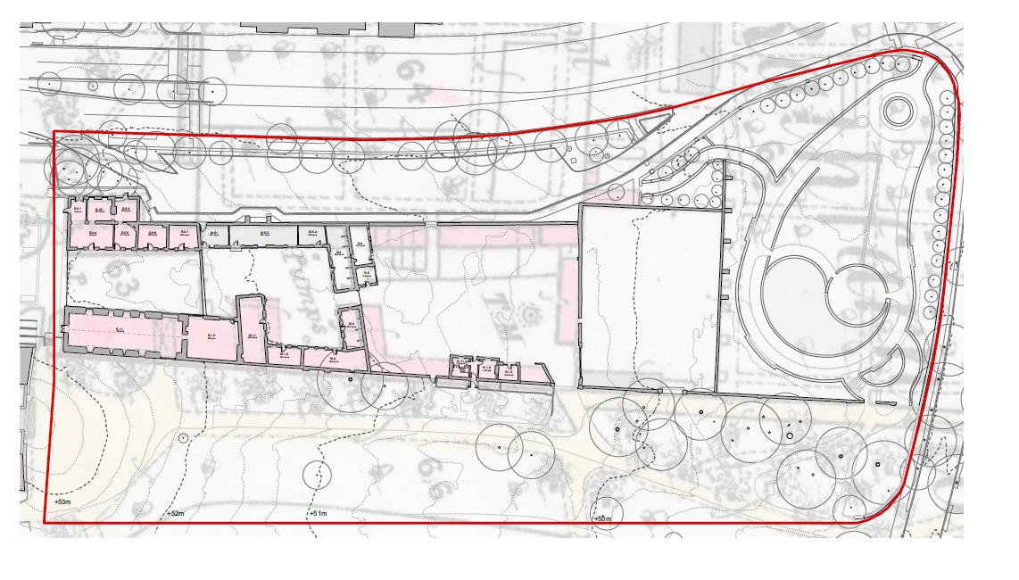
Existing Site – 1864 Historic Map Underlay

Slide 11
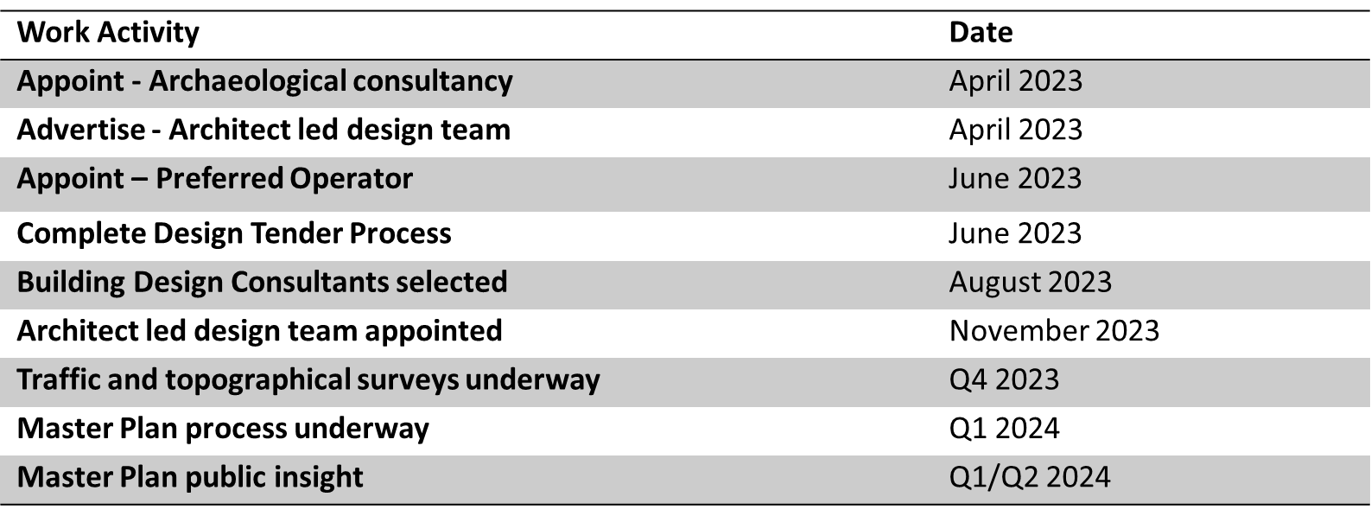
Next Steps

