Slide 1
Housing Delivery Update Report Housing Strategic Policy Committee Meeting 8th February 2024

Slide 2
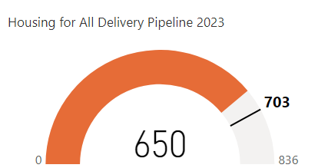
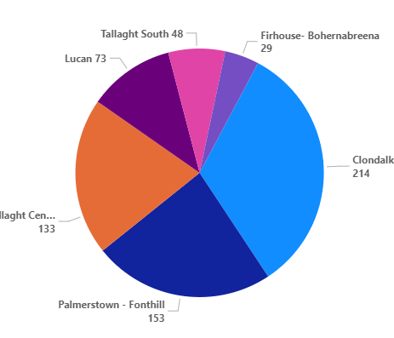
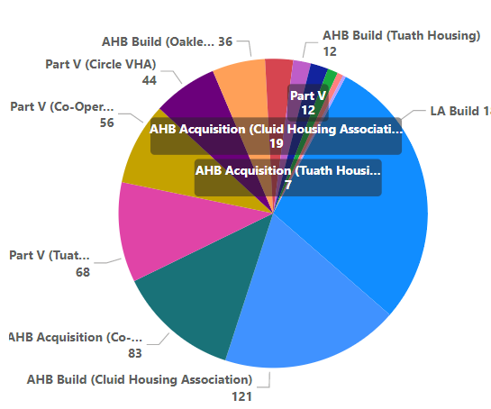
Housing for All – Delivered 2023
Target 2023
Delivery by LEA
Delivery Stream
Clondalkin
Tallaght-Central

Slide 4
Housing Developments Approved / Under Construction – Local Electoral Area
L.E.A | Project | Delivery | Units | Status
Clondalkin | Lindisfarne, Clondalkin | LA Build | 19 | Onsite- delivery in 2024
 | Old Nangor Road (Eircom) | LA Build | 93 | Onsite- 33 units complete in 2023. Balance of 60 for delivery in 2024
 | Canal Extension, Clonburris | LA Build | 56 | Onsite – delivery to commence 2025
 | Sevenmills, Clonburris | Part V | 140 | Onsite- delivery in 2024.
 | Clonburris (Keepers Lock) | Part V | 62 | Part V to be agreed/potential delivery from late 2024.
 | St Finians Way, Newcastle | Part V | 1 | Onsite- delivery in 2024
 | Gordon’s Park | Part V | 7 | Onsite- delivery in 2025

Slide 5
Housing Developments Approved / Under Construction – Local Electoral Area
L.E.A | Project | Delivery | Units | Status
Tallaght South | Rossfield | LA Build | 16 | Part 8 Derogation advertised in December 2023. Procurement process for contractor to commence
 | Cuil Duin, Citywest | Part V | 36 | Onsite- delivery in 2024
 | Foxwood Barn, Citywest | Part V | 77 | Part V negotiations ongoing. Delivery 2024 /2025
 | Silken Avenue Kingswood | Part V | 1 | Part V under negotiation delivery Q1 24
 | Citywest Drive | Part V | 29 | Part V agreed. Delivery 2025/ 2026
 | Parklands, Citywest | Part V | 23 | Onsite- delivery in 2024
Tallaght Central | St Aongus Green (Age Friendly) | LA Build | 10 | Tender under evaluation.
 | Airton Rise, Airton Road | Part V | 50 | Part V agreed. Delivery 2025

Slide 6
Housing Developments Approved / Under Construction – Local Electoral Area
L.E.A | Project | Delivery | Units | Status
Tallaght Central | Airton Plaza, Belgard Road | Part V | 30 | Part V agreed. Delivery 2024/2025
Lucan | Aderrig Phase 2 | Part V | 21 | Part V agreed. Delivery 2025 (check Ankit)
 | Tandy's Lane Ph 2 | Part V | 35 | On site due, delivery 2024/2025
 | St Helens Plaza | Part V | 4 | On site due for completion early 2025
 | Ardeevin | Part V | 2 | On site due for delivery 2024.
 | Adamstown Station/District Centre | Part V | 74 | On site due for delivery 2024.

Slide 7
Housing Developments Approved / Under Construction – Local Electoral Area
L.E.A | Project | Delivery | Units | Status
Lucan | Adamstown Boulevard | Part V | 26 | Part V agreed. Delivery due 2024/2025
Palmerstown/ Fonthill | Balgaddy | LA Build | 69 | Contractor on site, 20 units Dec 2023. Balance Q2 2024
 | St. Ronan’s (Age Friendly) | LA Build | 9 | Tender under evaluation
Rathfarnham/ Templeogue | Walkinstown House | Part V | 16 | Part V Agreed – Delivery 2025
Firhouse/ Bohernabreena | Homeville | LA Build | 16 | On site. Due for delivery Q3 2024
 | Pearse Brothers Park (Age Friendly) | LA Build | 10 | Contract awarded. Commencement on site Q1 2024
 | Laurel Manor | Part V | 2 | On site due for delivery 2024.

Slide 8
Large Development Sites
Kilcarbery: 1,034 homes with 30% social (310 homes)
Delivery of 74 social homes anticipated in 2024. Design work is continuing for the adjacent site with a proposed development of up to 88 social and affordable homes.
Killinarden Foothills: 620 homes (including 125 social , 123 Private & 372 affordable purchase).
Developer is currently completed pre-construction planning compliances and with a view to commencing works onsite.
Clonburris: Phases 1 & 2 comprising 382 homes (149 social), Phases 3,4,5 with potential for 1,430* homes ( approx. 40% social)
Construction continuing on-site Canal Extension. The tender process for construction of 266 social, affordable, and cost rental homes in the Kishogue sector has recommenced. Anticipated on-site date in Q3 2024, to allow for completion of road construction works. Design work is almost complete for 120 social homes on the PPP site adjacent to Lynch’s Park, with Part 8 due to commence once complete. Plans for approximately 1300 social and affordable homes are currently being advanced by external design teams with a Part 10 planning application to An Bord Plenála expected in Summer 2024.
Belgard Square North: 133 cost rental apartments
Contractor commenced on site April’23. Delivery March 2025 .
Rathcoole: Number of homes & tenure mix to be confirmed
Due to commence procurement process to appoint consultant to progress the masterplan through to Part 10 planning application application to An Bord Plenála .

Slide 9
Planning Derogation Sites - ( Section 179A)
Location | Units | LEA | Status | Next Action
Rossfield | 16 | Tallaght South | Planning | Scheme advertised in December 2023. Tender to be advertised in Q1 2024
Alpine Heights | 13 | Clondalkin | Detailed Design | Final design complete. Architects to meet with residents prior to advertising of scheme.
Deansrath/Melrose | 24 | Clondalkin | Planning | Scheme advertised in December 2023. Tender to be advertised in Q1 2024
Kilcarbery 2 (Social & affordable) | 88 | Clondalkin | Detailed Design | Scheme advertised in December 2023. Procurement process to be commenced shortly
Old Castle Clondalkin ( Social, affordable, & TA) | 130 | Clondalkin | Detailed Design | Consultation with residents ongoing. Design to be finalised.
Castlefield (Social & affordable) | 33 | Firhouse/Bohernabreena | Detailed Design | In house design. Detailed design ongoing
Stocking Lane | 25 | Firhouse/Bohernabreena | Feasibility Report | Progress for planning advertising
Sarsfield Park, Lucan | 5 | Lucan | Planning | DHLGH Funding approved Nov 2023
Owendoher Haven | 9 | Rathfarnham / Templeogue | Detailed Design | Design for the scheme currently being finalised
Kishogue Park | 15 | Lucan | Planning | Scheme design progressing

Slide 10
Overview
105
Purchased / Sale Agreed
Notes:
Total Number of EOIs
No alt text provided
Number of EOIs by LEA
No alt text provided
Number of EOIs By Status
No alt text provided
image
No alt text provided
textbox
No alt text provided

Slide 11
90

Slide 12
Targeted Leasing Initiative - 2023

