Slide 1

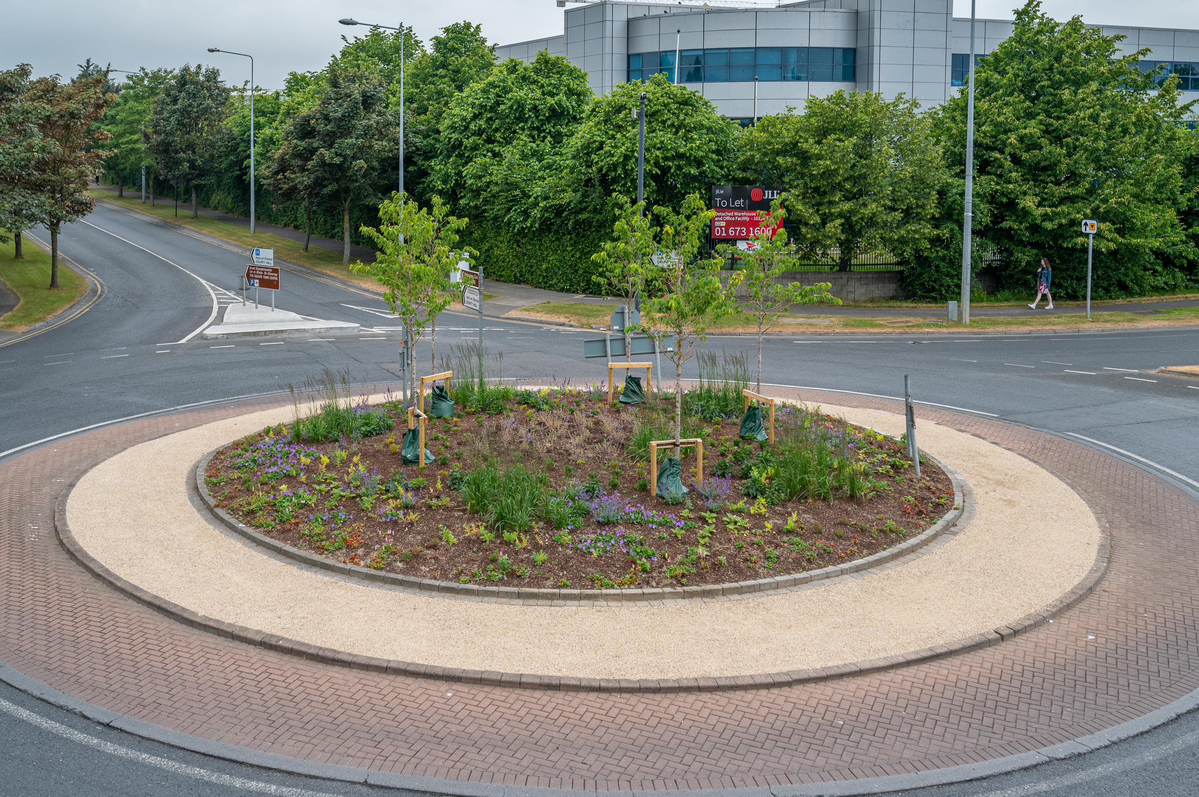
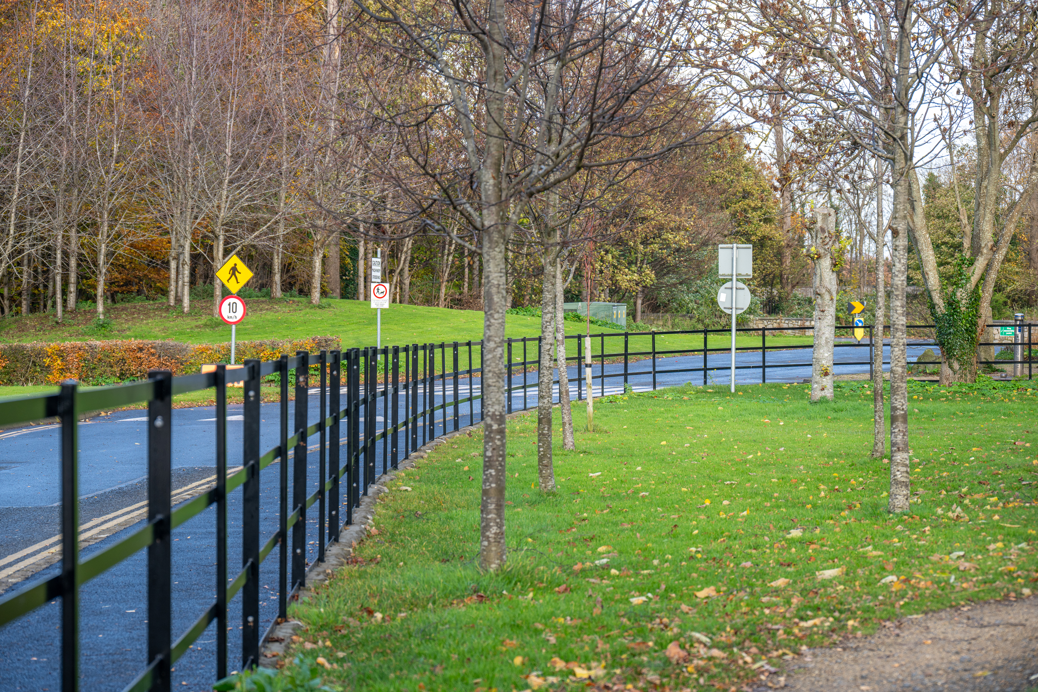
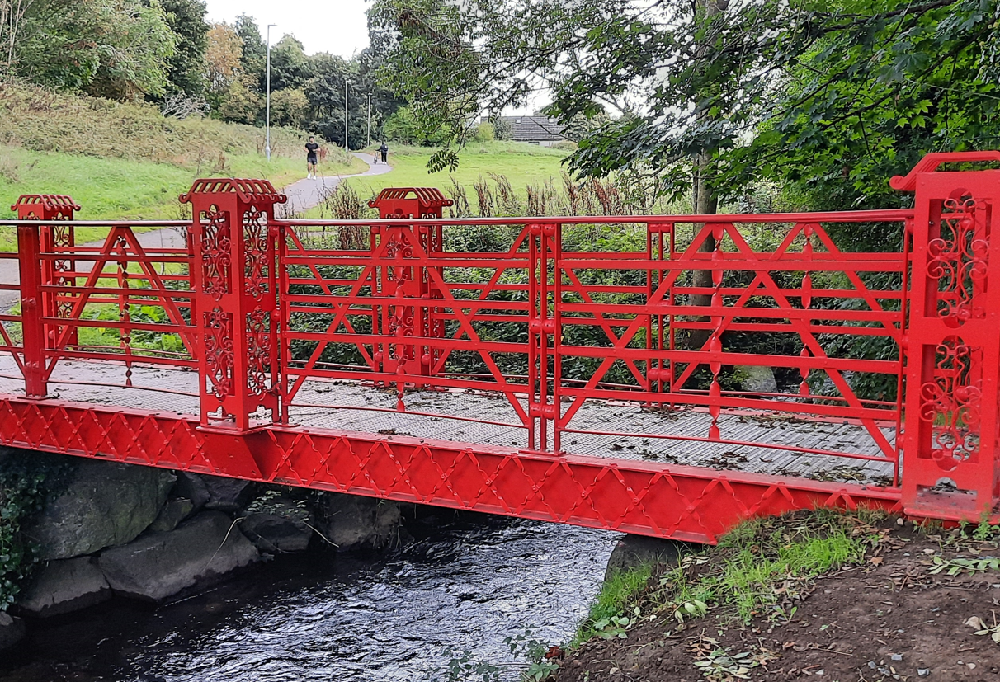
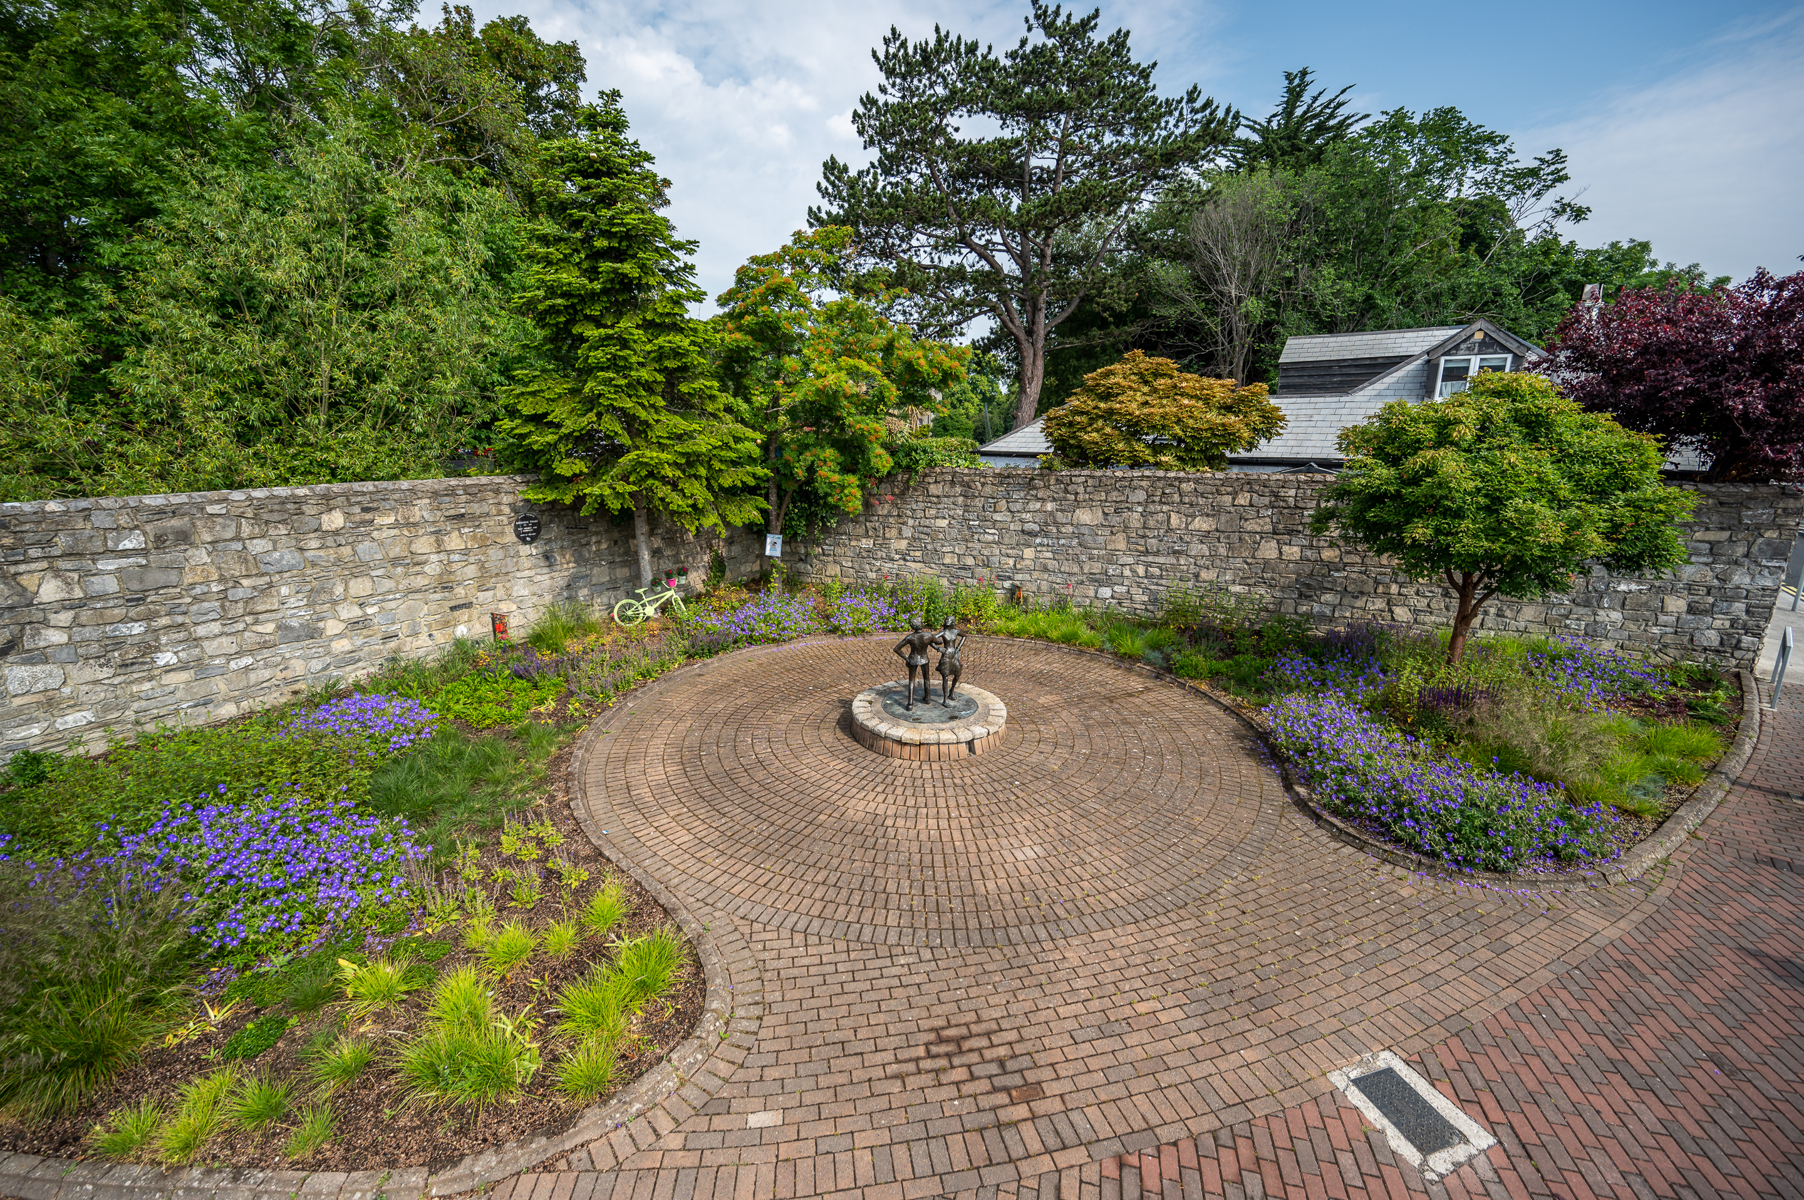
2024 Public Realm & Surface Water Improvement Works Programme
12/02/2024
February Council

Slide 2
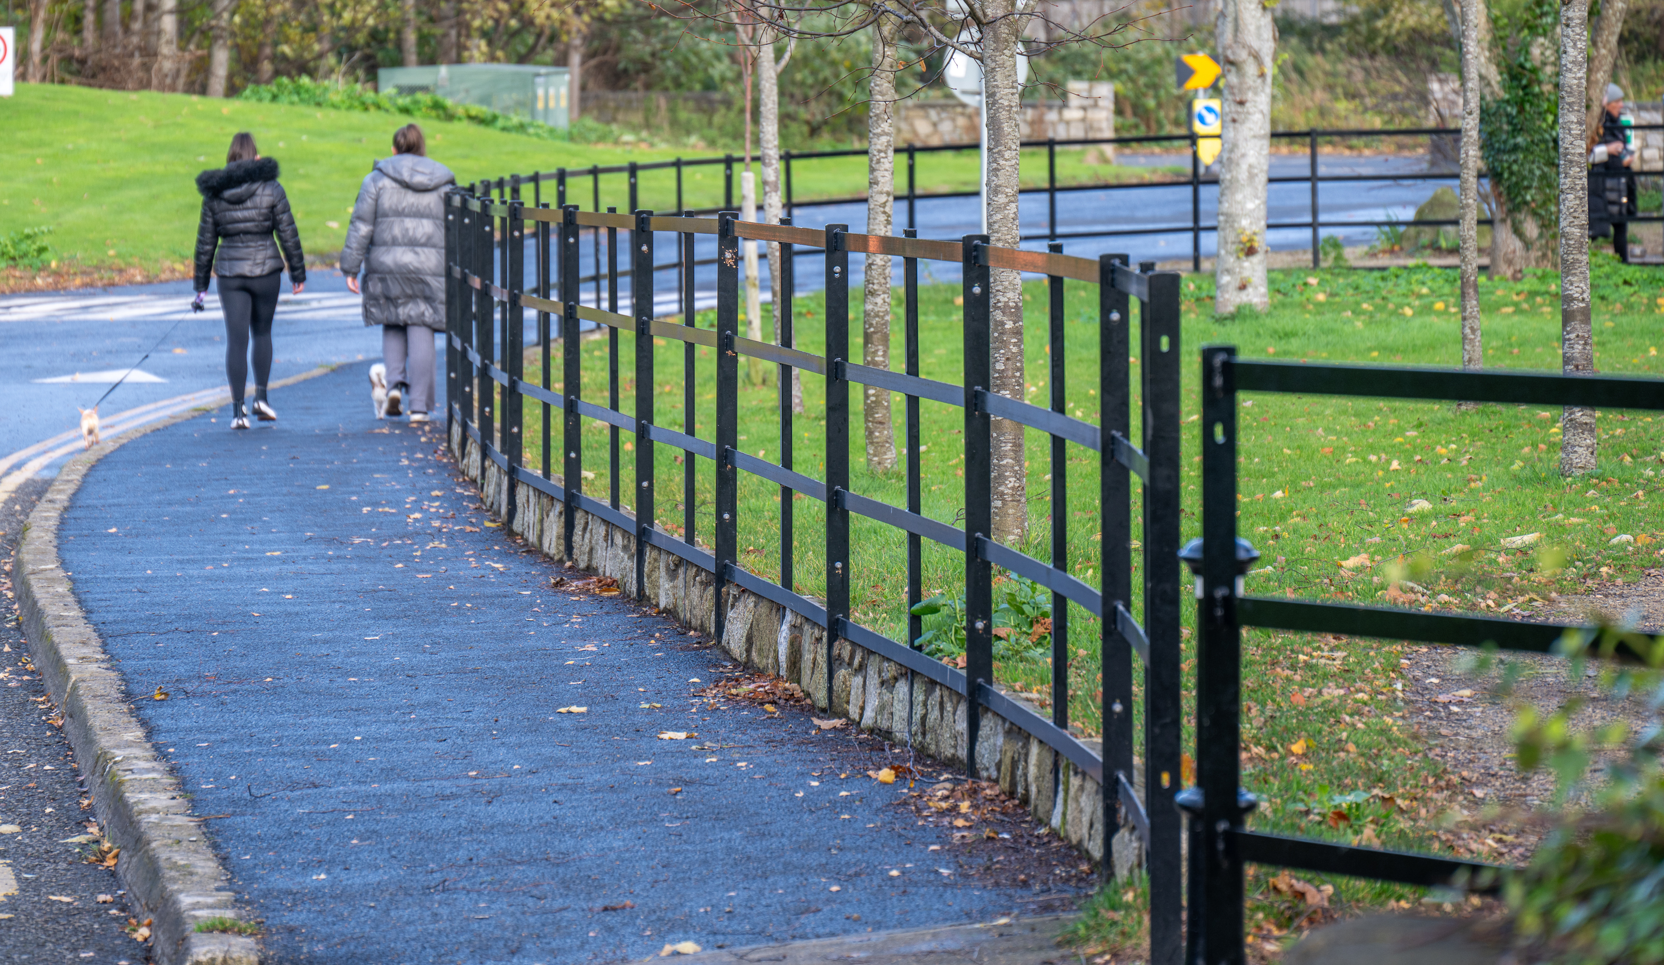
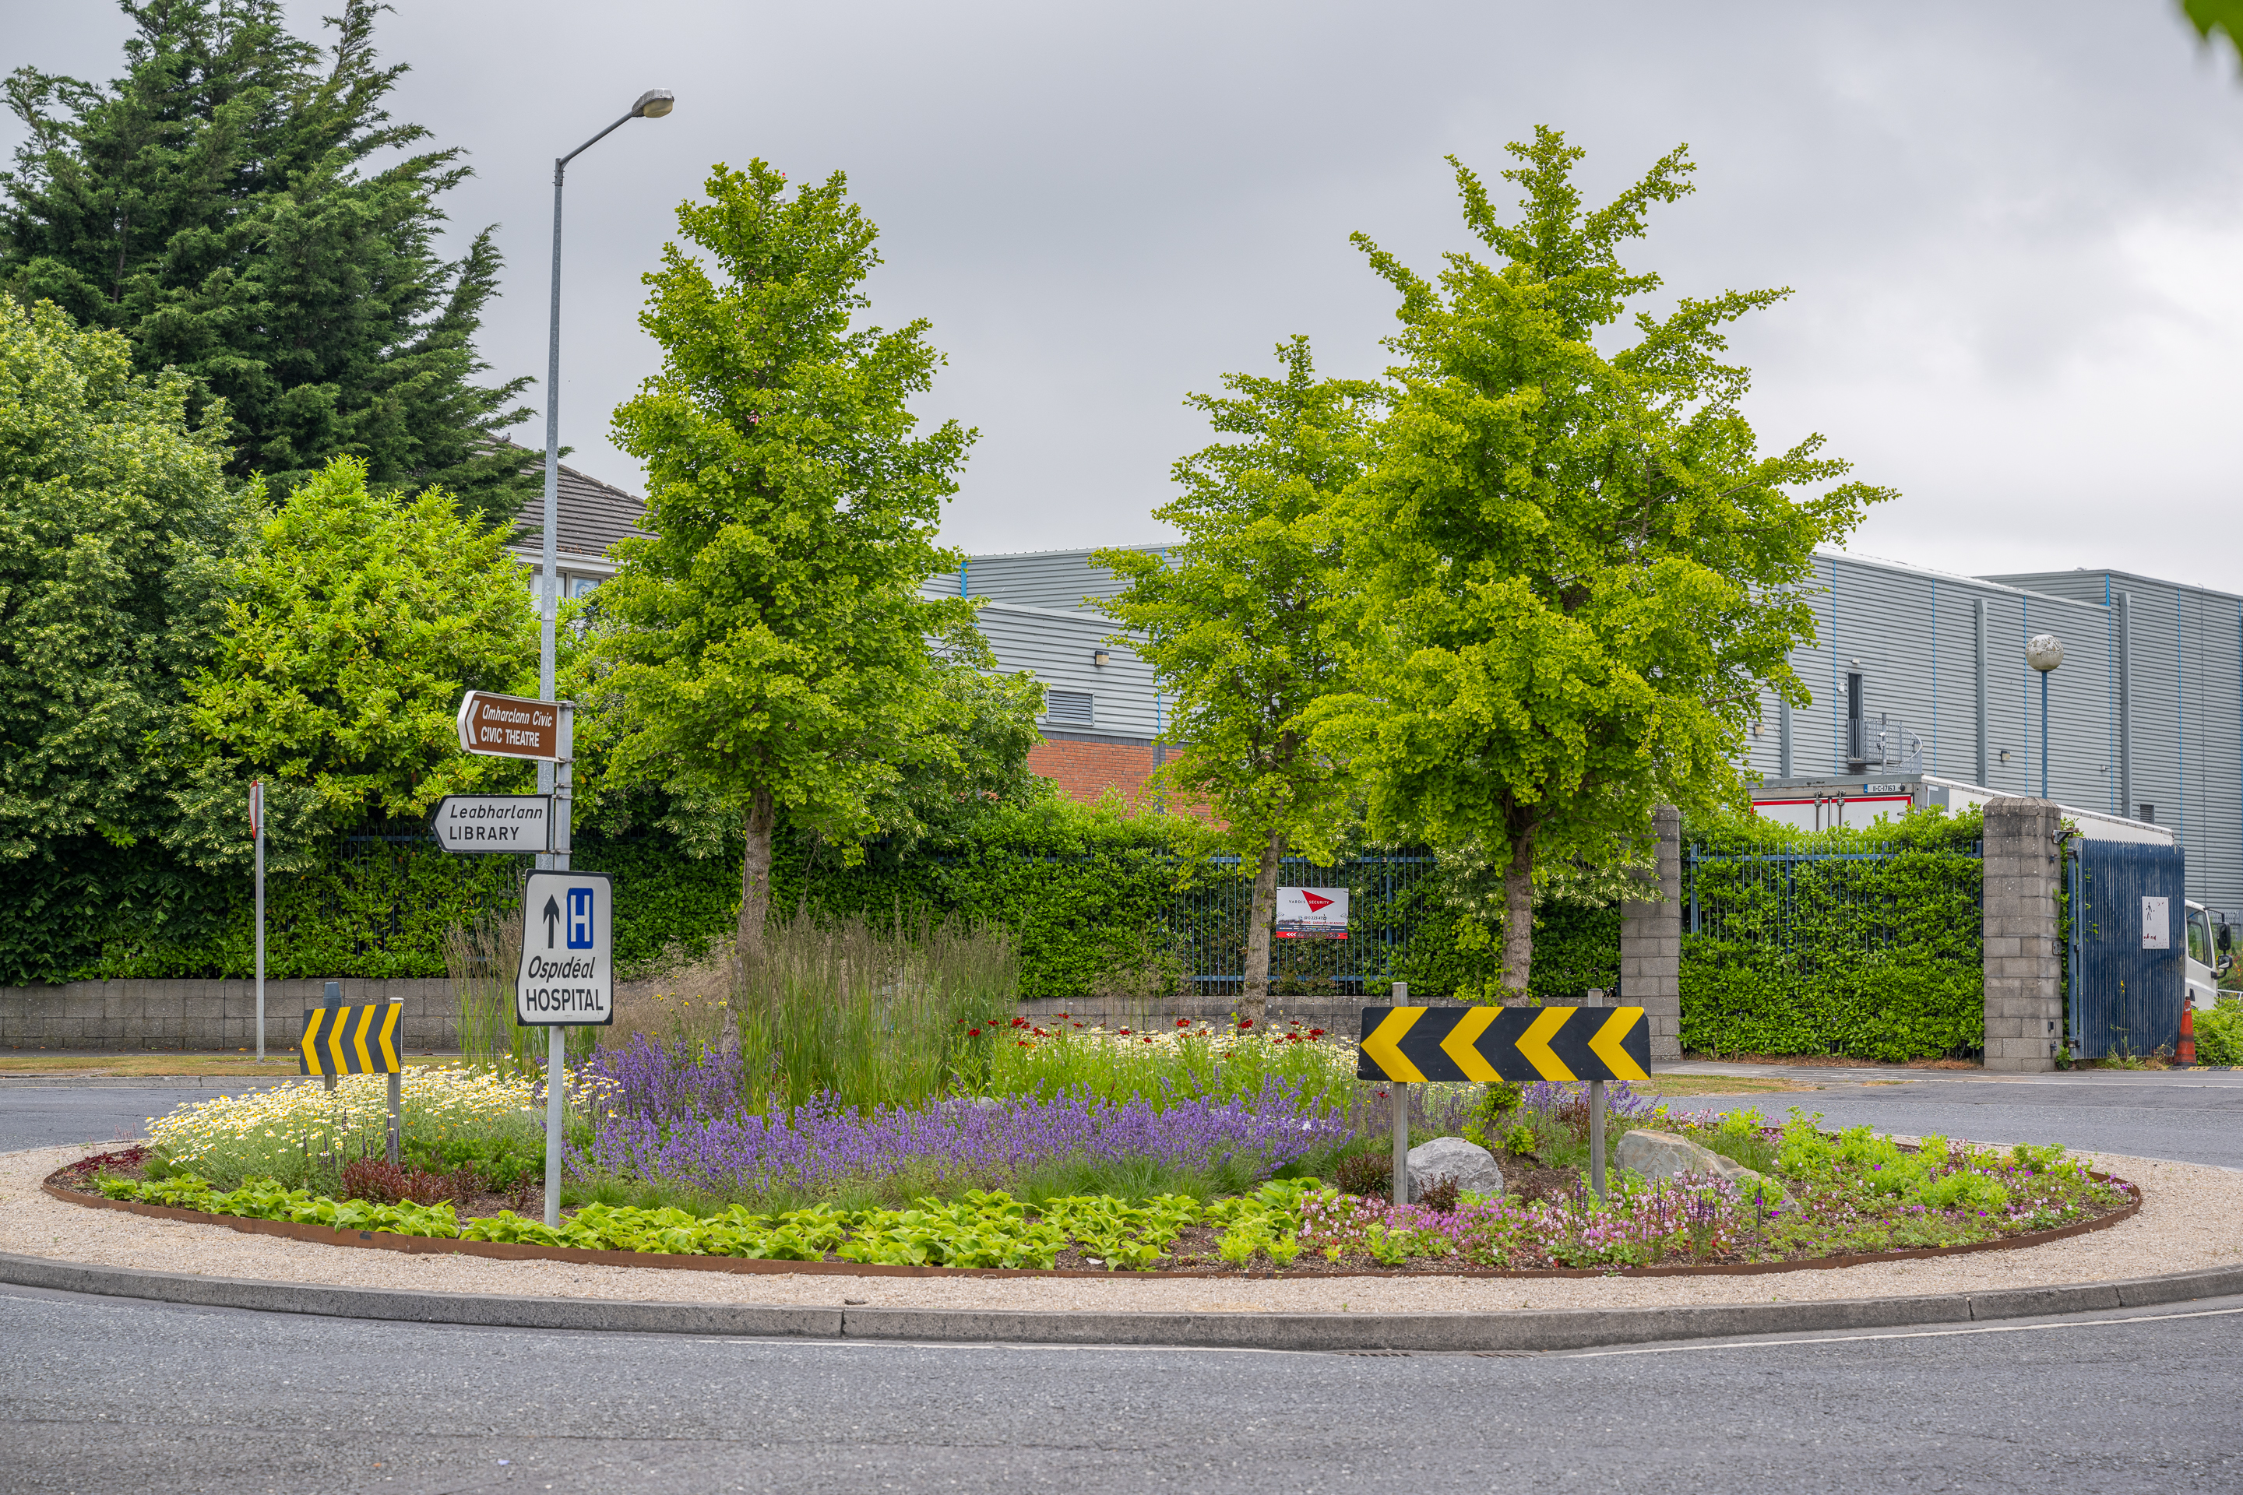
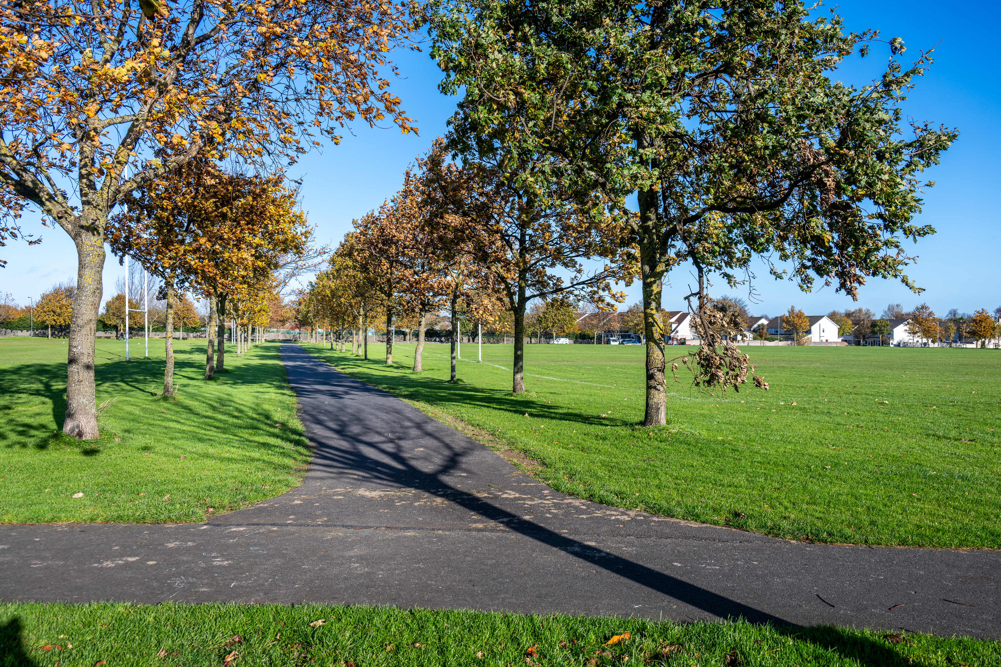
Tallaght ACM
No | Location | Description of Works | Cost estimate
1 | Seskin View Road | Install footpath through the open space running adjacent to Seskin View Road & The Wood, Millbrook Lawns | €40,000
2 | Lios na Sidhe and Old Bawn Avenue | Construct footpath on greenspace between Lios na Sidhe and Old Bawn Avenue | €30,000
3 | Suncroft Park | Construct loop footpath around open space, including tree planting | €45,000
4 | Aylesbury | Install accessible footpath between Pineview to Kiltipper crossing Dalepark road. | €10,000
5 | Sean Walsh Park | Realign footpath in Sean Walsh park phase 2 adjacent to Cill cais with associated drainage and landscape works. | €20,000
6 | Belgard Park | Install public lighting along path across open space at Belgard Park | €25,000
7 | Cill Cais | Install public lighting along Cill Cais pedestrian footpath through open space. | €20,000
8 | Open space at Scoil Santain | Landscape improvements at open space in front of Scoil Santain. | €30,000
9 | Sheehy Skeffington | Install kissing gates at the entrance that leads from the Cheeverstown Luas Stop into Sheehy Skeffington Meadows | €10,000
10 | Sean Walsh Park | Install a dog run in Sean Walsh park | €50,000
11 | Belgard heights | Pollinator-friendly bulb planting. | €10,000
12 | Castle Park to Bancroft Grove | Overlay footpath between Castle Park and Bancroft Grove. | €30,000
13 | Ashfield Park | Surface footpath. | €5,000
14 | Ballymount Park | Upgrade footpaths by stream, playground and pitch 93 to address water ponding issues. | €30,000
15 | Ballymount Park | Widen footpaths in two locations. | €25,000
16 | Kilnamanagh | Construct footpath loop around open space at Treepark Road adjacent to the M50 | €50,000
17 | Avonbeg/Homelawns/St Dominics open space | Install boundary railing | €50,000
 |  |  | €480,000
Tymon Park – new railings and path
Pollinator Planting - Belgard Sq
Aylesbury – New footpath

Slide 3
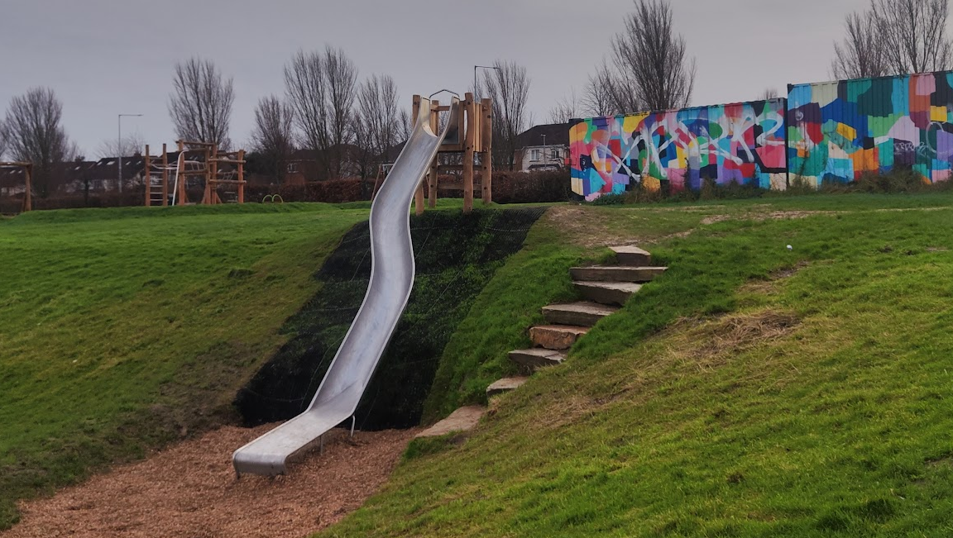
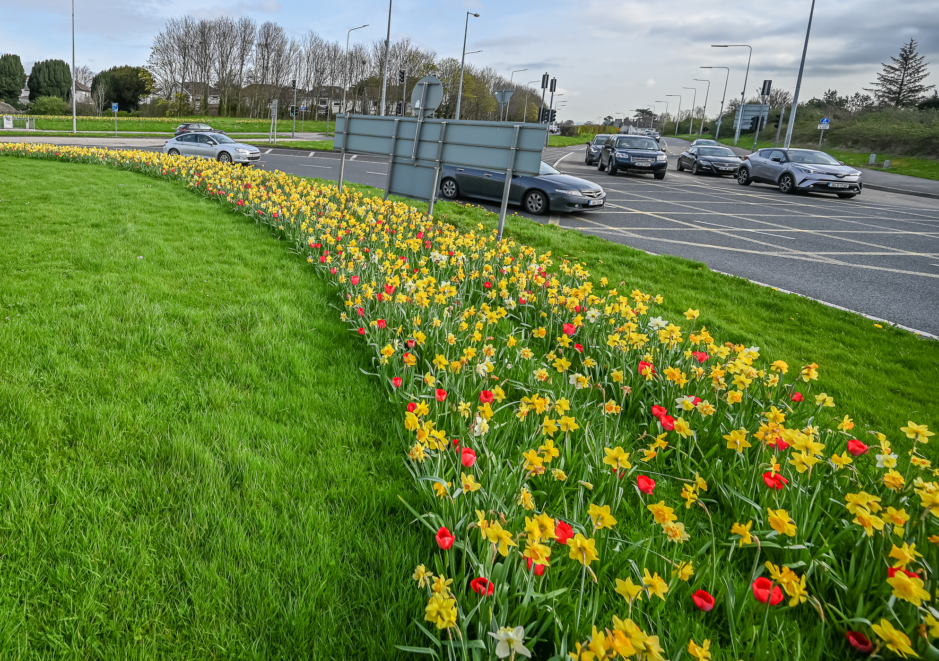
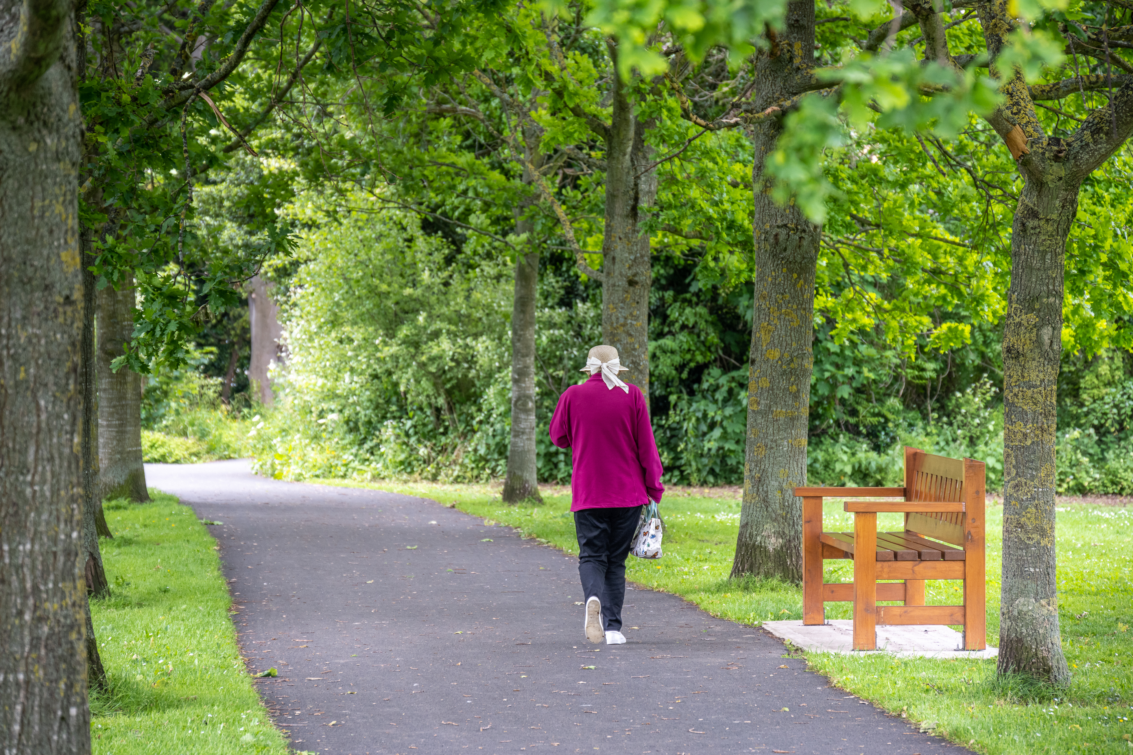
Rathfarnham / Templeogue / Firhouse / Bohernabreena ACM
Number | Location | Description of Works | Cost estimate
1 | Delaford Estate | Install walking loop around park | €40,000
2 | Riverside Cottages | Install footpath along the river. | €40,000
3 | Carrigwood, Firhouse | Complete the loop & connect the green space to the school | €40,000
4 | Tymon park | Footpath upgrades in various locations | €25,000
5 | Greenhills Park | Provide public lighting along the main pathway through Greenhills Park | €45,000
6 | Orwell Estate | Provide public lighting along footpath across open space. | €25,000
7 | Dodder Valley park | Upgrade entrances into Dodder Valley Park | €40,000
8 | Templeroan Roundabout, Knocklyon | Landscape planting upgrade | €20,000
9 | Tymon Park | Install Boules Court near Templeogue Utd | €25,000
10 | Tymon Park entrance | remove existing Kissing gate and install adjustable kissing gate at Limekiln Road entrance | €10,000
11 | Ely Arch | Boundary improvements along Dodder Road Lower | €50,000
12 | Dangan Park | Provide drainage and overly footpath through park. | €30,000
13 | Woodlawn Park Grove | Footpath linking Woodlawn Park Grove & Ballycullen Road | €10,000
14 | Dodder Valley Park | Overlay footpath at the rear of Scoil Carmel. | €40,000
15 | Firhouse/ Scoil Treasa | Provide link to footpath across open space from Scoil Treasa entrance. | €5,000
16 | Rathfarnham Castle Park | Install sensory walk/garden. | €30,000
 |  |  | €475,000
Carrigwood playspace slide
Bulb Planting – Spawell Roundabout
Rathfarnham Castle Park – upgrade paths

Slide 4
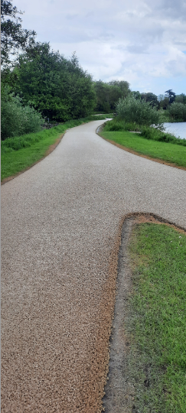
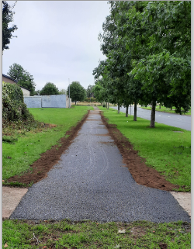
Clondalkin/Newcastle/Rathcoole/Saggart/Brittas ACM
No | Location | Description of Works | Cost estimate
1 | Corkagh Park | Upgrade dog run - new fence, gates, accessible entrance & seats | 40000
2 | Corkagh Park | Landscape island bed outside entrance to St Johns Road car park | 15000
3 | Corkagh Park | Upgrade rose garden | 25000
4 | Corkagh Park | Surface section back lane | 45000
5 | Corkagh Park | Phase 2 of 3 surface lake path | 45000
6 | Corkagh Park | Phase 3 of 3 surface lake path | 45000
7 | Corkagh Park | Mini woodland | 30000
8 | Knockmitten Park at Woodford Park | Surface section of path | 5000
9 | Clondalkin Park | Widen and surface path east of Camac beside soccer pitch | 35000
10 | Clondalkin Park | Fence around culvert - 35 metres x 1.4m high buff top | 10000
11 | Rathcoole Park | Upgrade rose garden with perennials and roses. | 50000
12 | Rathcoole Park | Path upgrade works | 30000
13 | Monastery Gate Villas | Public Lighting from Monastery Gate Villas to Monastery Road | 20000
14 | Castle Park open sapce | Boundary treatment and tree planting | 60000
15 | Michael Collins open space | Upgrade path leading to Clonburris National School | 15000
16 | Woodford open space | Pollinator Planting | 10000
 |  |  | 480,000
Corkagh Park
– lake path upgrade
Bawnogue Road
– new path

Slide 5
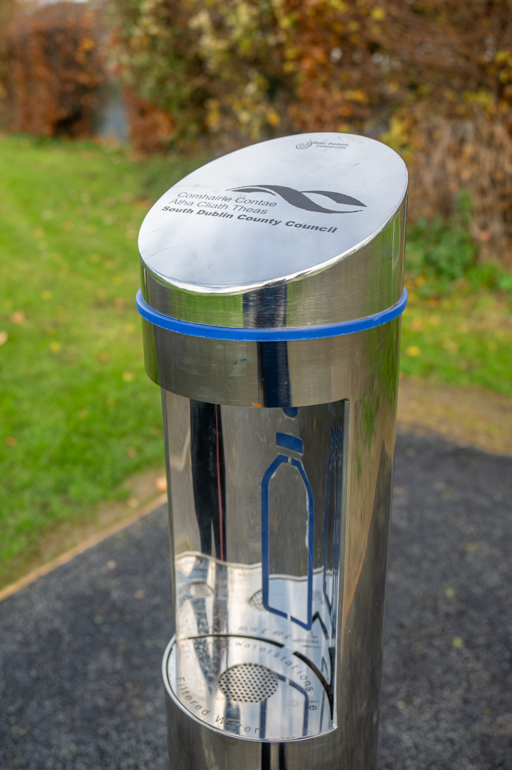
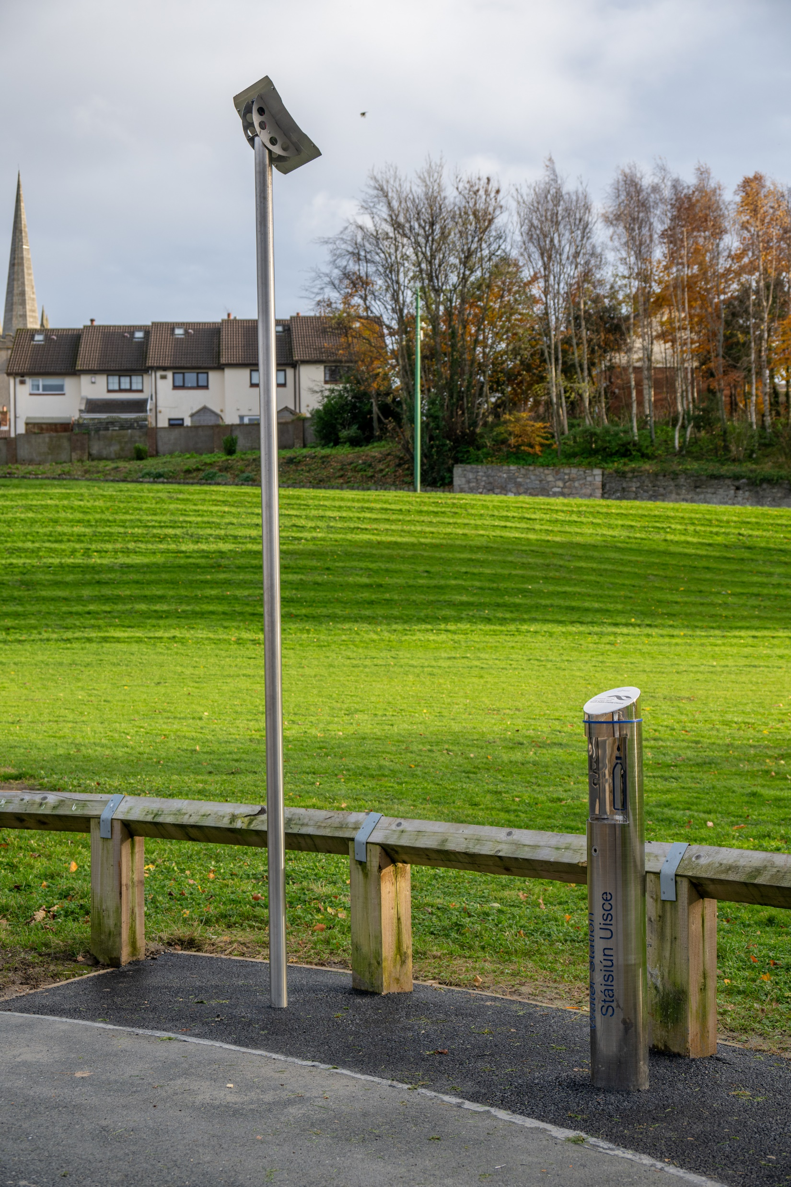
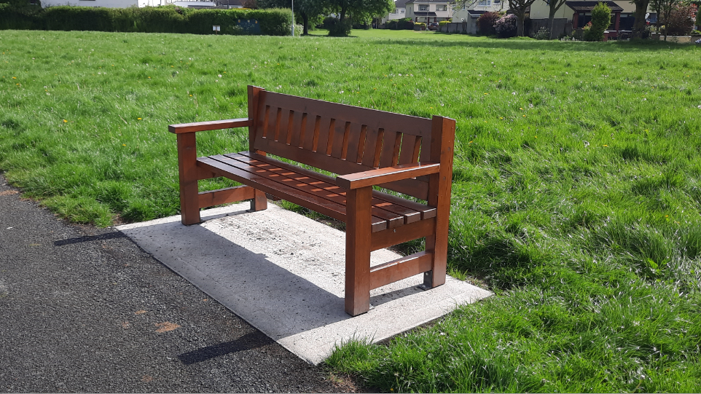
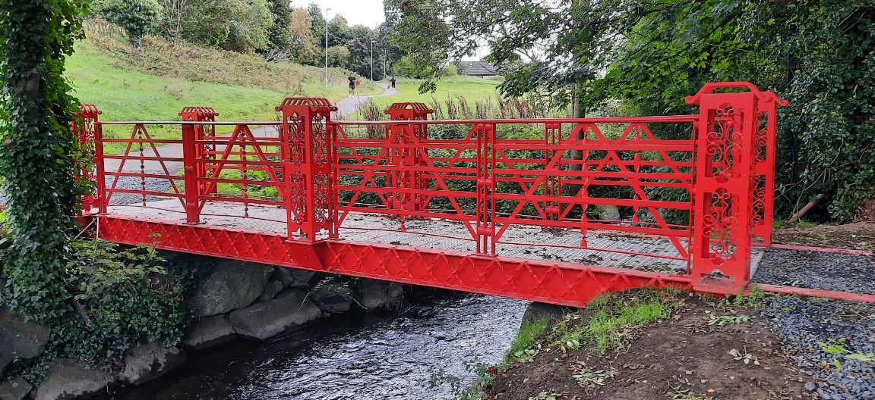
Lucan/Palmerstown/North Clondalkin ACM
No | Location | Description of Works | Cost estimate
1 | Hermitage Park | Upgrade vehicle entrance | 35000
2 | Hermitage Park | Path upgrade works throughout park | 40000
3 | St Finians Crescent open space | Path upgrade works | 40000
4 | Esker Glebe open space | New path between red bridge and post box | 15000
5 | Willsbrook Park | Path upgrade works throughout park | 40000
6 | Griffeen Valley Park | Upgrade Water font near playground/skatepark | 20000
7 | Griffeen Valley Park | Surface entrance path at The Old Forge | 10000
8 | Griffeen Valley Park | Upgrade model car track area - Fence on RHS of Haydens Lane car park + new kerbing on LHS | 30000
9 | Griffeen Valley Park | Replace Yellow bridge & upgrade entrance opposite Gaelscoil Eiscir Riada | 50000
10 | Griffeen Valley Park | Path upgrade works throughout Newcastle Road/Esker Drive section | 20000
11 | Griffeen Valley Park | Mini Woodland near King Johns Bridge | 25000
12 | Tandys Lane Park | Upgrade 3 water fonts to solar units @ playground near car park, Calisthenics, playground near orchard | 50000
13 | Woodview Heights | Trees & bulbs on open space | 15000
14 | Waterstown | New gates and pillars at lower car park | 25000
15 | Griffeen Road/Way roundabout | Bulb planting to include Galantus | 10000
16 | Rochfort/Abbeydale roundabout | Bulb planting | 10000
17 | Collinstown Park | Provide seating | 10000
18 | Ballyowen Park | Provide seating | 10000
19 | St Ronans Avenue | Resurface old section of black path | 20000
 |  |  | 475,000
Water Station
Beech Park – new bench
Esker Glebe – new bridge

Slide 6
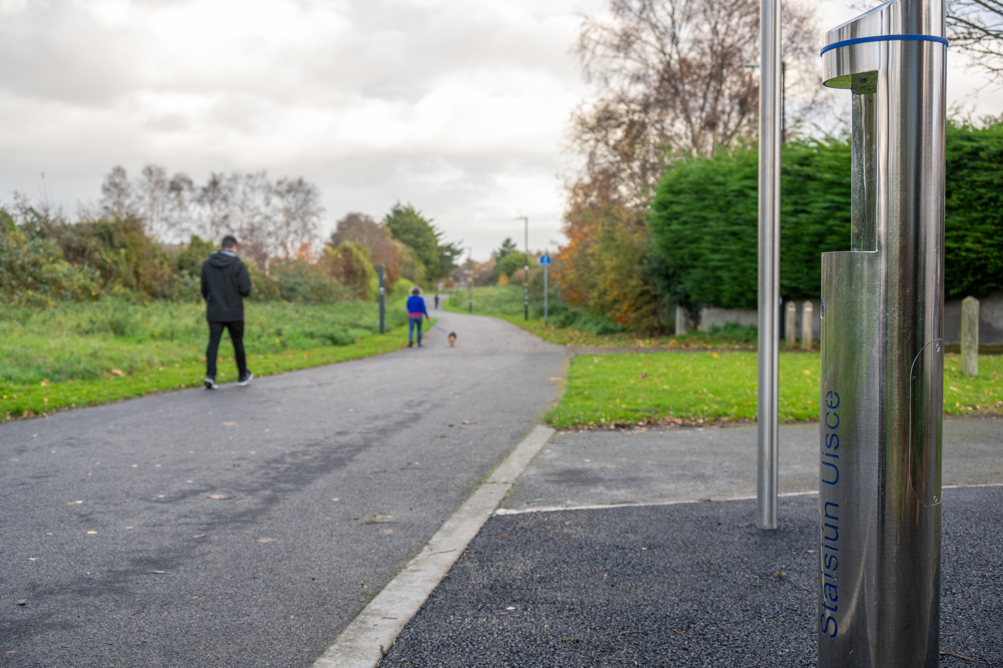
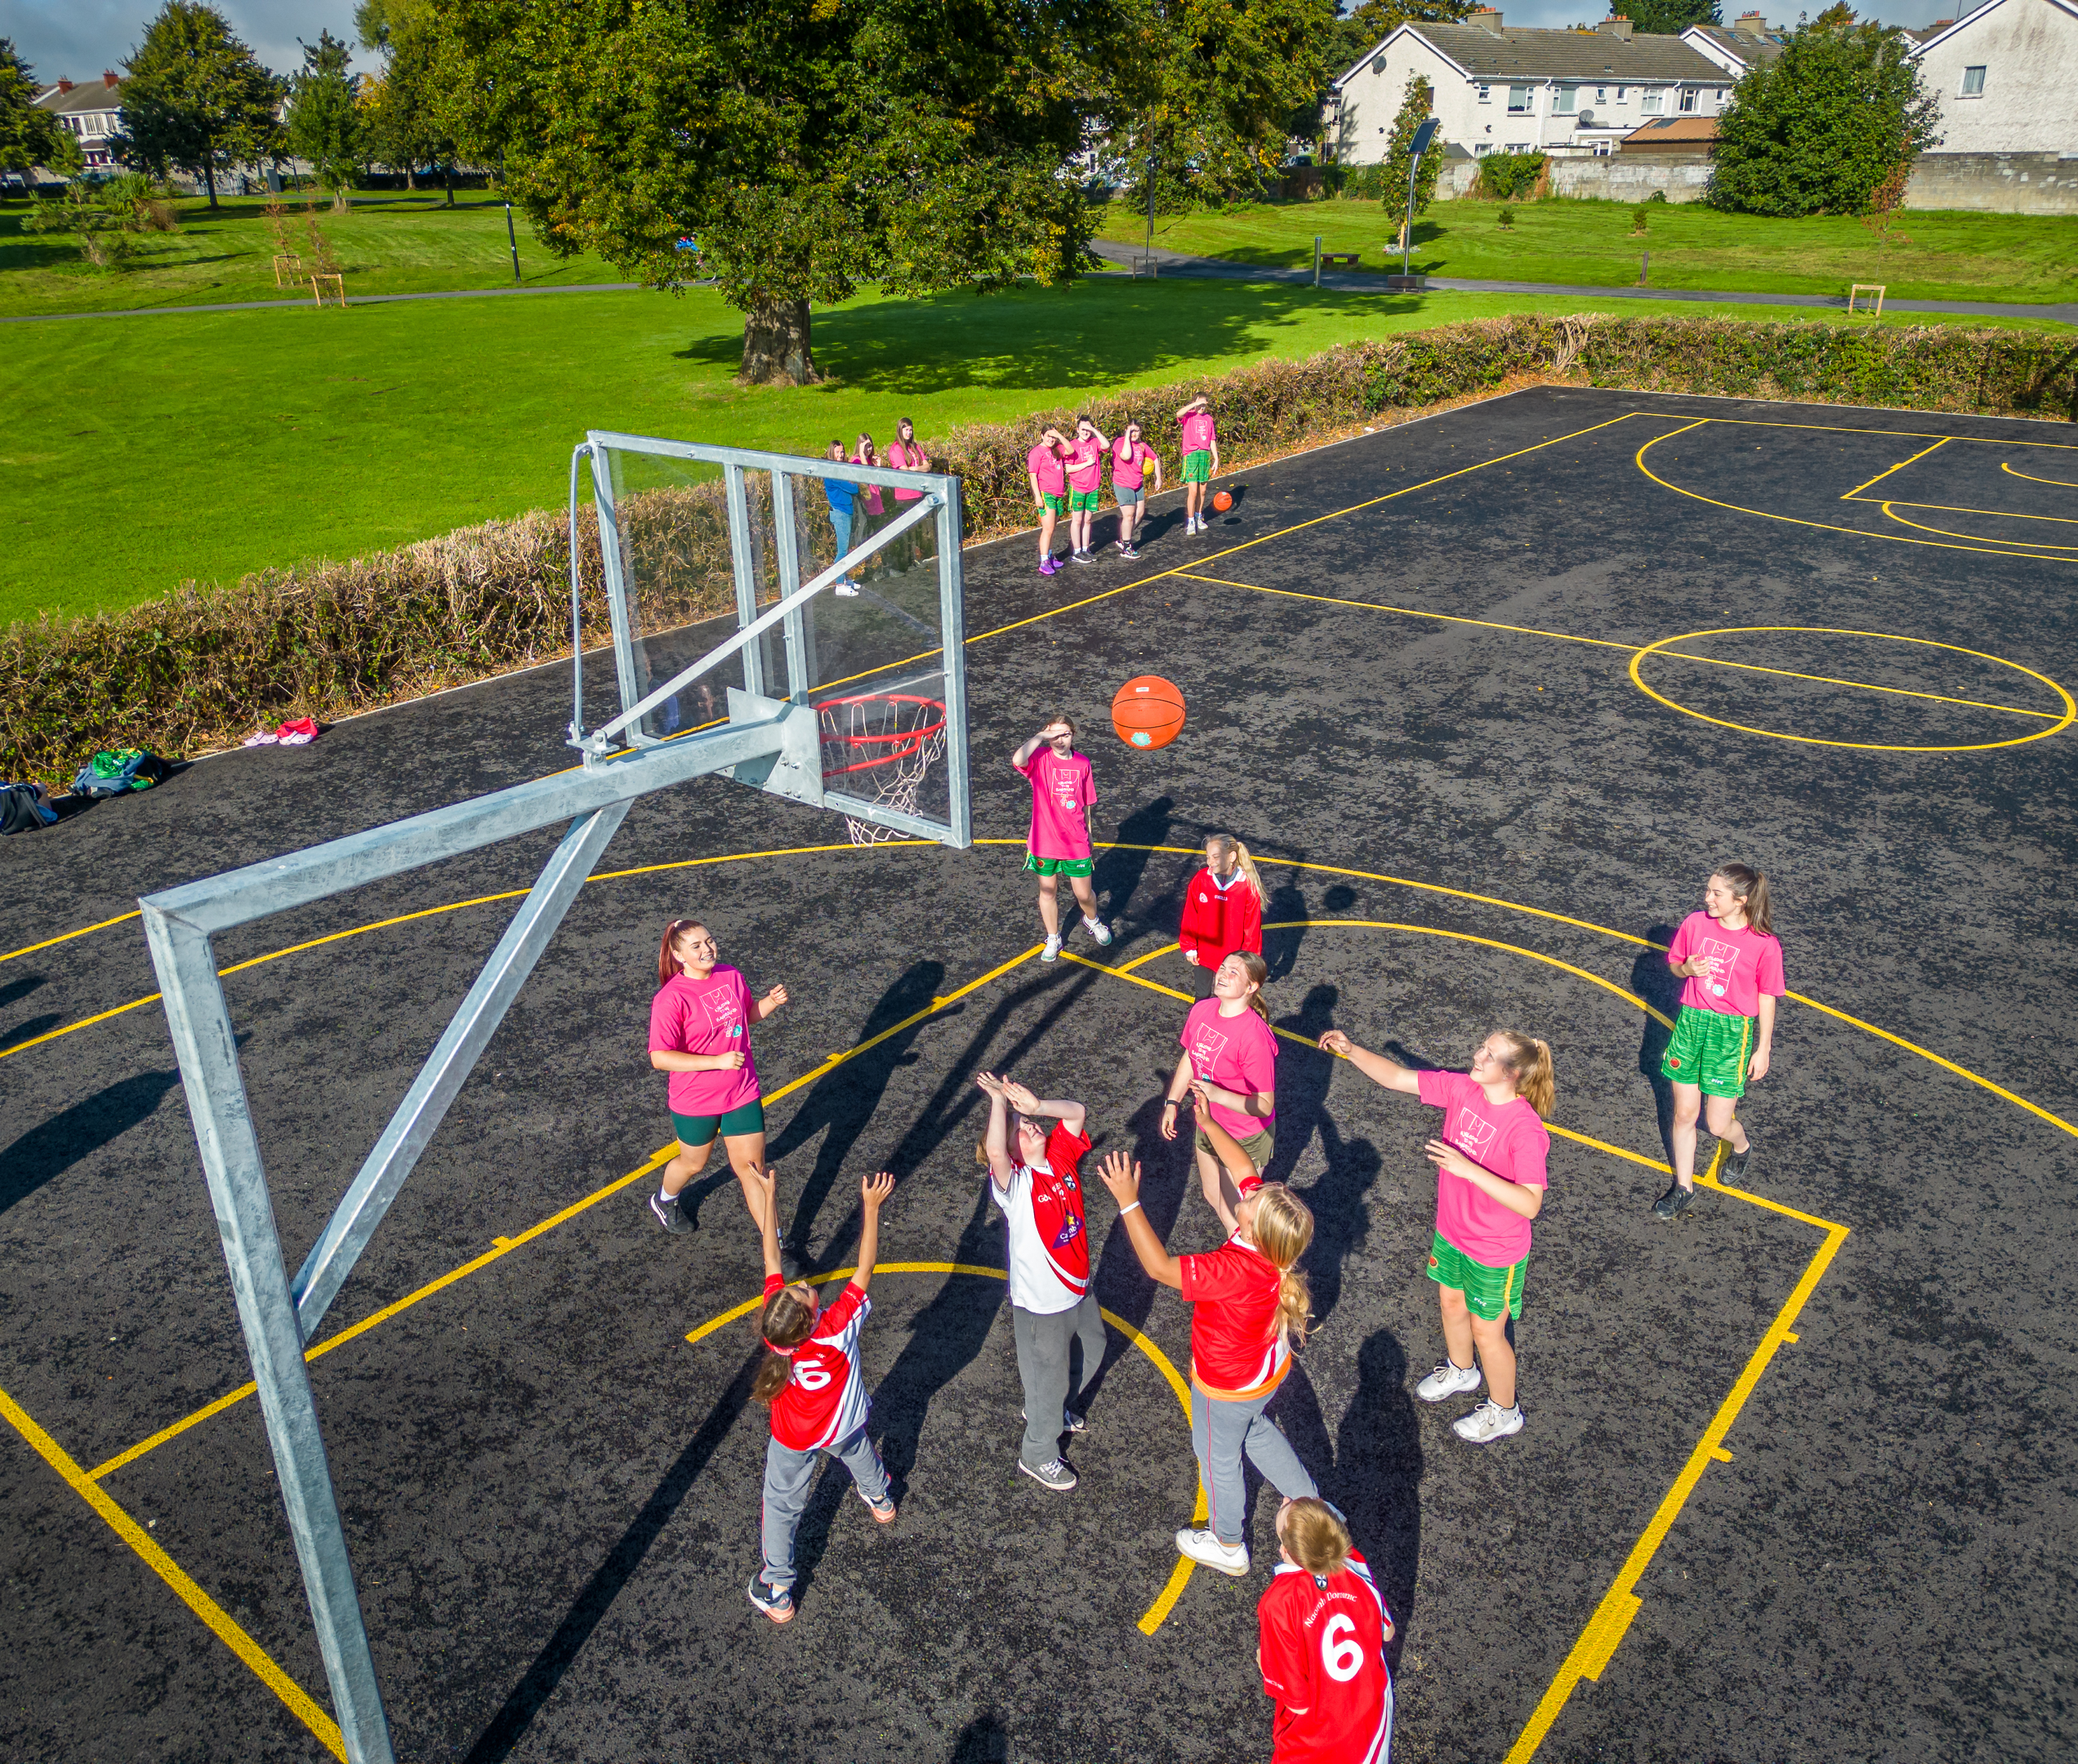
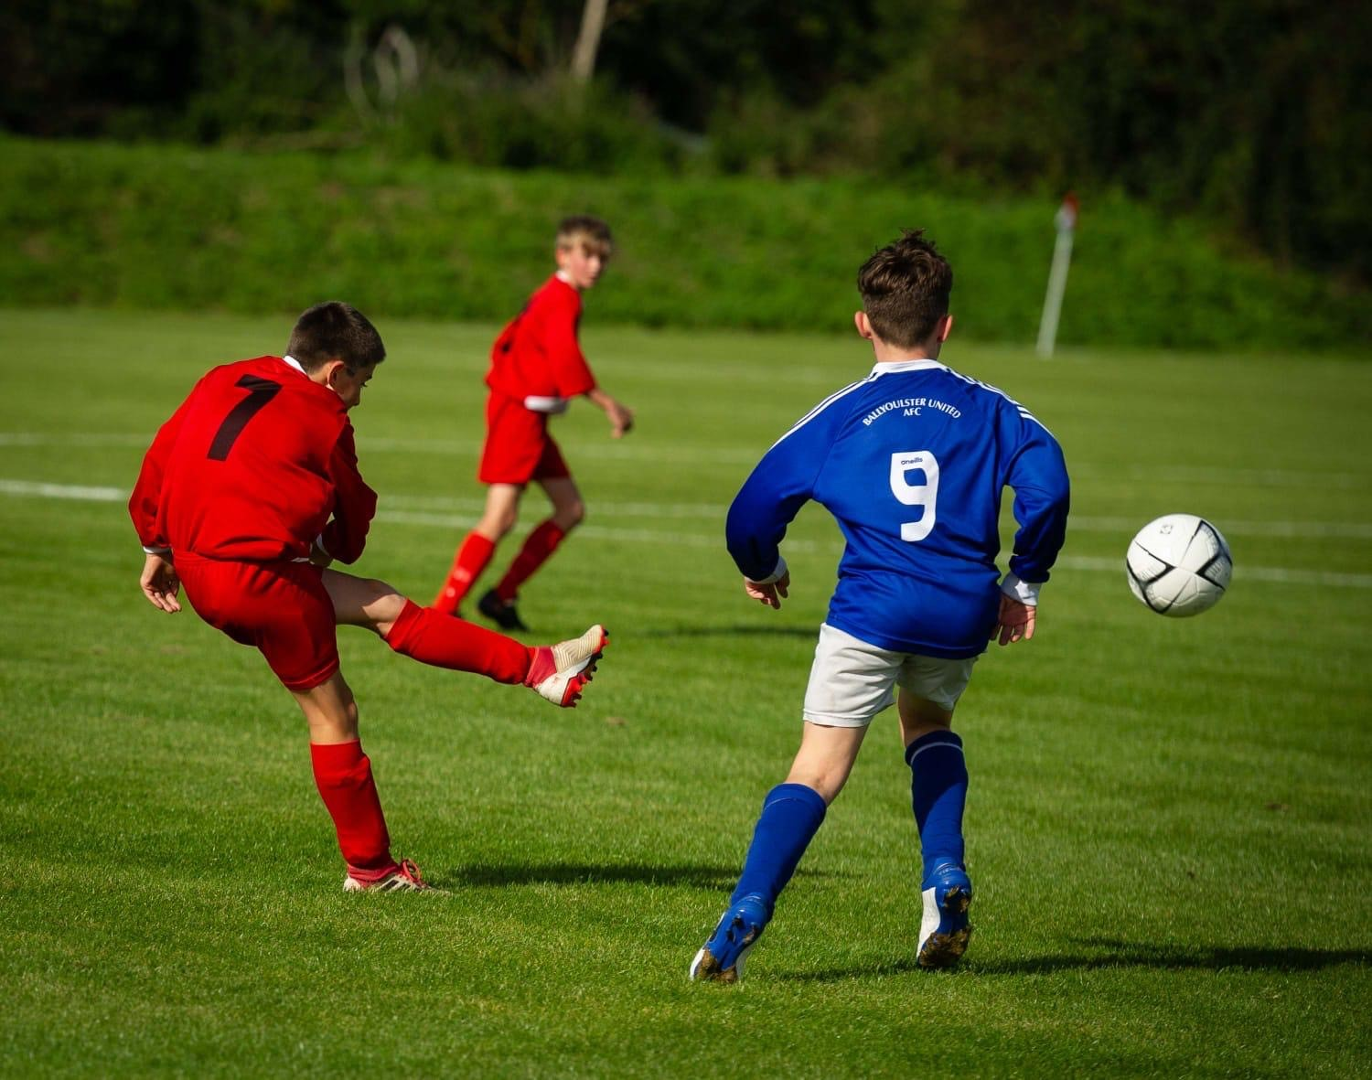
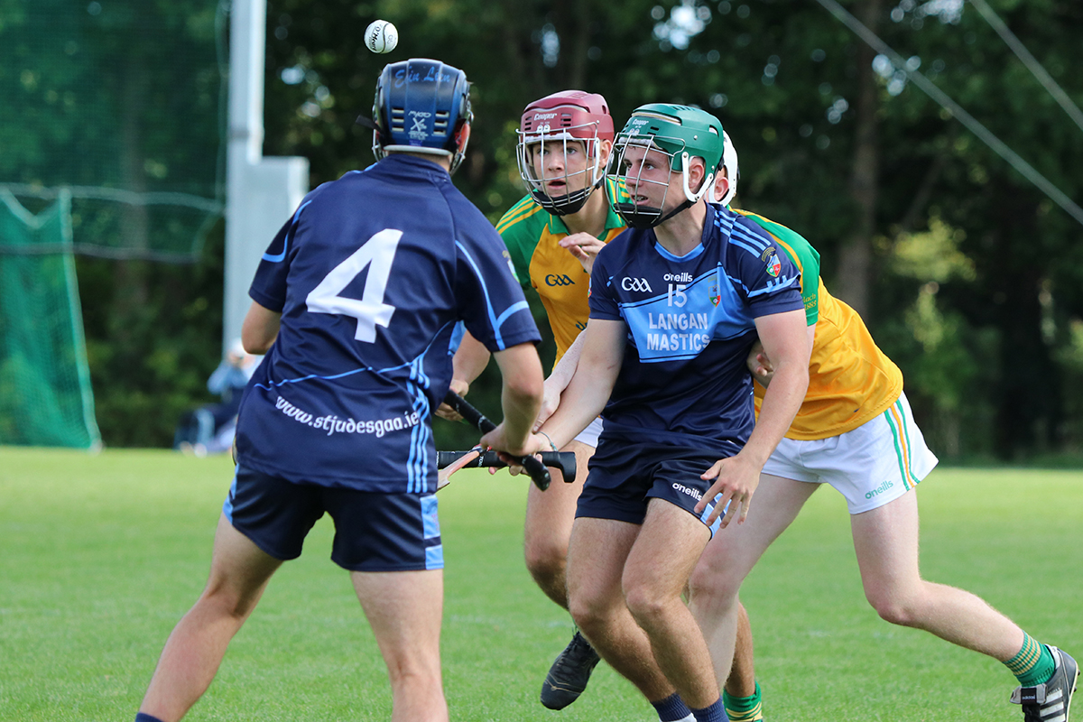
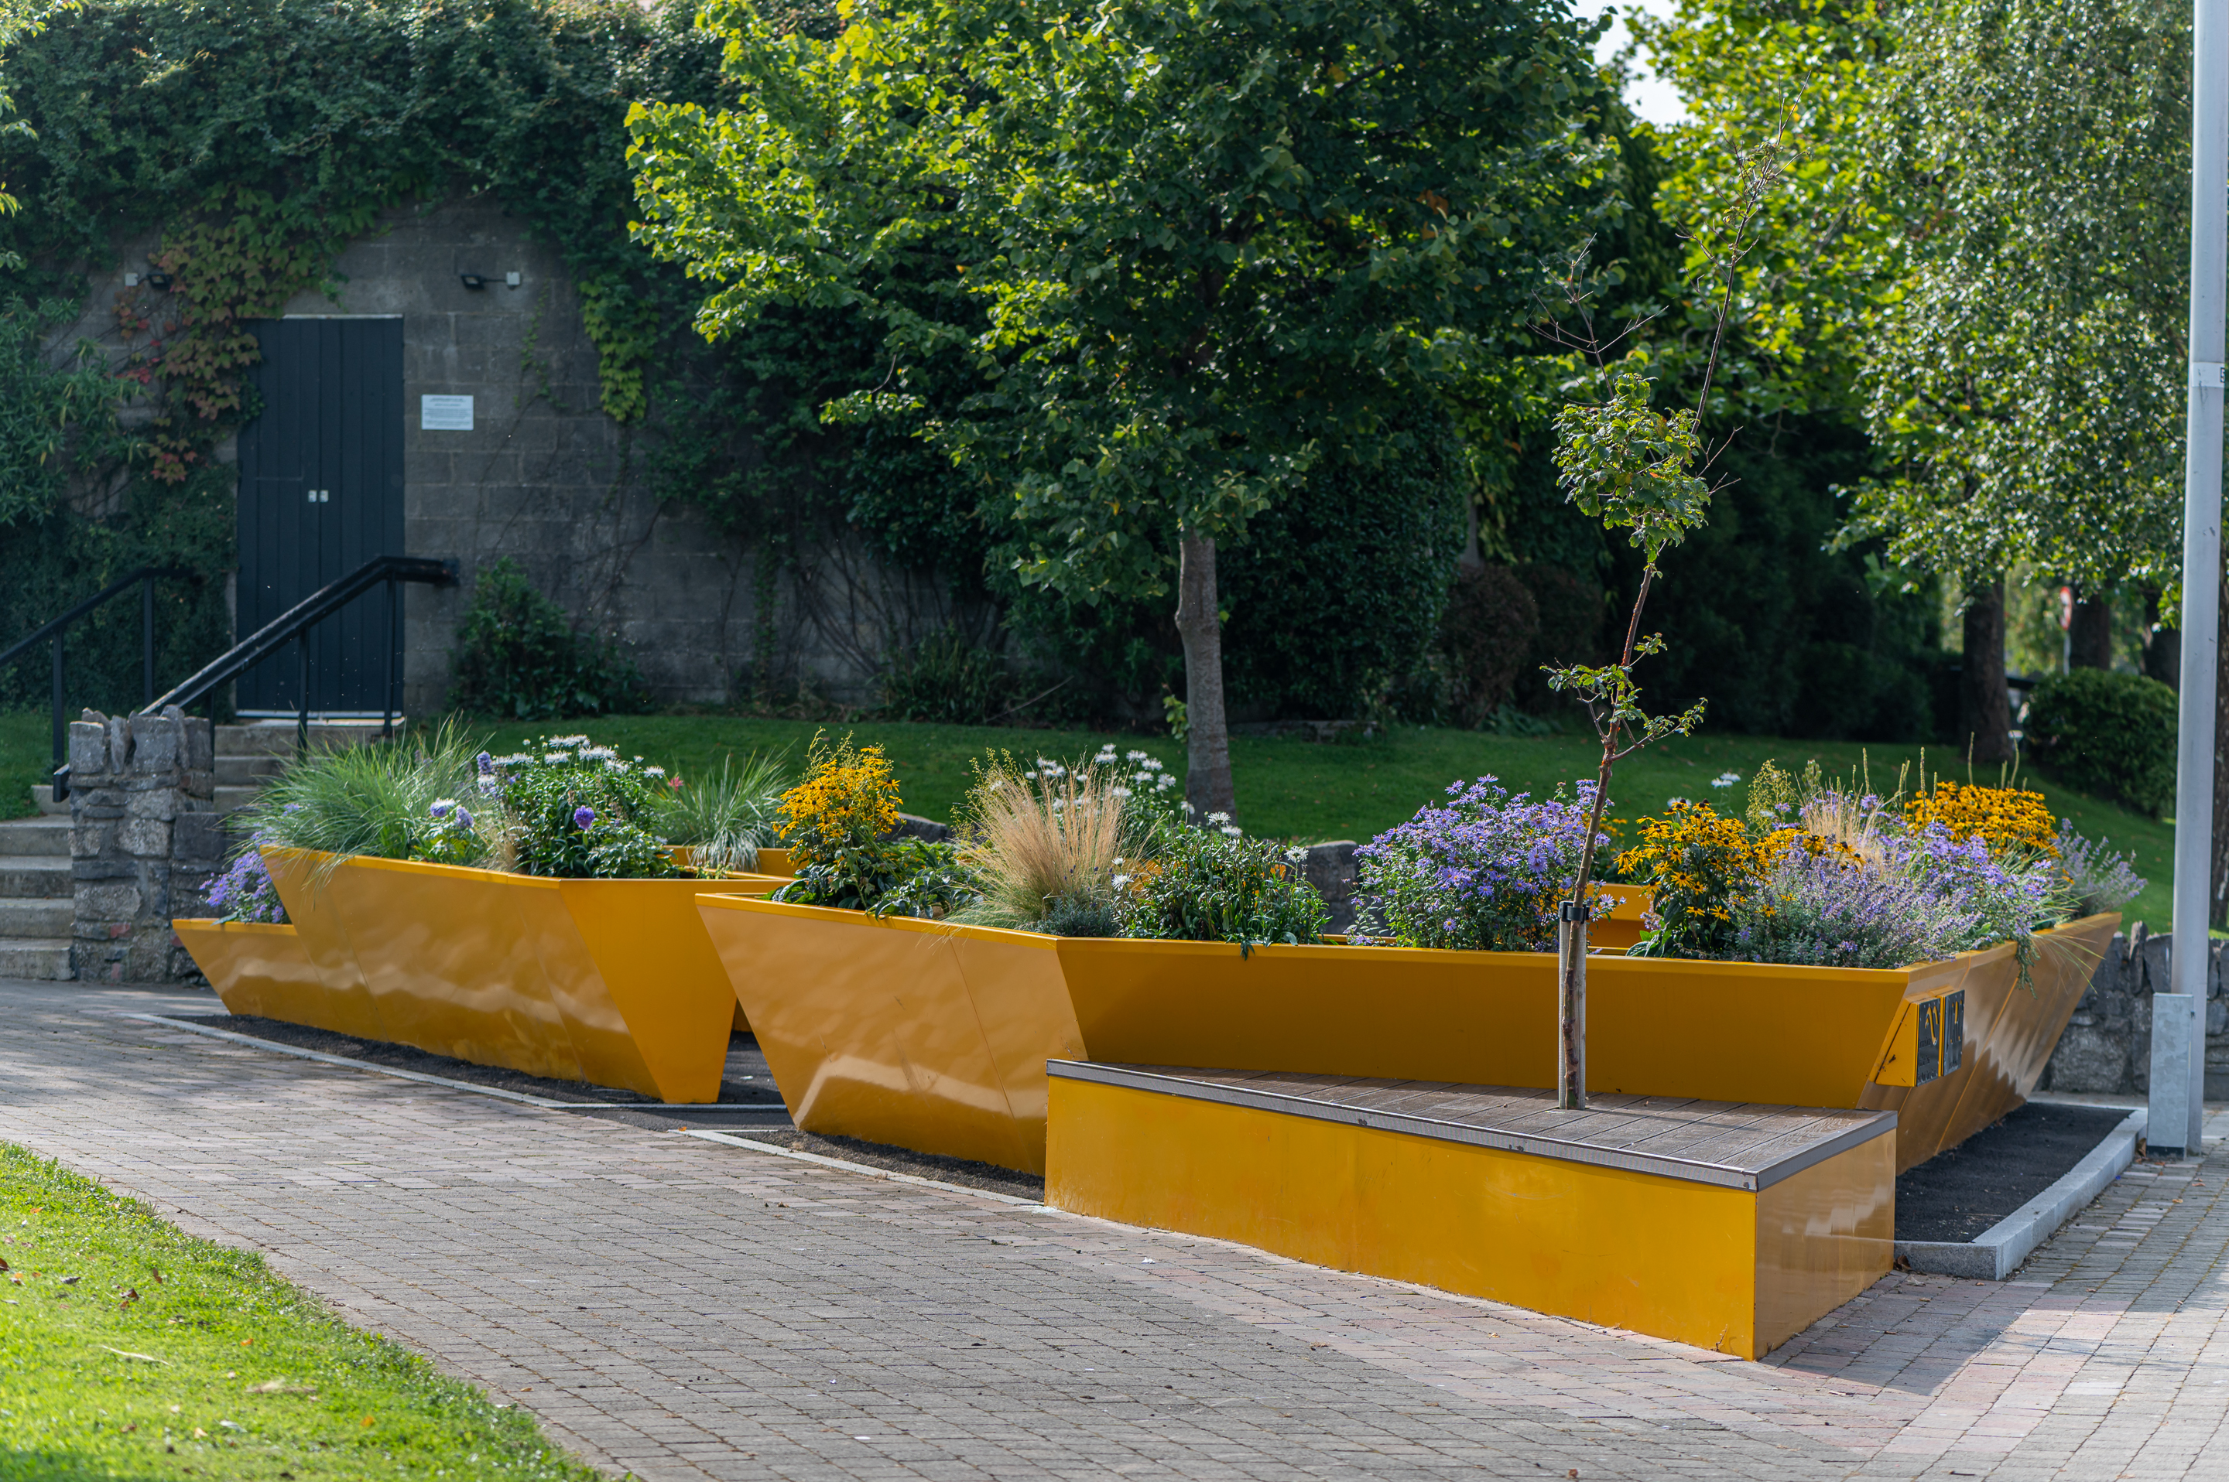
Minor Projects under €500k
No | Location | Description of Works | Cost
1 | Greentrees Park (8 acres & 5 Acres) | Installation of walking/jogging exercise loop, seating, tree planting, associated landscaping. | €75,000 per park (€150k total)
2 | Ballycragh Park | Goal storage compound | €20,000
3 | Greentrees (5 acres) | Goal storage compound | €20,000
4 | Kiltalown Park | Playground upgrade | €150,000
5 | 5 x Water Stations | Supply delivery and installation of water stations in various locations throughout the county | €90,000
Grange Greenway - Water Station
Sports Capital Projects to be delivered in 2024
 | Location | Description of the works | Cost estimate
1 | Dodder Valley Park GAA pitch 98 | Level pitch and drainage | €154,427
2 | Butler McGee Park Soccer Pitch 74 | Drainage | €133,000
3 | Glenaulin Park GAA Pitch 24 | Level & small drainage works | €45,000
4 | Griffeen Park GAA Pitch 13 | Level & small drainage works | €160,000
Dodder Valley Park - Basketball
Templeogue United FC - pitch upgrade
St Judes GAA – pitch upgrade
Firhouse Village - Accessible Planter

Slide 7
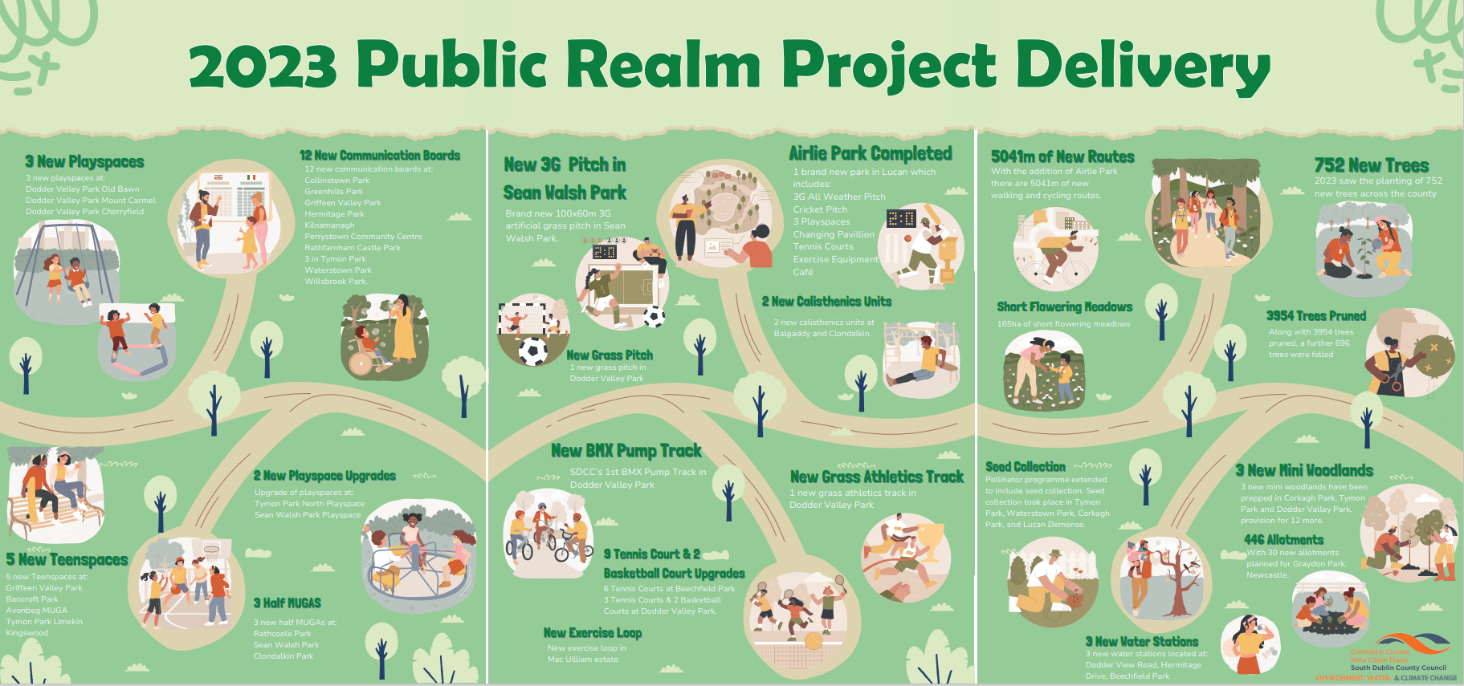

Slide 8

SURFACE WATER MINOR WORKS PROGRAMME 2024
Location | Project | Projected Exp. For 2024
Newcastle /Rathcoole | Clean, Repair and upgrade surface water pipe – follow on works from Surface Water Study | €140,000
Stocking Well | Survey and possible upgrade surface water network | €50,000
Tay Lane, Rathcoole | Regrade road to allow installation of upsized surface water pipework | €15,000
Rathcoole Park | Regrade river bank – to alleviate overspill during heavy rain fall | €5,000
Lucan Village | New surface water pipeline required to facilitate and improve road drainage | €100,000
Butterfield Park | New surface water sewer to allow separation of surface water and foul sewage to alleviate foul sewer flooding. | €65,000
Cloverhill Road (Palmerstown Woods) | New surface water pipeline required to provide improved drainage. Project will coordinate with a Roads project in same location. | €100,000
Total |  | €475,000

