Slide 1
Homeless/Allocations Update
December 2023
(including Homeless Presentations & Exits)
Housing Strategic Policy Committee
8th February 2024

Slide 2
Social Housing List
31st December 2023
Total Current Number of Applications |  |  |  | 6,199
Housing Need by Bedroom Size | North of Naas Road Only | South of Naas Road Only | Both North & South of Naas Road | Total Households | Ad/Ch
1-bed | 792 | 1241 | 1086 | 3,119 | 3,632
2-bed | 625 | 660 | 747 | 2,032 | 2691/2778
3-bed | 320 | 302 | 295 | 917 | 1534/2723
4-bed | 33 | 37 | 61 | 131 | 199/585
Totals | 1,770 | 2,240 | 2,189 | 6,199 | 8,056/6,086
New Applications 2023
 | Jan | Feb | Mar | Apr | May | Jun | July | Aug | Sep | Oct | Nov | Dec | Total
Social Housing | 205 | 164 | 155 | 144 | 243 | 216 | 232 | 215 | 236 | 236 | 211 | 142 | 2399
HAP Approvals YTD | 37 | 45 | 55 | 56 | 61 | 85 | 106 | 112 | 120 | 128 | 134 | 149

Slide 3
Allocations Report 2023
Category | 2022 | 2023
CBL-General | 188 | 118
CBL-HAP | 80 | 120
CBL-RAS Fixed T/F | 3 | 3
CBL-Homeless | 0 | 0
Priority – Welfare | 0 | 0
Homeless | 71 | 172
Medical | 80 | 38
Age Friendly | 55 | 37
Tenant in Situ | 0 | 47
Total | 477 | 535
Transfers | 81 | 91
RAS NTQ | 49 | 50
* 15 Medical transfers

Slide 4
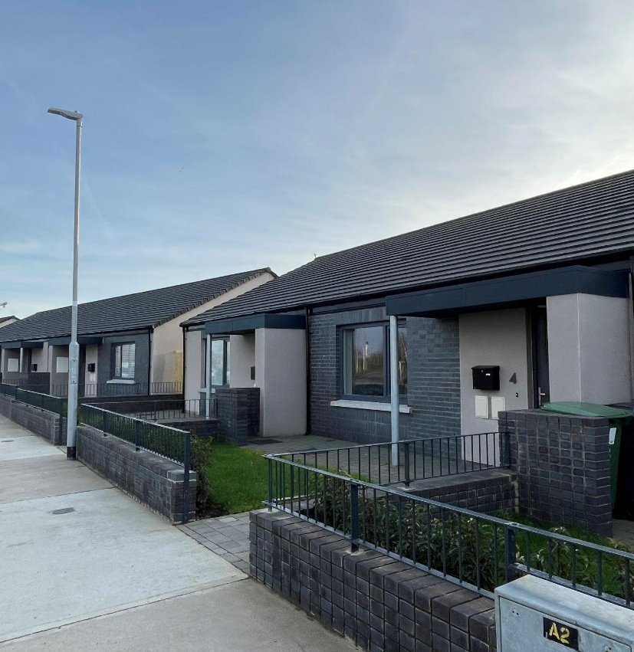
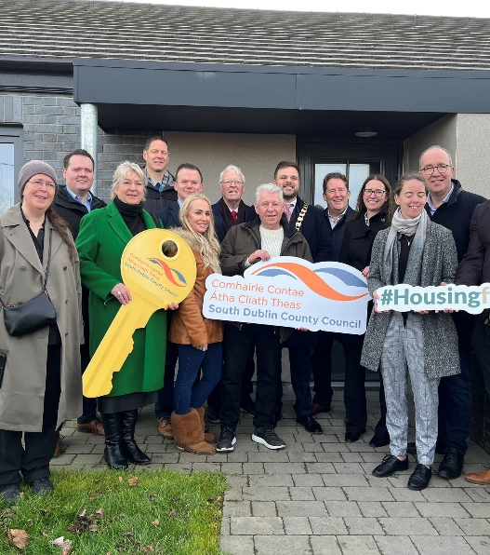
Images from recently tenanted Age Friendly development at Maplewood, Springfield and Targeted Leasing Initiative at Two Oaks, Knocklyon.

Slide 5
Allocations Report 2023
By Bedroom Size/Electoral Area and Avg Time on List
Electoral Area | 1-Bed | 2-Bed | 3-Bed | 4-Bed+ | Total
Tallaght Central | 22 | 14 | 17 | 1 | 54
Tallaght South | 14 | 58 | 66 | 8 | 146
Clondalkin | 53 | 61 | 80 | 4 | 198
Lucan | 24 | 19 | 13 | 6 | 62
Palmerstown/Fonthill | 2 | 12 | 3 | 1 | 18
Firhouse/Bohernabreena | 1 | 2 | 1 | 0 | 4
Rathfarnham/Templeogue | 26 | 23 | 4 | 0 | 53
Total | 142 | 189 | 184 | 20 | 535
Time on List for Allocations | 1-Bed | 2-Bed | 3-Bed | 4-Bed+ | Overall
Average Time On List (years) | 8.8 | 9.7 | 9.6 | 10.2 | 9.6
(excluding Transfers)

Slide 6
Refusals of Properties
193 refusals in 2022
180 refusals in 2023 to date of which
22 refusals from families in EA.

Slide 7
Homeless Register
Homeless Register 2023 | Jan | Feb | Mar | Apr | May | Jun | Jul | Aug | Sep | Oct | Nov | Dec
No. of Homeless Households | 513 | 511 | 512 | 506 | 520 | 530 | 533 | 547 | 551 | 542 | 644 | 698*
Single Male | 245 | 243 | 244 | 229 | 231 | 235 | 237 | 248 | 243 | 233 | 255 | 300
Single Female | 68 | 68 | 68 | 74 | 74 | 73 | 72 | 77 | 76 | 76 | 88 | 94
New Presentations to Clinic | 69 | 91 | 80 | 92 | 81 | 102 | 76 | 104 | 103 | 115 | 90 | 43
Homeless Allocations | 12 | 13 | 13 | 9 | 17 | 15 | 12 | 17 | 15 | 15 | 16 | 18
Self Accommodate 2023
Households in Self-Accommodate by Month | Jan | Feb | Mar | Apr | May | Jun | Jul | Aug | Sep | Oct | Nov | Dec
No. of Households | 100 | 111 | 124 | 129 | 138 | 100 | 107 | 112 | 109 | 109 | 170 | 173
Rough Sleeper Count November 2023
 | Nov-23
Total Found | 118
Pass ID | 114

Slide 8
Homeless Need
(% of Housing List)
Housing List | 1-bed | 2-bed | 3-bed | 4-bed | Total
Housing Need (incl. Homeless) | 3,119 | 2,032 | 917 | 131 | 6,199
Housing Need % Breakdown | 50% | 33% | 15% | 2% | 100%
Homeless Housing Need | 698 | 162 | 107 | 35 | 1002
Homeless % Breakdown | 70% | 16% | 11% | 3% | 100%
% Homeless of Overall Housing Need | 22% | 8% | 12% | 27% | 16%
Exits from Emergency Accommodation
Category | 2019 | 2020 | 2021 | 2022 | 2023
Allocations | 203 | 179 | 136 | 71 | 172
Homeless HAP | 146 | 216 | 223 | 64 | 74
Total Exits | 349 | 398 | 359 | 135 | 246
Preventative HAP | 389 | 369 | 372 | 230 | 234

Slide 9
Age Friendly Housing Demand & Rightsizing Opportunities
Category | Number
Current Rightsizing Applications (age 55+) | 112
EOI’s from Private Homeowners (Community List) | 93
Housing List (1ad/2ad (age 55+)) | 817
Underoccupied 3-bed & 4-bed Tenancies (age 55+) | 1,154

Slide 10
Medical Approval List (including Transfers)
Medical list |  | Physical | Physical | Intellectual/Sensory/MH
 |  | Ground Floor | Wheelchair | Standard
102 | North | 50 | 23 | 29
180 | South | 94 | 35 | 51
139 | Both | 77 | 28 | 34
421 |  | 221 | 86 | 114
Supported Living |  | Physical | Physical | Intellectual/Sensory/MH
 |  | Ground Floor | WH | Standard
41 | North | 9 | 6 | 26
107 | South | 3 | 2 | 102
128 | both | 21 | 13 | 94
276 |  | 33 | 21 | 222

