Slide 1
Bawnogue District Centre Enhancement Scheme
Part 8 – For Approval
February 2024

Slide 2
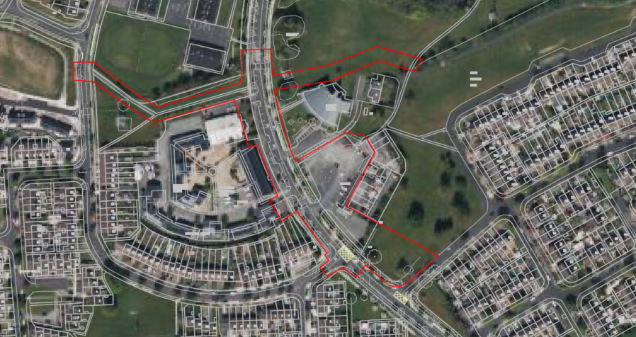
Site Location

Slide 3
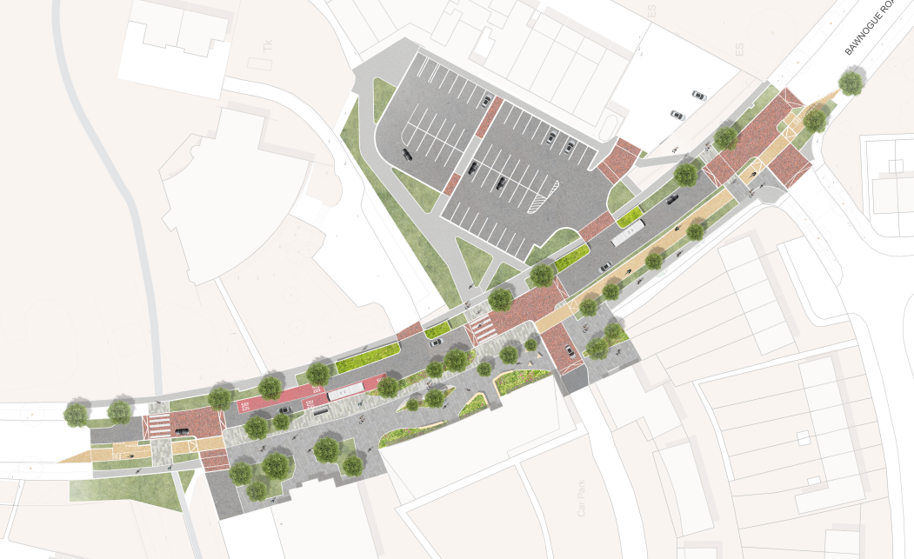
Scheme Proposal

Slide 4
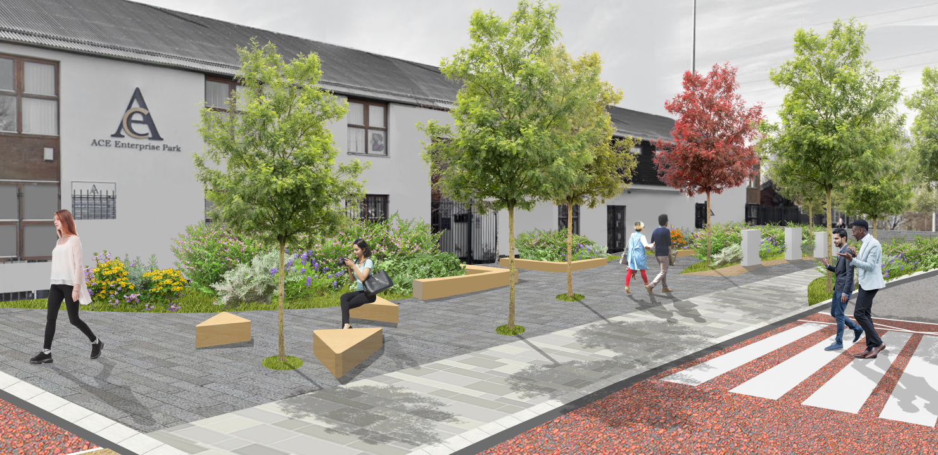
Summary
February 2023
Commencement of Preliminary Design Process
May 2023
Internal Workshop with SDCC Staff / Departments
May & June 2023
Two Stakeholder Workshops (Informal Consultation)
Attended by
Traders
Residents
Councillors
Creche
ACE Enterprise
November & December 2023
Statutory Public Consultation – 8th Sept. – 20th Oct.
February 2024
Part VIII Report brought to Council

Slide 5
Statutory Consultation
Legal Notices erected
Newspaper Advertisement (The Echo)
Corriboard Signage erected locally
Drawings and Particulars on display in Bawnogue ~community centre and online via SDCC Consultation Portal
Two drop-in sessions held in the community centre to discuss proposals
(sessions attended by approximately 70 people)
Regular Social Media Posts.
Notification to prescribed bodies, access groups and local schools.

Slide 6
Statutory Consultation Summary
Online Survey (via SDCC Consultation Portal)
10 Responses
6 in support of the scheme
4 in support of the scheme with changes
0 against the scheme
Submissions (via SDCC Consultation Portal and email/post)
5 Submissions Received
2 in support of the scheme
1 in support of the scheme with changes
0 against the scheme
(Note – Excludes responses that made no selection)

Slide 7
Key Issues Raised
Concerns with Traffic Volume
Anti-Social Behaviour and Street Lighting
Traffic Calming and Road Narrowing
Request for a Playground
Reduction in Parking and Accessible Bays
Responsibility of Maintenance
Please refer to CE Report for a full summary, response and recommendation relating to the items raised.

Slide 8
Key Issues Raised
Please refer to CE Report for a full summary, response and recommendation relating to the items raised.
Key Issue | Issue Details | Summary of CE Recommendation
Concerns with Traffic Volume | Concerns that a narrower road and the traffic calming measures would increase traffic delays | - Narrower lanes will not reduce the capacity of the road but may slow vehicle speeds - Only very minor delays to vehicles may be caused by the introduction of new zebra crossings but this is acceptable considering the pedestrian benefit
Anti-Social Behaviour and Street Lighting | Concerns regarding anti-social behaviour and requesting public lighting as a deterrent | - The scheme increases the level of passive surveillance which is shown to deter anti-social behaviour - Public Lighting improvements are included as part of the scheme and will be considered further at the detailed design stage.
Narrowing of Junctions | Concern regarding the ability to turn in and out of entrances with tight radii | - Junctions will be designed in accordance with National Design Standards and will not impact on the ability of any vehicles turning left or right, however, drivers may have to drive more slowly at junctions. This will have the added benefit if improved safety.
Request for a Playground | Requests for a playground | - Natural play features are provided but no formal playground is proposed under this scheme and there is insufficient budget to provide a new play space within this scheme. - However, the scheme will deliver improved connectivity to the soon be revamped St. Cuthberts Park is part of the scheme
Reduction in Parking and Accessible Bays | Concerns regarding the removal of on street parking | - Surveys have shown ample available parking is available in the Bawnogue Shopping Centre - The re-allocation of vehicle space to public realm space is a crucial part of these schemes
Responsibility of Maintenance | Council to ensure the scheme is maintained to the correct standard | - SDCC will fully maintain the delivered scheme including road, cycleways, and soft landscaping

Slide 9
Recommendation
Following consideration of the submissions received, the Chief Executive is of the view that the minor issues raised by way of submissions and survey responses can be addressed at detailed design stage and as outlined in the CE Report.
It is recommended that as the proposal is consistent with County Development Plan and the proper planning and sustainable development of the area, that the council proceed with the Part 8 proposal for the Bawnogue District Centre Enhancement Scheme

Slide 10
Next Steps
Subject to Part 8 Approval, the scheme will progress to detailed design and subsequently to tender in Q3 of 2024 with a view to commencing construction in Q1 of 2025.
A detailed cost control exercise will be required to ensure the scheme can be delivered in line with the available budget and this will impact scheme options such as materials, landscaping etc.

Slide 11
Thank You

