Slide 1
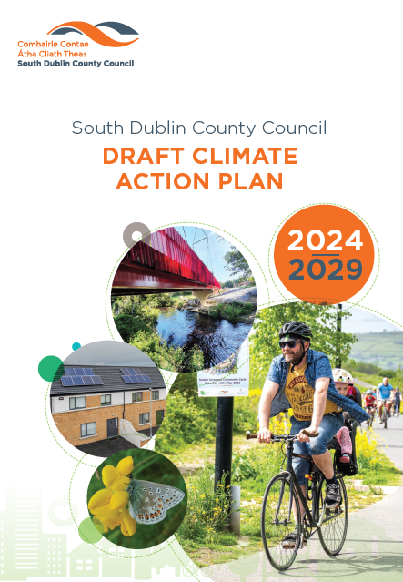
South Dublin County Council Draft Climate Action Plan 2024-2029
County Council Meeting
Monday 12th February 2024
Teresa Walsh
Director of Environment, Water and Climate Change

Slide 2
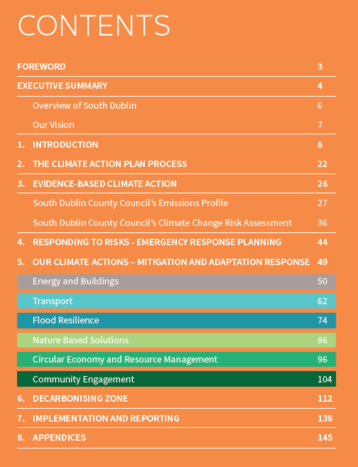
Draft Climate Action Plan 2024 – 2029
Statutory LA CAP 2024-2029 must be ‘approved’ within 12 months and be in line with the Ministerial Guidelines – by 23rd February 2024.
The Draft Plan was on Public Consultation for over 6 weeks from 20th September to 3rd November 2023.
The Draft Plan is accompanied by the Strategic Environmental Assessment (SEA) and the Natura Impact Report (NIR).
It is an evidenced-based approach, building on a Baseline Emissions Inventory, a Climate Change Risk Assessment, and the previous CCAP 2019-2024.
Local Authority CAP Guidelines published by Minister.

Slide 3
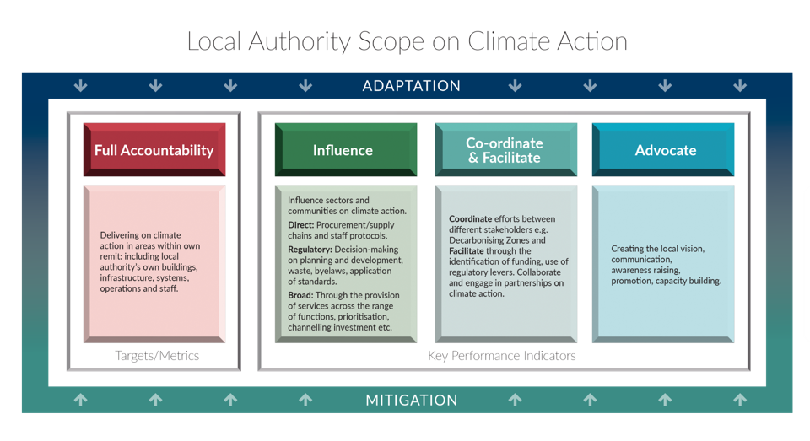
LA Climate Action Plan Guidelines

Slide 4
Our Climate Action Targets and Action Areas
Draft Climate Action Plan 2024-2029 Targets
50% improvement in the Council’s energy efficiency by 2030;
6 Action Areas in SDCC’s Draft CAP
Transport
Flood Resilience
Nature Based Solutions
Circular Economy and Resource Management
Community Engagement
Energy & Buildings
51% reduction in the Council’s greenhouse gas emissions by 2030;
To make Dublin a climate resilient region, by reducing the impacts of future climate change-related events; and
To actively engage and inform our communities on climate action.
121 proposed Actions across the 6 Action Areas

Slide 5
Pre-Draft Engagement
Early Engagement Workshops with Elected Members and all Strategic Policy Committees (SPCs) prior to Public Consultation, held on 7th and 8th June 2023.
An update on Draft CAP preparation was given at each of the Environment, Public Realm and Climate Change SPC Meetings, held on 7th February, 2nd May and 5th September 2023.
An update on Draft CAP preparation was given at Corporate Policy Group (CPG) Meetings, held on 6th March, 2nd June and 2nd October 2023.
Chief Executive Monthly Reports – articles, including notifying of Draft Plan preparation.
Meeting and follow-up workshop with Senior Management, held on 17th April 2023.
Workshops with each of the six Climate Action Sub Teams held on 9th, 10th, 17th May 2023.
Meetings with Climate Action Steering Group, 22nd May 2023.
Monthly meetings as chaired by the Dublin Climate Action Regional Office (CARO)
Coordination with the Dublin local authorities and Codema – Dublin’s Energy Agency, on the preparation of the Draft Plans.
Meeting with adjoining Dublin local authorities, Meath, Wicklow and Kildare local authorities held on Friday 28th July 2023.
Notes:
!

Slide 6
CAP 2024–2029: Public Consultation
Public Consultation took place from 20th September to 3rd November 2023.
Draft Plan was on display at a number of locations:
County Hall, Tallaght
Clondalkin Civic Offices
County Library, Library Square, Tallaght, Dublin D24A3EX.
Ballyroan Library, Orchardstown Avenue, Rathfarnham, Dublin D14 VY33.
Clondalkin Library, Monastery Road, Clondalkin, Dublin D22 XPO3.
Lucan Library, Lucan Shopping Centre, Newcastle Road, Lucan, Dublin K78 V295.
North Clondalkin Library, Liscarne Close Rowlagh, Dublin 22.
Castletymon Library, Tallaght, D24
Submissions could be made through one of the following two options only:
Electronically through the Council’s Online Public Consultation Portal - http://consult.sdublincoco.ie | up to 11.59pm on Friday 3rd November 2023
In writing, addressed to the Senior Engineer, Climate Action, Environment, Water and Climate Change Department, County Hall, Tallaght, Dublin 24 | not later than 4.00pm on 3rd November 2023

Slide 7
CAP 2024–2029: Public Consultation
Events were advertised on Council website, SDCC Climate Action Website and Social Media.
Public Consultation Events – Come and Speak to us! | When
Edge café, The Edge, Avonmore Rd, Tallaght, Dublin 24, D24 K07Y | 5-9pm on Wednesday 4th October
Lucan Presbyterian Church, 2 Hanbury Ln, Main St, Lucan, Co. Dublin, K78 AD90 | 3-7pm on Wednesday 11th October
Clondalkin Civic Offices, Ninth Lock Rd, Clondalkin, Dublin 22, D22 E9X5 | 3-7pm on Thursday 12th October
Mansion House, Dublin, the four Dublin local authorities hosted a joint event, with lots of speakers and activities | 3-8pm on Tuesday 17th October
Pop Up Information Stand in SDCC Libraries | When
Tallaght Library, Dublin D24A3EX | Monday October 9th, 3-5pm
Castletymon Library, Tallaght | Friday October 13th, 2-4pm
Ballyroan Library, Rathfarnham, D14 VY33 | Wednesday October 18th, 3-5pm
Lucan library, Newcastle Road, Lucan, Dublin | Wednesday October 25th, 3-5pm
Clondalkin Library, D22 XPO3 | Thursday October 26th, 3-5pm
North Clondalkin Library, D22 E2Y2 | Tuesday October 31st, 3-5pm

Slide 8
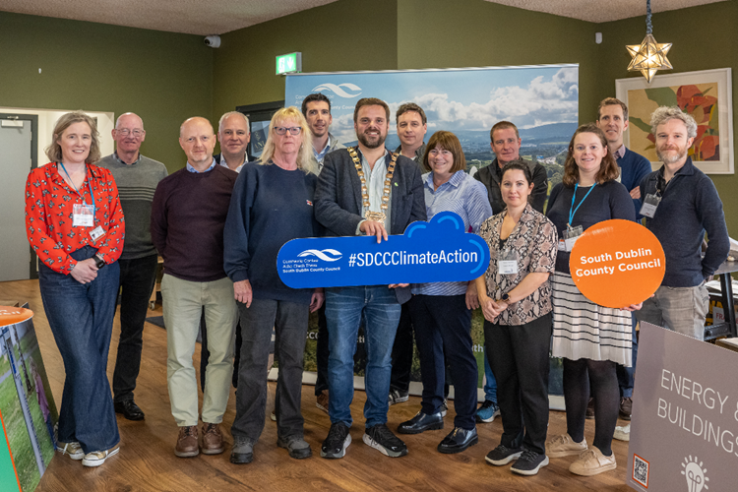
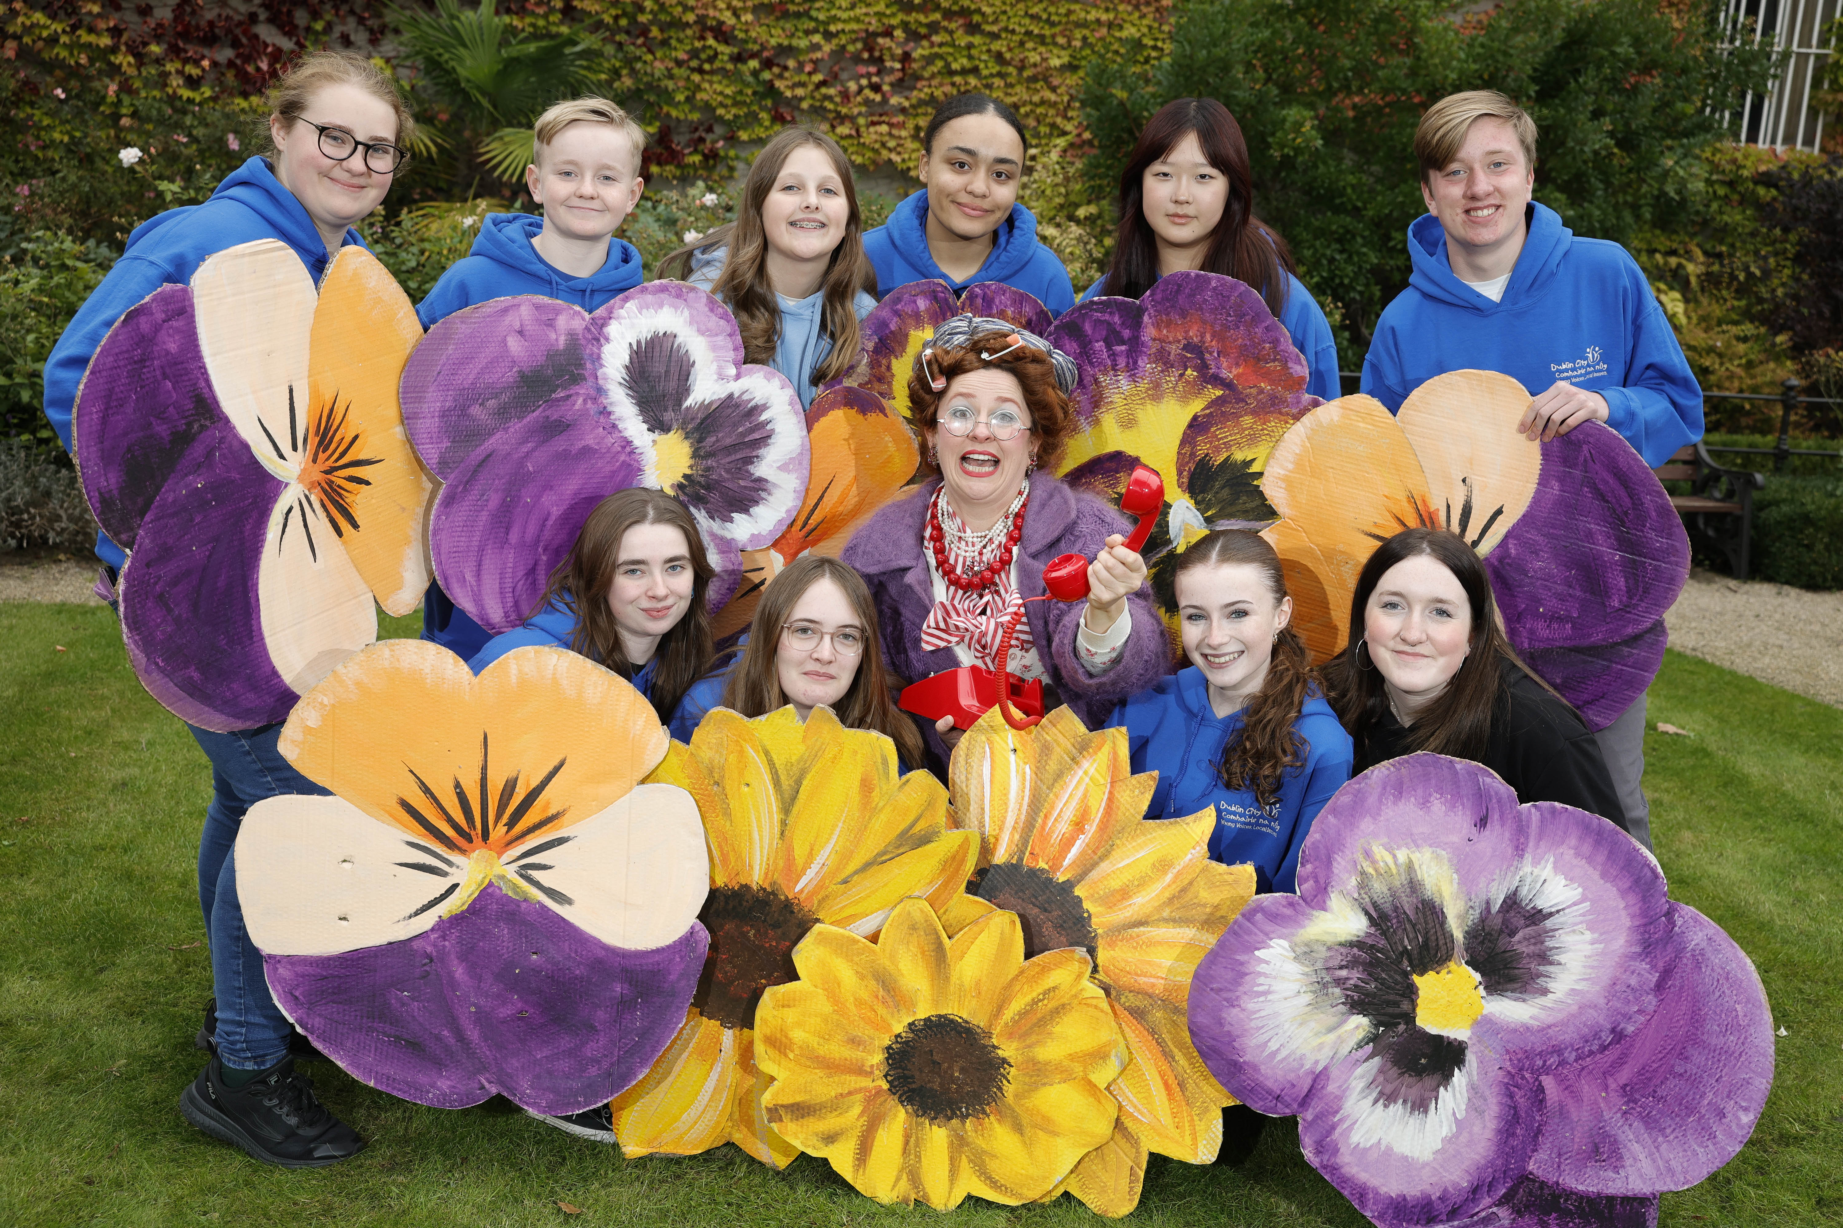
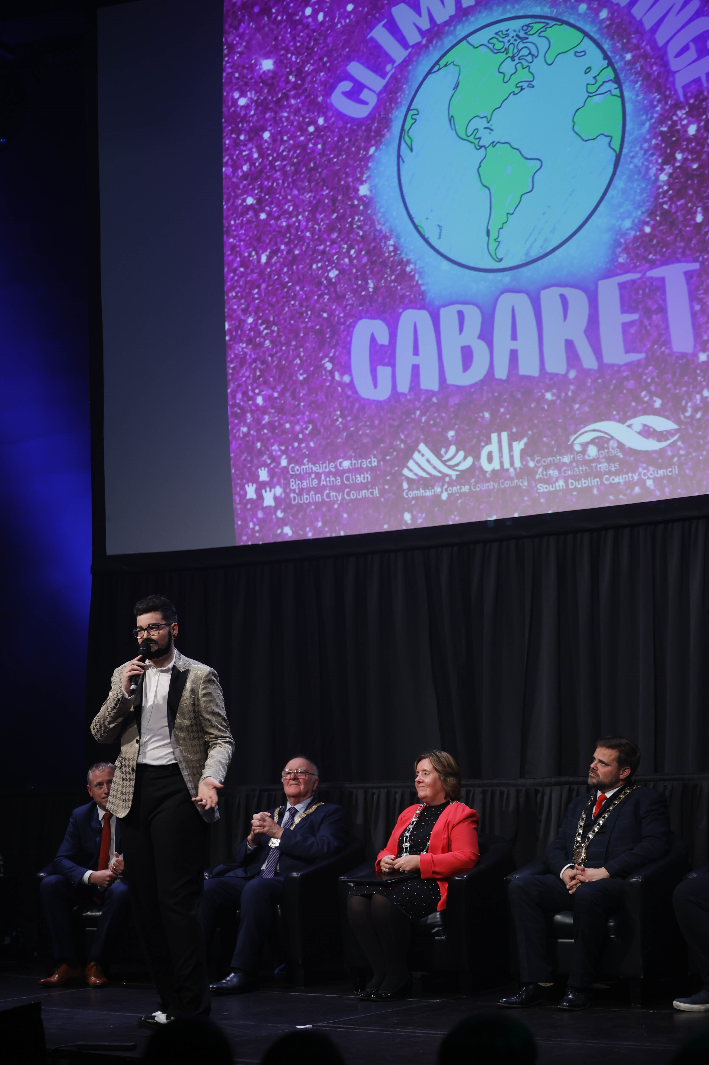
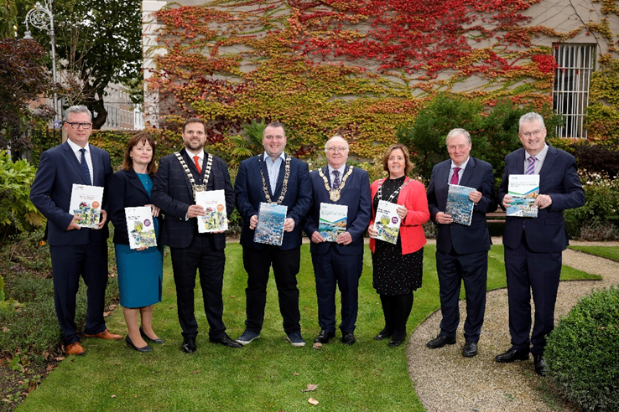
CAP 2024–2029: Public Consultation
Notes:
!

Slide 9
General Overview of Submissions
32 valid submissions received – range of individual and stakeholder submissions.
Submissions from the Department of the Environment, Climate and Communications, Department of Transport and others.
Submissions from Elected Members, MEP.
Most submissions focused on one or two chapters or topics of specific interest to the submitter.
The majority of submissions were supportive of the Climate Action Plan, providing comments or contributing suggestions to the Plan contents.

Slide 10
CAP 2024–2029: Issues Breakdown
Submission Heading | No. of Issues Raised | % of Issues Raised
Department of the Environment, Climate and Communications | 3 | 1.3%
Department of Transport | 17 | 7.1%
Section 1: Introduction | 6 | 2.5%
Section 2: Climate Action Plan Process | 5 | 2.1%
Section 3: Evidence Based Climate Action | 12 | 5%
Section 4: Responding to Risks - Emergency Response Planning | 2 | 0.8%
Section 5a Energy & Buildings | 32 | 13.4%
Section 5b Transport | 50 | 21%
Section 5c Flood Resilience | 13 | 5.5%
Section 5d Nature-based Solutions | 38 | 16%
Section 5e Circular Economy and Resource Management | 19 | 8%
Section 5f Community Engagement | 22 | 9.2%
Section 6 Decarbonizing Zone | 3 | 1.3%
Section 7 Implementation & Reporting | 8 | 3.4%
Strategic Environmental Assessment (SEA) and Appropriate Assessment | 8 | 3.4%
Total | 238 | 100%

Slide 11
Proposed Non-Material Modifications include…
Energy & Buildings:
Maximise opportunities to avail of funding sources, to support a range of climate action projects across the County, including European Union (EU) funding streams.
Community Engagement:
Engage with communities and residents across the County, through local pop-up awareness raising events, on home energy upgrades, funding and other supports available.
Nature Based Solutions:
Maintain and expand allotments for local food production across the County, in accordance with SDCC’s Allotments Policy.
Support the provision of Community Gardens for local food production across the County, in partnership with Community Centres, Schools and other local groups.

Slide 12
CAP 2024–2029: Approval and Publication
In accordance with the requirements of the Climate (Amendment) Act 2021, the Elected Members must decide by resolution, whether to:
approve, or
approve, subject to such modifications as they consider appropriate, the local authority climate action plan.
Given the statutory 12-month duration of the Plan making process, as set out in Section 16 of the Climate (Amendment) Act 2021, a Material Amendment phase, is not provided for under the legislation.
As such, all local authorities are required to make and approve their Climate Action Plan, by 23rd February 2024.
Within thirty (30) days of the approval of the final local authority Climate Action Plan by the Elected Members, the Council will publish the final plan – by March 12th 2024.
The Climate Action Plan shall have effect for a period of five years from the date on which it is approved by the Elected Members.

Slide 13
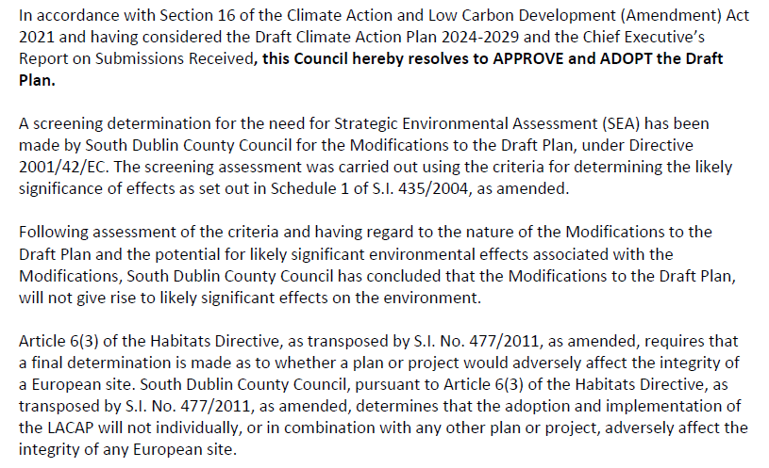
Resolution

Slide 14
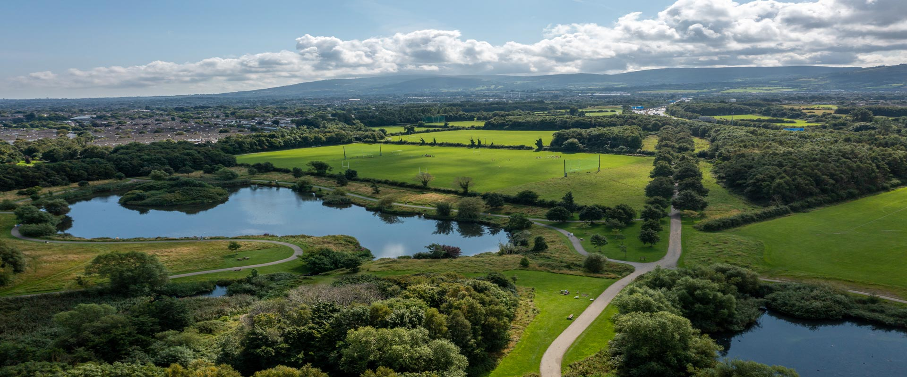
Thank You

