Slide 1
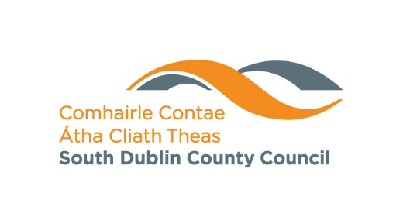
In Context 5 - CONNECT South Dublin County Council’s Public Art Programme under the % for Art Scheme 2022-2025

Slide 2
SDCC Arts Office
Arts Officer, Orla Scannell,
Assistant Arts Officer, Meabh Butler
Creative Ireland Engagement Officer, Eithne Swaine,
NOISE Music, Gerry Horan
Graduate Sound Engineer, Bryan Fleming
Music Generation Music Development Officer, Fionnuala Howard

Slide 3
SDCC Arts office strategies
ReFrame – Arts Development Strategy 2022- 2026
Early Years and Childrens Strategy 2020- 2025
South Dublin County Development Plan
Creative Ireland South Dublin strategy 2022 - 2027

Slide 4
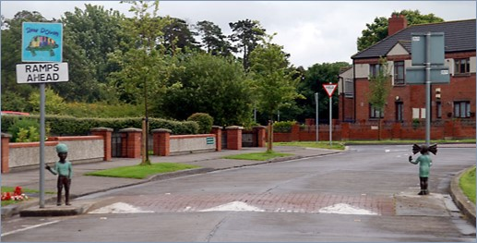
In Context – South Dublin County Councils Public Art Programme
Began in 1997
4 iterations since then
22 commissions and projects across the county – temporary and permanent interventions
Sugar and Spice, Louise Walsh. St. Finians Estate

Slide 5
Main Features
Sensitivity to context
Community engagement
Diversity and excellence in art form and discipline
Site or non-site specific and permanent or temporary
Value of community involvement
Blip, Corban Walker

Slide 6
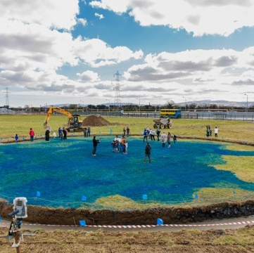
In Context 5 – CONNECT Strand 1 Early Years, Children and Young People Every Individual is part of our story
Identity – building a pride of self, community and place
Community – participation and co-creation
Leaving it better - legacy
Image: The Central Field, Rhona Byrne

Slide 7
6 commissions
Early years x 2
7-12 year olds x 2
13 – 18 year olds x 2
Image: Doors to Elsewhere, at the Public launch of In Context 4

Slide 8
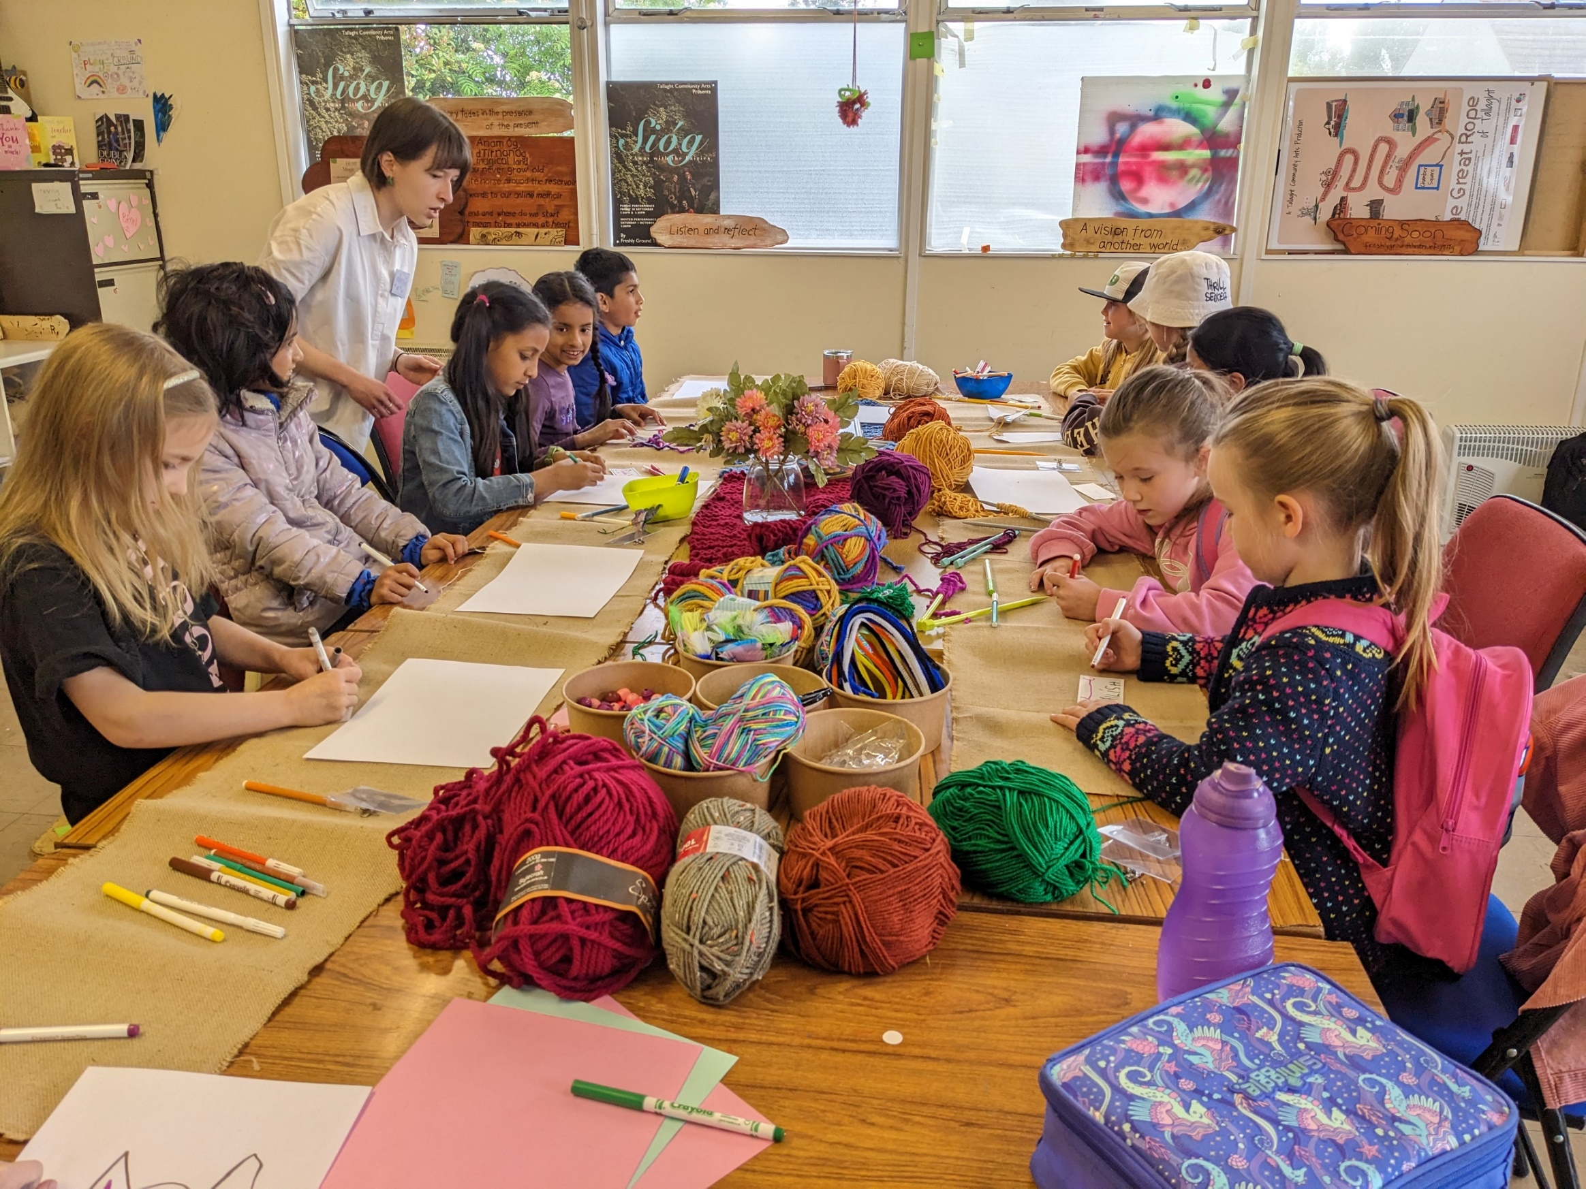
Artists: Freshly Ground Theatre
St. Aidan’s, Brookfield (4-6 years old)
Project: Under the Sea
An open, interactive exhibition where children and their parents will be invited to play and discover together, exploring the beauty and wonder of life under the sea and the importance of maritime stewardship
Potential Partners: Creative Places MacUlliam, Barnardos, Meadow bank and the local community
Timescale: April – June 2024

Slide 9
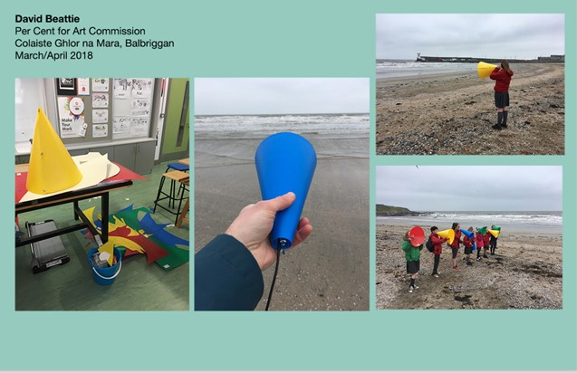
David Beattie w/ Arts educator Anne Bradley and illustrator Fuchsia MacAree
Mayfield Court, Clondalkin (0-6 years old)
Project: A, B, C
A, B and C is a collaborative, multi-part project that will explore sound and the sonic environment of a locality from a child’s perspective. the project intends to deliver a series of workshop engagements with children aged 3-6 in the Clondalkin area around three core areas- listening and exploring the sonic landscape of the area from a child’s perspective, playfully exploring language, both written and oral, through phonics to help describe a child’s experience of sound, and working with the children through image, illustration and visual means to help visualise their sonic worlds.
Partners: Clondalkin Library, Aras Chronain, Gaelscoils, The Towers

Slide 10
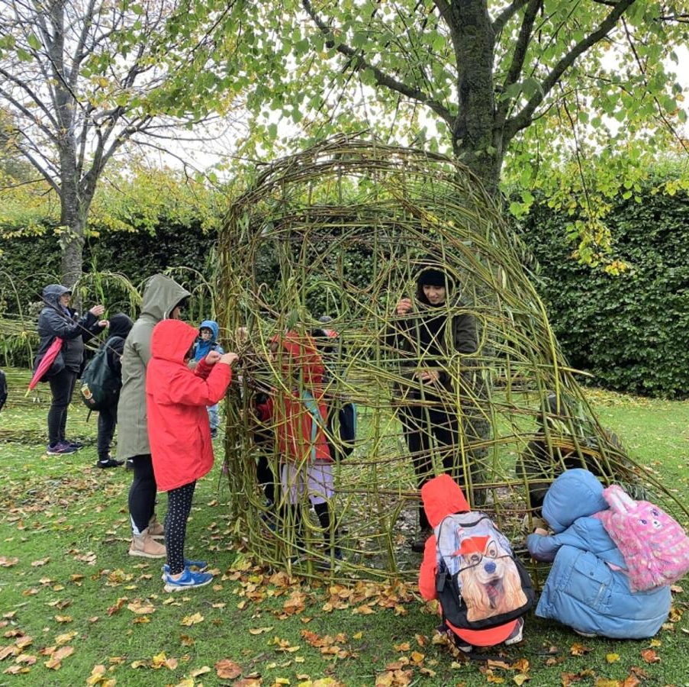
Sophie Van Maltzan
Killininny, Firhouse (7 – 12 year olds)
Project: Feel the Land – a temporary outdoor community centre.
A series of creative workshops that explore the biodiversity and environment of Killininny. The children will explore nature in the neighbourhood with Von Maltzan and an entomologist, botanist and ecologist. This will be followed by spatial explorations through, for example, making land art with natural and recycled materials, making clay and other art materials from the environment, and then using the clay for making sculptures and also exploratory painting, culminating in a one-day festival in May / June
Partners: Local Schools, Park Community Centre, Community Department, SDCC public realm

Slide 11
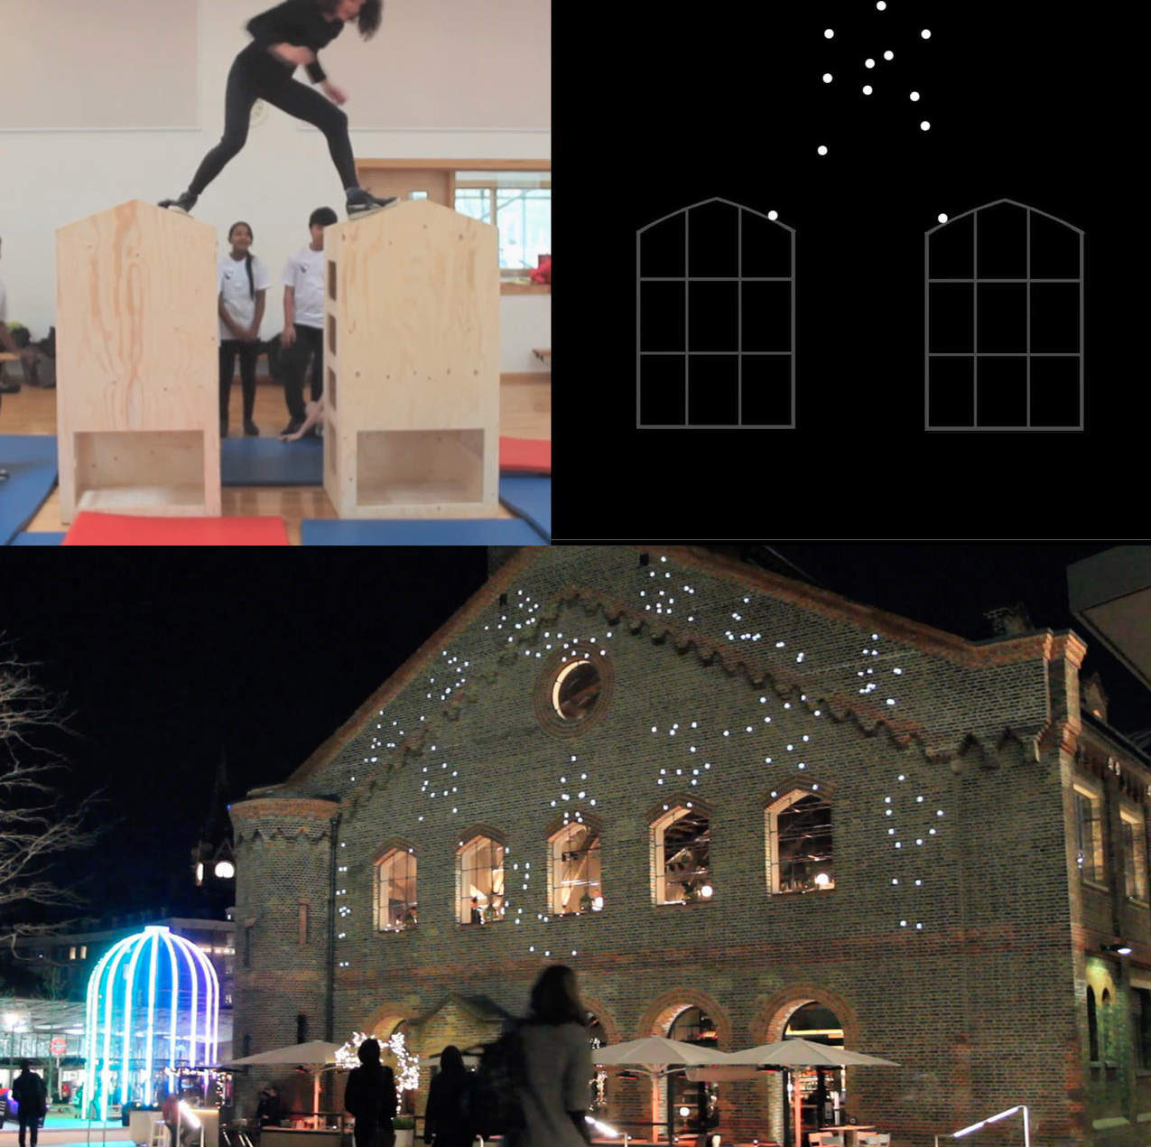
Cleary Connolly with Cindy Cummings (dancer) and Mandivar (musician)
St Cuthberts Meadow, Deansrath, Clondalkin (78 – 12 year olds)
Project: Dancing dots
a participative art project for 7-12 year olds and their families living on St. Cuthberts Meadow. It is a study of the human body in motion reduced to a simple play of moving dots, using movement and music
Partners: St Ronans (?), Talbots (?), Intercultural Centre (?)

Slide 12
John Conway with Elaine Hoey
Lett’s Field, 9th Lock, Ronanstown, Clondalkin (13 – 18 years old)
Project: a film and augmented reality project exploring loss and bereavement in the community

Slide 13
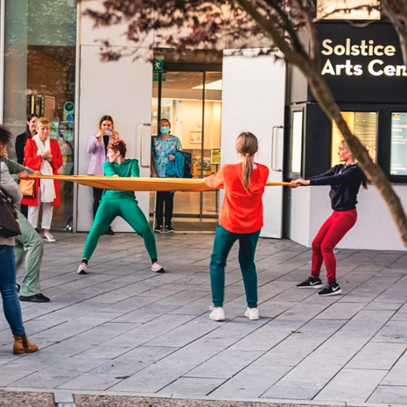
Selma Daniels - OutWall
OutWall is a dance theatre performance for public spaces that explores architecture, movement and the concept of self-isolation, that will take place the end of April in the Cultural Quarter. It will be a collaboration between Choreographer Selma Daniels and Creative Places Mac William.
Funded under the Outdoor Public Performances Scheme % for Art.

Slide 14
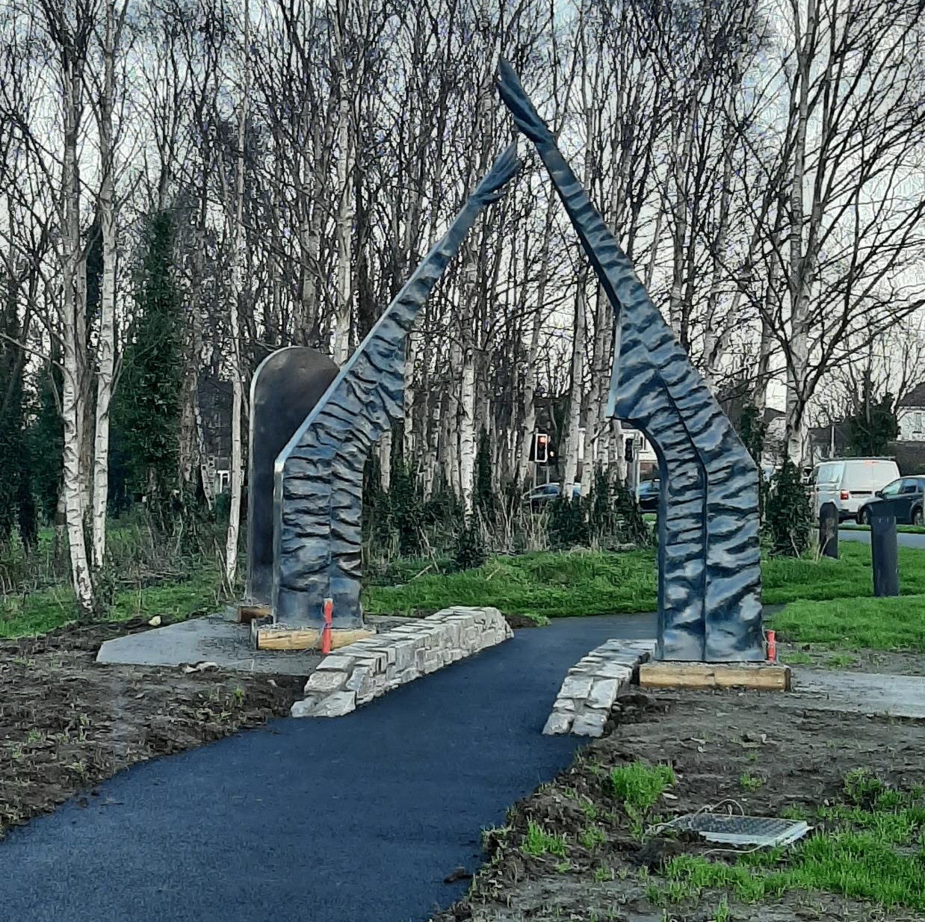
Holger Lonze - An Chluain
Location: Adjacent Woodford Roundabout, Clondalkin. Height: 3.4m
An Chluain is a sculptural installation that draws from the historic, cultural and natural environment of the area: the 8th C. monastic settlements on the Camac River together with references to Viking seafaring and the large Vikings Halls
It is composed of two slender, upright elements, forming a distinctive, contemporary gateway, is informed by the monastic architecture of Irish early medieval churches. The ‘door’ element in Cor-Ten weathering steel, is laser-cut and back-lit text of a medieval manuscript.
In Context 5: Strand 2, Watery Lane % For Art, NTA and SDCC

Slide 15
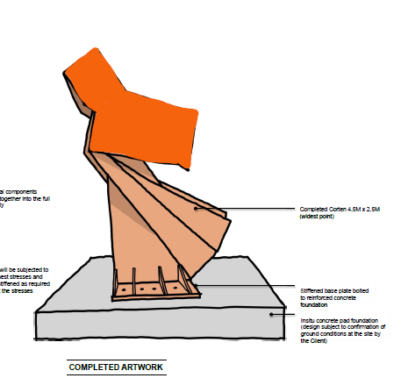
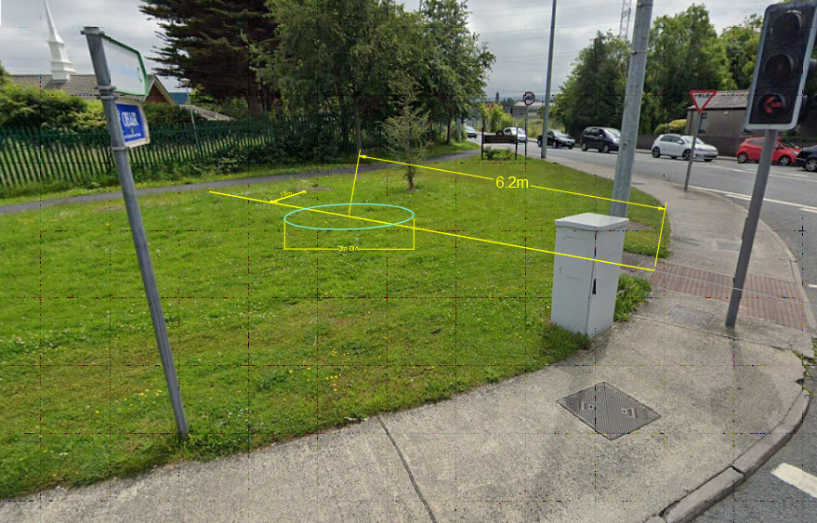
Origami Monk- Ngaire Jackson
Location: New Nangor Road and Ninth Lock Road. Height 2.5m.
Origami Monk is a large-scale monastic figure in corten steel- a compelling visual link to the important monastic sites of Clondalkin contributing to a strong and unique sense of place.
It’s rigid, geometric design alludes to the rigid rules and order that shaped the daily life of a monk in Christian Era Clondalkin.
This bold geometric design hints at a ‘paper’ folding technique, an interesting reference to The Clondalkin Paper Mills.
In Context 5: Strand 2, Watery Lane % For Art

