Slide 1

Balgaddy
Estate
Quarter 4 2023

Slide 2
Allocations and Relets 2023
Pre - Works | Work in Progress | Ready for Allocation | Total
4 | 5 | 9 | 18
Surrenders | New Tenancies
20 | 22

Slide 3
Response Maintenance
2023

Slide 4
Housing Maintenance Operations - Balgaddy
  Repairs to Vacant Properties – Reduce turnaround times
      May 2023 - Dedicated relet maintenance contractor for Palmerstown-Fonthill LEA.
      8% reduction in relet turnaround times county-wide in comparison to 2022.
  Response Maintenance and Property Management
      January 2024 - Dedicated response maintenance contractor to be appointed for Palmerstown-Fonthill LEA.
      Clean-up of communal areas took place 25th November 2023
  Property Condition Surveys – Identify condition and maintenance requirements
      Properties surveyed on 5-year cycle
      Tender documents to be prepared Q1-2024 for roll-out of conditional stock surveys.
      Balgaddy included in year 1 surveys
      Outcome of surveys will determine future planned maintenance programmes

Slide 5
Planned Maintenance- Balgaddy
  Roofing Works
      Roofing repair works identified, and contractors appointed for
        Tor an Rí – flat roofed properties
        Méile an Rí Drive – apartment units
  Energy Efficiency Retrofit Programme
      BER surveys completed on properties in Tor an Rí Walk and Lane.
      Tender documentation currently being prepared.
      Award works Q1-2024

Slide 6
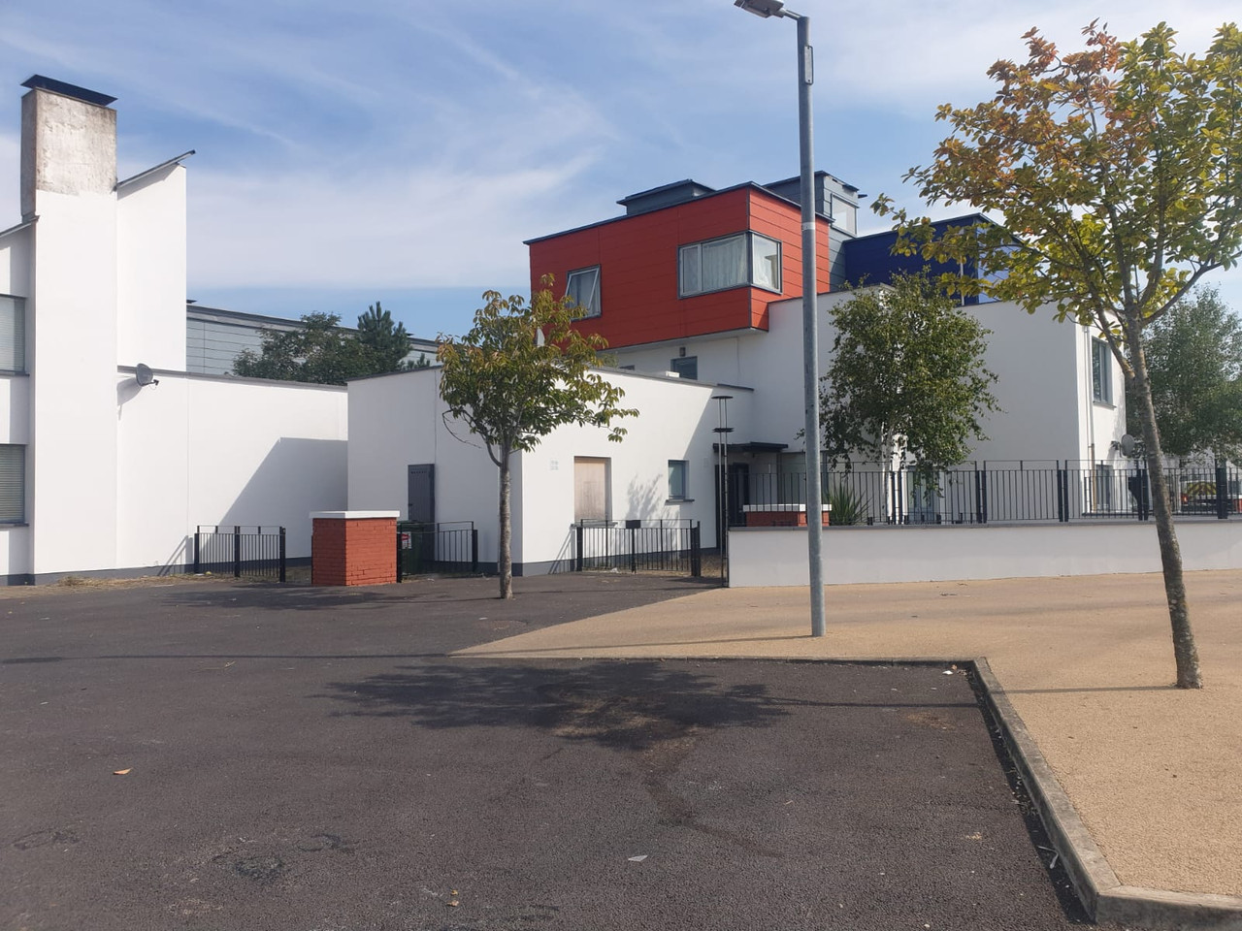
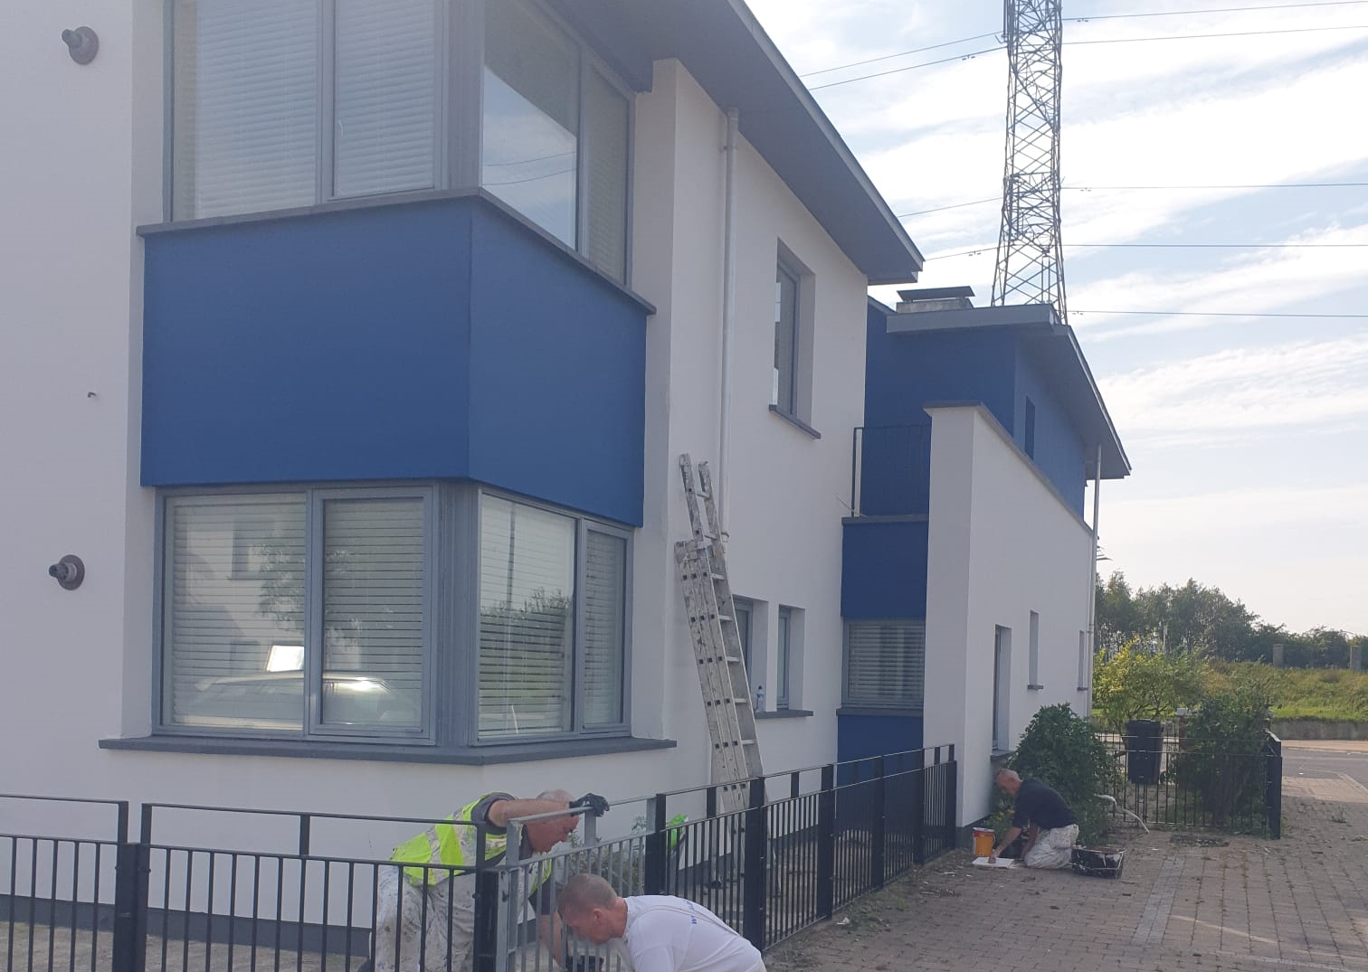
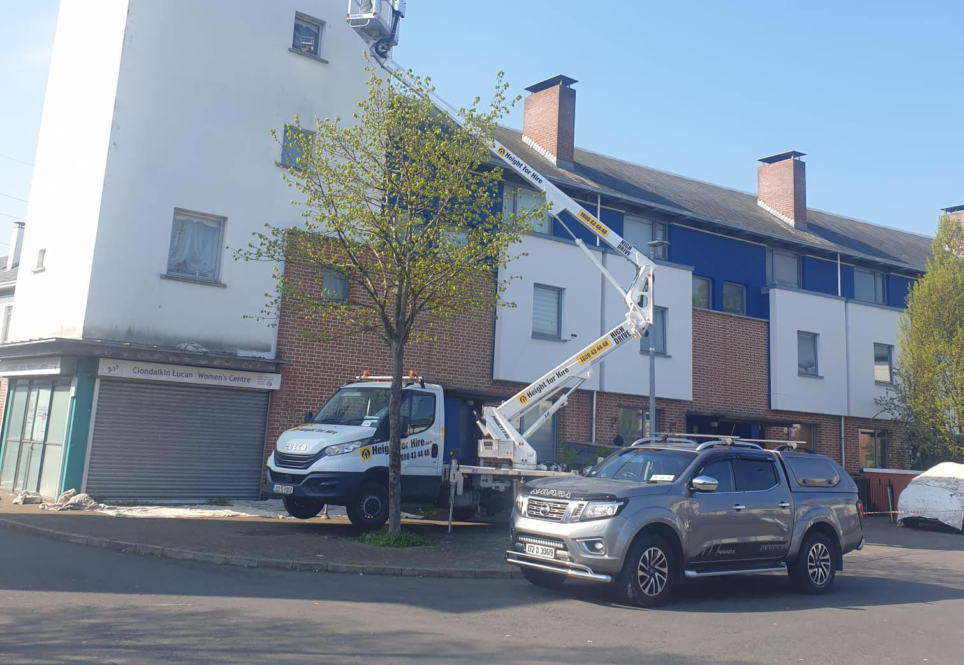
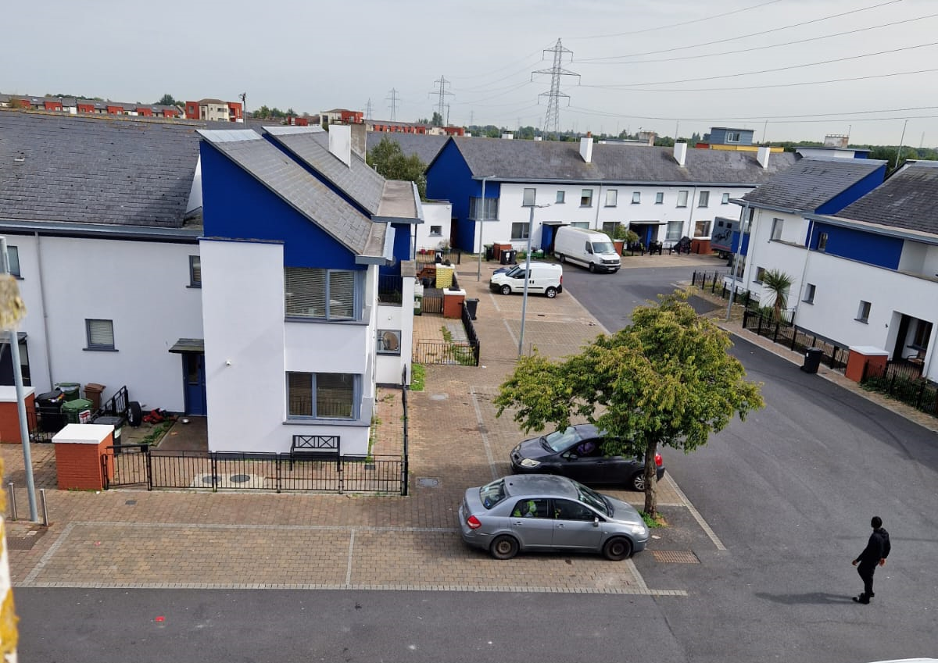
Painting in Tor an Rí
  Works on 57 properties in Tor and Rí completed
  Extent and award of painting works for Tor An Ri Walk, Méile an Rí and Foxdene Avenue Q1-2024
  Commencement of works Q2-2024.

Slide 7
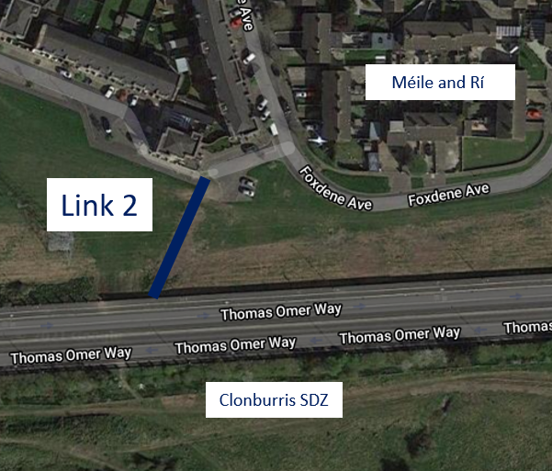
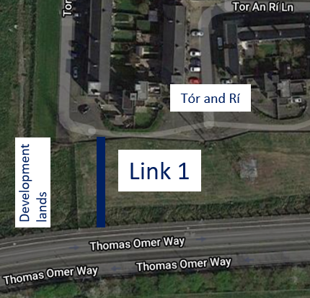
Permeability Routes
Tór an Rí & Méile an Rí to Thomas Omer Way
Contractor has commenced works with footpath base constructed.
Full completion expected Q1-2024.

Slide 8
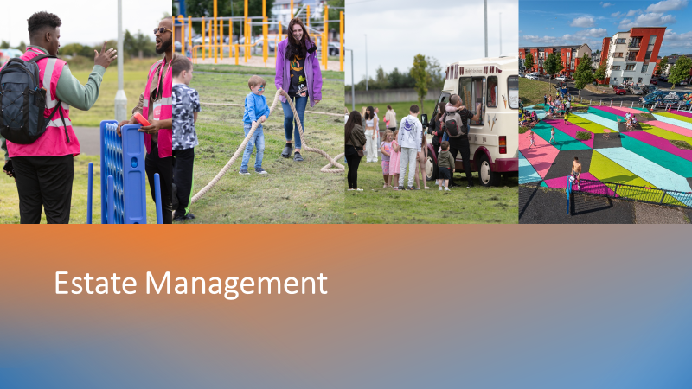

Slide 9
New Estate Management Structure
New Community Safety Officers and New Housing Officers will be assigned in Q1 2024
Additional resource to existing Estate Management and Anti-social Officers

Slide 10
Estate Management Initiatives
Anti-Social Team following up on issues regarding vacant dwellings in Tor an Ri.
Estate management and Housing Maintenance are currently liaising with residents regarding planned works to be carried out in Tor an Rí.
Joint housing maintenance and Estate Management approach agreed and commenced to monitor communal areas to ensure items do not accumulate. Records will be kept and notification/warning letters to issue as appropriate.

Slide 11
Balgaddy Higher Level Working Group
  Independent Chair has resigned, actively seeking a nomination for replacement chair.
  Nominations sought for representatives from Tusla and DLETB – awaiting response.
  4 meeting dates agreed for 2024.
  The Working Group was informed that constructions works are continuing to progress on the new Balgaddy Community Centre as part of the Housing Scheme. Anticipated works completion late Q2 2024. Working Group working with the community to promote the centre and promote membership on the board. Essential training to be provided to all Board members.

Slide 12
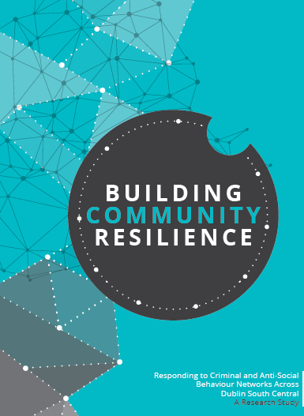
Balgaddy Working Group
The Balgaddy working Group was established to implement the recommendations outlined in the Community Crime Impact assessment undertaken in March 2021. Group meets on a quarterly basis. The membership consists of:
Estate Management and Community Development Teams from SDCC
An Garda Siochana (Ronanstown)
North Clondalkin Community Development Programme
Co- Ordinator from Clondalkin Drugs Task Force
Ronanstown Crosscare
Chair of Local Policing Forum
DDETB ( awaiting response and nomination)
Tusla (awaiting response and nomination)
Meeting Dates for 2024
13th February 2024
14th May 2024
10th September 2024
10th December 2024

