Slide 1
Tallaght to Clondalkin Cycle Scheme
Notes:
My name is Stephen Cullen, and I am an assistant engineer in Roads Maintenance. I will be presenting on Criteria 5 Continuous improvement through creative problem solving and innovative solutions

Slide 2
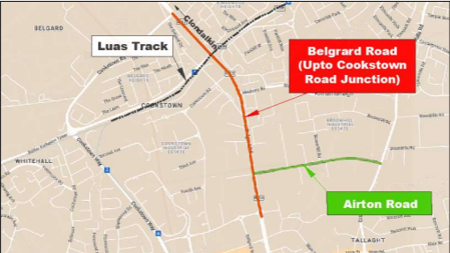

Slide 3
Project Overview
Phase 1 : Rapid Build – Belgard and Airton Road
The Tallaght to Clondalkin Cycle scheme is a mobility and public realm improvement project which aims to improve cycle facilities in the Tallaght/Clondalkin area.
The scheme includes upgrade works to 1.8km of Belgard Road from Belgard Road / Blessington Road junction in the south to Belgard Road / Cookstown Road junction in the north, and along 0.88km of Airton Road from Airton Road / Belgard Road junction in the west to Airton Road / Greenhills Road junction in the east. This new infrastructure can generally be accommodated within the existing carriageway or verge and is “rapid build” in nature. The construction works involved will be less than a typical “full build” active travel scheme.
Notes:
There are three examples of creative problem solving and innovative thinking which have been displayed in SDCC projects which I would like to highlight today.
Tallaght District Heating Scheme
Dodder Greenway
SuDS – Sustainable Drainage System

Slide 4
Project Overview
Belgard Road
At present, Belgard Road has intermittent cycle lanes which in most cases are narrower than the desired width and do not include proper segregation from other road users. Carriageway lane widths would be reduced to 3.0m and the cycle track would be widened into the verges to provide a 2m width. Segregation of cyclists from traffic is proposed by constructing a new in-situ concrete kerb, road gullies will be relocated to suit the new kerb arrangements.
The roundabout at Belgard Square North will see more significant works with the provision of two new zebra crossings and two toucan crossing to allow pedestrians and cyclists to safely cross.
Pedestrian crossing facilities will be installed at Airton Rd Junction and Cookstown Road Junction.
Notes:
Heat is transferred from the Amazon data centre to highly insulated pipes which run underground, transferring heat to a blend of public, commercial, and private premises.

Slide 5
Project Overview
Airton Road
At present, Airton Road does not have any cycle lanes. The existing road carriageway is sufficiently wide that cycle lanes can be added by narrowing the lane widths and removing the informal parking areas along the road. The cycle lanes will be segregated from vehicular traffic by a new in-situ concrete kerb.
The details of the proposed cycle scheme are outlined in the following fly through video.
Tallaght Fly Through Final
Notes:
Bespoke LED units with sharp optical cut-offs allowed for clearly defined boundary between the illuminated and non-illuminated areas, which minimised light spill.
The lights in particularly sensitive areas, i.e., foot bridges and Bushy Park, were not mounted on six metre poles but rather installed in handrails and low-level bollards to minimise the spill over of light.
Lights will be operated on a motion sensor basis that switches the lights on for a set period of time when a person is detected in the vicinity and completely off otherwise.

Slide 6
Project Timeline
Section 38 Planning – Q1 2024
Detailed Design – Q1 to Q3 2024
Construction – Q1 2024 to Q1 2025

Slide 7
Thank You
Questions?
Notes:
My name is Stephen Cullen, and I am an assistant engineer in Roads Maintenance. I will be presenting on Criteria 5 Continuous improvement through creative problem solving and innovative solutions

