Slide 1
River Poddle Flood Alleviation Scheme – Commencement of Scheme

Slide 2
River Poddle FAS - History
Devised from Eastern CFRAM Study (Final Report 2011) following introduction of National Flood Policy in 2004
2014 Poddle Options Report
1. Hard Defences and Sealing Manholes
2. Option 1 and Upstream Storage
3. Option 1 and diversion to the Dodder
Funded by OPW – SDCC Lead Authority
Tri-Agency Input – OPW, DCC and SDCC
Consultant Appointed in March 2018 – Nicholas O’Dywer Ltd
Planning Application to An Bord Pleanala in February 2020
Planning Approval granted in June 2023
Notes:
Poddle considered an AFA – Area of Further Assessment

Slide 3
River Poddle FAS Main Scope of Works - South Dublin
Designed for 1 in 100yr event – greater than the 2011 event
Main Flood Storage at Tymon Park. 220m long 2m high Earthen Embankment – Tymon Lake with new flow control structure
Integrated Constructed Wetland at Tymon Park
Combination of Raised Earth Embankments, Hard Defences and Sealed Manholes
Realignment of the river channel at Whitehall Park (Wainsfort) to create storage, alleviate local flooding and improve water quality
Tree Removal/Replacement programme
Biodiversity Plan
Inclusion of Trash Screens

Slide 4
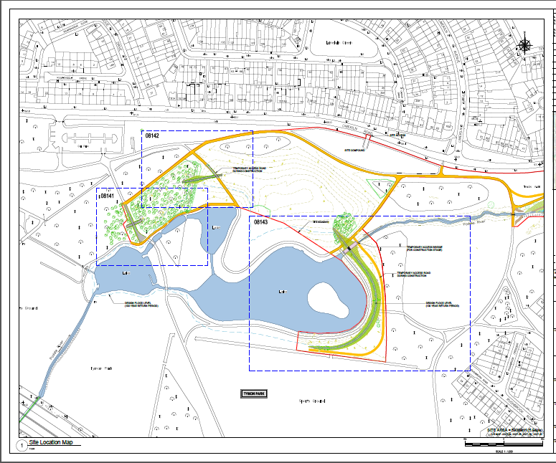
Proposed Scheme Layouts – Tymon Park Lakes

Slide 5
Schematic Layout – Tymon Park Embankment

Slide 6
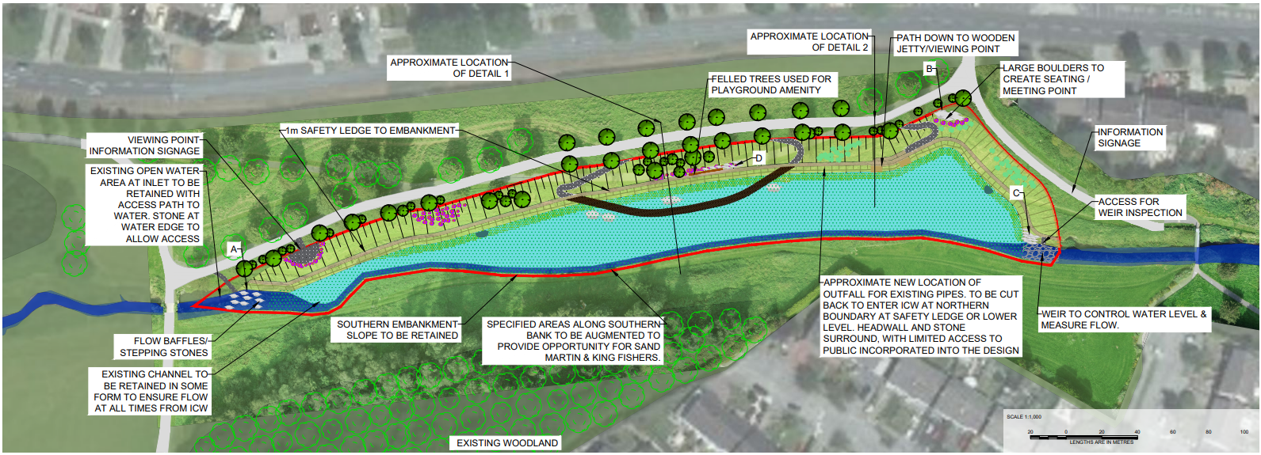
Proposed Scheme Layouts – ICW Tymon Park
Benefits:
Cells will be planted in native species
Improvement in Water Quality in line with the WFD
Increase in Aquatic life
Protection and enhancement of Biodiversity
Largely self sustaining so limited follow on maintenance costs

Slide 7
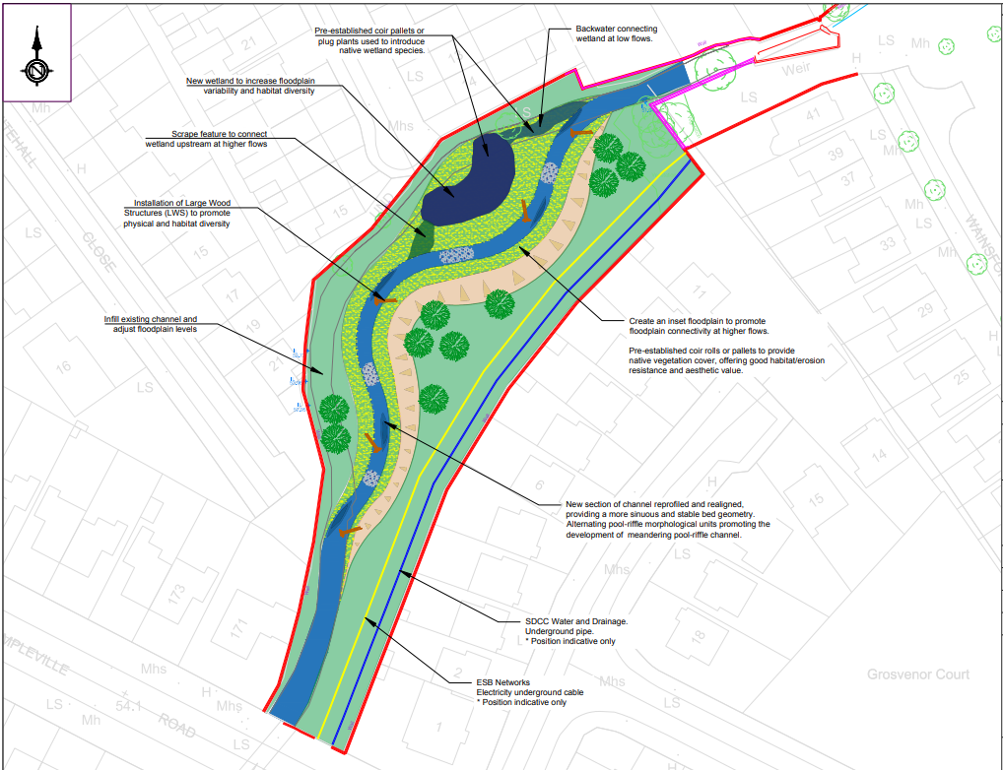
Proposed Scheme Layouts – River Realignment at Rear of Grosvenor Court/Whitehall Park

Slide 8
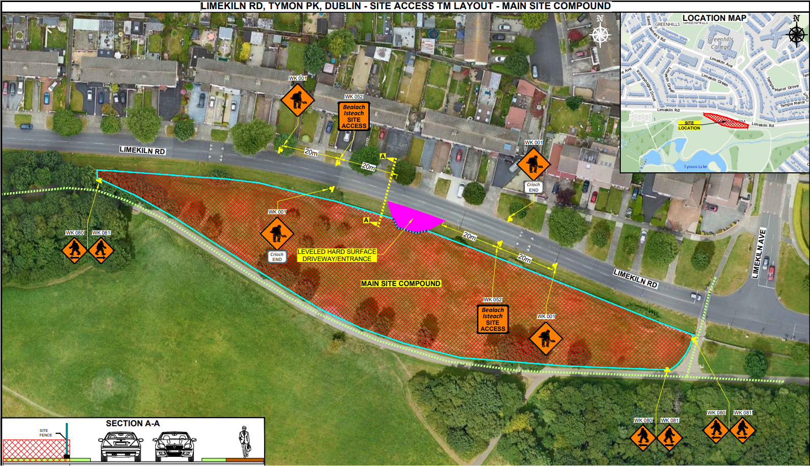
Other Works
Main Site Compound – To be installed from February 2024

Slide 9
Other Works - Continued
Embankment at ESB Substation in Tymon Park North
Flap Valves at pipe outlets into river
Landscaping enhancements
Extra Telemetry - Cameras and Leve Gauges
Cross Border Maintenance and Flood Response Plan in conjunction with Dublin City Council
New footpaths in Tymon Park and access points to the river
Communications
Direct contact with residents, resident associations and park user groups impacted by the construction of the scheme
Updates to Area Committees and EWCC Strategic Policy Committee throughout the scheme
Leaflet Drops when required
Pre Construction Events – First on 23rd January in Tymon Park Pavilion
Updates on Project Website www.poddlefas.ie
Formal launching of the scheme – Currently Q1 2024

Slide 10
Current Schedule
Works to be constructed by OPW Eastern Region Construction Section
Currently expected to take 36 months to complete – May 2027
Site Compound – Q1 2024
Works commence in Tymon Park – Q2 2024
Whitehall River Enhancement and Wainsfort Manor - Late Q3 2024
Rear of 1-21 Fortfield Road – Q3 2025
ANY QUESTIONS?

