Slide 1
Brine Saturation Facility
Part VIII
19th December 2023
Notes:
Sign in sheet

Slide 2
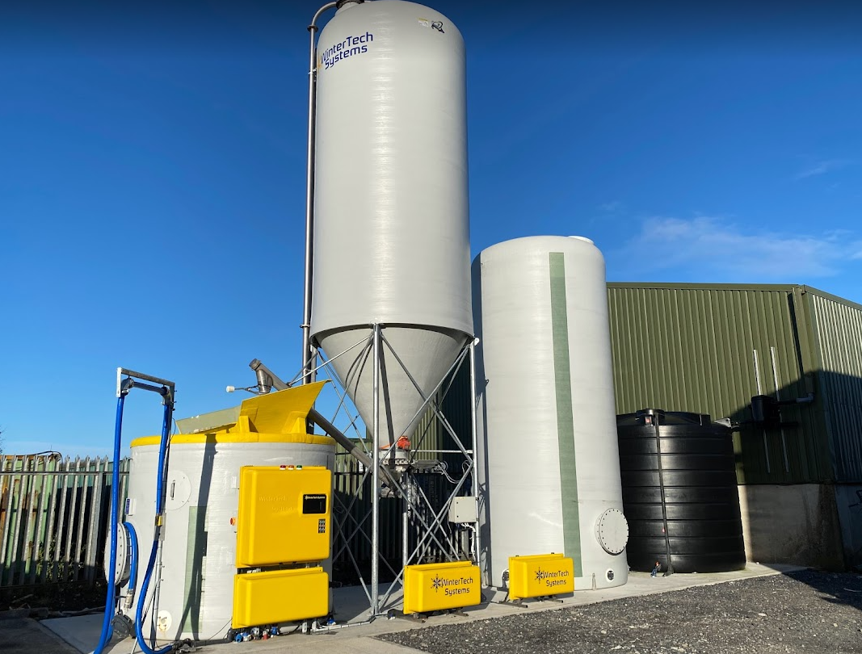
Context
SDCC wish to convert our winter maintenance process from dry treatment (rock salt) to pre-wet treatment (brine)
To enable this conversion we require a Brine Saturation Facility to be constructed beside the existing salt barn at our Palmerstown Depot
This facility requires Part VIII Planning Permission
Brine Saturation facility – Westmeath Co Co

Slide 3
Project Proposal
The facility will consist of;
Rainwater harvesting tank with back up mains feed
Brine storage tank
Salt Silo
Brine Saturator
The whole facility will be constructed on a raised concrete plinth.
A cesspool will be constructed to store any brine run-off.
Brine Saturation facility – Westmeath Co Co

Slide 4
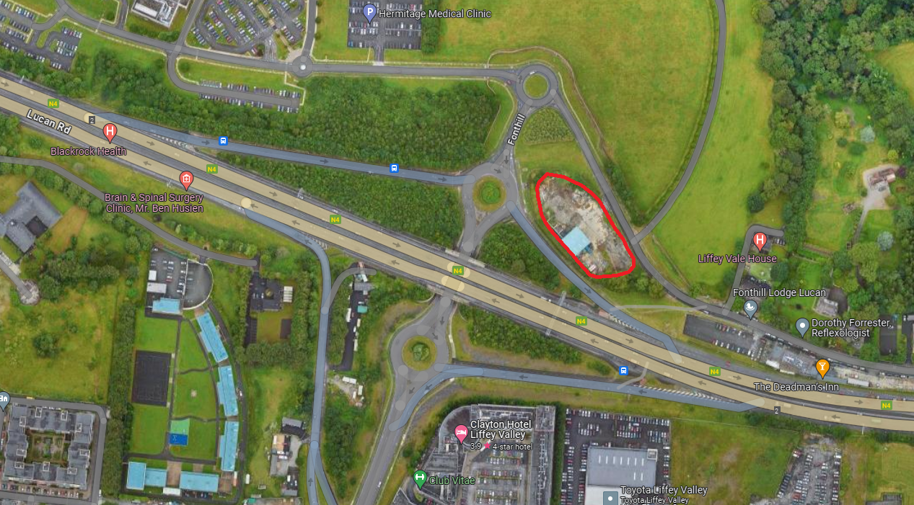
Site Location

Slide 5
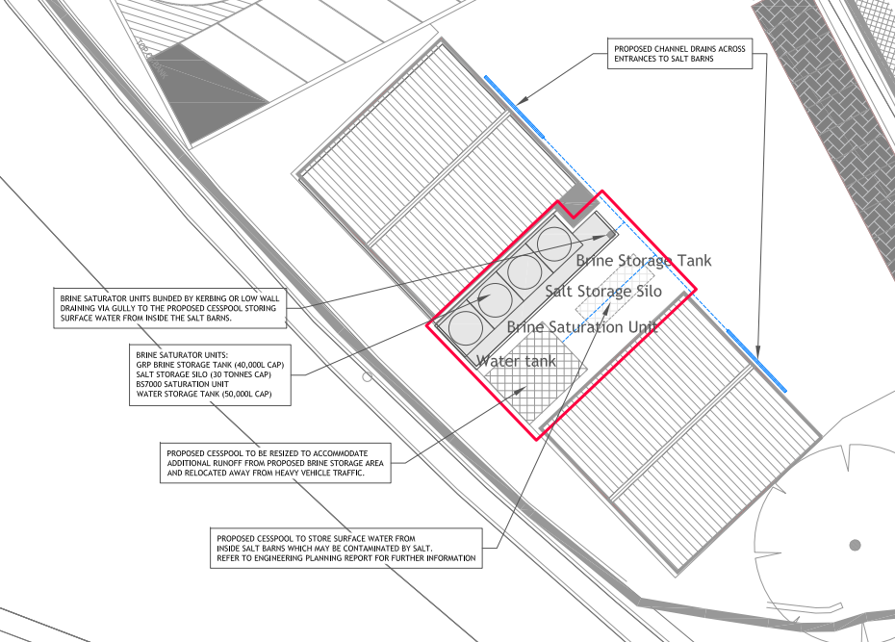
Site Location
Site has Part VIII approval for a mechanical depot to be constructed, this proposal is designed to have no impact on the delivery or functionality of that project

Slide 6
What is Brine
Brine is a solution consisting of salt and water that is used in conjunction with rock salt for the treatment of roads during cold periods
Benefits of Brine
Provides a faster acting treatment
More efficient use of salt, can spread less while getting the same result
Less salt wasted through bounce off
Environmental benefits through less salt being spread
Increases residual salt on the road

Slide 7
Timeline
Task | Timeline
Public Consultation | Dec21st - Feb 15th
Part VIII Report Preparation | Feb 18th - 28th
Part VIII Approval | March Council Meeting
Procure Design and Build Contractor* | April 2024
On Site Construction* | September 2024
Project Complete* | October 2024
* Subject to Part VIII Approval

Slide 8
Thank You
Notes:
Sign in sheet

