Slide 1
Carrigmore Park Part 8
Planning & Projects | Public Realm

Slide 2
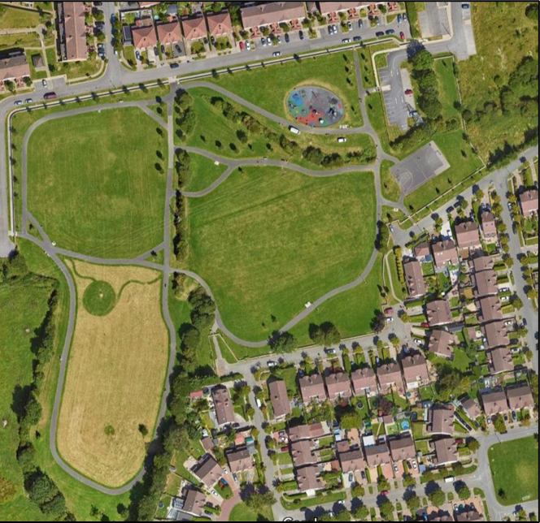
Context of Project & Location
Carrigmore Park
(approx. 4.2 hectares) is located within the townland of Fortunestown.

Slide 3
Carrigmore Park Part 8 proposals:
Provision of a pump track and calisthenics area.
Provision of an active age area.
Upgrading of existing footpaths, to involve the removal and realignment of existing paths.
Installation of goal posts onto existing soccer pitch.
The provision of a new sports pitch area (65m x 40m).
Retaining existing entrances and upgrading where required.
Provision of a new pedestrian entrance.
Provision for new entrances to the development lands to the west.
Renovation of existing hedgerows.
Planting new trees, hedgerows, and other planting.
Removal of 12 trees (as per arborists recommendation).
Planting of trees along the verge outside of park.
Provision of 2 wetland attenuation areas to provide drainage for pitch and enhance biodiversity.
Planting of a mini woodland for enhanced biodiversity.
Planting of pleached Tilia trees along existing basketball court.
All associated landscape works including furniture and planting.
All ancillary works.

Slide 4
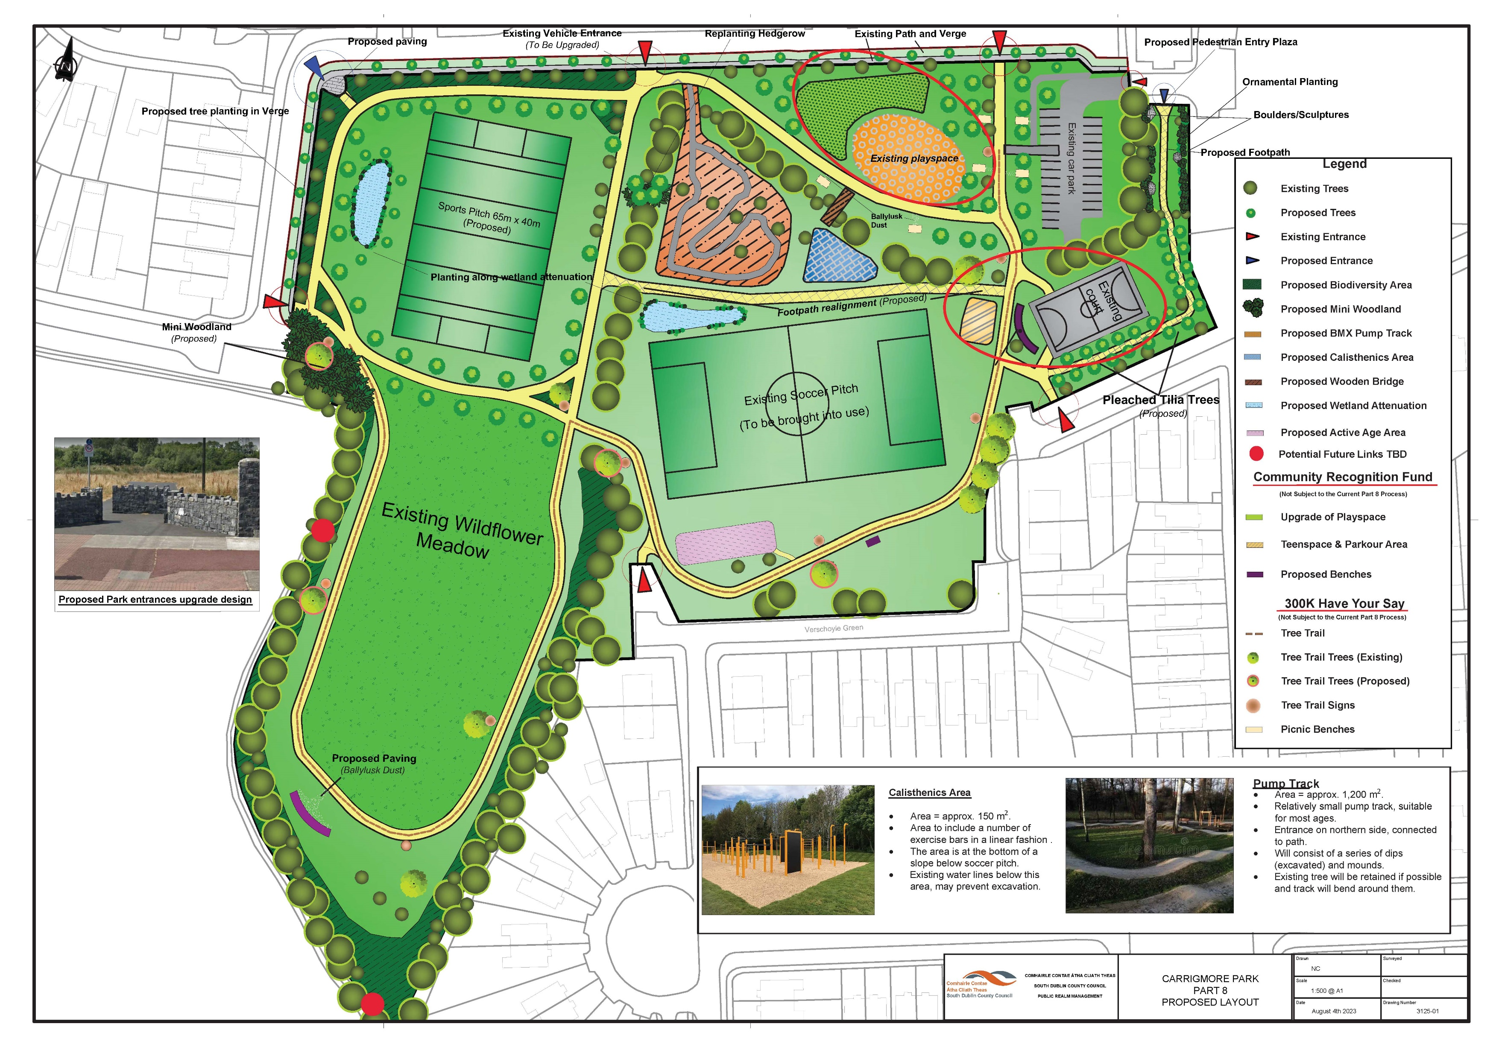
Part 8 Masterplan

Slide 5
Part 8 Process
The proposed development and accompanying Appropriate Assessment, Environmental Impact Assessment and report were placed on public display for the statutory period from Thursday 19th October 2023 to Thursday the 30th November 2023
The plans and particulars of the proposed development were available for inspection online on the Council’s Public Consultation Portal website (http://consult.sdublincoco.ie) during the period from 19th October 2023 to 30th November 2023. Printed plans and particulars were available for inspection or purchase at a fee not exceeding the reasonable cost of making a copy at County Hall, Tallaght, Dublin 24 during office hours from 19th October 2023 to 16th November 2023.
A total of 7 submissions were received by the end of the consultation period.
Submissions or observations with respect to the proposed development dealing with the proper planning and sustainable development of the area in which the proposed development will be situated were made in writing up to 5pm on Thursday the 30th of November 2023 and were submitted either:
via Online Submissions: http://consult.sdublincoco.ie
or By post
It should be noted that the Freedom of Information Act, 1997-2006 (as amended) applies to all records held by South Dublin County Council. South Dublin County Council’s Personal Data Privacy Statements can be viewed at www.sdcc.ie and all personal data will be retained in line with statutory requirements.

Slide 6
Issues that were raised in submissions
Additional facilities requested
Amendments to the design
Removal of existing car park
Concerns with bicycles using the park
Proposals regarding access
Security concerns
Lighting requested
Request for spaces for community events and trading
These issues raised were all summarised and responded to in the CE Report.

Slide 7
Recommendation
Following consideration of the submissions the Chief Executive is of the view that the issues raised by way of the submissions can be satisfactorily addressed during the detailed design stage and the operational and management stage and as outlined in the Chief Executive report.
It is recommended that, as the proposal is in conformity with proper planning and sustainable development, that the Council proceed with the Part 8 proposal for the Upgrade of Carrigmore Park, Fortunestown, Dublin.

