Slide 1
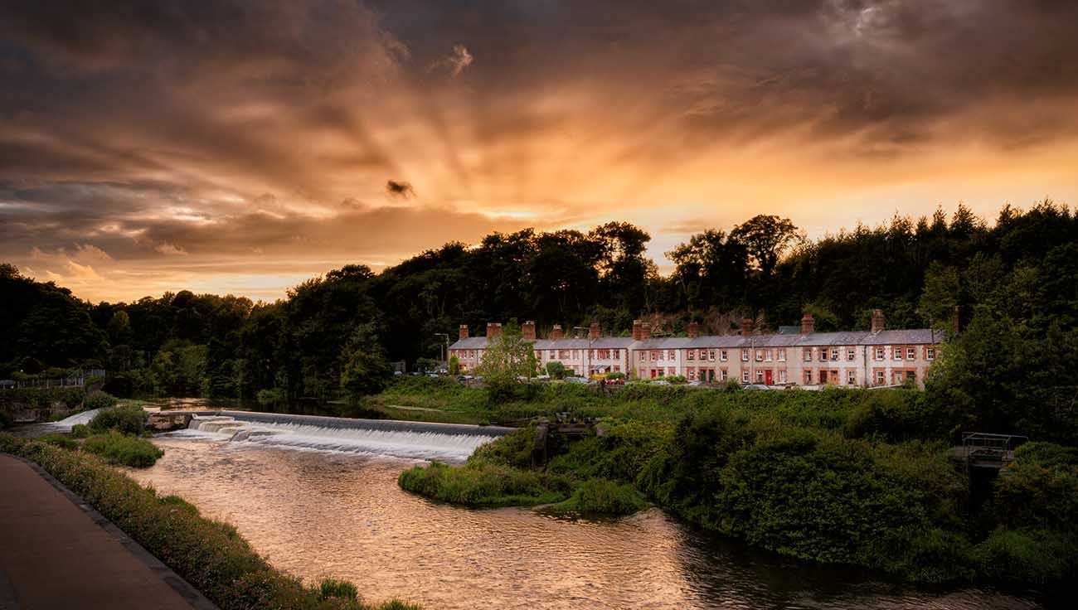
South Dublin
Draft Tourism Strategy 2024 - 2029

Slide 2
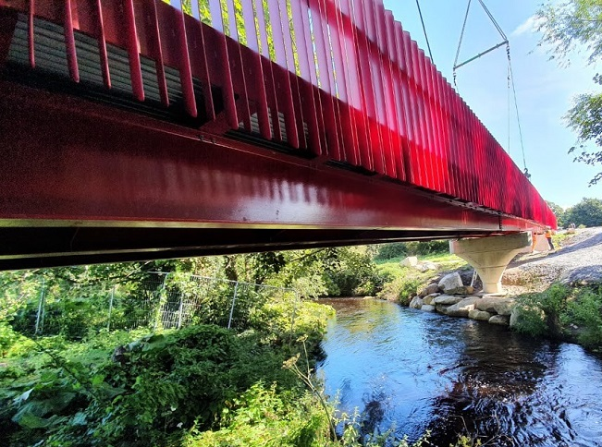
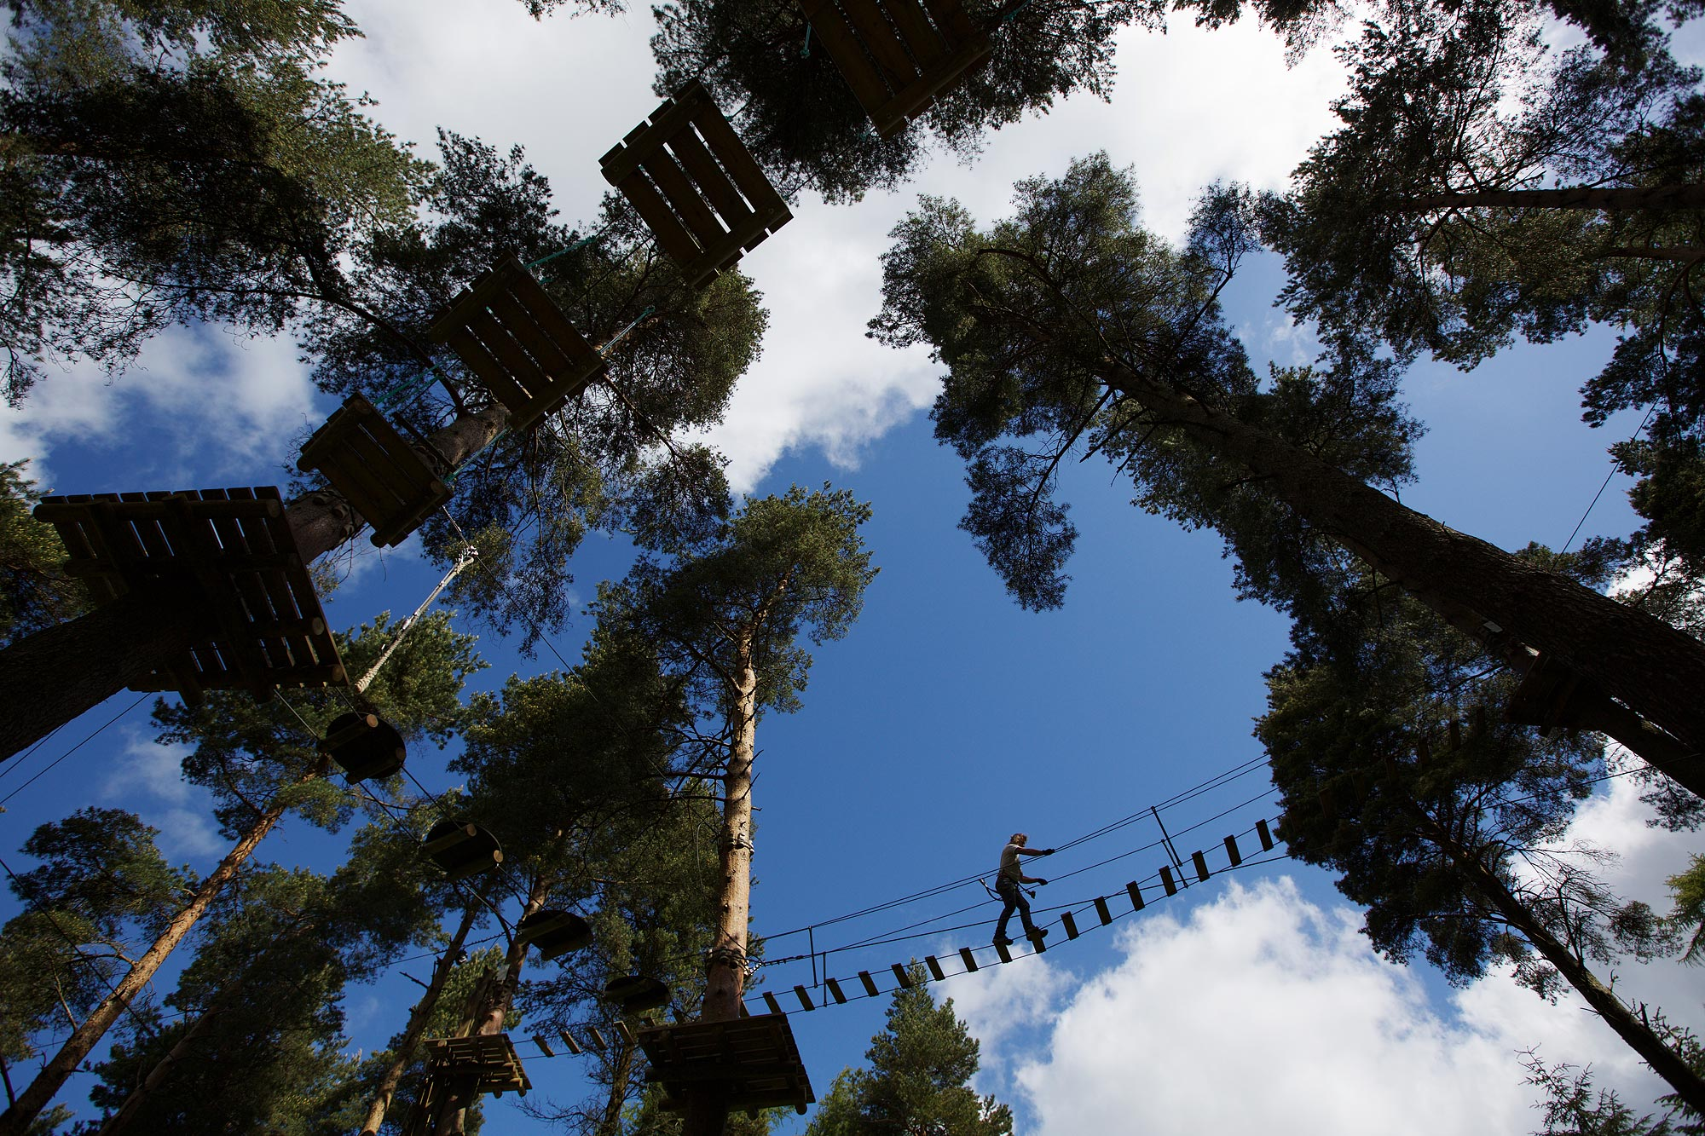
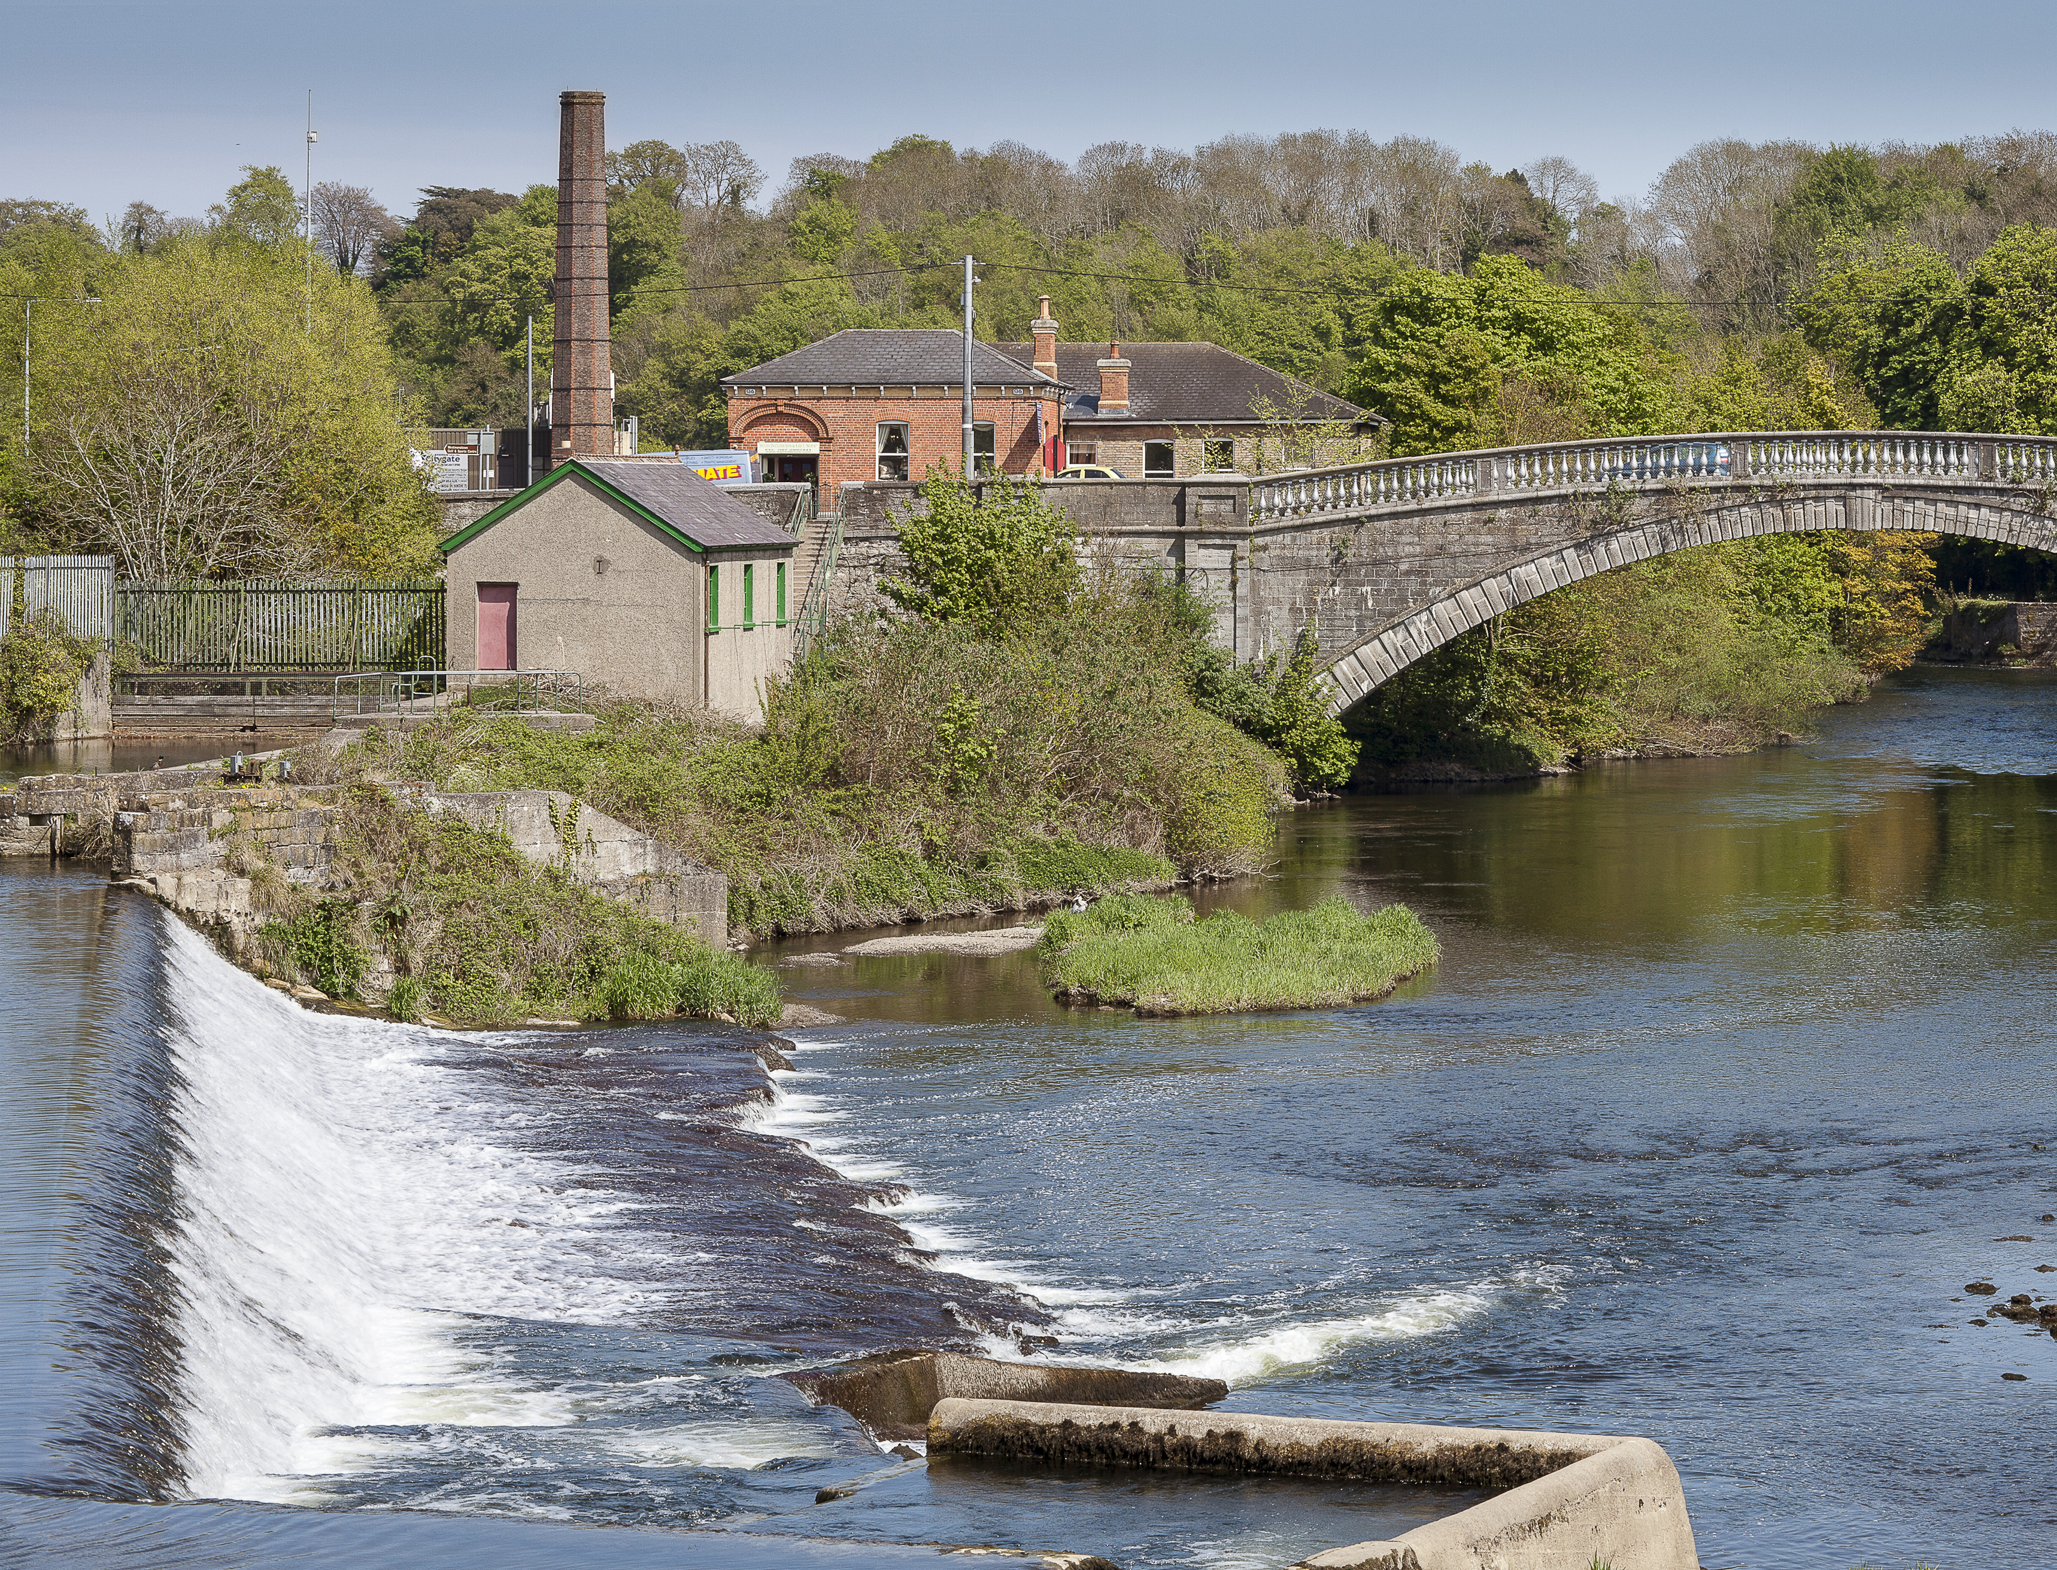
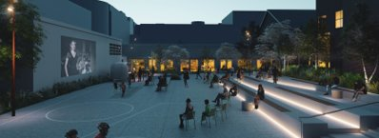
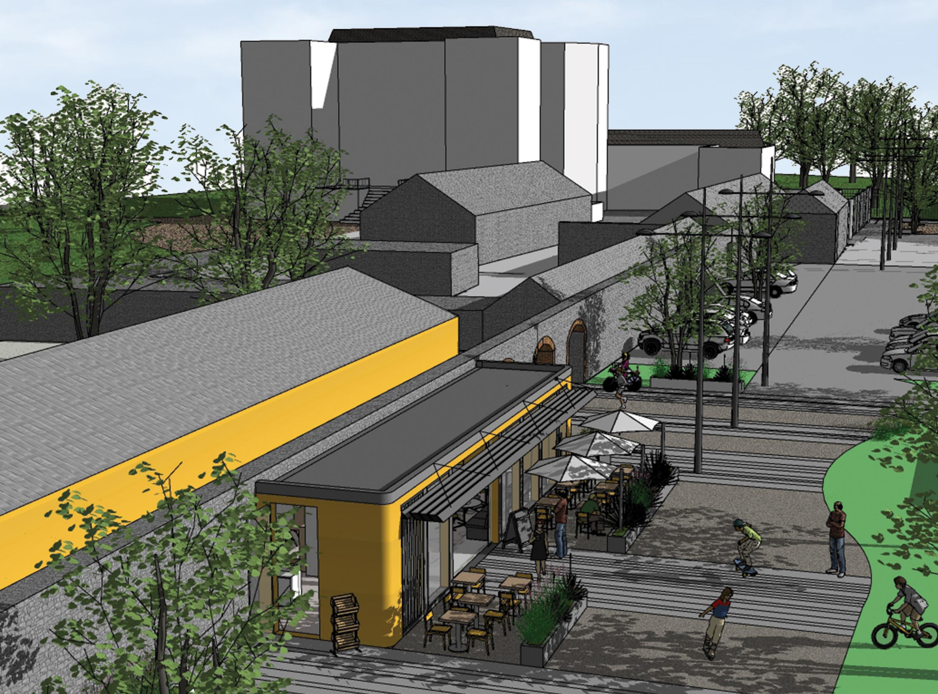
South Dublin Draft Tourism Strategy
Strategic Vision & Priorities
“South Dublin is a welcoming, vibrant and thriving place to live, work and visit with a wealth of natural, built and cultural heritage celebrating the beauty and diversity of our County. We are the gateway to the Dublin Mountains, seamlessly connected to the city centre and packed full of exceptional and enriching visitor experiences.”
Realise Our Potential
Reinforce Connectivity
Regenerate our Natural Spaces
Refresh Partnership Working
Redefine Our Reputation

Slide 3
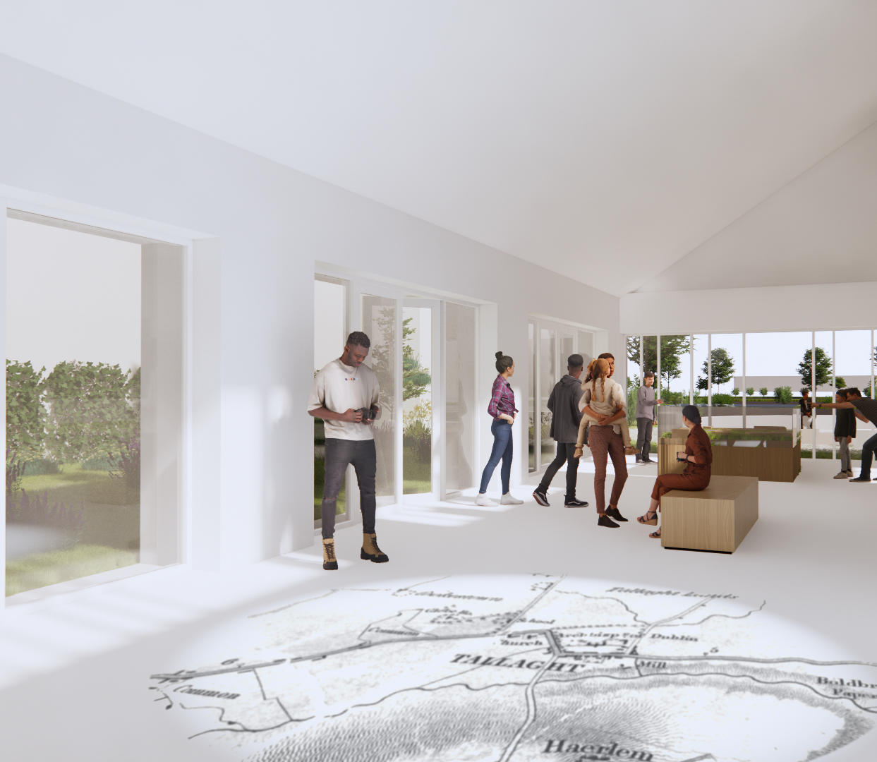
Current Activity
Dublin Mountains Visitor Centre
Rathfarnham Stables & Courtyards
Cycle South Dublin
Camac Valley Masterplan
12 Lock Masterplan
Destination Lucan
Outdoor Markets
Dodder Valley Greenway
Liffey Valley Greenway
Grand Canal Greenway
Tallaght Public Realm
Tallaght Stadium
Tallaght Heritage Centre
Intergenerational Centre
Digital Tourism Trails
Round Tower Visitor Centre

Slide 4
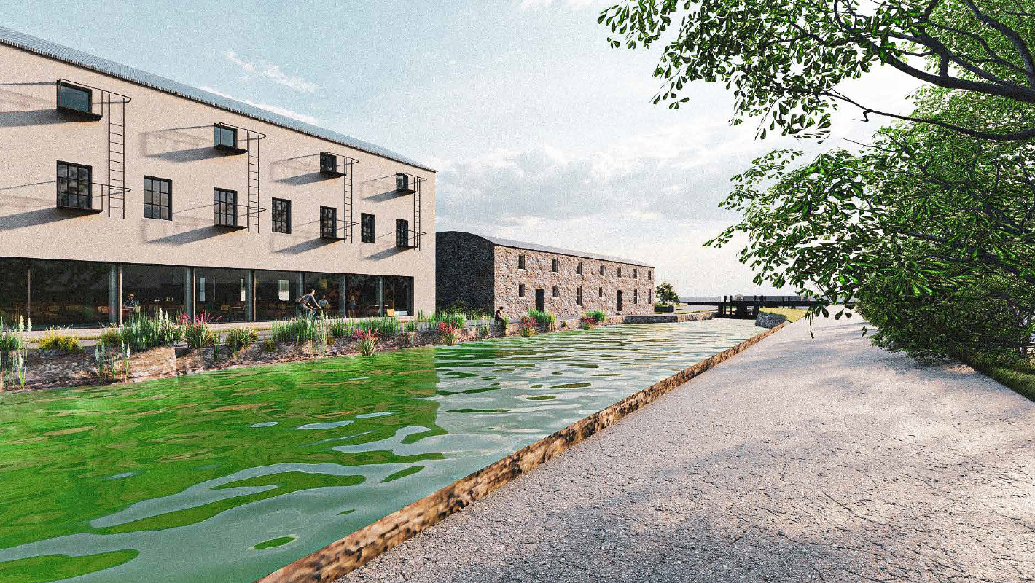
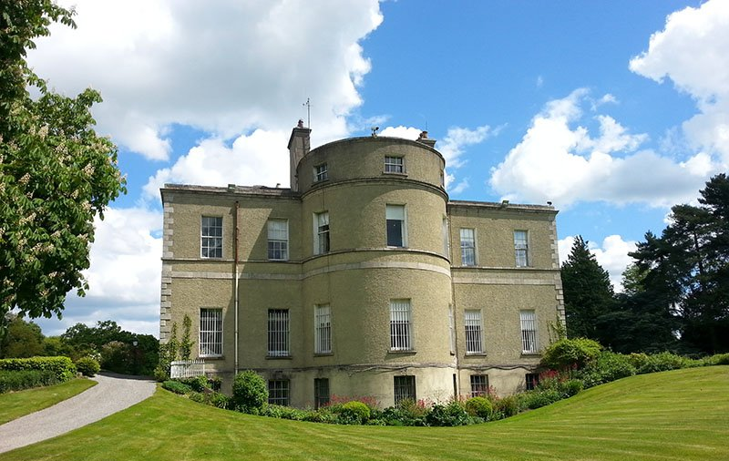
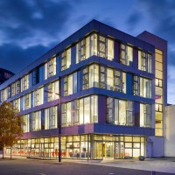
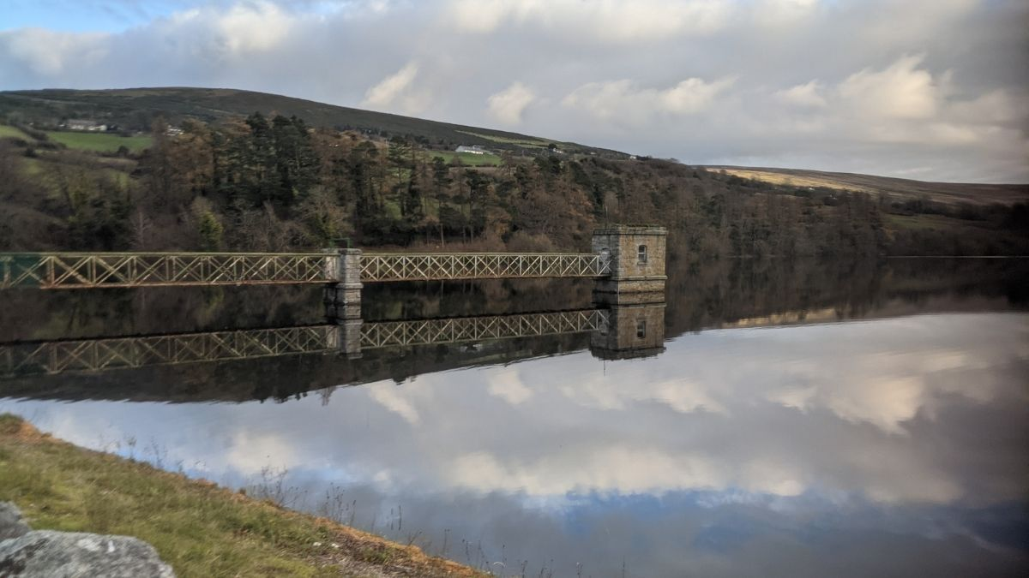
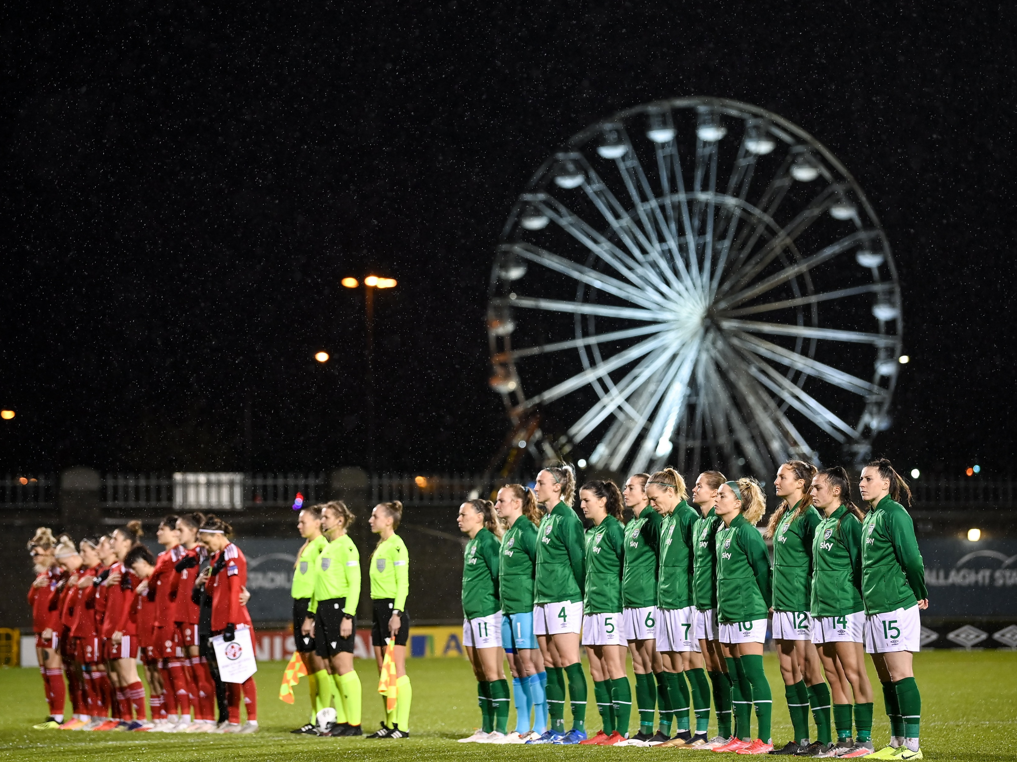
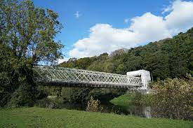
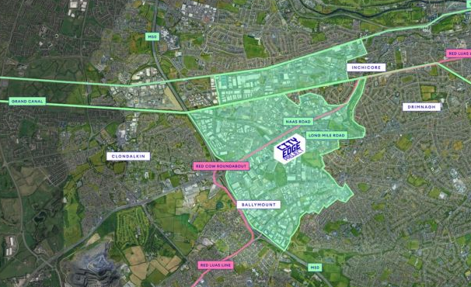
Lucan House
Night-time Economy
Tourism Development Cohesion
Events & Festivals
Business Tourism
Feasibility Studies
City Edge Tourism Opportunities
Future Tourism Opportunities

Slide 5
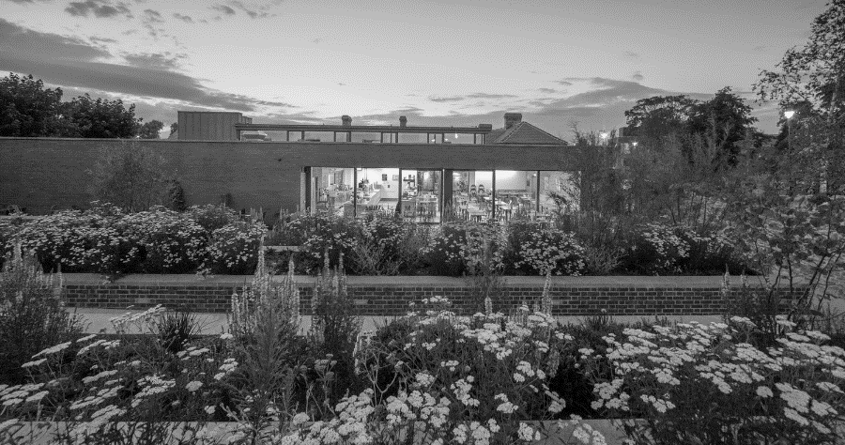
Tourism Economic Impact
Annual Tourism Revenue Generation: €137m
Job Support: 3,600 Tourism Jobs
South Dublin County Tourism Value: €31.5m
Regional Economic Impact: €205m
Direct & Indirect Economic Impact: €342m

Slide 6
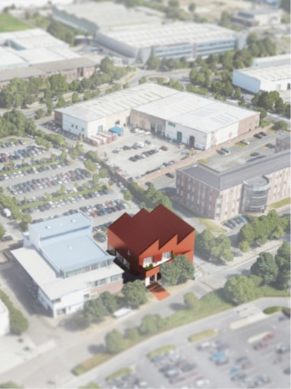
South Dublin Draft Tourism Strategy
Public Consultation
13
Submissions
State Agencies
Tourism Businesses
Residents Associations
Public Open
Space
Active Travel & Associated Infrastructure
Nature Based Approach

Slide 7
Public Consultation
Tourism Strategy Recommendations
Clondalkin & Camac Valley Cluster
Local Tourism Forums Support
Environmental Considerations
Dublin Mountains Bus Service
- Bicycle Transport
- Bicycle Parking & Charging
- Broader Accessibility
Public Transport & Active Travel Strategic Priority
Palmerstown ACA Opportunities
Rathcoole & Saggart Walking Trail Opportunities
Events & Festivals Cultural Group Partnerships
Corkagh Park Additional Visitor Experience Opportunities

Slide 8
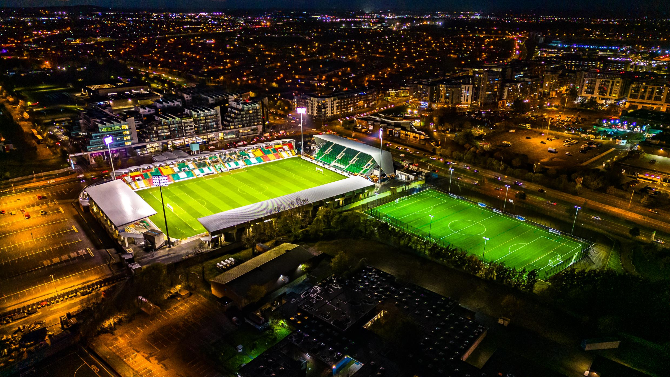
Thank You
Questions

