Slide 1
Clondalkin Local Area Plan Update
Presentation to SPC 27th November 2023

Slide 2
County Development Plan context
Objectives: QDP14 - 3 and EDE4 - 14
“To prepare a LAP for Clondalkin, the extent of the boundary to be defined, which will be guided by the Local Area Plans Guidelines for Planning Authorities, 2013 (Department of the Environment, Community and Local Government) or any superseding guidelines and which will incorporate:
A vision for the development of Clondalkin
Wider urban design principles
Framework plans for larger infill sites
A Conservation Plan
A local Green Infrastructure strategy derived from the County GI Strategy
Transport movement study.”

Slide 3
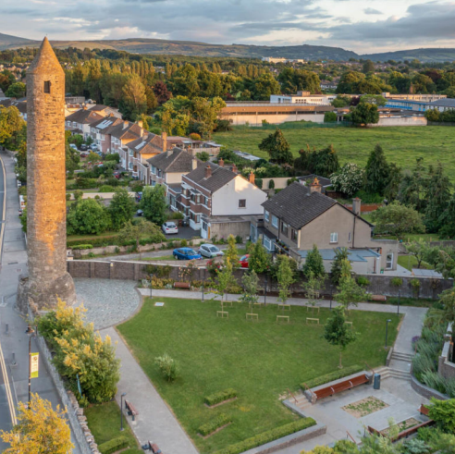
Reflecting the Objective
Relevant Expertise procured:
Urban Design and Conservation – O’Mahoney Pike and Molloy, team includes urban design, conservation expertise, Green Infrastructure (JBA) and urban movement
Transport (Local Transport Plan) – ARUP
Strategic Flood Risk Assessment – JBA
SEA and AA - CAAS

Slide 4
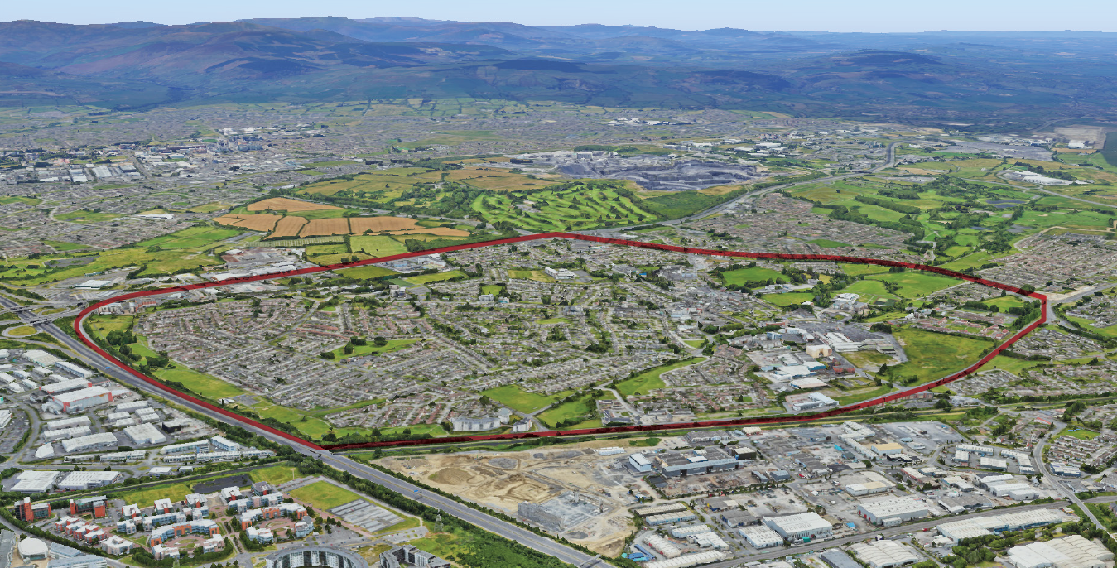

Slide 5
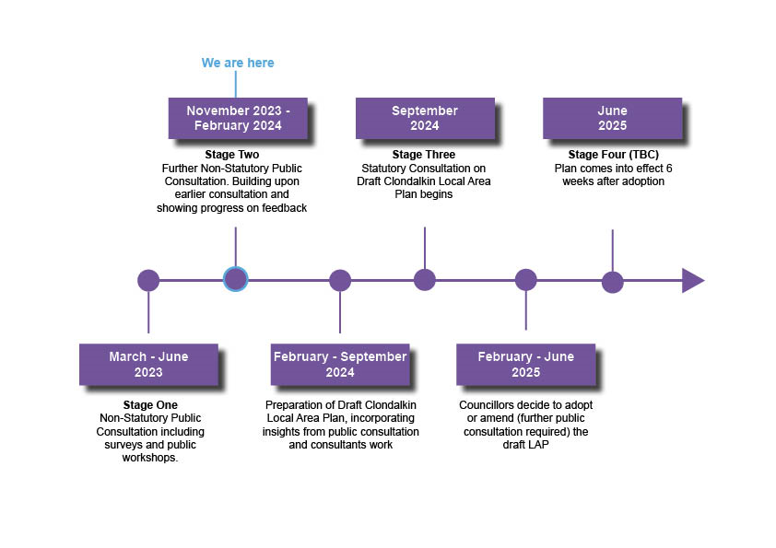
Timeline
Pre-Draft Stage:
First public consultation report is on-line.
Second public consultation targeted for February 2024

Slide 6
Online Survey FEEDBACK: April - may

Slide 7
Online survey - Feedback

Slide 8
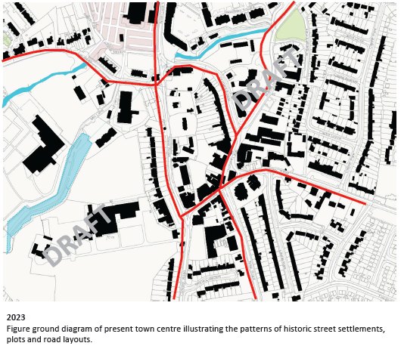
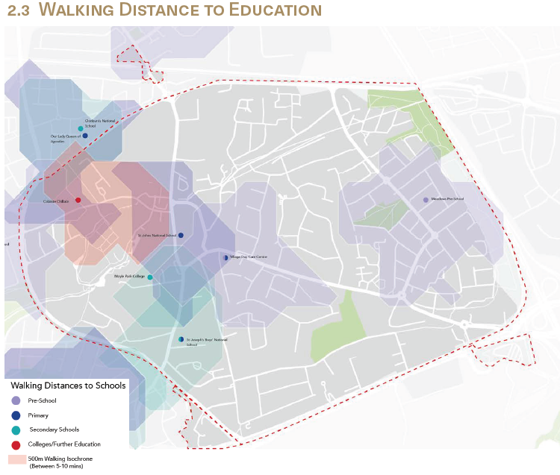
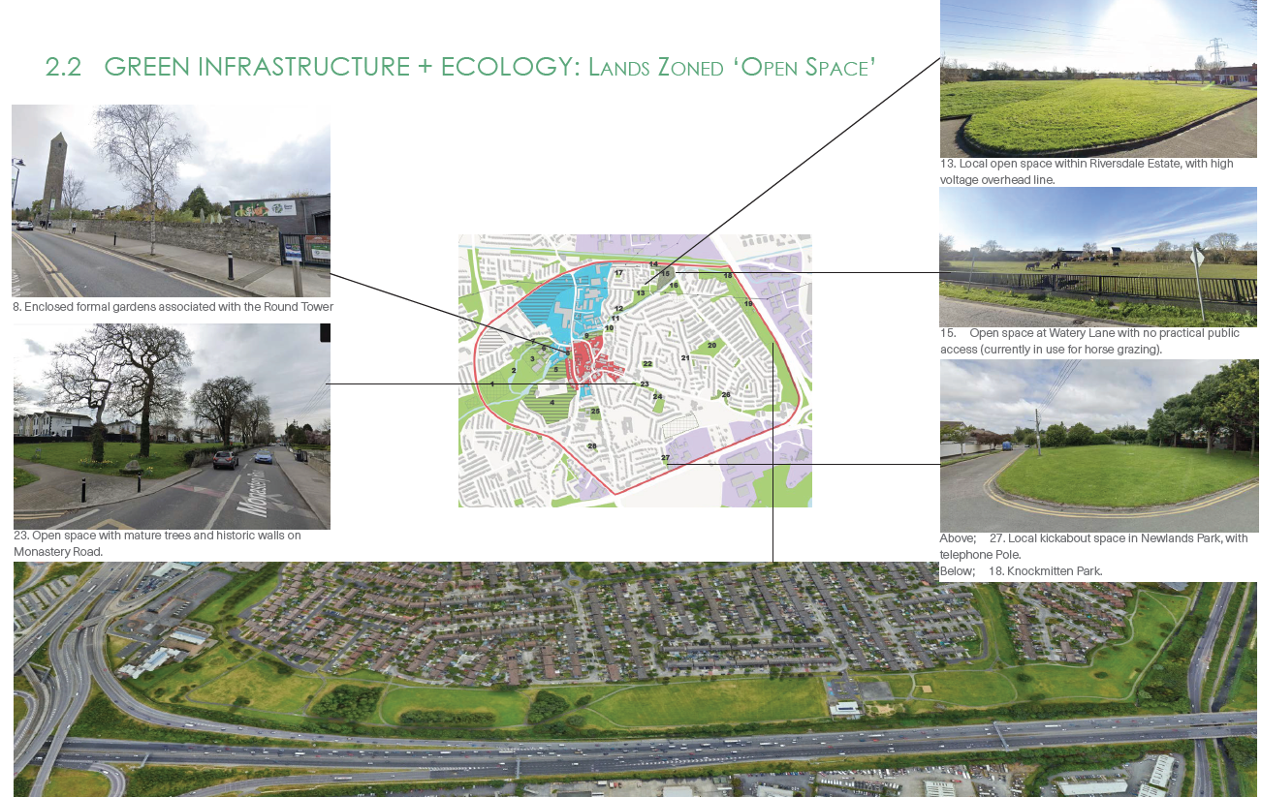
Progress to Date – Urban Design Team
Draft Baseline and SWOT analysis
Work starting on different high level scenarios
Conservation plan draft document
Green Infrastructure approaches outlined
Movement patterns and opportunities being identified

Slide 9
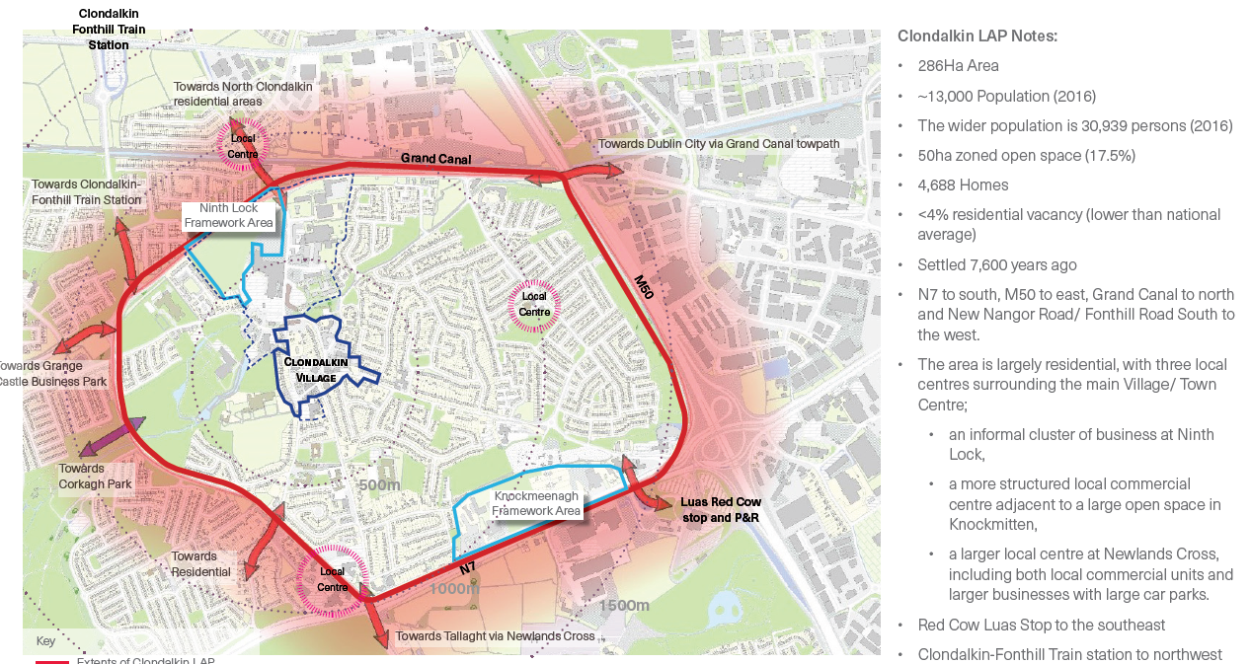

Slide 10
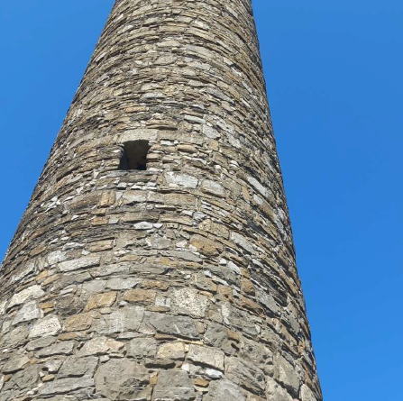
Progress to Date – Conservation
Co-ordination of the different consultants and work outputs to ensure holistic approach to conservation
Conservation plan being drafted and will guide urban design and transport approach
Will identify key features and structures
Will provide character appraisals
Will outline vulnerabilities
Will make policy recommendations for integration into LAP

Slide 11
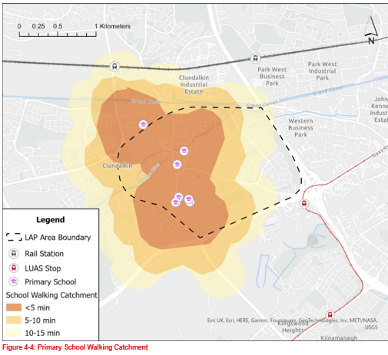
Progress to Date – Local Transport Plan
The LPT is being carried out by ARUP using NTA assessment process
Baseline and SWOT analysis is underway
Traffic surveys were carried out in late October and are now being analysed
Modelling of transport movement will take place as part of next stage of LTP

Slide 12
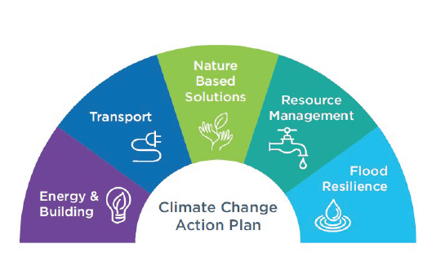
Progress to Date – climate change, SFRA and SEA/AA
Strategic Flood Risk Assessment
SFRA template prepared and to be agreed with OPW
Liaison with Camac Flood Alleviation Scheme team
SEA and AA
Alternatives being developed will be assessed through SEA process
SEA scoping report will be sent to EPA for comment in December
AA screening as first step under Habitats Directive

Slide 13
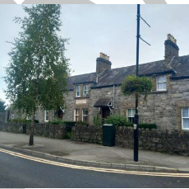
Next Steps
Baseline and SWOTs to be completed
Agreement on transport modelling approach with NTA
Consultation with landowners within Framework areas and other capacity sites
Development of different high level options
Examination of possible village enhancement schemes
Second round of pre-draft Public Consultation in February 2024

