Slide 1
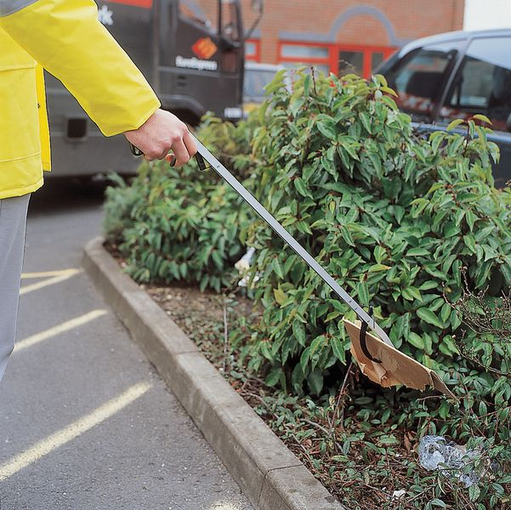
South Dublin County Council Litter Management Plan 2023-2025
South Dublin County Council
13th November 2023
Notes:
The SDCC Litter Management Plan was reviewed and a Draft replacement plan for consultation purposes was prepared for public consultation.

Slide 2
Requirements of the Litter Management Plan
Requirements:
The LMP is prepared as prescribed in Section 10 of the Litter Management Acts
Section 11 sets out the requirements of a litter management plan
Section 12 sets out the procedure for making, amending or replacing a litter management plan
Section 13 provides that the making, review, amendment or replacement of a litter management plan shall be a reserved function

Slide 3
Timeline of the Litter Management Plan 2023-2025
Timeline:
Review of LMP 2020-2022 & Initiation of 2023-2025 plan – went to Environment SPC in 2022
Draft plan for public consultation: Tues 8th August 2023 – Tues 19th September 2023
Submissions/observations were received up to 4.00 p.m. on Tues 19th September 2023
129 submissions/observations were received in total
Final draft plan went to Environment SPC 6th November 2023 and was recommended to Council for approval by the members

Slide 4
Public Consultation Draft Litter Management Plan
Consultation period ran from 8th August 2023 to Tuesday 19th September 2023.
Published on SDCC Consultation Portal
Advertised on Radio and in the Press
Coverage on the Council’s Social Media

Slide 5
Categories of Submissions/Observations
Ref | Category/main topic of submission | Number of submissions received
1 | Abandoned Vehicles | 1
2 | CCTV/Technology | 5
3 | Chewing Gum | 1
4 | Cigarette Litter | 1
5 | Cleansing Schedules/Street Sweeping | 15
6 | Communication and Awareness | 15
7 | Customer Care System | 4
8 | Dog Fouling | 7
9 | Graffiti | 7
10 | Household Waste | 3
11 | Illegal Signage | 1
12 | Junk and Bulky Items | 2
13 | Laneways | 4
14 | Litter Bins | 17
15 | Litter Fines | 4
16 | Litter Wardens | 7
17 | Parks and Open Spaces | 2
18 | Recycling Facilities | 5
19 | Single-use plastics | 2
20 | Sources of Litter – General | 11
21 | Tidy Towns | 4
22 | Unauthorised Waste Collectors | 2
23 | Waste Collection | 4
24 | Waste Byelaws | 3
25 | Waterways | 2
 | TOTAL | 129

Slide 6
129 submissions / observations received
Litter Warden Service/Enforcement Activity
Graffiti
Communication & Awareness
Litter Bins
Dog Fouling
Sources of Litter
CCTV/Technology
Cleansing Schedules/Street Sweeping

Slide 7
Additions to the Revised Draft Plan
Linkages to actions and indicators under the Climate Action Plan and the new Draft Climate Action Plan
Additional Actions included in 2023 implementation plan having regard to submissions/obs received
Enhanced reporting of statistics and actions
SDCC endeavour to respond to reports of illegal dumping within a 24 to 48-hour timeframe
Fixed payment for penalty notice/fine to increase from €150 to €250
Action plans will be revised annually as appropriate

Slide 8
RECOMMENDATION
Having considered the submissions made, a revised Draft Litter Management Plan was prepared and presented to the Environment Public Realm and Climate Change SPC at their meeting held on 6th November. The revised plan will cover the period 2023-2025 (three years) and action plans put in place in each of the three years of the plan will seek to address the issues raised in the submissions, subject to the availability of resources. It is noted that the new Litter Management Plan 2023 – 2025 will be closely linked to the Climate Change Action Plan 2024-2029.
On the recommendation of the Environment, Public Realm and Climate Change SPC, the proposed revised Draft Litter Management Plan 2023 – 2025 drafted in accordance with the Litter Pollution Act 1997 as amended, is now before the members for approval.

