Slide 1
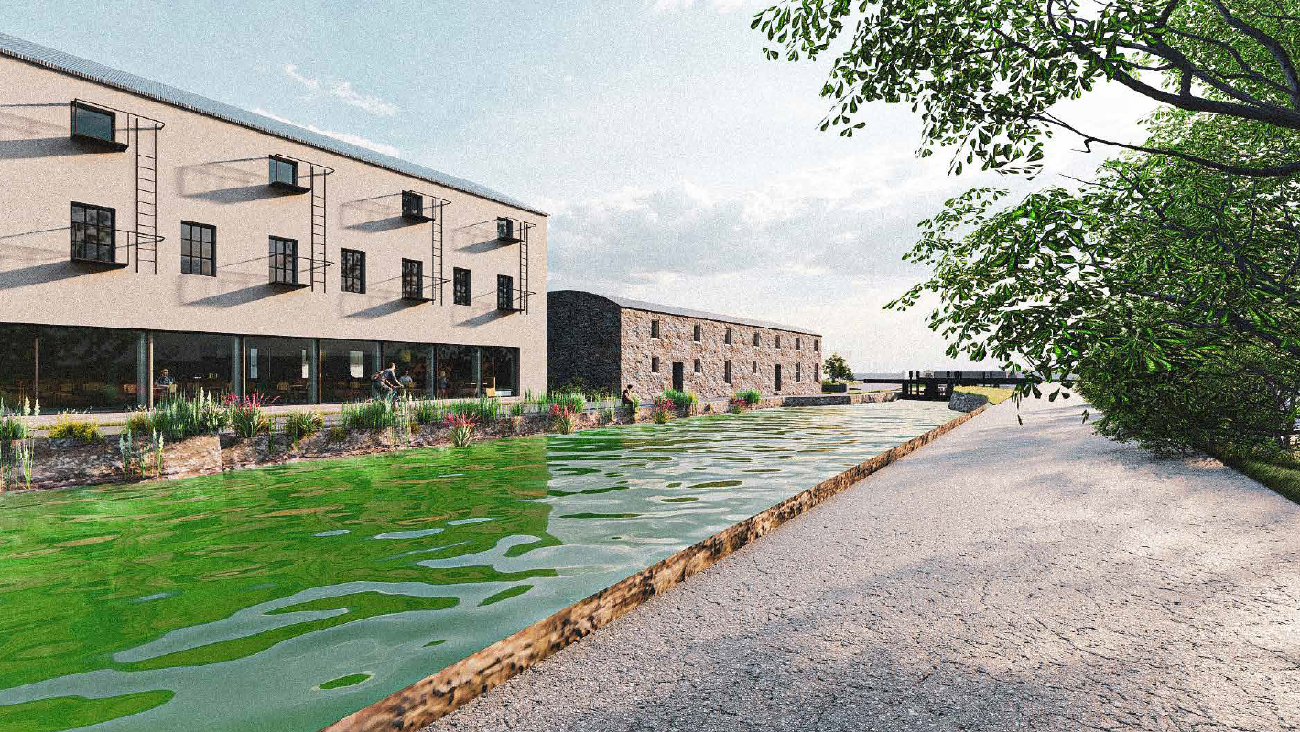
County Promotion Unit
Tourism Updates

Slide 2
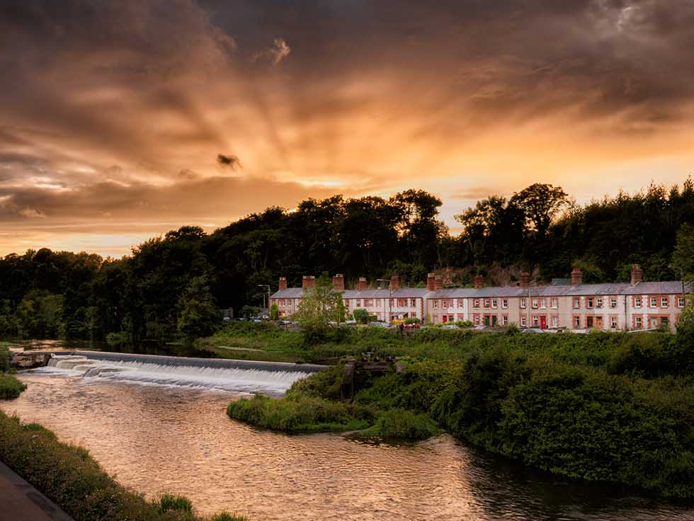
South Dublin
Draft Tourism Strategy

Slide 3
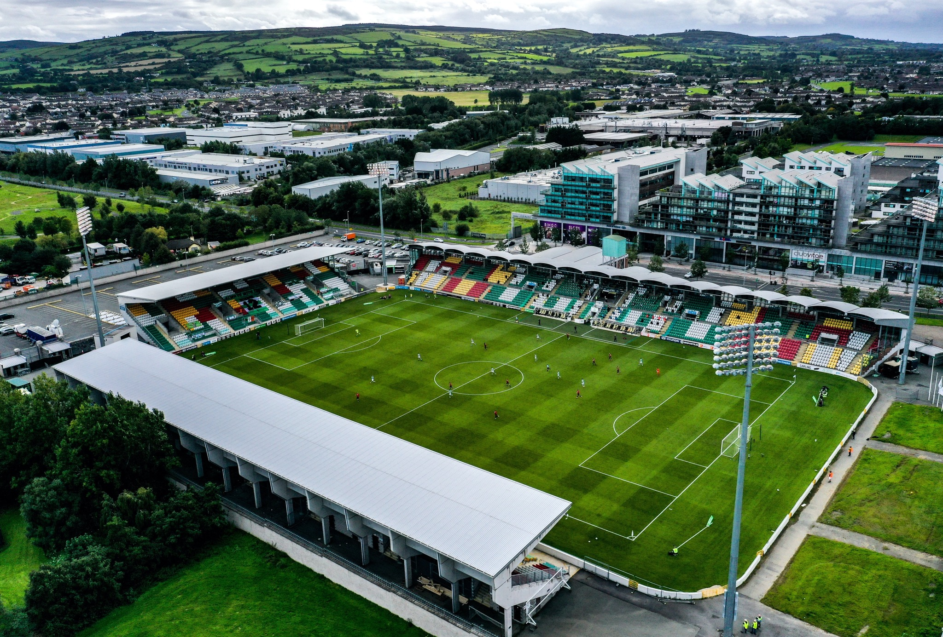
South Dublin Draft Tourism Strategy
Strategic Priorities
Realise Our Potential
Redefine our Reputation
Reinforce Connectivity
Refresh Partnership working
Regenerate our Natural Spaces
Environment & Climate Action

Slide 4
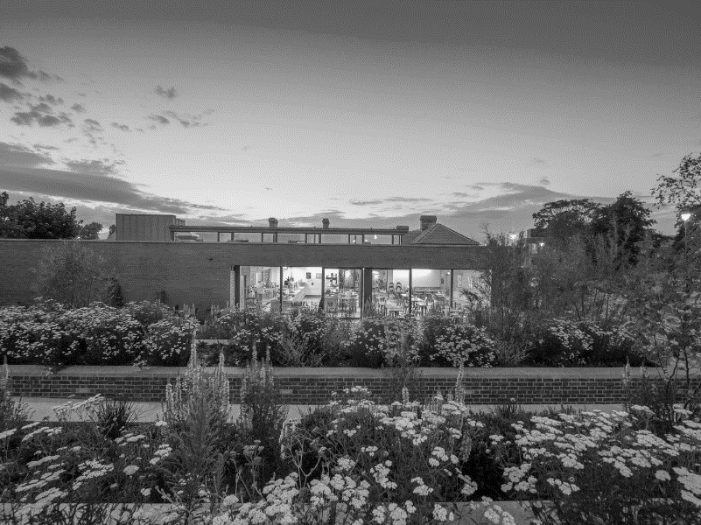
Tourism Strategy Timeline
Tourism Strategy Public Consultation
Council Meeting
Public Consultation Report
Plan Approval
August
2023
September 2023
November 2023
December2023
2024 – 2029
Draft Tourism Strategy
Elected Members Update
Review Feedback
Final Tourism Strategy
Plan Implementation
Ongoing Monitoring/Review

Slide 5
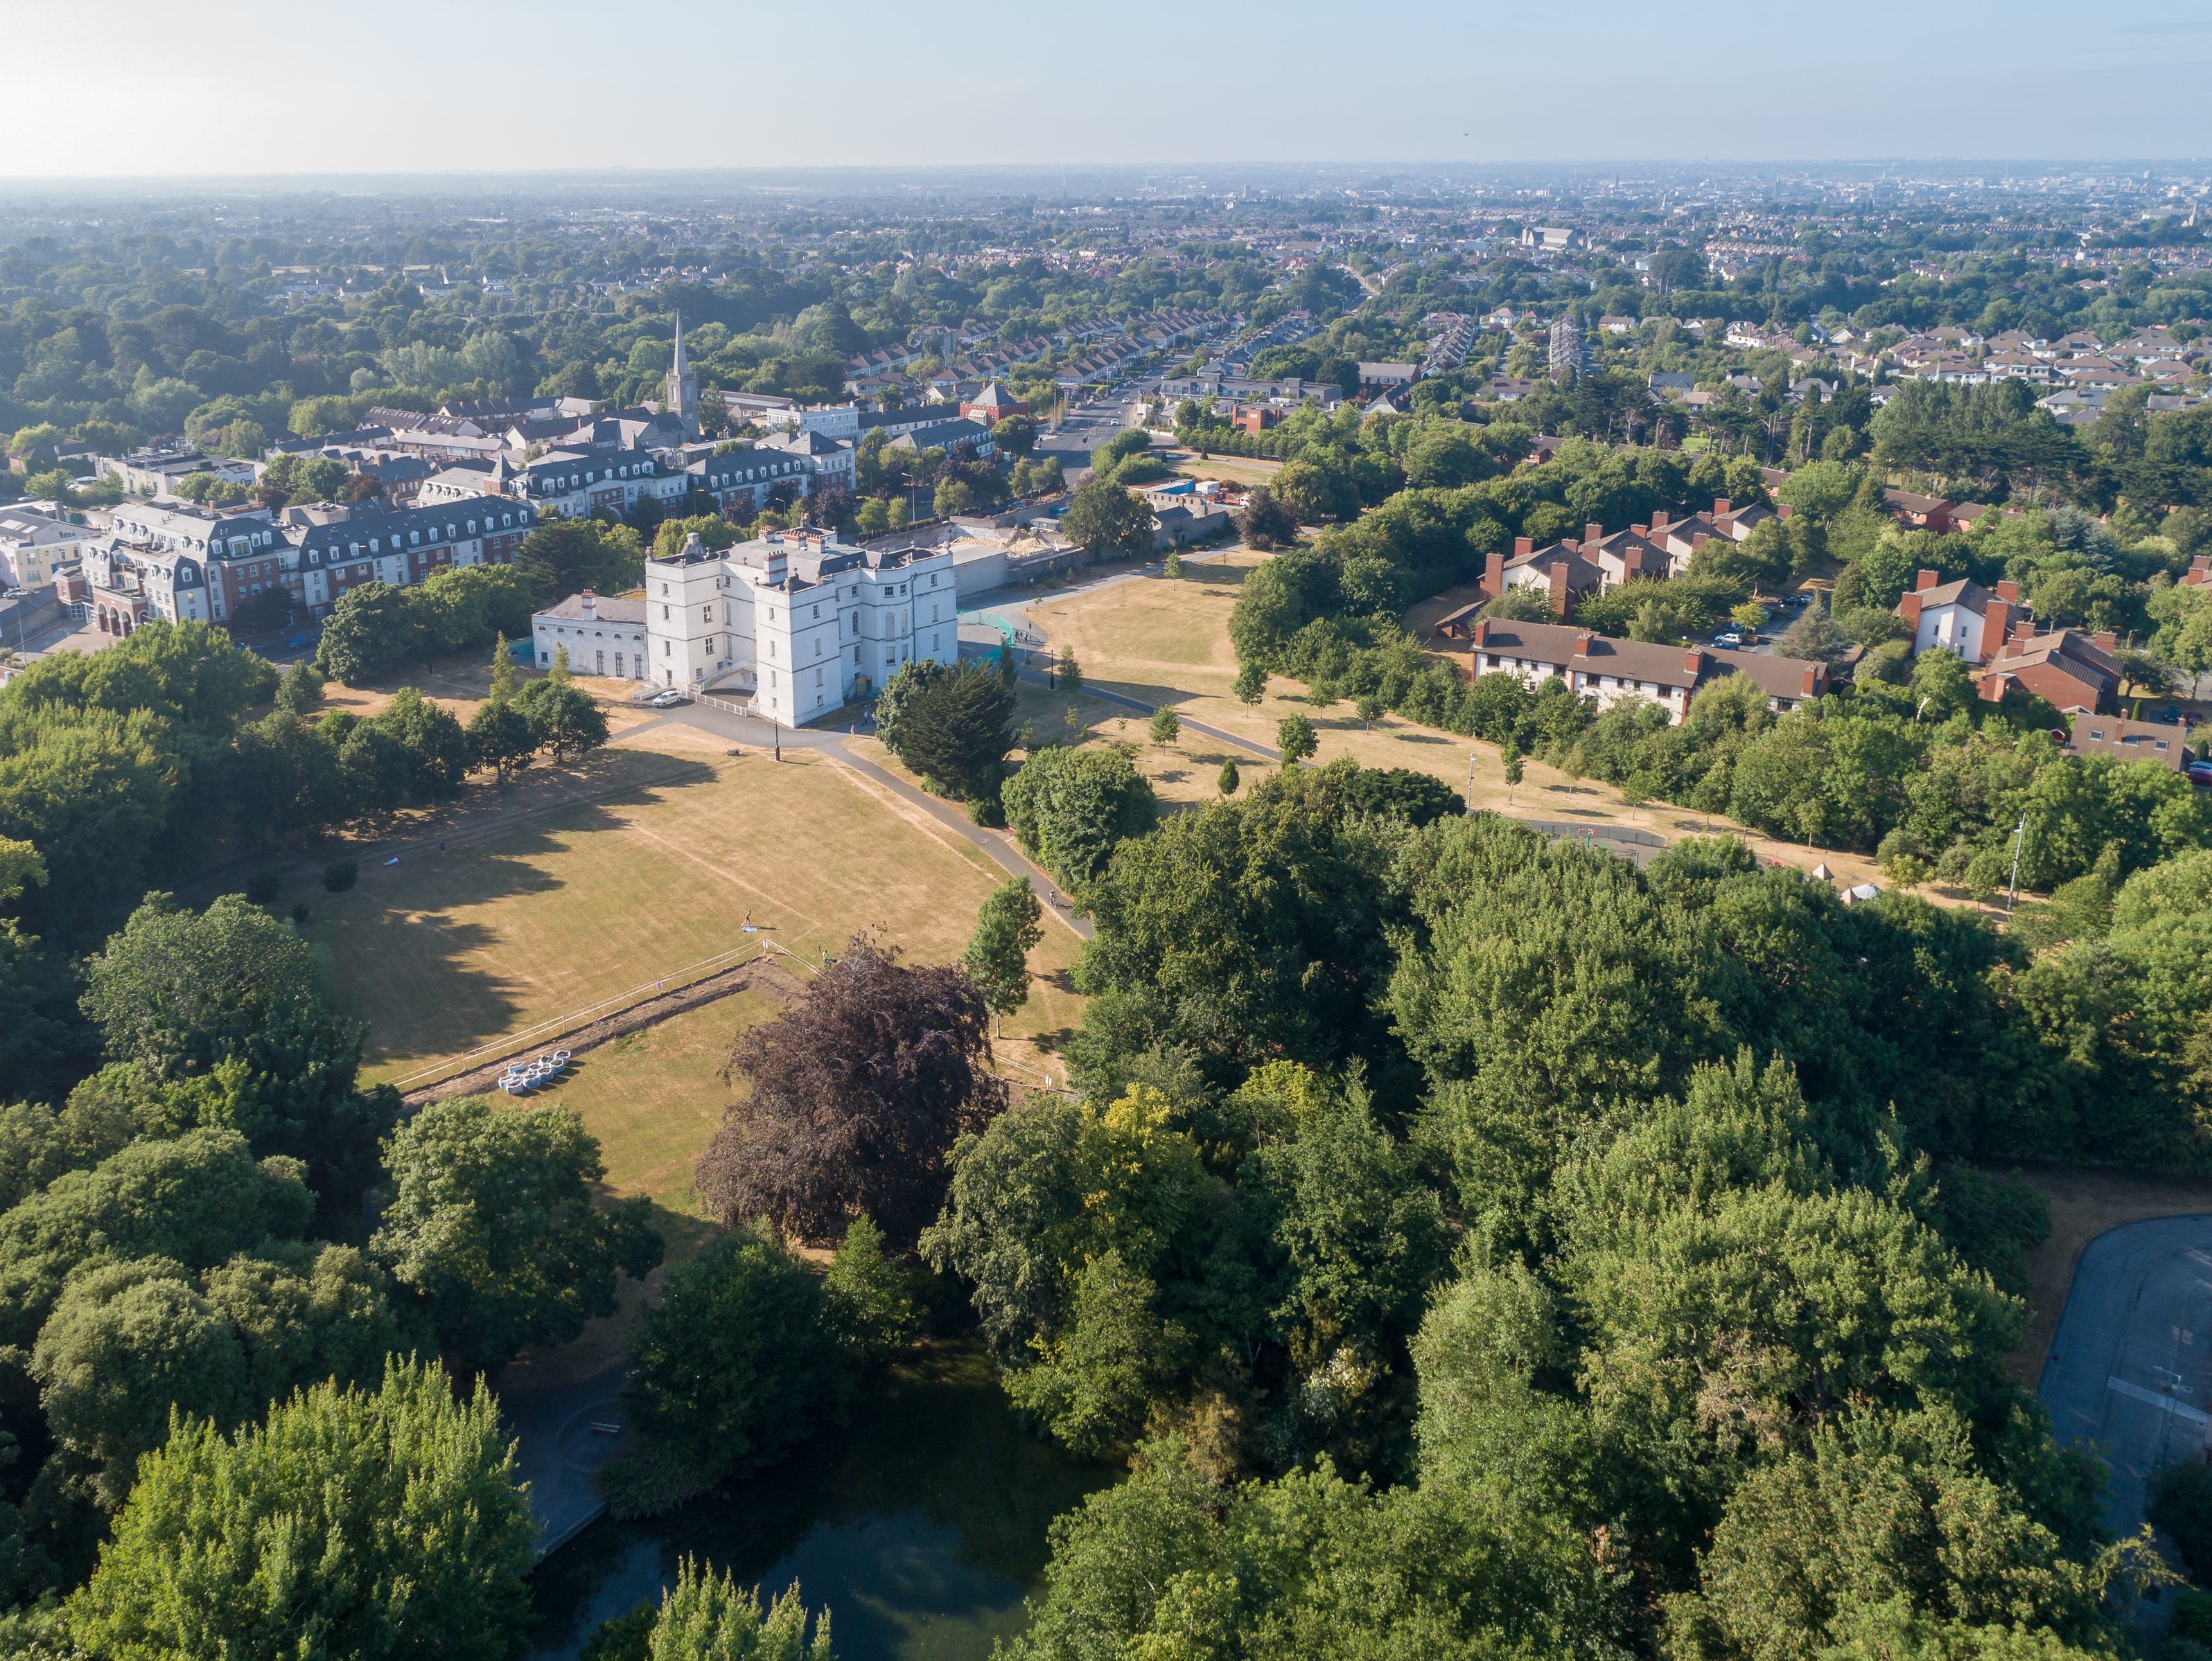
Rathfarnham Castle Courtyard and Stables

Slide 6
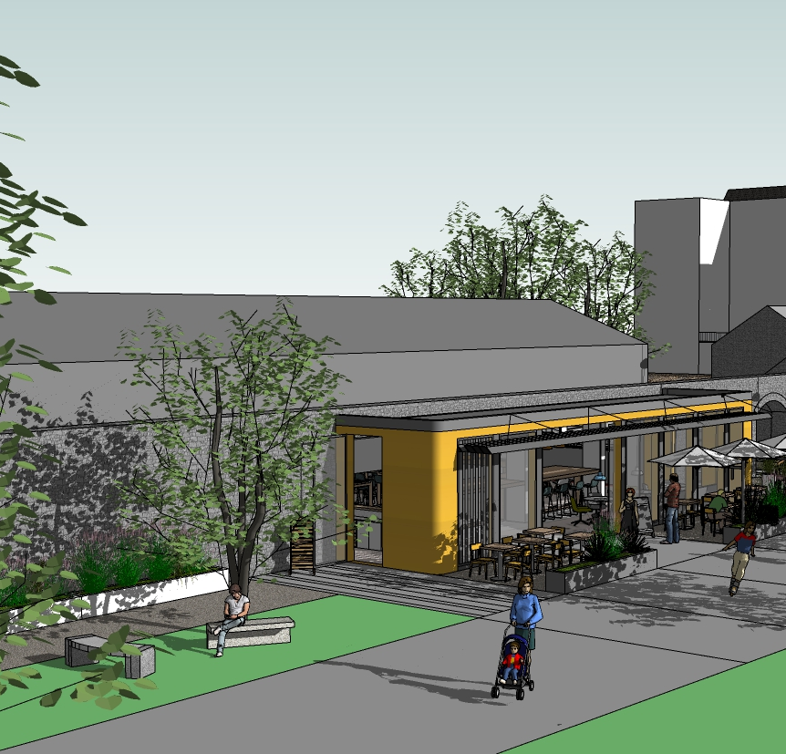
Current update
Commercial Operator selected
Design Team Appointed
Vegetation removal at site

Slide 7
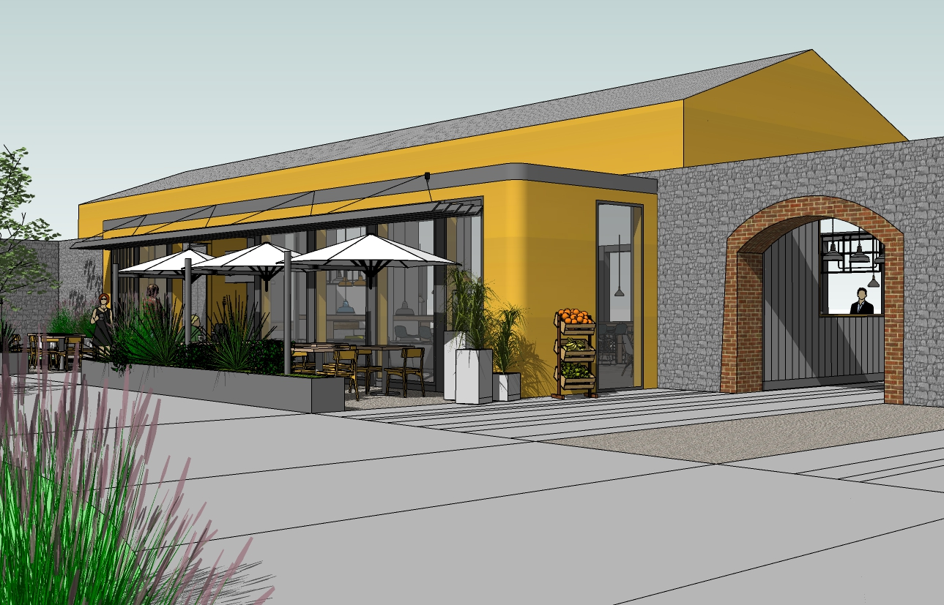
Next Steps
Master Plan Preparation
Public Consultation
Progression to Part 8

Slide 8
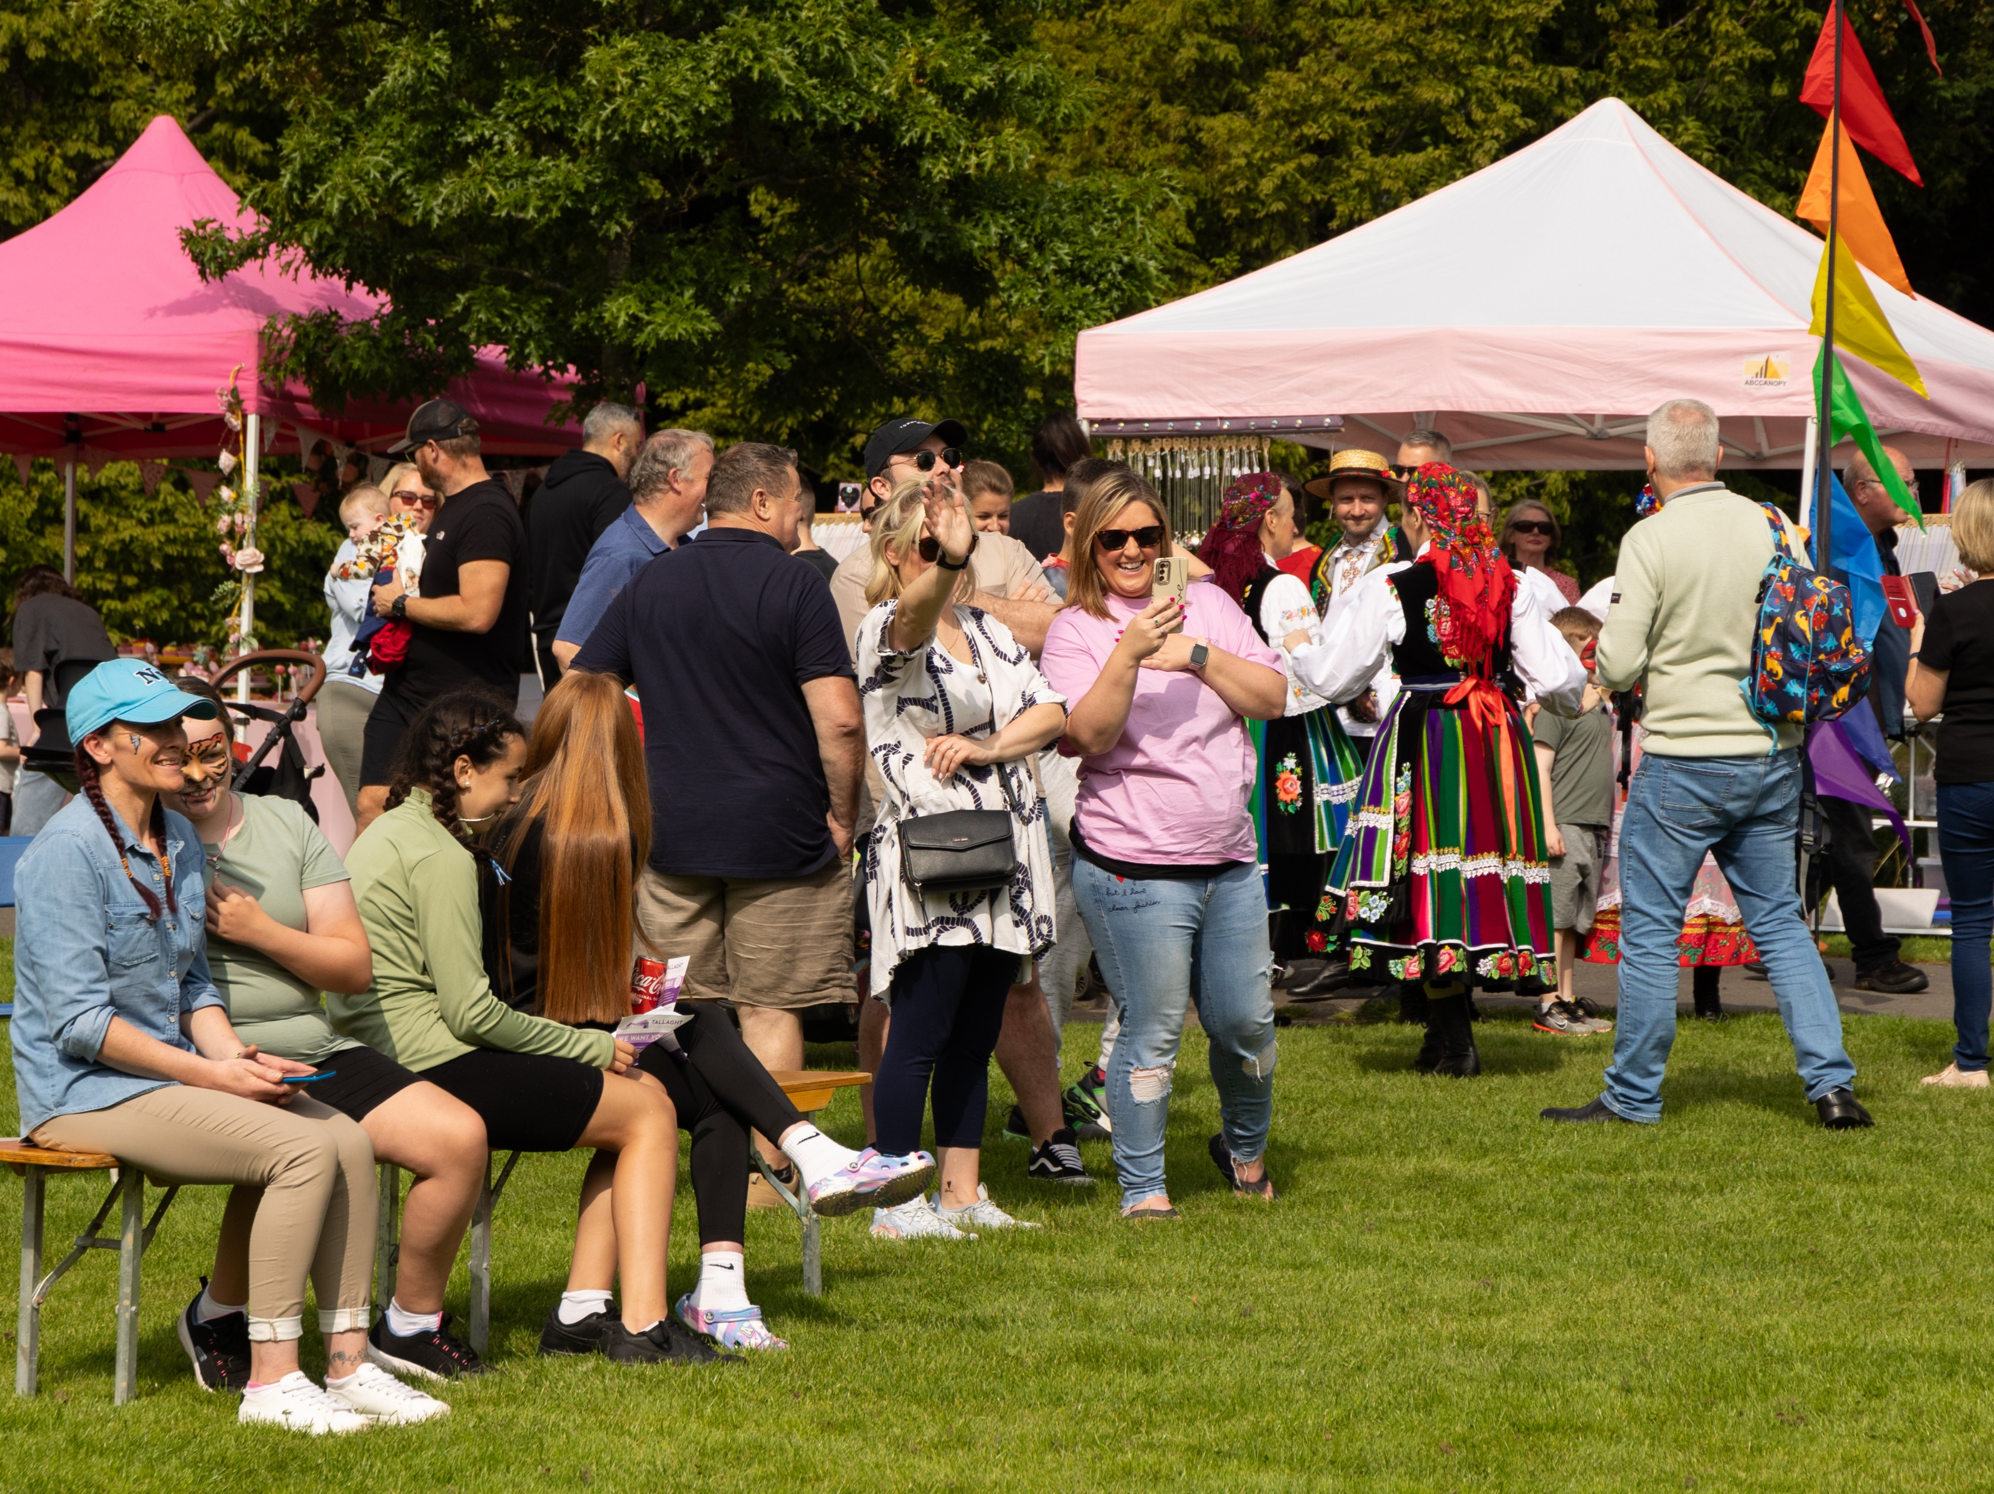
Outdoor Food & Craft Markets
Success of Tymon Park markets
Corkagh Markets
Christmas Markets

Slide 9
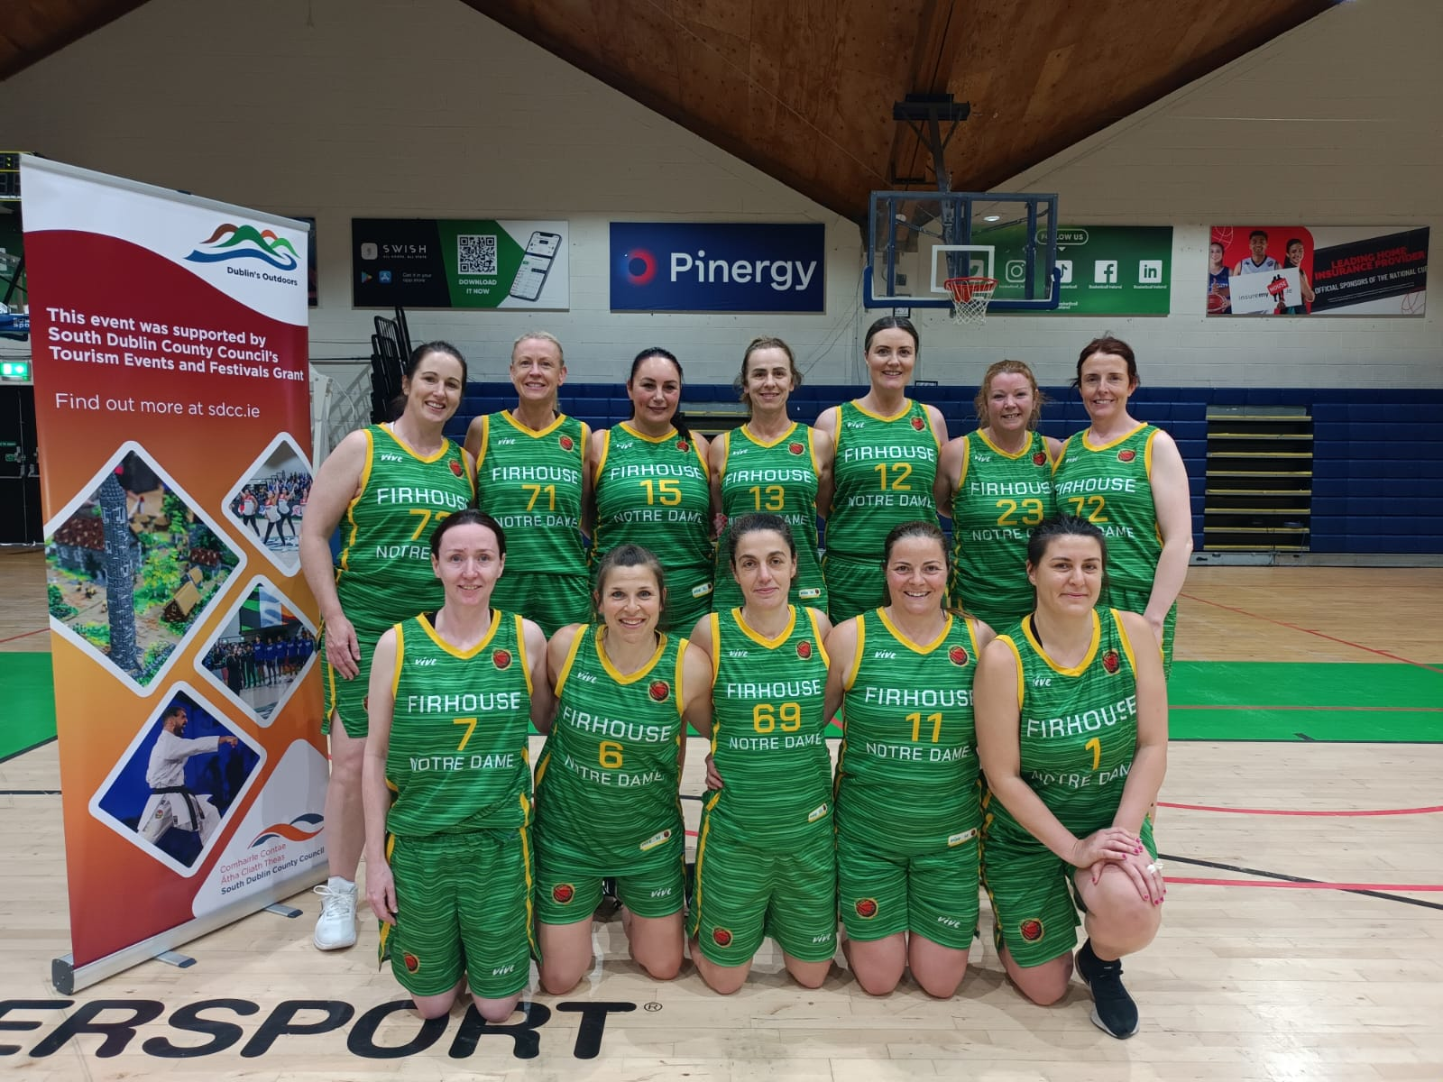
Tourism, Events and Festivals Grant
Events supported 2023
2023 Scheme Review
2024 Scheme

Slide 10
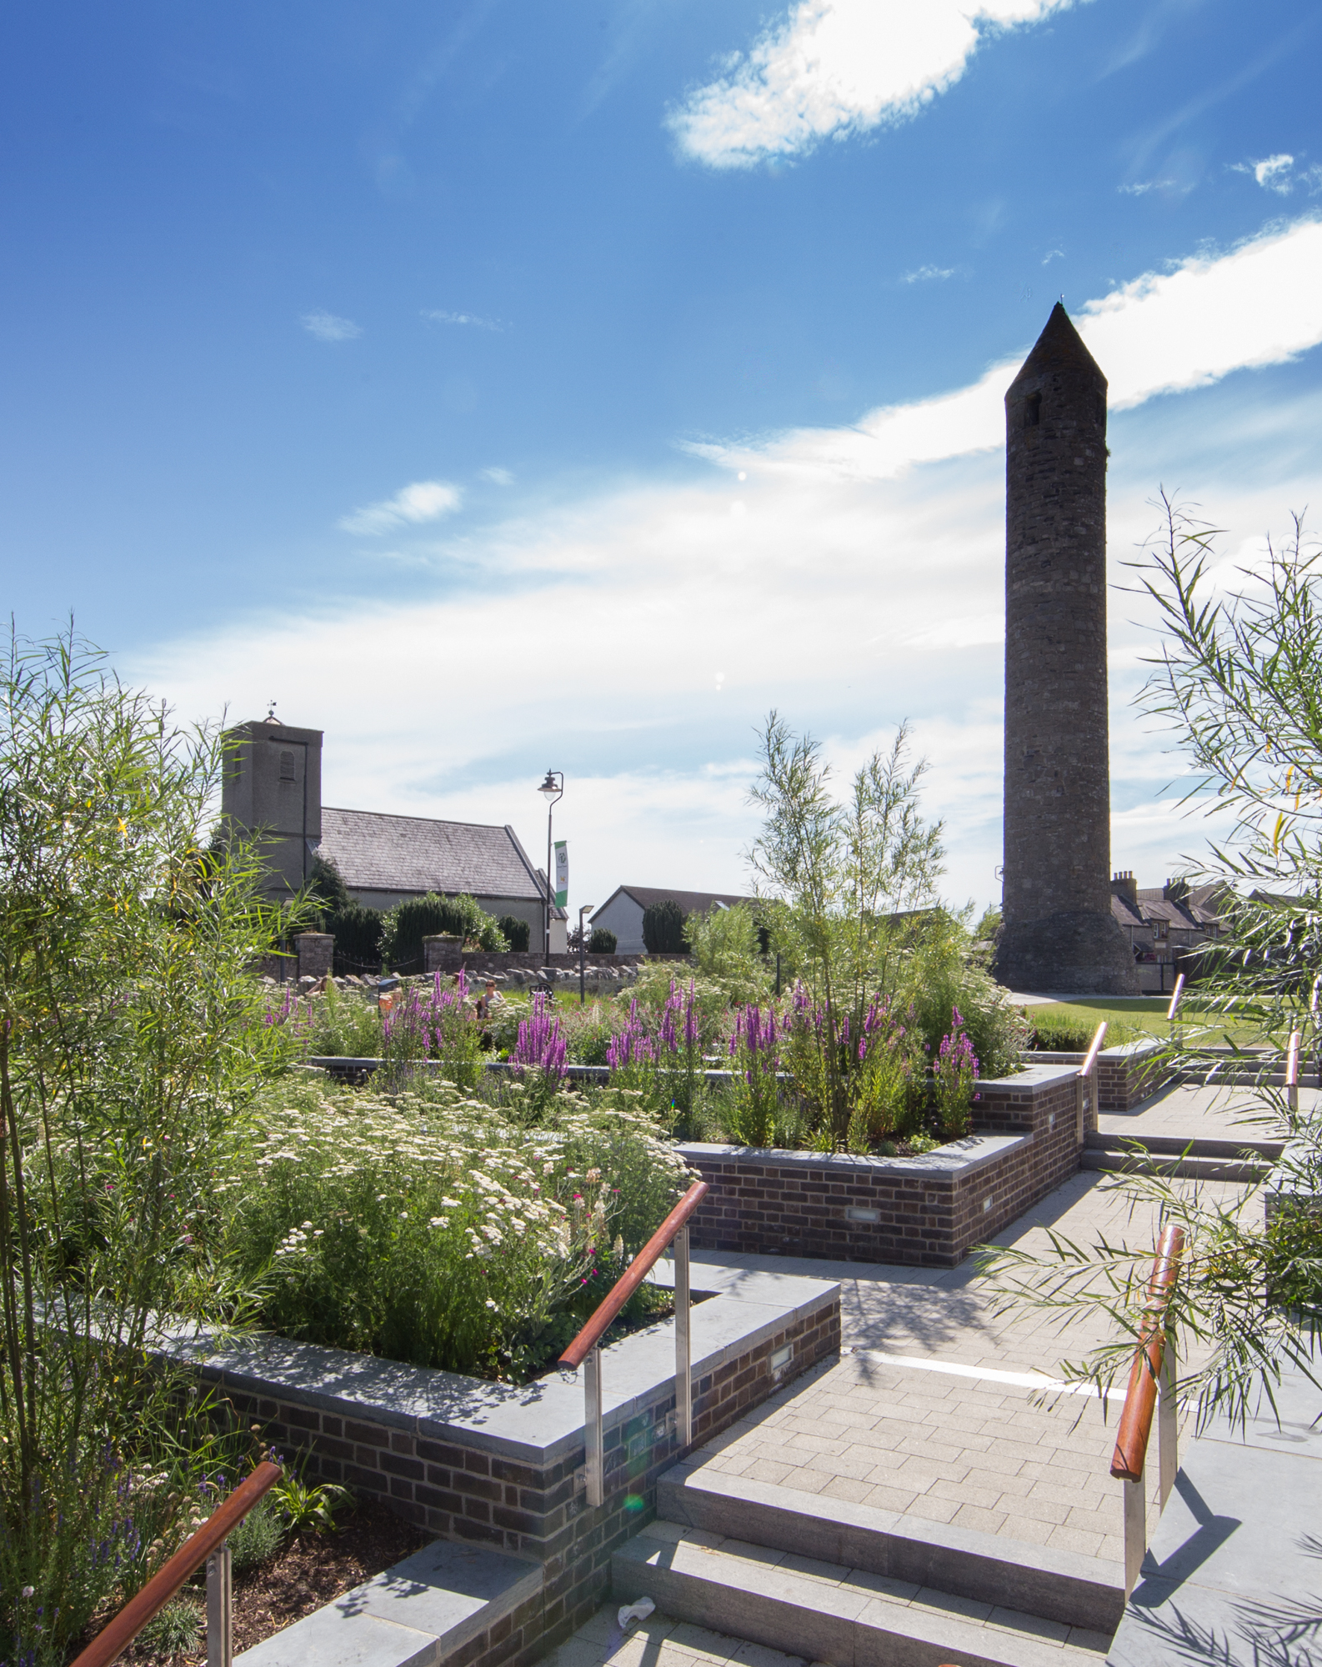
Clondalkin RTVC
Footfall Counters
Events
RTVC Design & Craft Shop

Slide 11
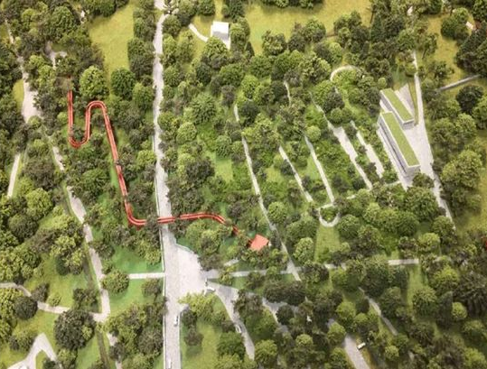
Dublin Mountains Visitor Centre
Detailed
Design
Survey
Work
Communications
Strategy
Construction Process

Slide 12
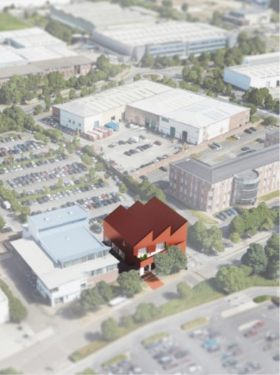
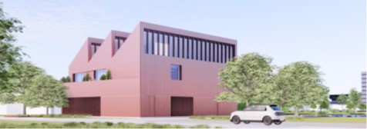
Tallaght Heritage Centre
Site Selection
Part 8 Approval
Interpretation & Planning
Detailed Design
Construction

