Slide 1
EETD SPC MEETING
LEO SOUTH DUBLIN
KEY ACTIVITIES UPDATE
WEDNESDAY 8TH NOVEMBER 2023

Slide 2
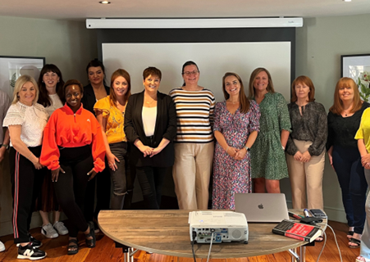
Key Stats YTD…………
M1 Financial Grants – Pipeline strong but completed applications slow
15 Approved and 10 new applications for Evaluation / Approval next week plus further for December
Total 2022 – 29 Estimate 2023 30
Training Programme –
2022 96 courses - 2023 98 Courses
Mentoring Programme [2022 579 – 2023 +600 ]
Trading on-line vouchers [2022 107 –ytd 2023 79]
TAME – Targeted Assistance for Micro Enterprises
2022 – 21 Approved 2023 13 Approved
Green for Micro – [2022 – 23 ytd 2023 – 20]
Lean [2022 – 11 ytd 2023 – 14 ]
Digital Start
[2022 – 9 ytd 2023 – 13 ]

Slide 3
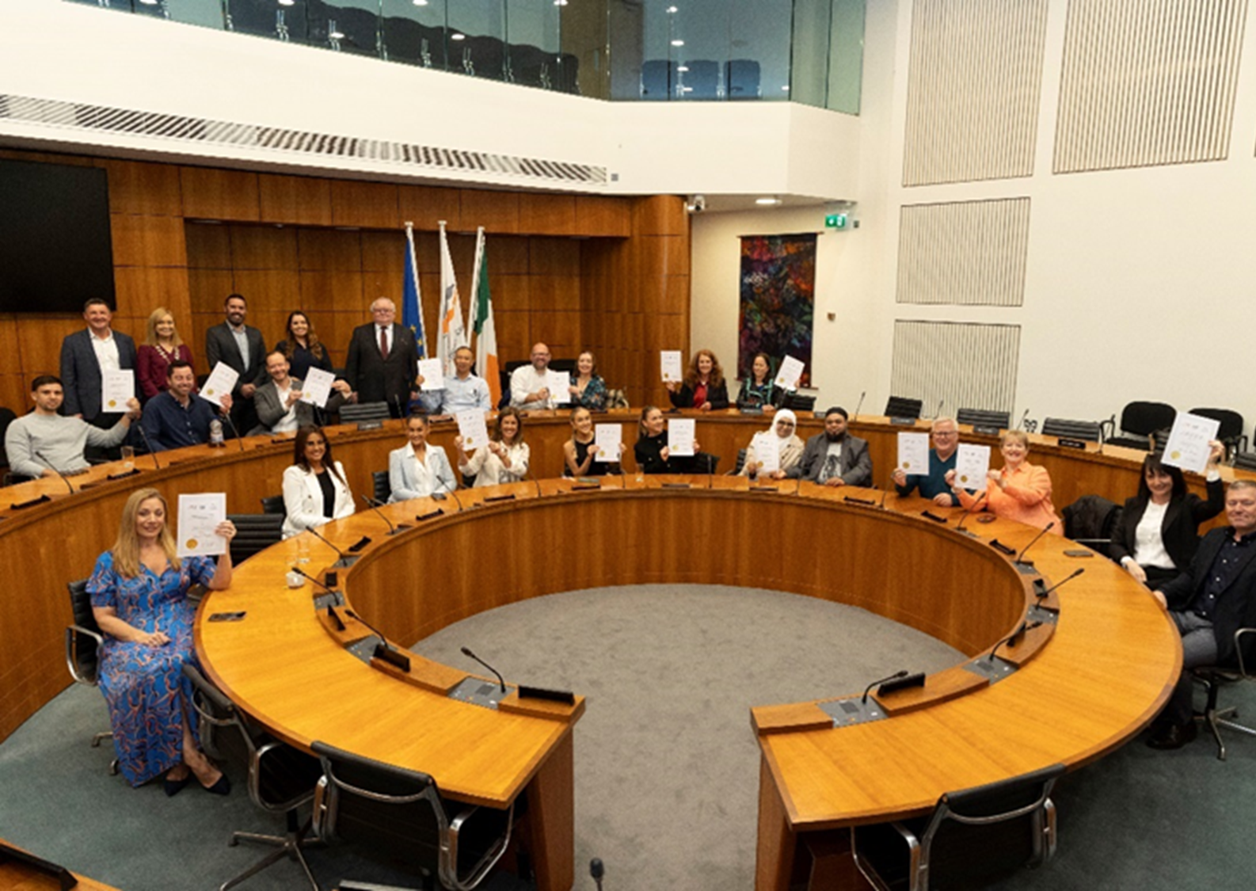
Updates cont./…
Annual Employment Survey currently underway
Food Feasibility Study –
Events & Social Media
Schools Enterprise Programme 2023/2024
Leadership Development Programme / New Network
24 Companies received certificates following completion of 6 month programme and presentation on Business plans
Minister Richmond visit to South Dublin Monday next 13th November

Slide 4
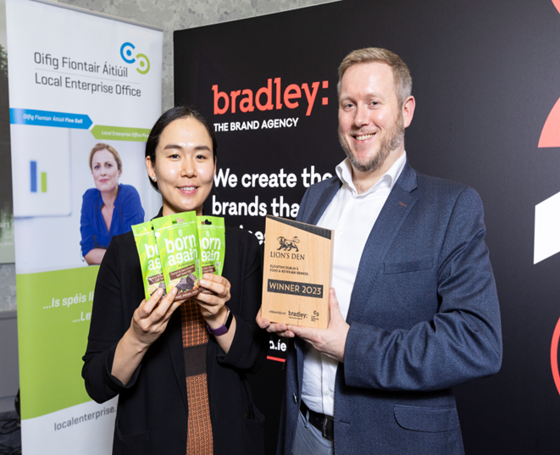
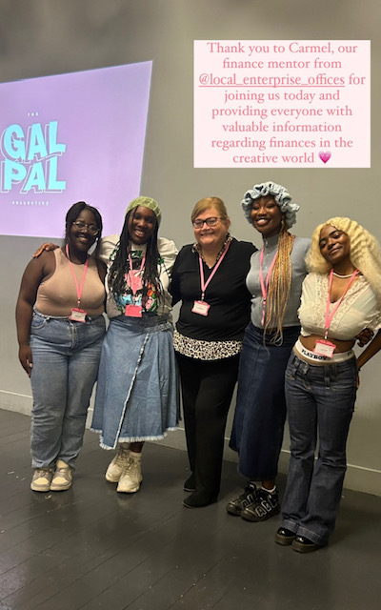
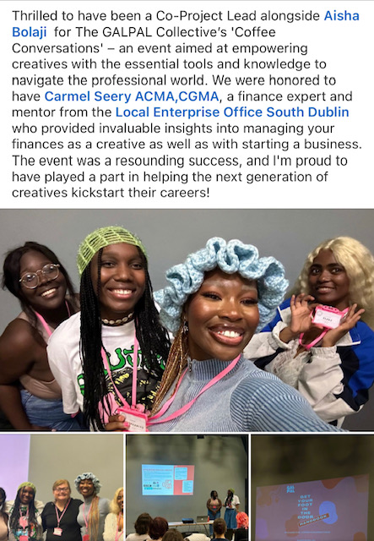
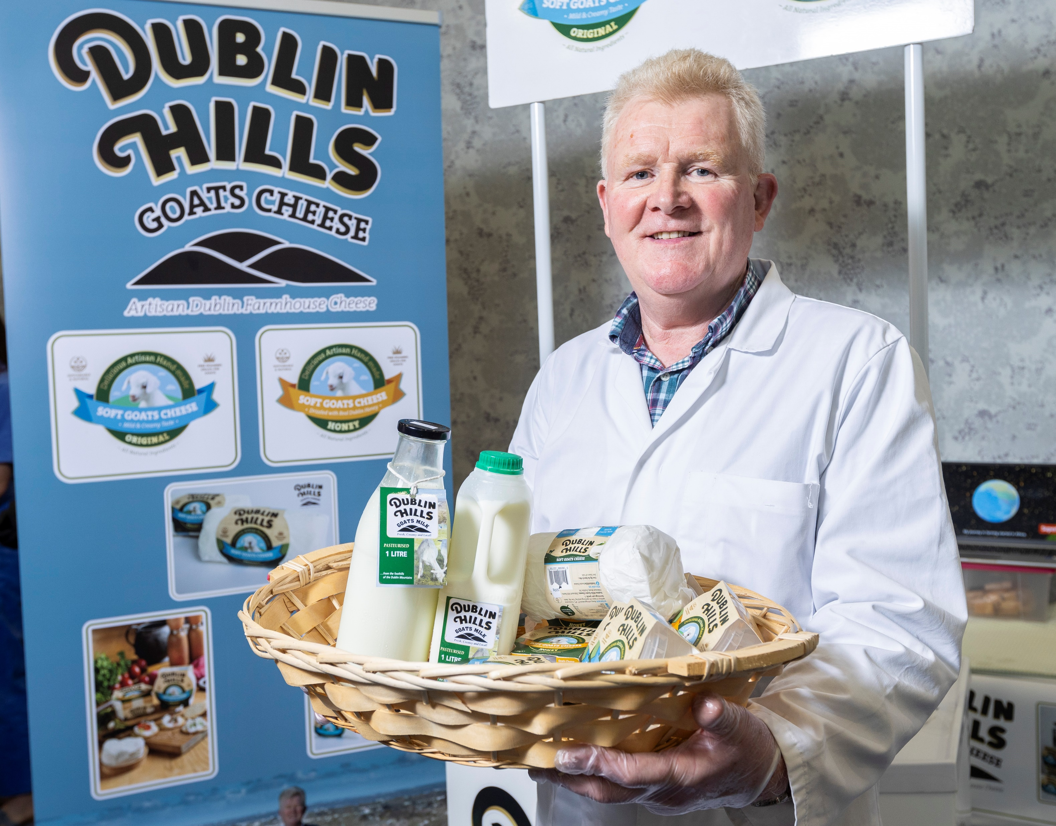
Other activities
GalPal Collective
Meet the Buyers – Dublin Food Chain

Slide 5
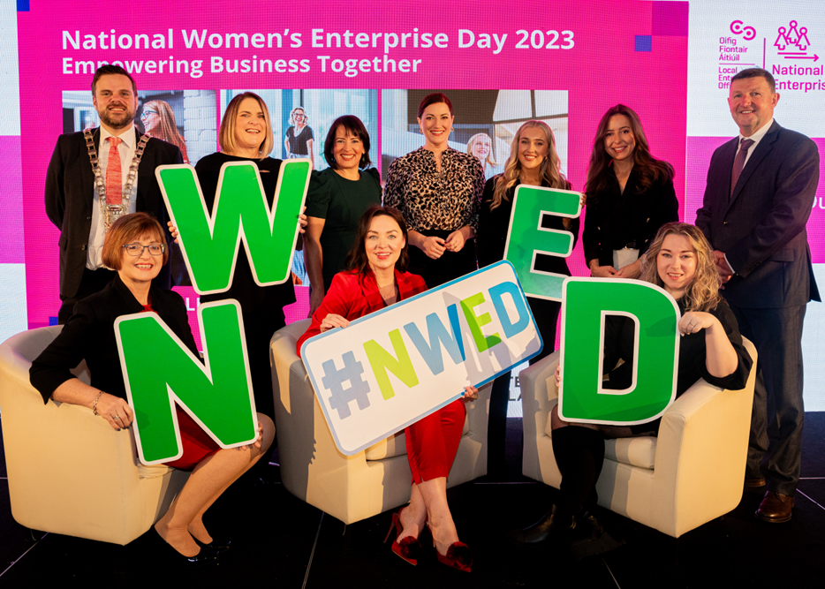
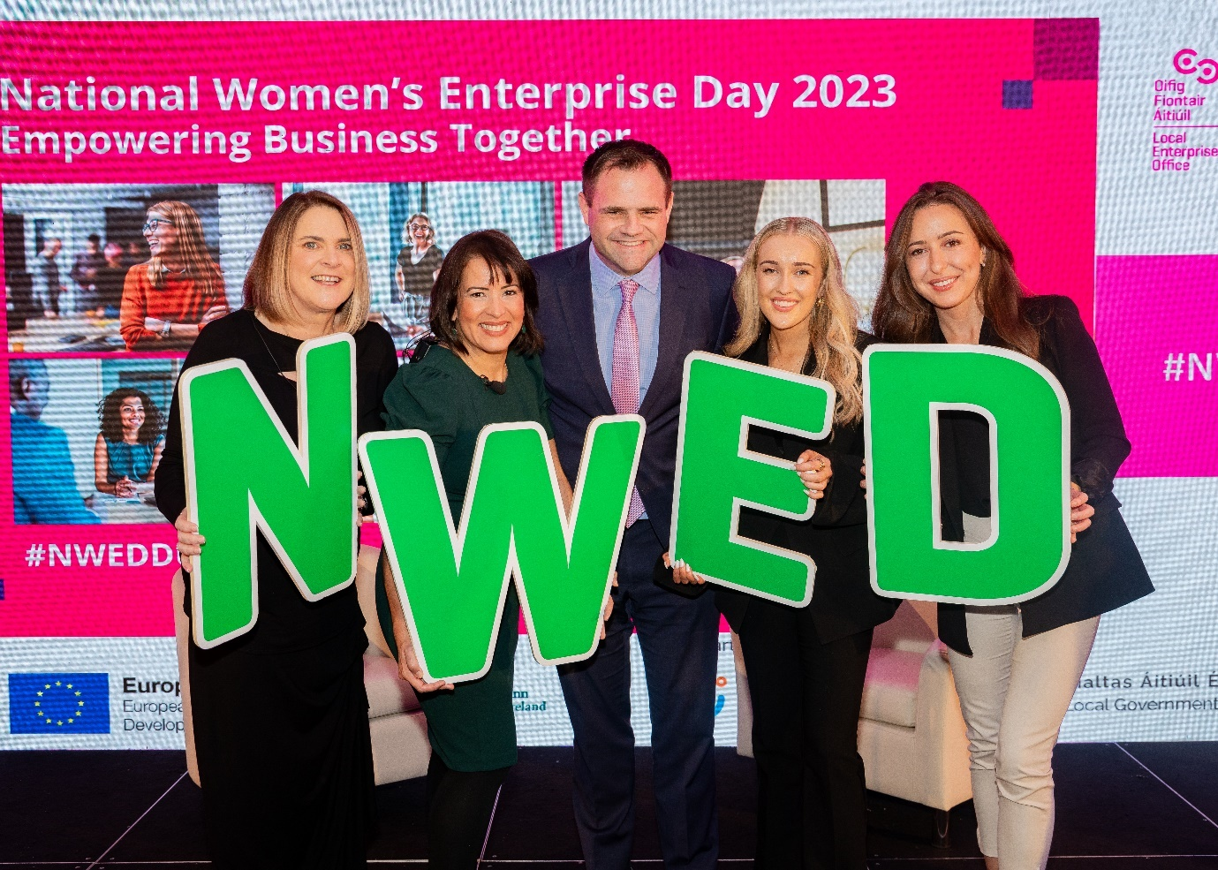
National Women’s Enterprise Day 19th October 2023
Dublin Regional event hosted by Local Enterprise Office (LEO) South Dublin in collaboration with (DLR, Fingal, and Dublin City Council)
Part of wider national initiative, "Empower Business Together."
200 Attendees
+40 % from SD
Ireland Am Televised
event live from Maldron
National & Regional PR

Slide 6
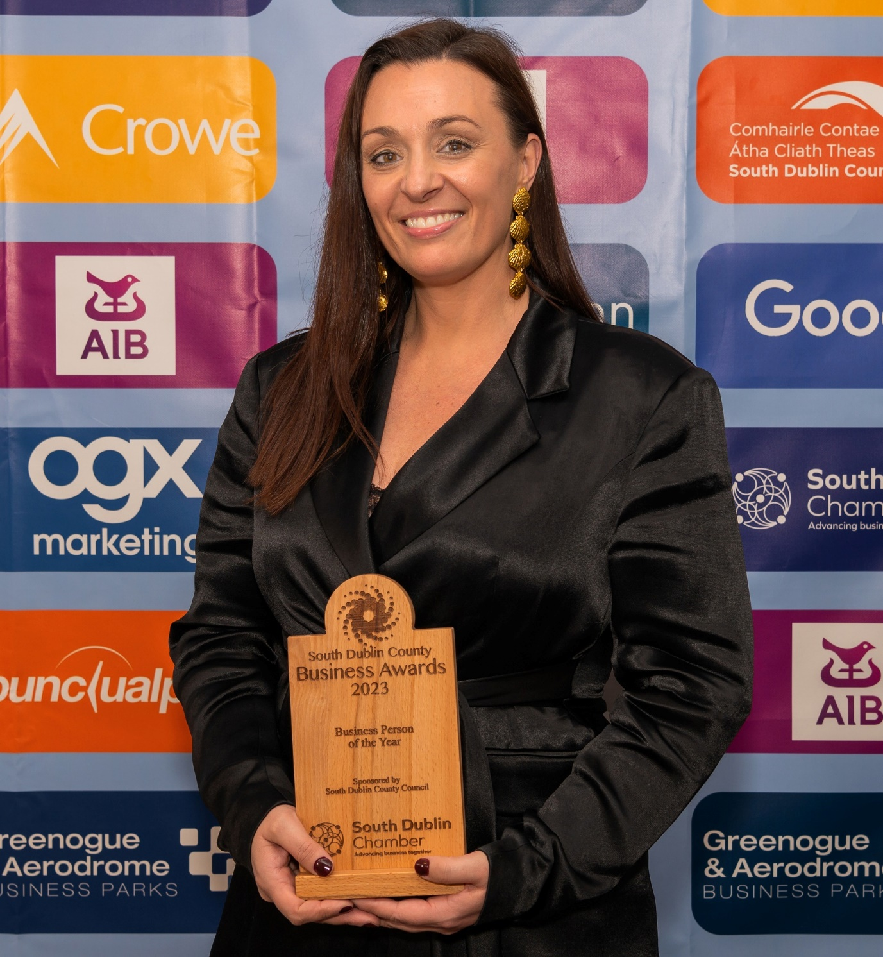
South Dublin Chamber Awards 19th October 2023
Kerrie-Ann Keogh, the Managing Director of local company High Res, was named Business Person of the Year at recent Dublin Chamber Awards. “It was a fantastic evening celebrating a wealth of enterprise and entrepreneurship, across a wide range of sectors, from large corporations to small businesses, within the region”, Kerrie-Ann said.
“I’d like to thank the South Dublin Chamber and LEO South Dublin for their recognition and ongoing support.
“I accept this award on behalf of the entire High Res team, it marks our collective efforts, and as a company it’s exciting to be part of such a vibrant business community.”
Based in Ballymount, High Res is an award-winning full service Creative Production Company, specialising in virtual production services for the global film and television industry.
A host of other LEO South Dublin businesses were recognized / shortlisted on the night across a number of categories
Best Start-up/New Business Award LEO Client My Cloud PA won an award
Employee of the Year winner, Lynn Downey – Pretzel Direct / Cookie Dough

Slide 7
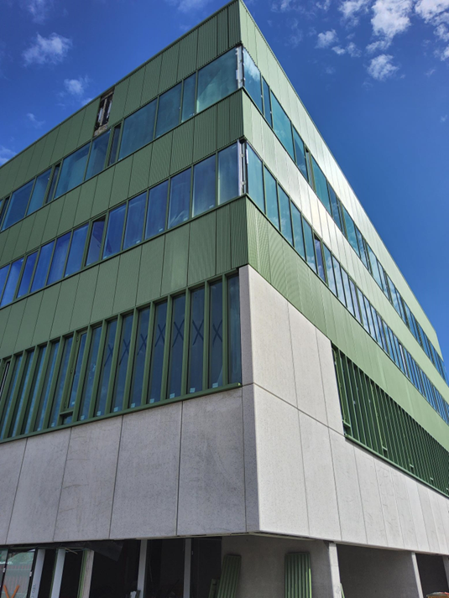
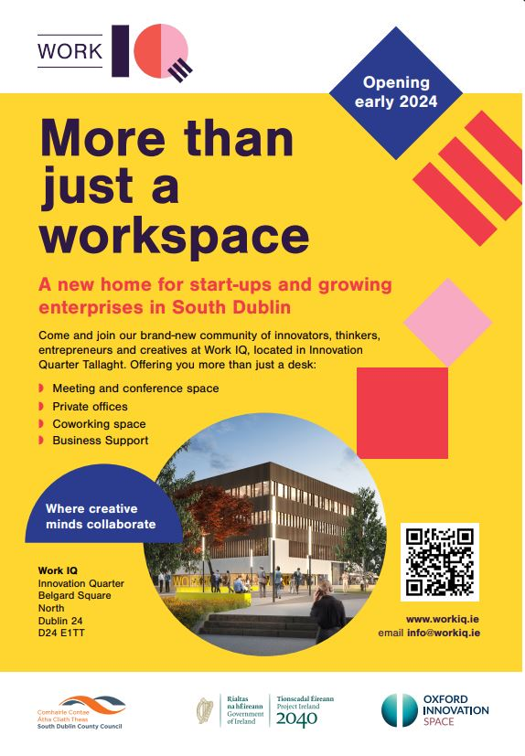
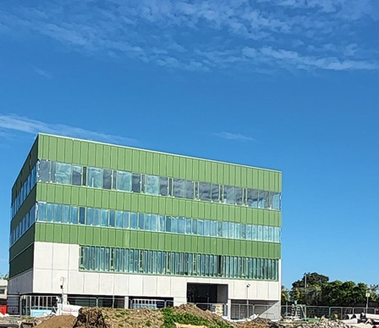
WORK IQ Innovation Centre
Building due for completion in late November / early December
Internal fitout progressing well
Oxford Innovation –Management Company
WORK IQ Immobilisation Plan and Marketing Plan also well in progress
3 Members of staff hired
Website and Advertising Campaign on going
Open for sign up by start-ups enquiries for Workspace

