Slide 1
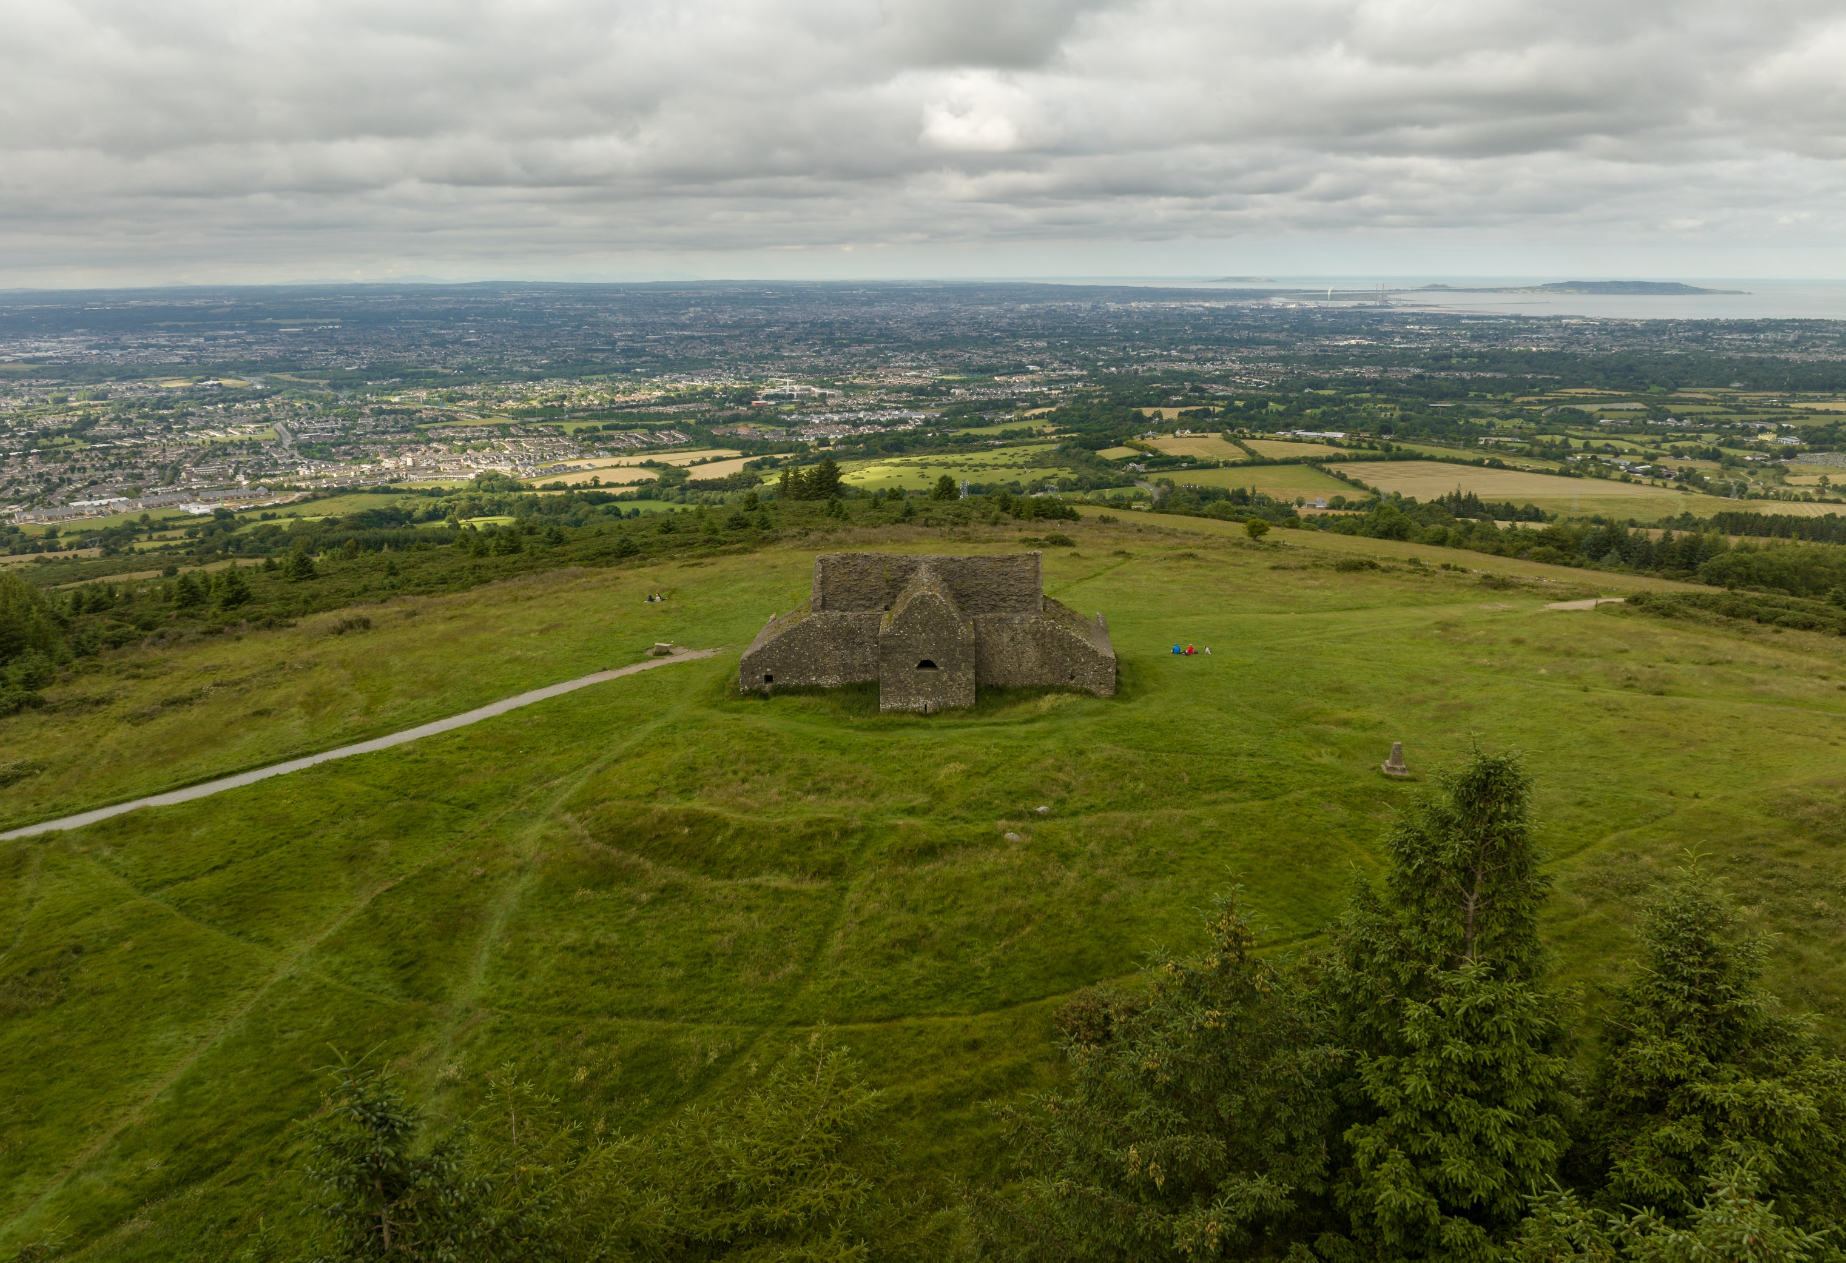
Wide screen template
South Dublin
LECP
Workshop
Insert photo cover from KPMG Tab “Title slides”
Right click and select Open Link to access further PowerPoint resources and templates
Delete this box when completed.
Subtitle goes here
—
Date
November 2023

Slide 2
Agenda 1. Introduction to today and LECPs 2. Previous Process 3. High Level Goals Discussion 4. Objectives and Actions Group work

Slide 3
Introduction
01

Slide 4
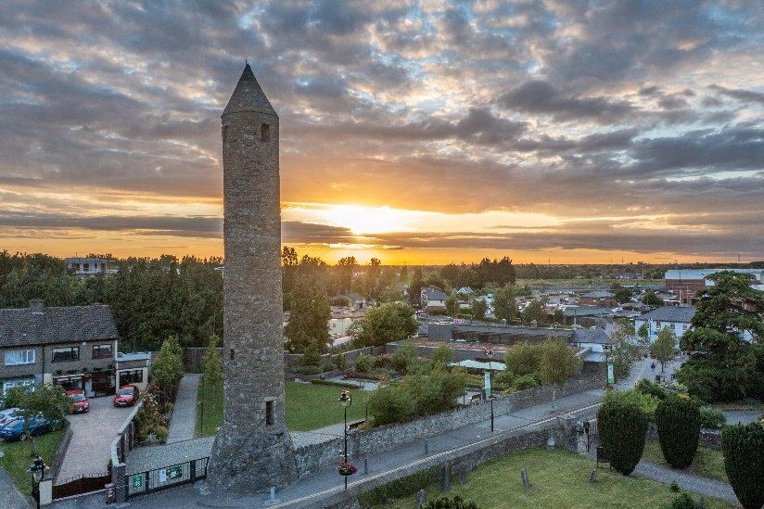
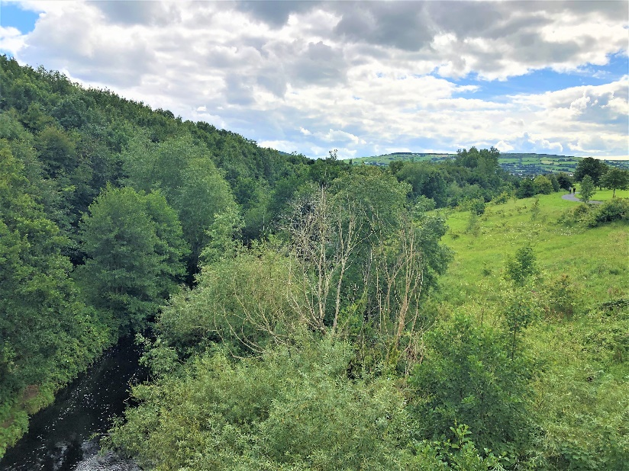
Purpose of the Project
The new Local Economic and Community Plan (LECP) will cover 2024-2030 and will guide the sustainable economic and community development of South Dublin.
It will include goals and objectives related to:
Economic elements such as actions to promote job creation and support existing businesses
Community elements including actions to support inclusion, access to services and addressing disadvantage, amongst other areas

Slide 5
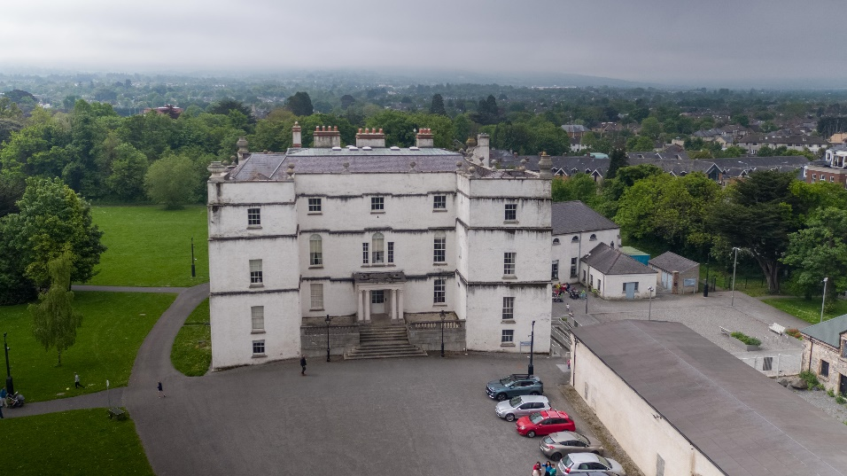
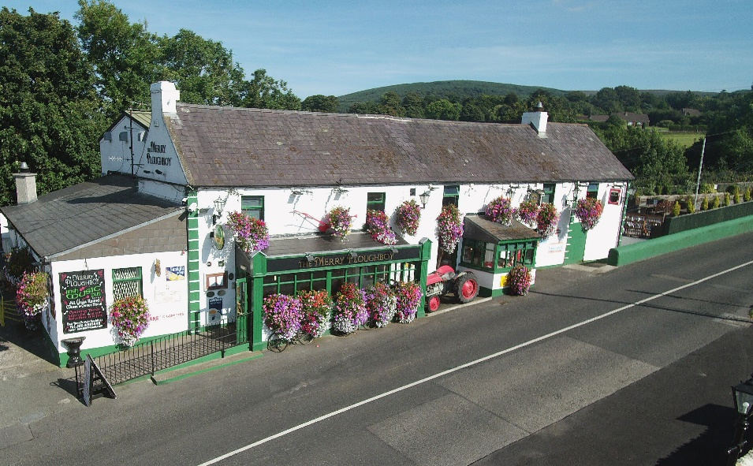
Purpose of Today
Provide information on the LECP process
Look at what went wrong and how the process can be improved.
Give you an opportunity to contribute to the development of the new LECP’s objectives, actions and outcomes
Explore ideas through examining the 5 draft high-level goals.
Discuss opportunities and ideas for South Dublin.

Slide 6
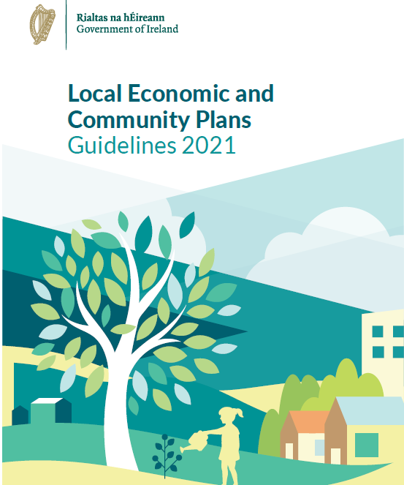
Overview of the LECP
LECP Framework – 6 year period (2024 – 2030)
Goals which provide the general direction of the plan
The objectives which look to address specific areas related to the goals
The desired outcomes/impacts that interventions through the Plan will aim to achieve by 2030
Actions and KPIs – 2 year Implementation plan
The actions and KPIs are now part of a more flexible implementation plan
The actions and their related KPIs work to support the achievement of the goals, objectives and the desired outcomes

Slide 7
LECP Overview
LECP Framework
High-Level Goals
Objectives
Desired Outcomes
Actions and KPIs
Flexible Implementation Plan

Slide 8
Previous Process
02

Slide 9
Discussion
What was done well?
1.
2.
3.
4.
5.
Where did things go wrong?
1.
2.
3.
4.
5.

Slide 10
High Level Goals
03

Slide 11
South Dublin County Council High-Level Goals
Economic | Community | Overarching Theme | Wording High Level Goal Example
Enhance South Dublin County Council’s reputation as a primary location to live, visit, work and do business | Support sustainable community development | People and Place | Our LECP includes actions to support people living and working in the county of South Dublin
Actively promote and improve equality, safety and diversity within wider South Dublin Community | Support the health and wellbeing of all citizens and develop opportunities for increase in sport and active recreation in the County | Health and Wellbeing | Our LECP is focussed on improving health and wellbeing of all
Support All individuals in SDCC to realise their full potential with engagement in economic activity and training | Lifelong learning pathways for all citizens | Learning and Working | Our LECP is focussed on increasing access to lifelong learning and upskilling opportunities for all
Support the creation of a sustainable low carbon county | Enhance opportunities for people to live sustainably | Climate Action | Our LECP is focussed on supporting people living and working in SDCC to make the transition to a low carbon County.
Digital and Data led approach to services and amenity development | Enhance Community connectivity | SMART County | Our LECP is focussed on supporting a smart, sustainable and socially inclusive County through Smart led Initiatives and skills development.

Slide 12
High-Level Goals
01
Our LECP includes actions to support people living and working in the county of South Dublin
04
Our LECP is focussed on supporting people living and working in SDCC to make the transition to a low carbon County
02
Our LECP is focussed on improving health and wellbeing of all
05
Our LECP is focussed on supporting a smart, sustainable and socially inclusive County through SMART led Initiatives and skills development
03
Our LECP is focussed on increasing access to lifelong learning and upskilling opportunities for all

Slide 13
Discussion / Q&A (15mins max)
Are these right for South Dublin?
Have anything been missed?
1. Our LECP includes actions to support people living and working in the county of South Dublin
3. Our LECP is focussed on increasing access to lifelong learning and upskilling opportunities for all
5. Our LECP is focussed on supporting a smart, sustainable and socially inclusive County through SMART led Initiatives and skills development
2. Our LECP is focussed on improving health and wellbeing of all
4. Our LECP is focussed on supporting people living and working in SDCC to make the transition to a low carbon County

Slide 14
Objectives and Actions
04

Slide 15
Group work: Ideate (20mins max)
What should the objectives be for the High Level Goals?
What actions should be used to reach these objectives?
What should the main outcomes be?
1. Our LECP includes actions to support people living and working in the county of South Dublin
3. Our LECP is focussed on increasing access to lifelong learning and upskilling opportunities for all
5. Our LECP is focussed on supporting a smart, sustainable and socially inclusive County through SMART led Initiatives and skills development
2. Our LECP is focussed on improving health and wellbeing of all
4. Our LECP is focussed on supporting people living and working in SDCC to make the transition to a low carbon County

Slide 16
Group work: Refine (10mins max)
What are the actions with the highest potential?
Are these actions feasible?
Personnel to carry out the actions (i.e. who is responsible?)
Funding available or likely to become available
Governance and management systems in place
3. Choose three.
Remember initial implementation plan will be for 2 years.

Slide 17
liam.mannix@kpmg.ie 1 Stokes Place, St. Stephen’s Green, Dublin 2
Thank you

Slide 18
Some or all of the services described herein may not be permissible for KPMG audit clients and their affiliates or related entities.
kpmg.ie
The information contained herein is of a general nature and is not intended to address the circumstances of any particular individual or entity. Although we endeavor to provide accurate and timely information, there can be no guarantee that such information is accurate as of the date it is received or that it will continue to be accurate in the future. No one should act on such information without appropriate professional advice after a thorough examination of the particular situation.
The KPMG name and logo are trademarks used under license by the independent member firms of the KPMG global organisation.
© 2022 KPMG, an Irish partnership and a member firm of the KPMG global organisation of independent member firms affiliated with KPMG International Limited, a private English company limited by guarantee. All rights reserved.

