Slide 1
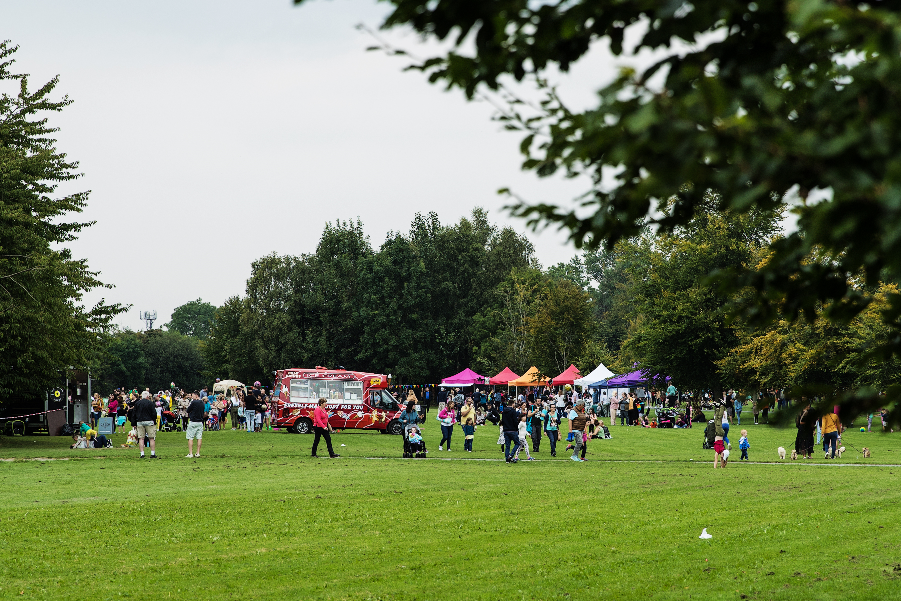
CASUAL TRADING BYELAWS

Slide 2
Casual Trading Byelaws
It was proposed to initiate a review of the South Dublin County Council Casual Trading Byelaws 2016 made under the Casual Trading Act, 1995 (the Act).
Section 6(1) of the Act provides a statutory requirement for each local authority to make byelaws in relation to the control, regulation, supervision, and administration of casual trading in its functional area. The procedure for making Casual Trading Byelaws is prescribed in Section 6 of the Act and includes a public consultation process.
The European Union (Casual Trading Act,1995) Regulations 2018 came into operation on 1st January 2019. The regulations provide for amendments to the Act in the following areas which will be considered as part of the proposed review:
• Selection procedures used by local authorities in issuing licences • The issue of charges and fees • The duration of casual trading licences
Section 6(9) of the Act provides that the making of Casual Trading Byelaws is a reserved function of the Council.

Slide 3
Current position:
The existing Casual Trading byelaws have been reviewed by the Enforcement and Licensing team.
We would now like to get the views of the public as part of the public consultation process in relation to the following:
Locations for Casual Trading, including views on whether the existing trading areas are considered appropriate
The types of goods that can be traded
Should trading times be specified in each licence
The appropriate level of fees to be charged
Whether “preferred licences” should be offered i.e. Licence issued in preference for locally/regionally produced food products or arts/crafts of exceptional quality

Slide 4
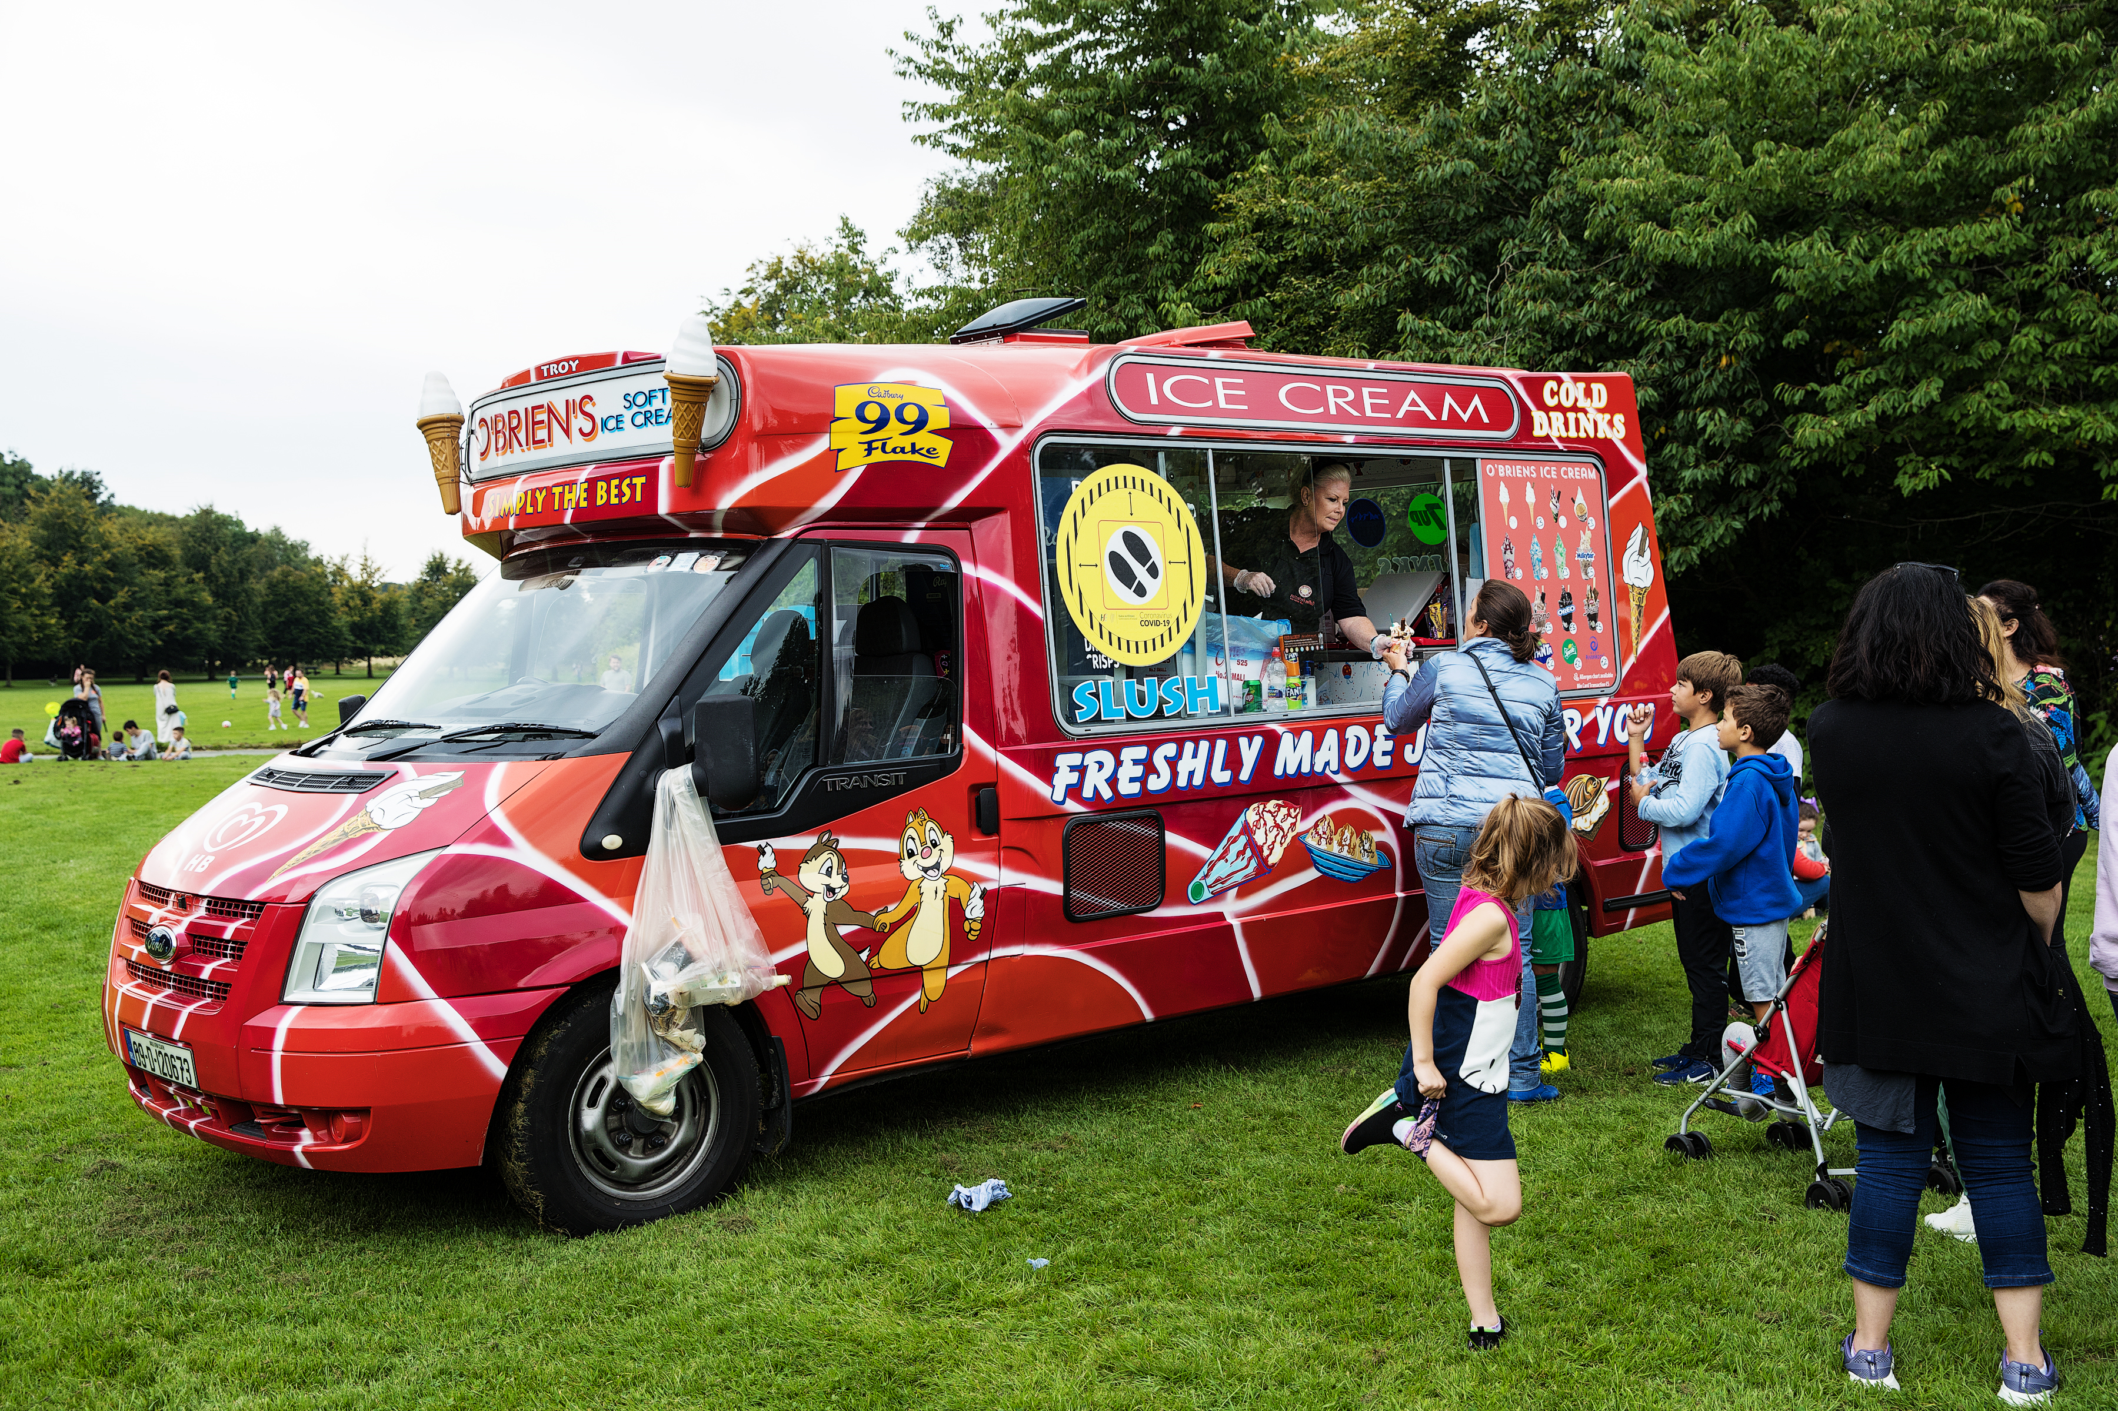
Next steps:
Would like to get the SPC members input here tonight, later through email and/or the consultation portal which will open in the New Year.
Amended draft byelaws can be brought back to the SPC after the consultation period for review before they go to Council.

