Slide 1
Rosemount District Centre Enhancement Scheme
Part 8 – For Approval
13^{h} November 2023

Slide 2
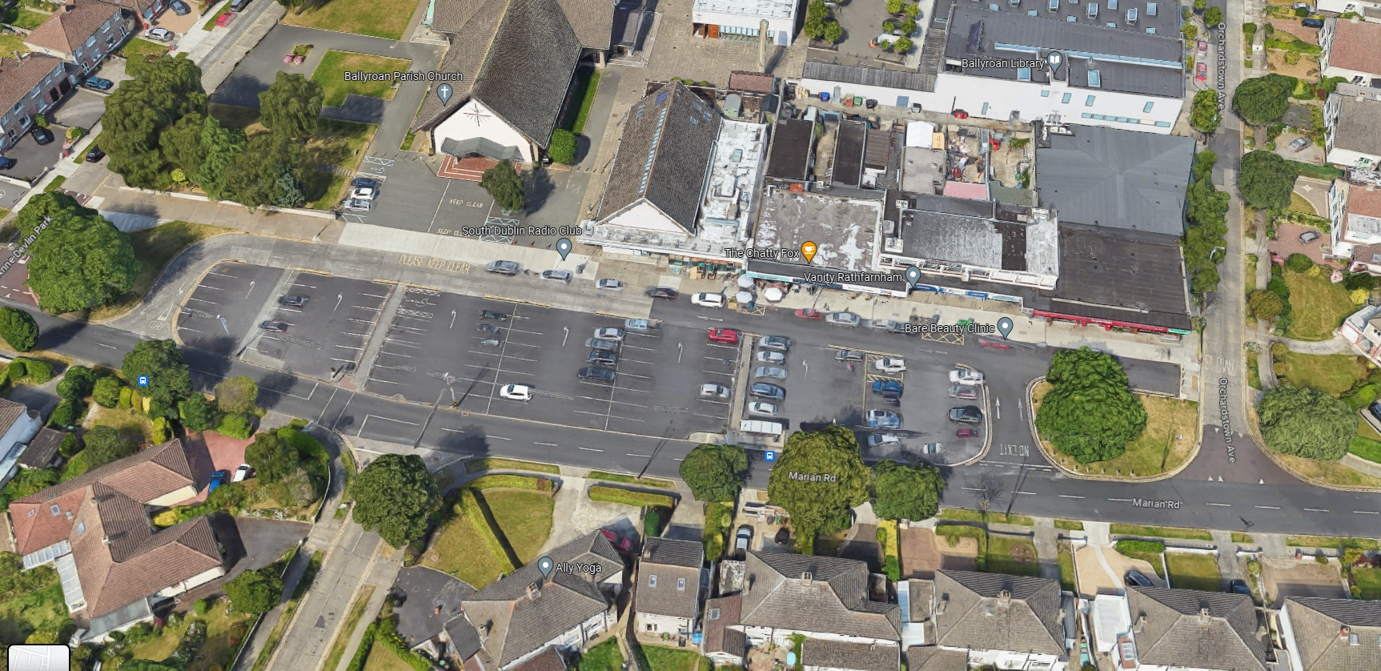
Site Location

Slide 3
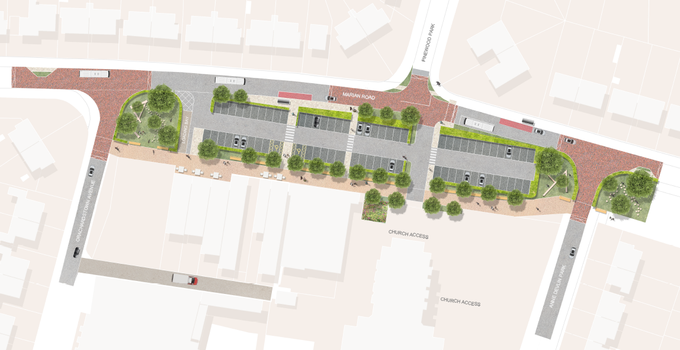
Scheme Proposal

Slide 4
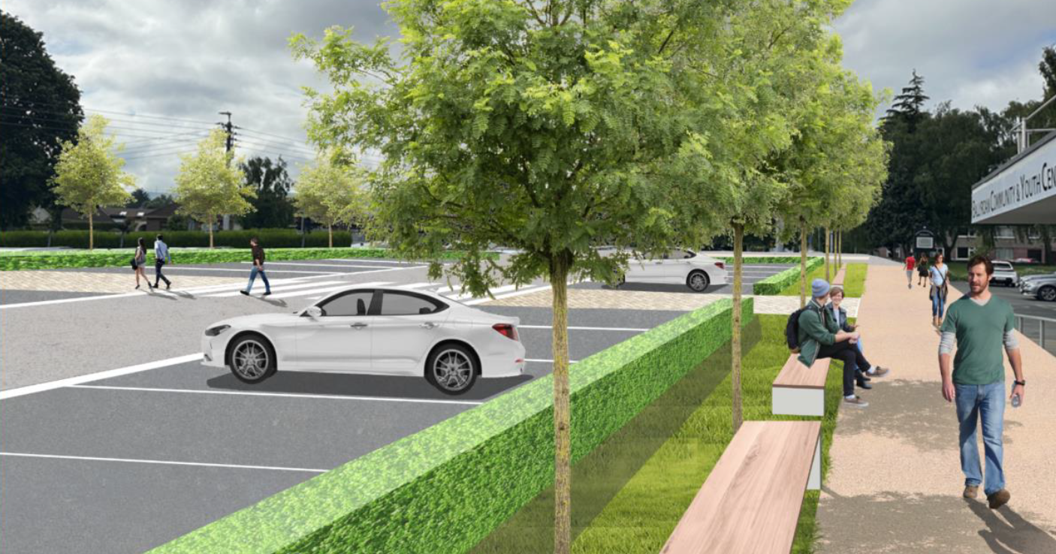
Summary
February 2023
Tender issued for Consultancy Services
April 2023
CIVIC Engineers Ltd. appointed to lead the design of District Centre Schemes at Rosemount, Bawnogue and Dodsboo.
May 2023
Internal Workshop with SDCC Staff / Departments
May & June 2023
Two Stakeholder Workshops (Informal Consultation).
September & October 2023
Statutory Public Consultation – 8th Sept. – 20th Oct.
November 2023
Part VIII Report brought to Council

Slide 5
Statutory Consultation
Legal Notices erected
Newspaper Advertisement (The Echo)
Corriboard Signage erected locally
Drawings and Particulars on display in Ballyroan Library and online via SDCC Consultation Portal
Part 8 Consultation Launch Event held at the Parish Centre (7th Sept)
Regular Social Media Posts.
Notification to prescribed bodies, access groups and local schools.

Slide 6
Statutory Consultation Summary
Online Survey (via SDCC Consultation Portal)
82 Responses
60.3% in support of the scheme
29.5% in support of the scheme with changes
10.3% against the scheme
(Note – Excludes responses that made no selection)
Submissions (via SDCC Consultation Portal and email/post)
32 Submissions Received

Slide 7
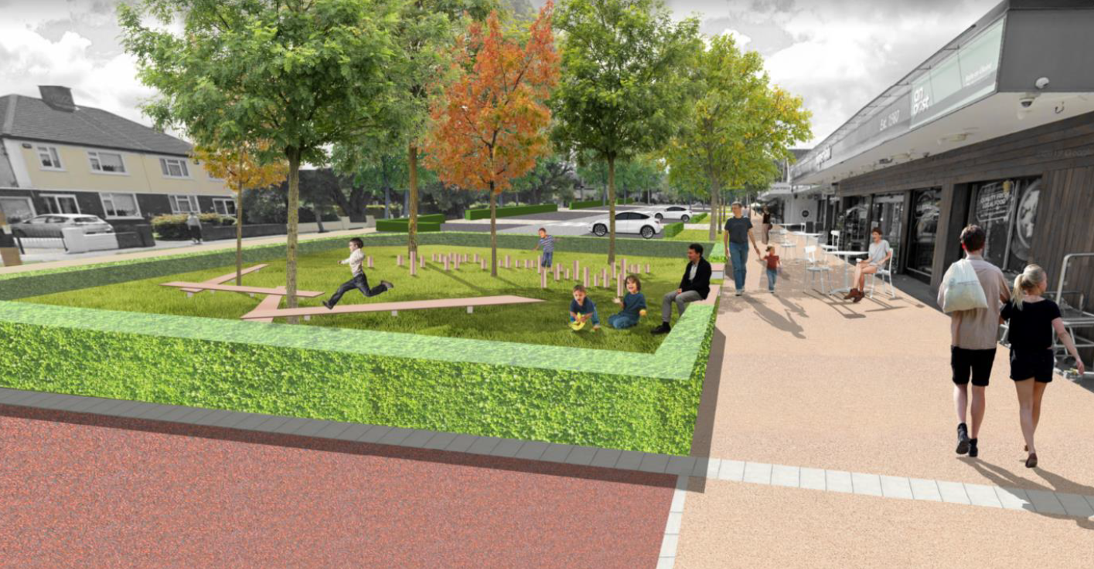
Key Issues Raised
Parking Concerns
HGV Access / Loading Bay Concerns
Request for Cycle Parking / Storage
Traffic Calming Measures Concerns
Access and Parking for the Church
Vandalism and Anti Social Behaviour
Requests for Security Measures
Please refer to CE Report for a full summary, response and recommendation relating to the items raised.

Slide 8
Key Issues Raised
Please refer to CE Report for a full summary, response and recommendation relating to the items raised.
Key Issue | Issue Details | Summary of CE Recommendation
Parking Concerns | - Reduction in Parking Numbers - Need for more age friendly and accessible bays | - Based on parking survey number of spaces is sufficient - Age Friendly and Accessible parking to be included at detailed design
HGV Access / Loading Bay Concerns | - Concerns regarding Loading Bay Layout - Concerns regarding proximity of loading bay to the adjoining green area | - Loading Bay Layout has been extensively examined and current proposal is considered the best and most balanced option - Increased separation/segregation of loading bay and green area to be included at design stage
Request for Cycle Parking / Storage | - Additional Cycle parking/storage requested | - Aditional Cycle parking/storage to be included at detailed design
Traffic Calming Measures Concerns | - Whether traffic calming measures would impinge on access - Comments on the style of traffic Calming | - Throttle gates will be designed to ensure access is maintained - Road currently has vertical traffic calming measures but average car speeds still exceed 30kph so an additional form of traffic calming is necessary
Access and Parking for the Church | - Access to Church at service times and parking availability | - Access to church is more direct. - Car parking requirement is not based on the 5% of time that a church service is occurring
Vandalism and Anti Social Behaviour | - Concerns of increased vandalism and anti-social behaviour | - Improved layout should increase footfall in the area and thus improve passive surveillance
Requests for Security Measures | - Requests for improved street lighting and CCTV | - Public lighting at district centre will be upgraded - Local Authority has no statutory ability to provide CCTV in this instance

Slide 9
Recommendation
Following consideration of the submissions received, the Chief Executive is of the view that the issues raised by way of submissions and survey responses can be addressed at detailed design stage and as outlined in the CE Report.
It is recommended that as the proposal is consistent with County Development Plan and the proper planning and sustainable development of the area, that the council proceed with the Part 8 proposal for the Rosemount District Centre Enhancement Scheme

Slide 10
Next Steps
Subject to Part 8 Approval, the scheme will progress to detailed design and subsequently to tender in Q1 of 2024 with a view to commencing construction in Q2 of 2024.

Slide 11
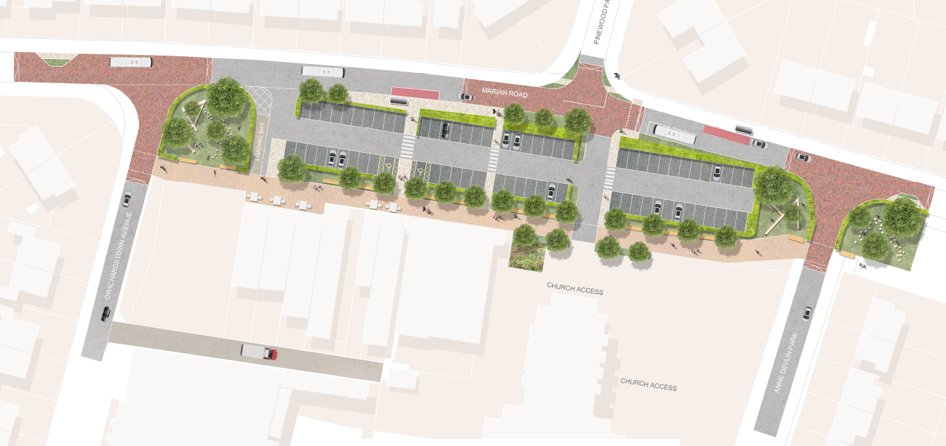
Thank You

