Slide 1
Winter Maintenance Plan
2023 – 2024 Season

Slide 2
Recap of 2022 – 2023 Season
52 Gritting Runs on all routes
8 Gritting Runs on hill routes only
2500 tonnes of rock salt spread
Lowest recorded road temperature: -5.8ºC
2022 - 2023 season would be considered to have been a mild winter overall but with one very significant cold spell in early December that lasted 10 days. During this period significant snow fall was experienced and low daytime temperatures prevented any thaw from occurring.

Slide 3
2023 – 2024 Season
Starts – Oct 16th
Finishes – April 28th
Gritting Runs will be generally be carried out at 7pm and/or 5am depending on forecast
Standard spread rate will be 10g/m2 but increased in the event of extreme low temperatures or snow
Snow ploughs available for all routes but snow falls must be greater than 30mm to be effective

Slide 4
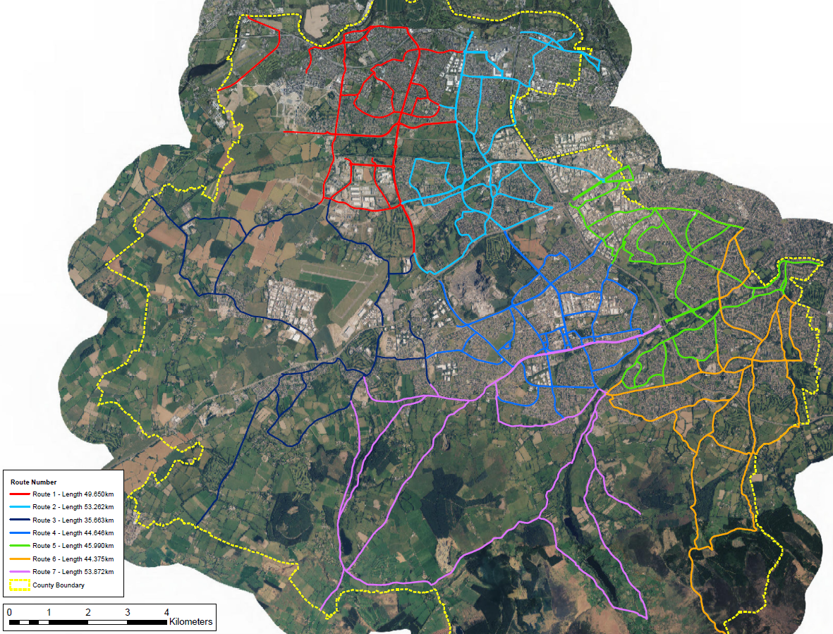
Gritting Routes
7 routes within the county
340km of roads treated

Slide 5
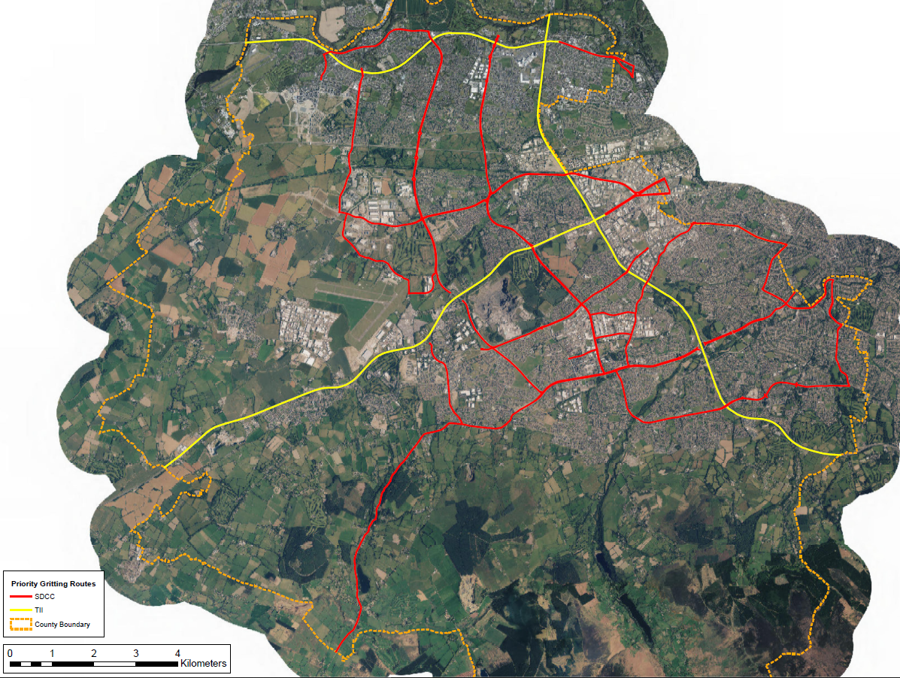
Priority Routes
SDCC Priority Routes
Private Priority Routes
Priority Routes are
the main distributor roads to the county
essential services such as hospitals, airport, emergency services
food distribution points

Slide 6
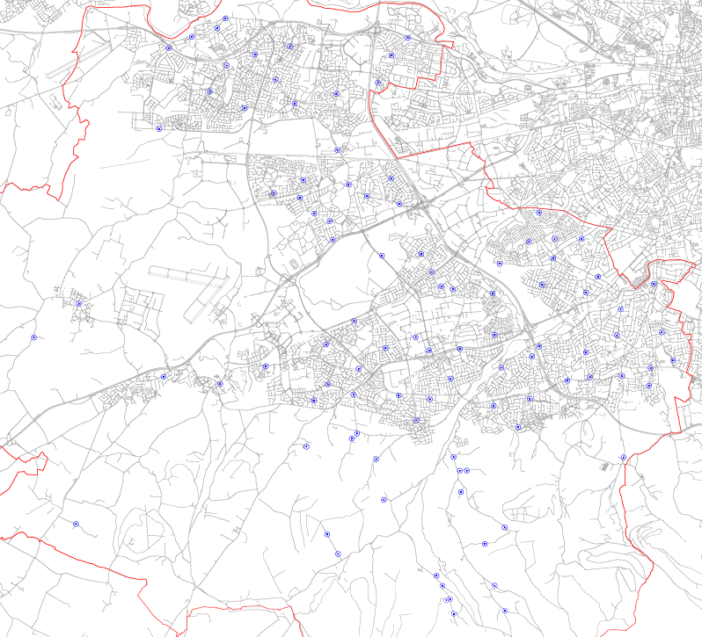
Salt Bin Locations
99 salt bins located throughout the county
Bins restocked at the start of every season and upon request following that
We will be getting salt bins GIS mapped and will share it on our website

