Slide 1
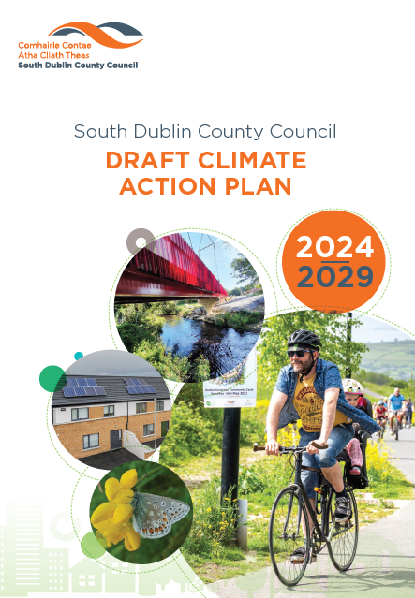
South Dublin County Council Draft Climate Action Plan 2024-2029
October 2023

Slide 2
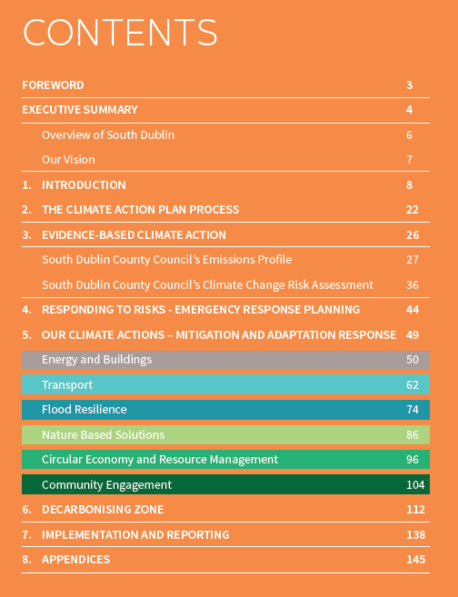
Draft Climate Action Plan 2024 – 2029
Statutory LA CAP 2024-2029 must be in place within 12 months and be in line with the Guidelines – by 23rd February 2023.
The Draft Plan has been prepared and released for Public Consultation.

Slide 3
Draft Climate Action Plan 2024 – 2029
Statutory LA CAP 2024-2029 must be in place within 12 months and be in line with the Guidelines – by 23rd February 2023.
The Draft Plan has been prepared and released for Public Consultation.
The Draft Plan is accompanied by the Draft Strategic Environmental Assessment (SEA) and the Natura Impact Report (NIR).
It is an evidenced-based approach, building on a Baseline Emissions Inventory, a Climate Change Risk Assessment, and the previous CCAP 2019-2024.
Notes:
Baseline Emissions Inventory is a breakdown of how such emissions are coming from each sector such as transport (South Dublin County’s highest sector) and then through the climate pathways and Gap to Target – identifying how we will reach the targets outlined in the next slide.

Slide 4
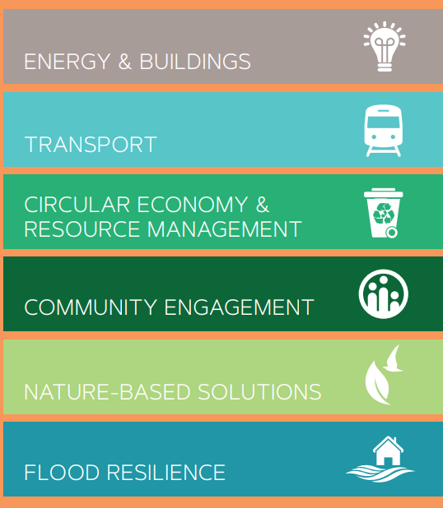
Our Climate Action Targets and Action Areas
Draft Climate Action Plan 2024-2029 Targets
50% improvement in the Council’s energy efficiency by 2030;
6 Action Areas in SDCC’s Draft CAP
Transport
Flood Resilience
Nature Based Solutions
Circular Economy and Resource Management
Community Engagement
Energy & Buildings
51% reduction in the Council’s greenhouse gas emissions by 2030;
To make Dublin a climate resilient region, by reducing the impacts of future climate change-related events; and
To actively engage and inform our communities on climate action.
121 proposed Actions across the 6 Action Areas

Slide 5
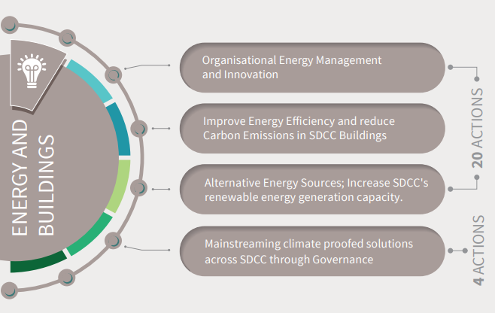
Energy & Buildings 2024-2029 – Action Areas
Notes:
Continue upgrading public street lighting with LED lamps for example; retrofits in civic hall, libraries, leisure centres, County housing stock with things like deep insulation, heat pumps, solar panels. All retrofits will ensure less GHG emissions and also warmer, more comfortable homes & buildings.

Slide 6
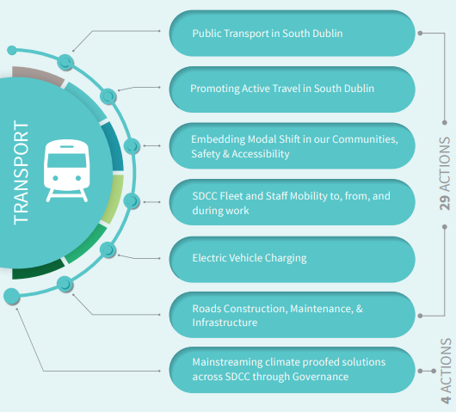
Transport 2024-2029 – Action Areas
Notes:
SRTS for safer school areas, with cleaner air quality; active travel – for safe and healthy travel for all ages, with more cycle lanes, EV charging

Slide 7
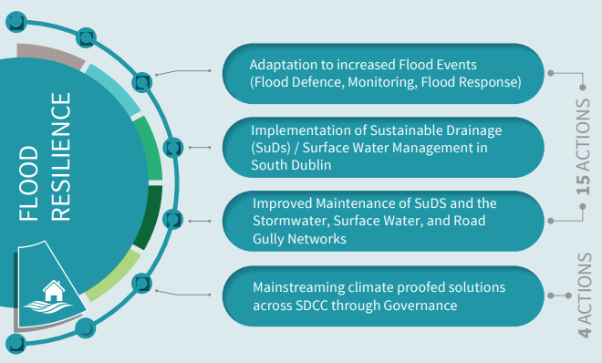
Flood Resilience 2024-2029 – Action Areas
Notes:
Flood alleviation schemes on rivers including Rivers Poddle, Camac & Whitechurch stream, using green infrastructure solutions where possible to alleviate against any future flooding events. Green infrastructure is usually a more cost effective approach with other benefits for biodiversity and water quality etc.

Slide 8
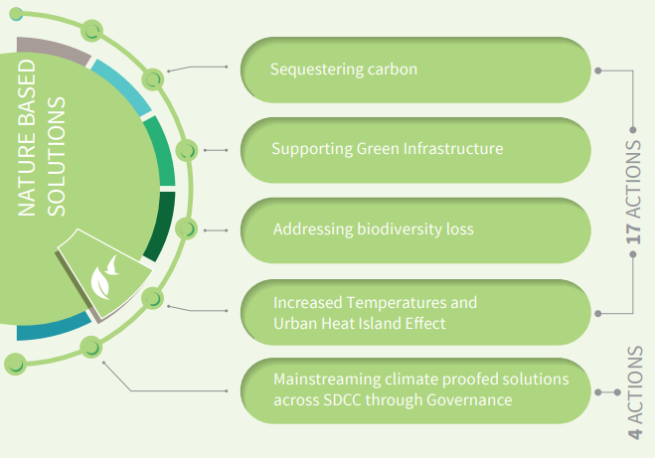
Nature Based Solutions 2024-2029 – Action Areas
Notes:
Increase native tree planting, increase & maintain native hedgerows, plant more mini-woodlands, enhance & expand wetlands & ponds - Co-benefits of climate action with NBS is in things like improving water quality & air quality, providing shade and cooler regions, which will be more important with the increasing heat island effect, experienced in built up areas caused by increasing temperatures.

Slide 9
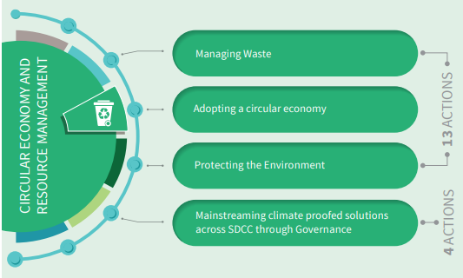
Circular Economy and Resource Management 2024-2029 – Action Areas
Notes:
Monitor & improve all internal waste & water mgmt. systems; the circular economy will make systems more efficient, while creating more local jobs and reducing potential pollution streams.

Slide 10
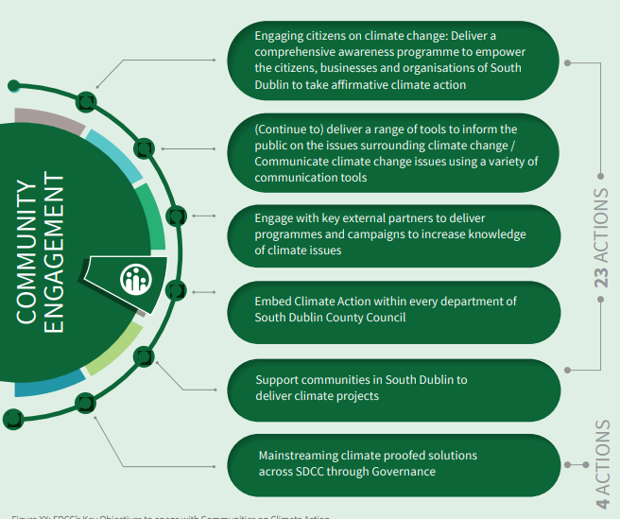
Community Engagement 2024-2029 – Action Areas
Notes:
Climate Training & awareness internally; Green-schools, Eco Week, Dublin CAW; Home energy savings kits in libraries & develop a youth friendly version of NRG kits; social media, work with SEC’s, TT’s, local clubs to implement GAA Green Clubs, CCAF

Slide 11
CAP 2024–2029: Engagement Strategy
Internal Engagement
Workshop with Senior Management
Workshops with each Climate Action Sub Team (min 6 No.)
External Engagement
Climate Action questions in the Clondalkin LAP survey
Engagement with wider council staff (Stands in Canteen for visioning exercise, Online survey.)
Update for Climate Action Steering Group
Formal public consultation campaign – 20th September to 3rd November 2023
Coordination with DLAs to review draft actions -Early Engagement Workshop with Councillors and SPCs (prior to Statutory Consultation) – Held on 7th and 8th of June 2023
CE Monthly Report (article notifying of launch published in April edition)
Updates at SPCs/CPGs/Council Meetings - Ongoing
Early Engagement Workshop with Councillors and SPCs (prior to Statutory Consultation) – Held on 7th and 8th of June 2023

Slide 12
CAP 2024–2029: Public Consultation
Public Consultation scheduled from 20th September to 3rd November 2023
Draft Plan is currently on display at a number of locations:
County Hall, Tallaght
Clondalkin Civic Offices
County Library, Library Square, Tallaght, Dublin D24A3EX.
Ballyroan Library, Orchardstown Avenue, Rathfarnham, Dublin D14 VY33.
Clondalkin Library, Monastery Road, Clondalkin, Dublin D22 XPO3.
Lucan Library, Lucan Shopping Centre, Newcastle Road, Lucan, Dublin K78 V295.
North Clondalkin Library, Liscarne Close Rowlagh, Dublin 22.
Castletymon Library, Tallaght, D24
Submissions can be made through one of the following two options only:
Electronically through the Council’s Online Public Consultation Portal - http://consult.sdublincoco.ie | up to 11.59pm on Friday 3rd November 2023
In writing, addressed to the Senior Engineer, Climate Action, Environment, Water and Climate Change Department, County Hall, Tallaght, Dublin 24 | not later than 4.00pm on 3rd November 2023
Notes:
We want to hear from the public and would urge all councillors to share within their networks details on making submissions.

Slide 13
CAP 2024–2029: Public Consultation
Events advertised on Council website, SDCC Climate Action Website and Social Media.
Public Consultation Events – Come and Speak to us! | When
Edge café, The Edge, Avonmore Rd, Tallaght, Dublin 24, D24 K07Y | 5-9pm on Wednesday 4th October
Lucan Presbyterian Church, 2 Hanbury Ln, Main St, Lucan, Co. Dublin, K78 AD90 | 3-7pm on Wednesday 11th October
Clondalkin Civic Offices, Ninth Lock Rd, Clondalkin, Dublin 22, D22 E9X5 | 3-7pm on Thursday 12th October
Mansion House, Dublin city, the four Dublin local authorities will host a joint event, with lots of speakers and activities | 3-8pm on Tuesday 17th October
Pop Up Information Stand in SDCC Libraries | When
Tallaght Library, Dublin D24A3EX | Monday October 9th, 3-5pm
Castletymon Library, Tallaght | Friday October 13th, 2-4pm
Ballyroan Library, Rathfarnham, D14 VY33 | Wednesday October 18th, 3-5pm
Lucan library, Newcastle Road, Lucan, Dublin | Wednesday October 25th, 3-5pm
Clondalkin Library, D22 XPO3 | Thursday October 26th, 3-5pm
North Clondalkin Library, D22 E2Y2 | Tuesday October 31st, 3-5pm
Notes:
Please share within your circles!

Slide 14
CAP 2024–2029: Next Steps
A Chief Executive Report will be prepared following public consultation
The Submissions will be reviewed and a Final Draft CAP will be prepared (including any necessary SEA or AA reviews)
The Final Draft Plan, the SEA and NIR Reports, and the Chief Executive Report on Submissions Received will be provided to the Elected Members by January 3rd 2024.
The Elected Members will have up to 6 weeks to consider the Chief Executive’s Report on Submissions Received, in accordance with the requirements of the Climate (Amendment) Act 2021. Within this statutory timeframe, the Elected Members must decide by resolution, whether to:
approve, or
approve, subject to such modifications as they consider appropriate, the local authority climate action plan.
Notes:
We’ll keep you updated on timelines.

Slide 15
CAP 2024–2029: Next Steps
A Chief Executive Report will be prepared following public consultation
The Submissions will be reviewed and a Final Draft CAP will be prepared (including any necessary SEA or AA reviews)
The Final Draft Plan, the SEA and NIR Reports, and the Chief Executive Report on Submissions Received will be provided to the Elected Members by January 2nd 2024.
The Elected Members will have up to 6 weeks to consider the Chief Executive’s Report on Submissions Received, in accordance with the requirements of the Climate (Amendment) Act 2021. Within this statutory timeframe, the Elected Members must decide by resolution, whether to:
approve, or
approve, subject to such modifications as they consider appropriate, the local authority climate action plan.
Given the statutory 12 month duration of the Plan making process, as set out in Section 16 of the Climate (Amendment) Act 2021, a Material Amendment public consultation phase, is not provided for under the legislation.
As such, all local authorities are required to make and approve their Climate Action Plan, by 23rd February 2024.

Slide 16
CAP 2024–2029: Training
AILG providing training on the LACAPs
Notes:
Local Authority Services National Training Group. AILG is in the process of communicating the training for the LACAPs.

Slide 17
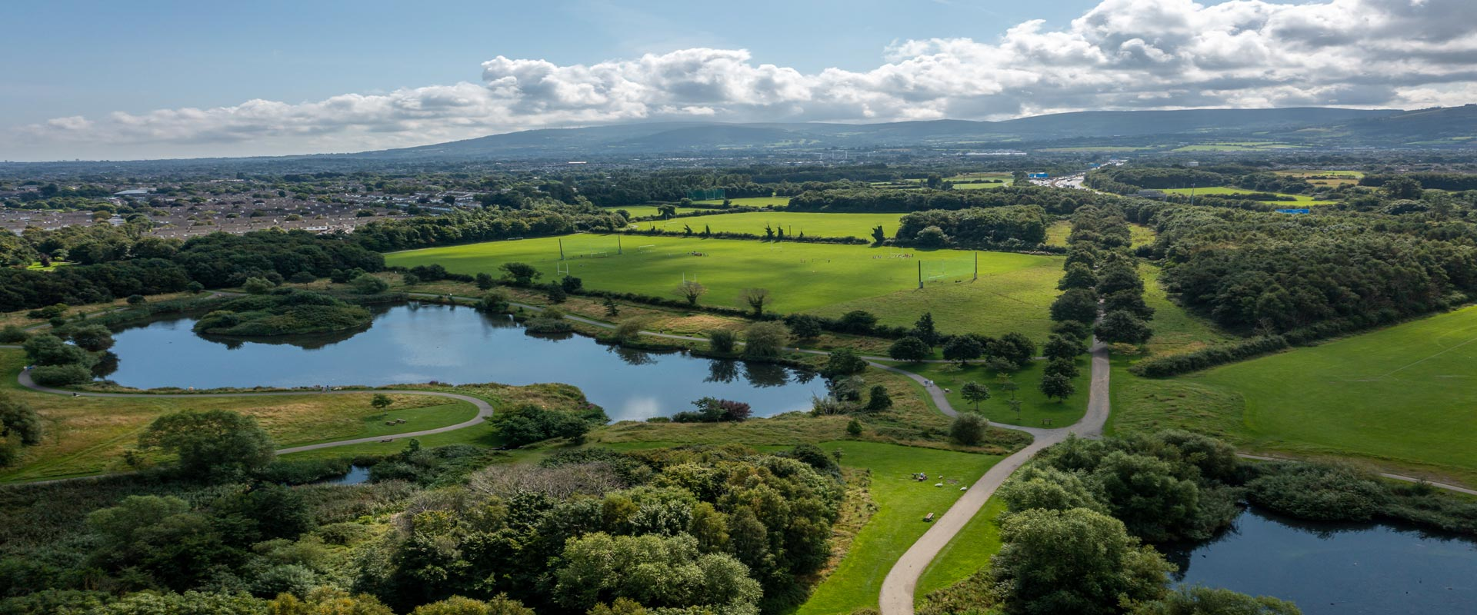
Thank You

