Slide 1
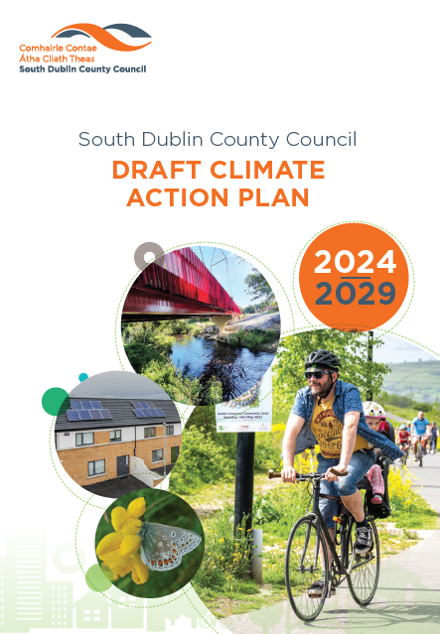
South Dublin County Council
Draft Climate Action Plan 2024-2029
October 2023

Slide 2
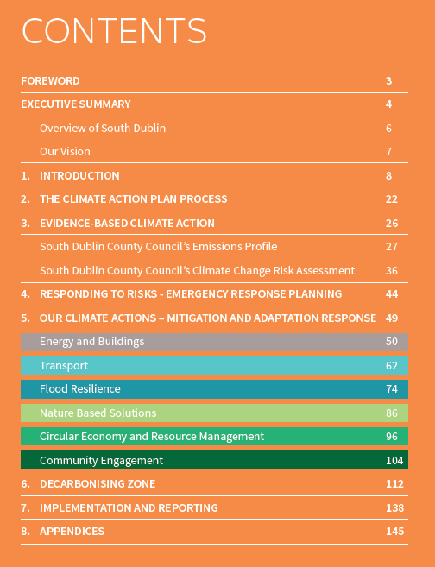

Draft Climate Action Plan 2024 – 2029
Statutory LA CAP 2024-2029 must be in place within 12 months and be in line with the Guidelines – by 23rd February 2023.
The Draft Plan has been prepared and released for Public Consultation.

Slide 3
Draft Climate Action Plan 2024 – 2029
Statutory LA CAP 2024-2029 must be in place within 12 months and be in line with the Guidelines – by 23rd February 2023.
The Draft Plan has been prepared and released for Public Consultation.
The Draft Plan is accompanied by the Draft Strategic Environmental Assessment (SEA) and the Natura Impact Report (NIR).
It is an evidenced-based approach, building on a Baseline Emissions Inventory, a Climate Change Risk Assessment, and the previous CCAP 2019-2024.

Slide 4
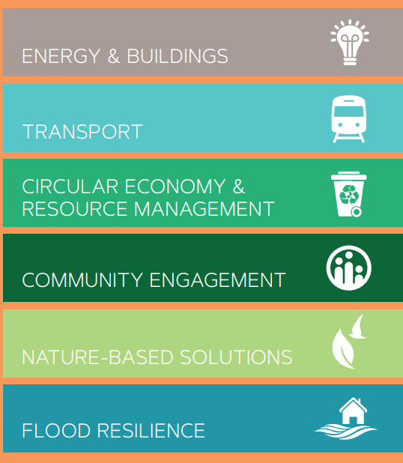
Our Climate Action Targets and Action Areas
Draft Climate Action Plan 2024-2029 Targets
50% improvement in the Council’s energy efficiency by 2030;
6 Action Areas in SDCC’s Draft CAP
Transport
Flood Resilience
Nature Based Solutions
Circular Economy and Resource Management
Community Engagement
Energy & Buildings
51% reduction in the Council’s greenhouse gas emissions by 2030;
To make Dublin a climate resilient region, by reducing the impacts of future climate change-related events; and
To actively engage and inform our communities on climate action.
121 proposed Actions across the 6 Action Areas

Slide 5
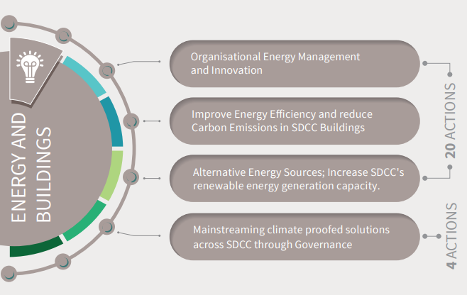
Energy & Buildings 2024-2029 – Action Areas

Slide 6
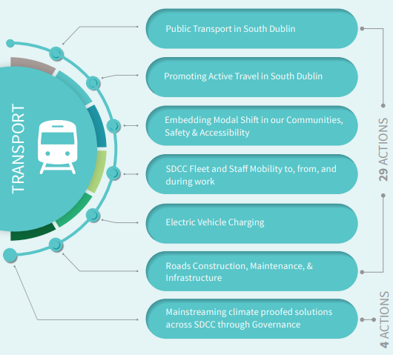
Transport 2024-2029 – Action Areas

Slide 7
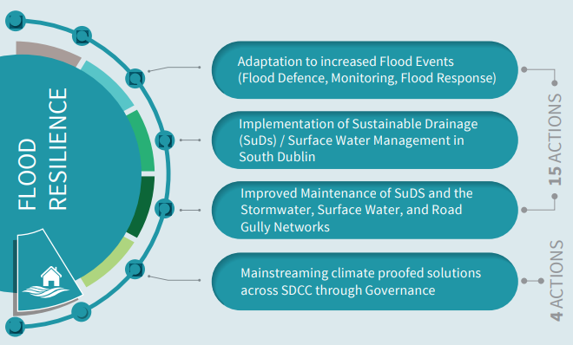
Flood Resilience 2024-2029 – Action Areas

Slide 8
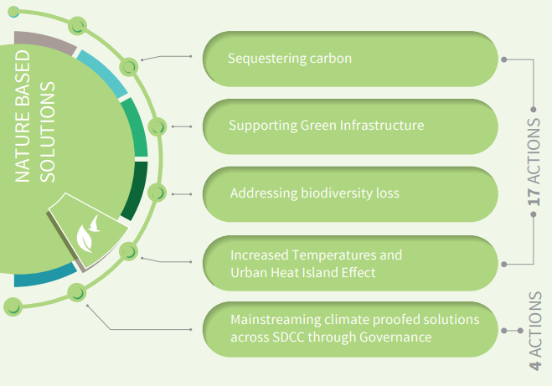
Nature Based Solutions 2024-2029 – Action Areas

Slide 9
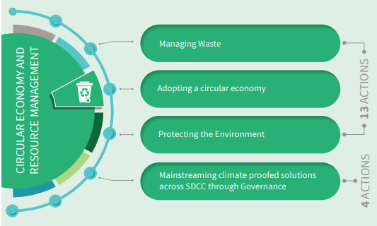
Circular Economy and Resource Management 2024-2029 – Action Areas

Slide 10
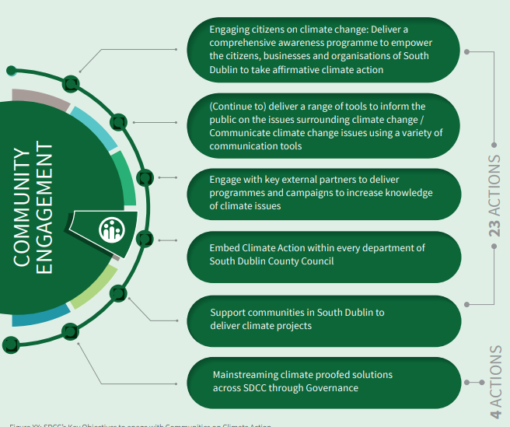
Community Engagement 2024-2029 – Action Areas

Slide 11

CAP 2024–2029: Engagement Strategy
Internal Engagement
Workshop with Senior Management
Workshops with each Climate Action Sub Team (min 6 No.)
External Engagement
Climate Action questions in the Clondalkin LAP survey
Engagement with wider council staff (Stands in Canteen for visioning exercise, Online survey.)
Update for Climate Action Steering Group
Formal public consultation campaign – 20th September to 3rd November 2023
Coordination with DLAs to review draft actions -Early Engagement Workshop with Councillors and SPCs (prior to Statutory Consultation) – Held on 7th and 8th of June 2023
CE Monthly Report (article notifying of launch published in April edition)
Updates at SPCs/CPGs/Council Meetings - Ongoing
Early Engagement Workshop with Councillors and SPCs (prior to Statutory Consultation) – Held on 7th and 8th of June 2023

Slide 12
CAP 2024–2029: Public Consultation
Public Consultation scheduled from 20th September to 3rd November 2023
Draft Plan is currently on display at a number of locations:
    County Hall, Tallaght
    Clondalkin Civic Offices
    County Library, Library Square, Tallaght, Dublin D24A3EX.
    Ballyroan Library, Orchardstown Avenue, Rathfarnham, Dublin D14 VY33.
    Clondalkin Library, Monastery Road, Clondalkin, Dublin D22 XPO3.
    Lucan Library, Lucan Shopping Centre, Newcastle Road, Lucan, Dublin K78 V295.
    North Clondalkin Library, Liscarne Close Rowlagh, Dublin 22.
    Submissions can be made through one of the following two options only:
Electronically through the Council’s Online Public Consultation Portal - http://consult.sdublincoco.ie | up to 11.59pm on Friday 3rd November 2023
In writing, addressed to the Senior Engineer, Climate Action, Environment, Water and Climate Change Department, County Hall, Tallaght, Dublin 24 | not later than 4.00pm on 3rd November 2023

Slide 13
CAP 2024–2029: Public Consultation
    Events advertised on Council website, SDCC Climate Action Website and Social Media.
Public Consultation Events – Come and Speak to us! | When
Edge café, The Edge, Avonmore Rd, Tallaght, Dublin 24, D24 K07Y | 5-9pm on Wednesday 4th October
Lucan Presbyterian Church, 2 Hanbury Ln, Main St, Lucan, Co. Dublin, K78 AD90 | 3-7pm on Wednesday 11th October
Clondalkin Civic Offices, Ninth Lock Rd, Clondalkin, Dublin 22, D22 E9X5 | 3-7pm on Thursday 12th October
Mansion House, Dublin city, the four Dublin local authorities will host a joint event, with lots of speakers and activities | 3-8pm on Tuesday 17th October
Pop Up Information Stand in SDCC Libraries | When
Tallaght Library, Dublin D24A3EX | Monday October 9th, 3-5pm
Ballyroan Library, Rathfarnham, D14 VY33 | Wednesday October 18th, 3-5pm
Lucan library, Newcastle Road, Lucan, Dublin | Wednesday October 25th, 3-5pm
Clondalkin Library, D22 XPO3 | Thursday October 26th, 3-5pm
North Clondalkin Library, D22 E2Y2 | Tuesday October 31st, 3-5pm

Slide 14
CAP 2024–2029: Next Steps
    A Chief Executive Report will be prepared following public consultation
    The Submissions will be reviewed and a Final Draft CAP will be prepared (including any necessary SEA or AA reviews)
    The Final Draft Plan, the SEA and NIR Reports, and the Chief Executive Report on Submissions Received will be provided to the Elected Members by January 2nd 2024.
    The Elected Members will have up to 6 weeks to consider the Chief Executive’s Report on Submissions Received, in accordance with the requirements of the Climate (Amendment) Act 2021. Within this statutory timeframe, the Elected Members must decide by resolution, whether to:
    approve, or
    approve, subject to such modifications as they consider appropriate, the local authority climate action plan.

Slide 15
CAP 2024–2029: Next Steps
    A Chief Executive Report will be prepared following public consultation
    The Submissions will be reviewed and a Final Draft CAP will be prepared (including any necessary SEA or AA reviews)
    The Final Draft Plan, the SEA and NIR Reports, and the Chief Executive Report on Submissions Received will be provided to the Elected Members by January 2nd 2024.
    The Elected Members will have up to 6 weeks to consider the Chief Executive’s Report on Submissions Received, in accordance with the requirements of the Climate (Amendment) Act 2021. Within this statutory timeframe, the Elected Members must decide by resolution, whether to:
    approve, or
    approve, subject to such modifications as they consider appropriate, the local authority climate action plan.
    Given the statutory 12 month duration of the Plan making process, as set out in Section 16 of the Climate (Amendment) Act 2021, a Material Amendment public consultation phase, is not provided for under the legislation.
    As such, all local authorities are required to make and approve their Climate Action Plan, by 23rd February 2024.

Slide 16
CAP 2024–2029: Training
    LASTNG aiming to provide training on the LACAPs – likely before the end of 2023.
Notes:
Local Authority Services National Training Group

Slide 17
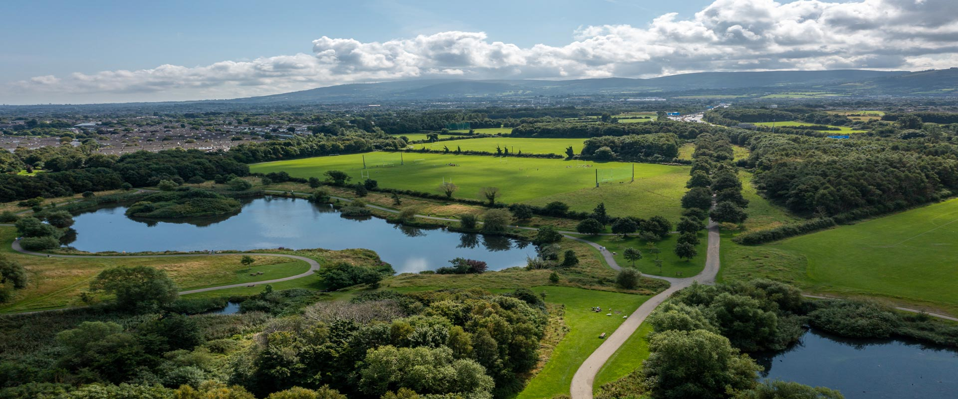
Thank You

