Slide 1


Sustainable and Compact Settlements
Guidelines for Planning Authorities
Draft for Consultation August 2023
LUPT SPC 5th October 2023 (Sept SPC)

Slide 2
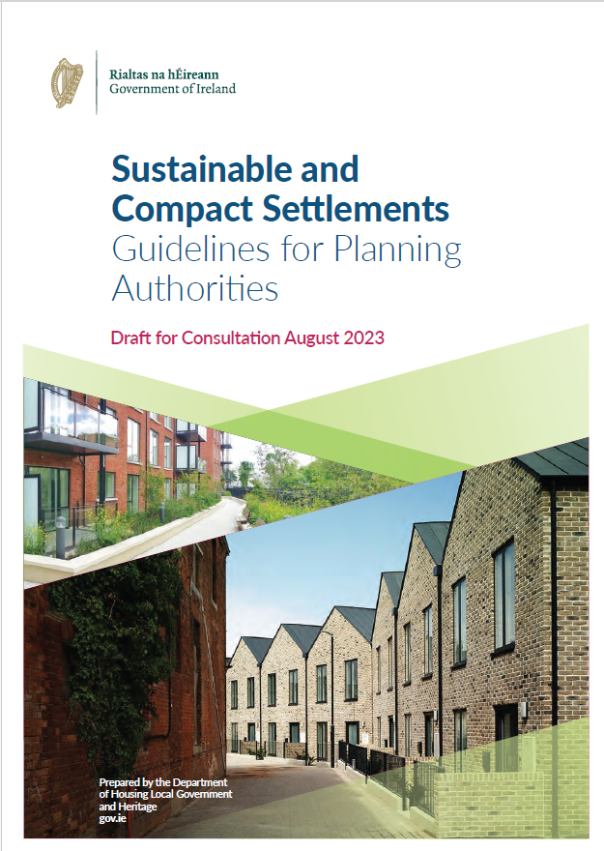
Presentation Overview
Public Consultation
Themes covered
Main changes
Implications

Slide 3
Public Consultation
Issues Raised by SDCC in March:
Density – higher densities plan-led. Clearer understanding of how to differentiate the different area types listed.
Housing Standards – the range of housing options must be able to meet people’s needs if compact growth is to achieved.
Open Space - Changes to private open space need to be further considered. Public open space standards need to recognise the drive to increased densities and meet recognised minimum open space standards.
Placemaking - Indicators of quality would be welcomed. Greater consideration of GI in the context of higher residential densities.
  March 2023 consultation on initial summary draft
  31st August - 5th October 2023 Public consultation on draft Guidelines
  SDCC made submission in March and will make a further submission in October.
  Guidelines being introduced under Housing for All

Slide 4
Stated Purpose of the Guidelines
The Guidelines will replace the current 2009 Guidelines, ‘with a renewed focus on the renewal of existing settlements and ‘the interaction between residential density, housing standards and quality design and placemaking to support sustainable and compact growth’.

Slide 5
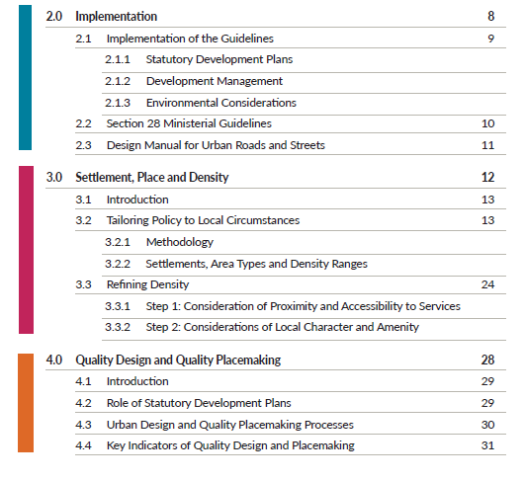
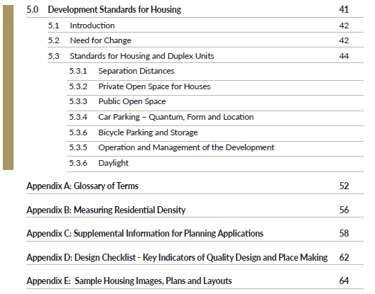
Contents of Guidelines
Extract from Draft Sustainable and Compact Settlement Guidelines

Slide 6
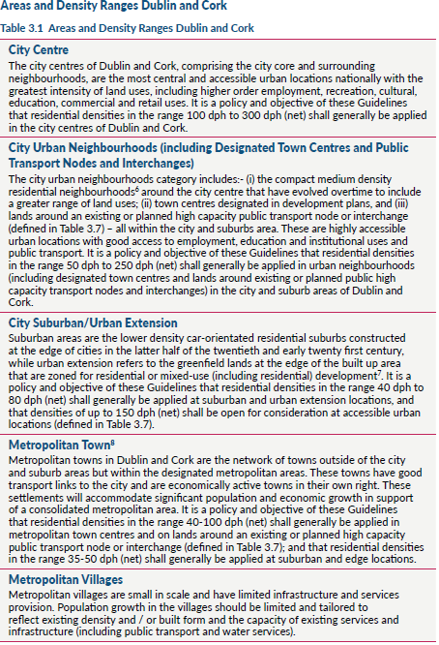
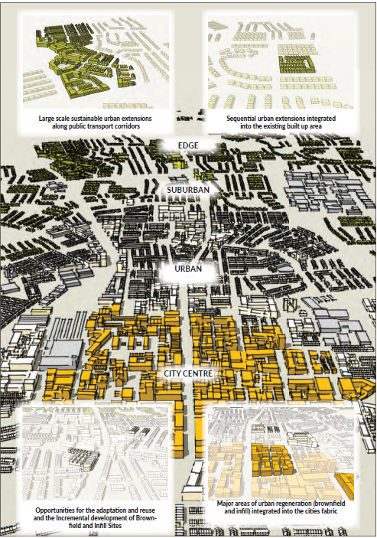
Density Ranges for Dublin Extracts – Discussion to Follow
Notes:
Small/medium sized towns – Edge 20-40dph

Slide 7
Density – Defined Areas and Ranges
A refined settlement hierarchy within the MASP area each with a recommended density range.
Three area types relevant to SDCC –
City Urban Neighbourhood (Urban): 50-250 dph, within city and suburbs, highly accessible to employment, education and institutional uses, public transport
City Suburban/Urban Extension (Suburban/Edge): 40-80 dph but up to 150dph considered for accessible urban locations (defined)
Medium/Small towns: Respond to context in town centre, on town edge 25-40dph
Density is refined based on proximity and accessibility to services and to the surrounding built environment and historic settings, amenity or natural environment.
Settlement Hierarchy
Density Areas and Ranges
Refining Density
Notes:
Urban – medium density res neighbourhoods that have evolved to include a range of land uses/zoned town centres/high capacity public transport node
Suburban – low density car oriented res areas at the edge of cities latter half of 20th c early 21st c
Urban Extension – greenfield lands at the edge of built up areas zoned for res or mixed use
Interim position where SPPRs differ from adopted Development Plans – further clarity required on this in relation to Material Contravention.

Slide 8

Placemaking – Indicators of Quality
Sustainable and Efficient Movement
  Active travel and permeability
  Public Transport
  Car park reduction
Mix and Distribution of Uses
  Promotion of mixed use neighbourhoods around a hierarchy of centres and a move away from segregrated land use areas
  Activation of public spaces
  Promotion of intensification e.g. adaption of existing buildings, under-used land
  Diverse mix of housing
Green Infrastructure and urban greening
Public open space as part of a wider GI network
Responsive built form
  Legible and coherent urban structure, responding to established pattern of development

Slide 9
Public Open Space – Guidelines Provision
Placemaking – a ‘benchmark’ of 2.5ha / 1000 population is recognised as international standard, but no mechanism provided for delivery beyond local parks
POS is to be multi-functional – catering for active and passive recreational needs, and to conserve and restore nature and biodiversity. No understanding of how this is to be achieved.
Class 2 Open Space – Local parks, squares, plazas. Minimum requirements of 10% based on net site area for development is the only clearly required open space – SPPR3.
No blanket minimum requirements allowed for other than the 10%

Slide 10
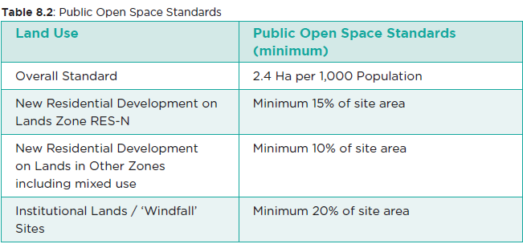
Public Open Space – Implications
Class 1 Open Space – Regional, settlement, district, local level parks (sic) – no reference on how these are to be delivered
SPPR3: Class 2 Open Space –Minimum requirements of 10% based on net site area for development the only clearly required open space.
Implications for CityEdge, Tallaght, Development Plan standards and amenity of growing populations
Development Contributions – provided for but no mechanisms for delivery of open space outside the development site area
How are larger parks to be provided and funded?
Adopted Development Plan Standards

Slide 11
Compact growth: guidelines seek innovation and greater flexibility in standards and their application.
Outline need for change from suburban housing standards to low rise medium density, ‘own door’ (3-4 storey, 40-100dph)
= tighter arrangement of housing
= narrower streets and smaller street setbacks
= reduced car parking ratios
= reduced/different private open space types
Development Standards for Housing

Slide 12
5 SPPRs (Specific Planning Policy Requirements), focused on:
SPPR1 – Separation distances not to exceed 16m (reduced from 22m min)
SPPR2 – Minimum Private Open Space – set by no. of bedspaces, significantly reduced (3 bed now 40 sq m, previously 60 sq m; 1 bed 20 sq m)
Facilitates further reduction if high quality semi-private is provided in lieu
SPPR3 – Public open space – collectively minimum 10% of net site area, greater can be required in historic settings, no blanket requirements for historic settings
Provision in part or whole to seek a financial contribution in lieu of provision within application site. Examples of circumstances where this might be appropriate is given.
Development Standards for Housing - SPPRs

Slide 13
SPPR4 – Car parking – Maximum for cities & urban neighbourhoods settlement tier is 1 space per dwelling
SPPR5 – Cycle Parking and Storage– required in all new housing schemes including mixed use.
Quantity: Generally, 1 cycle storage space per bedroom. Deviation at discretion of PA and justified
Quality: dedicated permanent construction, safe and secure
Development Standards for Housing - SPPRs

Slide 14
Guideline Implications
Provides for more compact growth in the form of more dense development but guidelines clear on the need to assess density against local context
Planning Department will identify the relevant density for the area types in the guidelines and assess against the current core strategy capacity
Implementation – not clear what the transitional arrangements are if a SPPR conflicts with the Development Plan
Public Open Space – Clearer understanding of delivery mechanisms for larger parks needs to be provided
Private Open Space – If guidelines are approved the implications of reduced open space should be reflected in revised exempt development regulations

