Slide 1
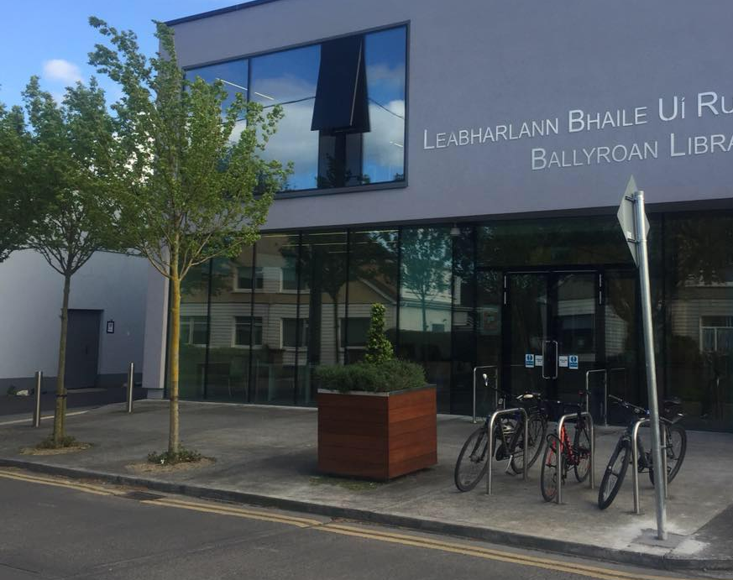
Rathfarnham/Templeogue/ Firhouse/ Bohernabreena ACM
Libraries Report |October 2023

Slide 2
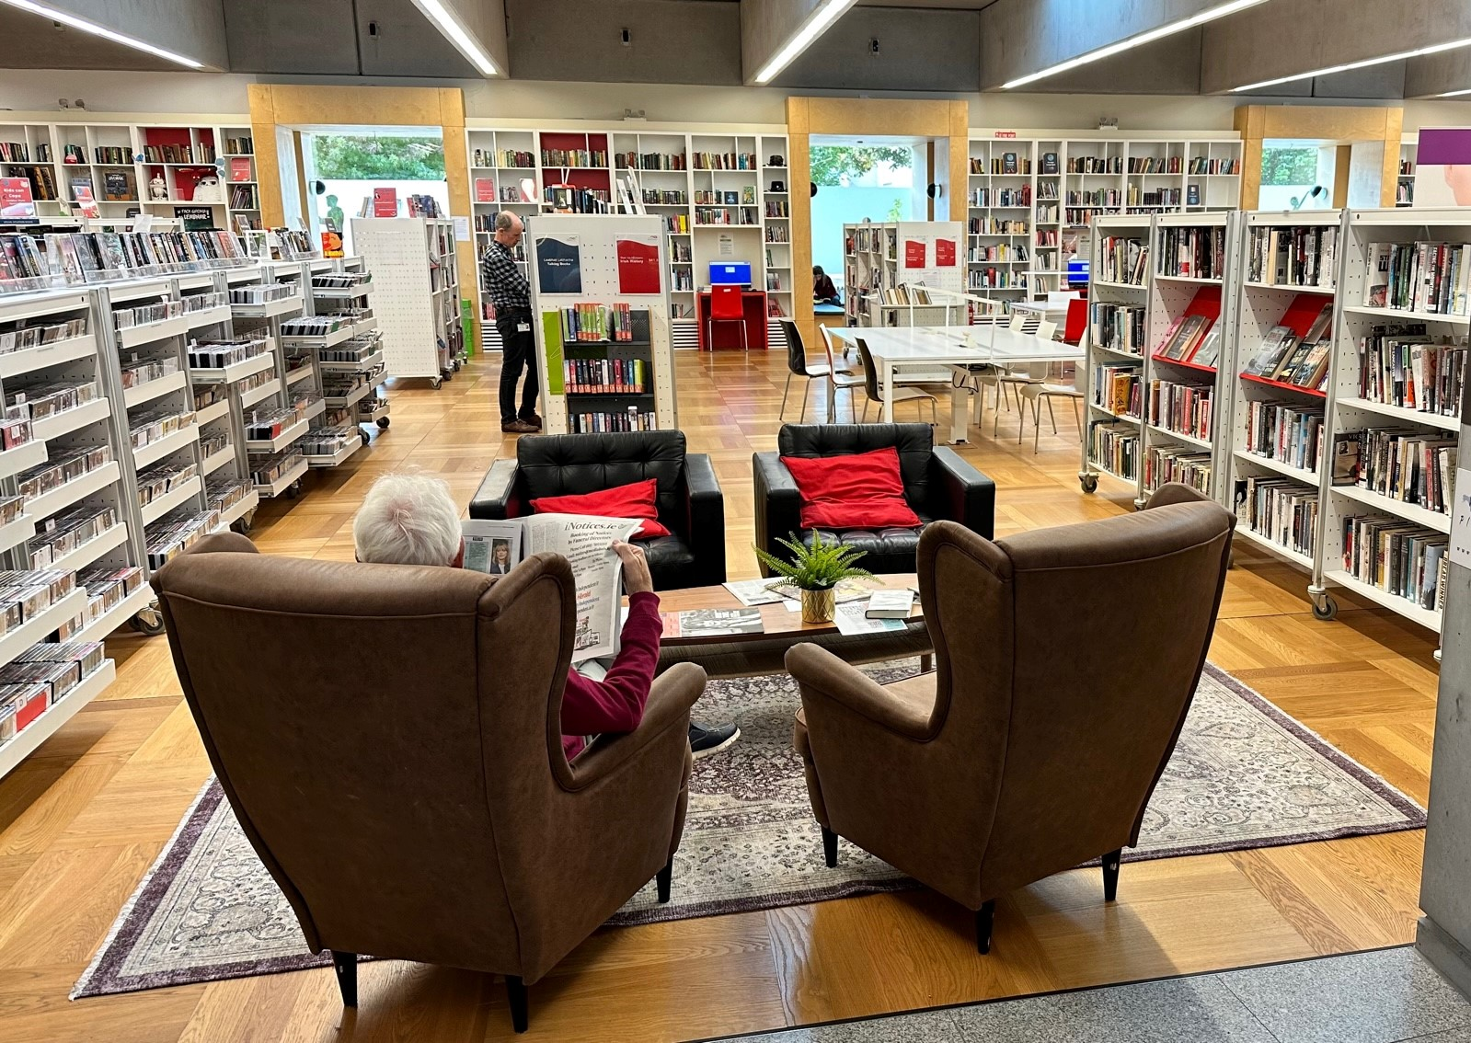
September Statistics
Ballyroan Library had 17,649 visitors in September. We hosted 68 events with a total of 1,175 attendees. 15,107 items were issued and 478 new members joined the library.
Castletymon issued almost 3000 items and added 124 new members.

Slide 3
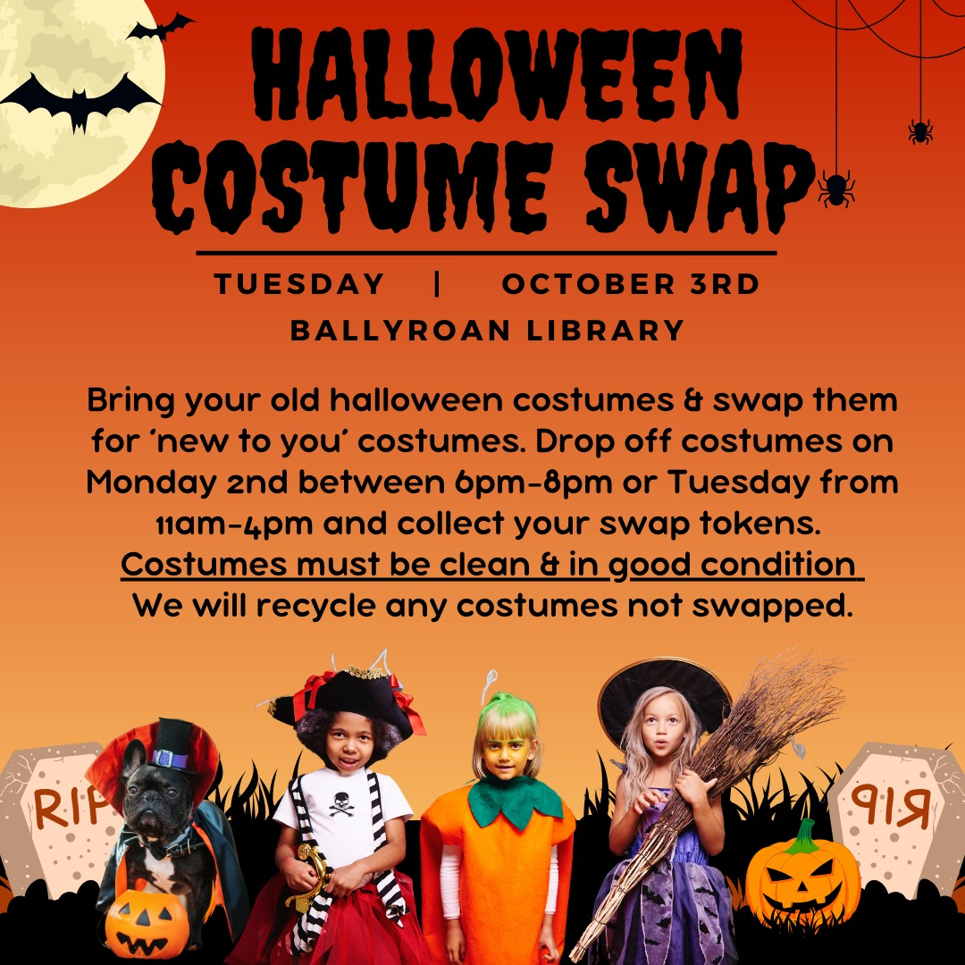
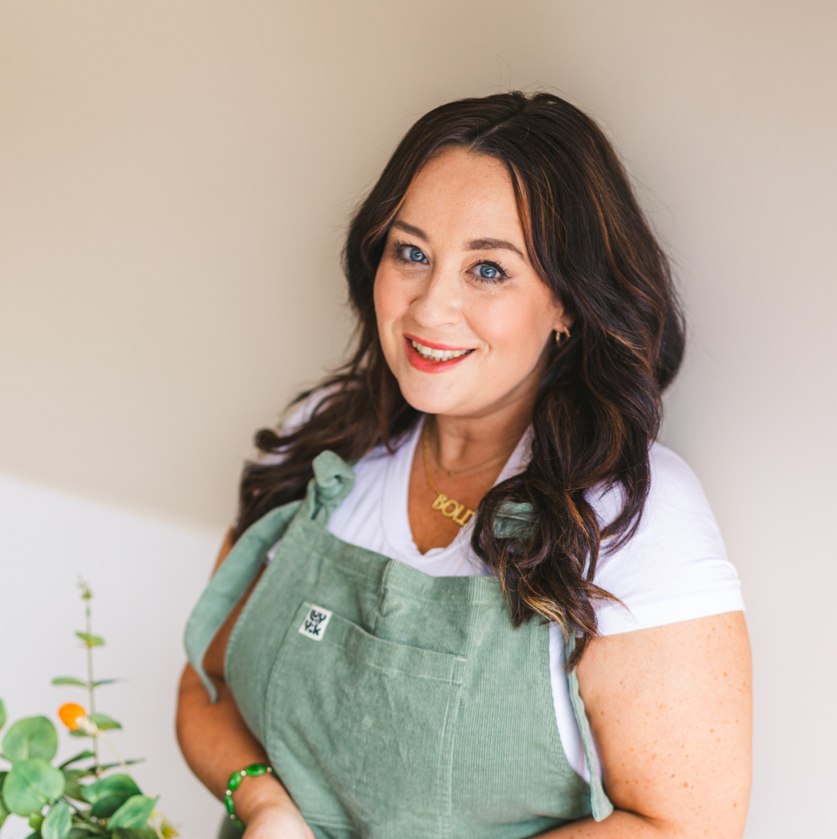
October Event Highlights Ballyroan
Green in ’23
Tuesday 3rd October 6pm Halloween Costume Swop
Bring along your old Halloween Costumes and receive a token per costume. Swap tokens for other costumes from 6:00-7:00pm on. Please ensure all costumes are clean and in good condition. Booking through Eventbrite.
Tuesday 24th October 6.30pm Finding Magic & Medicine in Your Garden with Feebee Foran
Join us for a fun, interactive and educational talk with Feebee Foran as she delves into the plants that grow around us in abundance. She'll be exploring their medicinal properties as well as their folkloric and historical background. It will be a mix of visual and interactive elements, as she brings plants along for the audience to touch and feel. Booking through Eventbrite.
Notes:
The junior library lends itself very well as a performance space. The Local Vocal choir will be back fro songs of the 50’s/60’s & 70’s on 31st May @ 7pm

Slide 4
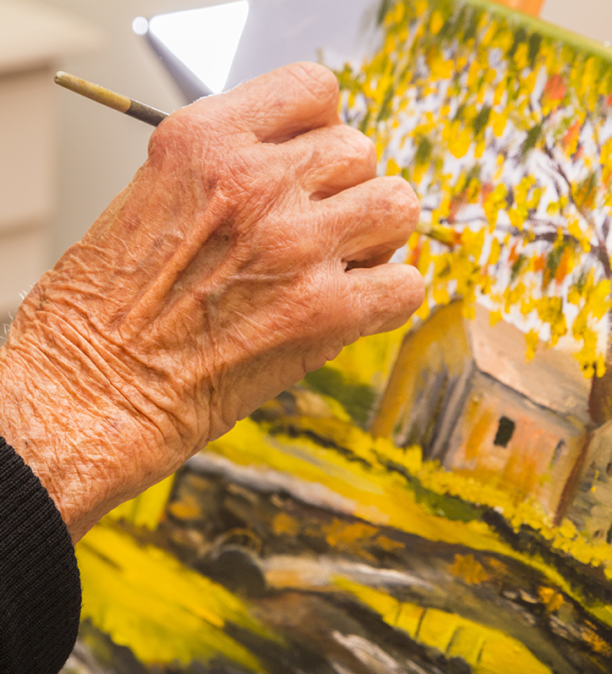
October Event Highlights Ballyroan - adults
The Pendulum Project
This is an exciting new art project especially for older people which explores themes of memory using various art media. The project is made up of a series of workshops focusing on different forms of art – Drawing, Creative Writing, Painting and Textiles. Each participant is guided by an expert through 4 weekly sessions after which everyone will have completed a piece of work based on a specific theme. All pieces will be linked through the theme of memory. Completed pieces will be exhibited at Ballyroan library in January. The course was created in Ballyroan library and is being funded through the Community Department.
Creative Writing – Martin Byrne – Oct 4, 11, 18, 25 at 10am – 12pm
Drawing - Christine Lennon Cary – Oct 10, 17, 24, 31 at 2-4pm
Painting – Christine Lennon Carey – Nov – Tuesdays at 10am – 12pm
Textiles – Marie Dunne – Nov – Tuesdays 2-4pm.
Notes:
We had a full house for the annual Joe Williams talk on 12th April. The talk was given by Dr. Seamus Cullan on the Slí Mor.

Slide 5
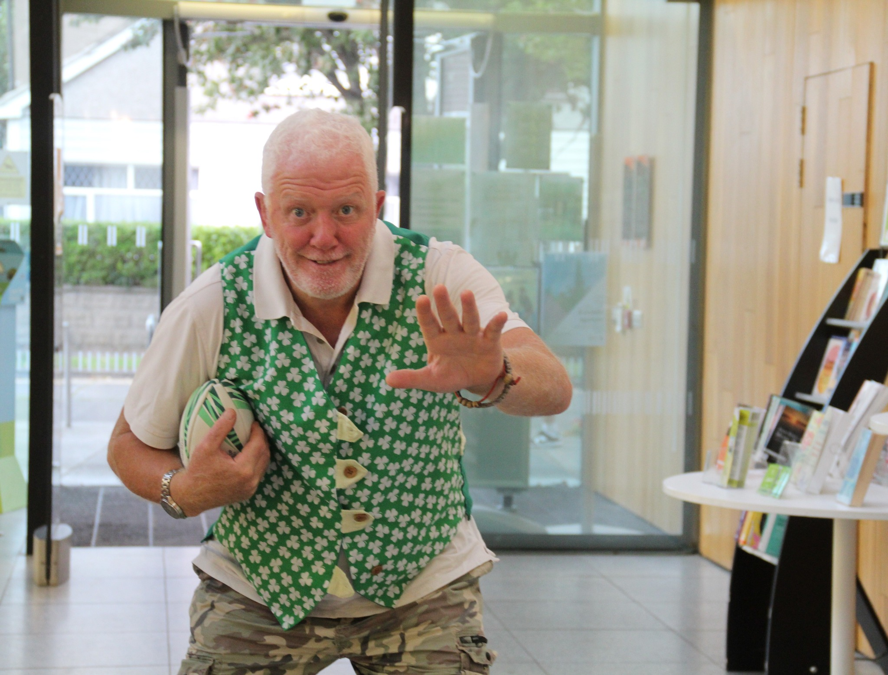
October Event Highlights Ballyroan - adults
Thursday 26th October at 7pm
The Shared Reading Experience
Shared Reading offers a welcoming space for individuals to forms real connections with the literature and themselves.
Tuesday 10th October at 18.30pm
Local History Talk by Tony Duffy
Thursday 26th October from 2-3pm
Ciorcal Comhra
Tomás Maher will facilitate at this informal Irish conversation class, where people of all abilities are welcome to converse with each other.
Monday 23rd October at 2pm
Golden Moments: Creating Your Family Memoir: How to Begin?
Michael Fewer presents an illustrated talk on how to approach writing a memoir or a family history.
Regular Adult Events
Every Monday at from 11am until 12.30pm and every Thursday from 6.30 until 8pm
Stitched Together – Our Self-Helping Crafting Group
Wednesday 4th and 18th October at 11am
Scrabble Club
Friday 6th October at 10am
Ballyroan Gardening Group Gardeners of all ages welcome.
Thursdays at 10.30am
Age Action Computer Classes
These are one-to-one classes for older people facilitated by Age Action every Thursday.
Saturday 21st October at 11am
The Ulysses Reading Group
This monthly meet-up is dedicated to reading and discussing extracts from Ulysses.

Slide 6
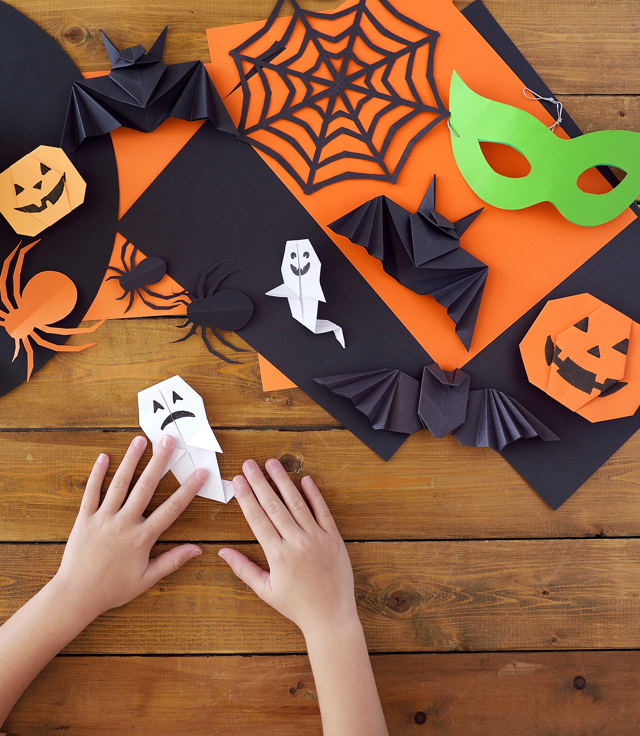
Ballyroan October Event Highlights – children and teens
Thursdays 5th+ 19th October from 4 to 7pm Teen Lounge @Ballyroan Library
Saturday 14th October from 2.30pm to 4pm Game Zone – Sticker Swap
Halloween Mid Term Break
Tuesday 31st October
Design your own trick or treat bag (11.30am)
Halloween Fancy Dress Storytime (3.30pm)
Wednesday 1st November
Erupting Pumpkins Science Workshop (10am)
Halloween Potions Science Workshop (11am)
Thursday 2nd November
Two Poetry Workshops funded through 300k Have Your Say
Animal Antics! Poetry workshop Age 8-9
The Poetry Machine Age 10-12

Slide 7
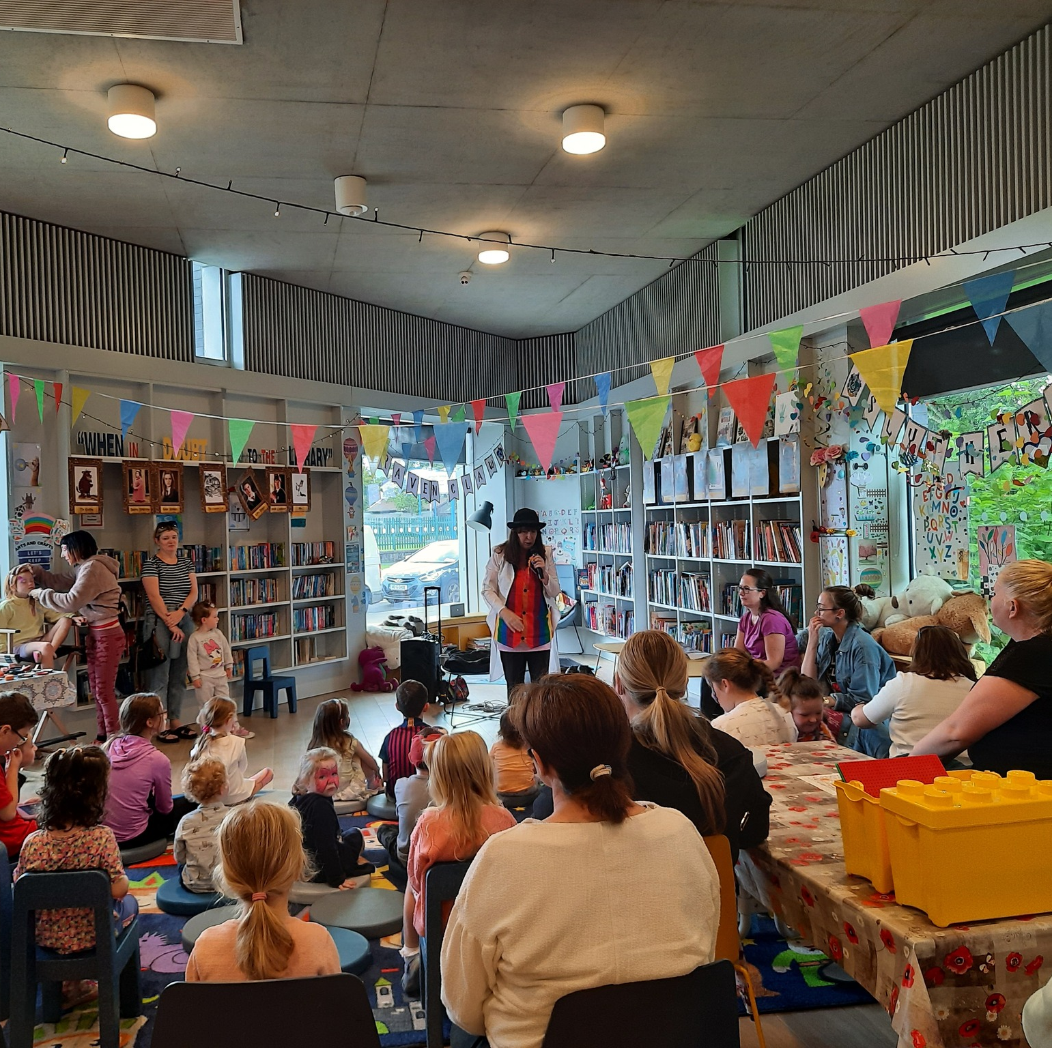
Castletymon Library October Highlights
STEAM Monday 16th October - 6pm ENGINO Creative Builder. Suitable for ages 8+. Booking on Eventbrite Mon 9th Oct -10am
Drumming workshop Saturday 7th October - 2pm Join Thomas Annang for some joy as he brings his wonderful rhythmic & musical drumming workshop to Castletymon.
Rob's Radical Readers Tuesday 10th October - 3:30pm
Rob hosts our children's book club in a relaxed, fun and encouraging environment. Beginner's Irish - 6 weeks
Beginning Tue 26th Sept - 6.30pm Join us for a relaxed approach to learning the Irish language with Tomás Maher! This 6 week series will take you through the basics so you'll be speaking cuplá focal in no time at all! Suitable for adults.

Slide 8
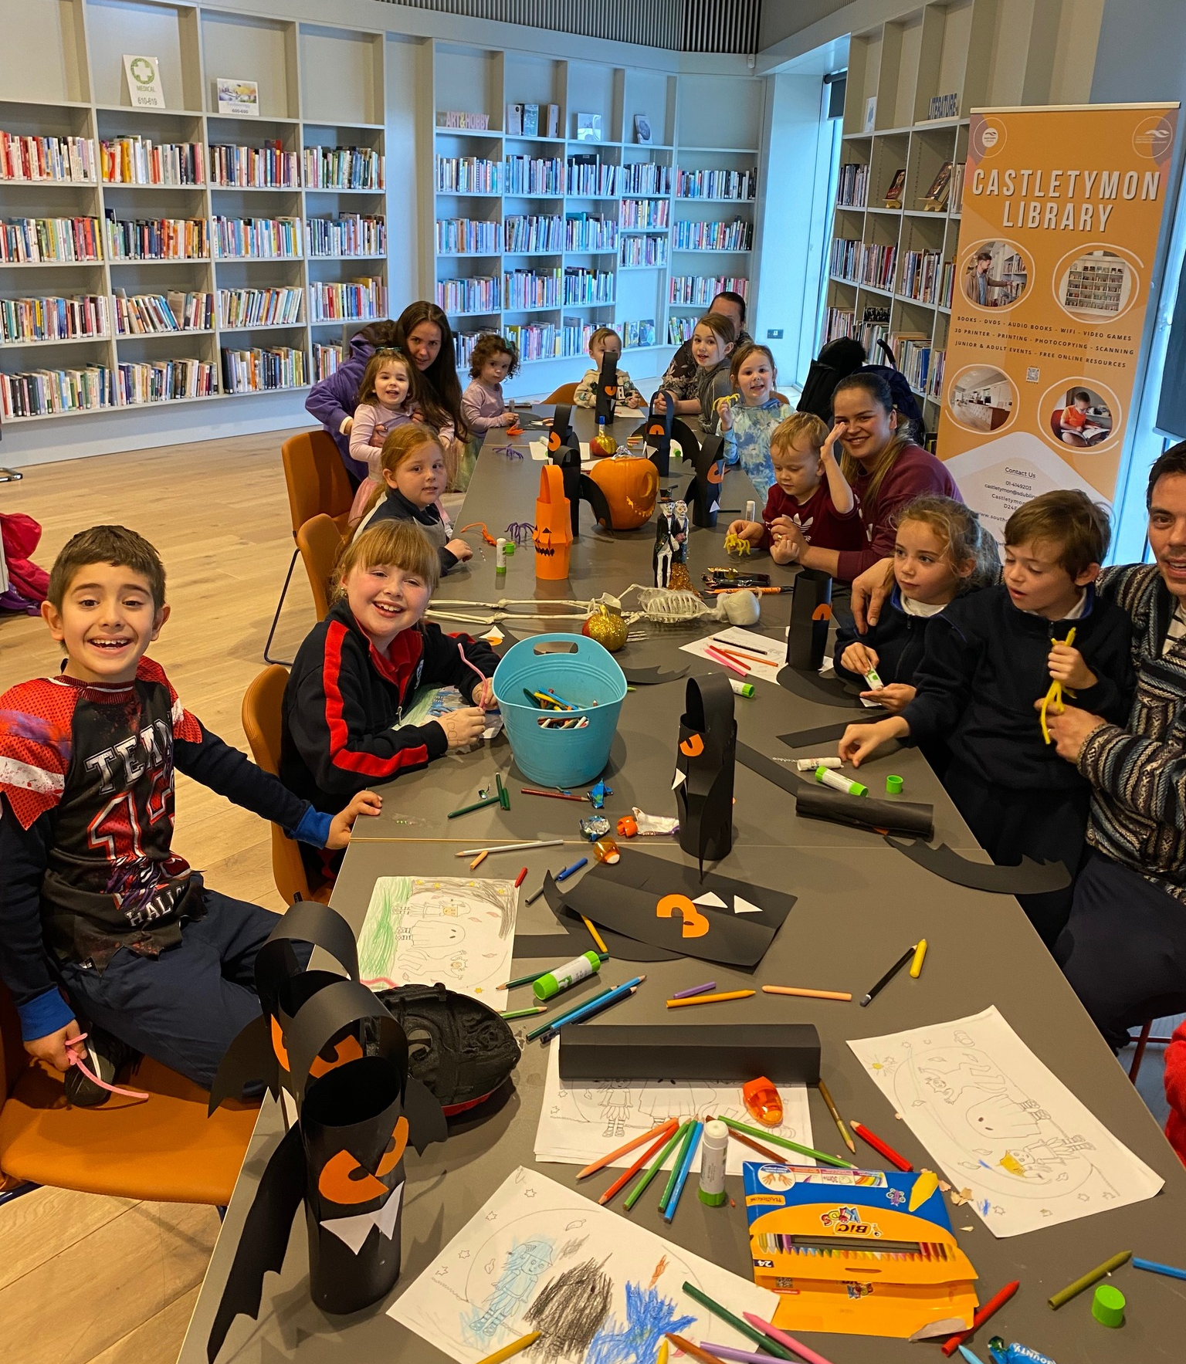
Castletymon Library October Highlights
Steam For children with additional needs
Saturday, 27th October - 12pm A fun, relaxed STEAM workshop for children with additional needs to get the creative brains moving!
The Tymon Sessions
Wednesday 25th October - 6:30pm Some trad and tunes with Mick and Co; bring your instrument and play a song for us, or just come along with your ears!
Borrow Box Clinic Thursday 19th October - 10:30am Did you know you can download and read/listen to free audiobooks, e-books and magazines onto your phone or tablet? Bring your device to the library where we'll show you how!
Halloween Party! Tuesday 31st Oct: Fancy Dress Party and competition, spooky colouring, and chilling tunes, Spooky Halloween Crafting and Fairly Scary Story, Frightfully fun Face painting.
Beginner watercolours: create a spooky scene
Mon, 23rd Oct - 12pm & Wed, 25th Oct - 12pm Create a spookily atmospheric watercolour landscape in this 2 part beginner’s workshop. Suitable for Adults.

Slide 9
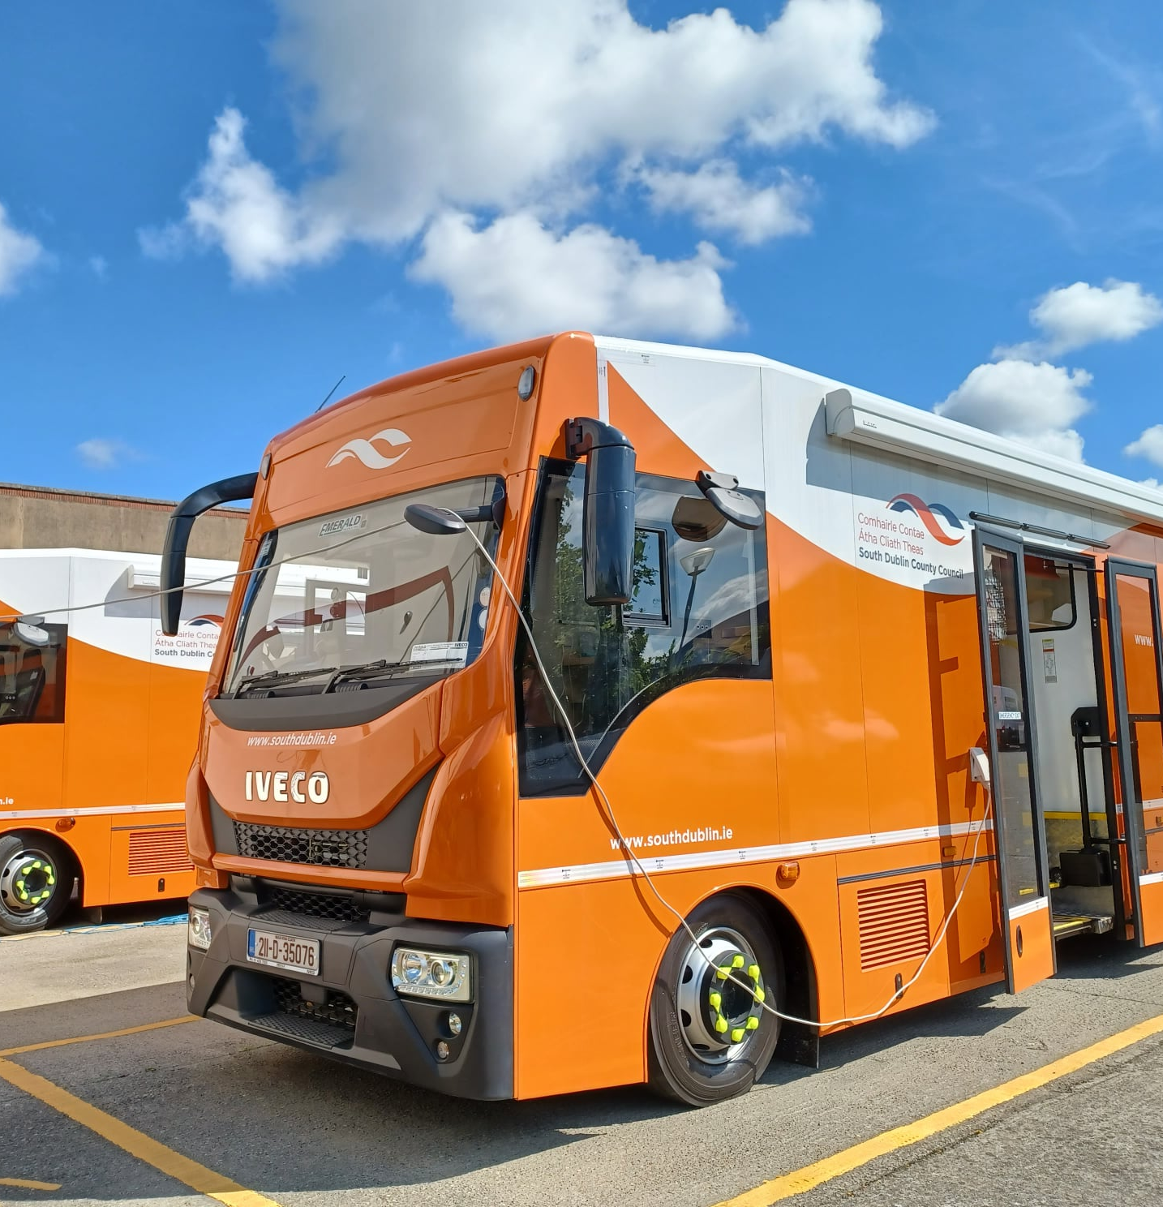
Mobile Libraries Highlights
In September, the Mobile Library service made 152 public stops and outreach visits, with 2,496 people availing of the service.
Since the beginning of September, the usual morning service to schools has resumed.
101 home deliveries were made to housebound patrons.

Slide 10
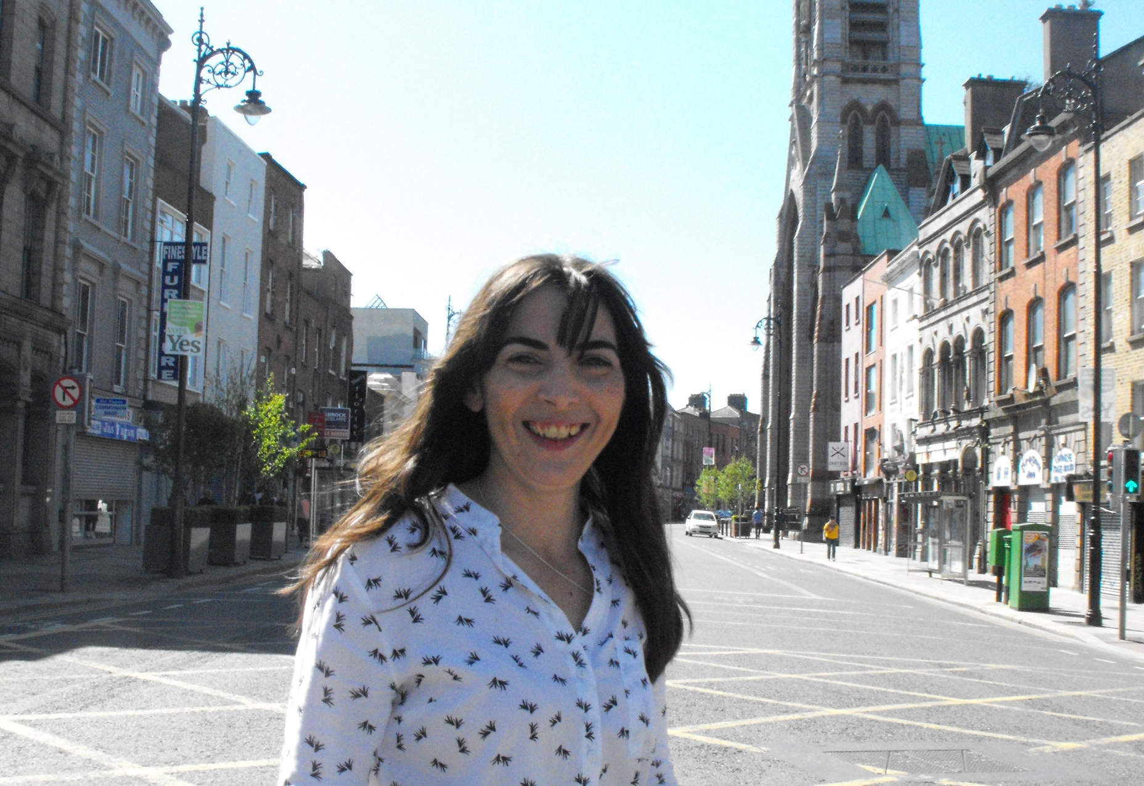
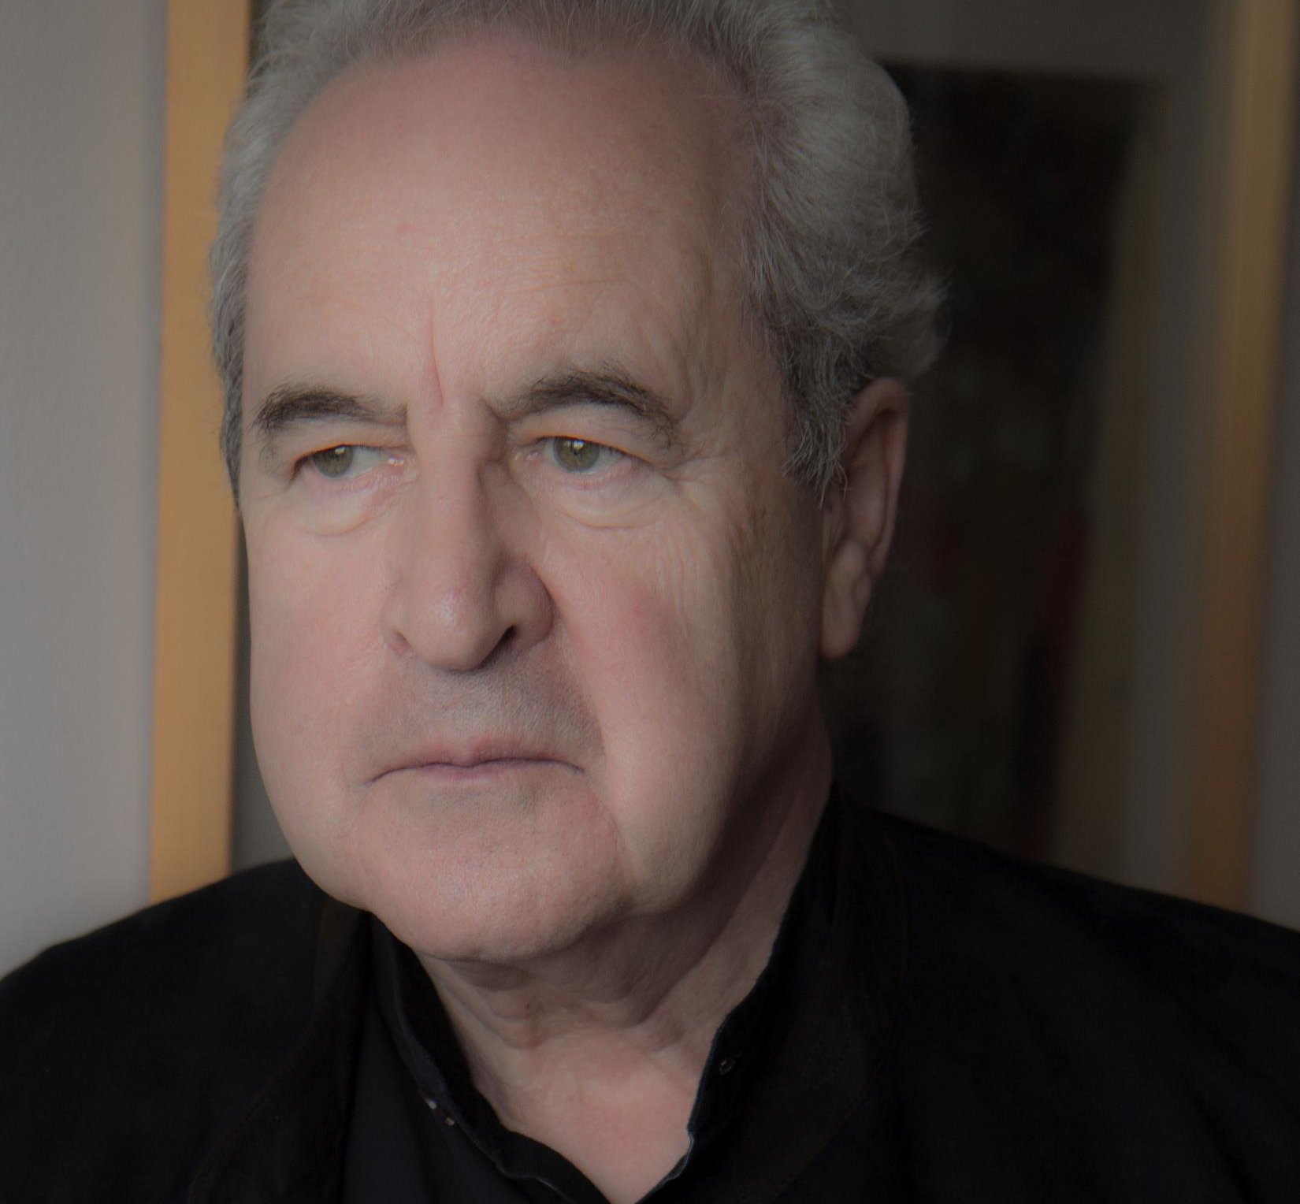
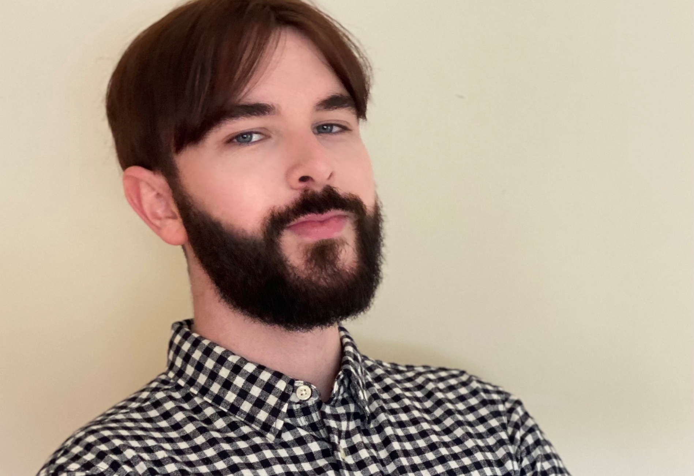
Red Line Book Festival 16th-22nd October | Rathfarnham events
Monday 16th October at 7pm – Ballyroan Land of Milk and Honey: C Pam Zhang in conversation with Sinéad Cuddihy
Tuesday 17th October at 7pm – Ballyroan Daring Debuts: who says men can't write romantic fiction? Join host Claire Hennessy as she talks to debut authors J.F. Murray, Bryan Moriarty and Ryan Love about their debut novels.
Saturday 21st October at 12pm – Ballyroan Writing Flash Fiction with Claire Hennessy
Exhibition – Month of October – Ballyroan Quentin Blake: Book Covers. We will be hosting a touring exhibition from Quentin Blake Centre for Illustration features 60 of Blake’s book covers from the 1960s to the present for the month of October.
Wednesday 18th October – Rathfarnham Castle – John Banville in Conversation with Dermot Bolger
Thursday 19th October – Pearse Museum – Prison Notebooks: Showing of short film about revolutionary writer Dorothy McArdle, followed by a talk with Liz Gillis

Slide 11
Red Line Book Festival 16th-22nd October | Castletymon events
Jen’s Journey Wednesday, 18th Oct - 7pm Instagram star and author of “Jen’s Journey”, Jennifer Carroll chats to host Fiona Brennan about her journey to healthier living, Instagram success and writing a book.
Beginning to write with Claire Hennessy Thursday, 19th Oct - 6pm This workshop is for anyone looking to dip their toes into creative writing, or anyone who hasn’t put pen to paper since school. We’ll explore how to generate ideas and start getting material down on the page.
All Red Line Book Festival event details are at www.redlinefestival.ie

