Slide 2
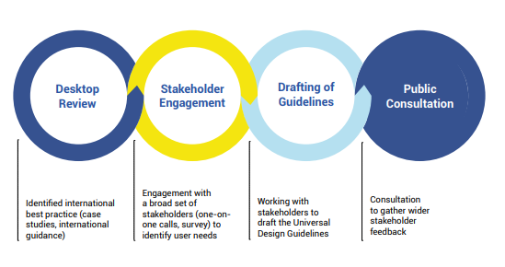
The Steps Undertaken to arrive at these Draft Guidelines:

Slide 6
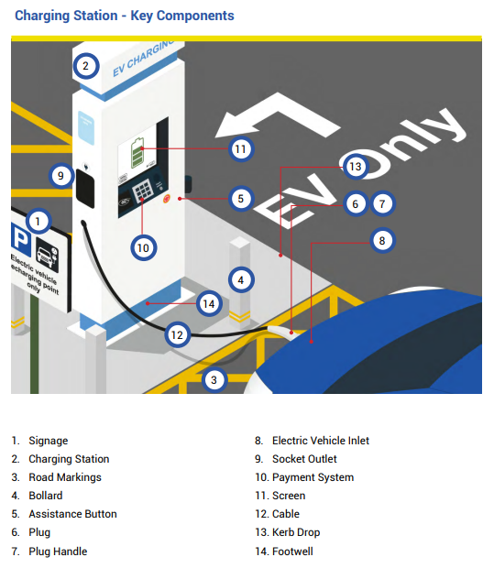

Slide 7
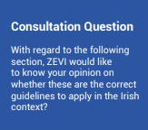
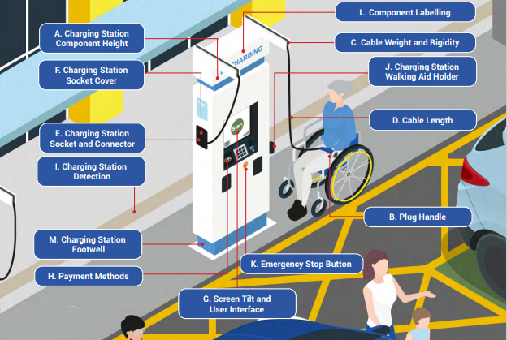

Slide 8
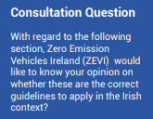
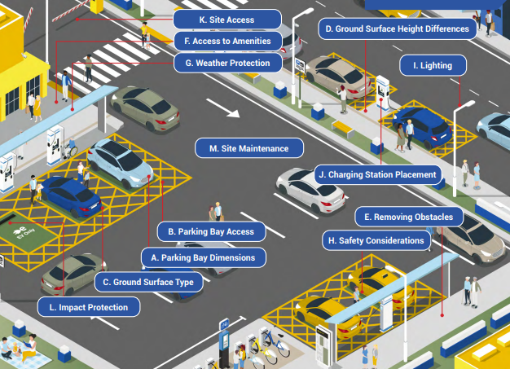

Slide 9
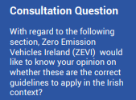
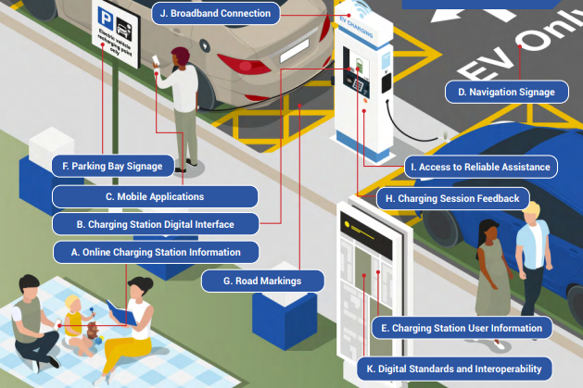

Slide 11
Last Submissions Accepted: 26 September 2023
SDCC made a submission on the proposals through Environment Section.
Following Review of all Submissions a final Guidelines Document will be published on the Government’s Webpage in December 2023.

