Slide 1
Lucan Pool Hoist Update Sept 2023
Notes:
Hi, my name is Niall Noonan and I’m the still newish Communications Manager of South Dublin County Council. I joined in July of this year and it is my first post within a local authority. So I’ve received a crash course in citizen engagement at local government level and want to take you through a few of SDCC’s key campaigns and achievements.

Slide 2
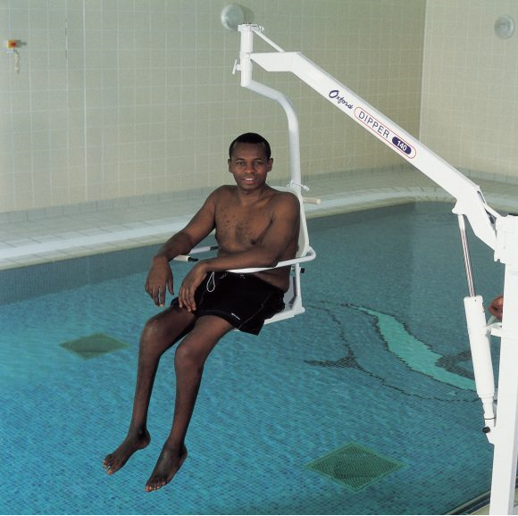
Proposed Hoist
The Oxford® Dipper - a proven, reliable and safe method of gaining access to the water.
Highly functional and easy to use
Currently in use in Aura Leisure Centre, Drogheda
Changing Places changing facility and Hoist is approved by users

Slide 3
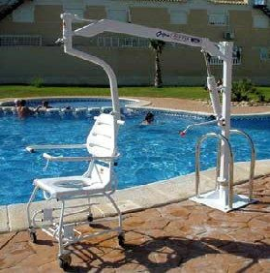
Will use chair instead of sling type attachment
Lower maintenance then Pool Pod
Requires same staff assistance as Pool Pod

