Slide 1
Balgaddy Estate Quarter 3 2023

Slide 2
Allocations and Relets 2023
Pre - Works | Work in Progress | Ready for Allocation | Total
6 | 7 | 6 | 19
Surrenders | New Tenancies
16 | 15

Slide 3
Response Maintenance 2023

Slide 4
Housing Maintenance Operations - Balgaddy
Repairs to Vacant Properties – Reduce turnaround times
May 2023 - Dedicated relet maintenance contractor for Palmerstown-Fonthill LEA
Number of relet maintenance contactors across the county increased from 2 to 5
Response Maintenance – Reduce response time
Nov 2023 - Dedicated response maintenance contractor for Palmerstown-Fonthill LEA
Number of response maintenance contactors across the county will increase from 2 to 5
Property Condition Surveys – Identify condition and maintenance requirements
Properties surveyed on 4/5 year cycle
Balgaddy included in year 1 surveys
Outcome of surveys will determine future planned maintenance programmes

Slide 5
Planned Maintenance- Balgaddy
Roofing Works
Roofing repair works identified, and contractors appointed for
Tor an Rí – flat roofed properties
Méile an Rí Drive – apartment units
Energy Efficiency Retrofit Programme
BER surveys completed on properties in Tor an Rí Walk.
Tender documentation currently being prepared
Works to commence Q1 2024
Bin Storage Areas
Ongoing refurbishment to reduce anti-social behaviour.

Slide 6
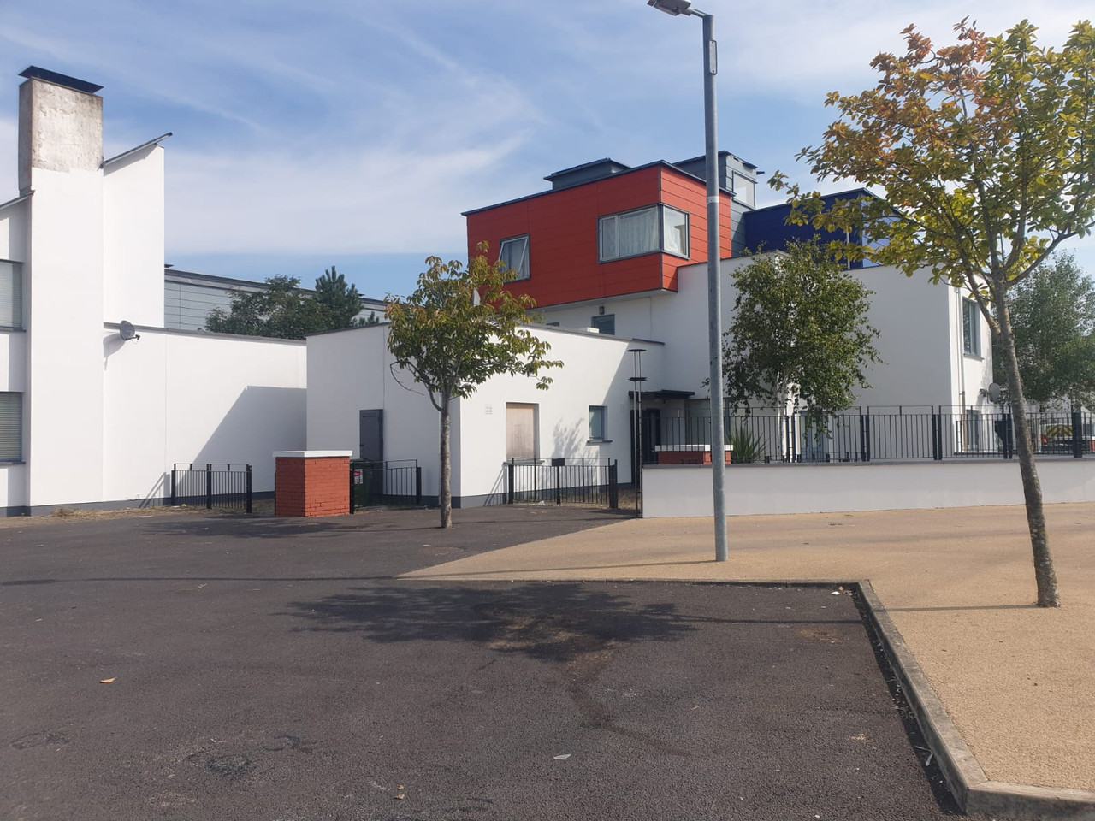
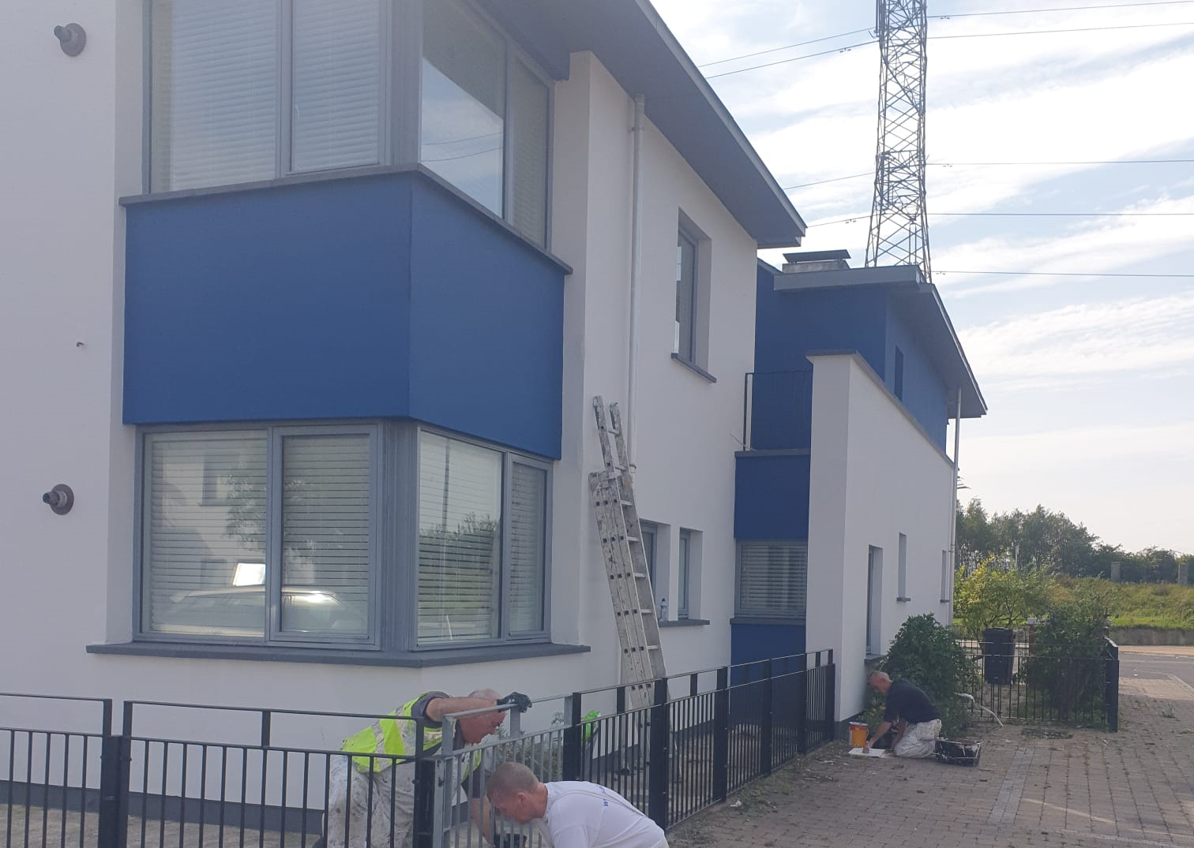
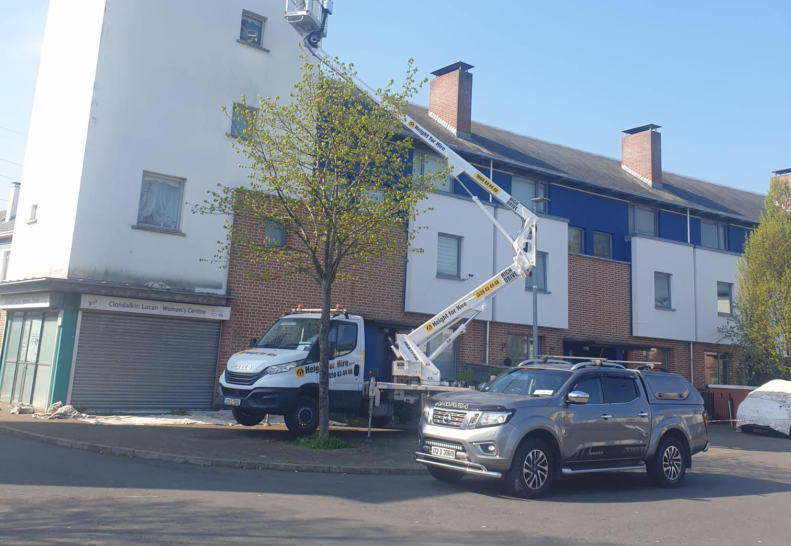
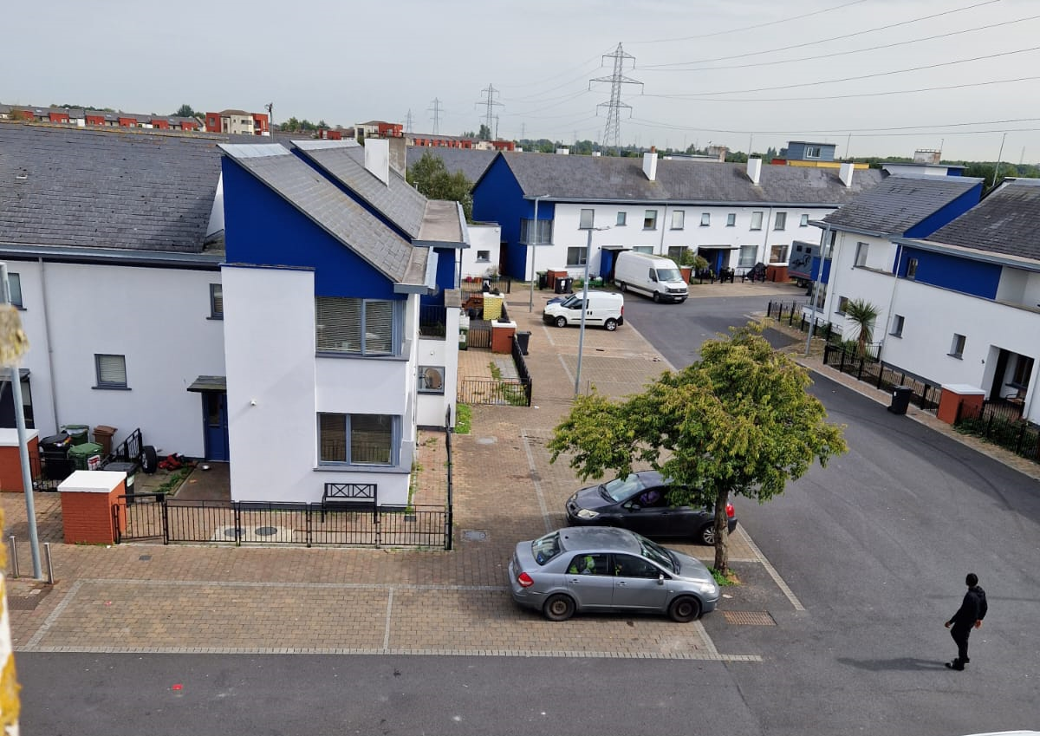
Painting in Tor an Rí
Works on 57 properties in Tor and Rí near completion
Painting for Méile an Rí and Foxdene Avenue to commence Q1/2 2024

Slide 7
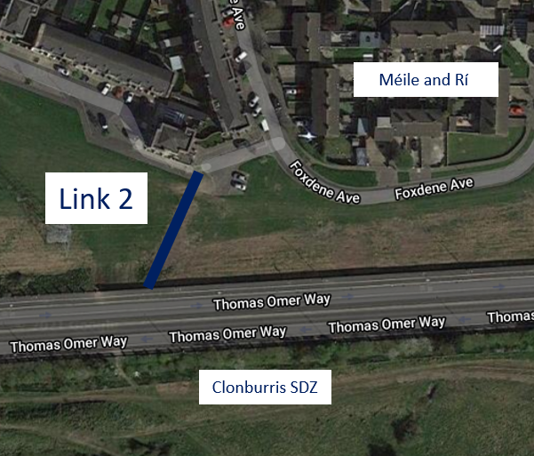
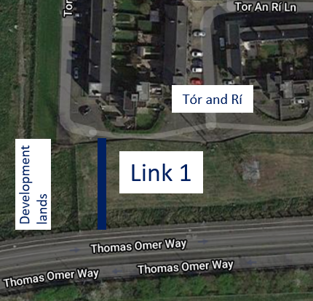
Permeability Routes
Tór an Rí & Méile an Rí to Thomas Omer Way
A contractor has been engaged to carry out the works.
Works are due to commence in Q 4, 2023.

Slide 9
Estate Management Initiatives
Estate Management supported the Balgaddy Family Fun Day on Friday 4th August, staff from both Estate Management and Anti-Social Team were in attendance on the day.
Anti-Social Team following up on issues regarding vacant dwellings in Tor an Ri.
Estate management and Housing Maintenance are currently liaising with residents regarding planned works to be carried out in Tor an Rí.

Slide 10
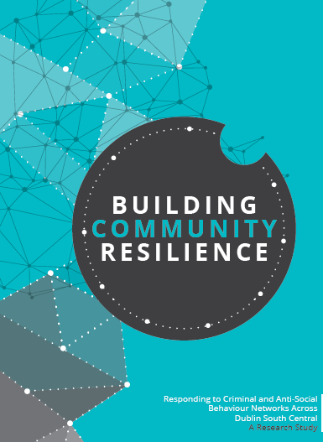
Balgaddy Working Group
The Balgaddy working Group was established to implement the recommendations outlined in the Community Crime Impact assessment undertaken in March 2021. Group meets on a quarterly basis. The membership consists of:
Estate Management and Community Development Teams from SDCC
An Garda Siochana (Ronanstown)
North Clondalkin Community Development Programme
Co- Ordinator from Clondalkin Drugs Task Force
Ronanstown Crosscare
Chair of Local Policing Forum
DDETB ( seeking nomination)
Tusla (seeking nomination)
Meeting Dates for 2023
14th March
6th June
28th September – rescheduled from 12th September
5th December

