Slide 1
Kishoge Station – Section 38 works at Kishoge Station and resulting proposed new Special Speed Limit on R136
Headed Item for Elected Members of the
Lucan and Clondalkin ACMs
Eoin Burke, Senior Planner, Delivery Team, LUPT
John Hegarty, Senior Engineer , LUPT

Slide 2
Content – 2 Elements
1. Notification of non statutory consultation under Section 38 of the Roads Act for traffic calming works on the R136 at Clonburris
2. Pre- Draft notification of commencement of Special Speed Limit Bye Law process

Slide 3
1. Notification of non-statutory consultation under Section 38 of the Roads Act for traffic calming works on the R136 at Clonburris
4 week non statutory consultation commencing in October
Revert to ACM with report on submissions received
The extent of works is to the existing road/verge/cyclepath/footpath footprint with no works outside the existing. Primarily consists of;
Provision of c.56 new car parking spaces and c.4 new Universal Access car parking spaces.
New road markings, increased concrete footpath build outs at signalised junctions, removal of concrete median barrier at signalized junctions, removal of metal vehicle restraint barriers in verges on both sides, north and south of the bridge.
Installation of traffic signals, Ducting and Junction Boxes, Dowelled in bollards, Kerb cuts, ramp accesses and small sections of footpath to connect into existing footpath.
Improvement in markings, tactiles and signage for footpaths/cycle tracks both sides. Modifications to existing drainage – no increase in hardstanding envisaged, Temporary traffic management during the works.
All associated works

Slide 4
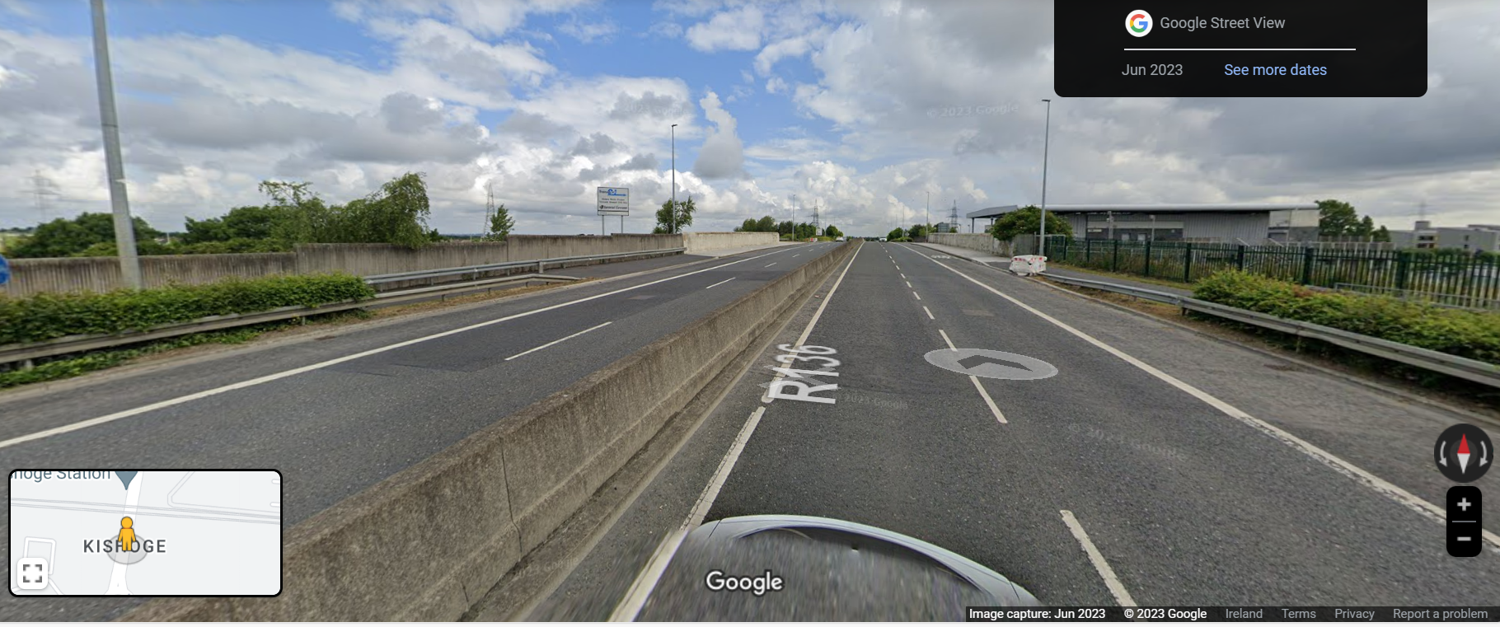
1. Notification of non-statutory consultation under Section 38 of the Roads Act for traffic calming works on the R136 at Clonburris

Slide 5
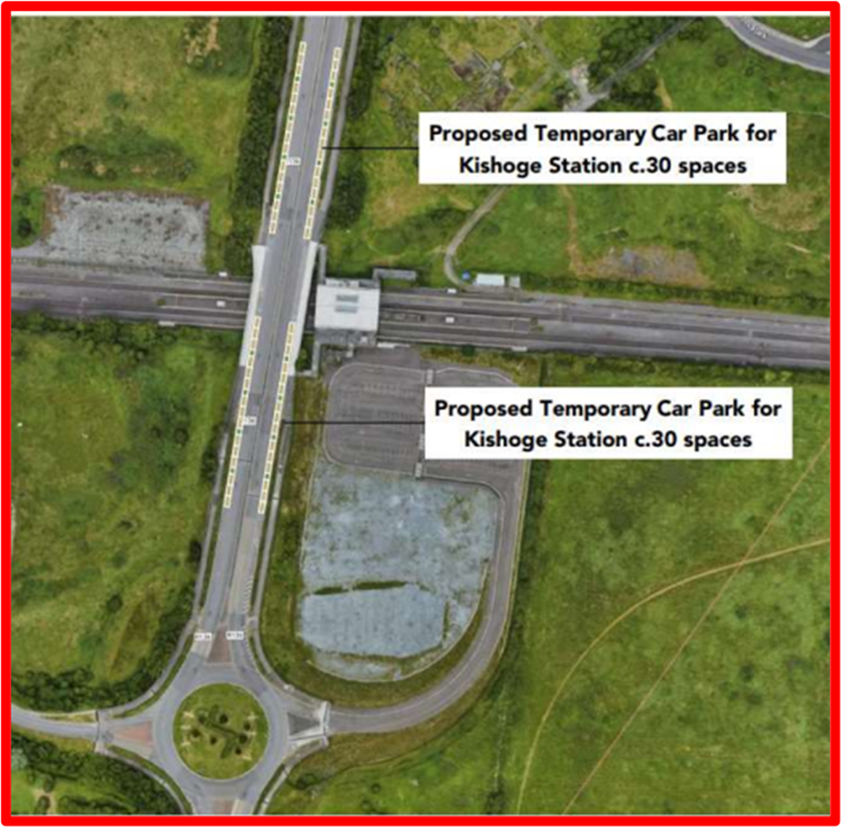
Context
Station
Section 38 Traffic Calming proposal on R136 – required to open Kishoge Station
Kishoge Station built and not opened
Works now required to the station to enable opening (internal and external repair/finishes)
Kishoge station contractor appointment due by Irish Rail
Existing car park land is part of Kishoge Urban Centre
Car parking is required to facilitate the opening of the station
Planning Scheme
Section 38 proposal – Supports the implementation of the Clonburris Planning Scheme
Facilitates opening of Kishoge Station (Phasing Requirement)
R136 (Grange Castle Road) – Arterial Street in Planning Scheme
Planning Scheme requires upgrading of Arterial Streets
‘To promote walking and cycling and create streets that are more attractive and urban in character, these streets should be upgraded and redefined through a combination of measures including signalised junctions, double planting, transition zones, on-street parking and frontage from development’
Section 38 traffic calming proposal is to amend the environment of the R136 outside the station, providing improved and safer pedestrian and cycle facilities and on street car parking for the station in the context of development of this area of the SDZ and opening of Kishoge Railway Station

Slide 6
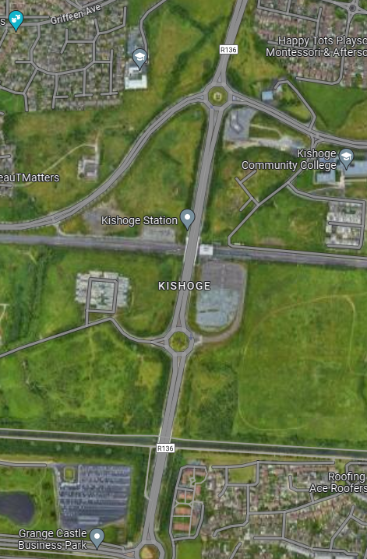
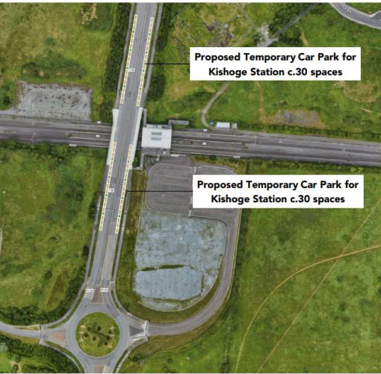
Non Statutory Consultation on Traffic Calming / Kishoge Station Parking – Section 38
- Provision of improved pedestrian routes, including pedestrian crossings
- Provision of parallel on street car parking
- Bus Lane maintained
- Removal of a lane of traffic

Slide 7
Non Statutory Consultation on Traffic Calming / Kishoge Station Parking – Section 38

Slide 8
2. Pre- Draft notification of commencement of Special Speed Limit Bye Law process (Section 9(3) of the Roads Traffic Act (as amended)
- Notification of commencement of process for a Special Speed Limit Bye Law for R136
- Process as per Guidelines for Setting and Managing Speed Limits in Ireland (2015)
- Notify An Garda Síochána, Elected Members and District Engineers of proposed decision to review the Special Speed Limit bye-law in this area and invite submissions
- Submissions to activetravel@sdublincoco.ie

Slide 9
2. Pre- Draft notification of commencement of Special Speed Limit Bye Law process
- Reduction in speed limit to 50kph on the R136 adjacent to Station
- Reduction in speed limit to 60kph on section of R136 to tie in 50kph zone
- Starting and Finishing points to be agreed through process
- Revert to ACM with report on consultation

